Slide 1
RTOE Integration study results review
Charlie McCoy

Slide 2

Objectives
Study Inputs
Analysis
Study Results
Mitigations
Seek Approval
Review study inputs and assumptions
Walk through the analysis methodology
Provide an overview of the study results
Summarize mitigations that were provided by each member
Seek approval of study results

Slide 3
Study Inputs and Assumptions
Summary of study inputs

Slide 4
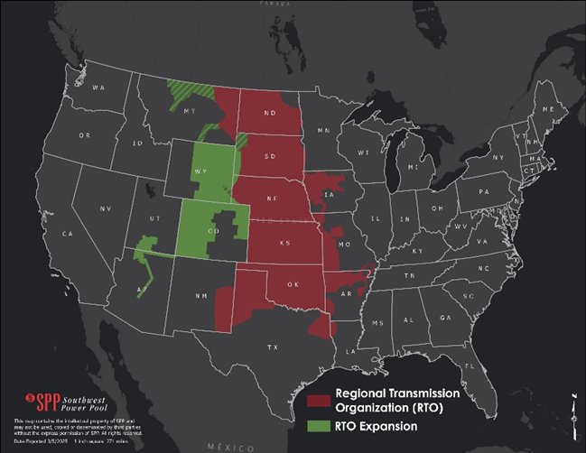
General Study information
Steady State Reliability Analysis
  Identify potential reliability-based issues
  Coordinate needs and existing/planned mitigations with RTO expansion members
Includes Western and Eastern integrating members
Power flow software utilized
  Power System Simulation for Engineering (PSS®E 35.3)

Slide 5
General Study information
Modeling Areas of Interest
20 Models Used
Steady State (6)
Maximum Output DC Tie Sensitivity (12)
Short Circuit (2)
Analysis
Steady State Needs Assessment
DC Tie Sensitivity Assessment
Short Circuit Assessment
Eastern Interconnection (EI)
Western Interconnection (WI)

Slide 6
integration study reliability Models
Modified WECC Models (Western Interconnect)
24HS_RTOE_Initial_Final Heavy Summer
ITP Base Reliability (BR) Models (Eastern Interconnect)
2025 ITP IF-25S
25HW_RTOE_Initial_Final Heavy Winter
25LW_RTOE_Initial_Final Light Winter
2025 ITP IF-26W
2025 ITP IF-26L
2025ITPIF-26S_SC
24HS_MAX_FAULT

Slide 7
integration study DC Tie Sensitivity Models
Three DC ties to be included in the analysis and modeled as follows:
Results from the Integration Study will also be incorporated into the DC Tie Sensitivity Results
DC Tie | Maximum Output (MW)
 | East-to-West | West-to-East
Miles City | 200 | 150
Stegall | 110 | 110
Sidney | 200 | 200

Slide 8
integration study DC Tie Sensitivity Models (WI)
Modified WECC Models East-West DC Tie Models
24HS_RTOE_Initial_Final_E-W
Modified WECC Models West-East
DC Tie Models
24HS_RTOE_Initial_Final_W-E
25HW_RTOE_Initial_Final_E-W
25LW_RTOE_Initial_Final_E-W
25HW_RTOE_Initial_Final_W-E
25LW_RTOE_Initial_Final_W-E

Slide 9
integration study DC Tie Sensitivity Models (EI)
BR Models East-West
DC Tie Models
2025ITPFinal-25S_E-W
BR Models West-East
DC Tie Models
2025ITPFinal-25S_W-E
2025ITPFinal-26L_E-W
2025ITPFinal-26W_E-W
2025ITPFinal-26L_W-E
2025ITPFinal-26W_W-E

Slide 10
Analysis
Overview of study methodology

Slide 11

Evaluation Criteria
Objective: Evaluate integrating entities’ transmission systems to assess the reliability prior to the time of integration
Evaluation Criteria derived from following:
SPP’s OATT Attachment O Section III.6
NERC Reliability Standards
SPP Planning Criteria
ITP Manual

Slide 12
Study methodology – Contingency analysis
Auto-Generated N-1
Internal and Tier-1 Areas
Member Submitted
Included all contingencies provided by integrating members
P3 (N-G-1)
Events were created similar to the ITP based on the following:
Voltage Range
65 kV – 999 kV
Mitigation required only for contingencies that do not allow for NCLL per TPL-001
Generator Shift Factor
Electrical distance

Slide 13
Study methodology- p3 contingencies
P3.1
Both generators must have >= 5% GSF on the same transmission element
P3.2, P3.3
Generator must have >= 5% GSF on the transmission line or transformer
P3.4
Generator and shunt device must be within 10 buses of each other

Slide 14
Study methodology – solution settings
The following solution parameters were applied in performing the study:
  Fixed slope decoupled Newton-Raphson
  Tap Adjustment – stepping
  Switch shunt adjustments – enable all
  Area interchange disabled
  Adjust phase shift
  Adjust DC taps
  VAR limits – apply immediately

Slide 15
Study methodology – Monitored facilities
All RTO expansion members facilities and Tier-1 facilities with a voltage level greater than 60 kV were monitored for the Study against the SPP Planning Criteria
Western Interconnect
    Facilities 69 kV and greater were monitored and reported on
    Facilities less than 100 kV were out of scope and reported for informational purposes only
    Facilities 100 kV and greater were considered in scope of study
  Eastern Interconnect
      Facilities 69 kV and greater were monitored and considered in scope of study

Slide 16
Study methodology – Short Circuit Analysis
SPP simulated three-phase faults and single line-to-ground faults for both the Western and Eastern Interconnection short circuit models
  Full bus-fault current and line-out results using an automatic sequencing fault calculation
  Full bus-fault current and line-out results using an American National Standards Institute fault calculation

Slide 17
Reliability Study results
Summary of violations identified for reliability assessment

Slide 18
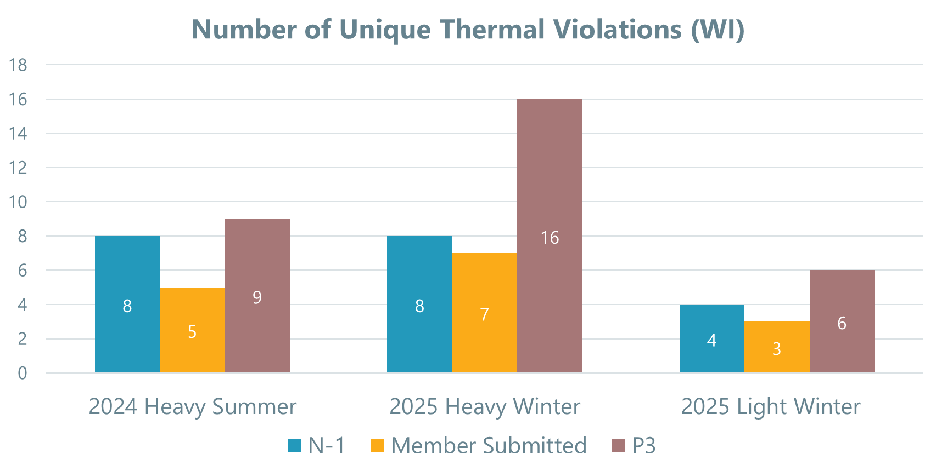
Summary of Thermal Needs (WI)
P3 Contingencies generally showed more thermal violations

Slide 19
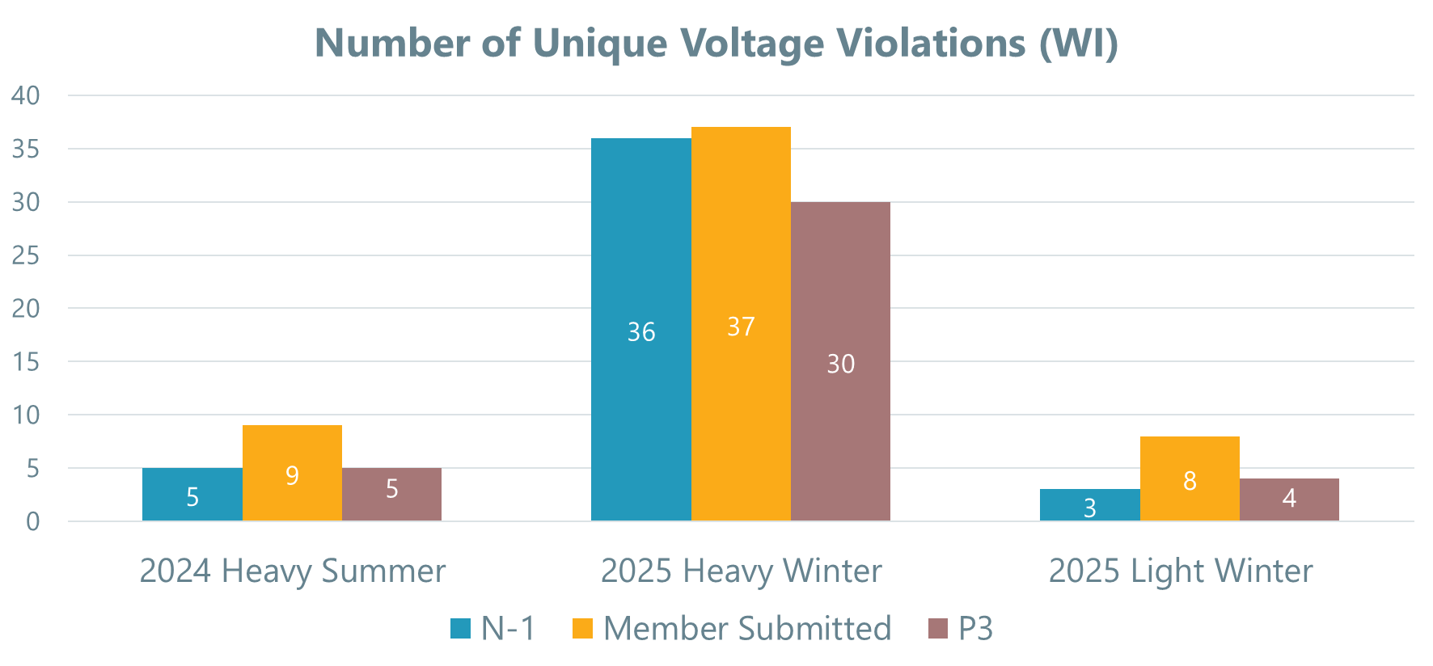
Summary of Voltage Violations (WI)
Heavy Winter Cases showed the largest number of voltage violations

Slide 20
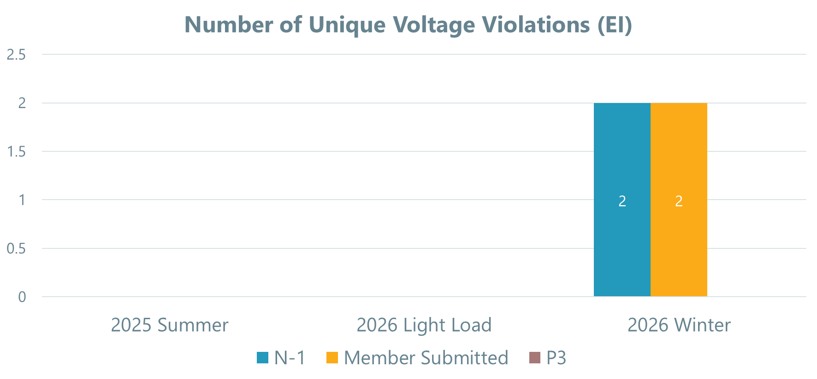
Summary of Voltage Violations (EI)
Very few violations for EI facilities. Four total unique voltage violations

Slide 21
Summary of Thermal Violations (EI)
No thermal violations were found for WAPA-RMR facilities that are integrating into the RTO in the Eastern Interconnect

Slide 22
DC Tie sensitivity Study results
Summary of violations identified from dc tie sensitivity analysis

Slide 23
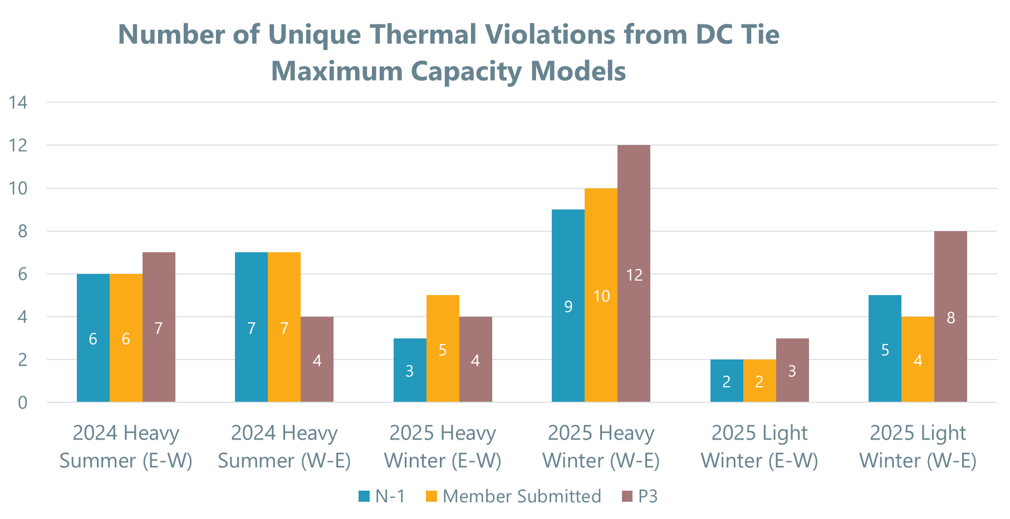
Summary of Thermal Needs (WI)

Slide 24
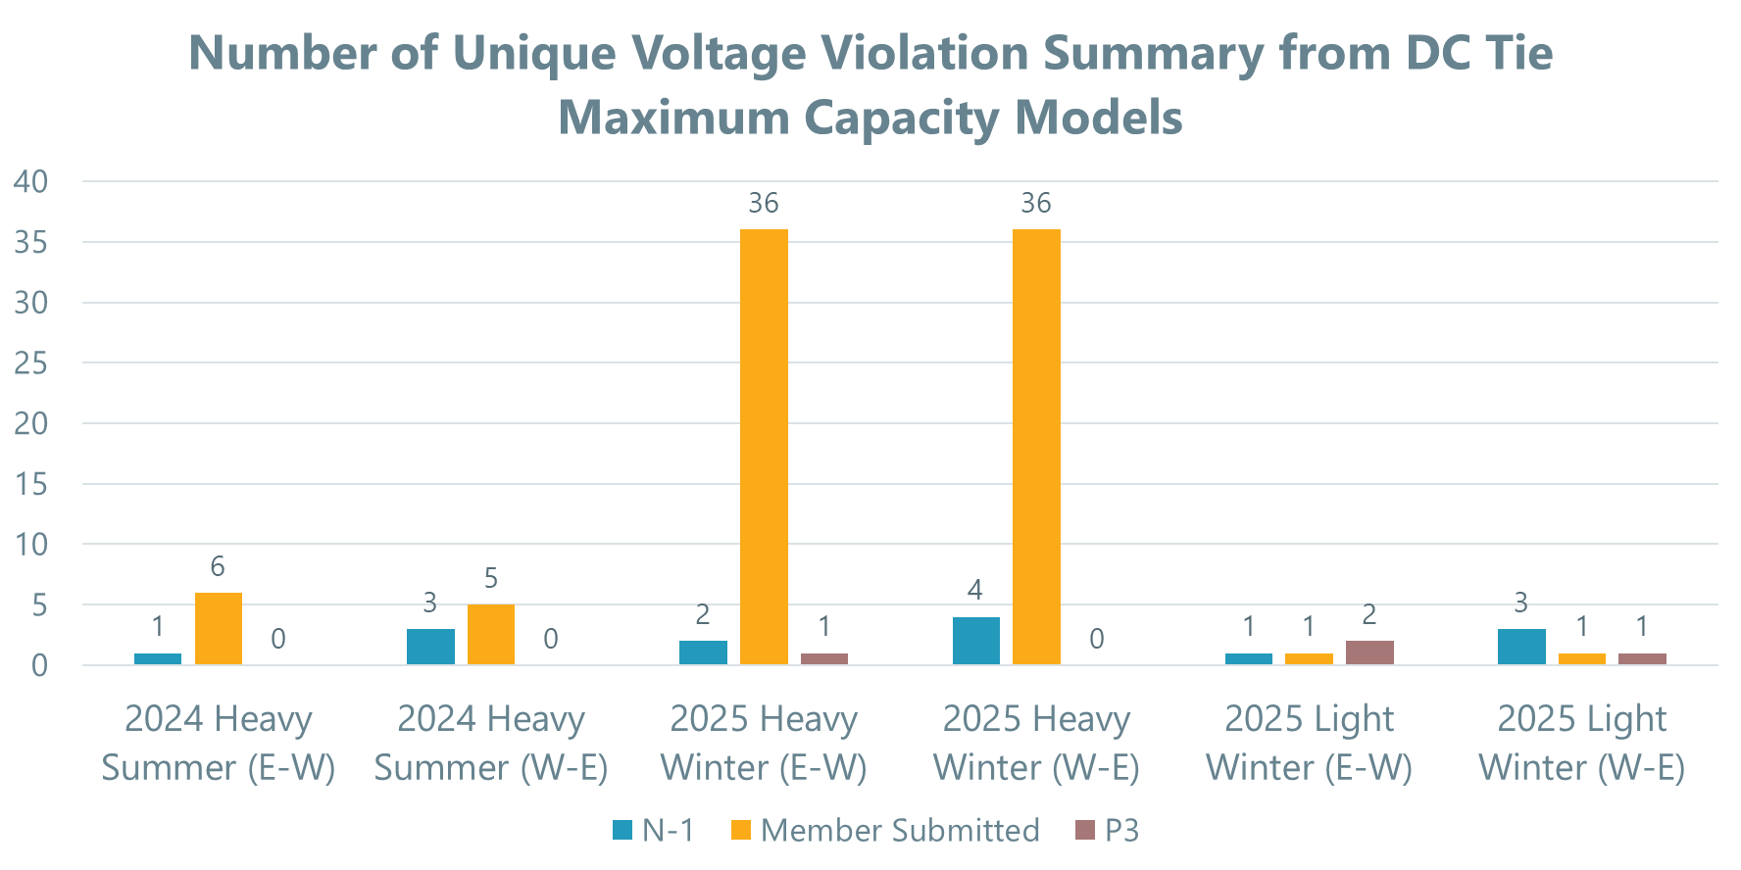
Summary of Voltage Violations (WI)
Member submitted contingencies generally showed higher number of voltage violations

Slide 25
DC Tie sensitivity Study results (EI)
No Thermal or Voltage violations were found from the DC Tie Sensitivity for WAPA-RMR facilities that are integrating into the RTO in the Eastern Interconnect

Slide 26
Mitigations
Summary of Mitigations provided for violations by area

Slide 27
Steps taken after violations were identified
Apply mitigation
Verify violation is resolved
Verify no additional violations were created by mitigation

Slide 28
BASIN ELECTRIC POWER COOPERATIVE
BEPC reviewed the results of the study and confirmed that no violations were identified for facilities on their system

Slide 29
COLORADO SPRINGS UTILITIES
CSU reviewed the results of the Study and confirmed that no violations were identified for facilities on their system.
Short Circuit Analysis
  CSU staff provided feedback that all breakers on their system have an interrupting capability of at least 40 kA.

Slide 30
DESERET POWER ELECTRIC COOPERATIVE
DPEC reviewed the results of the Study and confirmed that no violations were identified for facilities on their system.
Additional Feedback
  Calamity Ridge Tap and Deserado Mine 138 kV buses are the only facilities integrating into SPP footprint

Slide 31
PLATTE RIVER POWER AUTHORITY
PRPA reviewed the results of the Study and confirmed that no violations were identified for facilities on their system.
Short Circuit Analysis
  PRPA staff provided feedback that all breakers on their system are rated at 40 kA except for the Valley substation (25 kA)

Slide 32
TRI-STATE GENERATION AND TRANSMISSION ASSOCIATION
Type | Name
Model Correction | Axial - Hayden Ratings Update
Model Correction | Henry Lake & Reunion Load Update
Model Correction | Update Henry Lake 230/115kV XFMR Ratings
Planned Project | Burlington-Lamar 230 kV Project (ISD Feb 2025)
RAS | Comanche / Walsenburg RAS
System Adjustment | Craig Redispatch
System Adjustment | Hesperus Reactor On
System Adjustment | Open Waanibe Tap Cap 1 & 2
Redispatch | Spring Canyon Redispatch
TSGT confirmed that their post contingent voltage criteria is 1.10 p.u. which voided many initial voltage violations reported above 1.05 p.u.

Slide 33
WESTERN AREA POWER ADMINISTRATION – ROCKY MOUNTAIN REGION
Type | Name
Model Correction | San Juan 230/115 Hogback Transformer Correction
Model Correction | West Canon 115/230 kV Ratings Update
Op Guide | Path 30/31 Op Guide
Planned Project | Fort Morgan Cap Project
RAS | Glen Canyon RAS
System Adjustment | Gering Cap On
System Adjustment | Rimrock/Billings PST Adjustment
System Adjustment | Spence Inductor On
System Adjustment | Sidney Reactive Support
Redispatch | Weld Redispatch
WAPA-RMR confirmed that their post contingent voltage criteria is 1.10 p.u. which voided many initial voltage violations reported above 1.05 p.u.

Slide 34
WESTERN AREA POWER ADMINISTRATION – UGP
Thermal Violations:
  WAPA-UGP supplied 2 system adjustment mitigations.
Voltage Violations:
  WAPA-UGP supplied 2 contingency corrections and 2 system adjustments.
Type | Name
System Adjustment | Crossover PST Adjustment
System Adjustment | Great Falls Reactor On
System Adjustment | Havre Overvoltage Mitigation
System Adjustment | Rimrock / Steamplant PST Adjustment

Slide 35
Next steps
Outline of next steps in process

Slide 36
Next Steps (utilizing Study results)
Applicability to Future Relevant Studies
  SPP will retain the study results from the Integration Study and will use all mitigations provided from the analysis in relevant and subsequent planning assessments
  Some examples include:
    Operating Guides and Procedures
    Remedial Action Schemes
    High Voltage Criteria

Slide 37
Next Steps (Tentative Study schedule)
Milestone | DEADLINE
TWG/ESWG approval | By May 28th, 2025
MOPC approval | By July 16th, 2025

Slide 38
Questions?

Slide 39
Recommendation

Slide 40
Recommendation
  SPP recommends approving the study results as shown in the RTOE Study Report.

Slide 41

Charlie mccoy
Engineer II – Transmission Planning
cmccoy@spp.org
(501) 482-2257

