Slide 1
MISO-SPP 2024 CSP Study Update
ESWG-TWG
05/28/2025

Slide 2
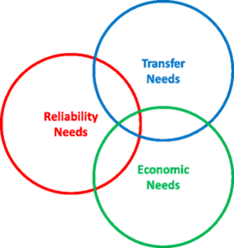
2024 CSP Overview
The RTOs launched the 2024 CSP to support a more effective interregional planning process.
The study will monitor the Eastern Interconnection and focus on the southern seam of MISO and SPP which encompasses Oklahoma, Arkansas, Texas, and Louisiana.
Focused on identifying transmission upgrades to improve reliability and resiliency in both MISO and SPP.
Evaluates reliability, economic, and transfer needs equally, targeting overlapping issues and boosting interregional transfer capability.
Incorporates long-term drivers and assumptions, including resiliency needs and extreme weather planning.
Study scope redlines and updated document can be found with meeting materials: MISO-SPP IPSAC Meeting Materials 20250328
https://spp.org/spp-documents-filings/?id=20975https://spp.org/spp-documents-filings/?id=20975

Slide 3
Study update recap
Overview of the 2024 CSP Study
MISO-SPP JOA Waiver Filing Update
CSP Blended Model Development
Economic
Reliability
Transfer Capacity Scenarios
Interregional Triple Hurdle
2024 CSP Study Timeline
Request for Stakeholder Feedback

Slide 4
Model development feedback
Received feedback from 5 entities regarding modeling and transfer scenarios
SPP & MISO are coordinating on responses, additional questions, and implementation
Aiming for second week of June for updated model posting
Includes models only

Slide 5
Next steps
Develop input & event files for reliability and economic analysis
Files will be blended files that represent the blended model topology
Simulate and obtain initial results to prepare for study analysis

Slide 6
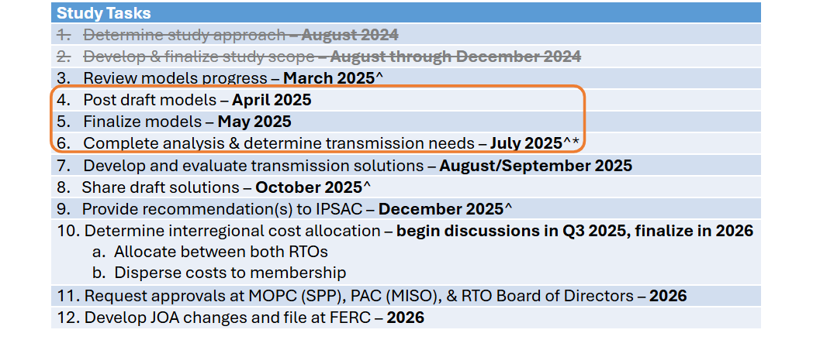
MISO-SPP Study Timeline

Slide 7
Contact slide
Interregional Relations (SPP) interregionalrelations@spp.org

Slide 8
Appendix

Slide 9
MISO-SPP JOA Limited Waiver
MISO and SPP filed a joint waiver request for certain specific language in the MISO-SPP Joint Operating Agreement (JOA) on January 15, 2025 (ER25-943):
Model requirements
Valuation of benefits for Reliability and Public Policy projects (consider more than just avoided costs)
The filing received support from stakeholders and no protests
The RTOs requested a response by March 15, 2025; however, FERC is not required to respond on a certain timeline
The RTOs believe the study as scoped can proceed as a CSP; however, certain JOA provisions may prove challenging
A response from FERC would clarify the need for additional model years for issue/needs analysis and whether reliability and public policy projects could be alternatively valued, and not limited to replacement cost of regional projects
Notes:
Jon/Clint

Slide 10
Blended Model Development Description
Detailed blended or combined model description can be found with SPP-MISO IPSAC Reference Documents https://spp.org/spp-documents-filings/?id=20988

Slide 11
Reliability Model Blending Process
Start with SPP model
Remove MISO footprint
Save MISO footprint from MISO model
Read MISO footprint into the SPP model
Apply area interchange, tie line, and load updates as appropriate
Solve
SPP Model (MISO Removed)
MISO data from MISO model
Blended Model
Updates
11
Notes:
Spencer
Challenges:
Model Dispatch
Adding future resources to SPP's existing model to closer align with MISO's existing models
Tie Lines

Slide 12
Economic Model Blending Process
MISO Model
SPP Model
Updates to MISO Region in SPP Model
Search for matching components(generator, bus, branch, load, etc.) between the two models
MISO model components in SPP Model and visa versa
If it exists in both, update all SPP parameters with the data from the MISO model
If it exists in MISO but not SPP, add model element consistent with MISO model
If it exists in SPP but not MISO, “remove’ the component from the SPP model
Add
Update
Remove
MISO
SPP
New Model
Add
Update
Remove
12
Notes:
Spencer
Economic Model Challenges:
Fuel forecast differences
Topology differences
Load mapping
Area mapping

Slide 13
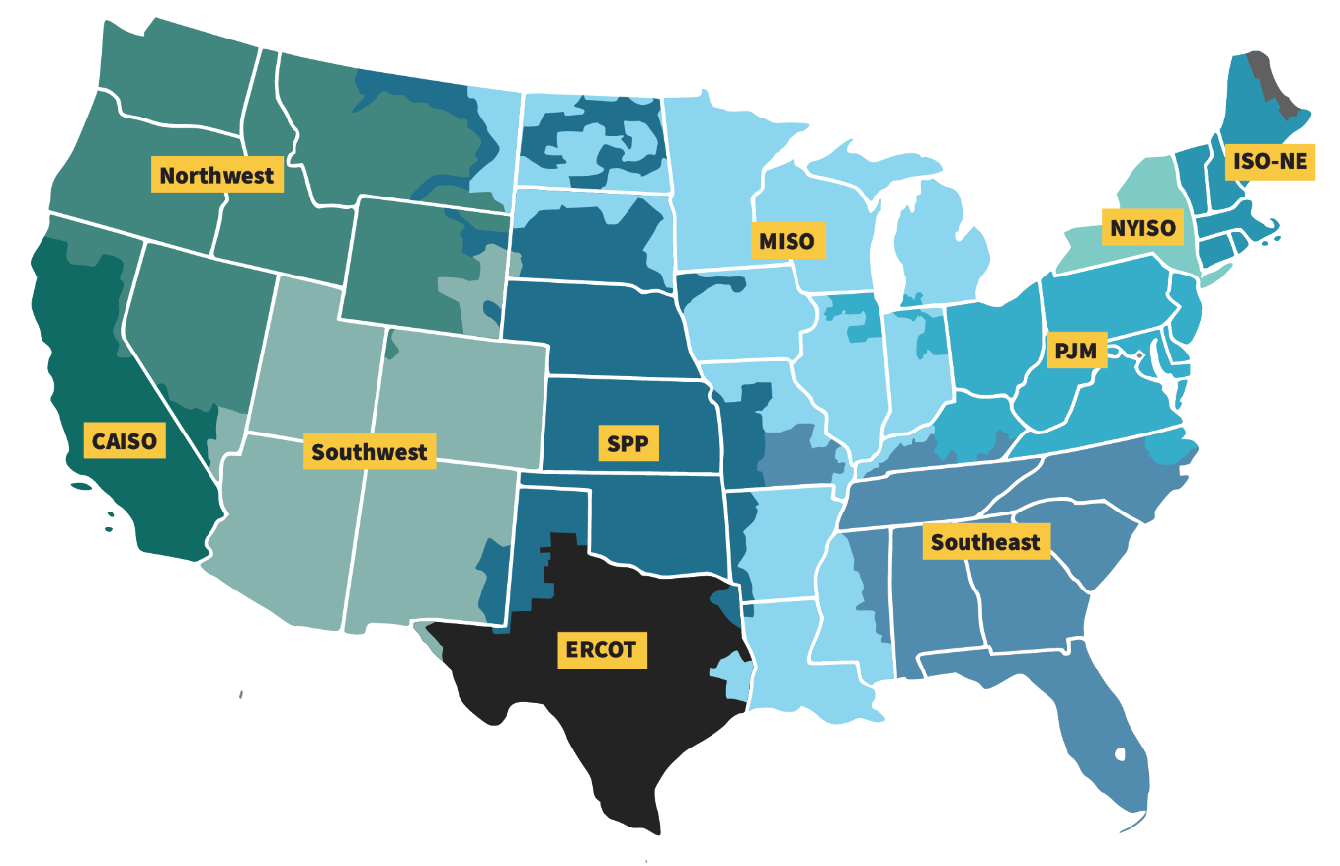
Economic Model Blending Process
Use ITP Study Regions currently in SPP’s model
"Other Regions" are not translated​
Align MISO Region with LRTP model
13
Notes:
Spencer

Slide 14
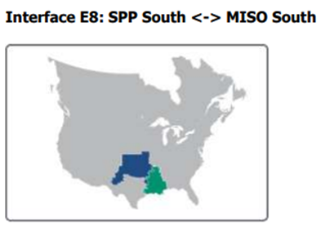
MISO-SPP CSP – DRAFT Transfer Scenarios The RTOs request feedback on the transfer scenarios below:
Transfer Short Name | Interface Name | Transfer No. | Source | Sink
MISO South Exports to SPP South | MISO South – SPP South (NERC ITCS) | 1a | MISO South | SPP South
MISO South Imports from SPP South |  | 1b | SPP South | MISO South
Arkansas Exports to Oklahoma | Arkansas – Oklahoma | 2a | LRZ8 | SPP AR-OK¹
Arkansas Imports from Oklahoma |  | 2b | SPP AR-OK¹ | LRZ8
LA/TX Exports to OK | Louisiana/Texas – Oklahoma | 3a | LRZ9 | SPP LA-TX²
LA/TX Imports from OK |  | 3b | SPP LA-TX² | LRZ9
¹ SPP AR-OK: AEP, AECC, SPA, GRDA, OGE, WFEC
²SPP LA-TX: AEP (LA-TX), SPS
Notes:
Jon

Slide 15
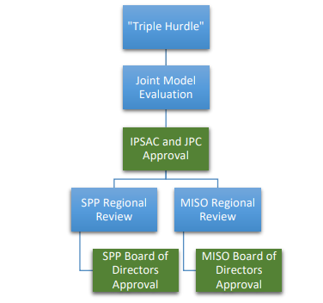
The “Triple hurdle” Issue and Evolution
Original CSP Design 2015-2019
“Triple hurdle” identified in previous CSP studies. Multiple hurdles still present today
JOA currently requires interregional projects must be studied and approved by two separate planning processes
Hurdle 1
Hurdle 2
Hurdle 3
1

Slide 16
Current CSP Design 2019-Today (No joint model requirement)
Hurdle 1
Hurdle 2

Slide 17
2024 CSP blended model CSP process
Blended Model Development
Needs Assessment
Solution Development
Benefits Anaylsis
IPSAC & JPC Evaluate Solutions & Benfits and Provide Recommendations to BOD
BOD Approval
Single Hurdle

Slide 18
"New" Blended model approach could remove the SPP (ITP) and MISO (MTEP) regional review hurdles
Steps and analyses are comparable to the ITP process promoting transmission investment along the MISO and SPP Seam.
The study includes reliability, economic, and transfer analysis using forward-looking models and assumptions
Focused on improving system resiliency by identifying and recommending projects that support the system during extreme weather
MISO & SPP stakeholders collaborate to develop and analyze interregional transmission needs and solutions
Benefit analysis is performed on proposed economic, reliability, and public policy solutions
CSP blended model projects are evaluated and recommended by IPSAC & JPC
Board of Director Approval

Slide 19
Analyses Summary
 | Reliability Analysis | Transfer Analysis | Economic Analysis | Extreme Cold Weather Analysis
Analyses: | NERC TPL: 001-5 Planning Contingencies: P0, P1, P2, and P7 | First Contingency Incremental Transfer Capability (FCITC) NERC TPL: 001-5 Planning Contingencies: P0, P1, P2, and P7 Single initiating and common mode outages | SPP and MISO will develop a blended Event File reflecting each RTOs approach to flow gate identification | NERC TPL: 001 Planning Contingencies: P0, P1, P2, and P7
Notes:
Jon/Spencer

Slide 20
WHAT IS THE IPSAC?
Joint planning advisory groups provided for in the joint operating agreements between SPP and neighbors
AECI-SPP IPSAC and MISO-SPP IPSAC
SaskPower-SPP IPSAC also provided for, but has not met to date
Facilitate stakeholder review and provide stakeholders the opportunity to advise the Joint Planning Committee (JPC) on matters related to the development of the coordinated system planning processes outlined in the applicable joint operating agreements

Slide 21
IPSAC Members
MISO-SPP IPSAC
All SAG Members and any SPP TO with facilities interconnected to MISO that does not have a representative that is a SAG Member
AECI-SPP IPSAC
Members of the SPP Markets and Operations Policy Committee (MOPC)

Slide 22
Meeting Cadence and other information
Meet ad hoc
Most meetings are two to three-hour virtual meetings
Link to IPSAC site

