Slide 1

Video Creation with iMovie
Edit and Enhance Videos to
Produce High Quality Content

Slide 2


Session Agenda
Introduction to iMovie
Importing Media
Editing Video Clips
Adding Transitions and Text
Enhancing with Filters

Slide 3

Learning Objectives
Produce professional-quality video content that aligns with organizational branding requirements.
Demonstrate the ability to transform raw video footage into polished, engaging final products.
Apply video editing skills to create media that supports the organization’s business objectives.

Slide 4
Introduction to iMovie
iMovie is free and user-friendly
Mac users
Perfect for beginners
Ideal for creating marketing videos, tutorials, or personal projects.
What movies will you make with iMovie in your current role?

Slide 5
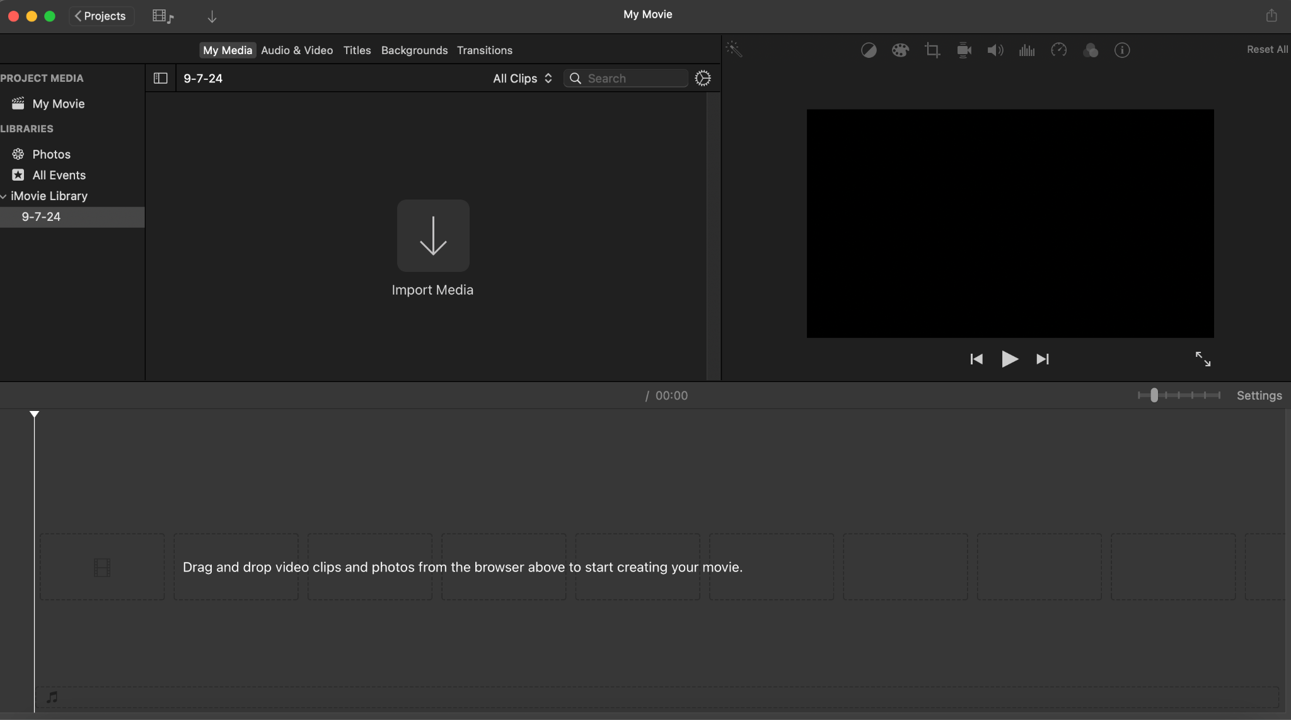
Introduction to iMovie
The iMovie Interface

Slide 6
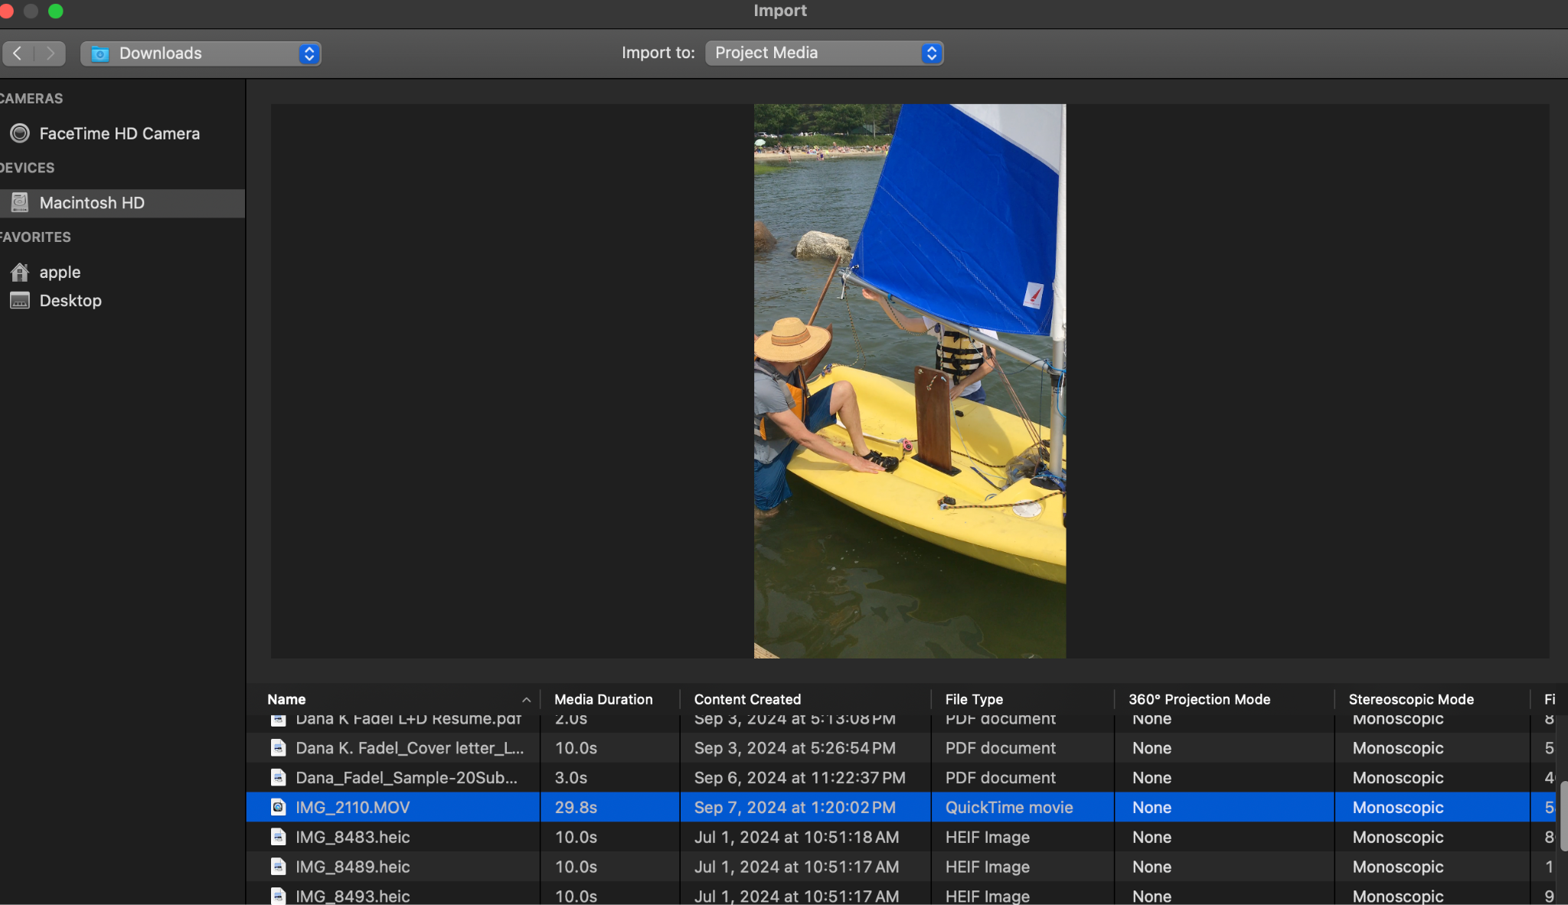
Importing Media into iMovie
Two different ways to add movie footage

Slide 7
Importing Media into iMovie
You've just recorded a video on your phone and want to edit it in iMovie on your Mac. What's the correct process to import this video into your iMovie project?
Knowledge Check!
Notes:
Connect your phone to your Mac using a USB cable or AirDrop the video.
Open iMovie and start a new project or open an existing one.
Click the "Import Media" button in the project window.
Locate your video in the file browser or from the connected device.
Select the video and click "Import Selected."

Slide 8
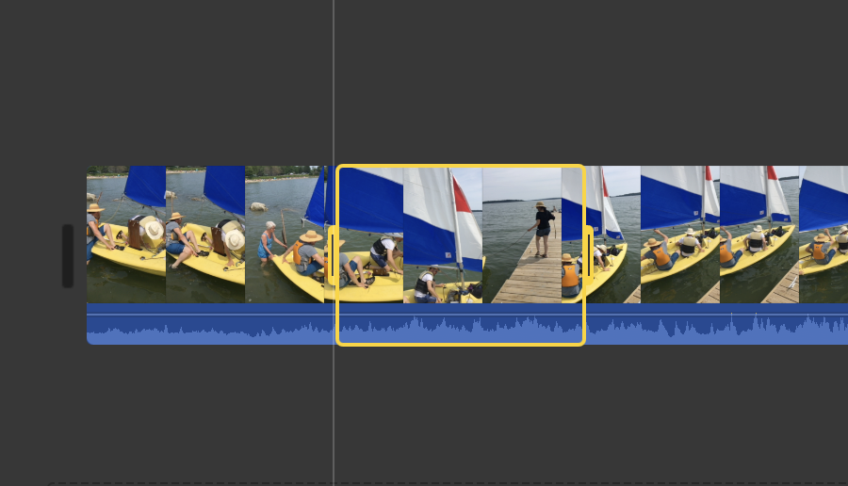
Editing Media in iMovie
Trimming, Splitting, and Cutting.

Slide 9
Editing Media in iMovie
You’ve imported a video clip into your iMovie project but notice there are parts you don’t need. How would you trim, cut, or split the clip to keep only the essential sections?
Knowledge Check!
Notes:
Select the clip in the timeline.
To trim, drag the edge of the clip inwards to shorten it.
To cut, move the playhead to where you want to remove a section, right-click the clip, and choose "Split Clip" to divide it. Then delete the unwanted portion.
To split, position the playhead where you want to break the clip, right-click and select "Split Clip" to create two separate clips.

Slide 10
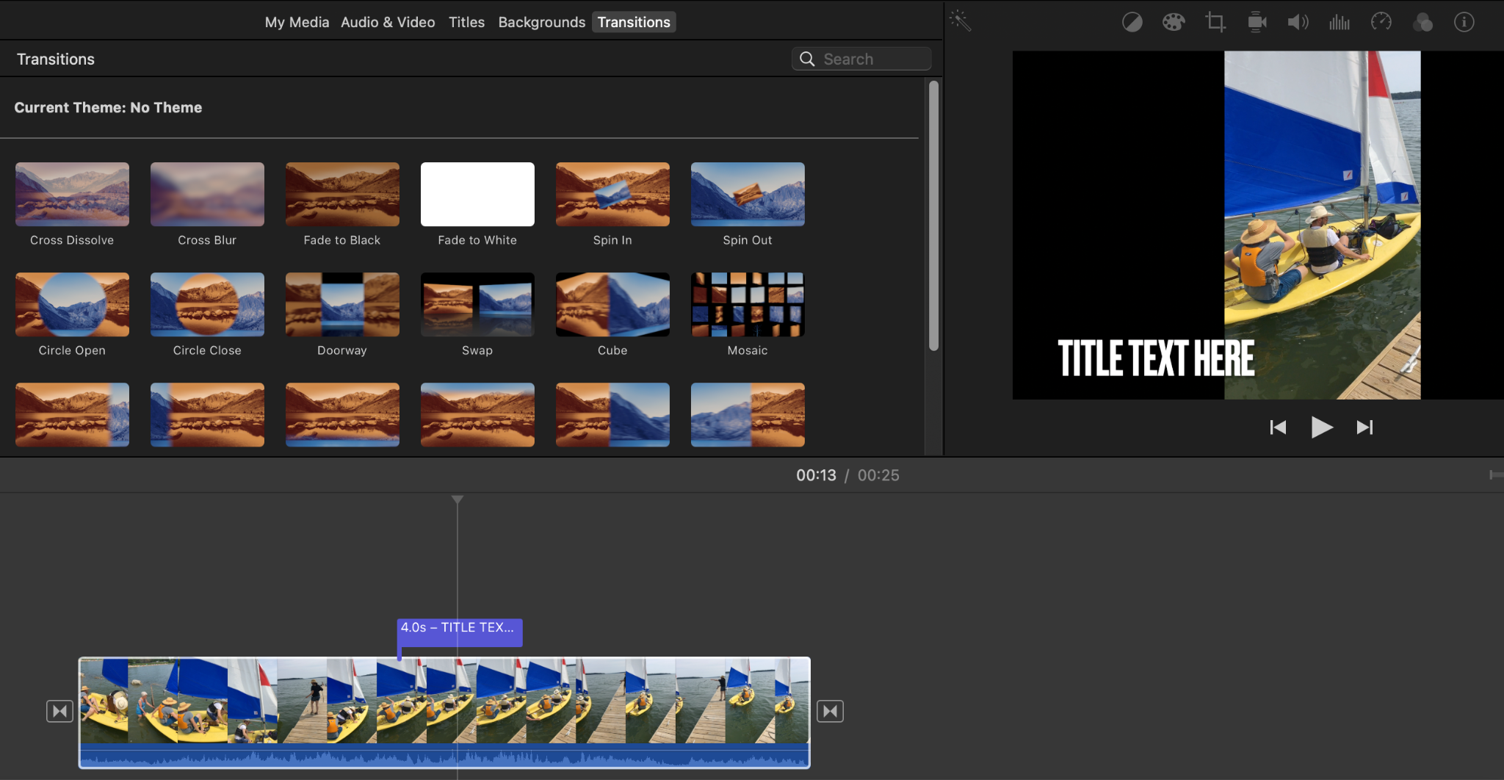
Transitions and Text in iMovie
Select Titles and Transitions

Slide 11

Break Out Groups
Play around with transitions and text.

Slide 12
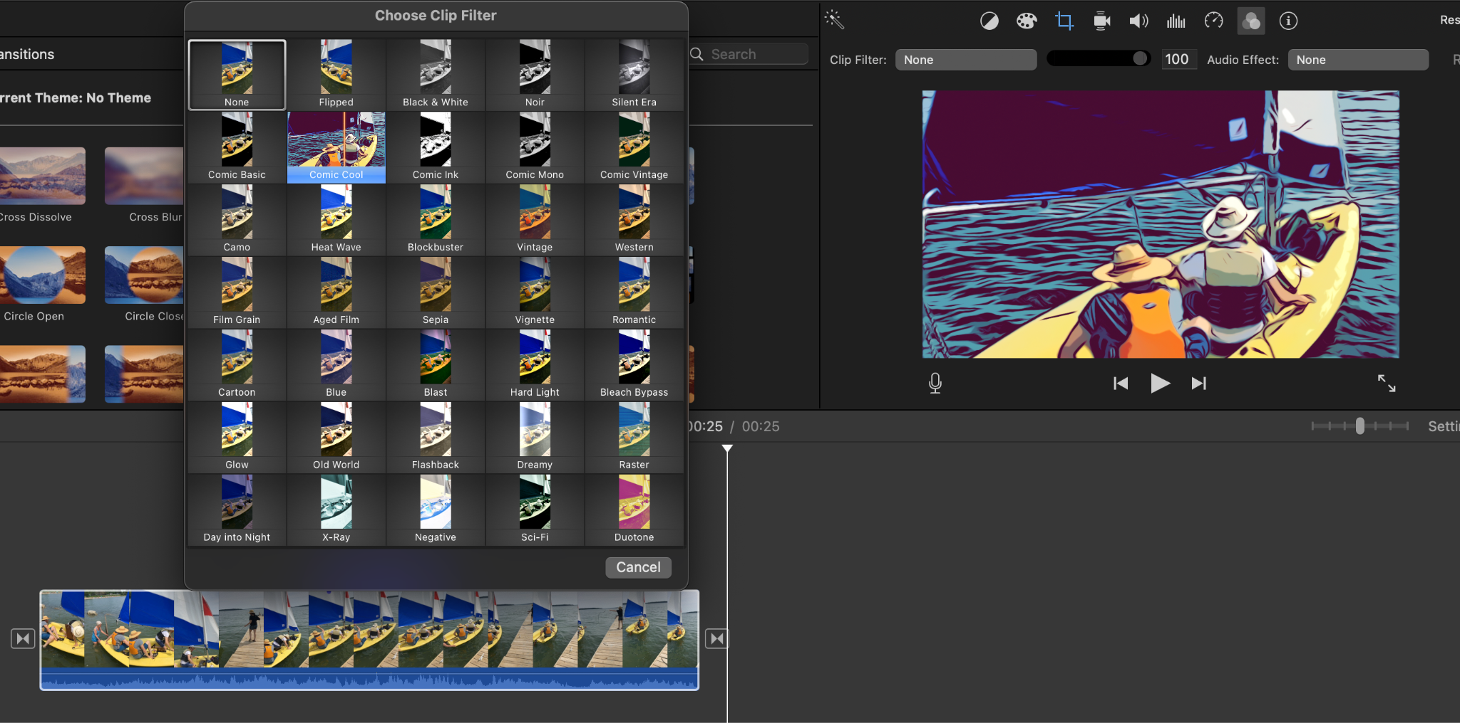
Enhancing Media in iMovie
Select Filters and Effects

Slide 13
Break Out Groups
Play around with filters and effects.

Slide 14

Thank you for participating!
My name
Contact information
Resources blog

