Slide 1


SPERS
Self-Powered Environmental
Remediation System
Turning Hazardous Waste into Clean Energy & Rare Elements.

Slide 2

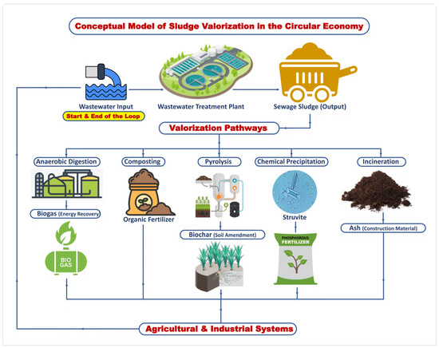
The Dual Crisis
1. Toxic Accumulation
Global industrial waste generation is outpacing containment capacity. Heavy metals, sludge, and chemical agents are permanent liabilities.
2. Energy Scarcity
Remediation is energy-intensive. Traditional incineration consumes massive grid power, creating a negative feedback loop of carbon emissions.

Slide 3

The SPERS Solution
A closed-loop Matter-to-Energy Converter.
Using Acoustic Inertial Confinement Fusion to transmute hazardous waste into inert byproducts, generating net-positive electricity in the process.

Slide 4
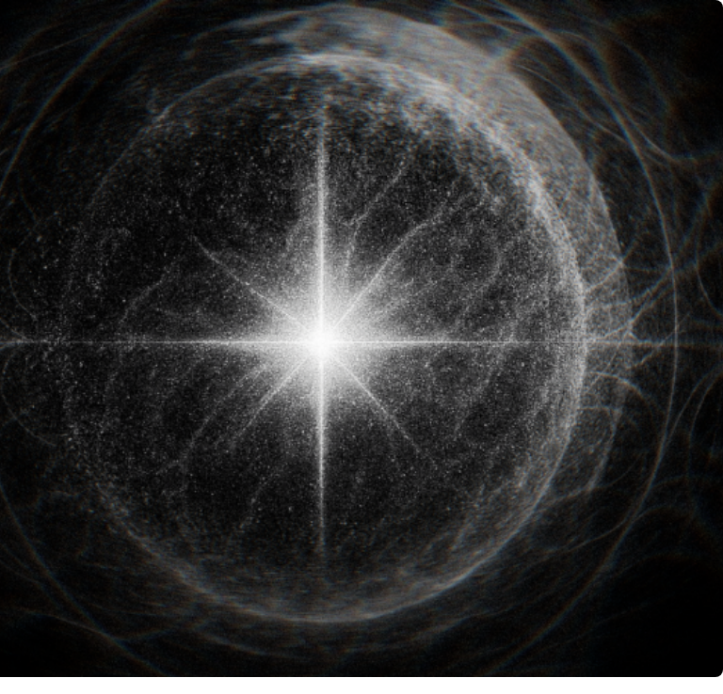
Acoustic Inertial Confinement Fusion (AICF)
The "Trip" Mechanism:
1. Resonance: Acoustic drivers create a standing wave in the reactor fluid.
2. Cavitation: Micro-bubbles form and expand.
3. Collapse: Bubbles implode violently, creating localized temperatures of 100 Million Kelvin.
4. The Spark: This nanosecond event triggers the nuclear fusion of Lithium-7.

Slide 5


The Proton-Lithium-7 Reaction
Inputs
Outputs
Protons (H+): Derived from water or waste slurry.
2x Alpha Particles: (Helium-4) Safe, inert, valuable.
Lithium-7: The primary fuel/catalyst.
Energy (17.6 MeV): Massive thermal release.
Waste: Dissolved heavy metals (Fe, As) act as targets.
Neutrons: High-flux burst breaks down heavy waste.

Slide 6
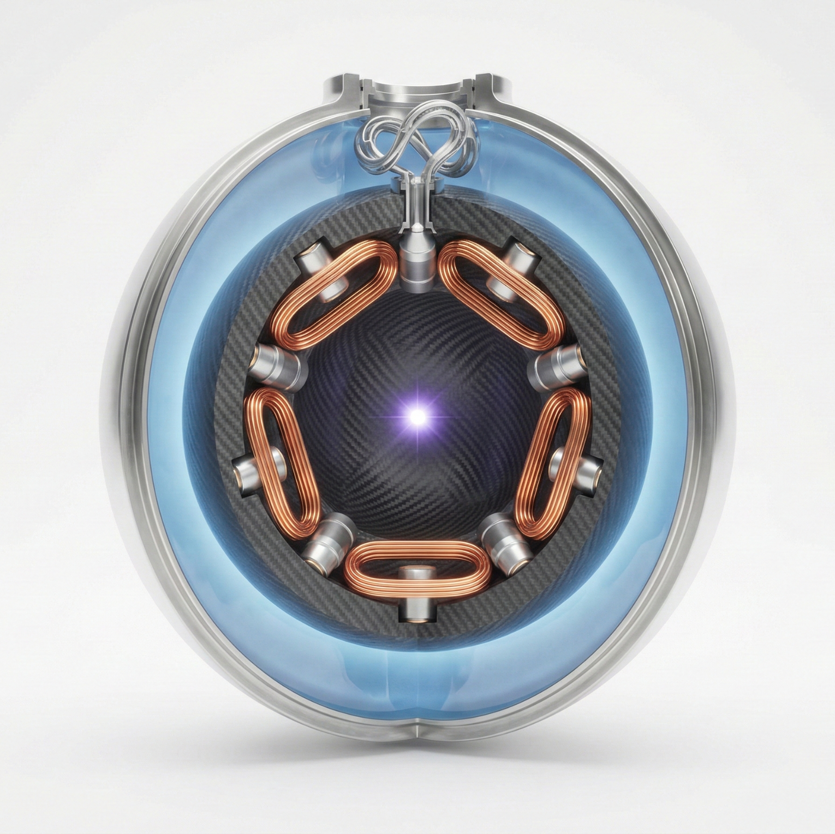
Reactor Geometry: Sphere-in-Sphere
Thermal Capture & Shielding
Inner Sphere: The cavitation chamber where fusion occurs. Sintered SiC construction withstands 1000 Bar transients.
Regenerative Heatsink
Outer Sphere: A water jacket that captures 100% of radiant heat and neutron kinetic energy, converting it instantly into steam to drive the turbines.

Slide 7
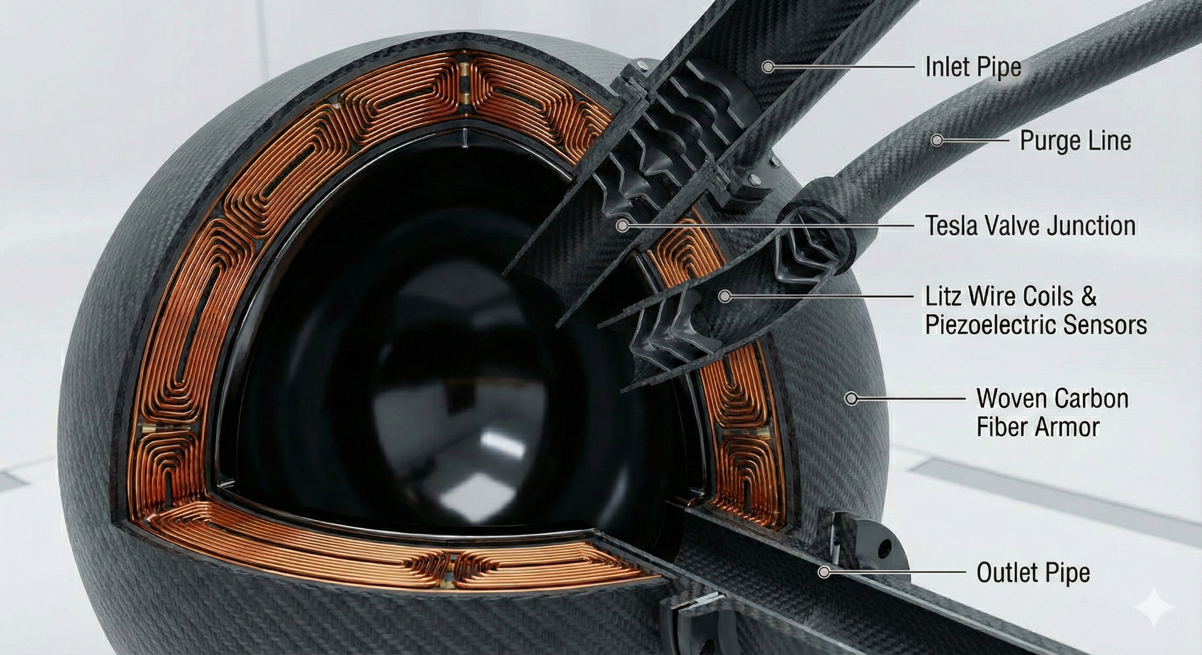
CORE-A1 Cartridge
The beating heart of SPERS. A modular, replaceable unit designed for zero-maintenance operation.
Material: Sintered Alpha-Silicon Carbide (SiC).
Active Matrix: Copper Litz Wire coils embedded directly into the ceramic wall for magnetic containment.
Drivers: 12x Piezoelectric nodes create the acoustic "Trip".

Slide 8
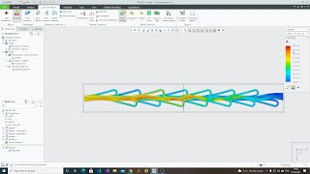

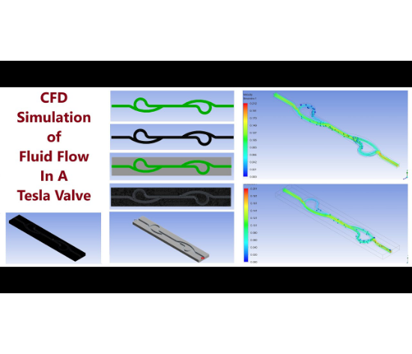
Fluid Control Systems
1. Tesla Valve Injection
A solid-state, no-moving-parts valve. It uses the reactor's own pressure pulses to passively inject fuel "slugs" in one direction only.
2. Graphite Nanoseeding
Carbon nanoparticles are injected to act as nucleation sites. They lower the cavitation threshold and absorb microwave energy to accelerate the burn.

Slide 9
Variable Operational Modes
Parameter | Mode A: Municipal | Mode B: Industrial
Feedstock | Sewage Sludge (5-8% Solids) | Arsenic / Lead Solvents
Primary Goal | Sterilization & Volume Reduction | Nuclear Transmutation
Pulse Frequency | 60 Hz (Standard) | 20 Hz (High Intensity)
Magnetic Power | 70% Peak (14 Tesla) | 100% Peak (20 Tesla)
Output Focus | Clean Water & Helium | Safe Stable Isotopes

Slide 10

The "Clean" Dirty Reactor
"How do you burn dirt without clogging the engine?"
The Pulse/Purge Cycle:
SPERS pulses 60 times a second. Every 100th pulse is a pure water "Flush Cycle" that scours the SiC walls, preventing waste buildup and ensuring the reactor remains pristine despite the dirty fuel source.

Slide 11





Defense-in-Depth Safety
Physics First
Deadman Switch
Passive Quench
The reaction is not self-sustaining. If power is cut, fusion stops in < 1ms. No meltdown risk.
Hard-wired analog interlocks monitor radiation and seismic activity. Any breach triggers an instant capacitor dump.
In a catastrophic failure, a gravity-fed tank floods the reactor pit with borated water, cooling the core without pumps.

Slide 12
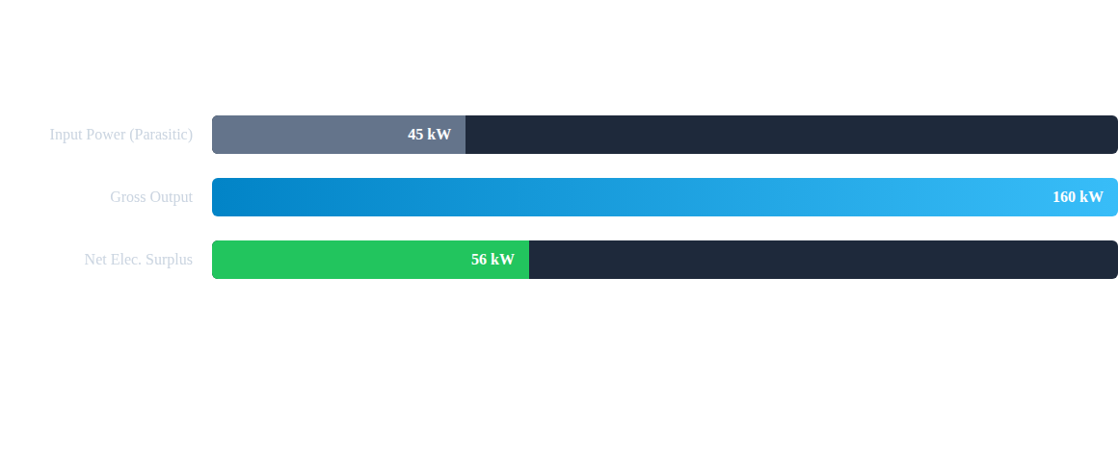
Energy & Revenue Balance
Revenue Multiplier: In addition to +56kW net power, the system captures ~100L of Helium-4 per day.

Slide 13
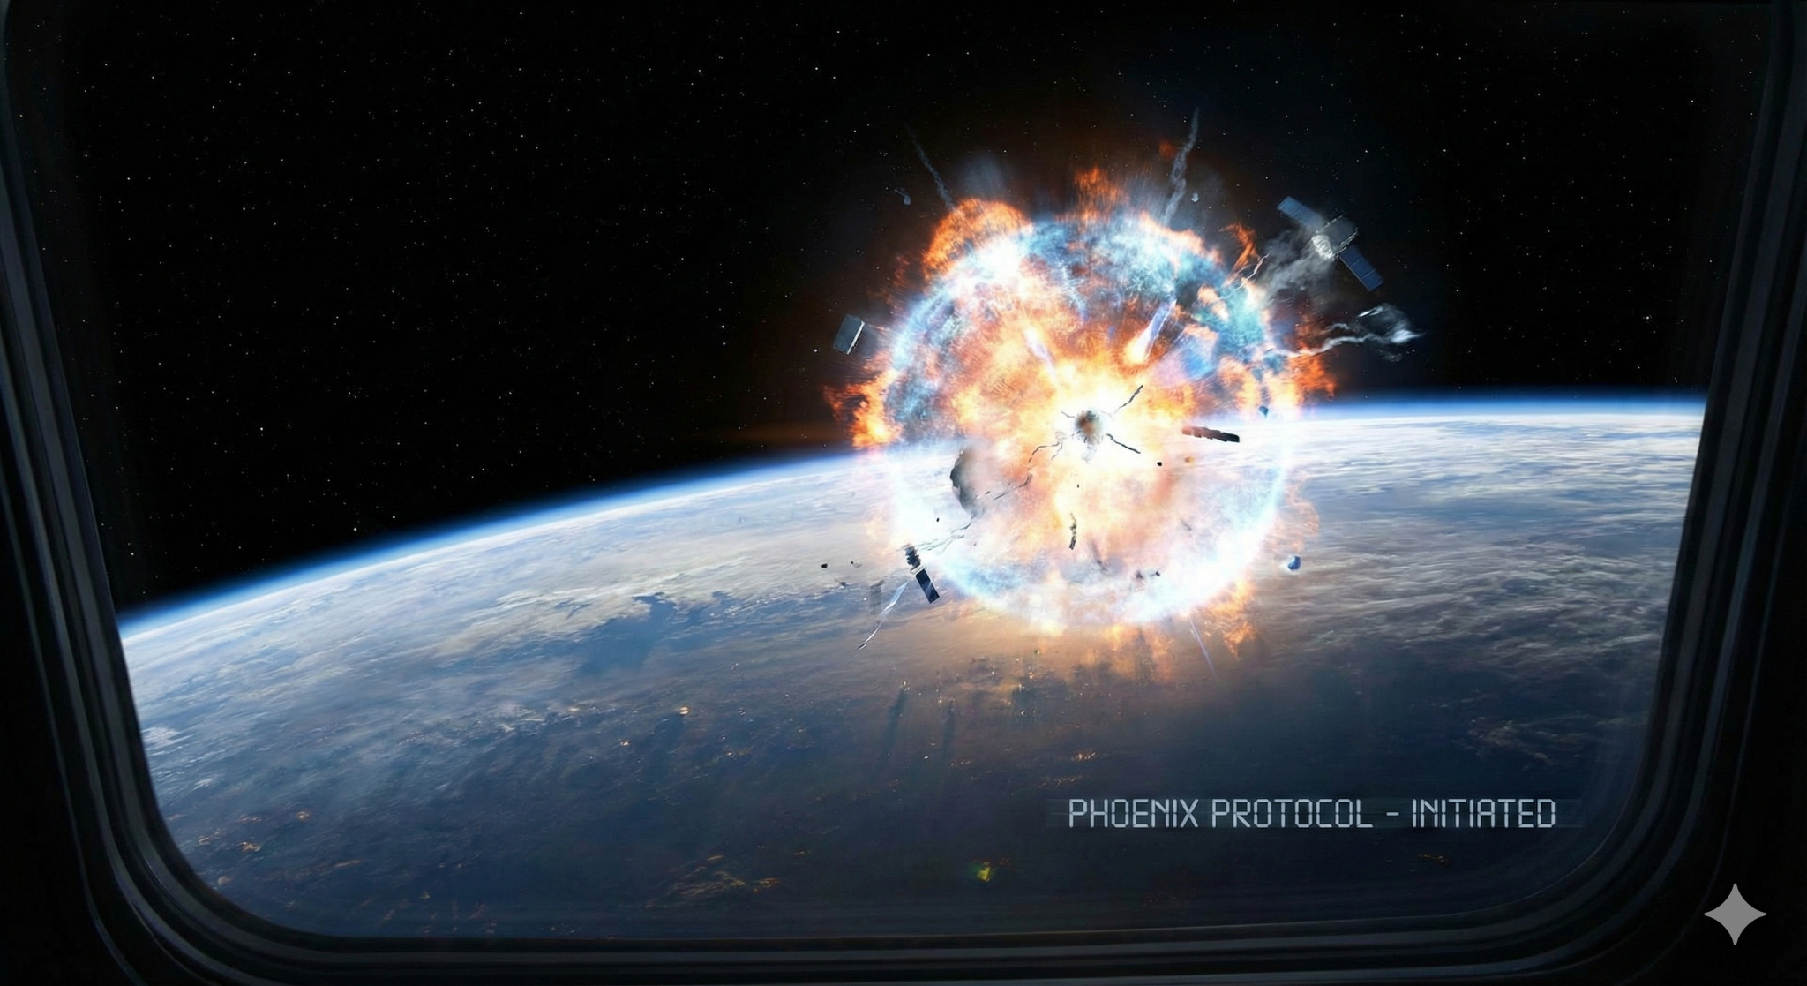
The Phoenix Protocol
End-of-Life (EOL) strategy for spent reactor cores.
Orbital Disposal
Rather than burying radioactive cores, SPERS launches sealed cartridges into High Earth Orbit (HEO). Using an inductive overload, the core is vaporized into plasma in the vacuum of space.

Slide 14
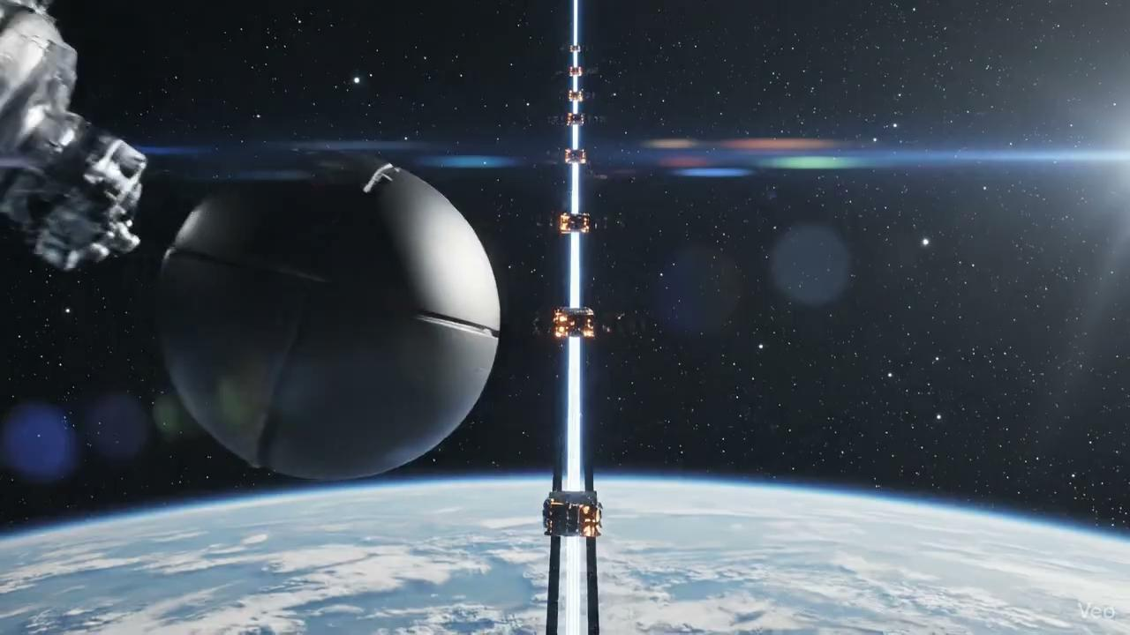
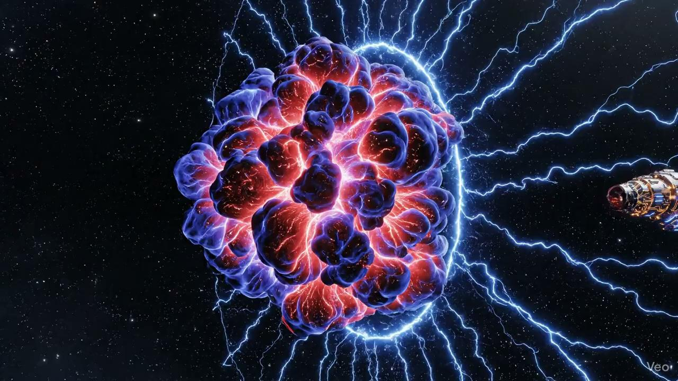
Mass Spectrometer in the Wild
Turning disposal into mining.
Once vaporized in orbit, the core's plasma cloud is intercepted by satellites equipped with magnetic shields.
The fields separate elements by mass. Aerogel panels then capture the separated streams, harvesting pure Rare Earth Elements (REE) produced by the transmutation process.
NOTE: Artist license as no sound in space.

Slide 15

Questions?
SPERS-MK1 Pilot Program
Contact Engineering: *****@spers.online
Investment Relations: *****@spers.online

Slide 16



Image Sources
https://www.mdpi.com/applsci/applsci-15-10954/article_deploy/html/images/applsci-15-10954-g002-550.jpg
Source: www.mdpi.com
https://miro.medium.com/1*KG_VaQeJzLt_W3hZy65I1Q.png
Source: medium.com
https://i.ytimg.com/vi/pdvuhpuoFkM/maxresdefault.jpg
Source: www.youtube.com

