Slide 1
Web Development Course Curriculum: HTML and CSS
Dimitra Kallergis-Anastasopoulos
Education Example Of Development

Slide 2
THE PROCESS Web Development Course
Analysis
Design
Implementation
Evaluation
Learner’s Needs and Goals
Curriculum
Development
Assessment design
Strategies
Content
Resources
Assessment tools
LMS
Course Delivery
Facilitation
Engagement
Summative
Formal
Learner Feedback
Course Review

Slide 3
Step 1: Analysis
Who?
What?
Where?
How?
When?
Adults
HTML and CSS basics
Computer Lab on campus
In-person and online
August-December (15 weeks)
Why?
Requirement or Elective
Notes:
Who is my audience?
What are the concepts that are required to learn the basics of HTML and CSS?
Where am I teaching?
How will I teach the content?
When will be I teaching the content?

Slide 4
Step 1: Analysis – Learner’s Needs
SME
Technical Skills
Design Principles
Critical Thinking
Collaboration
Career Readiness
Students need to acquire basic coding skills in HTML and CSS
Understanding aesthetics and usability in web design
Ability to solve problems and debug code
Working in teams to simulate real-world web design projects
Preparing for potential careers in web design and development
Notes:
Who is my audience?
What are the concepts that are required to learn the basics of HTML and CSS?
Where am I teaching?
How will I teach the content?
When will be I teaching the content?

Slide 5
Step 2: Design
Develop the course outline with concepts
Define the learning objectives
Plan a variety of assessments
Choose instructional learning strategies

Slide 6
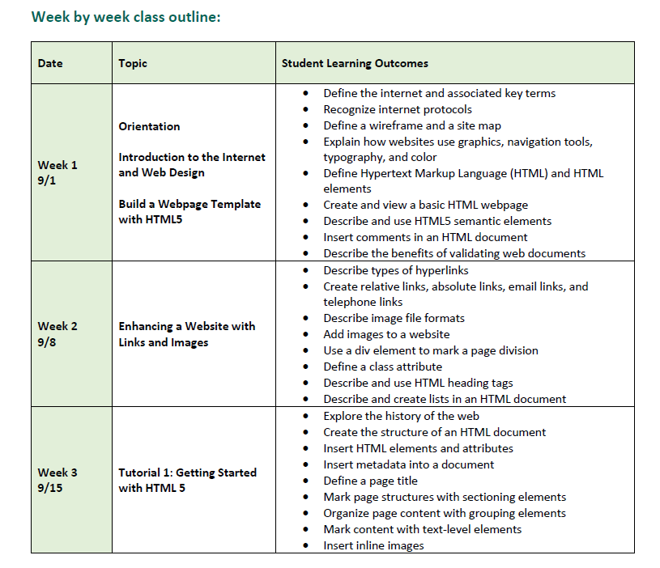
Web Development Weekly Course Outline

Slide 7
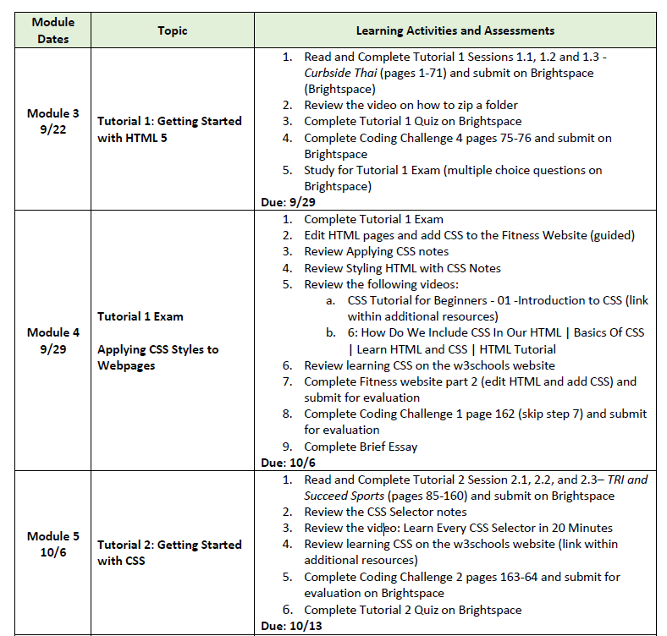
Web Development Weekly Course Schedule

Slide 8
Instructional Learning
Quizzes
Exams
Final Project
Scaffolding
Coding challenges
Hands-on Projects
Discussions
Notes:
Scaffolding – guided learners to build a website from simple to complex tasks

Slide 9
Step 3: Development
Create the instructional materials
Develop additional resources
Design the assessments
Build the course on the LMS

Slide 10
Additional Resources Developed
Module 1: Fundamentals of HTML

Slide 11
Additional Resources Developed
Module 2: Enhancing a Website

Slide 12
Additional Resources Developed
Module 5: CSS Selectors

Slide 13
Additional Resources Developed
Module 10: Creating Tables

Slide 14
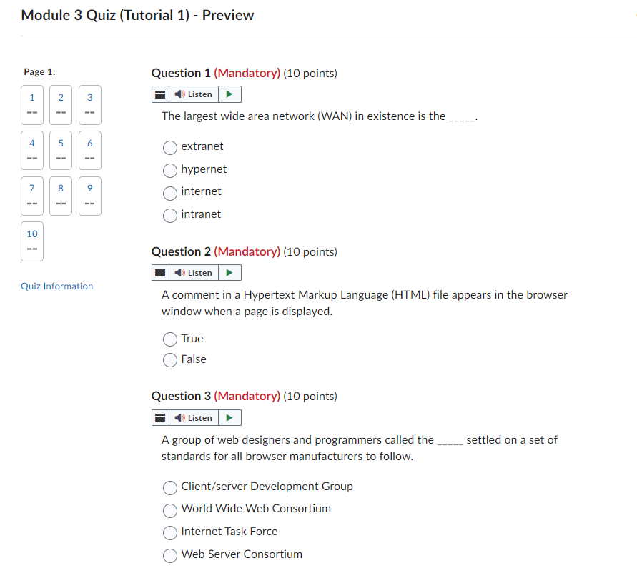
Assessments
Quizzes
Assignments
Projects
Exams

Slide 15
Build the Course Platform and Tools

Slide 16
Step 4: Implementation
Test the course on the LMS
Launch the course on the LMS
Deliver/facilitate the course
Create space for engagement - discussions, questions, and technical support

Slide 17
Launch on LMS

Slide 18
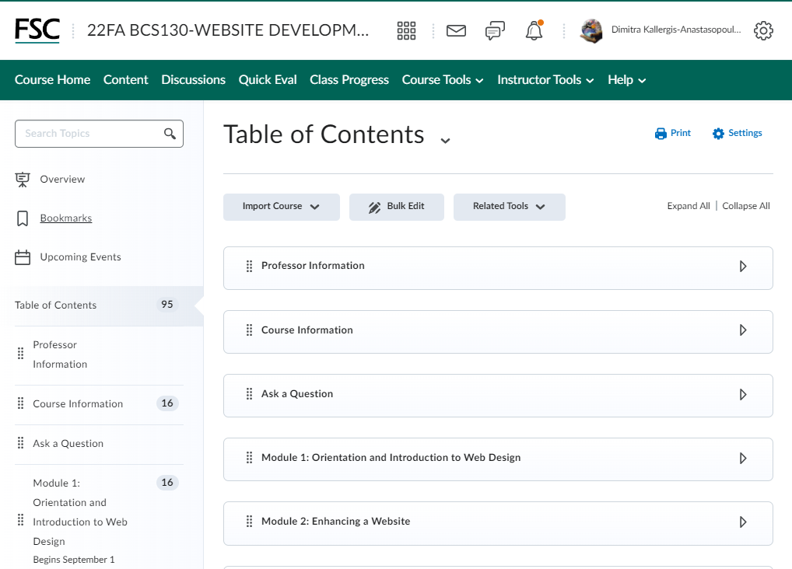
Launch on LMS

Slide 19
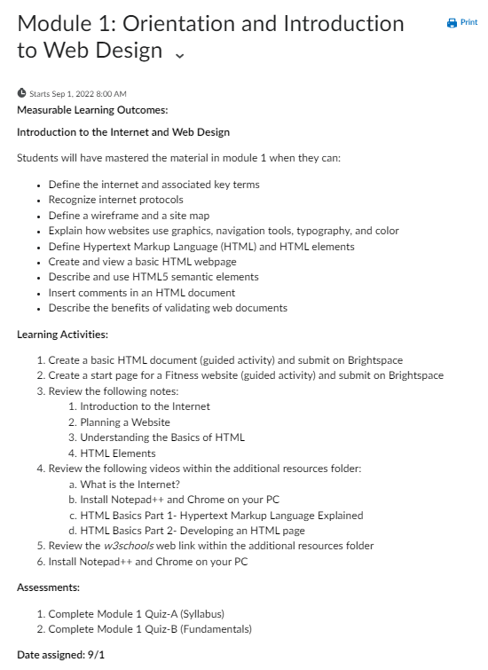
Launch on LMS

Slide 20
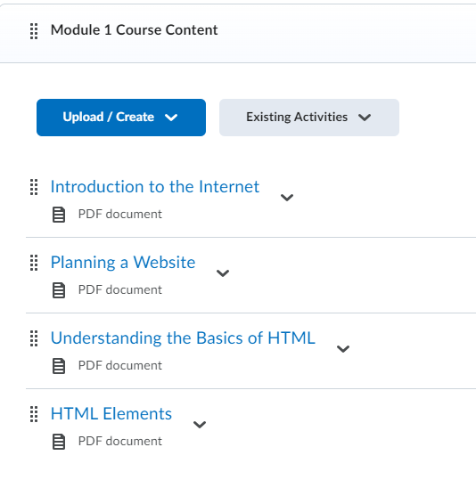
Launch on LMS

Slide 21
Announcement sent to learners

Slide 22
Discussion Forum Q & A

Slide 23
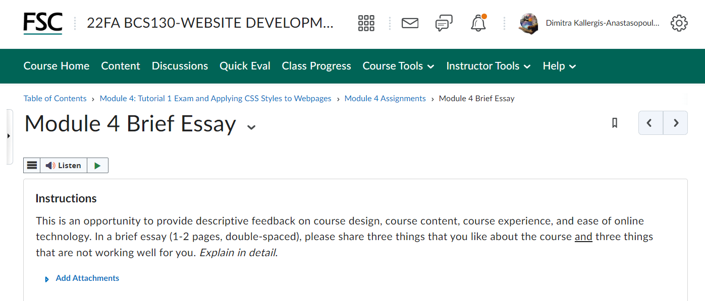
Step 5: Evaluation
How will I collect
learner feedback?
Direct communication
Course Review Survey
Reflections

Slide 24
Step 5: Evaluation
Organization
Interesting
Communication
Relevant
Assignments
Challenging
Workload
Enjoyment

Slide 25
Step 5: Evaluation
What is the data collected?
Scores from course survey
Percent of completion
Learner feedback

Slide 26
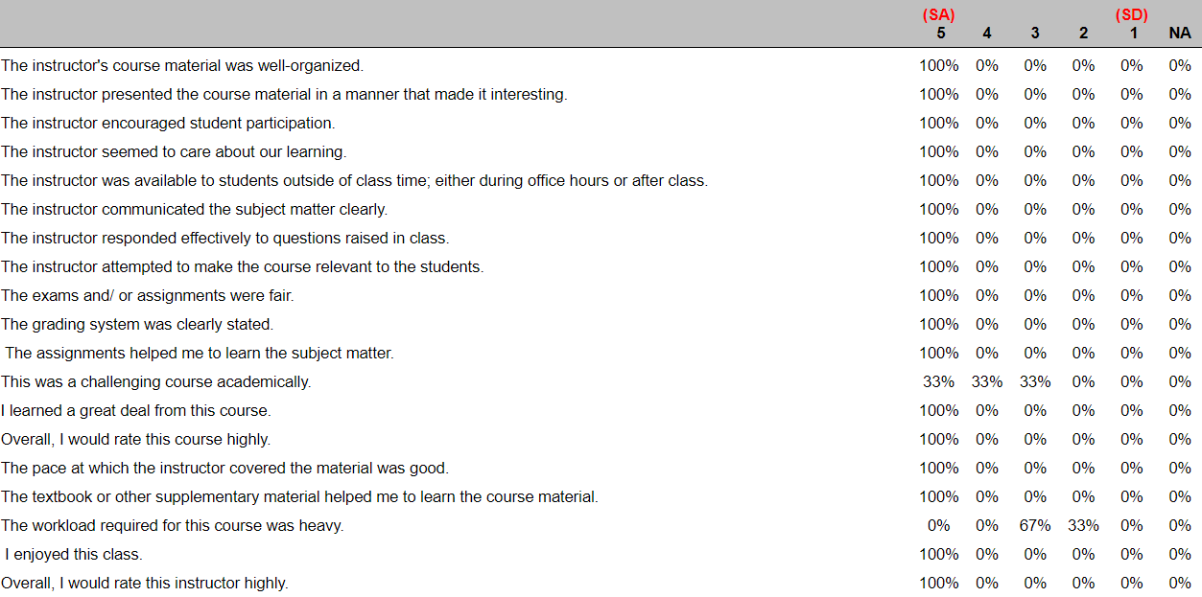
Step 5: Evaluation

Slide 27
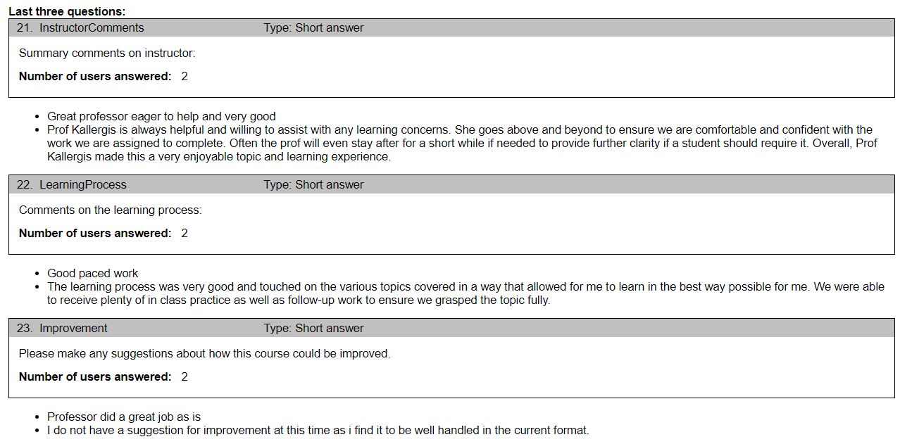
Step 5: Evaluation

Slide 28
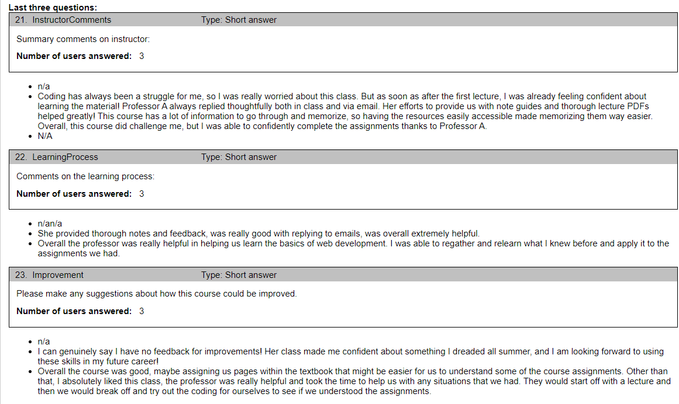
Step 5: Evaluation

Slide 29
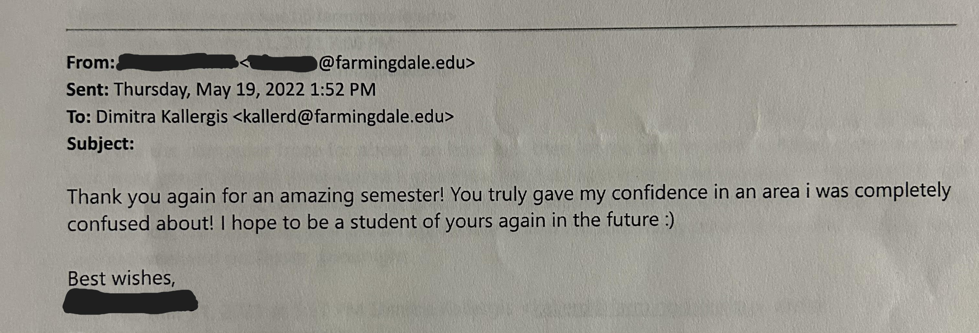
Step 5: Evaluation

Slide 30
Step 5: Evaluation
What needs improvement?
Content
Delivery method
Support
Tools

Slide 31
THE PROCESS Web Development Course
Analysis
Design
Implementation
Evaluation
Course outline
Instructional materials
Test on LMS
Learner Feedback
Course Review
Technical skills: HTML and CSS
Design Principles
Critical thinking
Learning objectives
Variety of assessments
Instructional learning strategies
Development
Additional resources
Assessments
Build course on LMS
Launch on LMS
Deliver/facilitate
Create space for engagement
Final Project
Career Readiness

Slide 32
Web Development Course Curriculum: HTML and CSS
Dimitra Kallergis-Anastasopoulos
Education Example Of Development

