Slide 1

Graphic notice
Pop in

Slide 2
Pop in
The pop in is opened via a button.
It is displayed on top of the screen in a white box.

Slide 3
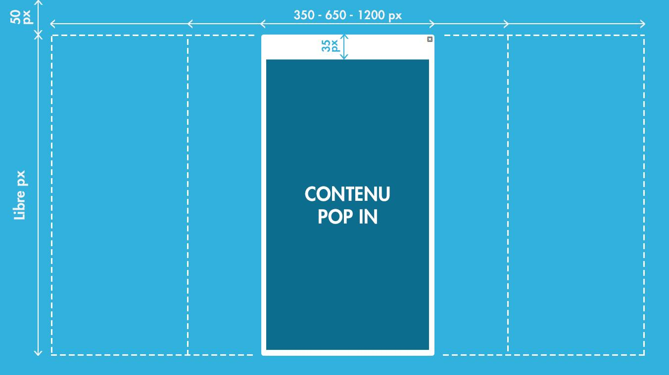
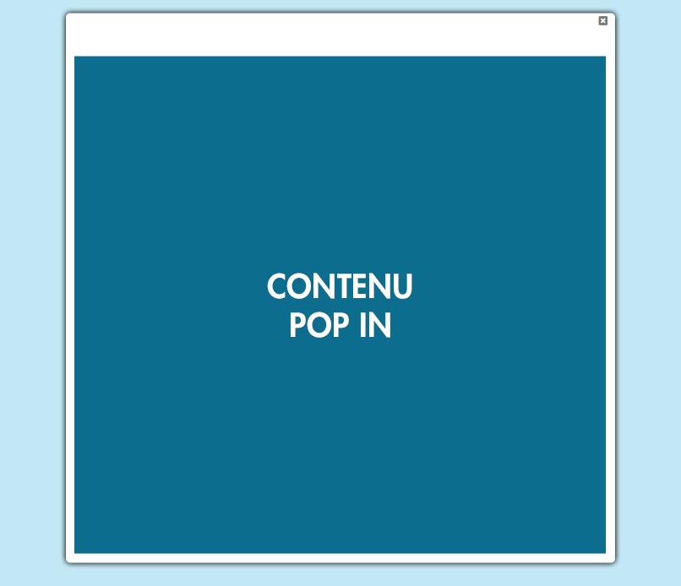
Pop in specifications
350 - 650 - 1200 px
50 px
35 px
Libre
A 70% opaque white cover is placed between the screen and the pop in.
An external black glow is applied to make the pop in stand out.
A 35 px white banner with a cross to close the pop in is automatically placed at the top of the exported visual.
Three pop in widths are available: 350px, 650px & 1200px
The height is up to you. Above 870px a scroll bar will automatically be added to the pop in.
The pop in is automatically placed 50px below the top of the screen.
Notes:
https://developers.facebook.com/docs/sharing/best-practices

Slide 4
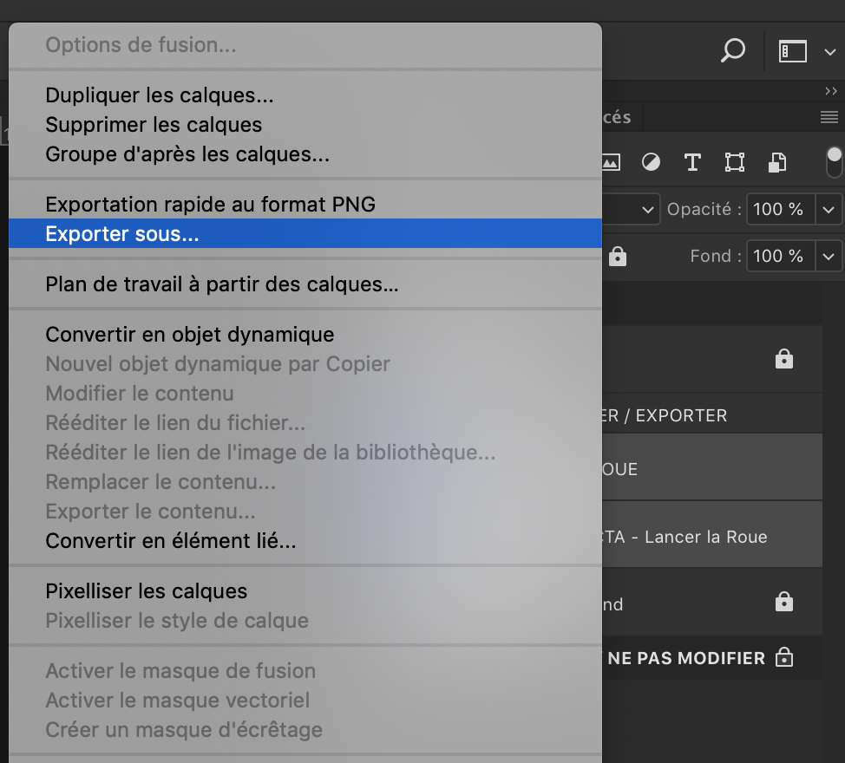

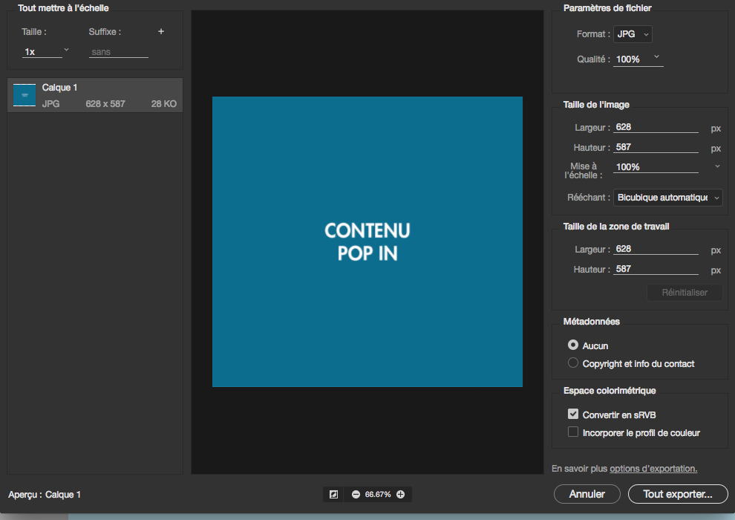
Export of the pop in
Select the pop in layer.
Right click and select Export as...
Select the following parameters in the export pop-up:
  JPG Format
  Quality : 100%
  Convert to sRGB: enabled
  Embed colour profile: enabled
Click on the Export All... button and select the destination folder "Assets - Pop in" from your Render directory.
This method automatically trims the empty space around the pop in.

Slide 5
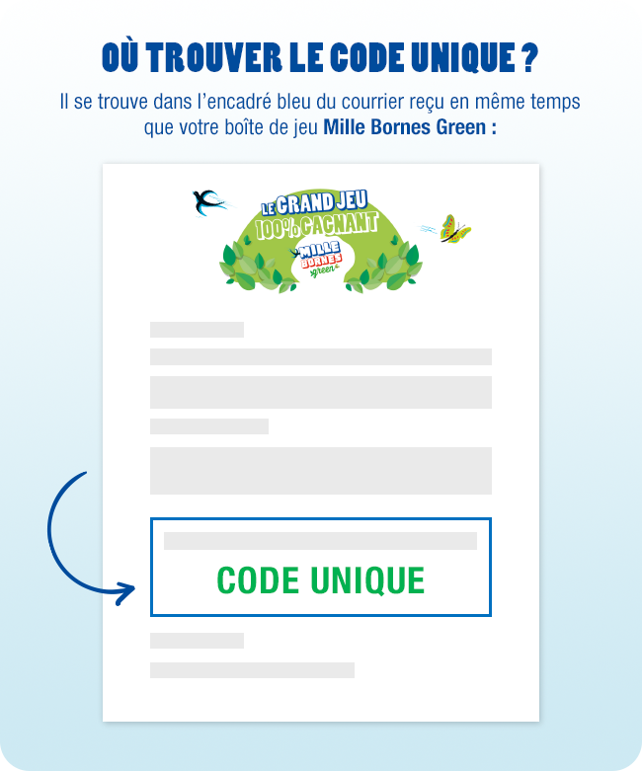


Examples

