Slide 1
Lecture 2 Brownian Motion
Chem 163
9/6/2022

Slide 2
Plan for today
Brownian motion
Random walks
Central limit theorem
Diffusion, Fick’s laws
Solutions to diffusion equation
Analogies to other physical phenomena

Slide 3
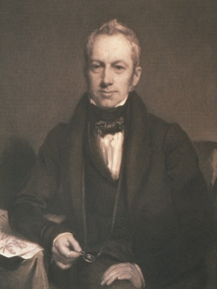
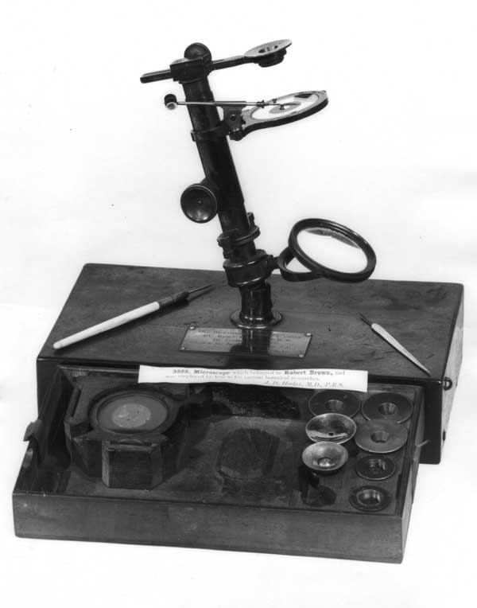
History of Brownian Motion
Robert Brown and his microscope (circa 1827)

Slide 4
What makes small particles move?
Idea 1: The pollen is swimming
“Having found motion in the particles of pollen of all the living plants which I had examined, I was led next to inquire whether this property continued after the death of the plant, and for what length of time it was retained.”
The motion persists in plants that have been dead 100 years
Idea 2: It is a property of pollen of phaenogamous (flowering) plants
Pollen from moss shows the motion too, even from dead moss
Idea 3: It is “the supposed constituent or elementary molecules of organic bodies”
The motion persists in ground-up fossil plants
Idea 4: It is a universal property of small pieces of matter
“To mention all the mineral substances in which I have found these molecules; would be tedious…a fragment of the Sphinx being one of the specimens examined…
Side note: Brown thought he was seeing individual molecules;
Actually he reached resolution limit of his microscope.

Slide 5
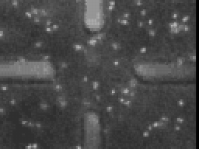
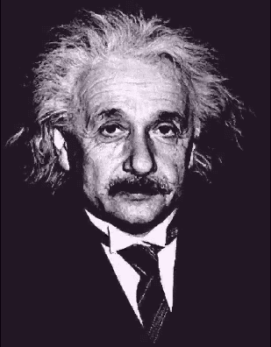
Einstein’s idea in 1905
“Bodies of microscopically visible size suspended in liquids must, as a result of thermal molecular motions, perform motions of such magnitude that these motions can easily be detected by a microscope.”
— A. Einstein
Annalen der Physik 17, 549 (1905)
5 μm

Slide 6
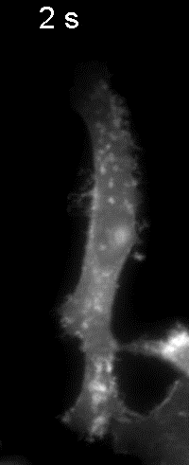
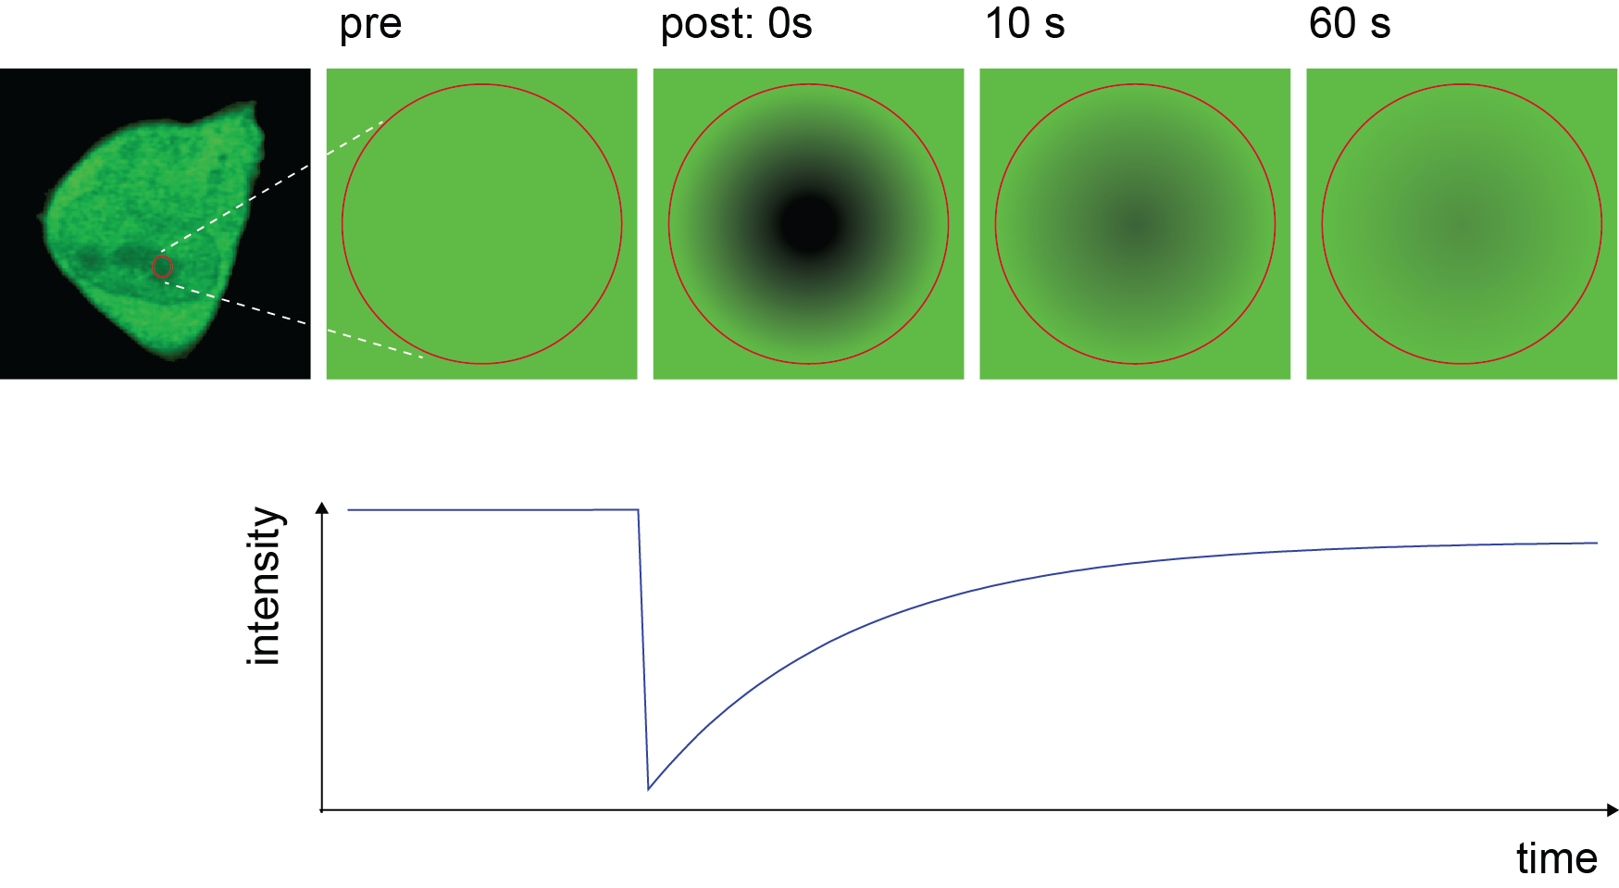
FRAP measurements of diffusion coefficients

Slide 7
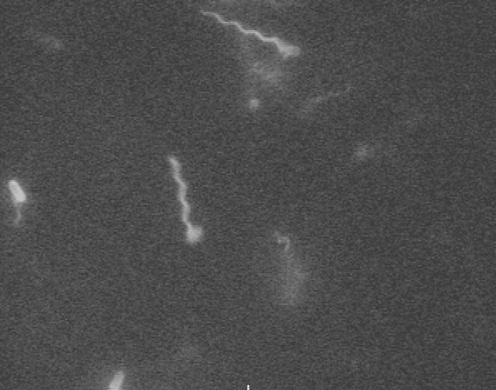
Tumbling of E. coli

Slide 8
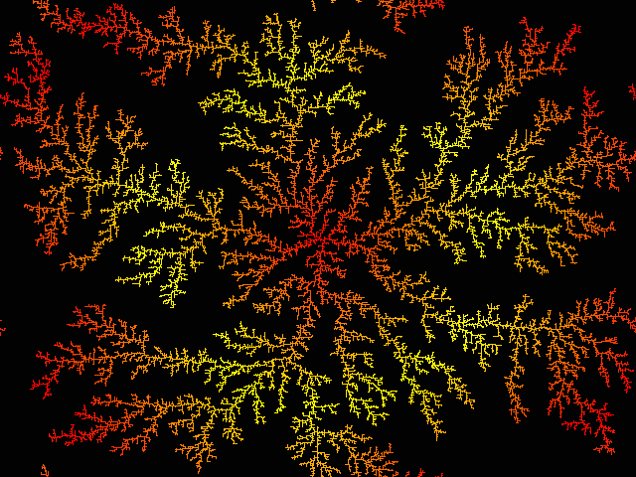
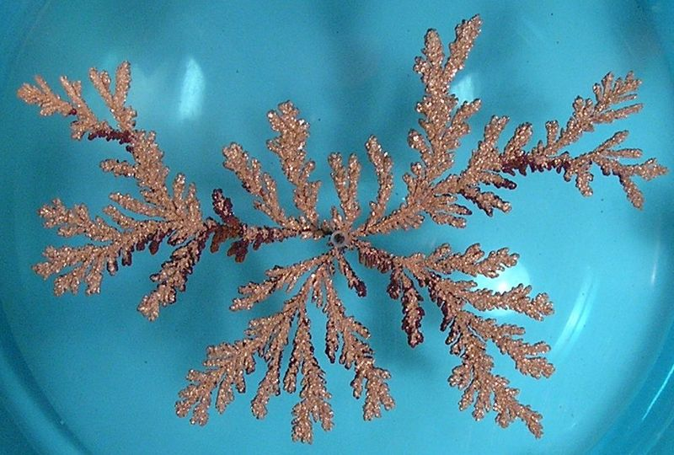
Diffusion-limited growth patterns
Computer simulation
copper sulfate solution
bacterial film

