Slide 1
Molecular motors
Chem 163
23 Sept 2021

Slide 2
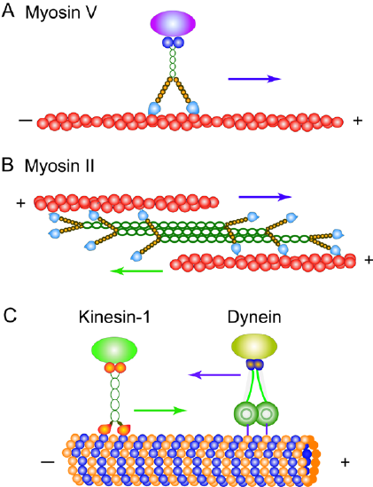
What is a molecular motor?
Cytoskeletal linear motors
Nucleic acid motor proteins
Rotary motors
Polymerase
Topoisomerase
Gyrase
Helicase
Ribosome
Bacterial flagellum
F₀F₁-ATP synthase
Transporters
Electrogenic (e.g. NKX)
Non-electrogenic
Light-driven
+ end is distal in most cells and axons
Dendrites have variable microtubule orientation

Slide 3
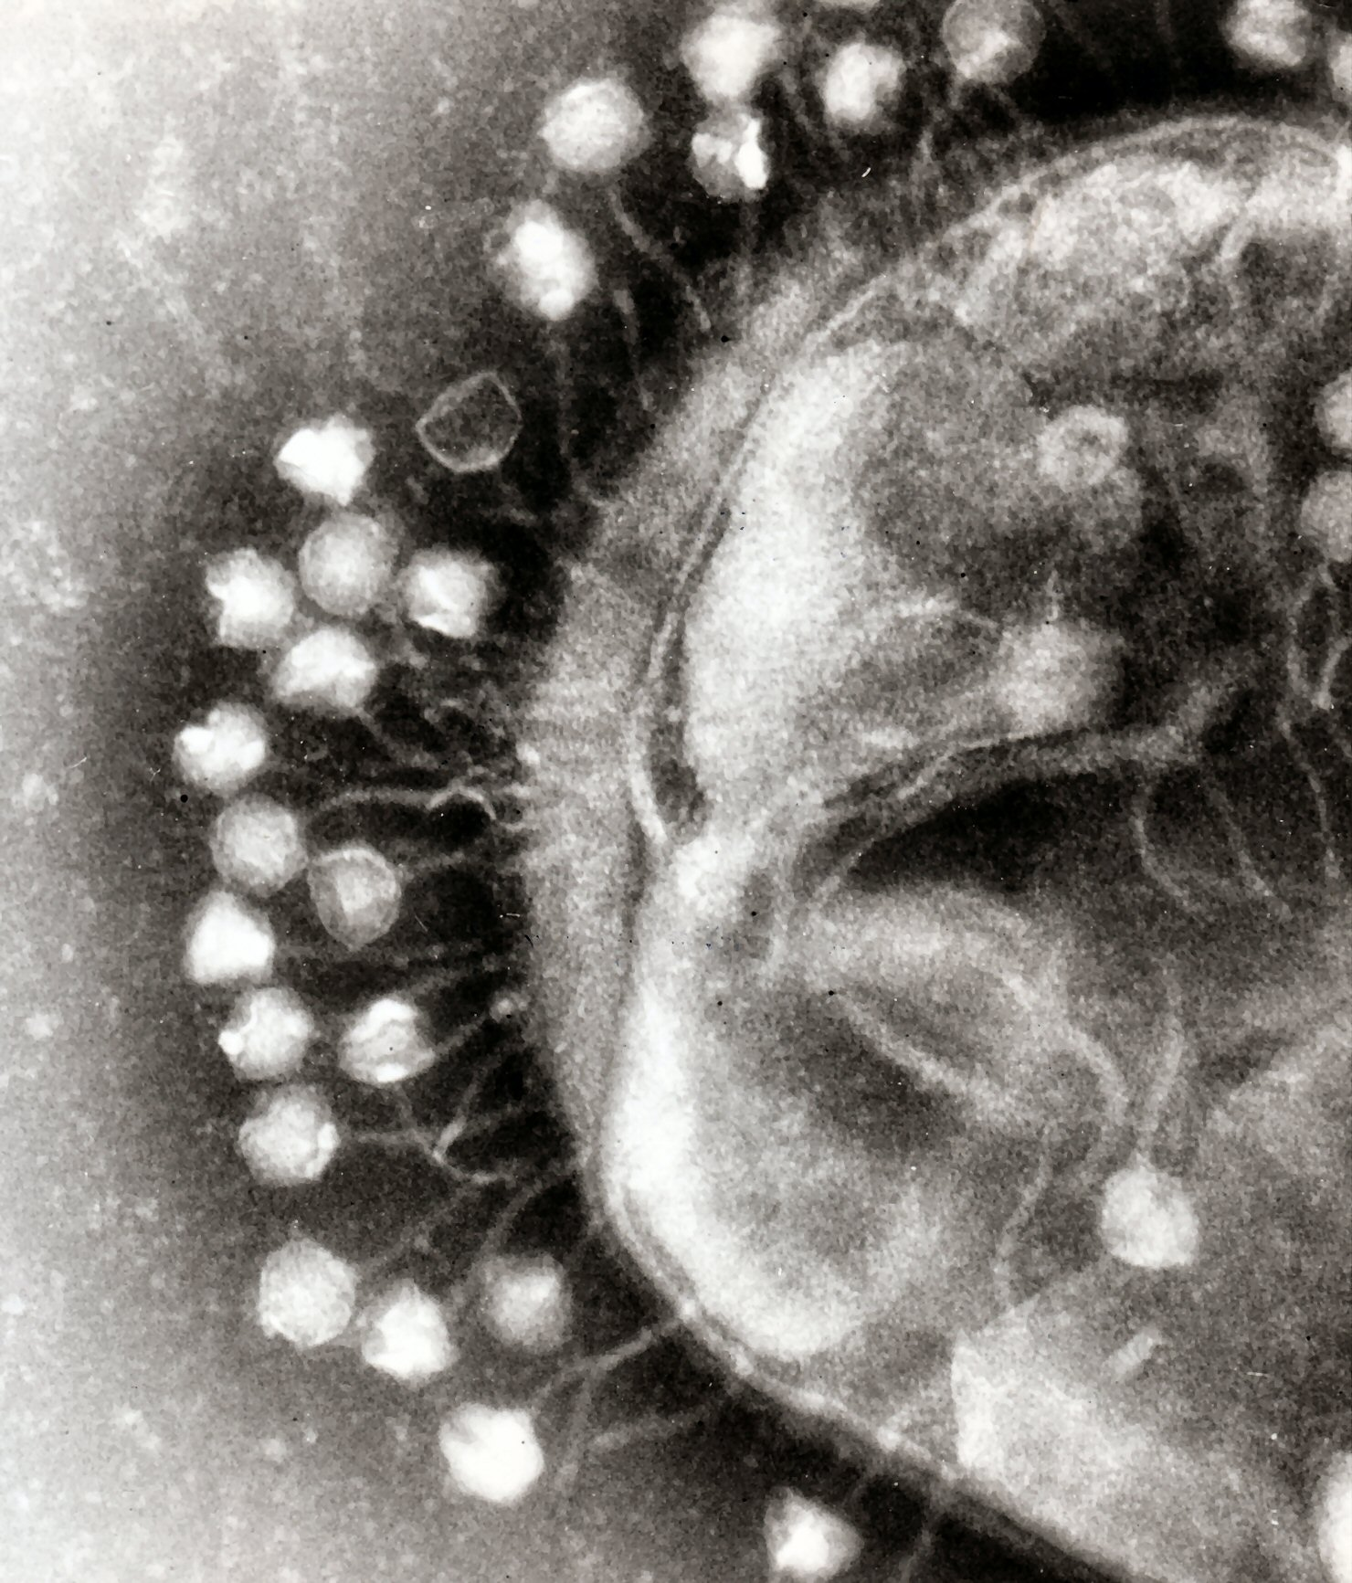
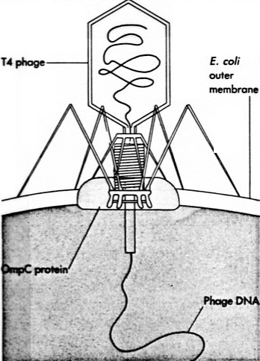
Bacteriophage DNA injection
Grayson, Paul, and Ian J. Molineux. "Is phage DNA ‘injected’into cells—biologists and physicists can agree." Current opinion in microbiology 10.4 (2007): 401-409.
Inamdar, Mandar M., William M. Gelbart, and Rob Phillips. "Dynamics of DNA ejection from bacteriophage." Biophysical journal 91.2 (2006): 411-420.
What if the proteins can diffuse along the DNA?

Slide 4
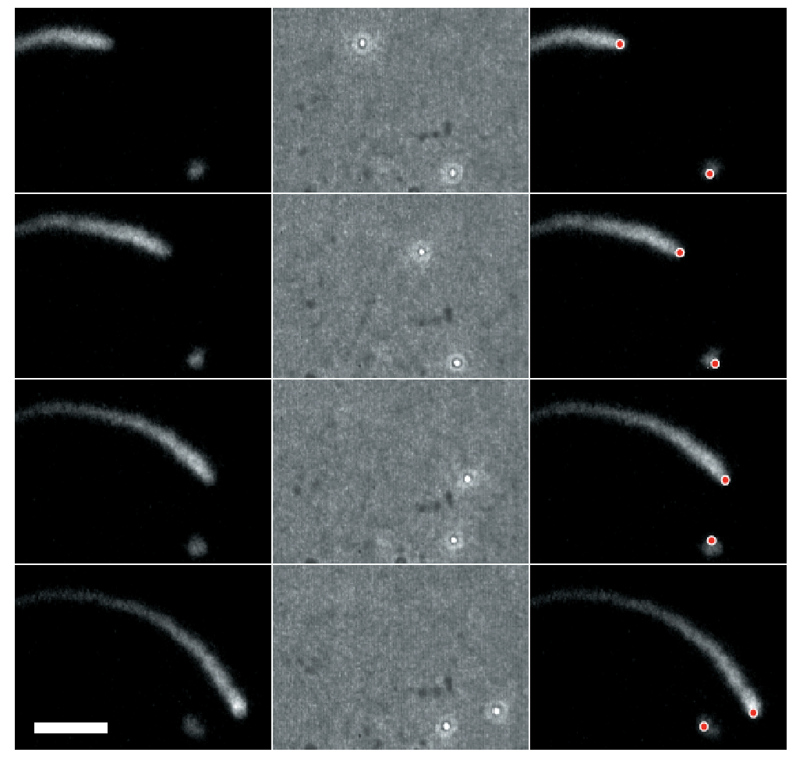
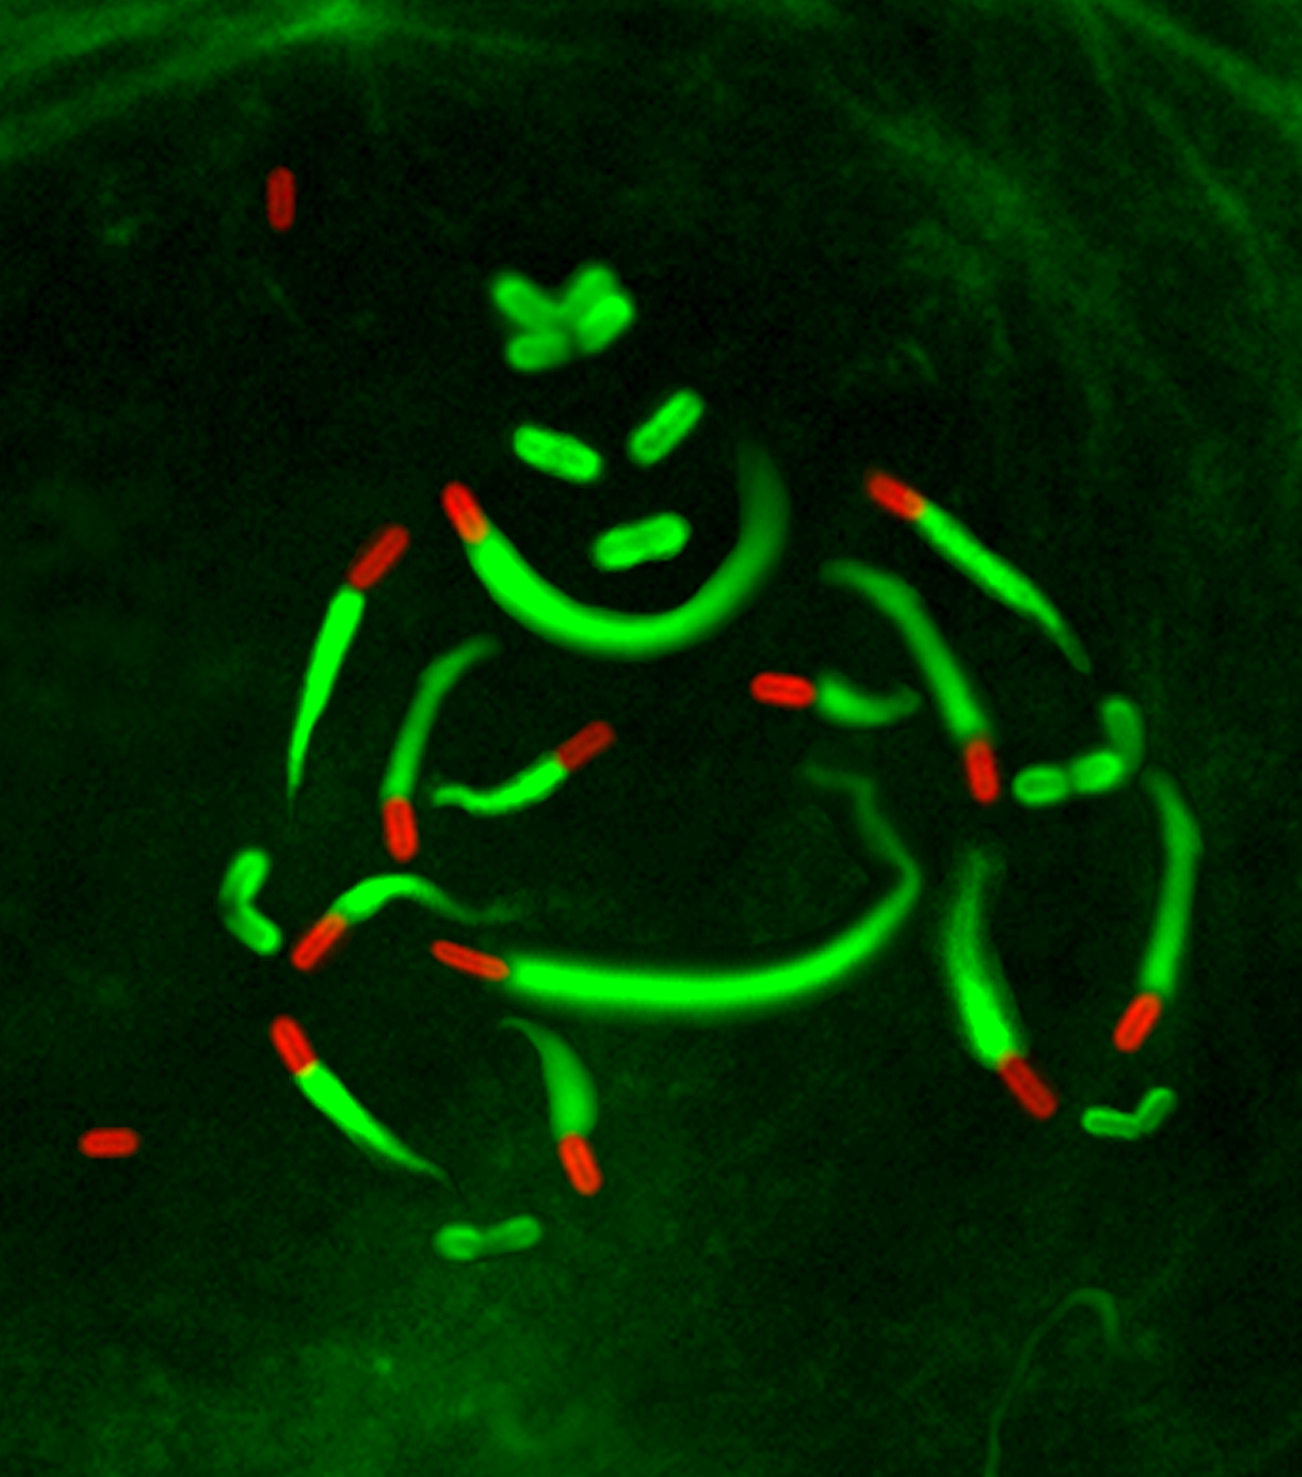
Brownian ratchets
Listeria monocytogenes
5 um
ActA-coated 0.5 micron plastic beads
30 s between frames.
https://www.youtube.com/watch?v=4JWpG8XPku4
Cameron, Lisa A., et al. "Motility of ActA protein-coated microspheres driven by actin polymerization." Proceedings of the National Academy of Sciences 96.9 (1999): 4908-4913.
ActA-driven polymerization

Slide 5
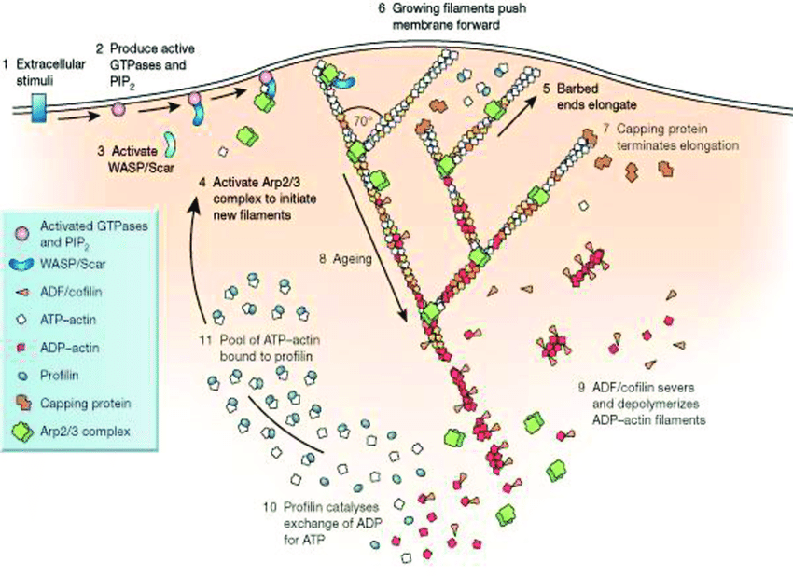
Actin-based motility
https://www.researchgate.net/figure/Dendritic-nucleation-model-of-lamellipodium-protrusion-1-External-cues-activate-cell_fig5_302564422

Slide 6
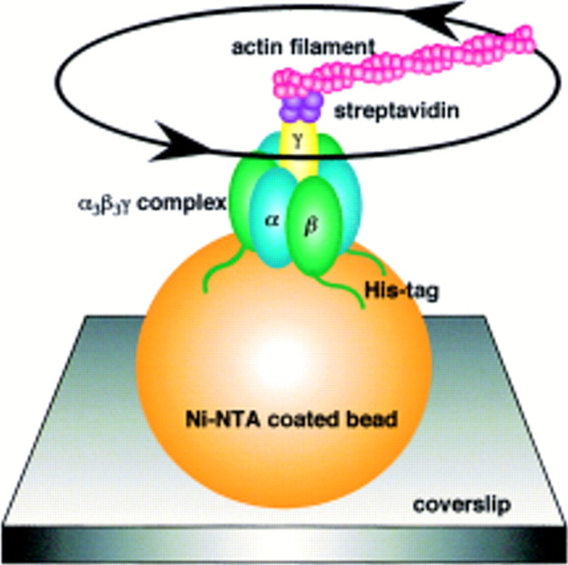
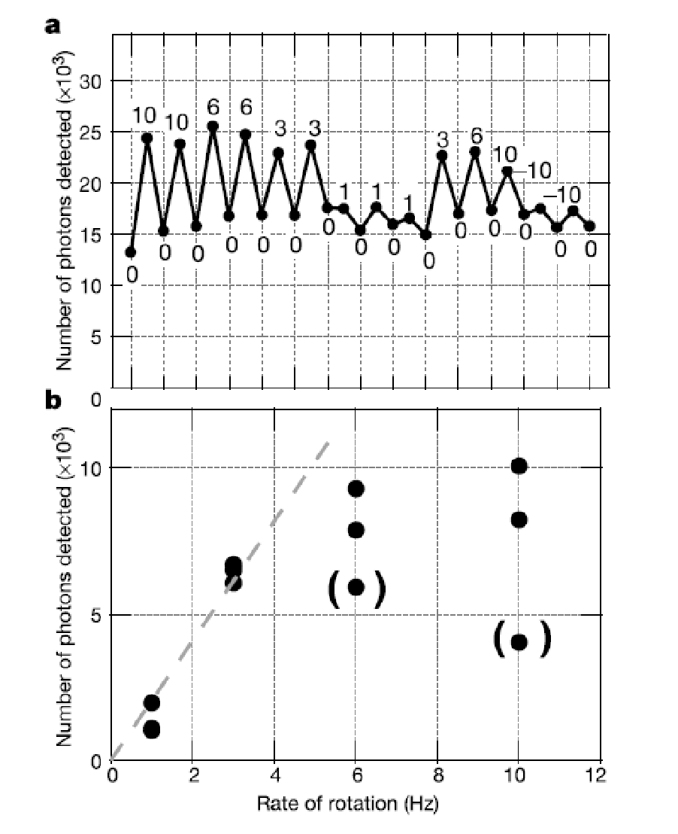
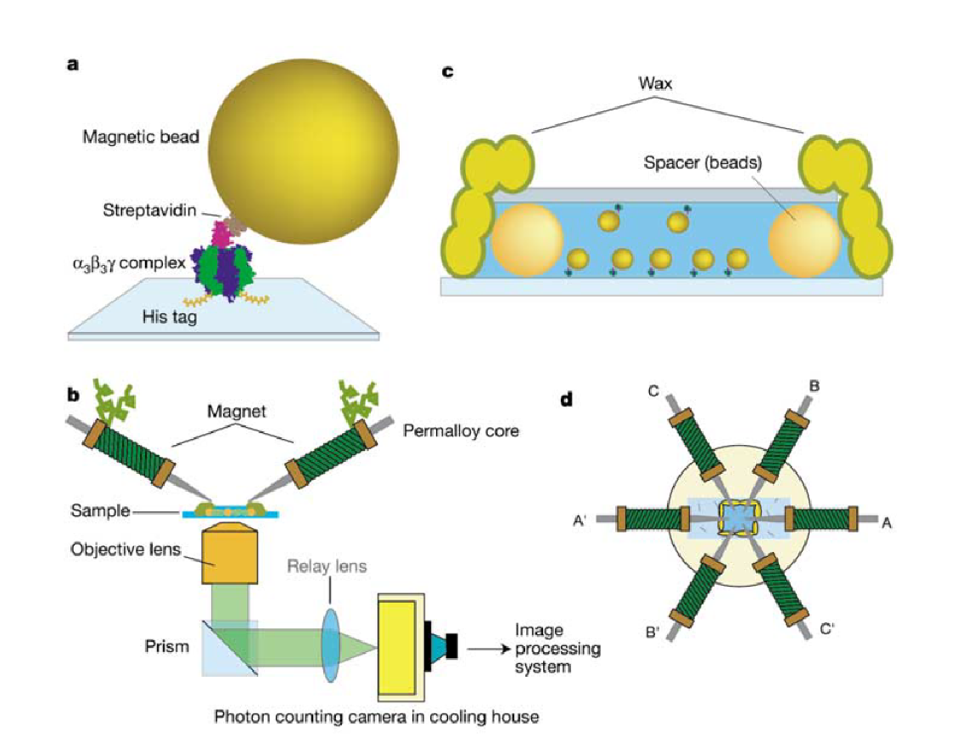
Example of a reversible rotary motor
Revolutions
Time (s)
Yasuda, Ryohei, et al. "F1-ATPase is a highly efficient molecular motor that rotates with discrete 120 steps." Cell 93.7 (1998): 1117-1124.
Itoh, Hiroyasu, et al. "Mechanically driven ATP synthesis by F 1-ATPase." Nature 427.6973 (2004): 465.

Slide 7
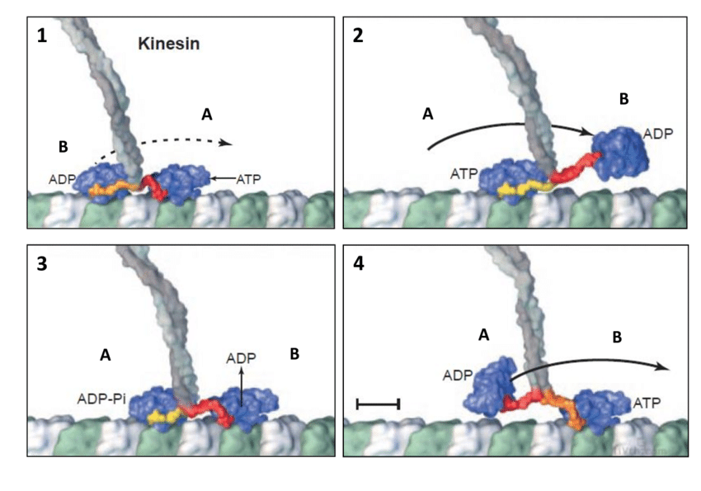
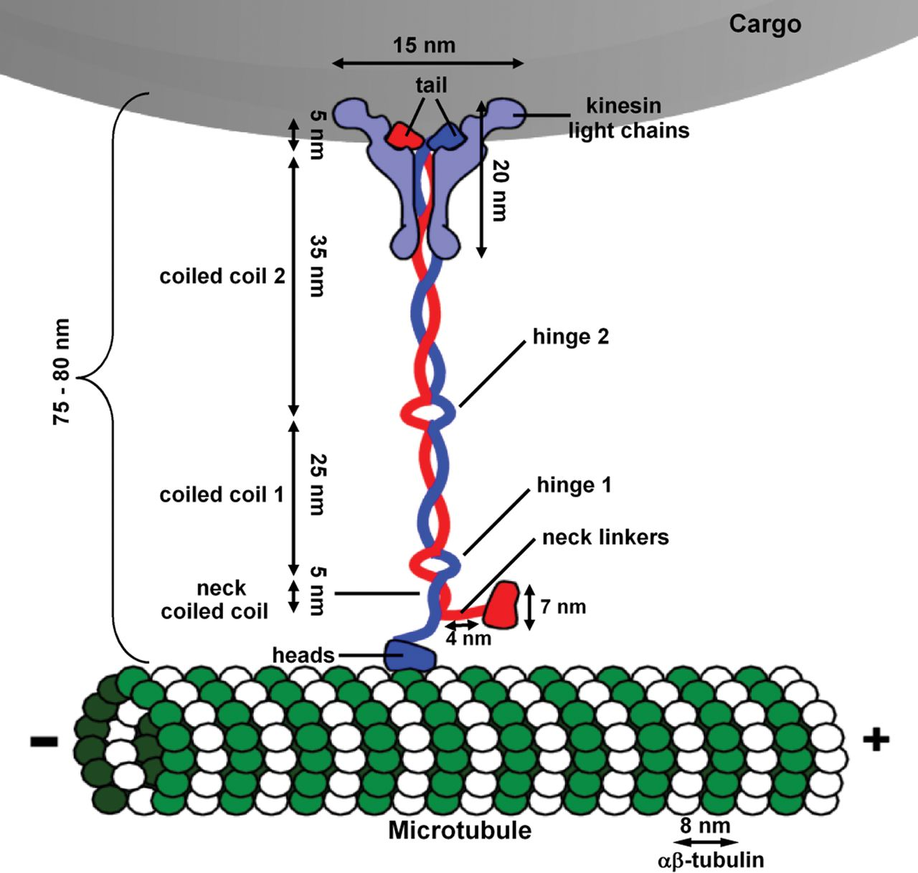
What is a molecular motor?
Example: kinesin
http://www.biochemsoctrans.org/content/40/2/438
https://www.researchgate.net/figure/Schema-du-fonctionnement-de-la-kinesine-issu-de-17-1-La-tete-A-a-lavant-est_fig3_320271191

Slide 8
What is the force-velocity relation?
What is the dependence on chemical driving force?

Slide 9
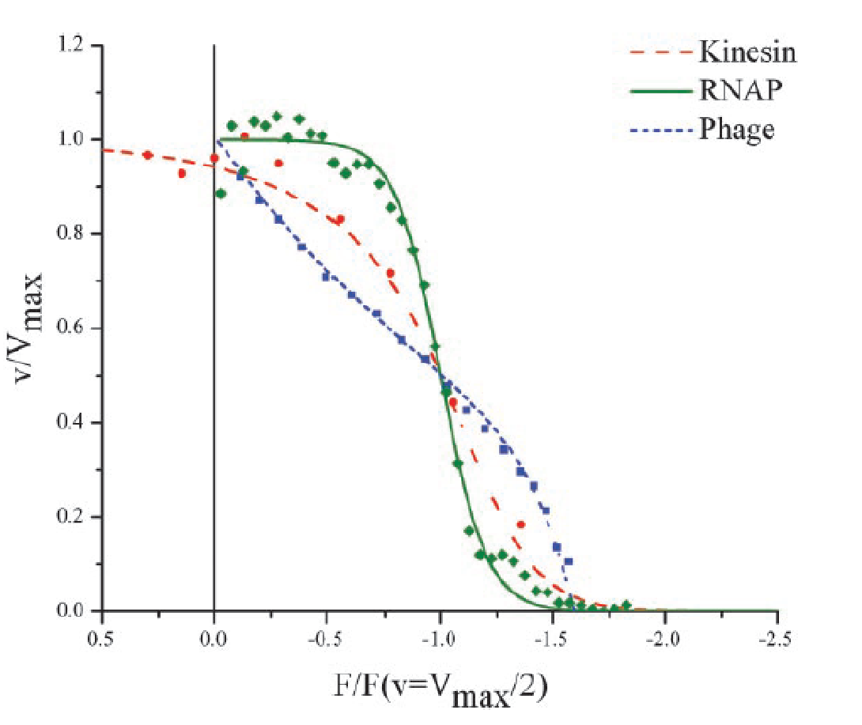
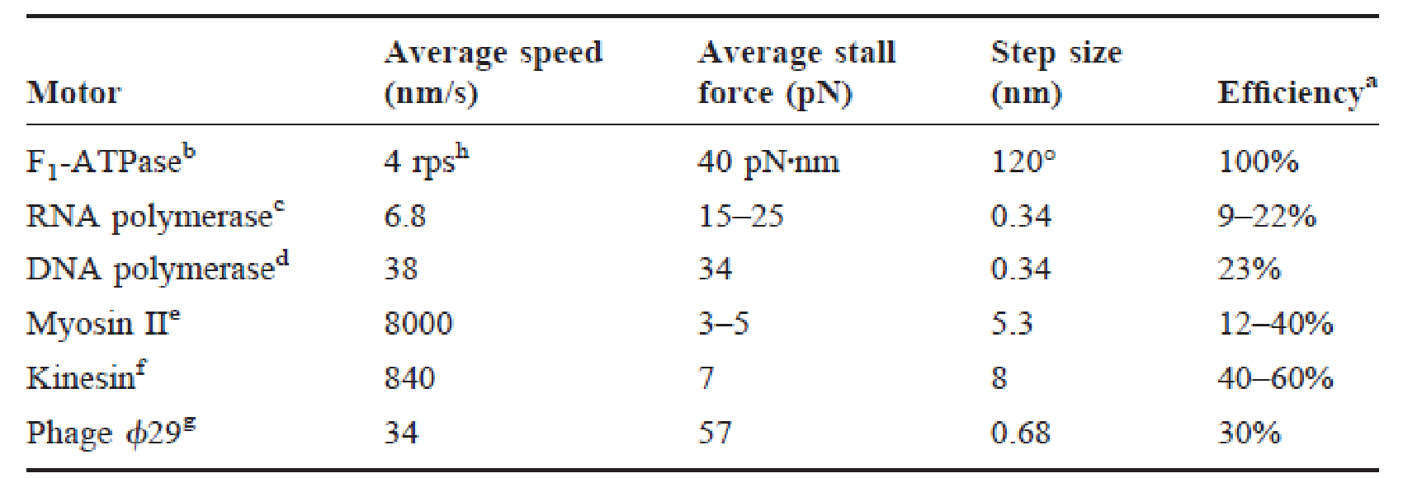
Properties of some motors
Bustamante, Carlos, et al. "Mechanical processes in biochemistry." Annual review of biochemistry 73.1 (2004): 705-748.

Slide 10
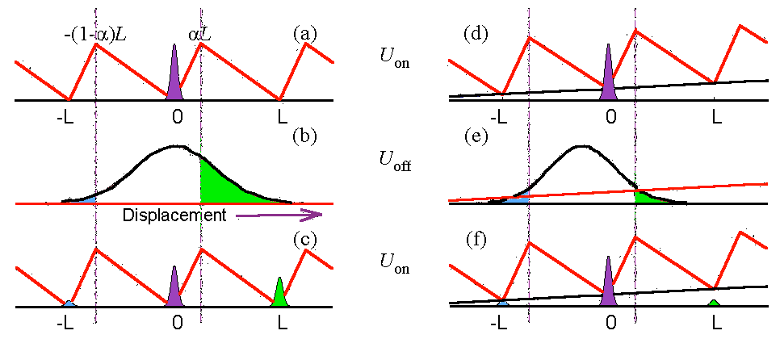
Flashing Brownian Ratchet (power-stroke model)

