Slide 1
2-state systems
Chem 163
29 Sept. 2022

Slide 2
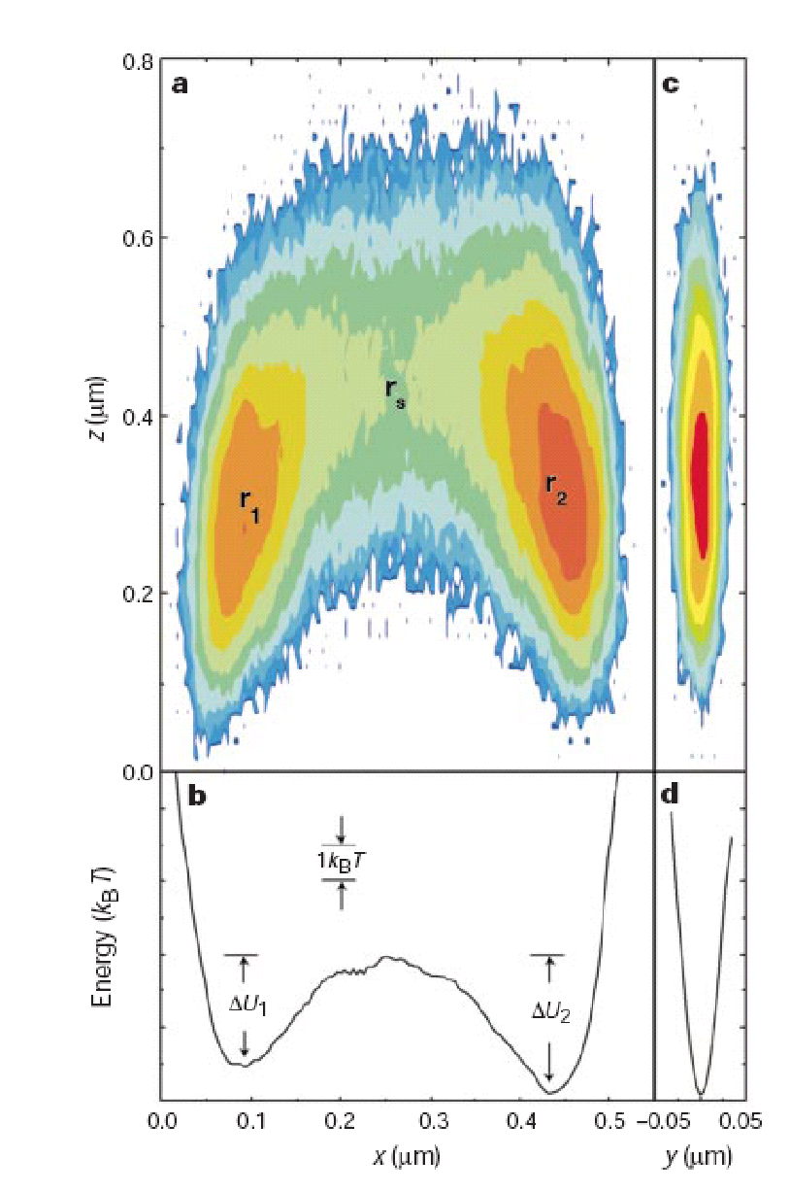
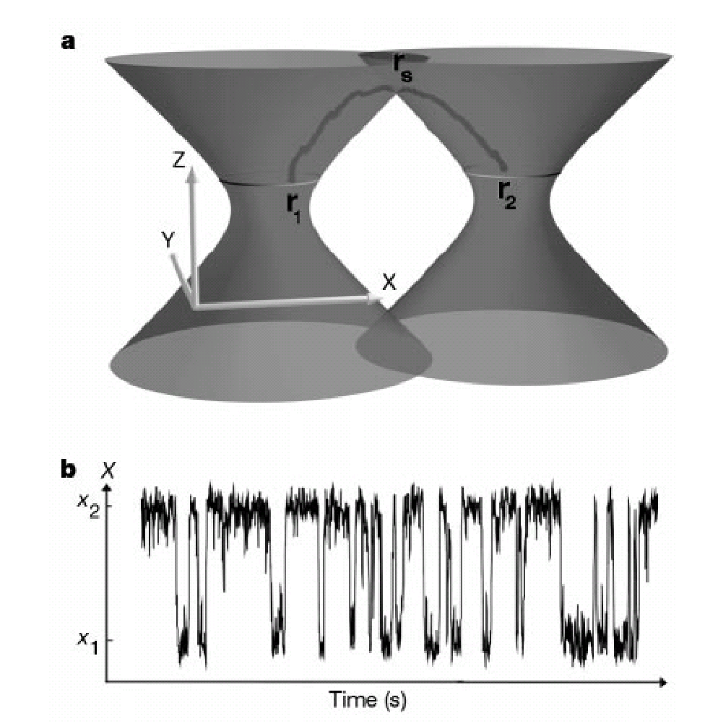
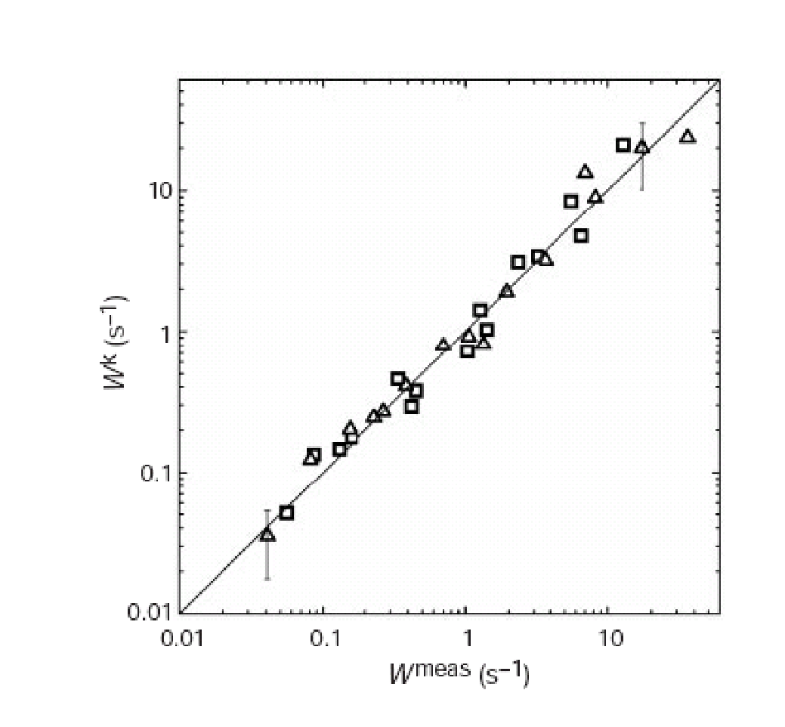
Hopping of a particle in a double laser tweezers
Thermally activated transitions in a bistable three-dimensional optical trap
Lowell I. McCann, Mark Dykman & Brage Golding
NATURE |VOL 402 | 16 DECEMBER 1999 | p. 785

Slide 3
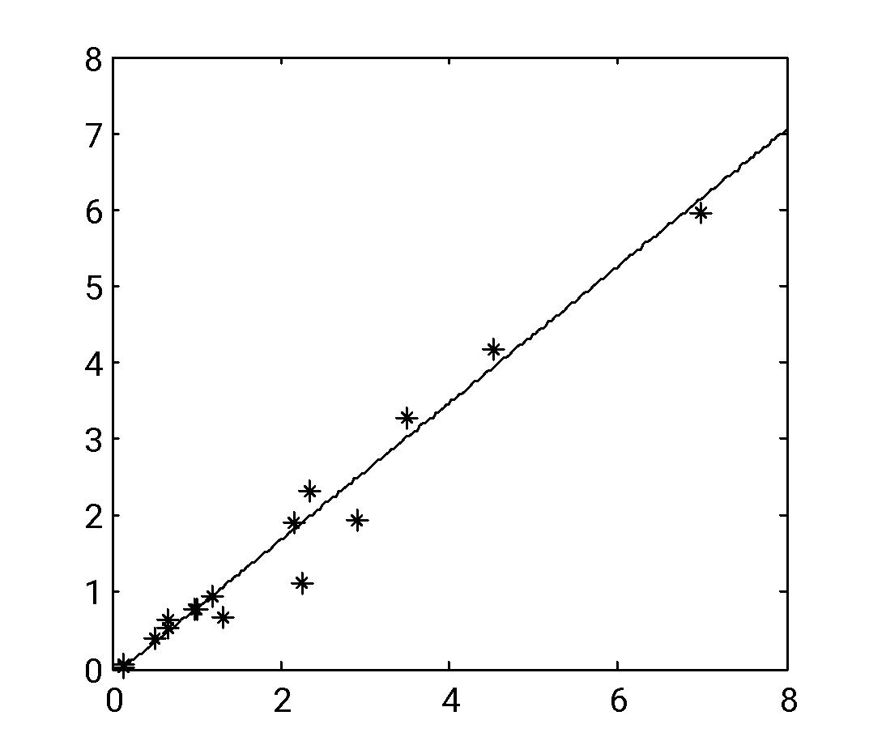
Arbitrary Force Fields
Double-well force-field
Representative trajectory
2
1
x (μm)
0
-1
-2
0
10
20
t (s)
30
40
50
Hopping rates are consistent with Kramers’ Theory
k_{pred} (s⁻¹)
k_{meas} (s⁻¹)
AEC, Phys. Rev. Lett., 94, 118102, (2005)

Slide 4
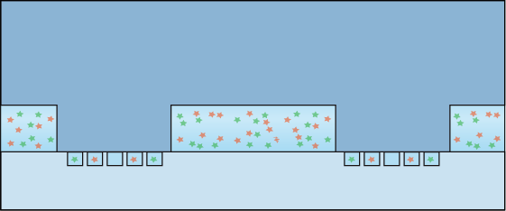
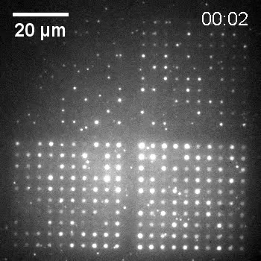
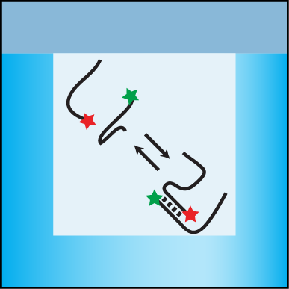
Chemical reactions in confined areas
PDMS lid with microposts
Micropost
Micropost
Dimple array
Dimple array

Slide 5
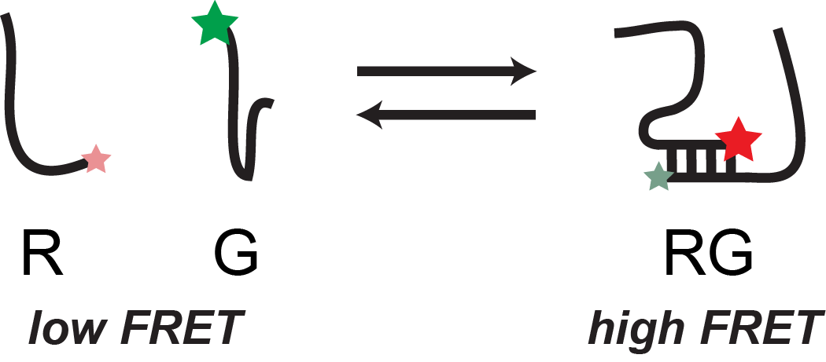
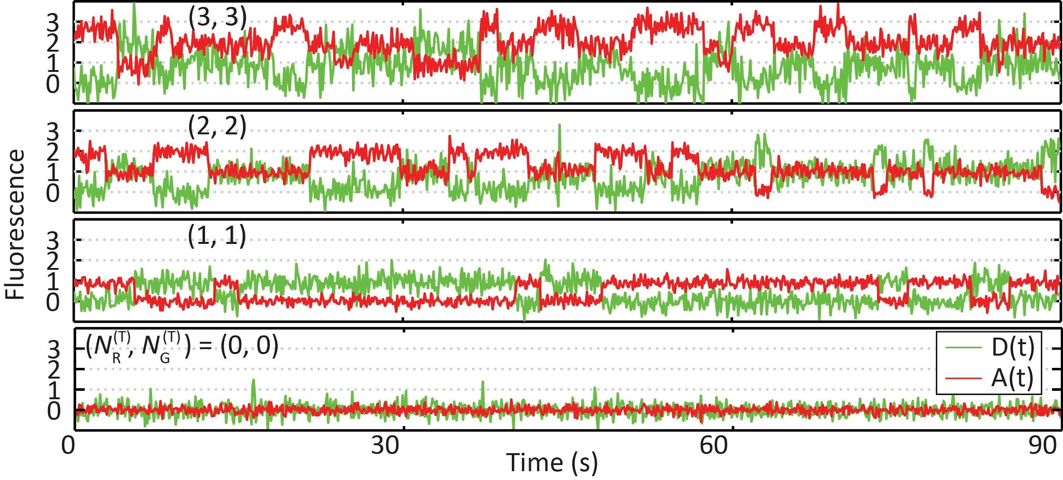
FRET imaging
K_{d}
R: Acceptor emission, or product
G: Donor emission, or reactant

Slide 6
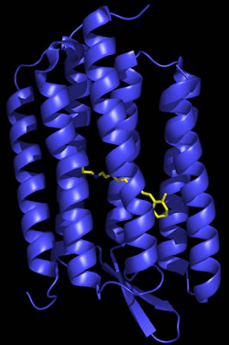
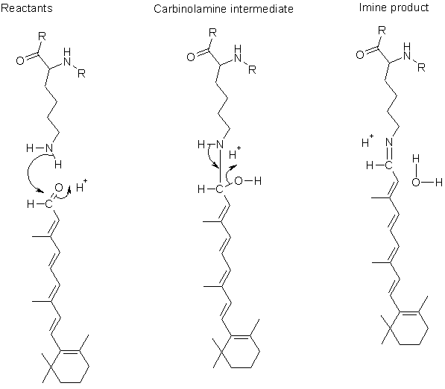
Isomerization in retinal
Bacteriorhodopsin from Halobacterium halobium

Slide 7
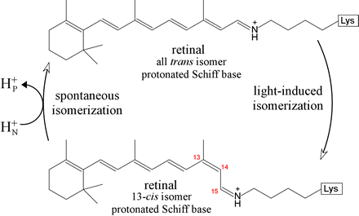
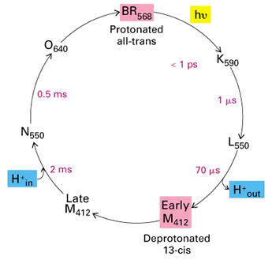
Bacteriorhodopsin Photocycle
http://guweb2.gonzaga.edu/faculty/cronk/biochem/B-index.cfm?definition=bacteriorhodopsin

Slide 8
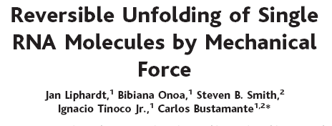
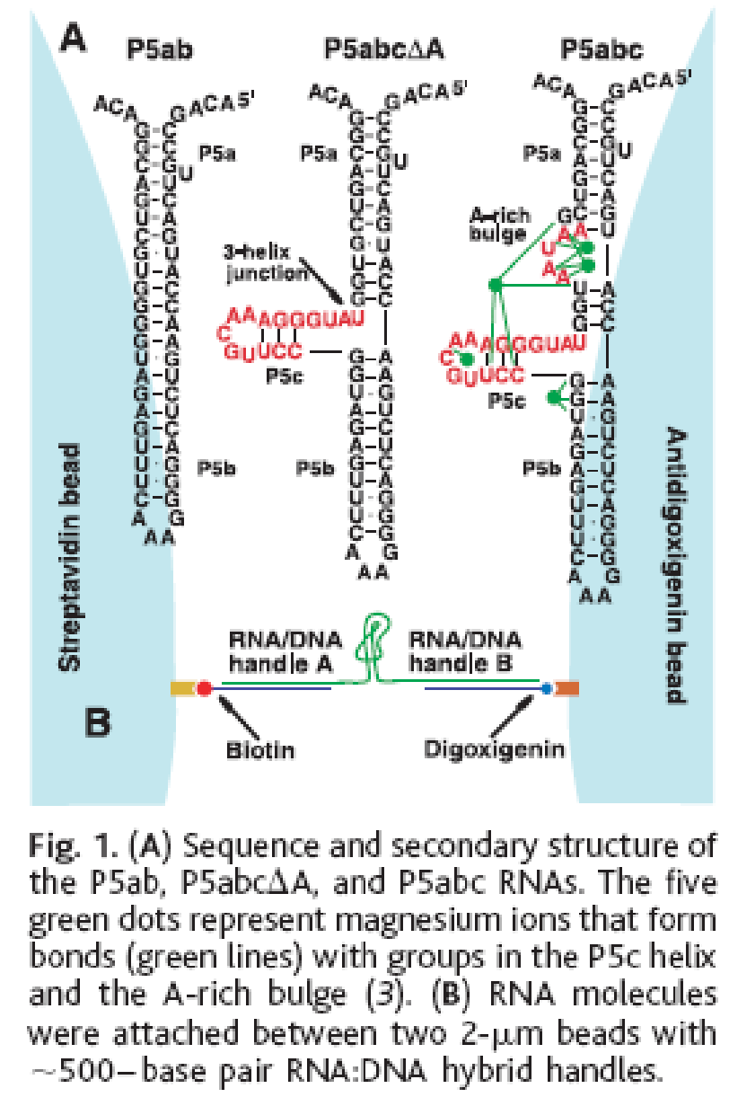
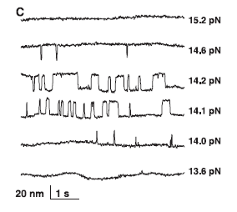

Slide 9
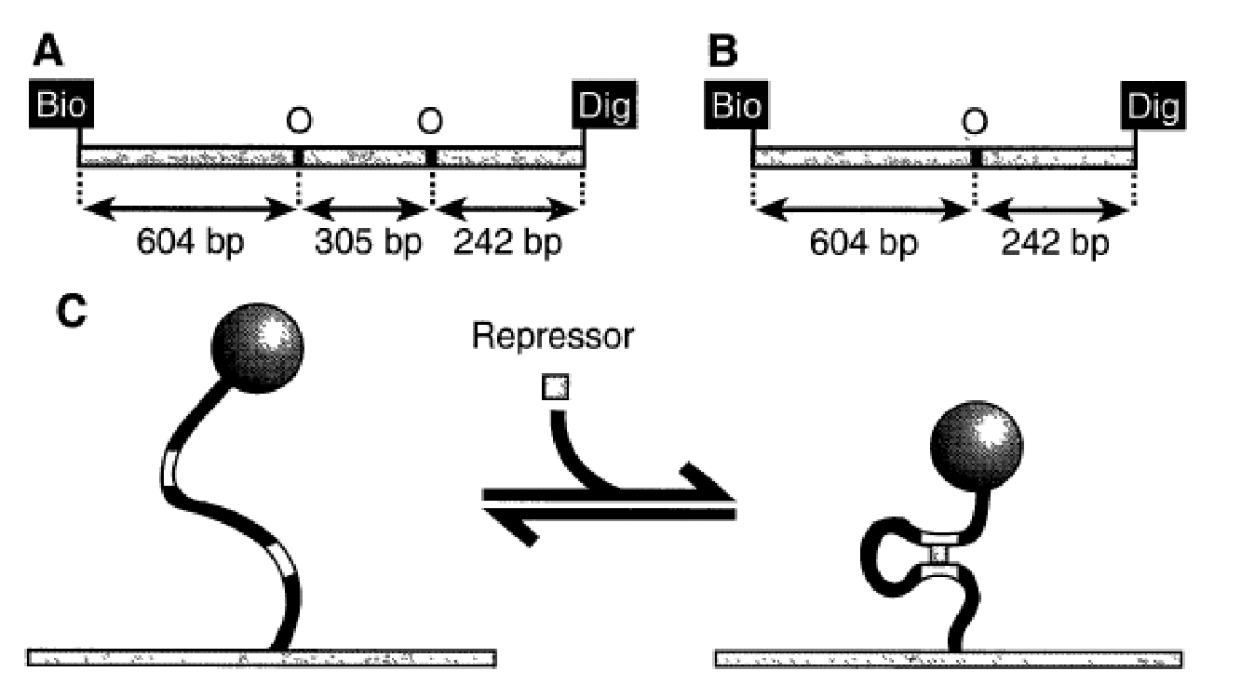
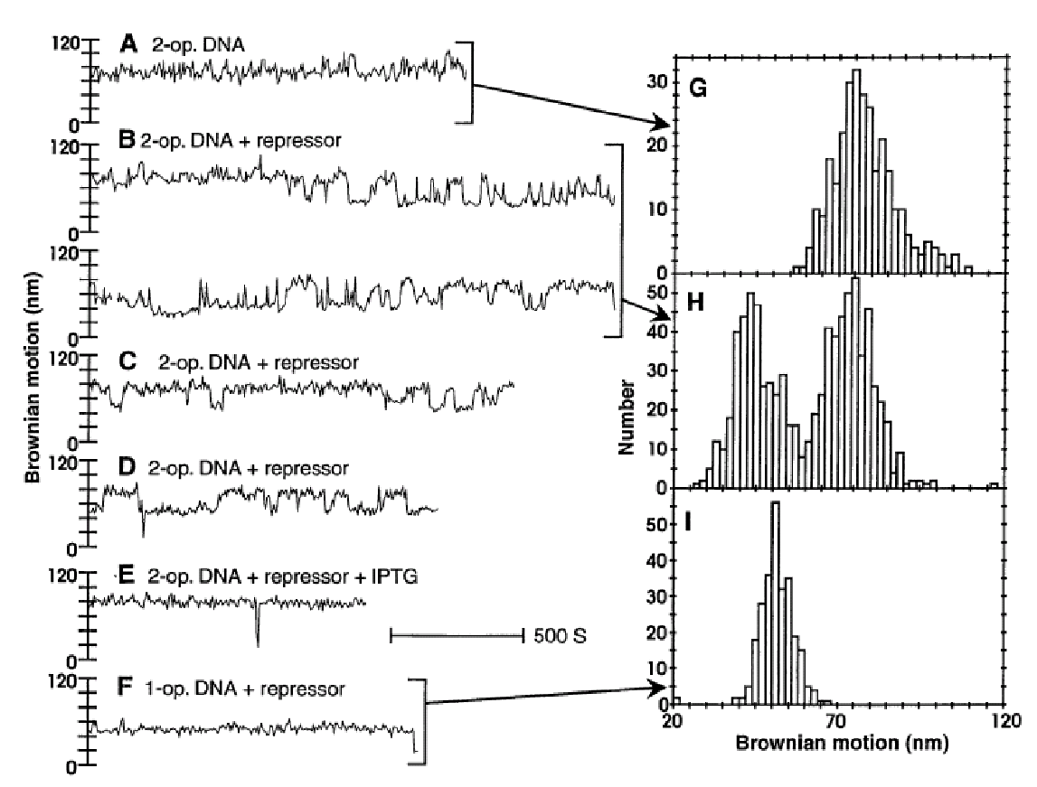
Lac repressor binding to DNA
Measurement of Lactose Repressor-Mediated Loop Formation and Breakdown in Single DNA Molecules
Laura Finzi and Jeff Gelles
Science, Vol. 267, No. 5196 (Jan. 20, 1995), pp. 378-380

Slide 10
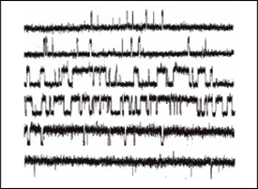
Ion channels
5 uM cAMP
300 uM cAMP

Slide 11
