Slide 1
June 30th, 2022 Gender consideration in Covid-19 rollout
Sofia de Almeida (UNICEF ESARO)
Stephanie Shendale (WHO)
Shirin Heidaris (WHO)
Carla Toko (VillageReach)

Slide 2
EXPERIENCE OF A HIGH VOLUME VACCINATION SITE IN ADDRESSING GENDER DISPARITY IN COVID-19 VACCINE UPTAKE IN DRC
Carla Toko, Senior Manager
VillageReach

Slide 3
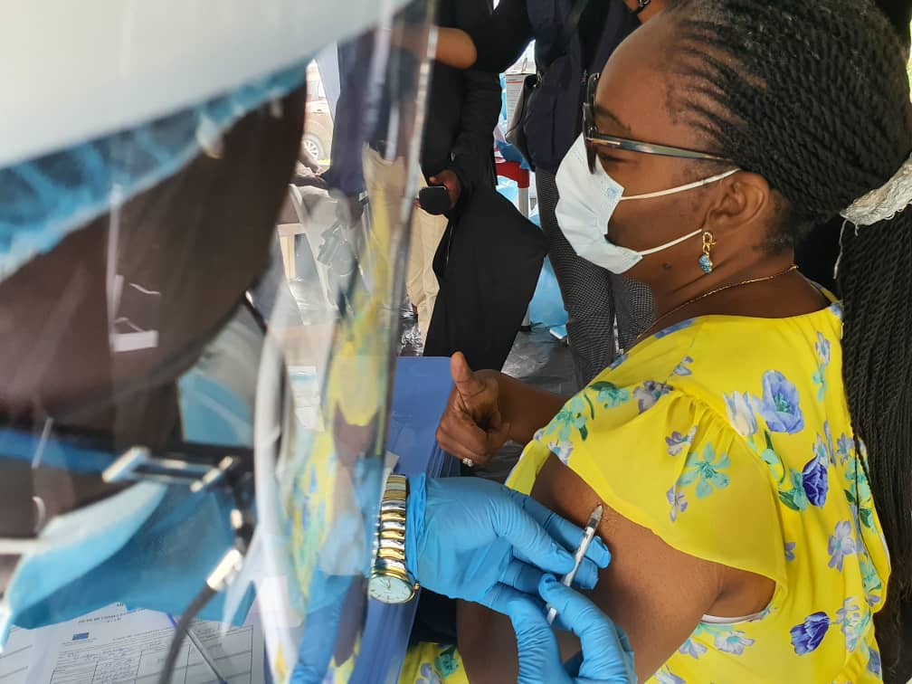
COVID-19 Vaccination in DRC
Less than 1% of people in the Democratic Republic of Congo had been vaccinated against COVID-19 (April 2021-Nov 2021)
In Kinshasa – the province with 60% of all confirmed cases of COVID-19 –59,153 had received at least 1 dose and 11,927 were completely vaccinated (Nov 29, 2021)
Notes:
In this period, in Kinshasa women represented 42% of all vaccinated while nationally, it was 38%

Slide 4
COVID-19 Vaccinodrome
On 29 Nov 2021, VillageReach launched a high-volume vaccination site, known as a “vaccinodrome” in Kinshasa.

Slide 5
Initial vaccinodrome challenges
Initial vaccination targets were ~1,000 per day, but throughput at the vaccination sites was not meeting these goals
Low traffic at fixed COVID-19 vaccination sites, despite the sites being located in high-traffic urban settings
Significant gender disparities in vaccine uptake
In December 2021, women represented only
20%
of those vaccinated at the vaccinodromes
Notes:
Through January 28th, national average had 40% of women among the vaccinated, while in the vaccinodrome, it was 23% only

Slide 6
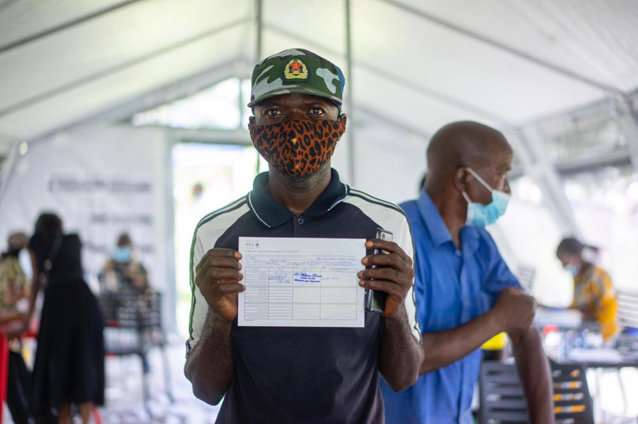
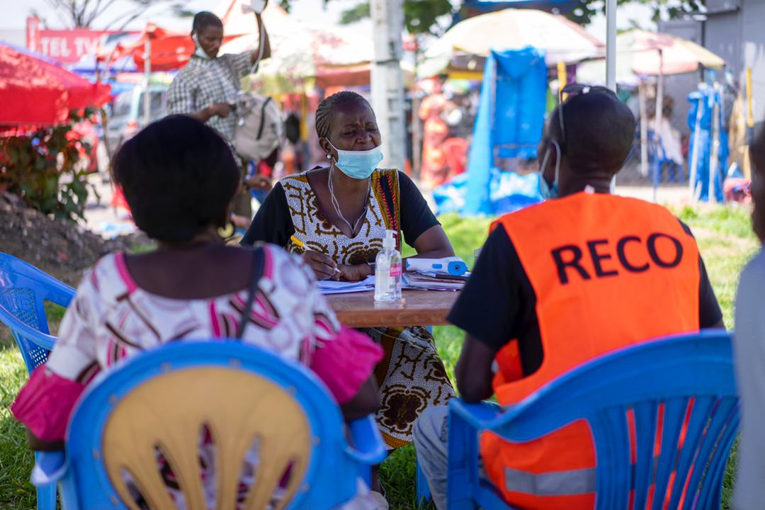
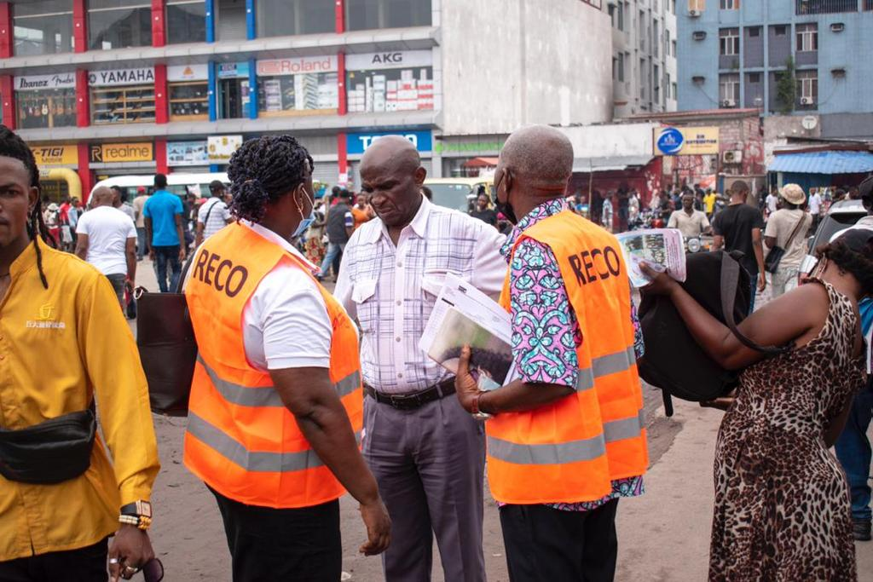
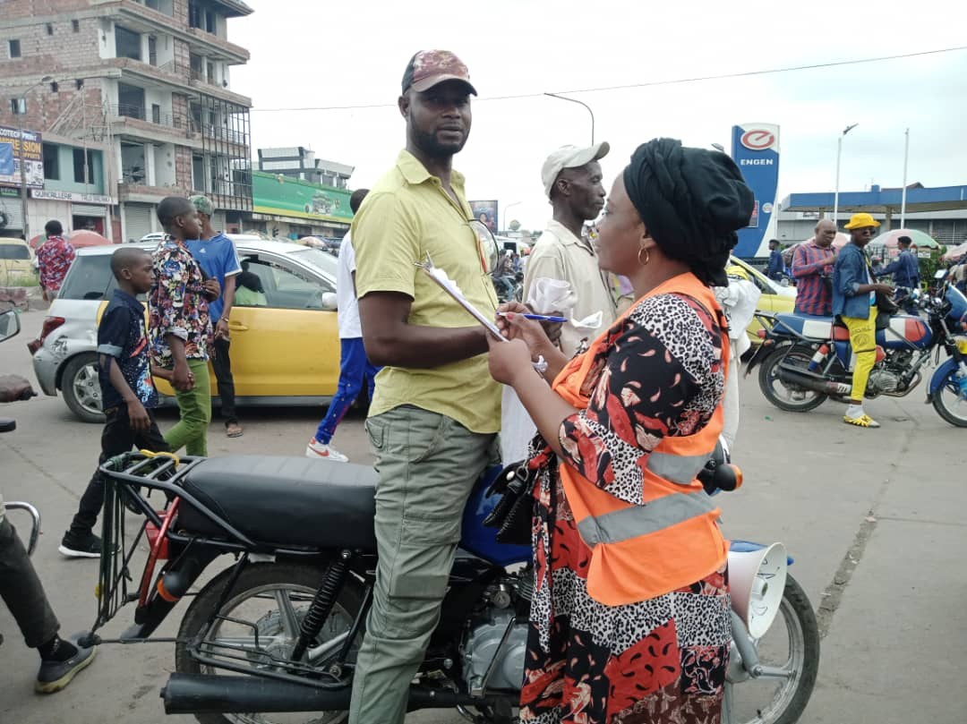
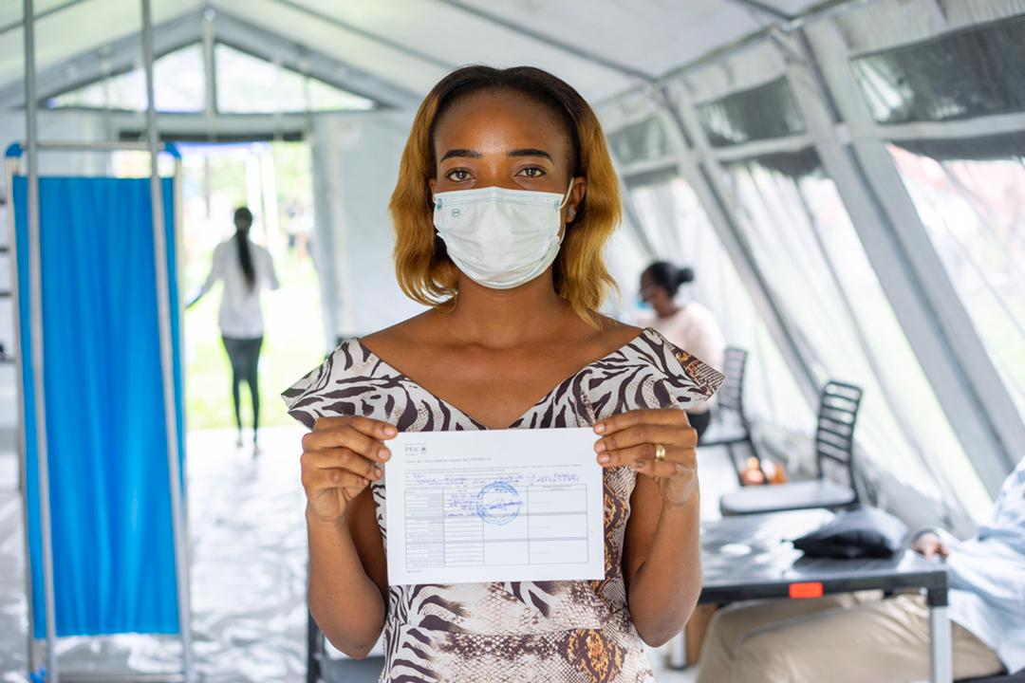
Strategies to increase COVID-19 vaccine uptake
Gender-related barriers to COVID-19 vaccine uptake in DRC
Hesitancy related to fertility and breastfeeding concerns
Address access by making vaccination more convenient
Challenges accessing fixed sites for women
Address demand with community health workers (CHWs) and sensitization
Doctor’s note requirement for pregnant women

Slide 7
Addressing gender-related ACCESS barriers
Generalized
Gender-specific
Increased number of vaccinodromes from 1 in Nov 2021 to 4 by April 2022
Use of “Hub and Spoke” model: Vaccination teams split between the fixed site and outreach sessions which change location depending on traffic and CHW suggestions
Increased focus on outreach teams vaccinating women where they are at in markets, etc.
Mapping of women’s associations across Kinshasa

Slide 8
Addressing gender-related DEMAND barriers
Generalized
Gender-specific
109 CHWs trained on COVID-19 vaccines and motivational interviewing
Each day, pairs of CHWs sensitize community members in high-traffic areas around vaccinodromes using megaphones and directly conversing with people
CHWs pre-register people for vaccination and give them a token to bring to the vaccination sites
CHWs pivoted to focus specifically on targeting women at markets, women’s associations, etc.
Even distribution of male and female CHWs hired
Group sensitization with businesses/ associations/ NGOs focused on women

Slide 9
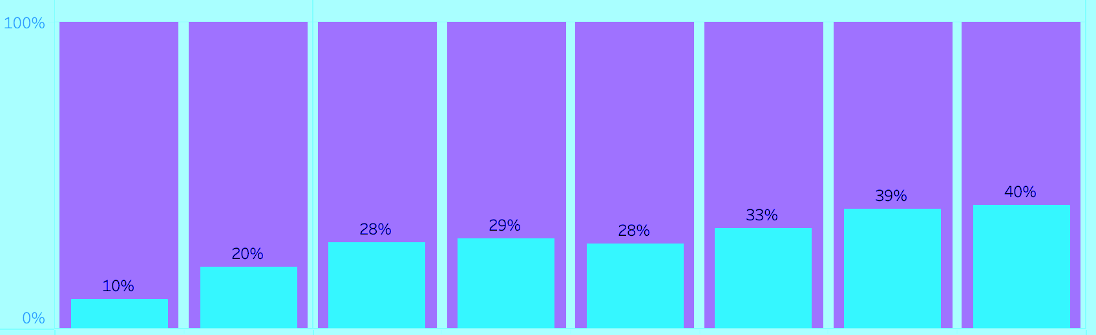
COVID-19 vaccine uptake for women has been increasing
Proportion of women vaccinated against COVID-19*
39%
40%
% Total vaccinated
29%
33%
28%
28%
20%
10%
November ‘21
December ‘21
January ‘22
February ‘22
March ‘22
April ‘22
May ‘22
June ‘22
Generalized outreach & sensitization
Gender-specific strategies
*Includes people vaccinated at both vaccinodrome fixed sites and associated outreach sessions

Slide 10
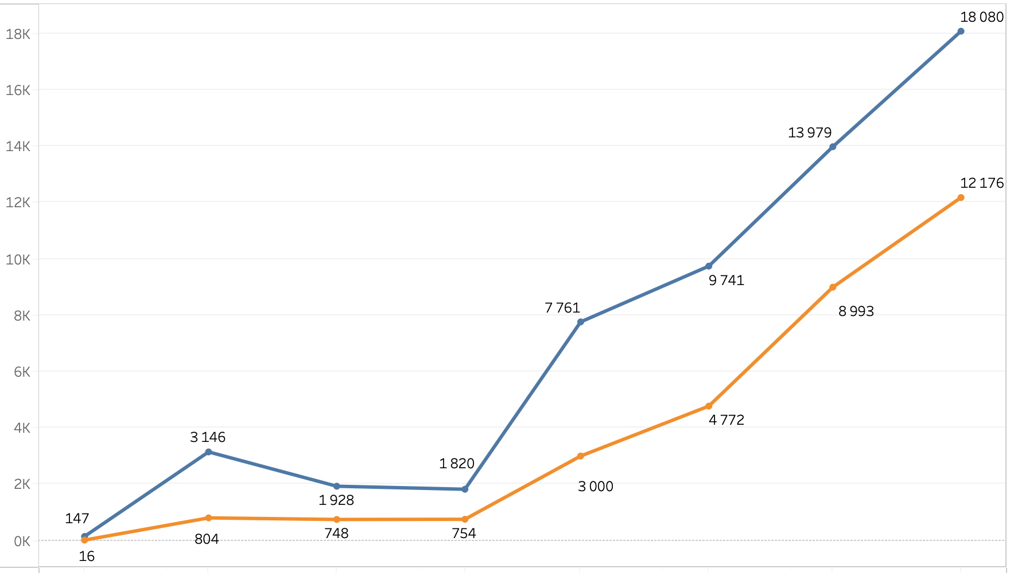
COVID-19 vaccine uptake overall has been increasing
Number of people vaccinated against COVID-19*, disaggregated by gender
Men Vaccinated
Women Vaccinated
Number of people vaccinated
November ‘21
December ‘21
January ‘22
February ‘22
March ‘22
April ‘22
May ‘22
June ‘22
Month
*Includes people vaccinated at both vaccinodrome fixed sites and associated outreach sessions

Slide 11
Key Learnings
Next Steps
Increasing convenient access to vaccines is key to increasing COVID-19 vaccine uptake for women.
Strategy requires flexibility and communication between CHWs and site managers.
Splitting vaccination site staff into teams including CHWs, vaccinators, and data staff makes it easier to conduct sensitization from outreach sites, vaccinate, and manage data collection.
Continue to address gender-related barriers by:
Integrating COVID-19 vaccines with routine immunization. During routine immunization sessions, 1) make COVID-19 vaccines available and 2) sensitize women/caregivers.
Additional targeted outreach to mapped women’s associations.

Slide 12
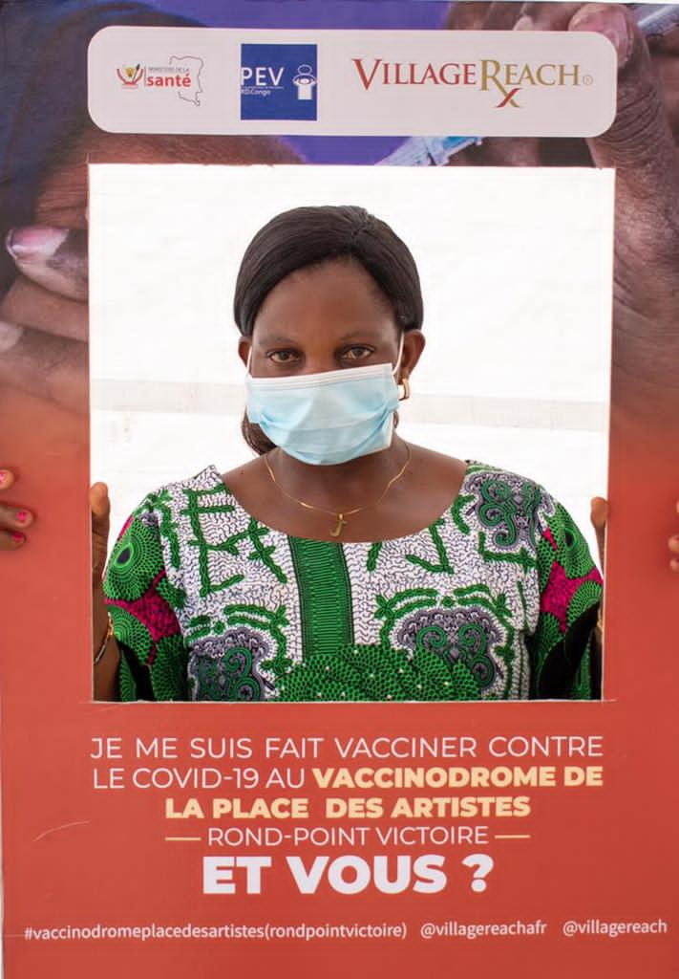
Thank you
Carla Toko, Senior Manager
VillageReach
Please direct any questions to:
Carla Toko (carla.toko@villagereach.org) or
Vidya Sampath (vidya.sampath@villagereach.org)

