Slide 1
ISCS: Data For Management Consultation
Prepared by Monique Smith

Slide 2
Consultation.
Number of experts consulted
Examples of interviewees
Different categories
of interviewees
Organization/ Team
Name/Position
PWG Members
  GAVI Secretariat
  Joanie Robertson
  David Sarley, Anna Rapp
  Osman Mansoor
  Gemma Orta-Martinez, Joseph Mabirizi
  Jan Grevendonk, Ryan McWhorter
8
  BMGF
  UNICEF PD
  UNICEF SD
  WHO
Research & Policy Institutes
  William Davidson Institute
  Prashant Yadav
  Gemma Berenguer
  Noel Watson
  John Lloyd, Jessica Yip
5
  Purdue University
  OPS MEND
  Independent
Implementing Partners
&
Civil Society Organizations
  AMP/ LOGIVAC
  Philippe Jailard
  CHAI
  Yann LeTallec, Gairav Bhattacharya
  JSI
  Mattias Wiklund, Asnakew Tsega, Lora Shimp, Michel Othepa, Ousmane Dia, Chris Wright, Marasi Mwencha
20
  PATH
  Kate Wilson, Liz Pelosa, Brian Taliesin, Henry Mwanyika
  MSH
  Nfor Emmanuel
  Bioforce
  Modibo Dicko
  SIVAC
  Alex Adjagba
Industry
Village Reach
Allen Wilcox, Wendy Prosser, Mike Kenney
5
  Logistimo
  Anup Akkihal
  Dimagi
  Rowena Luk

Slide 3
“The current issue is not lack of data- but that it is not used.”
In the least well equipped system—unwieldy registers and no electronic capture of data—it is functionally impossible to query the data or undertake a deep dive analysis. This results in the collection of data simply for the sake of data.
Most countries and global actors surveyed in GAVI’s public consultation felt that it was feasible to routinely populate these high level indicators of supply chain performance.
At the health center level in Mozambique, Village Reach successfully utilized MIS data to generate these six indicators for a sample of 10 facilities..
Source: Data from public survey administered as part of the GAVI supply chain strategy public consultation in July 2003. There were 74 respondents
from a range of global, country, and regional organizations including MOHs, country offices, WHO, UNICEF, and CSOs.

Slide 4
Emphasis on reporting yields low return on investment.
Systems, whether paper or electronic, are not designed in a user-centric fashion and are not optimally utilized.
The multiple reporting mechanisms are time intensive and often redundant.
  27+ tools providing guidance on immunization data collection were identified in a PATH landscape analysis.
  3 of the primary tools (from GAVI, UNICEF, and WHO), have the same content, asking the same questions but in different ways.
Moreover, systems do not routinely provide the right feedback to the right people
This begets a culture that emphasizes reporting rather than data as a tool to help make decisions.
Data from African sites surveyed by the
Gates Foundation suggests that approximately
1/3 of immunization session time is spent on
data capture and management.
Source: The Bill and Melinda Gates Foundation

Slide 5
The use of data for decision-making is inseparable from people and motivations.
Global Motivation
Government Motivation
Individual Motivation
Current, reliable data is essential for effective resource allocation, policy setting, and technical assistance.
Data enables accountability to the investment community and the decentralization of resource management.
Data reflects the individual's work product, and traditionally ties outcomes to performance.
Barrier
    Confounding individual with facility or district performance contributes to job insecurity.
    Little value placed on data when the individual has no connection to data (i.e. feedback that directly impacts individual’s work).
  Asset
    Potential for task shifting and greater focus on human engagement and problem-solving.
  Barrier
    Weariness of horizontal visibility that threatens resources and status amongst other ministries.
    Threat to job security for top officials.
  Asset
    There is a donor and government led increase in demand for information at senior levels.
    In the setting of better governance, there has been a shift in management attitudes and accountability structures.
  Barrier:
    Political will to share upstream data may be lacking.
    Institutional modus operandi may be challenged.
  Asset:
    Protection of Immunization investments.
      Avoid resource intensive vaccines in low capacity systems.
      Improve demand forecasting.
Source: Stakeholder Interviews

Slide 6
There are varied needs in the marketplace.
Information System Challenges | (%)
Insufficient Data Automation | 44.2
Network Challenges & Limited data exchange across SC | 42.3
Non-comprehensive report generation | 36.5
Business process support gaps | 28.8
Minimal data quality safeguards | 28.8
Challenges in exporting data | 28.8
While countries have largely employed paper and excel and access-based systems to track health care commodities, including vaccines, there have been an increasing number of electronic logistic management information systems ranging from pilots to scale introductions.
It is clear that on a country level there are different needs that can be met by ICT innovations.
The market can be segmented into tools, which help with a particular task; systems, which have multiple components responding to multiple issues; and platforms, which provide an imminently flexible infrastructure to manage information for a number of different settings.
Source: Novykov, Igor. Computerized LMIS in Health Supply Chain: Survey Report. Virtustores Project. Survey administered on
IAPHL platform generating 64 responses from 28 countries.

Slide 7
Policy levers will have to impact systems, technology, and people.

Slide 8
Data For Management Strategy Framework: Guidance & Standards
Initiatives
Measures
Guidance &
standards
Guidance, standards and recommendations for in-country information systems
  Define data standards and guidance on processes and data use.
  Develop guidance on how to select and implement better and more sustainable information systems
Innovation
Development and availability of technology, systems, and approaches for the collection and use of data
  Identify methods to share and disseminate experiences with data for management (incl. product catalogue, repository or similar)
  Help partners evaluate and document impact of ongoing interventions
  Invest in the development of promising ideas and approaches
Capability development
Global & National Leadership development
  Establish a group to advocate, oversee and adjust strategy implementation
  Use existing discussion forums (Technet-21 etc.) to enhance country expertise
  Develop methods, materials and training curricula to improve the capacity of national leaders and workforce to analyze, interpret and use data
Methods and tools
Technical assistance to support countries to evaluate needs, and select and implement sustainable solutions
  Support countries to plan, design, implement and sustain information systems
  Develop modules on data and information system assessment and improvement that can be used independently by countries or as part of EVM, PIE, EPI review etc.

Slide 9
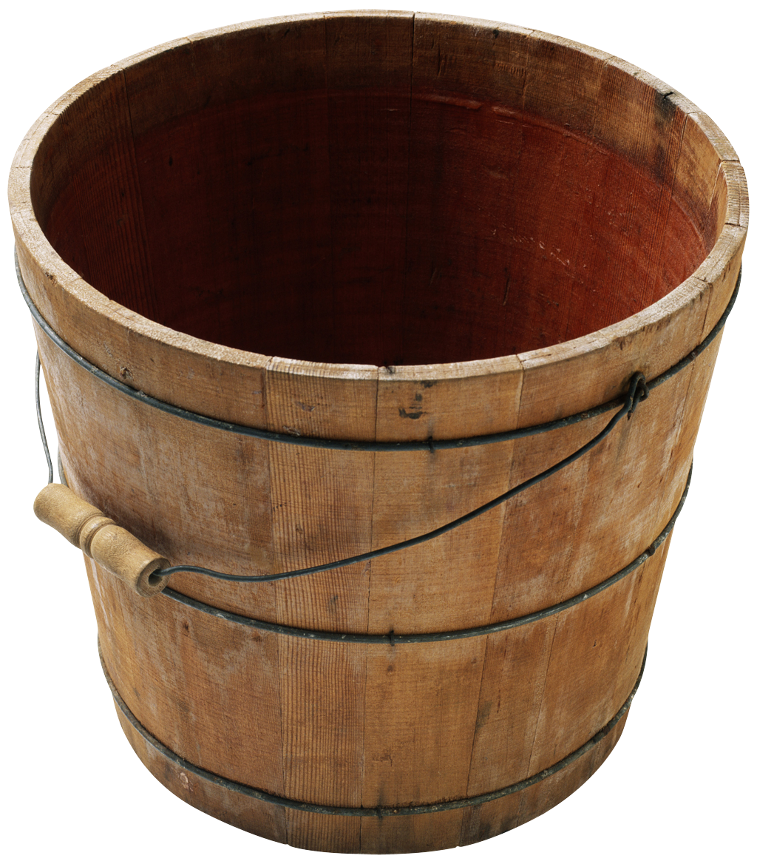
Data standards encompass global, operational and technical aspects of information systems.
Global
Operational
Technical
Key performance
indicators
Data definitions
Is the supply chain
delivering optimally?
Supply chain
best practices
- cost
- quality
- time
- flexibility
- innovativeness
Guidelines for new
technology
(interoperability)

Slide 10
What is the role of quasi-governmental organizations in setting technology standards?
Functional Market Mechanism
Technology standards usually rise from the bottom-up as a response to user demands.
Market Failure
“There seems to be some level of point to point integration between systems but it still tends to create silos within programs.”
Interoperability should happen naturally in a healthy market.
“If there are two tools working in the same space and both are good and worth integrating, it will certainly happen.”
Market interventions are necessary to create standards and general parameters for systems, which will allow innovation while ensuring interoperability.
Source: Stakeholder Interviews

Slide 11
Data For Management Strategy Framework: Innovation
Initiatives
Measures
Guidance &
standards
Guidance, standards and recommendations for in-country information systems
  Define data standards and guidance on processes and data use.
  Develop guidance on how to select and implement better and more sustainable information systems
Innovation
Development and availability of technology, systems, and approaches for the collection and use of data
  Identify methods to share and disseminate experiences with data for management (incl. product catalogue, repository or similar)
  Help partners evaluate and document impact of ongoing interventions
  Invest in the development of promising ideas and approaches
Capability development
Global & National Leadership development
  Establish a group to advocate, oversee and adjust strategy implementation
  Use existing discussion forums (Technet-21 etc.) to enhance country expertise
  Develop methods, materials and training curricula to improve the capacity of national leaders and workforce to analyze, interpret and use data
Methods and tools
Technical assistance to support countries to evaluate needs, and select and implement sustainable solutions
  Support countries to plan, design, implement and sustain information systems
  Develop modules on data and information system assessment and improvement that can be used independently by countries or as part of EVM, PIE, EPI review etc.

Slide 12
Marketplace challenges.
There is an innate trade-off between standardization of data and
innovation.
Data standards tend to be domain specific and thus are not easily
understood by innovators who may have clever solutions but are
not well versed in the domain.
Thus while data standards may be best practice for performance monitoring,
it may stifle innovation by creating increased barriers to entry.
Innovation
Funding
Historically, countries have not heavily invested in LMIS.
A small fraction of the total investment in health commodities could
finance in-country LMIS solutions.
While donor funded information systems may yield increased functionality and transparency, market entrants unsponsored (by donors) would be dis-incentivized to enter the market, diminishing cost effectiveness and innovation.
Implementation
The ICT market has largely been characterized by “free” pilots which have come at a cost—fragmented information systems and devaluation of systems.
Adopters are not aware of the true costs of solutions.
The culture of system selection does not prize the alignment of business and data requirements with technological solutions.
Source: Stakeholder Interviews

Slide 13
Data for Management Strategy Framework: Capability Development.
Initiatives
Measures
Guidance &
standards
Guidance, standards and recommendations for in-country information systems
  Define data standards and guidance on processes and data use.
  Develop guidance on how to select and implement better and more sustainable information systems
Innovation
Development and availability of technology, systems, and approaches for the collection and use of data
  Identify methods to share and disseminate experiences with data for management (incl. product catalogue, repository or similar)
  Help partners evaluate and document impact of ongoing interventions
  Invest in the development of promising ideas and approaches
Capability development
Global & National Leadership development
  Establish a group to advocate, oversee and adjust strategy implementation
  Use existing discussion forums (Technet-21 etc.) to enhance country expertise
  Develop methods, materials and training curricula to improve the capacity of national leaders and workforce to analyze, interpret and use data
Methods and tools
Technical assistance to support countries to evaluate needs, and select and implement sustainable solutions
  Support countries to plan, design, implement and sustain information systems
  Develop modules on data and information system assessment and improvement that can be used independently by countries or as part of EVM, PIE, EPI review etc.

Slide 14
At the crux of data for management is the lack of motivation to use data.
While other health programs invest in human resources for logistics management and innovative information systems, “ EPI has been stagnant for the last 7-10 years.”
Not all users have the same ability to generate, access, and interpret data.
Tools carry the potential to be motivational and a mechanism for capacity building.
  Emerging tools have the functionality to alert and perform basic analysis.
  Tools may also be leveraged to improve the capacity of users to interpret and use data.
    Fill technical support gaps
    Streamline the triangulation of data
    Reduce work burden so that time may be refocused on active problem-solving
Short-term goal: Adoption of systems that prime users in utilizing data—shifting the paradigm for traditional capacity building.
Long-term goal: Building a user base that can effectively employ data through a mix of professionalization (people),innovative solutions (technology), and an integrated eHealth infrastructure (systems).
Information system redesign is in an opportunity to realign decentralized systems such that resource allocation is also decentralized, and the district is the primary node of interaction but with the necessary visibility up the chain.
Source: Stakeholder Interviews

Slide 15
Data For Management Strategic Framework: Methods & Tools
Initiatives
Measures
Guidance &
standards
Guidance, standards and recommendations for in-country information systems
  Define data standards and guidance on processes and data use.
  Develop guidance on how to select and implement better and more sustainable information systems
Innovation
Development and availability of technology, systems, and approaches for the collection and use of data
  Identify methods to share and disseminate experiences with data for management (incl. product catalogue, repository or similar)
  Help partners evaluate and document impact of ongoing interventions
  Invest in the development of promising ideas and approaches
Capability development
Global & National Leadership development
  Establish a group to advocate, oversee and adjust strategy implementation
  Use existing discussion forums (Technet-21 etc.) to enhance country expertise
  Develop methods, materials and training curricula to improve the capacity of national leaders and workforce to analyze, interpret and use data
Methods and tools
Technical assistance to support countries to evaluate needs, and select and implement sustainable solutions
  Support countries to plan, design, implement and sustain information systems
  Develop modules on data and information system assessment and improvement that can be used independently by countries or as part of EVM, PIE, EPI review etc.

Slide 16
How should the Alliance approach investments in technology and tools ?
Approximately $10 billion is spent annually by GAVI, USAID, and Global Fund on medical commodities for low-income countries.
There is low visibility into the allocative efficiency of this investment due to fragmented and weak LMIS.
An estimated 8-30% of immunization supply chain value is commensurate with projected ICT cost.
What is the value of allocating a fixed percent of immunization funds or tiered investment (based on information system and supply chain maturity) to country initiated investments in ICT?
Value of excess wastage per health center in Cameroon's Ngong district, Feb.-May 2009
What is target level of investment in information systems in the next 5 years?
Excess ($)
1,196
Penta
YFV
Measles
OPV
BCG
Total wastage
Value of vaccine wastage levels in these four months is equivalent to cost to fully immunize 8% of target population.
Source: Data from Ebong and Levy, "Impact of the introduction of new vaccines and vaccine wastage rate on the cost-effectiveness of routine
EPI: lessons from a descriptive study in a Cameroonian health district" (2011). Analysis from McKinsey ISC Landscape based on 2009 Ngong district
population of 143,238 and 16 health centers; values represent average wastage recorded across health centers.

Slide 17
Proposed Mechanisms for Impact.
Partner Expertise
Proposals
GAVI WHO
UNICEF
BMGF
Third Party
Guidance & Standards
Guidance
1.1 Stimulate open discussion about sustainability models between vendors and countries.
1.2 Create dynamic listing (consumer report) of vendors and software.
1.3 Develop total cost of ownership model that reflects full cost of deployment, including technical assistance, training, and support.
Standards
1.4 Contribute to global guidelines for Ehealth architecture (e.g. Principles for Technology in Development).
1.5 Harmonize tools and indicators at the global level.
1.6 Develop standard evaluation tool for country assessment of level of maturity for implementation of electronic information systems and as benchmark for impact.
1.7 Create routine reporting system of 3-5 performance indicators on supply system quality, efficiency, and effectiveness.
Innovation
Platforms
Thought Leadership
2.1 Generate global conversation on best practices in data for management and LMIS tools.
2.2 Invest in academically rigorous research by third parties to develop impact analyses and contribute to evidence base for solutions.
2.3 Promote regional knowledge sharing.
Leader-ship
Advocacy
3.1 Create network of data for management champions in-country.
3.2 Actively engage district officers as the nexus of innovation.
Methods and Tools
Performance
Management
4.1 Mobilize resources for country-initiated investments in ICT.
4.2 Collaborate with academia to develop benchmarking methodologies that can be used in donor decision-making and performance incentives.
4.3 Establish inventory of facilities and equipment used in distributing vaccines, following standard proposed to UNICEF/CCL.
Source: Stakeholder Interviews

Slide 18
Recommended Modifications to HSS window to support Data For Management.
Require thinking around how data fits into the overall health systems and the identification of key dependencies within the health system.
Require countries to address data visibility in application. This will prompt thinking about better and more functional systems at the country-level.
  All funded programs should forfeit right to hide data from central or global hubs.
  Data should be available to manufacturers to enable intelligent SOP around pricing.
Financially support in-country initiatives to identify data requirements, optimize (re-engineer) business processes and identify the most suitable technology solutions for their needs.
In the GAVI funding mechanisms, investments in immunization products should be tied to investments in technology and human resources (i.e. proposals should have x% aimed at increased use and capacity while remaining % is for the technology/innovations).
Source: Stakeholder Interviews

Slide 19
Appendix

Slide 20
Data standards should reflect attributes of supply chains rather than metrics, which will vary in different settings.
Data should tell us not only (1) how we are doing but also (2) why we are performing the way we are.
Metrics are output oriented rather than diagnostic (improvement oriented).
Supply Chain performance should be measured across five attributes.
  Metrics, which are proxies for each attribute, may vary based on context.
As information systems evolve, actors should be moving towards tertiary metrics
Attribute | Level 1 Metrics
Reliability | Perfect order fulfillment
Responsive-ness | Order fulfillment cycle time
Agility | Flexibility, adaptability, VaR
Cost | SC mgmt cost, COGS
Asset Mgmt | Cash-cash cycle time, return on SC fixed assets, return on working capital
Strategic
Diagnostic I
Diagnostic II
Level I: At the position of stock
Level II: Identifies underlying processes
Level III: Data Mining: Identifies behaviors and trends driving outcomes.
Source: Watson, Noel. 2012. Supply Chain Performance Measurement in the Private Sector: Theory and Practice. The 5th
Global Health Supply Chain Summit.

Slide 21
Each attribute of performance should be measured across each supply chain function.
SCM Performance Measures Matrix by Function (USAID | DELIVER PROJECT)
Types of indicators SCM Function | Quality | Response Time | Cost/Financial | Productivity
Product Selection/ Forecasting / Procurement
Supplier/Sourcing (from purchaser’s perspective)
Warehousing/Storage
Inventory Mgmt/ LMIS/Customer Response
Distribution/Transport
Performance
Metrics
Source: USAID/ Deliver Guide presented by Chavez, Jennifer. 2013. Supply Chain Performance Approaches in Global Health. The 5th Global Health
Supply Chain Summit.

Slide 22
Examples of Indicators by supply chain function.
Inventory Management/LMIS/Customer Response
QUALITY: Stockout rate
RESPONSE TIME: Order lead time order placed to received
COST/FINANCIAL: Value of unusable stock due to expiration/damage
PRODUCTIVITY: Facility reporting rates
Distribution/Transport
QUALITY: On-time arrivals: % shipments arriving as scheduled
RESPONSE TIME: Average delivery time from dispatch to destination
COST/FINANCIAL: Average transportation cost per km/m³/kg of product
PRODUCTIVITY: Container capacity utilization per vehicle
Source: USAID/ Deliver Guide presented by Chavez, Jennifer. 2013. Supply Chain Performance Approaches in Global Health. The 5th Global Health Supply Chain Summit.

Slide 23
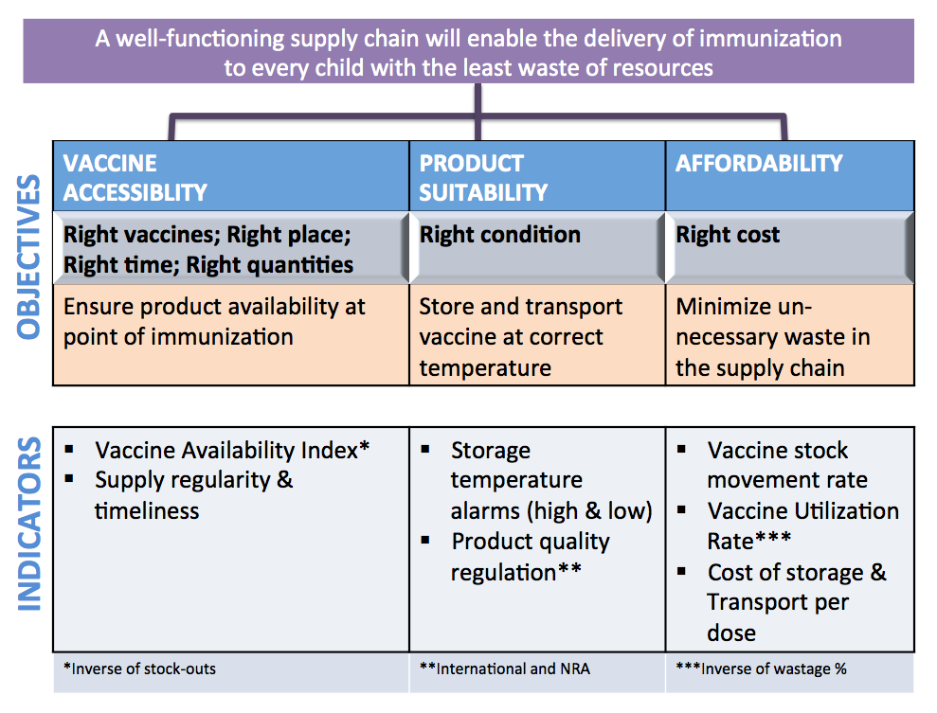
Six Performance Indicators Specific for Vaccine Stock Management.
Principles
Vaccine is available at the point of use whenever needed.
Vaccine is delivered or collected regularly and as frequently as scheduled.
Vaccine has been kept within a satisfactory temperature range with no risk of damage
Vaccines move through the distribution system rapidly, with little idle stock.
High proportion of vaccine is used, rather than wasted.
The cost of storage and transport per dose of all vaccines is optimal.
.
Source: Lloyd, John. (2013). Standard Performance Indicator for Vaccine Stock Management.

