Slide 1
the mobile forms company
Jørn Klungsøyr

Slide 2
Data capture anywhere on any device with or without mobile coverage
Notes:
Imagine your filling out a form while sitting on the train and network suddenly disapears in the tunnel.
On an expedition in himmalaya, in the basement of a warehouse or out in the sea on a fishingboat and there is no network connectivity and you can’t use your existing systems.
What do you do then?
Zegeba is all about capturing data
where you are,
with the device you have
even when there is no network

Slide 3
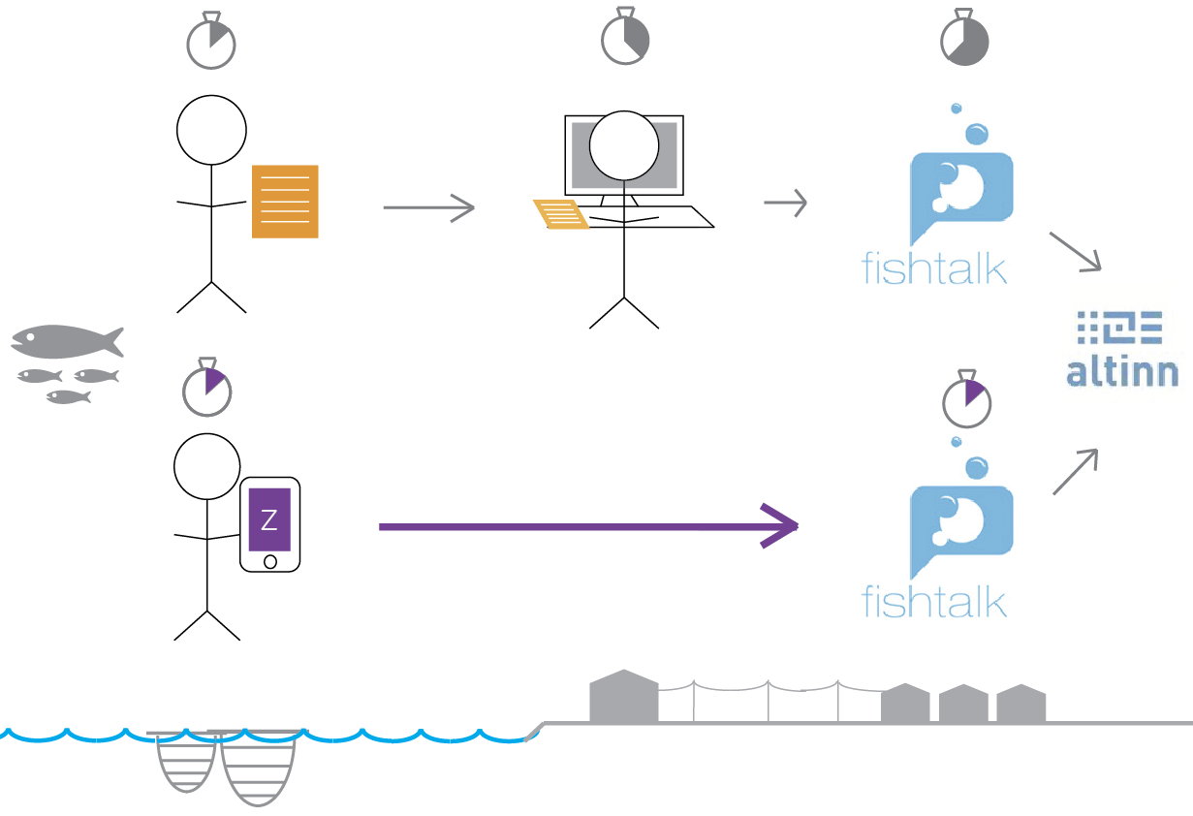
Data capture in Fishfarming
Notes:
A fishfarm can have fish cages at several locations.
Each day they need to inspect dead fish and report on fishlice.
Report on yellow-stickers.

Slide 4
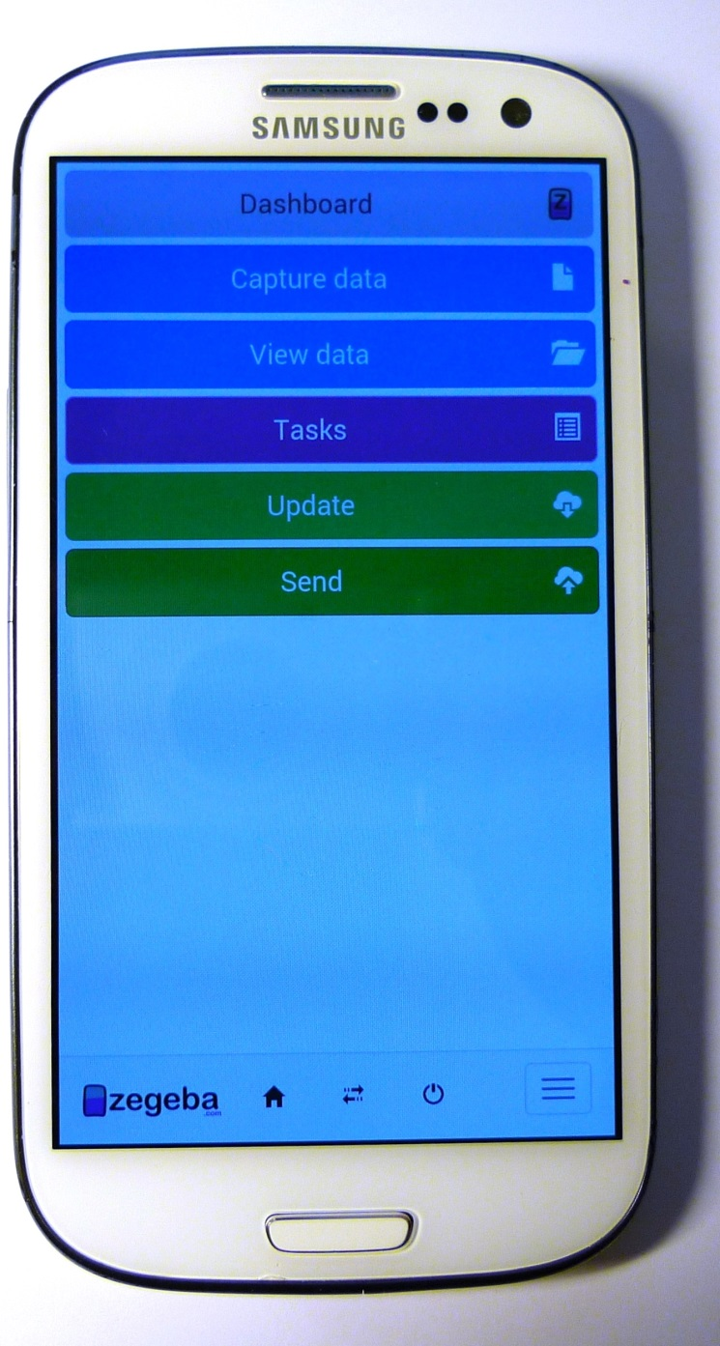
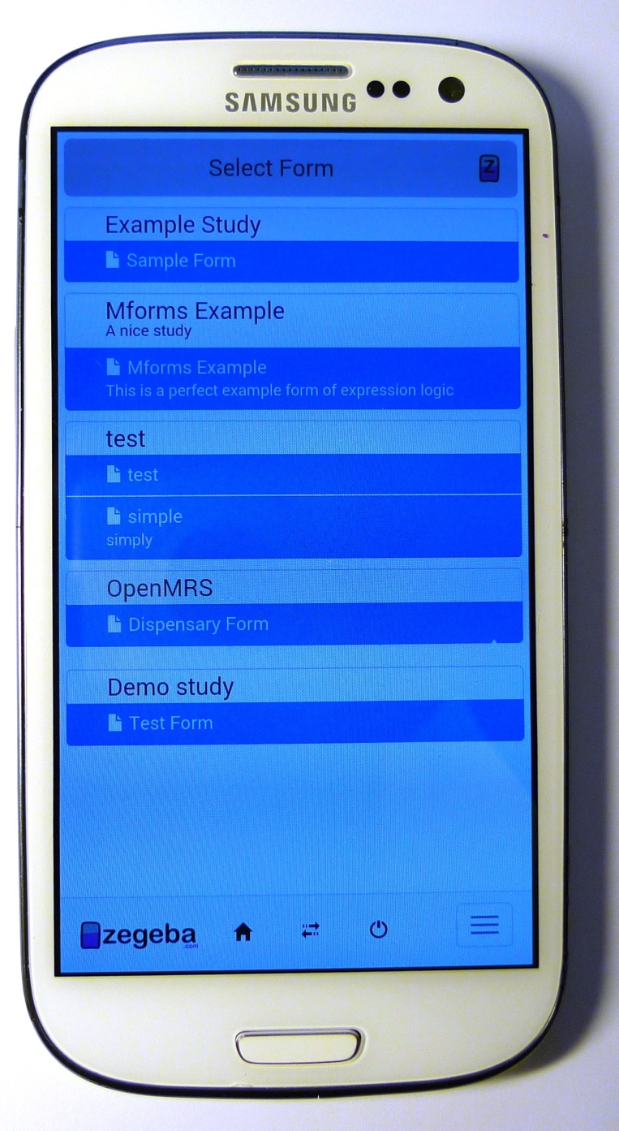
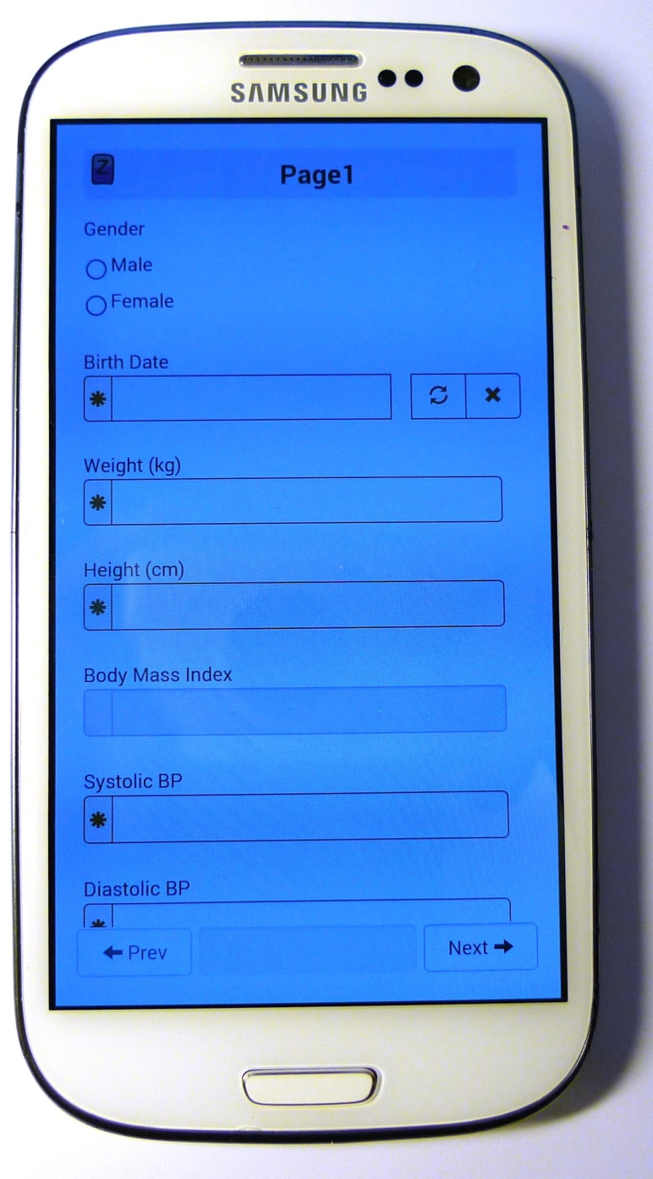
Zegeba Mobile Forms

Slide 5
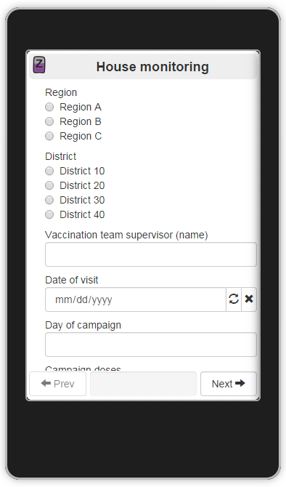
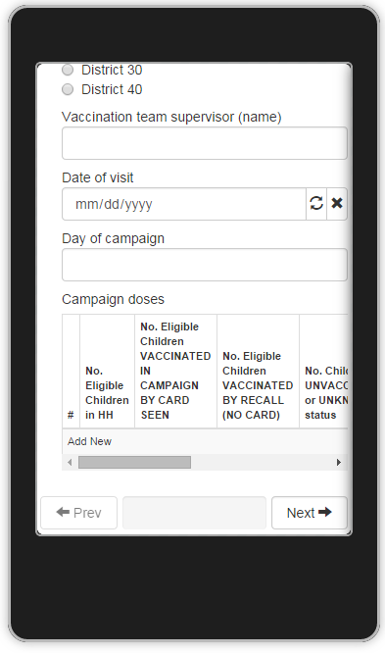

Slide 6
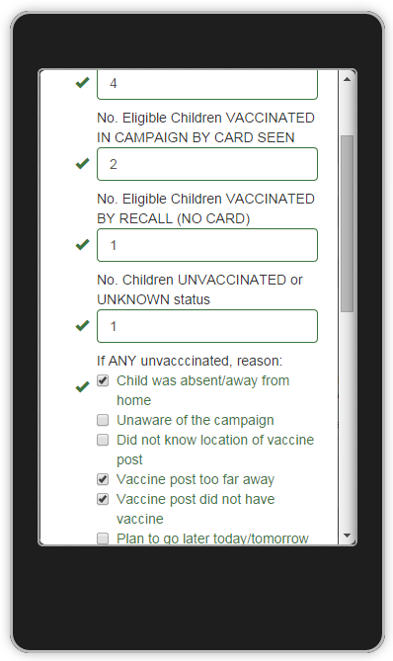
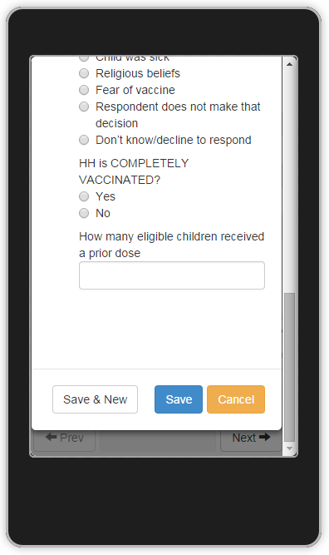

Slide 7
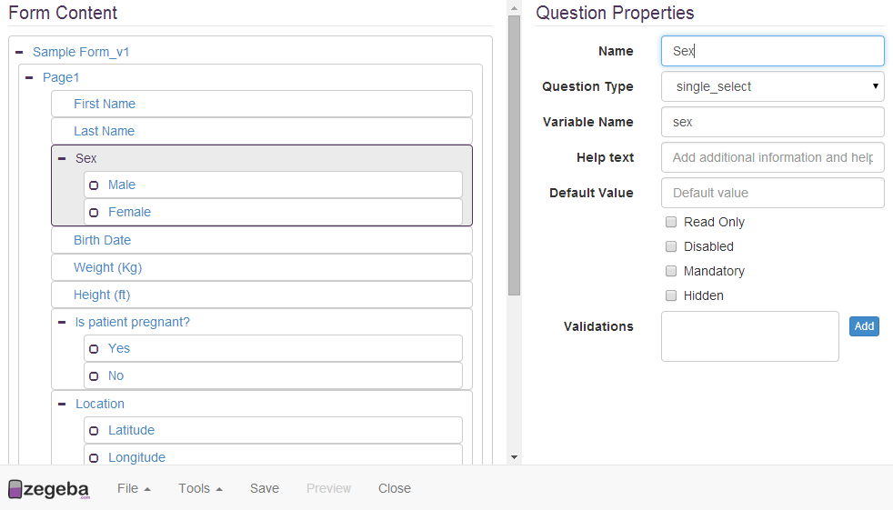
Zegeba Forms Designer
Notes:
We have also built a designer to create simple and complex forms with validation and calculations.
Think of it as a mobile app factory for non programmers.

Slide 8
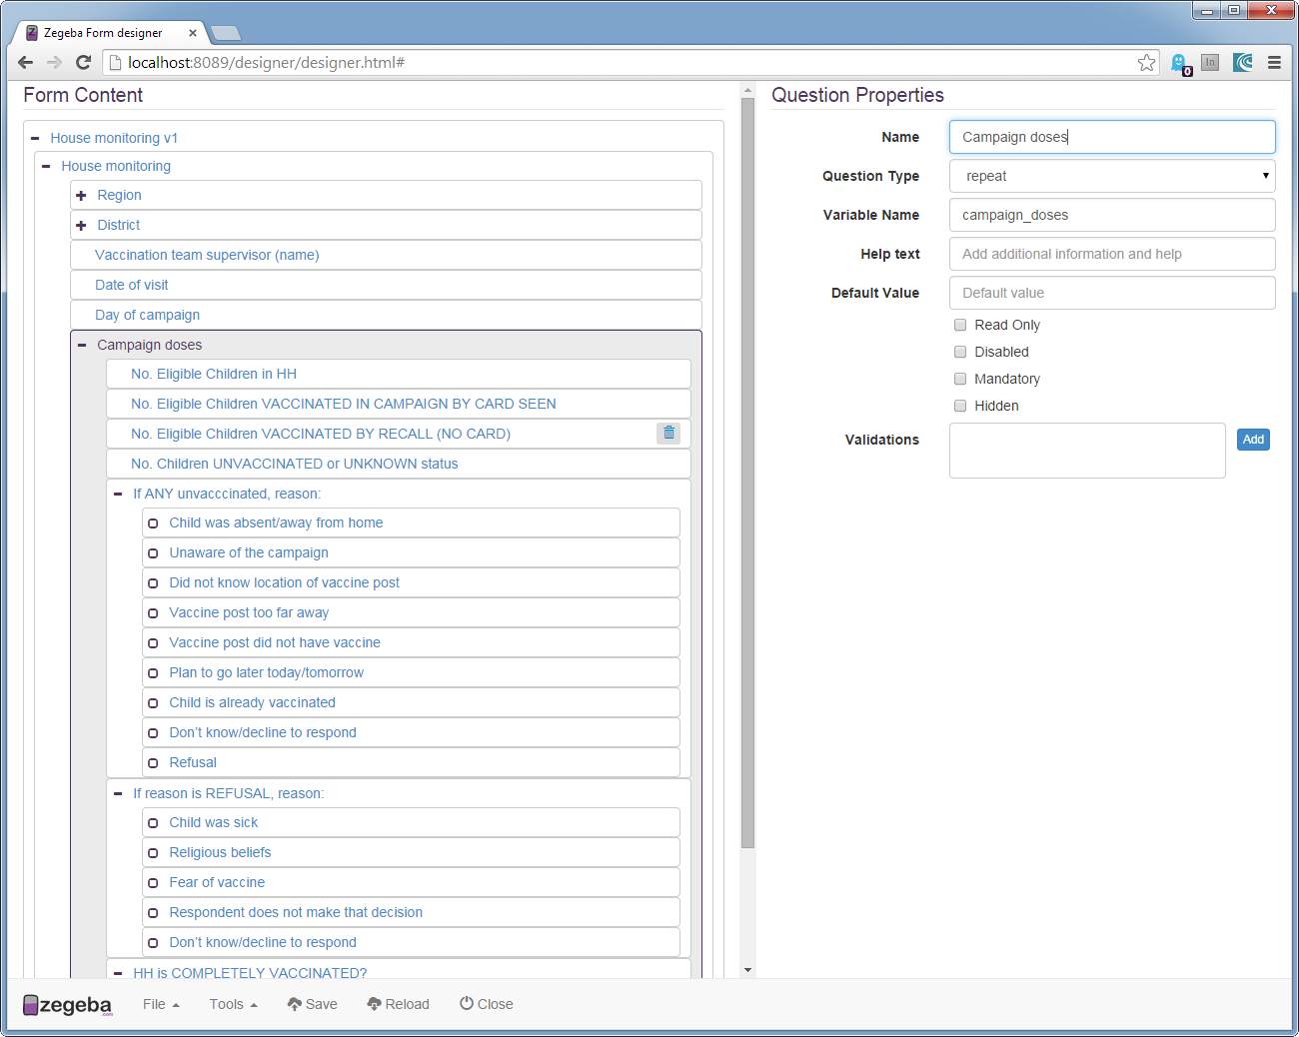

Slide 9
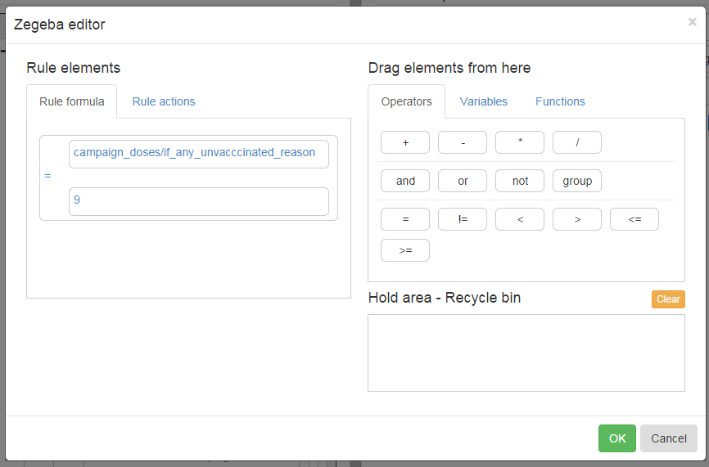
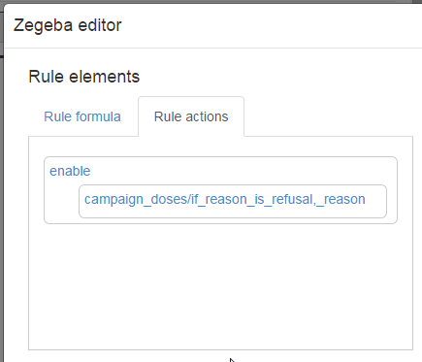

Slide 10
Key aspects of Zegeba
1. Capture anything, anywhere
2. Huge cost savings
3. Full integration with production system
4. Increased data quality and type
Notes:
Tell høyt – 1 – 2- 3 etc.
OBS: Capture anything anywhere – dette er snakk om media/QR-kode etc. som ikke kan registreres på papir

Slide 11
Key form features
Basic inputs (text/numbers)
Lists (single/multi)
Sub forms and repeats
GPS
Camera
Dynamic filtered lists
Versioning of forms and data
Internationalization
Scripts and typefaces
Skip logic
Input validation
Calculations

Slide 12
Mobile and web forms integrated with customers own/existing systems.
Online/offline with storage on device.
Your system
Notes:
What is new about Zegeba?
Solve an old problem/solution in a new and innovative way.
A form is self contained – including logic, pages++
A form is preprocessed and optimized on server
No need for continous server connectivity
Forms and data are separated
Integration with backends is through a converter plugin

Slide 13
Demo
Notes:
– same experience on all devices supported?

Slide 14
the mobile forms company
Jørn Klungsøyr

Slide 15
Device selection
Use devices and technologies known to users
Local purchase of devices
Batterylife?
Features?
Outdoor usage?
Screen size?
Likelihood of rain and moisture?
How will the devices be charged?
Sun? 12v car battery? Ex. USB battery?

Slide 16
Operational challenges
Distribution of devices and number of users
Install with SMS link
Distribution of usernames/passwords
Swapping of SIM cards distort mobile data
Is there mobile network coverage
Local hotspots (rooftops)?
Kiosk mode to prevent misuse? Trust?
SIM cards and GPRS settings
Payment of data cost

Slide 17
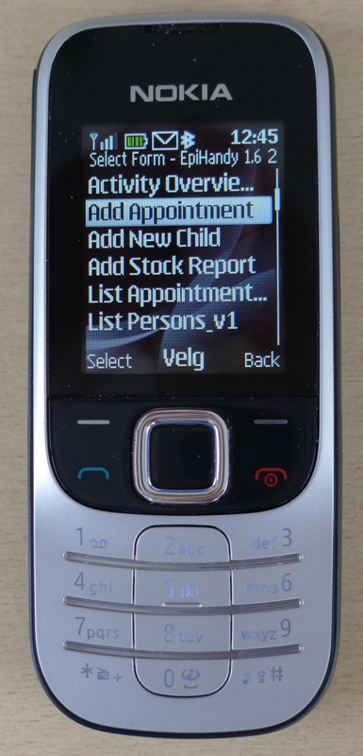
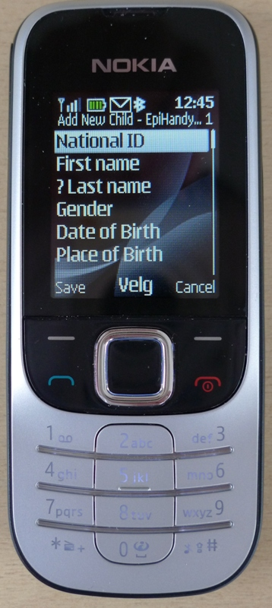
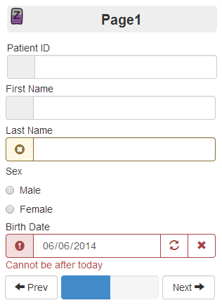

Slide 18
Dashboards and reports
Multiple sources – mashups
Who will analyze?
Automated alerts and reminders
Who will get the reports and how will they act?
Delivery and access
Online, PDF reports, on device?
Multiple tools in combination
Basic charts, advanced GIS modelling, flexible dashboards.
Notes:
Description of a dashboard
How would the data be collected, quickly analyzed.
Resources needed – running/setup/devices
Where would the data be handled and stored
Program managers – make it a tool that they can use.

Slide 20
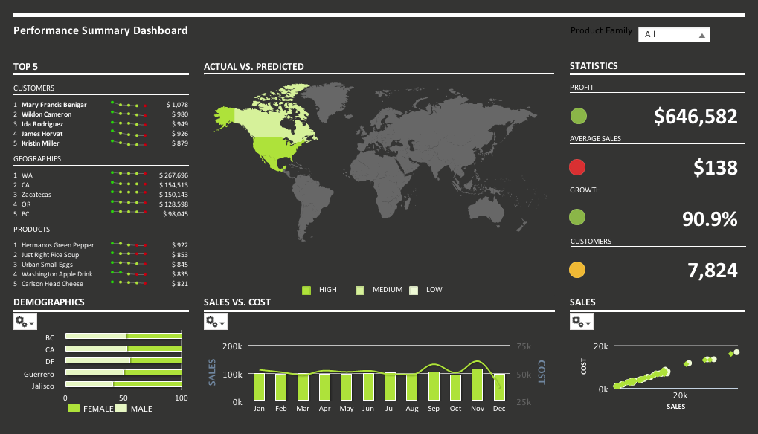

Slide 21
Security aspects
Ownership/theft of device
Users and passwords
Auto logout
Encryption of
data transfer (min SSL)
data storage
User errors – minimize through automation
Web trackers - risk of injections – insecure delivery.
Incorrect server / client configurations
Hacker/Attacks:
DoS/MiTM/Routing/SSL/CORS

Slide 22
Data storage and access
Cloud or inhouse hosting
Where is your data stored?
Who needs access – Groups/roles/permissions
Legal restrictions in different countries
Notes:
Cloud services, risks, security, legislation, costs
Data ownership and location

Slide 23
General aspects
Free vs. OpenSource vs proprietary
Total Cost of Ownership – Local support
Regularity of updates & bugfixes
Scalability
Functionalities
Vendor lock in
Security
Interoperability & Standards

Slide 24
General aspects II
Hosting and support (e.g on own server)
Logic and flexibility for adaptation
Inhouse expertice required
Data ownership and country specific legislation
Platforms supported (server/mobile)
Usage in country?
Form features supported
Usability
Equal experience on all devices supported?
Maintenance needs

