Slide 1
The Norwegian Immunisation Registry
- SYSVAK
Maria Hagerup-Jenssen
Senior Adviser
Norwegian Institute of Public Health
Istanbul 11th of November 2014

Slide 2
Online 24/7

Slide 3
Electronic Immunisation System
Norwegian Immunisation Registry
  SYSVAK was initiated as a project in 1976
    5 counties included
  Nationwide from 1995
  Organized by the Department of Vaccines at NIPH
SYSVAK regulation
  Mandatory notification of vaccinations in the Norwegian Childhood Immunisation Programme
  From 2011 notifications of all other vaccinations are mandatory given consent.

Slide 4
Notification
Notification to the Norwegian Immunisation Registry SYSVAK and regulations regarding consent
Vaccination Programme | Consent | Notification
Childhood Immunisation Programme | Not needed | Mandatory
Pandemic Influenza | Not needed | Mandatory
All other vaccinations | Required | Given consent

Slide 5
Purpose
Overview of vaccination status for each individual
Monitor and maintain high degree of vaccination coverage in the Norwegian population
  National, counties and municipalities
Publish vaccination coverage
Source for research, statistics and quality improvements

Slide 6
The Norwegian Childhood Immunisation Programme
Child's age | Vaccination against | No. of injections
6 weeks | Rotavirus (given orally) (October 2014) | -
3 months | Rotavirus (given orally) (October 2014) Diphtheria, tetanus, whooping cough, poliomyelitis and Hib-infection (DTP-IPV-Hib), pneumococcal disease | - 2
5 months | Diphtheria, tetanus, whooping cough, poliomyelitis and Hib-infection (DTP-IPV-Hib), pneumococcal disease | 2
12 months | Diphtheria, tetanus, whooping cough, poliomyelitis and Hib-infection (DTP-IPV-Hib), pneumococcal disease | 2
15 months | Measles, mumps, rubella (MMR) | 1
7-8 years | Diphtheria, tetanus, whooping cough and poliomyelitis (DTP-IPV) | 1
11-12 years | Measles, mumps, rubella (MMR) | 1
12-13 years – girls | Human papillomavirus (HPV),3 doses (Vaccine against cervical cancer) | 1
15-16 years | Diphtheria, tetanus, whooping cough and poliomyelitis (DTP-IPV) | 1
 | Tuberculosis (BCG), 1 dose*
 | Hepatitis B, 3 or 4 doses*

Slide 7
Vaccinations included in the Norwegian Childhood Immunisation Programme
The immunisations are usually provided by public health nurses
  Babies and toddlers are vaccinated at public health centres
  School children are vaccinated in the school health services
Vaccinations registered electronically by local public health nurses
All vaccinations are voluntary
Accept of vaccination means consent of notification

Slide 8
Data reporting
Single data entry
  Electronic patient record system (EPR)
Key identifier
  National identity number
Data entered in local EPR
  National identity number
  Name of vaccinee
  Standardized vaccination code
  Vaccination date

Slide 9
Communication
Vaccination transfer to SYSVAK instantly
Vaccination message:
  Standard national format (EbXML)
Message transmitted securely:
  National secured network for health professionals

Slide 10
Data security
SYSVAK contains health information and personal identification
  Needs adequate level of security
  Restricted access
  Logs all activity

Slide 11
My Vaccines
Electronic public service from the Norwegian Institute of Public Health
Norwegian citizens can access their vaccinations online
  Vaccination status for themselves and their own children of less than 16 years
  Access requires a personal log-in procedure with an electronic ID
  Download and print vaccination certificate in Norwegian and English

Slide 12
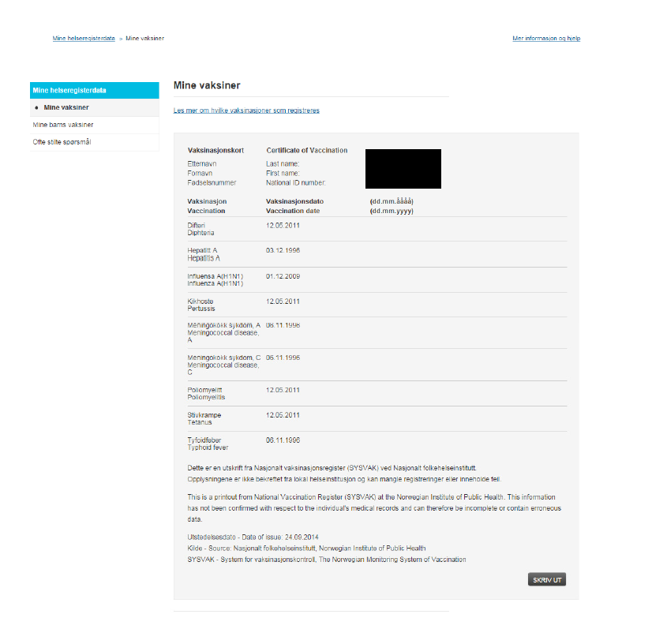

Slide 13
Vaccination coverage
Published annually for selected age cohorts on a national, regional and municipality level
Represents the percentage of children vaccinated according to the Norwegian Childhood Immunisation Programme
Based on the National Population Registry - all Norwegians have a unique national identity number

Slide 14
Calculating vaccination coverage
A built-in rule engine helps determine whether a person is covered or not at any given time
The rule engine is based on age at first vaccination, interval between doses and number of doses
The rule engine is unique for each disease
Vaccination coverage represents children vaccinated and covered against a disease

Slide 15
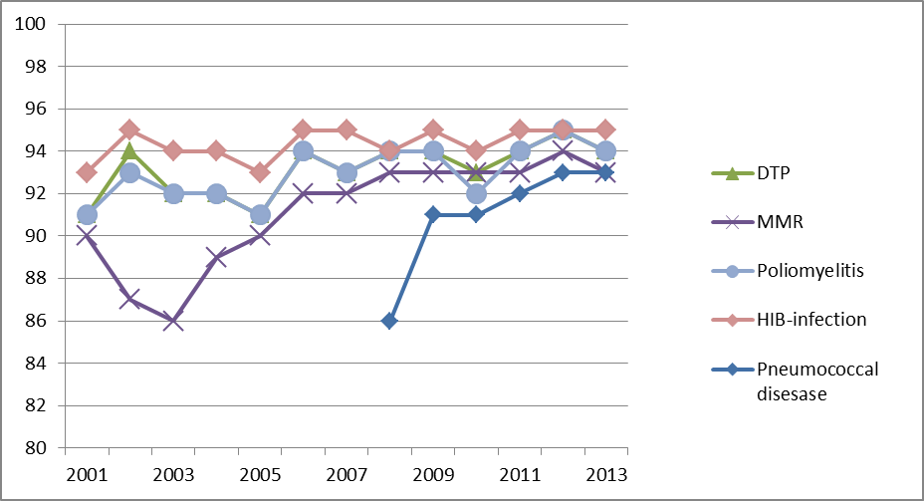
Vaccination coverage 2000-2013 for 2-year olds

Slide 16
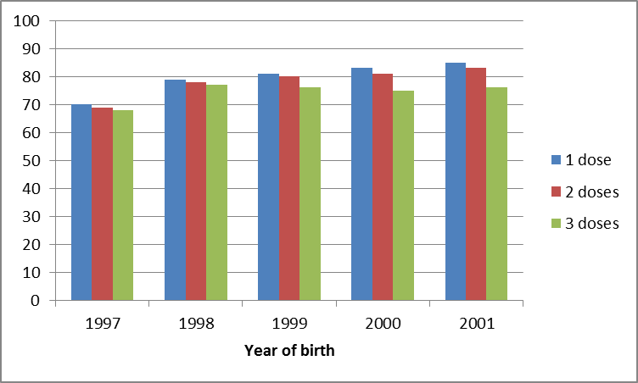
Vaccination coverage – HPV
Per August 2014

Slide 17
Monitoring the vaccination coverage
The local health personnel have access to information in the central registry
Complete vaccination history of all children in their district
Quality control
  List of children with incomplete vaccination records are provided for the municipalities annually

Slide 18
Validation
Automatic (continuious) message validation – electronic transfer
  Information - message accepted
  Warnings - message accepted
  Error - message rejected
Manual validation
  Phone and email support
  Data traffic surveillance
  Annual «qualitylists» based on a rule engine

Slide 19
“Qualitylist” example

Slide 20
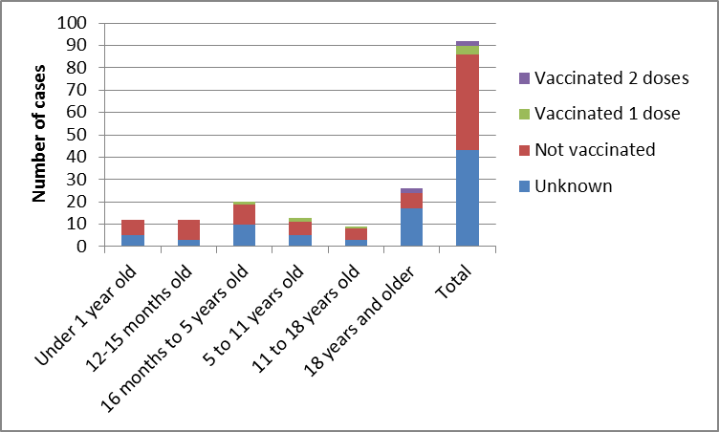
Use of SYSVAK
Cases of measles and vaccination status 2001-2011

Slide 21
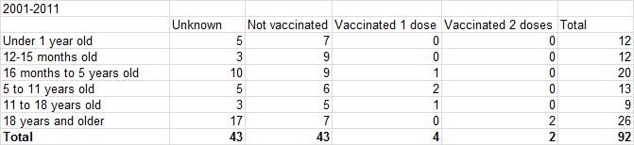
Cases of measles and vaccination status 2001-2011

Slide 22
Use of SYSVAK
Research
    Pandemic influenza A(H1N1) and narcolepsi
    HPVnorvaks study
      Monitoring and reporting of vaccination coverage and adverse events
      Research projects aimed at studying the effect of the vaccine on HPV infection, cervical dysplasia and cervical cancer
    All researchers can apply for data for projects with approval
Statistics
    Continuously on demand for different purposes

Slide 23
Challenges
Electronic transfer/communication
Paper forms registration
Missing registrations
Data quality (date and vaccine)
Immigrants without national identity number

