Slide 1
Tanzania eLMIS
Strengthening public health supply chain in Tanzania

Slide 2
eLMIS Demo

Slide 3
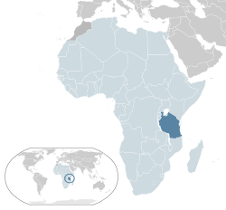
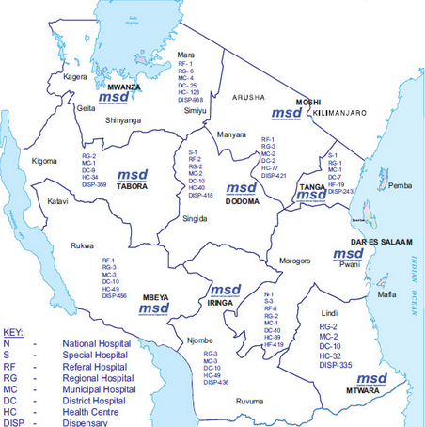
Tanzania in brief
TOTAL AREA:
945,203 km²
TOTAL POPULATION:
47.4 Millions
REGIONS & DITRICTS
25 Regions (Tanzania mainland
166 District Councils

Slide 4
Tanzania in brief
Health facilities
National Hospital = 1
Special Hospital = 4
Zonal referral Hosp = 3
Regional referral Hosp = 37
District Hospitals = 121
Health centers = 513
Dispensaries = 4,574
Medical Stores Department (MSD)
Central Store = 1
Zonal stores = 8
Sales points = 2

Slide 5
TZ Health Logistics Systems:
Lab
Supplies
ILS
ARV / OI
TB / EPI
MOHSW program
MOHSW program
MOHSW program
MOHSW program
ILS:
Essential medicines
Family Planning
Malaria
STI
PMTCT
MSD central
MSD central
MSD central
MSD central
MSD zonal
MSD Zonal
MSD zonal
MSD Zonal
Regional HMT
Regional
HMT
Regional
HMT
Regional
HMT
Order flow
District
CHMT
District CHMT
District CHMT
District CHMT
Commodity flow
Health facility
Health facility
Health facility
Health facility

Slide 6
Supply chain challenges
Infrequent adherence to reporting groups
Stockouts Overstock Expiry
Wastage
Late reported orders
Difficulties with ordering and reporting
Data accessibility and accuracy
HMTs require logistics data for supervision support
Absence of facility level data for decision-makers

Slide 7
Completed features
Development update

Slide 8
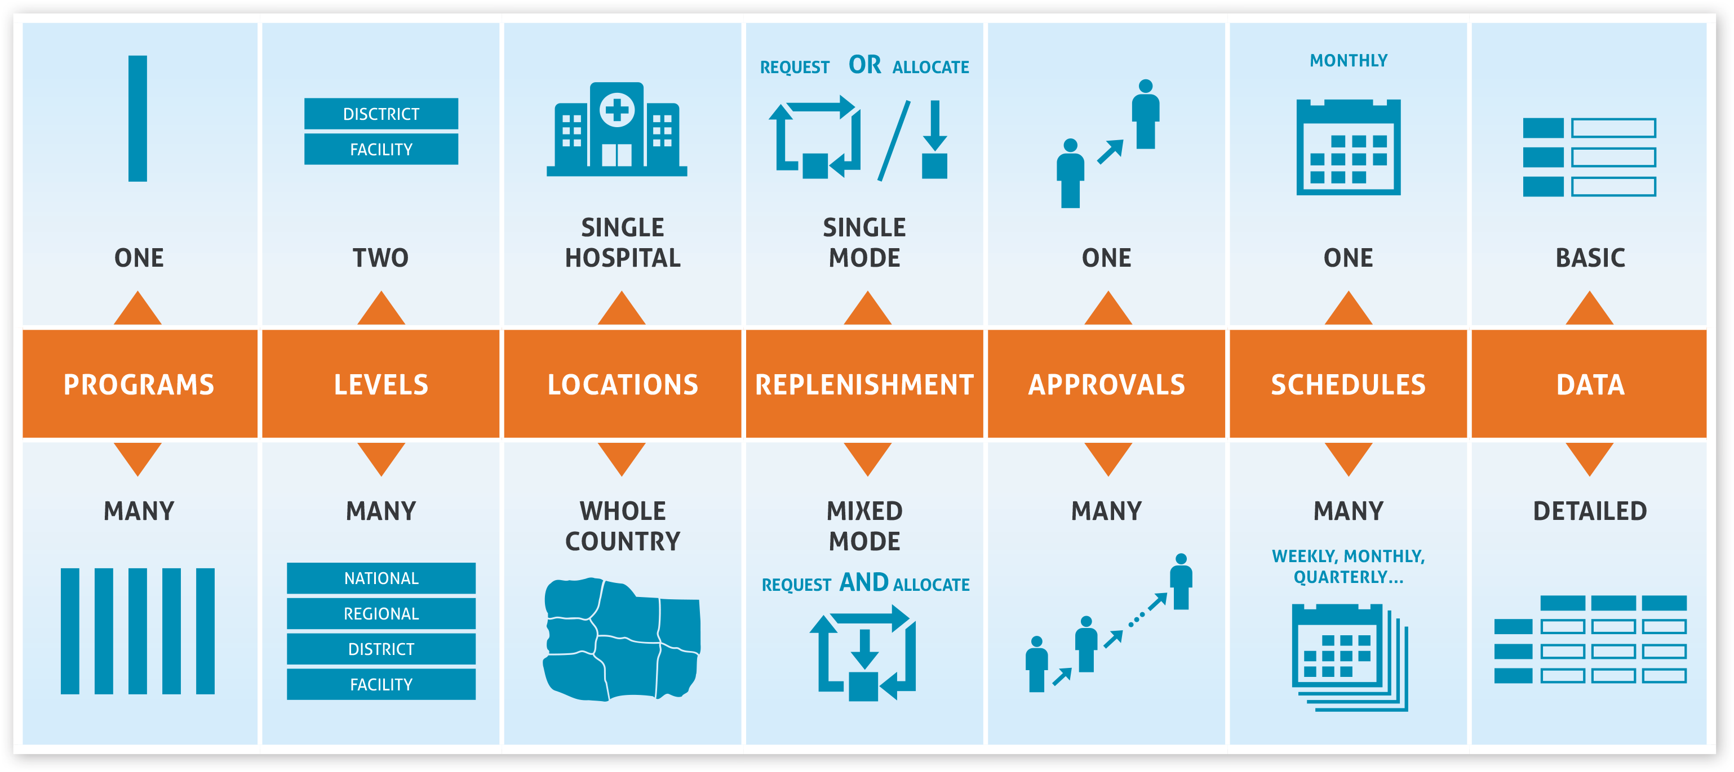
Highly Configurable
Notes:
Resulted in a highly configurable system…

Slide 9
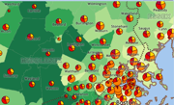
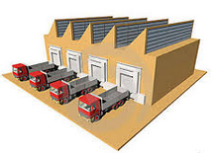
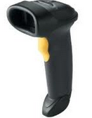
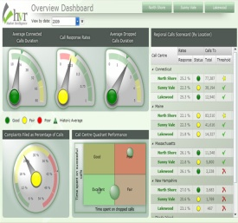
eLMIS (existing and expected Features)
GIS
Warehouse
Orders and
Shipments
Barcode
Scanner
(Expected for Vaccines SC)
eLMIS
LOGISTICS
DATA
WAREHOUSE
SMS Text
Data & Email Alerts
Reporting
Dashboard
Stakeholder Access
Web Based Data Entry and Data Uploads
Notes:
TZM Vision
An effective logistics management information system (LMIS) should ensure that adequate quantity and quality of health commodities are always available at the point of service to meet patient demand. In order to do this, the LMIS must incorporate:
Accurate, timely & routine consumption data
Real-time logistics management capabilities covering point of origin to point of consumption
Demand forecasting, capacity planning & modeling based on consumption

Slide 10
eLMIS - Interoperability
eLMIS is designed to support all existing electronic tools, including, EPICOR 9 ERP, ILS Gateway, DHIS2 etc
All ILS Gateway data is inputted into eLMIS and both ILS Gateway and eLMIS data are inputted to E9. All ERP order data, which was previously hand-keyed in, is now created from eLMIS.
DHIS2
A system that collect HMIS data such patients data, catchment population, treatment summary etc
A system that integrates Sales, Procurement, Finance, and Logistics functions into one place to facilitate transparent and efficient operations
E9
eLMIS
ILSg
A mobile health alert and reporting system designed to increase the visibility of logistics data and improve product availability
A system that processes electronic ordering and reporting and convert to order

Slide 11
eLMIS data Movement
Share and Review Reports
instant
paper
Review changes
Send R&R
eLMIS
for Incorrect Order
Send and Review Reports
eLMIS
District
Send R&R
E9
ILS Gateway Data
LMU/Zone
1
ILS Gateway Data
District Delivery
Health Facilities
Proof of Delivery notification
instant
Deliver Consignment
Central/MOH accesses ILS Gateway and eLMIS data instantly.
Deliver Consignment
Zone Deliver
2
eLMIS / ILSG
Central / MOH

Slide 12
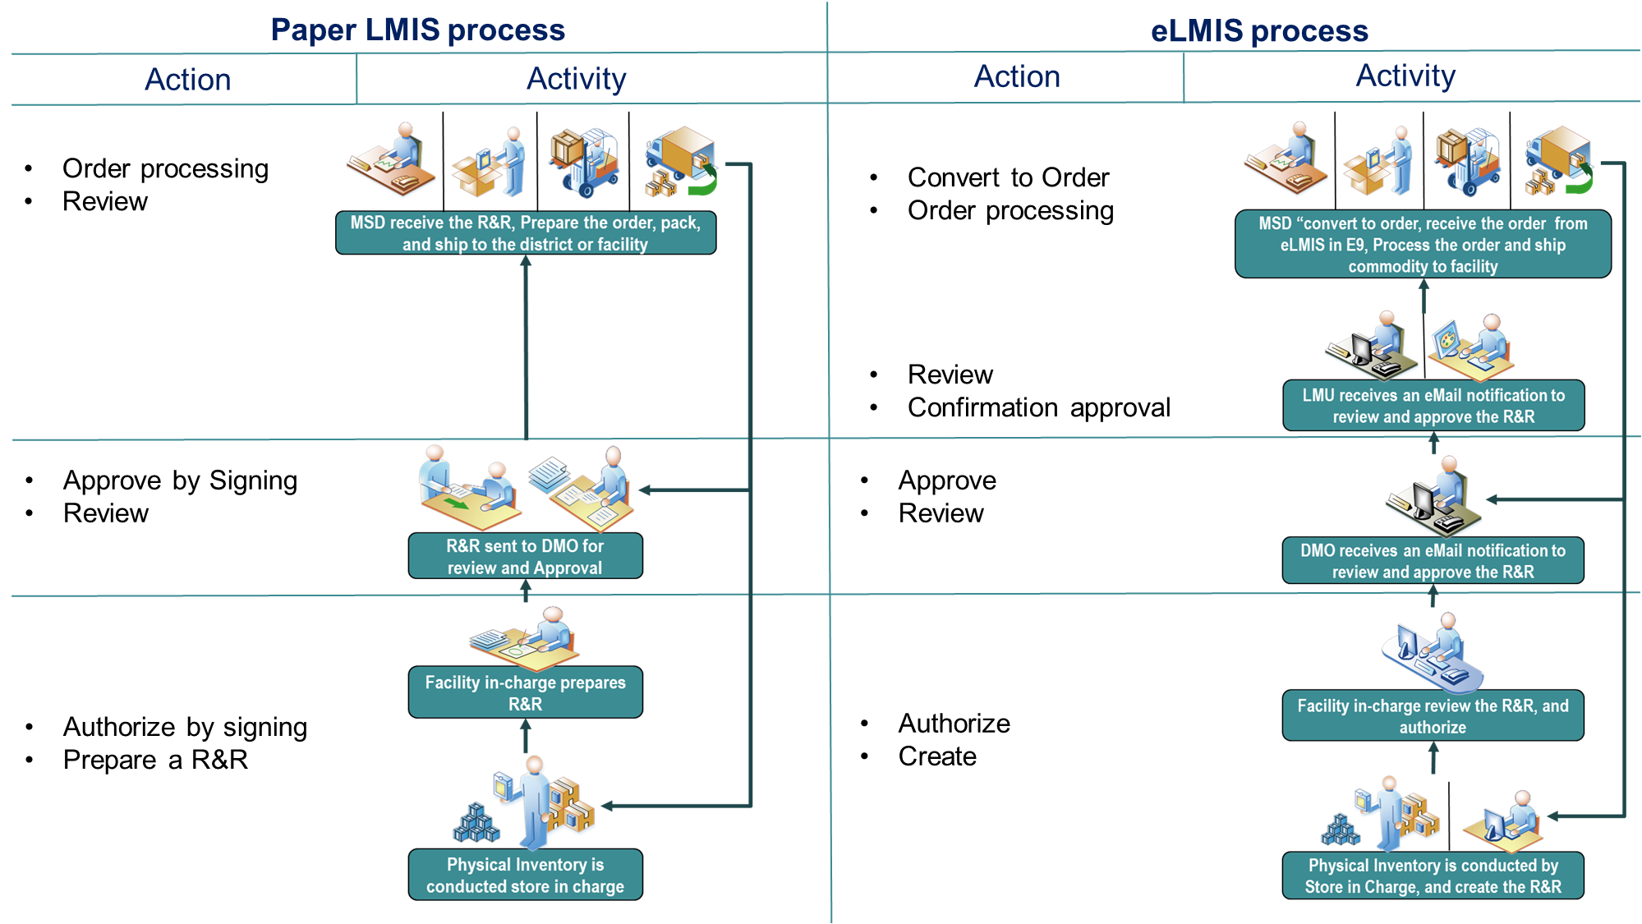
Paper LMIS vs eLMIS processes

Slide 13
Demo areas
System configurability
High level Requisition process flow
High level reports overview (For Informed decision making)
High level dashboards overview (For proactive decision making)
Question and Answers

Slide 14
Demo
For informed decision making

Slide 15
Equipment Asset Management
Feature Summary

Slide 16
Facility/Supervisor Interface

Slide 17
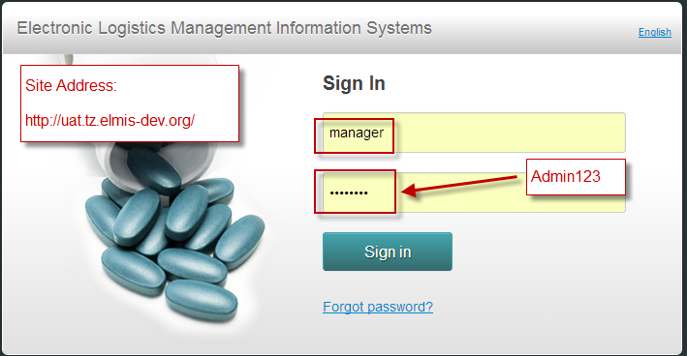
Login with Facility/Supervisor Account

Slide 18
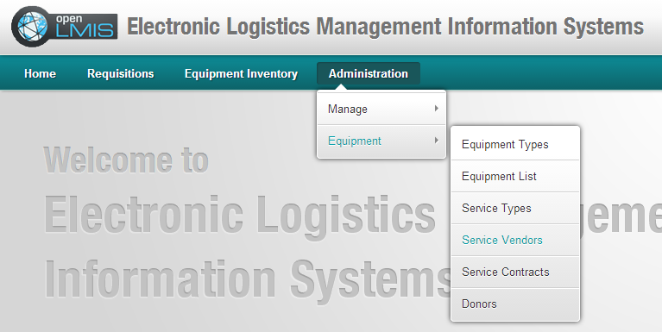
Admin Menu Related to Equipment Asset Management

Slide 19
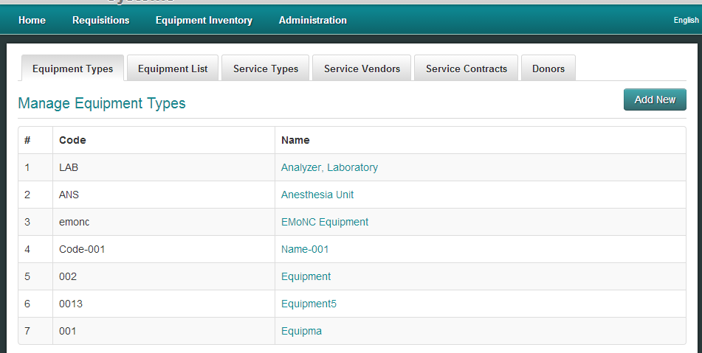
Add/Update Equipment Types

Slide 20
Associate Equipment with Equipment Type

Slide 21
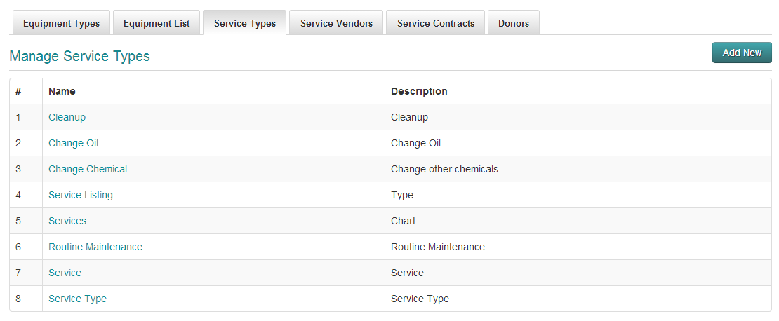
Add/Update Service Types

Slide 22
Add/Update Vendors Who Supports the Equipment

Slide 23
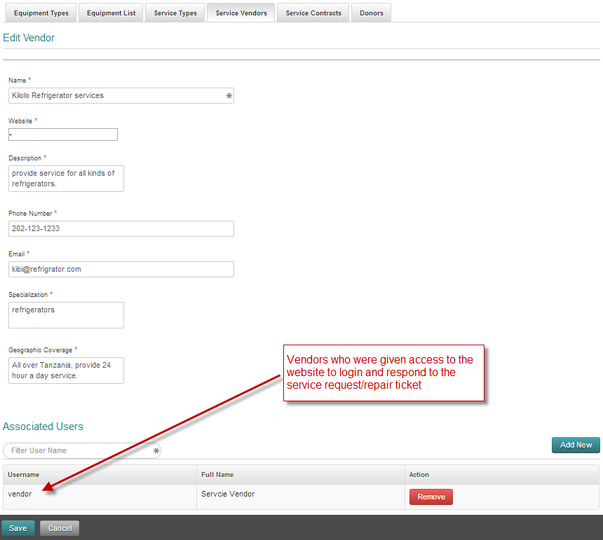
Vendor Detail and Vendor Login Accounts

Slide 24
Service Contract Details

Slide 25
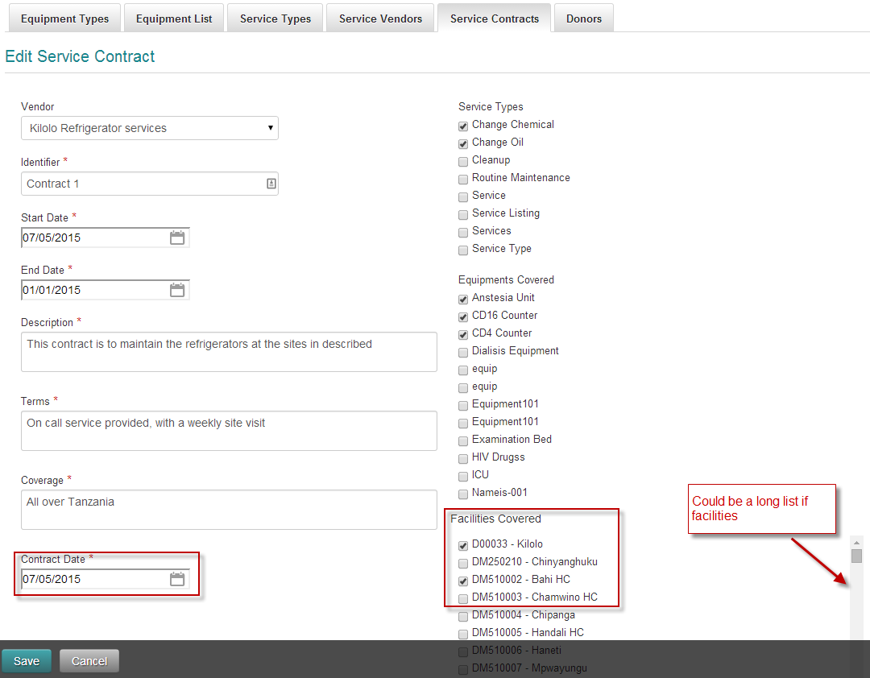
Service Contract Details

Slide 26
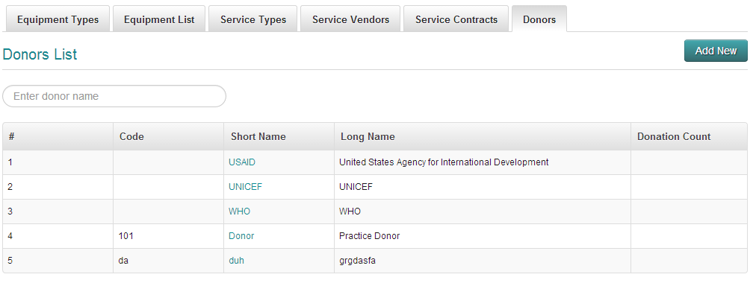
Donors

Slide 27
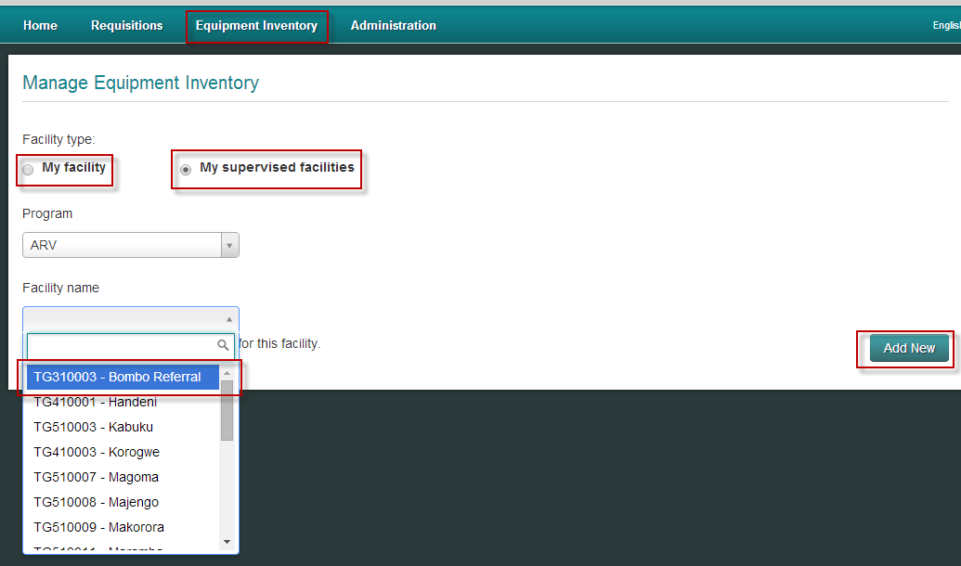
Interface for Facilities/Supervisor to Report on their Equipment

Slide 28
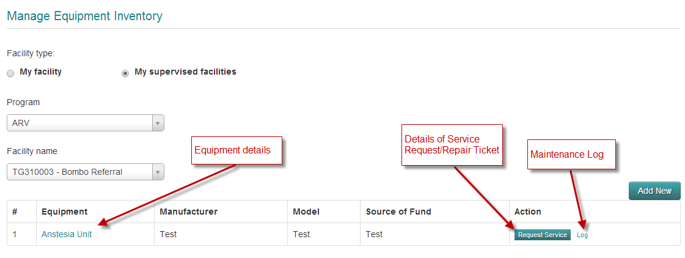
Facility to Manage their Equipment and Request Service

Slide 29
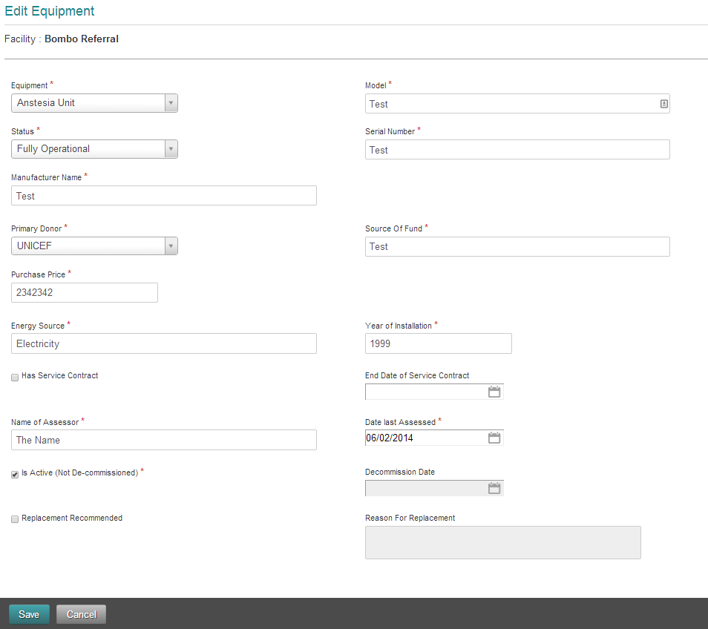
Equipment Details

Slide 30
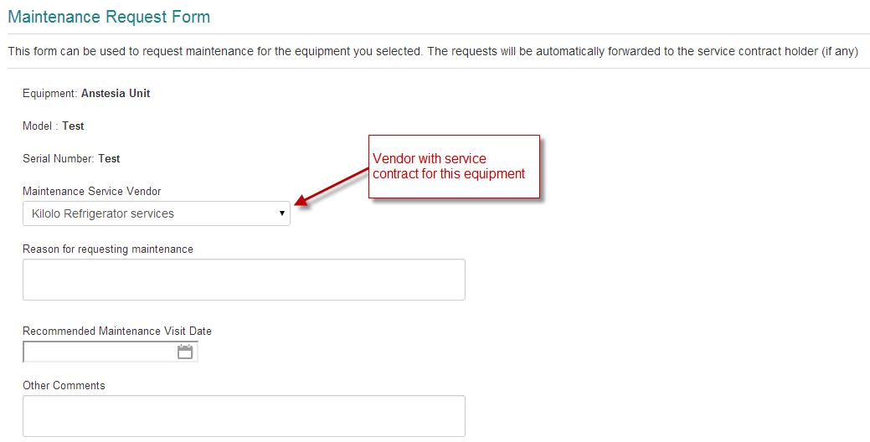
Service Request/Repair Ticket

Slide 31
Equipment Maintenance Log

Slide 32
Vendor Interface

Slide 33
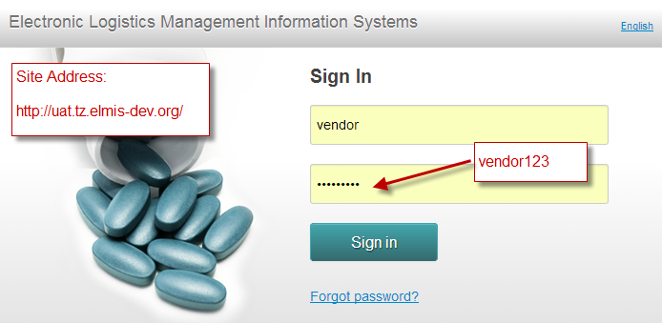

Slide 34
Vendor Login

Slide 35
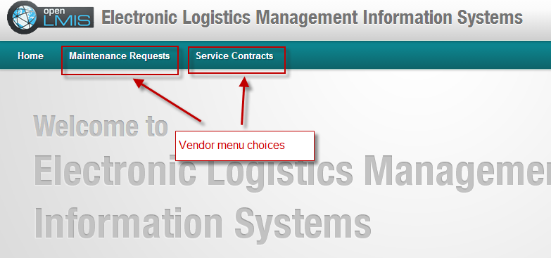
Vendor Interface

Slide 36
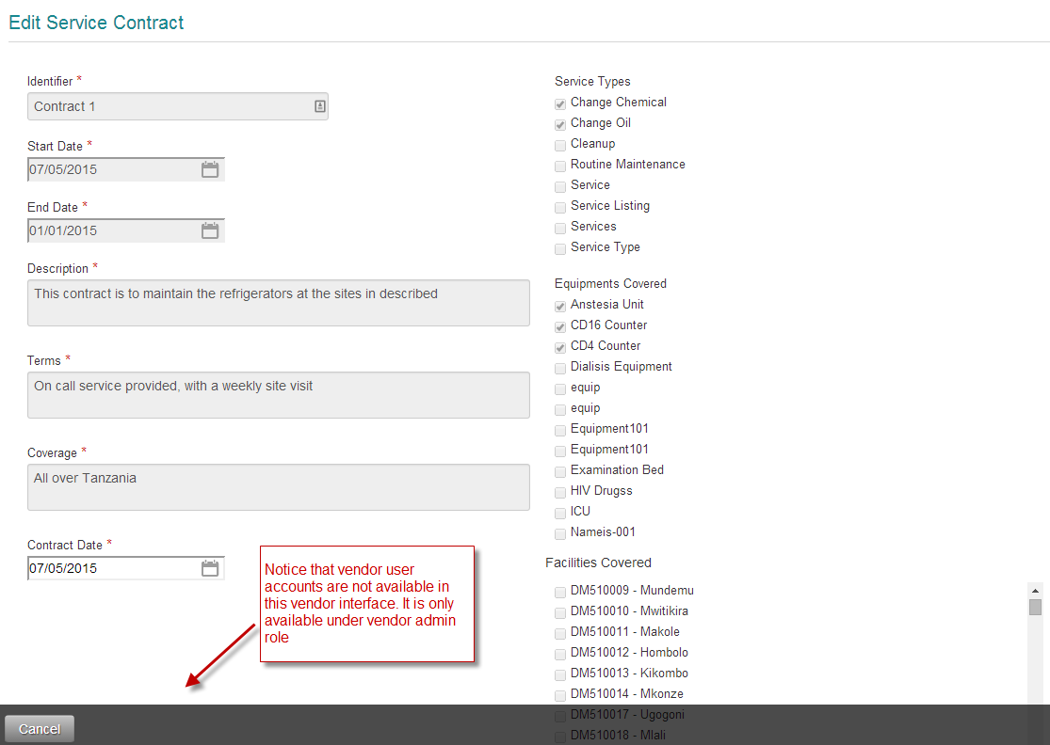
Service Contract Details

Slide 37
Interface to View Service Request/Repair Tickets

Slide 38
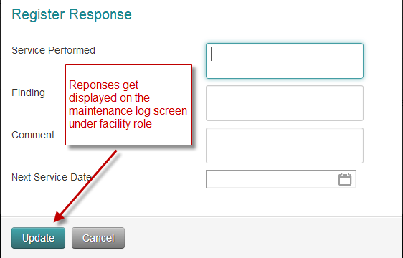
Repair Details

Slide 39
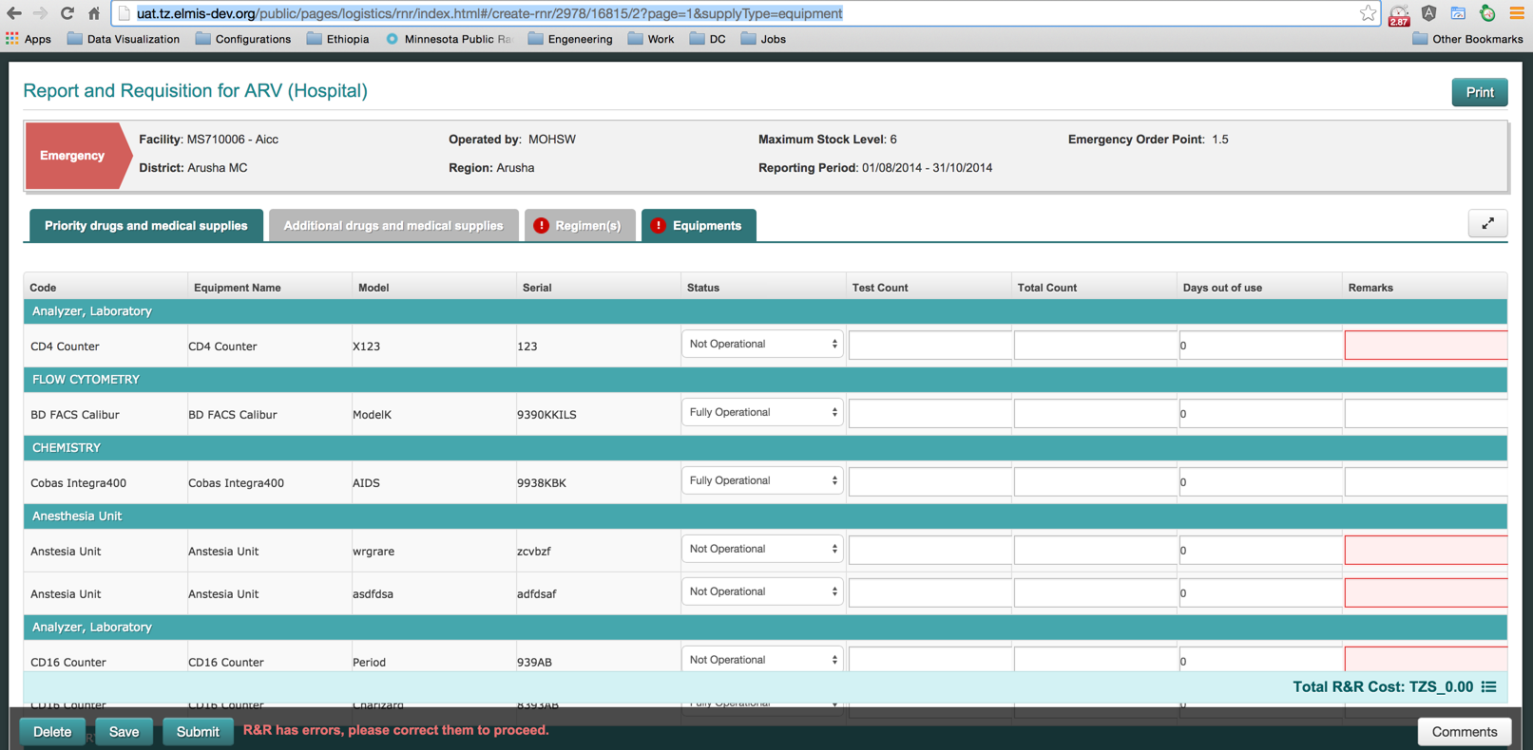
Demo areas

Slide 40
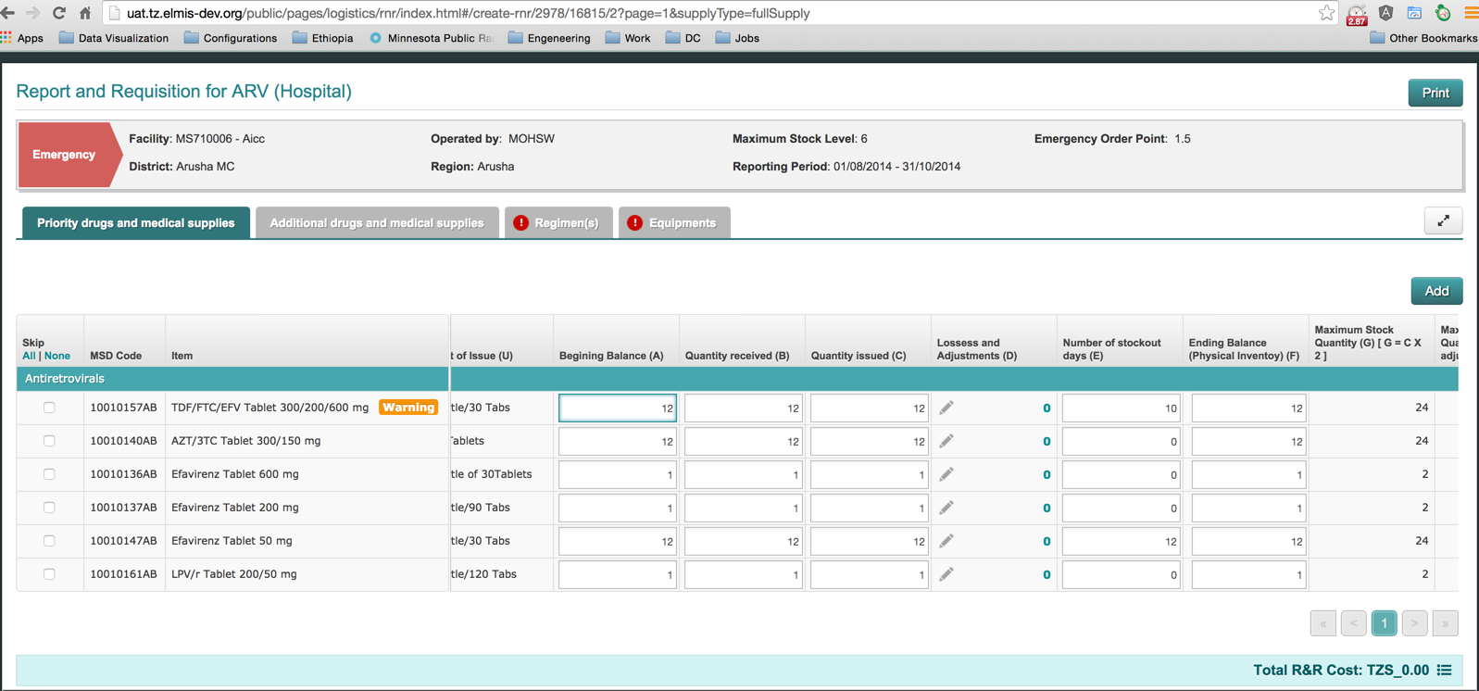
Demo areas

Slide 41
Reports & dashboards

Slide 42
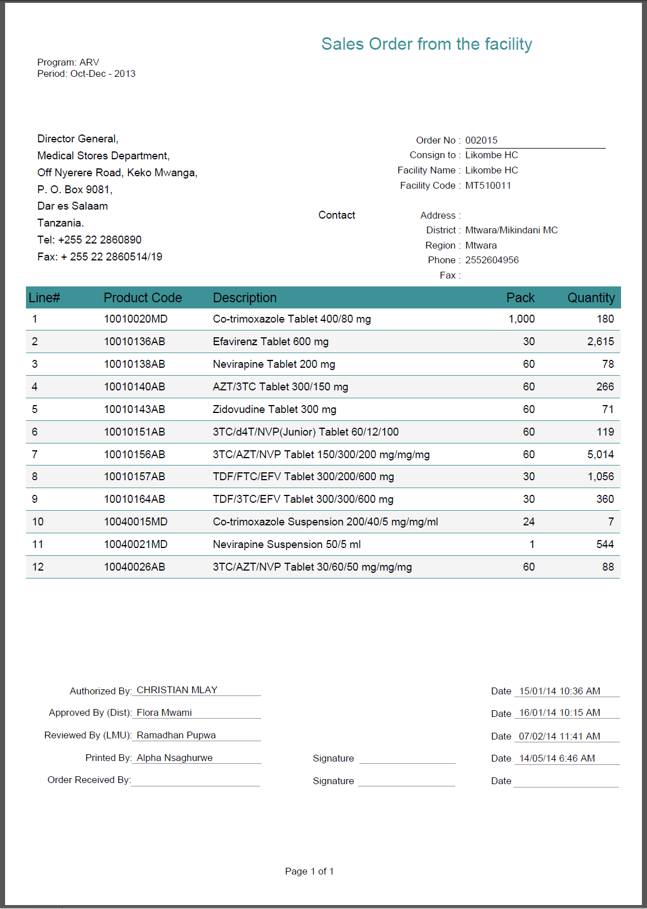
Sales order
eLMIS R&R ID
Facilities and districts contact details
List of all approved products with item code
Names, dates and time
Page number

Slide 43
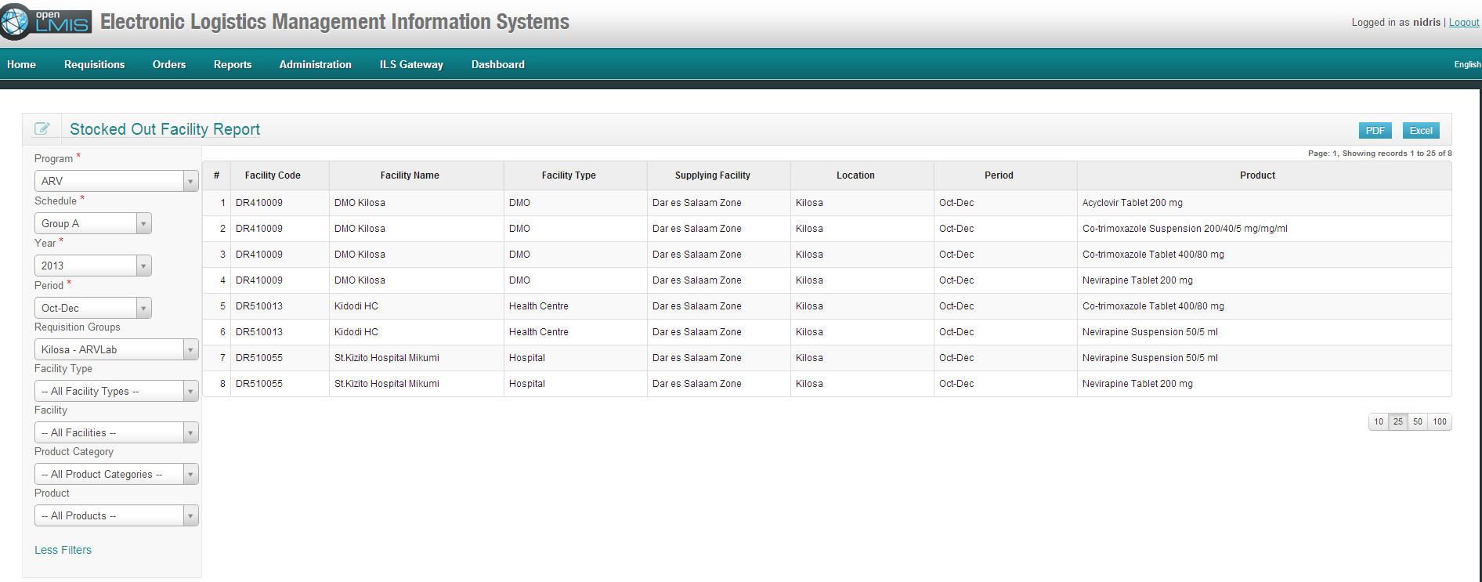
Stocked out facilities

Slide 44
Sample of consumption reports

Slide 45
Products adjustment report

Slide 46
Stocked out facility report

Slide 47
Stock imbalance report

Slide 48
Order fill rate summary report

Slide 49
Order fill rate summary report

Slide 50
Order fill rate summary report

Slide 51
Regimen report

Slide 52
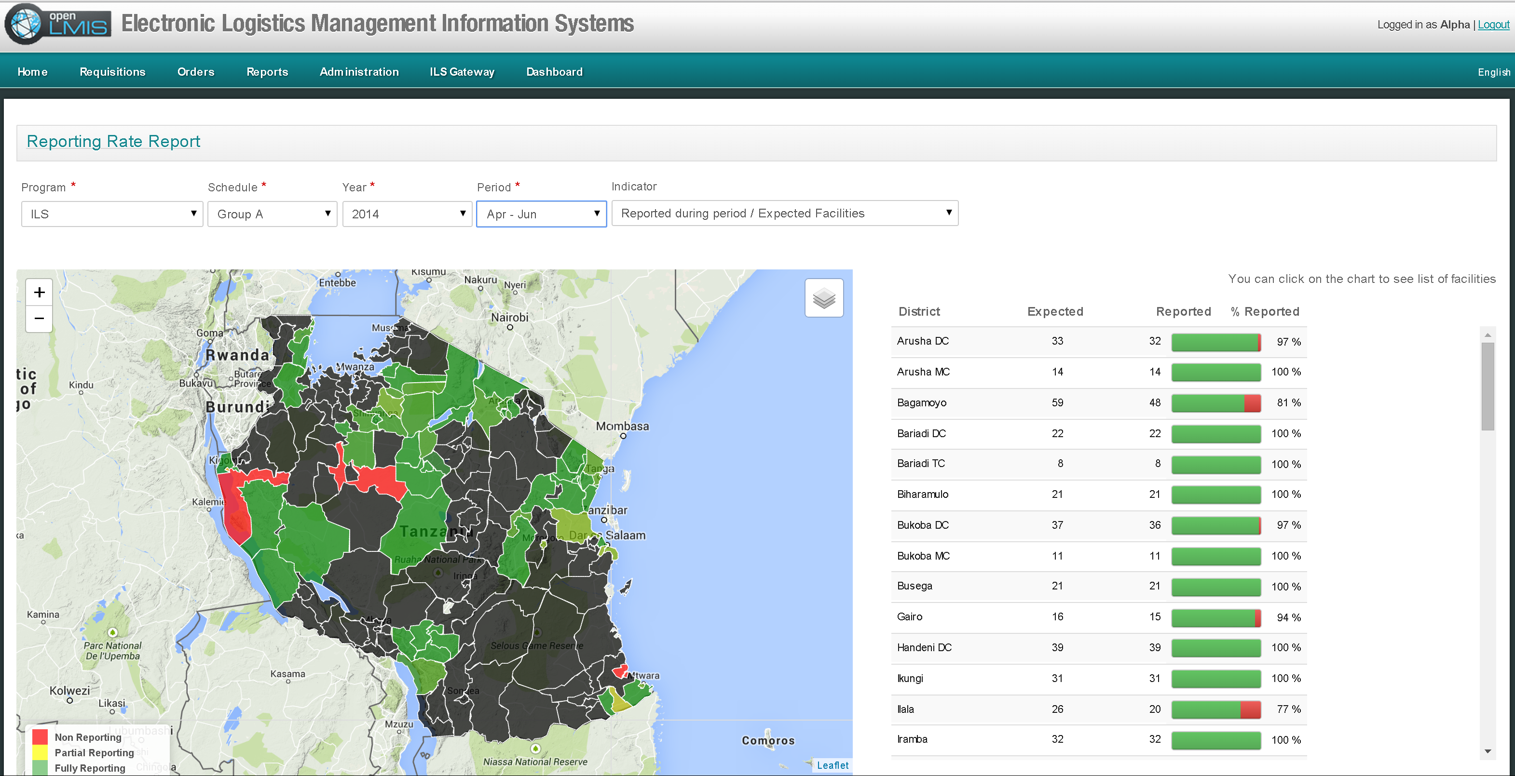
Color coded map showing reporting rate

Slide 53
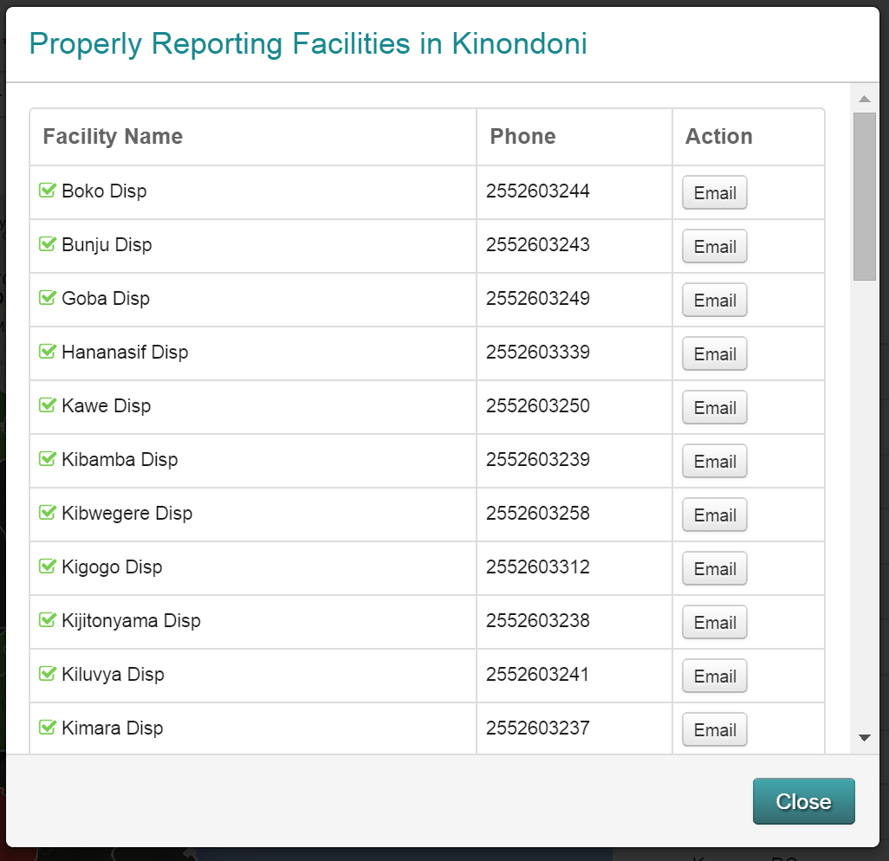
Contacts at facilities who can be contacted to follow-up for non-reporting cases

Slide 54
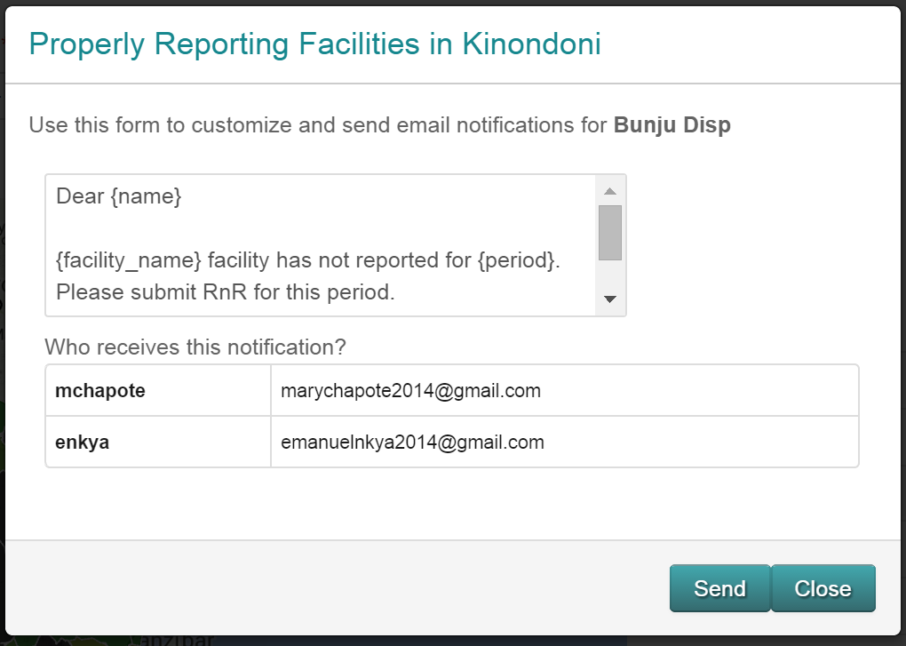
Contacts at facilities who can be contacted to follow-up for non-reporting cases

Slide 55
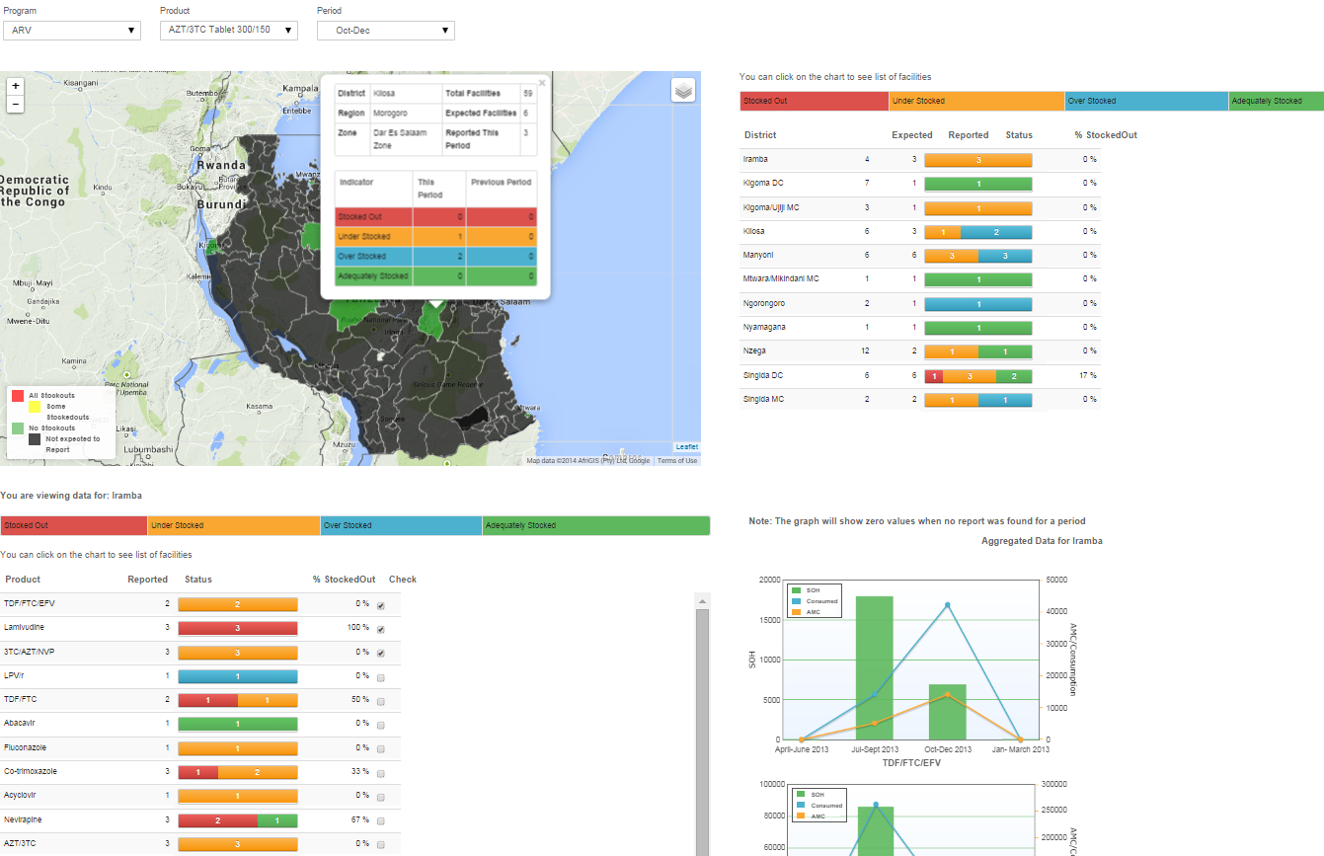
FACILITY STOCK STATUS ON THE MAP

Slide 56
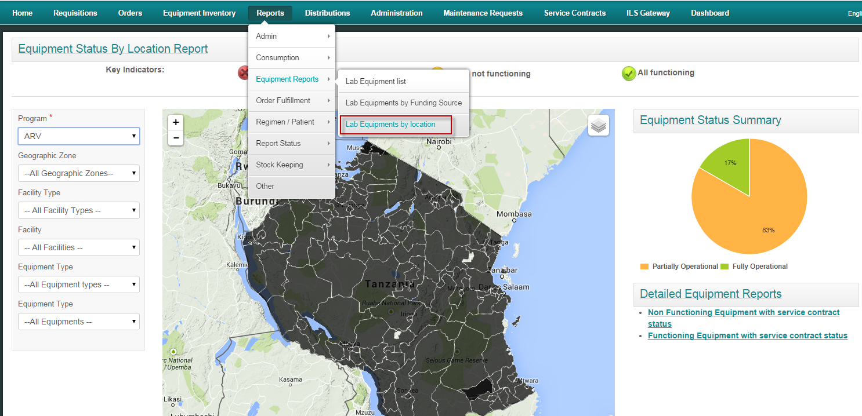
EQUIPMENT STATUS ON THE MAP

Slide 57
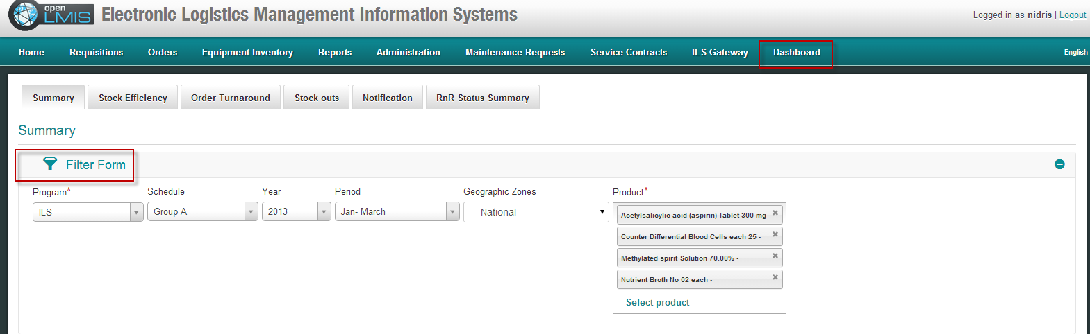
Dashboard Interface – Summary Info by selected filters

Slide 58
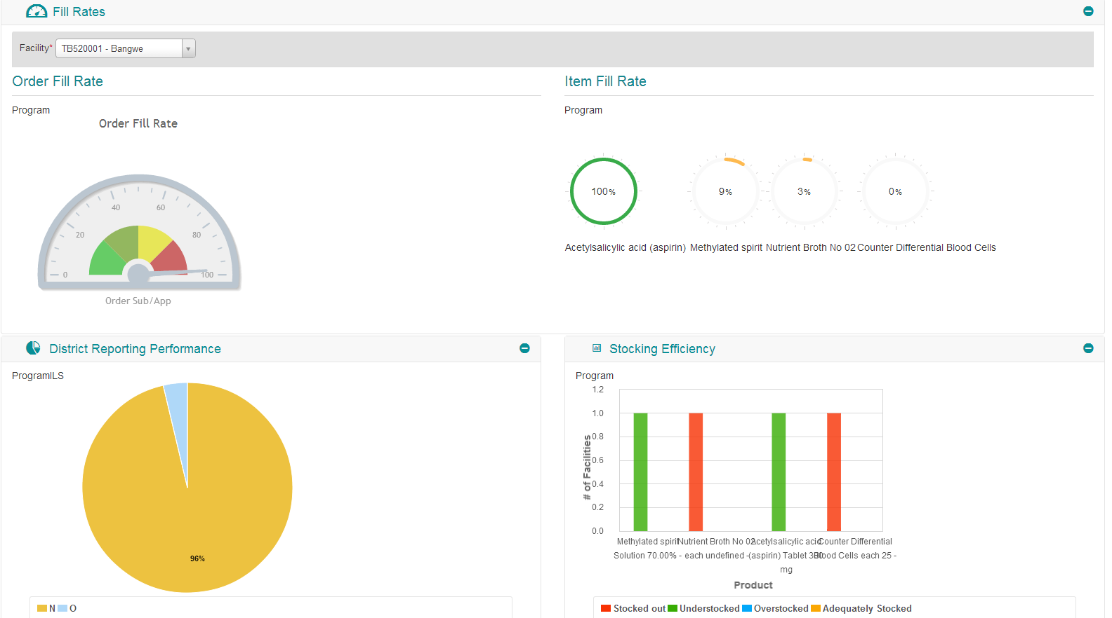
Dashlets with drill down capability

Slide 59
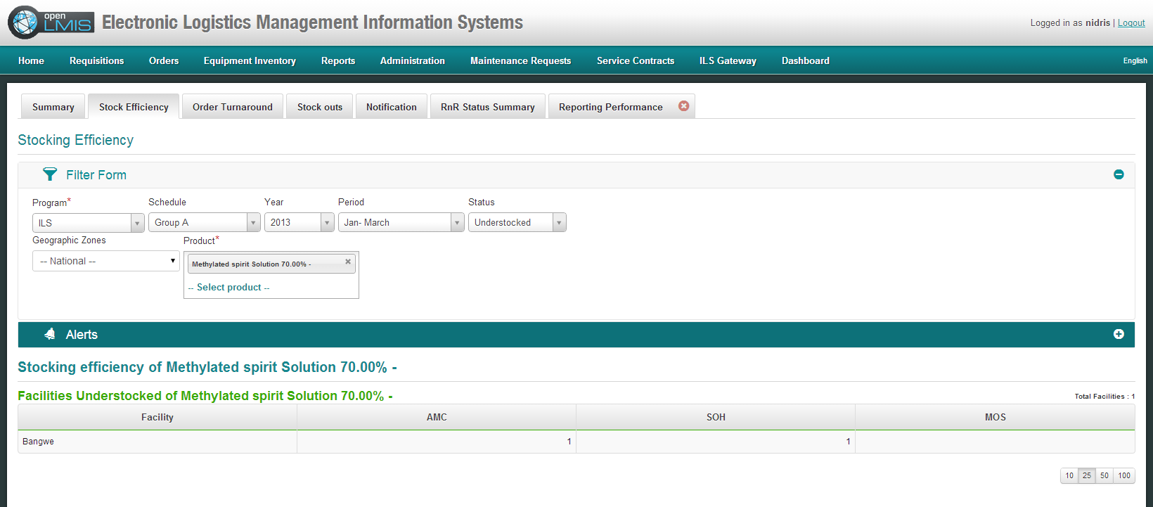
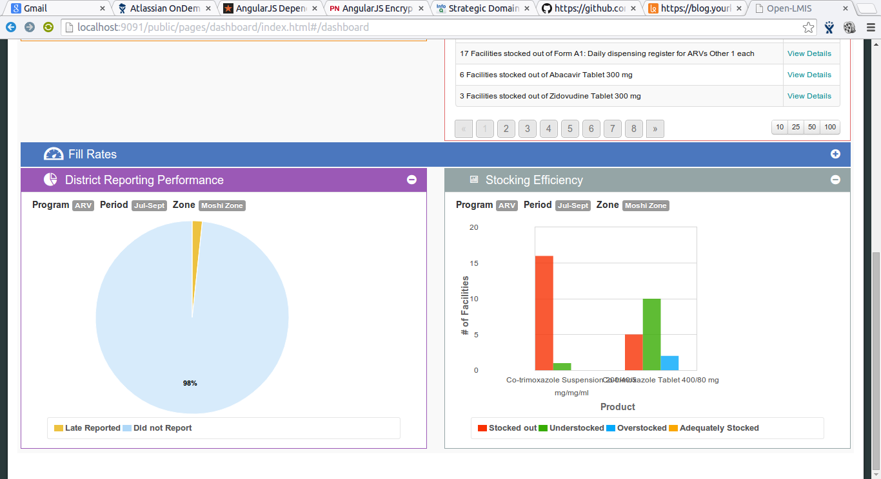
Stocking Efficiency

Slide 60
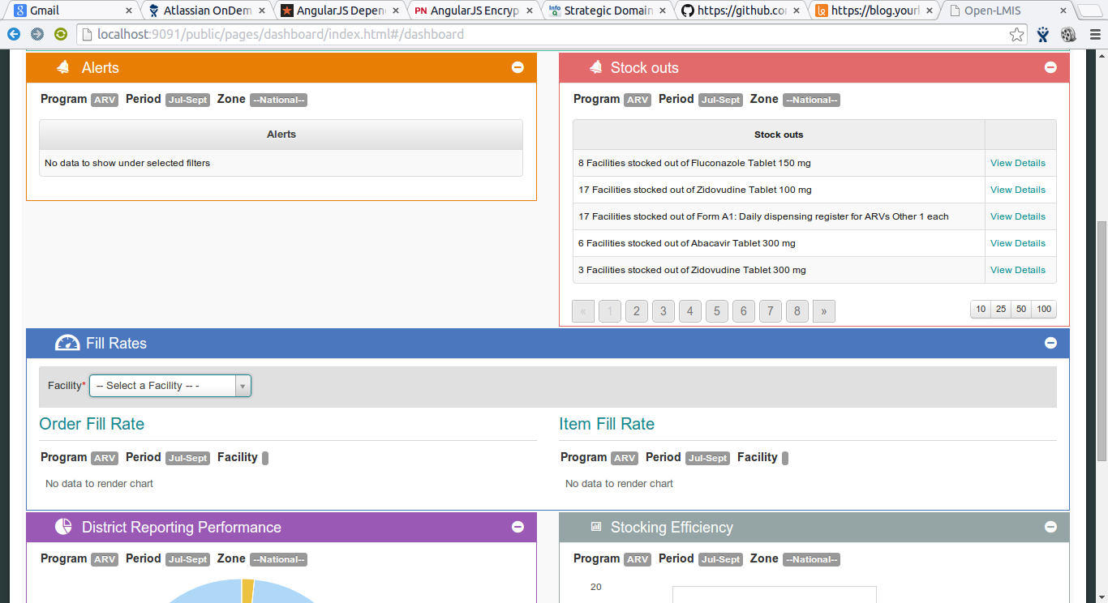
Stocking Efficiency

Slide 61
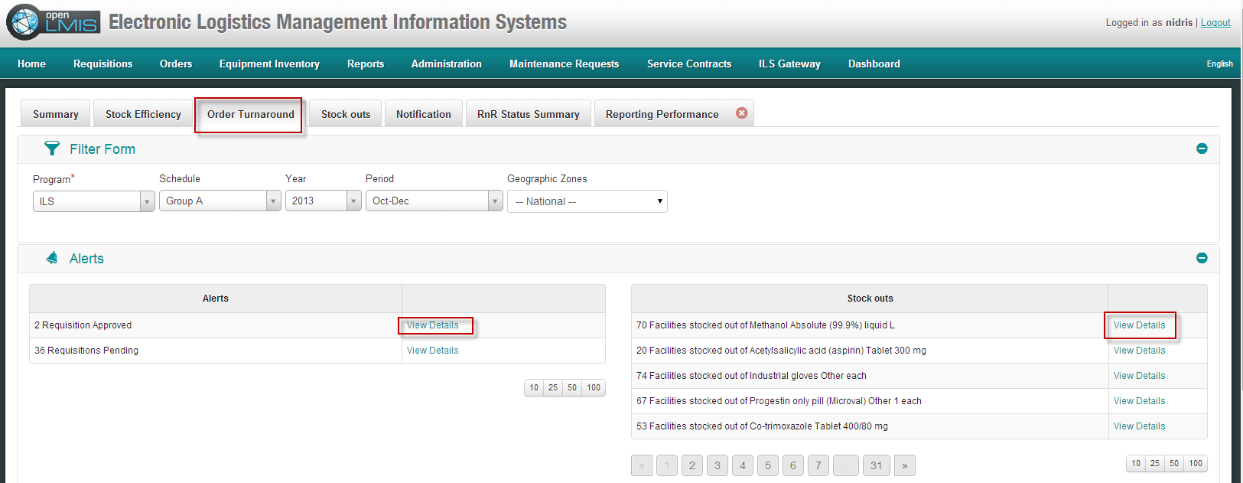
Order Turnaround – alerts with drill down capability

Slide 62
Order Turnaround – Average Lead Time

Slide 63
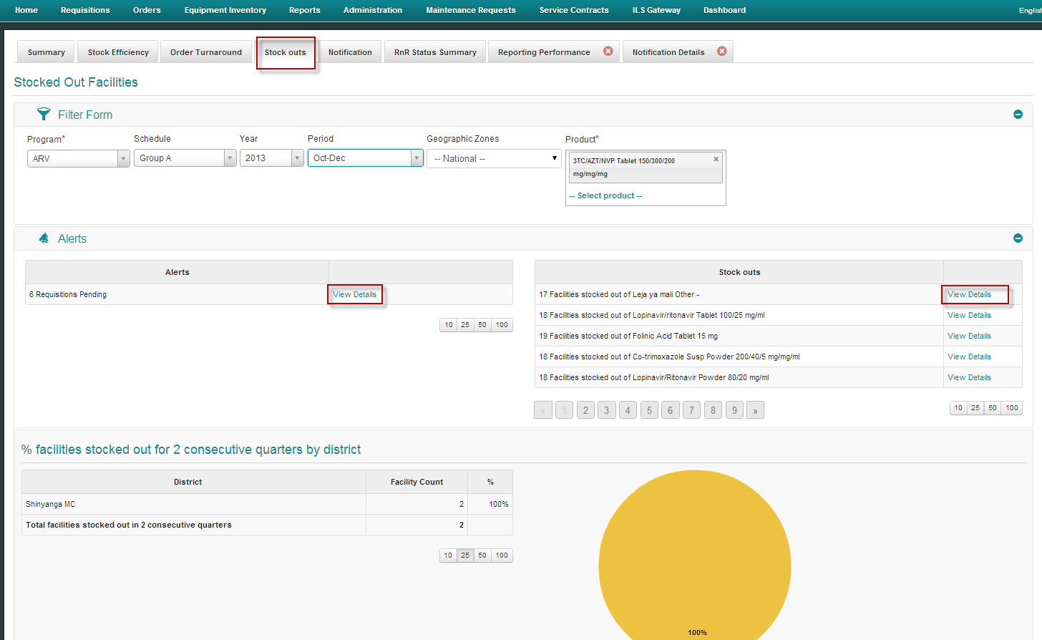
Specific filters to drill down to stock out cases

Slide 64
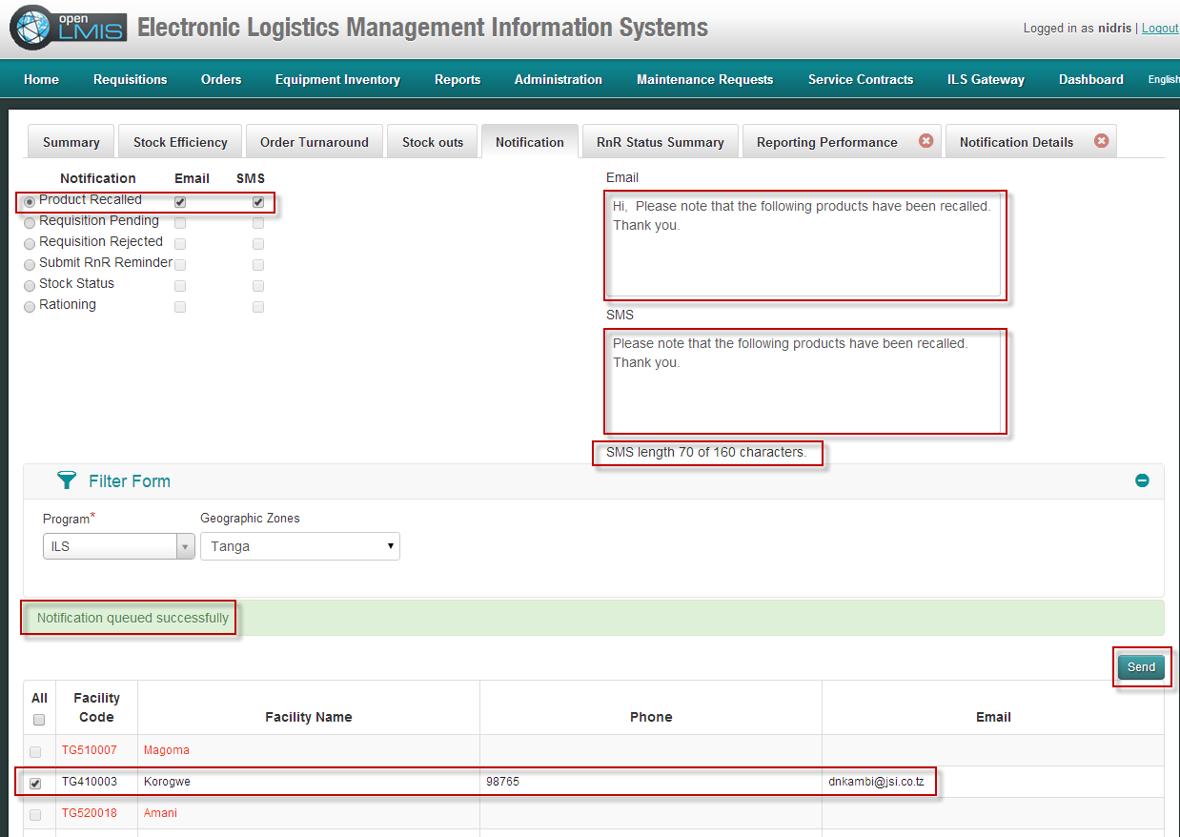
Notification Dashboard with ability to send SMS and Email from the dashboard

Slide 65
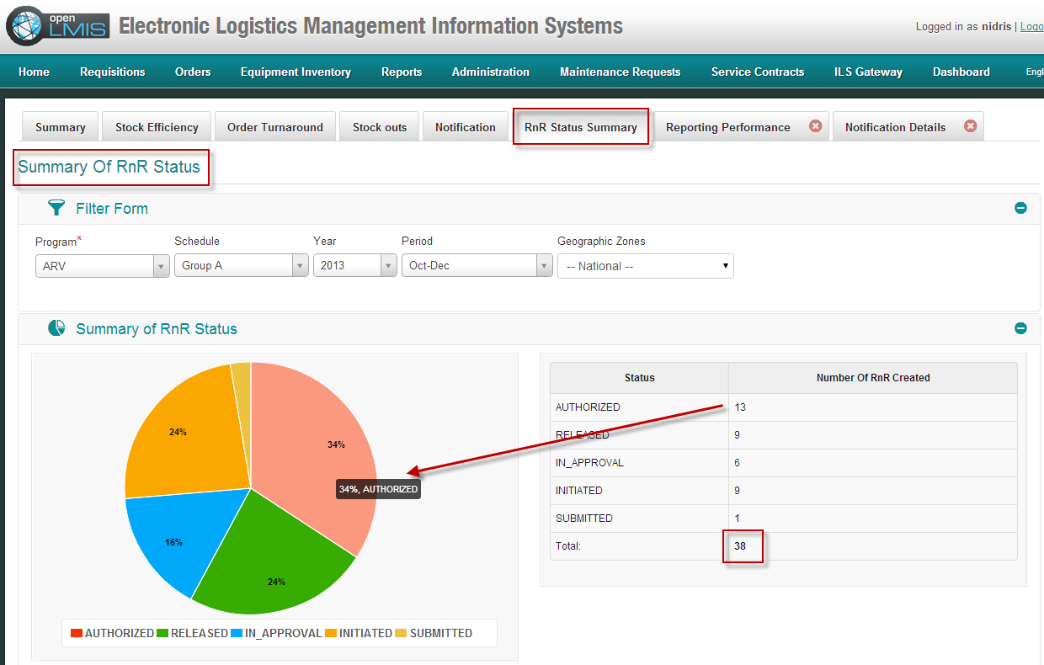
R&R Status Summary

Slide 66
Support structure
Sustaining the system

Slide 67
Support Structure
Level 3
Software developers
Address all issues reported from:
Level 2 support team
Level 2
ICT, MIS
Address all issues reported from:
Level 1 support team
Level 1
SOs, LDAs & 9 SCMAs
Address all issues reported from:
LMU users
Councils users
Facility users

Slide 68
Support and Help Desk
Email:
elmissupport@tz.pfscm.org
elmissupport@moh.go.tz
Call – Toll free:
TBD (On deployment)

