Slide 1
Surveillance work flow system with mobile phones in South Sudan
Peter Wakholi (Phd)
Lecturer, Department of Information Systems, Makerere University
CEO OMNI-Tech Ltd

Slide 2
More than Just Data Collection!
Longitudinal data – Requires updates based on the existing data
Time-dependent data – Requires collection at specified times
Resource dependent data – Requires follow-up action by a specified resource
You can see this in requirements like
Linking of forms
Data from center A to be reviewed by officer B
Data collection after X number of days from previous
View prefilled forms
Etc.

Slide 3
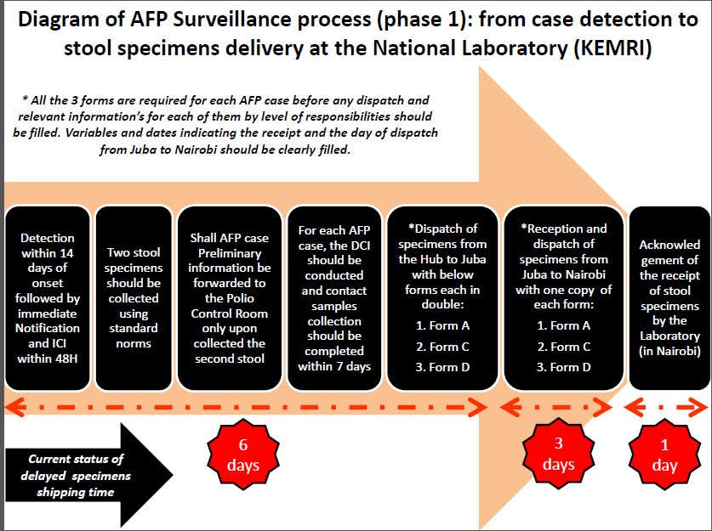
AFP S-sudan Example
The AFP data collection system sought to support the AFP surveillance activities of the WHO South Sudan.
It is a workflow system based on process below.

Slide 4
System Components
The system is composed of the following
The openXdata server which is used for defining forms for data collection and managing the data collected.
Mforms: A mobile client for collection of data based on the form definitions on a mobile phone.
Workflow Engine: For control and management of the data collection process.
SMS Gateway: For sending text messages to participants.
Offline Web Client: A workflow-based client for offline data collection, based on e-collect.

Slide 5
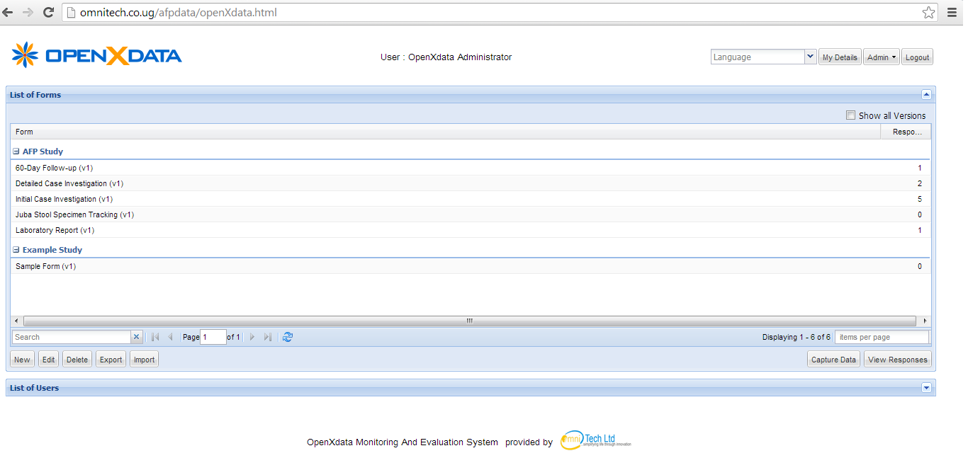
OpenXdata Server
All forms for data collection were created here. You can also view the records that have been submitted on an internet enabled web browser

Slide 6
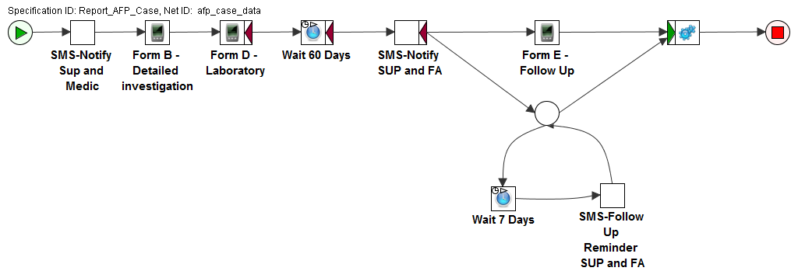
AFP Workflow
The Workflow controls the process that is followed when a new AFP case is reported. Process starts when Form A (initial Investigation) is completed and ends when 60 day follow up is done.

Slide 7
How the system works
A suspect AFP case is reported by a field officer by completing the “Report AFP case” form.
An SMS message is sent to the supervisor notifying him of the report and need to do a detailed case investigation.
The supervisor and medic will have the “detailed investigation” form.
The lab technician also fills the lab form once the specimen has been tested.
Finally, An SMS reminder is sent to the field officer and supervisor after 60 days to do the follow up
All information is kept on the server and is accessible by WHO staff.

Slide 8
Reporting a suspect AFP case
Step 1

Slide 9
The process implemented with forms
Supervisor - Form A
(Payam Level)
Doctor – Form B (District Level)
Lab tech
Form D
(Full program)
Supervisor – Form E (Payam Level)

Slide 10
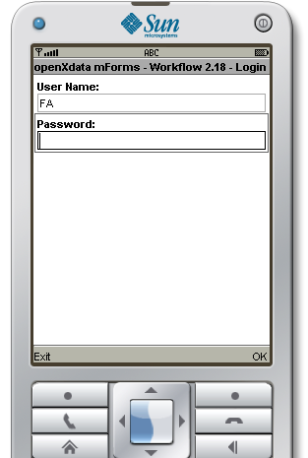
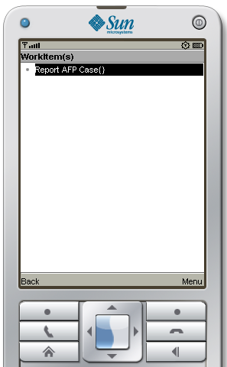
Reporting a case

Slide 11
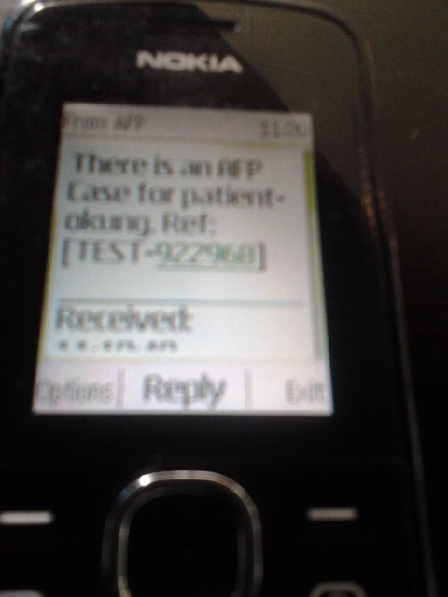
SMS Notification
The field Supervisor gets a notification SMS in order for him to arrange a detailed investigation.

Slide 12
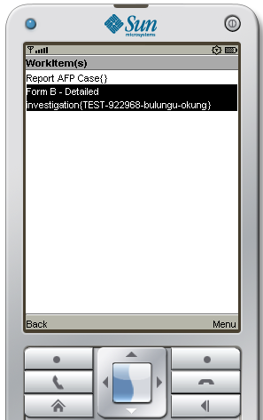
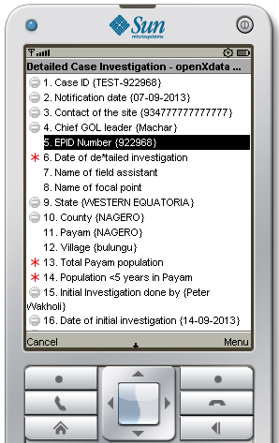
Tasks are downloaded with pre-filled data

Slide 13
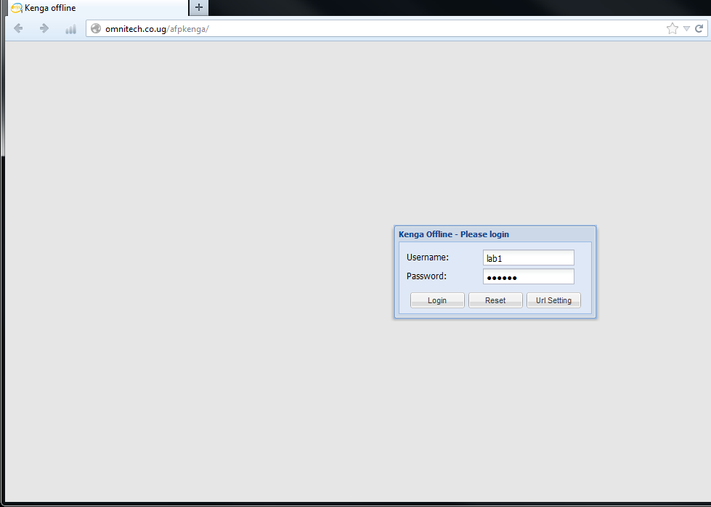
Logging into the web-based system
The lab tech logs into system to fill the results after tests have been done

Slide 14
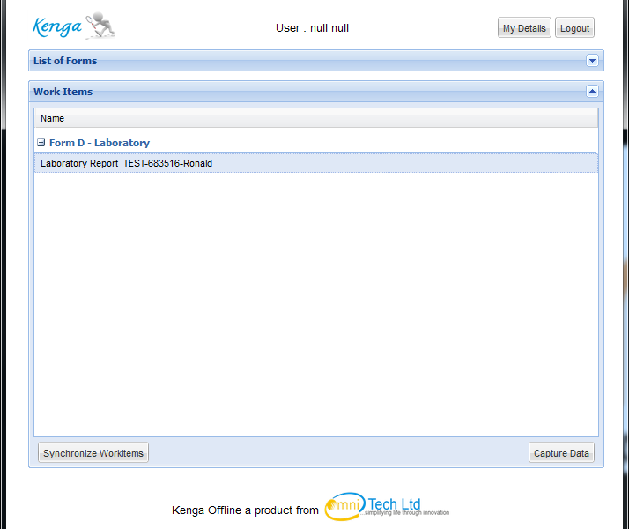
Selecting an item for lab report
The reference (case ID and name) of the case is provided as shown. Select “capture data” to vie the form

Slide 15
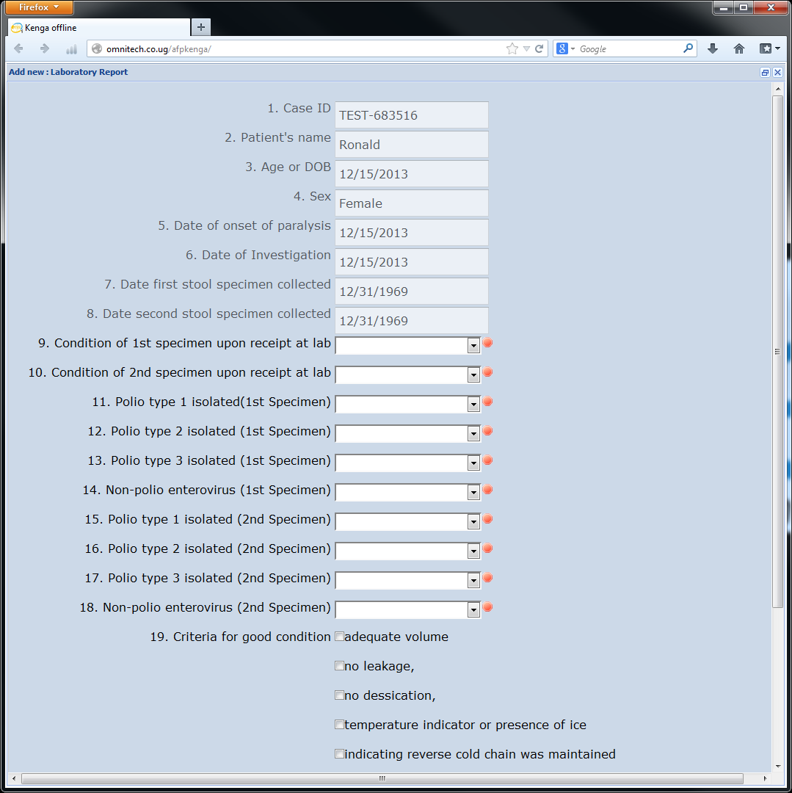
Filling the Laboratory form

Slide 16
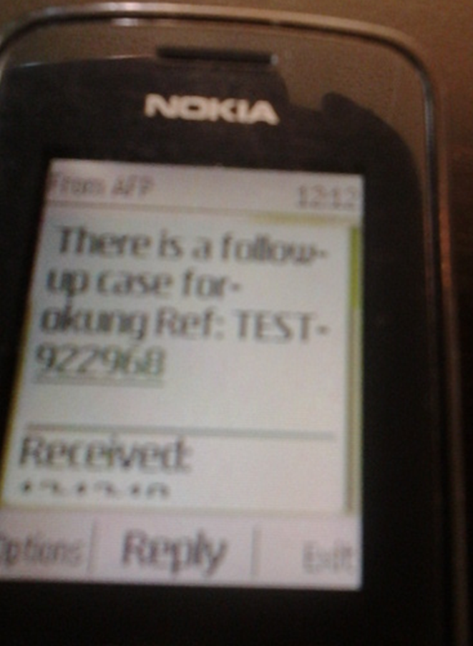
60 day follow up reminders
An SMS reminder is sent to the Field officer and Supervisor to follow –up the case. This is repeated every 7 days until the form is completed.

Slide 17
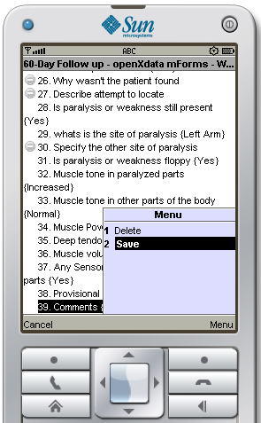
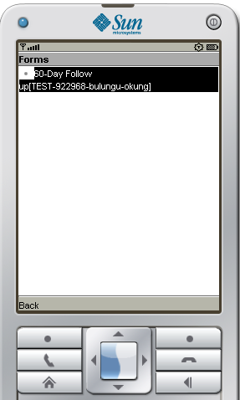
60 Day follow up
The form is only enabled after 60 days. Once it is enabled, an SMS message is sent out. Reminders will only stop when the FA uploads the assessment!

