Slide 1
Mobile-based Immunization Tracking for Community Health Workers in India
Using ICT to Improve Immunization Programmes Istanbul, Turkey
November 11-13, 2014

Slide 2
The Community Health Framework In Rural India And The Need For ICT

Slide 3
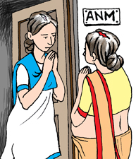
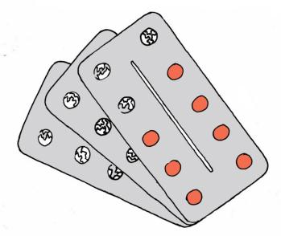
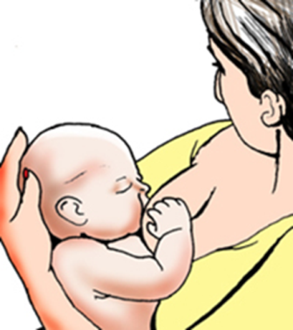
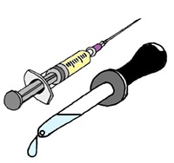
Data collection and case management solution
Java feature phones or Android smartphones & tablets

Slide 4
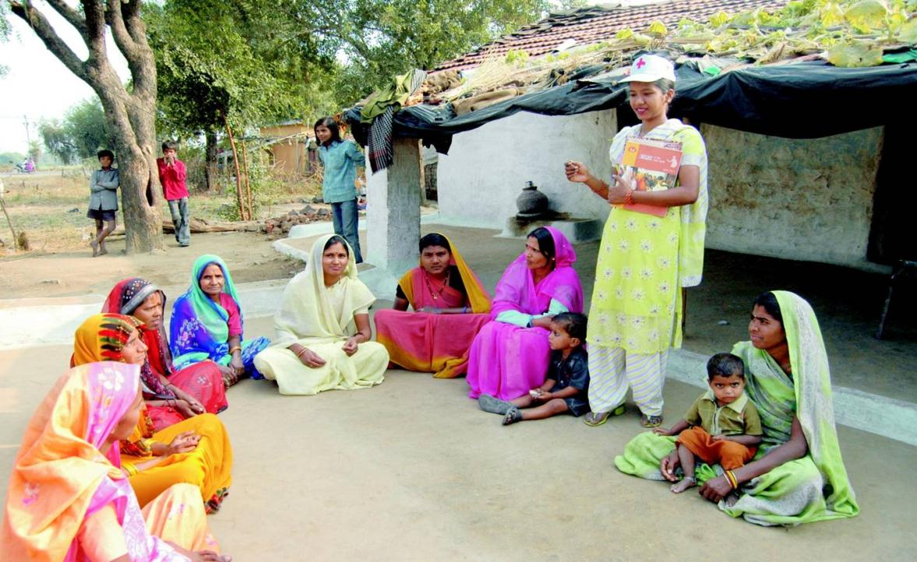

Slide 6
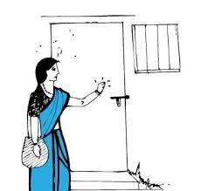
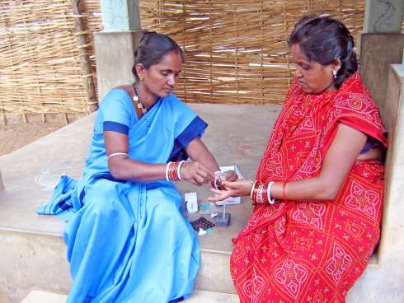
The ASHA Worker
Deputed for conducting home visits to pregnant women and newborns.
Responsible for mobilizing pregnant women and newborns to access key health services including immunizations and ante-natal care check-ups.
Counsels women on birth preparedness, importance of institutional deliveries, contraception, complementary feeding.
Data collection and case management solution
Java feature phones or Android smartphones & tablets

Slide 7
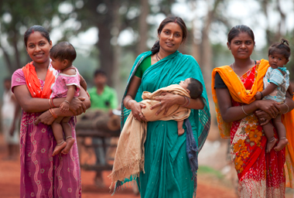
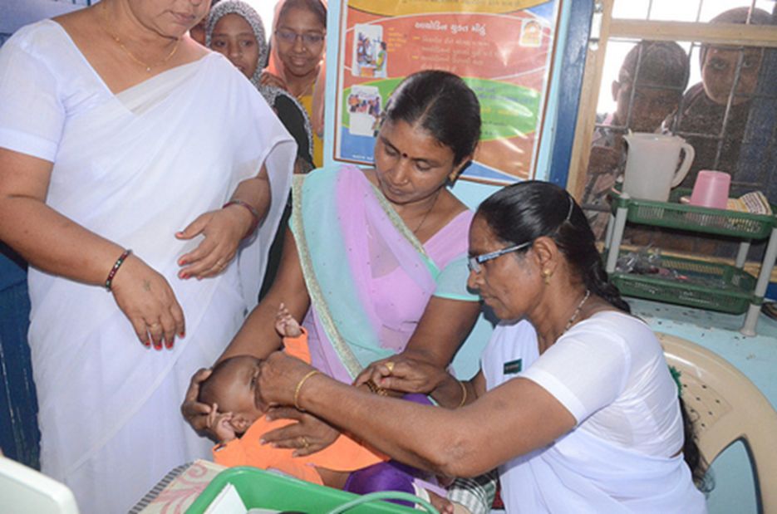
VHSND – Immunization Day
The Village Health, Sanitation and Nutrition Day
Organized once every month at the health center in each village
One of the primary objectives of the VHSND is to get pregnant women and children vaccinated
The ASHAs mobilize women and children to attend the VHSND
They prepare a paper-based “Due List” with the names of women and children due for services such as immunizations on a specific VHSND

Slide 8
?
?
?
?
?
?
?
?
?

Slide 9
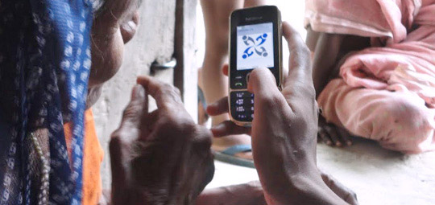
CommCare – A Mobile Tool for CHWs

Slide 10
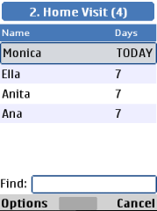
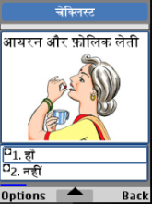
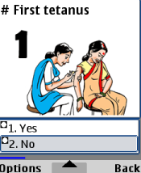
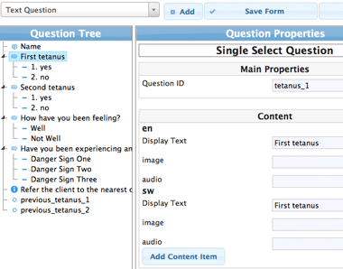
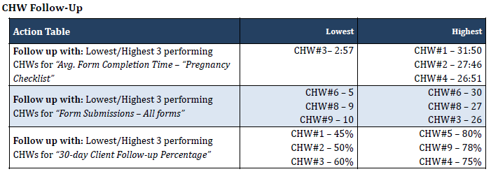
Example: CommCare Workflow
Question
SMS Reminder
Reena is overdue for his follow-up treatment please follow-up with her.
Select Exit
Select Exit
Find Existing Clients
Record Client information
Provide Multimedia counseling and Disseminate information
Follow-up with clients
CommCareHQ
Information System
Build / Modify Application
Manage Your Data and Workforce

Slide 11
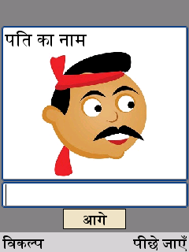
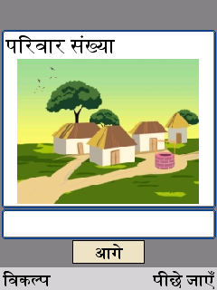
mHealth Applications for Low-Literate Users
Limit text entry, predominantly Yes/No questions
Audio reads each question for low literate users
Images and videos to help describe each question
All text and audio localized
Data collection and case management solution
Java feature phones or Android smartphones & tablets

Slide 12
The Due List

Slide 13
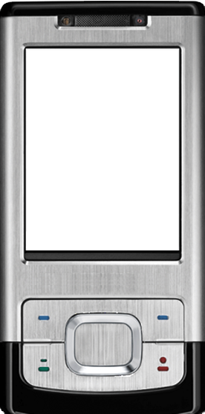
Before VHSND: Client Mobilization
Data collection and case management solution
Java feature phones or Android smartphones & tablets
Date of VHSND
Client List:
Today’s VHSND
Today
Today
Child Mother
Tomorrow
Ram Meena Sampat
In 2 Days
In 3 Days
Rajan Seema Kumari
In 4 Days
Kavi Das Rahima Das
Select Exit
Select Exit

Slide 14
On VHSND: Identify Immunization Due
Client Due for VHSND
11/11/2014
Child: Ram
Child’s Name
Ram
Mother’s Name
Meena Sampat
OPV0
Was DPT 1 administered to Ram?
Yes
DPT1
□ 1. Yes
□ 2. No
No
Ok Back
Options Back

Slide 15
On VHSND: Record Immunization Provided
Child: Ram
Was the DPT 1 administered to Ram?
1. Yes
□ 2. No
Options Back

Slide 16
After VHSND: Access Immunization History
Child: Ram
Child’s Name
Ram
DPT 1
Yes
DPT 1 - Date
11/11/2014
Measles 1
Yes
Ok Back

Slide 17
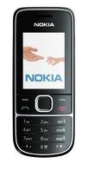
CommCare and MOTECH Setup For Due List Workflow
Client is visited by FLW
FLW registers beneficiary on the mobile app and records key case information including LMP Date. Application uses this to calculate EDD
Data submitted to CommCareHQ server
Data shared with MOTECH scheduling engine.
MOTECH uses EDD to create a case for each immunization that the client is due for. Each such case has a start date and an expiry date
Task cases are sent to the FLW’s phone where they appear in the Due List.
Task cases are passed back to CommCareHQ

Slide 18
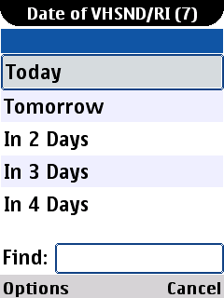
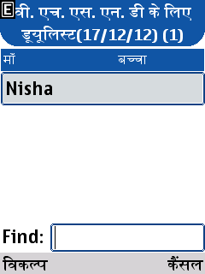
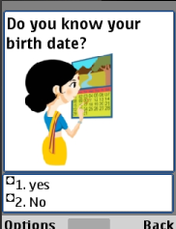
The Due List: Summary
Provides an updated list for each FLW of who to mobilize for immunizations
Shows what type of care is due at the health clinic (type of immunization, ANC, etc.)
Allows FLW to quickly punch in data at the clinic and update patient records.
Electronic immunization records are available on the web for supervisors to assess the efficacy of their programmes
Clients due for VHSND (17/12/12) (1)
Client due for VHSND (17/12/12)
Received TT #1?
Name Children
Name of Client
Nisha
ANC #1
ANC #1
TT #1

Slide 19
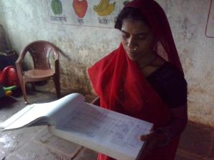
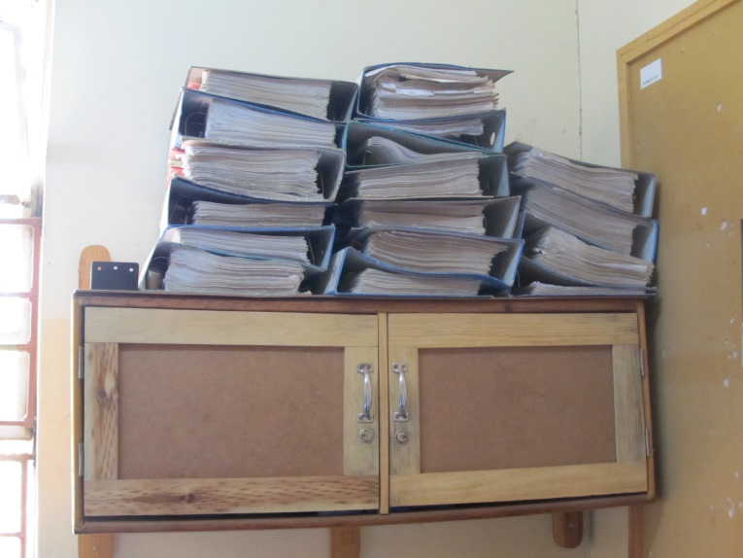
In the Pipeline: Integration with the Government’s MCH Database
The MCTS (Mother and Child Tracking System) in India is the database that houses the records of pregnant women and newborns
Currently, data is fed into the system manually
The ANM (ASHA’s supervisor) makes note of the immunizations given to a mother or child on VHSND
Paper records are sent to a district-level data entry operator who feeds it into the system

Slide 20
In the Pipeline: Integration with the Government’s MCH Database
MCTS
MOTECH server
CommCare:
ASHA’s Phone
CommCare HQ
server
CommCare:
ANM (Supervisor’s) Phone for Approval
Client’s Immunization Records

Slide 21
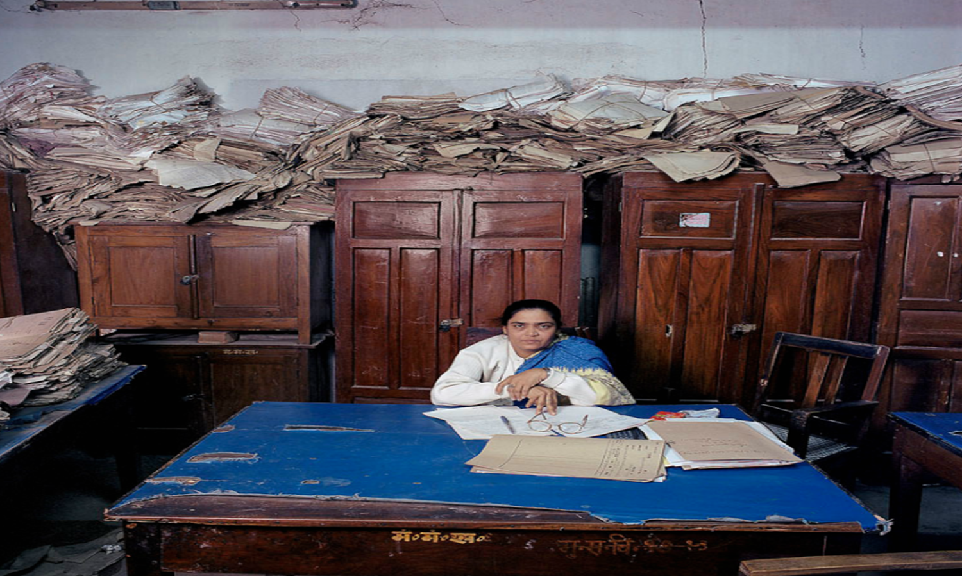
Notes:
No more paper immunization records!

Slide 22
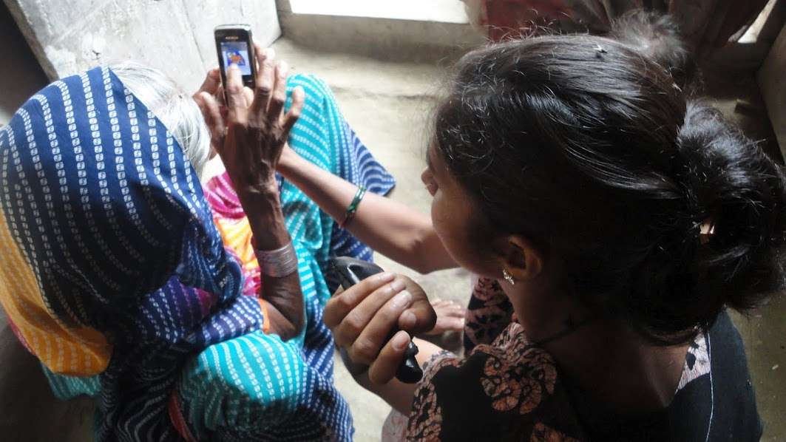
“Before if we met a woman on the road, I would talk to her for a couple of minutes and consider that as part of my quota or work. Now I sit down and go through each point. Nothing gets missed.”
- ASHA in Kaushambi, India

Slide 24
Thank you!
Dimagi's mission is to integrate innovative technology into global public and private services in order to improve human health and wellbeing.
We seek collaborations and partners that emphasize local ownership and open access to the systems and technologies that we support.
Contact: Rishad Gambhir (rgambhir@dimagi.com)
Jonathan Jackson (jjackson@dimagi.com)
Neal Lesh (nlesh@dimagi.com)
Additional Resources:
http://www.commcarehq.org
http://www.dimagi.com
http://youtu.be/QTjs61L5l2Q

