Slide 1
Use of GIS Tools in Planning
Mona Lacoul( lacoulm@who.int)
World Health Organization
Country Office for Nepal

Slide 2
National Immunization Programme
Through Expanded Programme on Immunization - started immunization activities
    3 districts in 1979 to all 75 district by 1997
With the goal : “reduce child mortality, morbidity and disability associated with vaccine preventable diseases”
clear directives on strategies and key activates on coverage monitoring, case reporting, case investigations, surveillance standard, access to quality vaccine and waste management etc.
Comprehensive Multi Year Plan/s

Slide 3
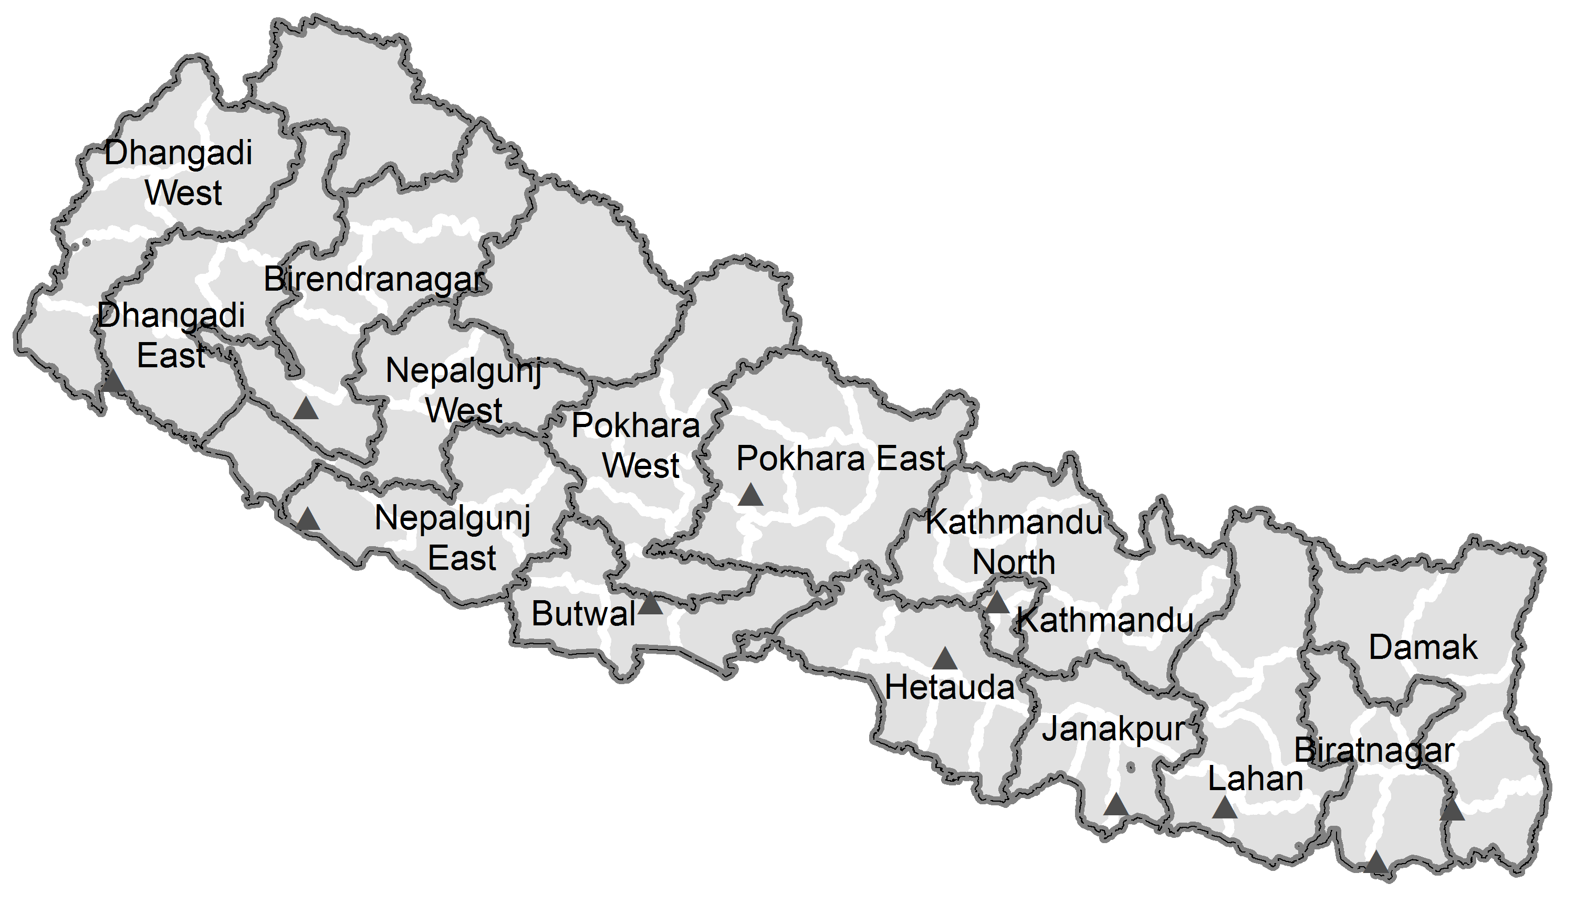
IPD/WHO
WHO IPD programme
- establishment in 1998
- technical support to the NIP/DoHS/MoHP), in strengthening surveillance and routine immunization

Slide 4
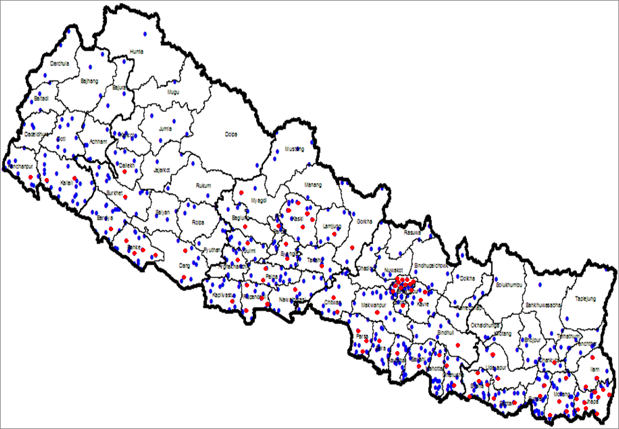
IPD/WHO: Surveillance sites
Note: the sites are health facility run by government or private run hospitals.

Slide 5
Data availability
IPD surveillance system - case based data
Immunization information is available in DHoS/CHD/NIP (government system)
A large volume of GIS data captured during various health infrastructure surveys and mapping activities initiated by WHO country office, Nepal.
evaluate programme performance against key activities set by NIP and provide feedback at district level (ie, to bring data from different source to single platform to make the data/information available to all level for timely use of data to solve the issues)

Slide 6
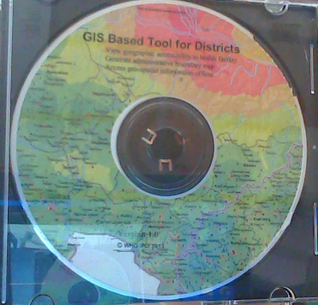
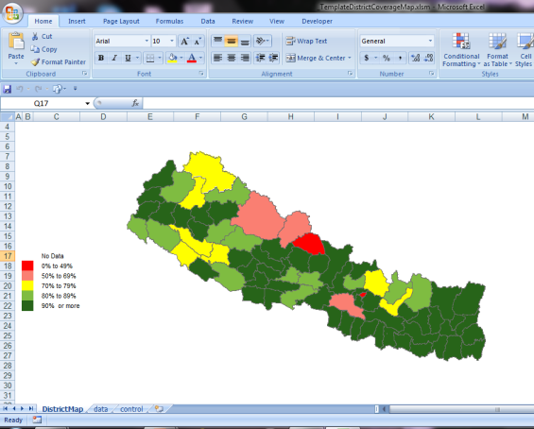
GIS based tools/target group
Vaccine preventable disease mapping system
GIS based tool for districts
Coverage mapping tool (Excel)
IPD SMO network
DPHO/DHO
EPI supervisor
Statistical officer

Slide 7
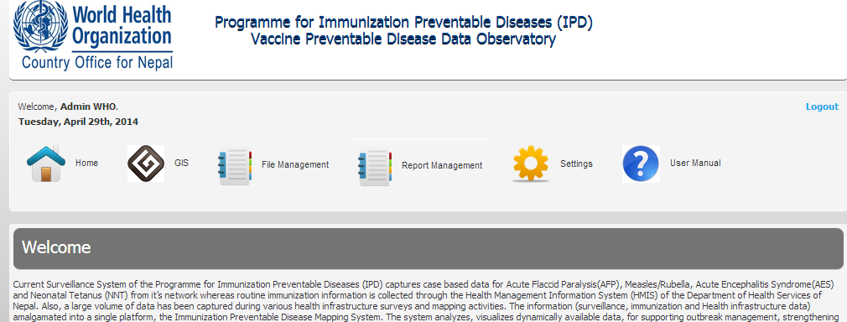
Vaccine preventable disease mapping system
An web based system with open source technologies
  Data Input:
  Visualization: Diseases data aggregation by Region/district/VDC over yearly/monthly time frames; Mapping with geo-analysis tools such as identification, distance, proximity analysis, time-slider; buffer, Graphs and table generation
  Report generation:
  Access:

Slide 8
Vaccine preventable disease mapping system
System architecture

Slide 9
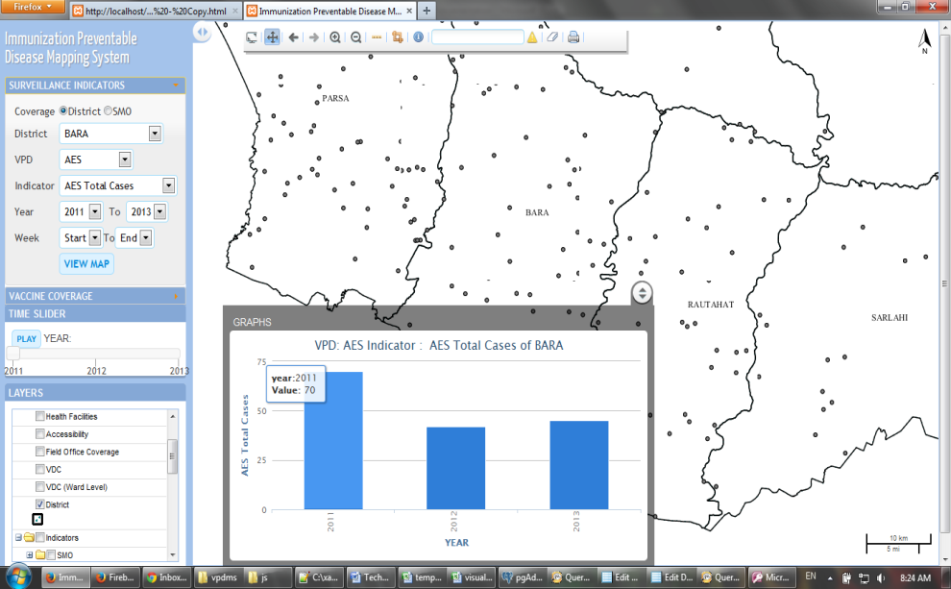
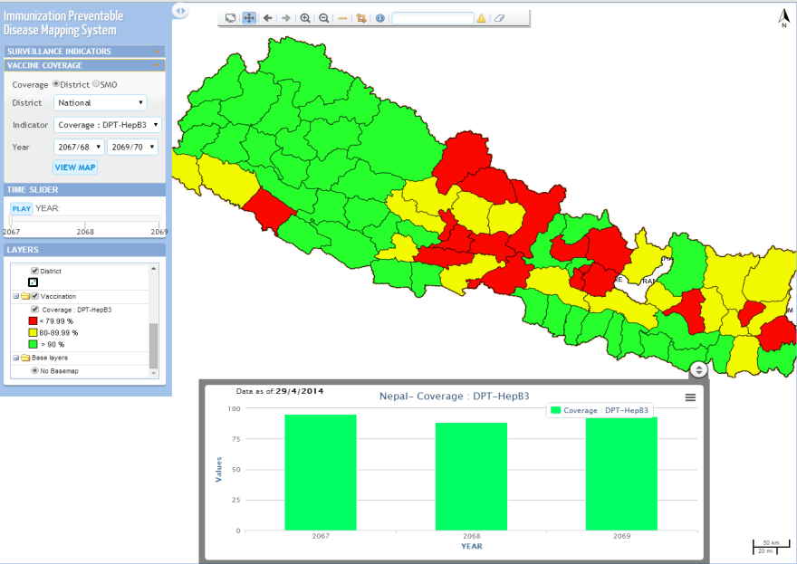
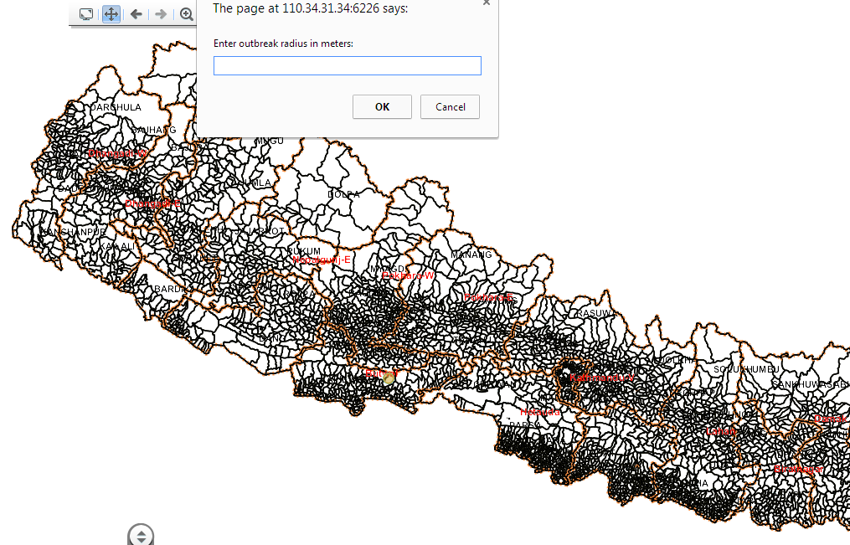
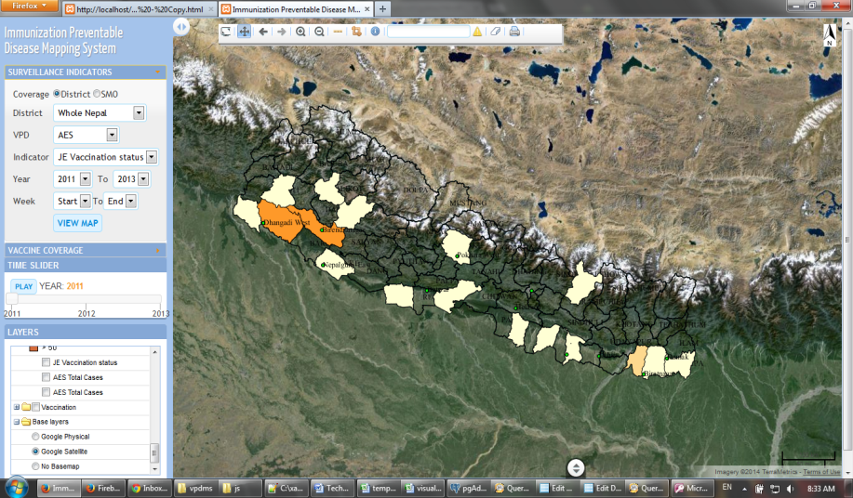
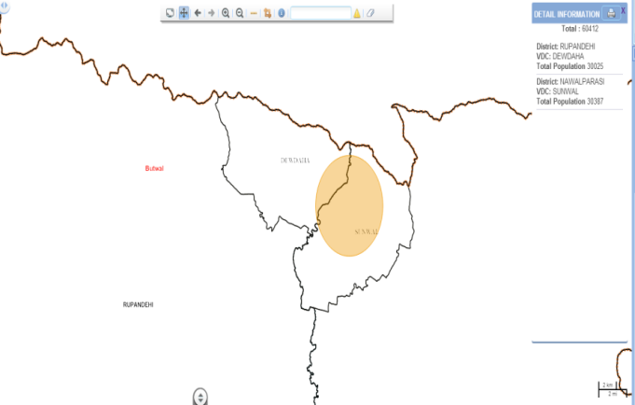
Vaccine preventable disease mapping system

Slide 10
Vaccine preventable disease mapping system
About the system
  3 months to build the system
  About 8000 US$
  SMO network and IPD Center Office to evaluate performance indicators for surveillance and immunization strenthening
  To regular briefing at RHD and DPHO/DHO
Challenges
  Use of data for reporting purpose
  Internet connectivity
Next
  Add VDC level information
  To be able to compare reports obtain form HMIS (specially, on surveillance side)

Slide 11
GIS based Tool for districts
Microplanning for immunization service delivery at health facility level requires an operational map
  designed for a non-GIS person
  contains all the necessary components/explanation
  no additional data/software required
  no need of internet connection
  Map file format (geopdf file)
  easily shared as an email attachment

Slide 12
GIS Based Tool for Districts:
GIS:
administrative boundaries(district, VDC, ward)
river and road network
Settlement
Health facility
Immunization booth location/session information
Remotely sensed data:
SRTM elevation
ESRI World Imagery (districts wo accessibility)
Derived data:
Accessibility

Slide 13
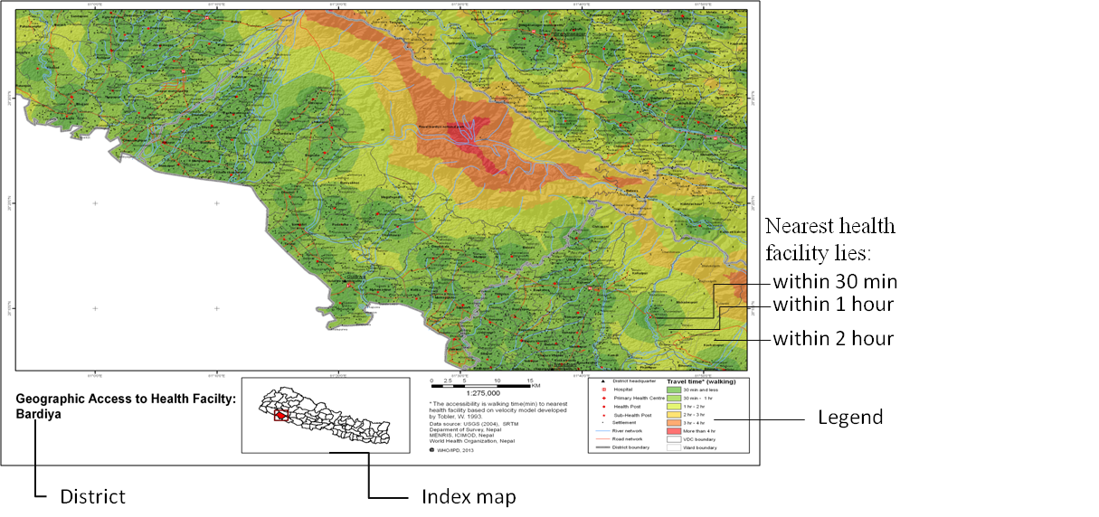
GIS Based Tool for Districts: View geographic accessibility to health facility
Notes:
Geographic accessibility (ie, walking time) is displayed at 6 intervals (30min, 1hr, 2hr and so on) in different colours (dark green, green, yellow and so on) in a map form. A sample map is attached in this document for reference. The travel time from the health facility to settlements are shown in gradient from colours (green to red). The darker the red, travel time is greater between the two. For example, the dark green area can be reached within 30 min walking time from the health facility situated at the center of the area. Similarly, the light green area can be reached within one hour walking from the facility. The red area is the most inaccessible. Such areas can be reached only after walking four hours or more from any facility in the surroundings

Slide 14
GIS Based Tool for Districts: View ward level immunization session information
Notes:
. Districts can visualize accessibility with existing booth location and session detail, which facilitates in micro-planning activity.
Plan for a suitable site for a session supervison visit.

Slide 15
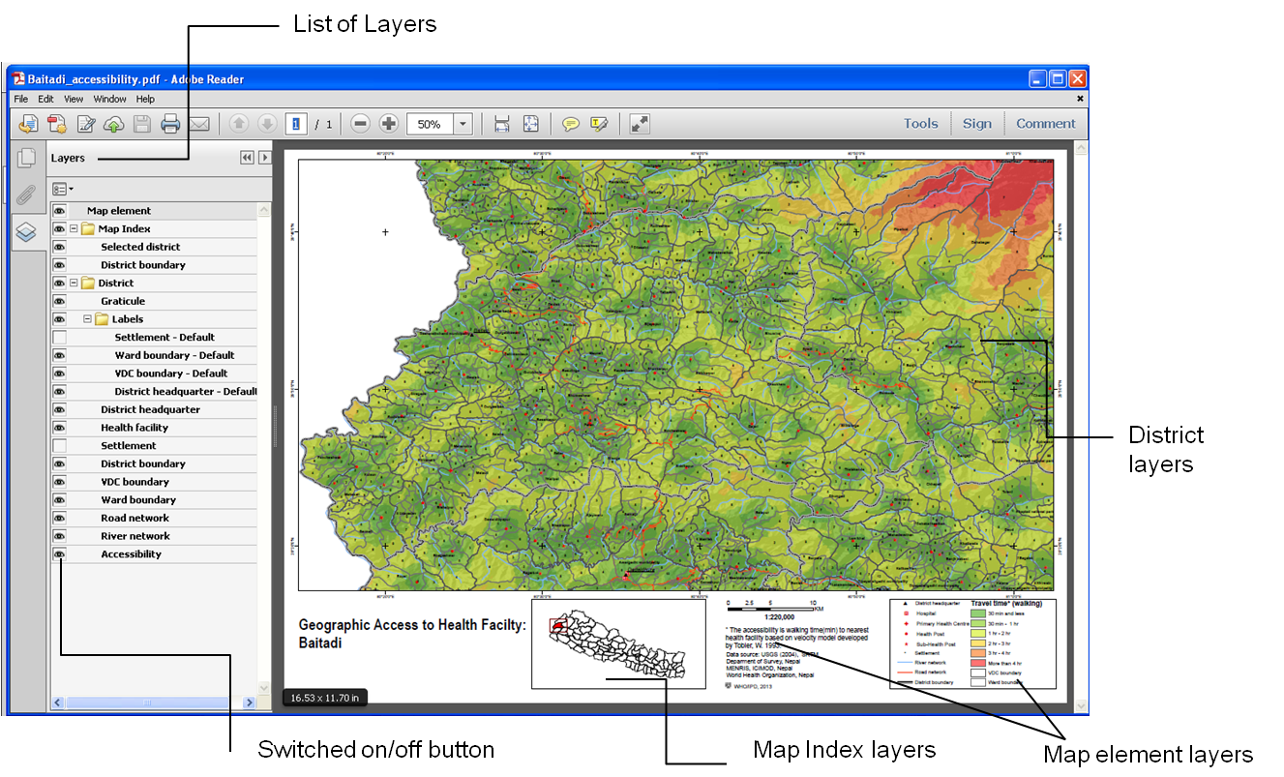
GIS Based Tool for Districts: Generate administrative boundary maps

Slide 16
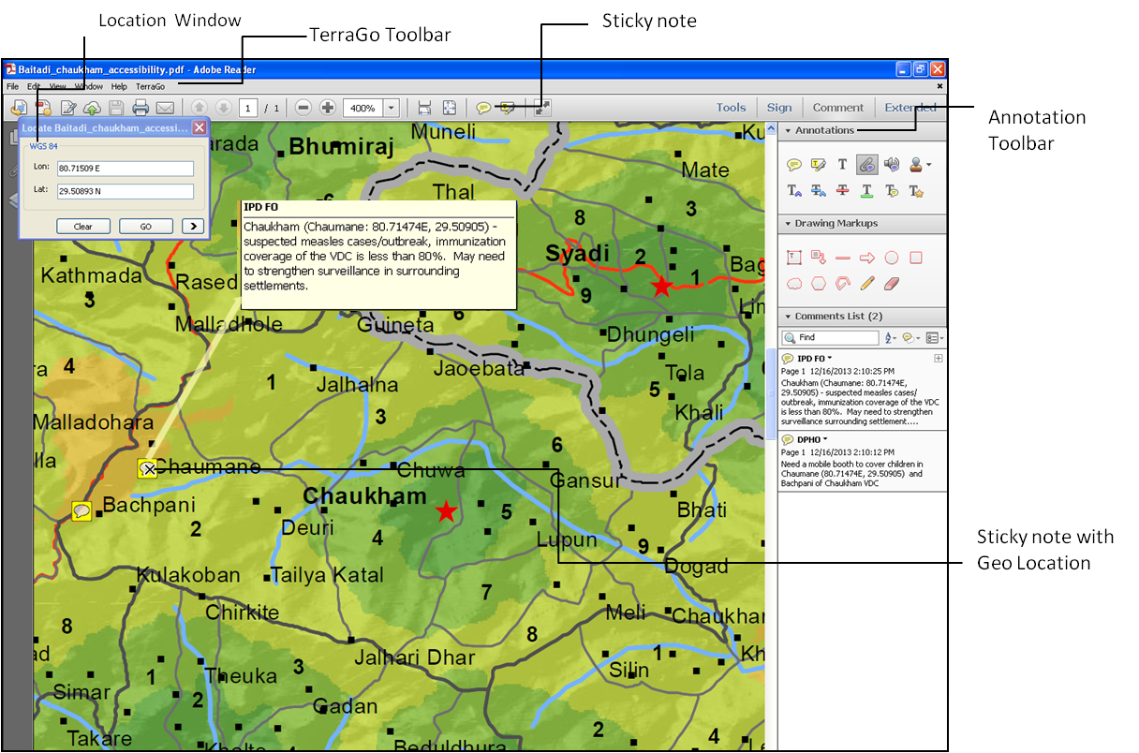
GIS Based Tool for Districts: Access geospatial information offline

Slide 17
Coverage mapping tool (Excel)
Designed for EPI supervisor and statistical officer
Customizable
No additional GIS software/training required

Slide 18
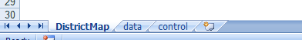
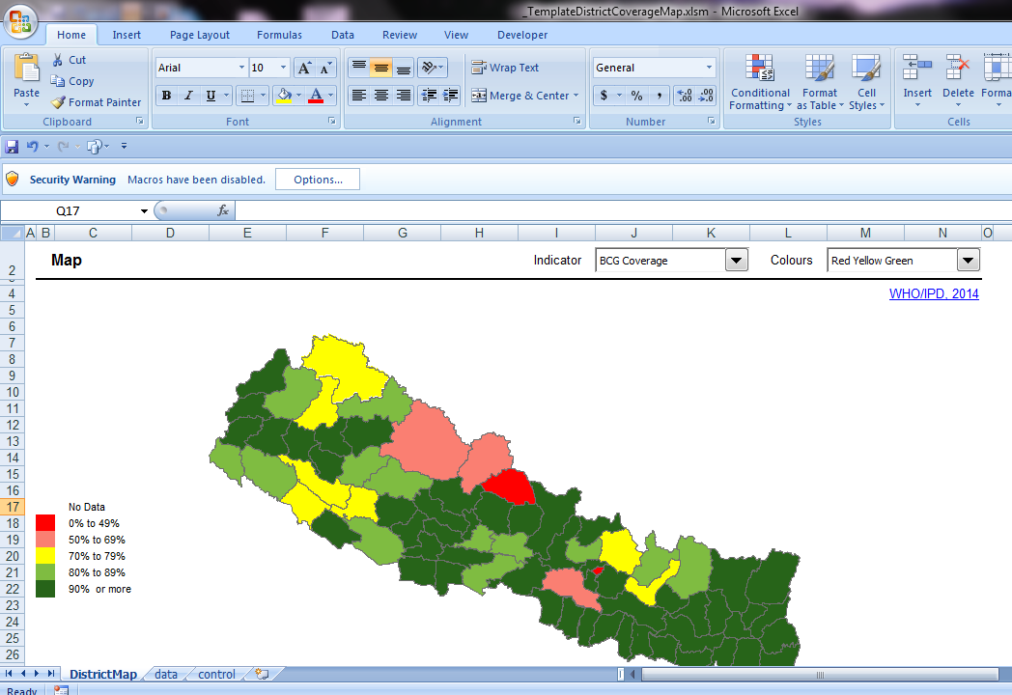
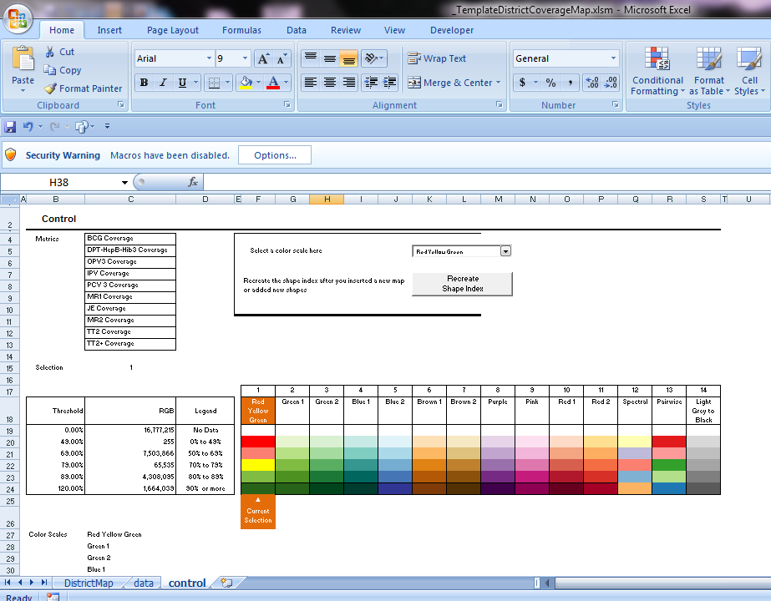
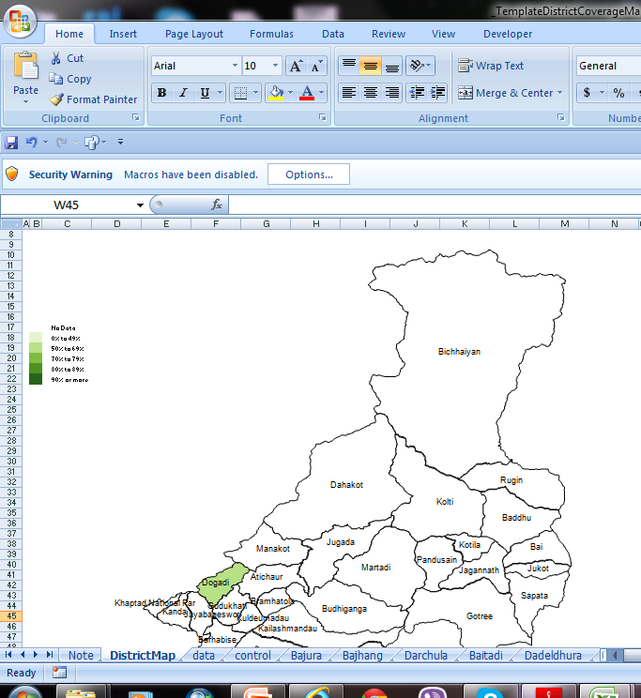
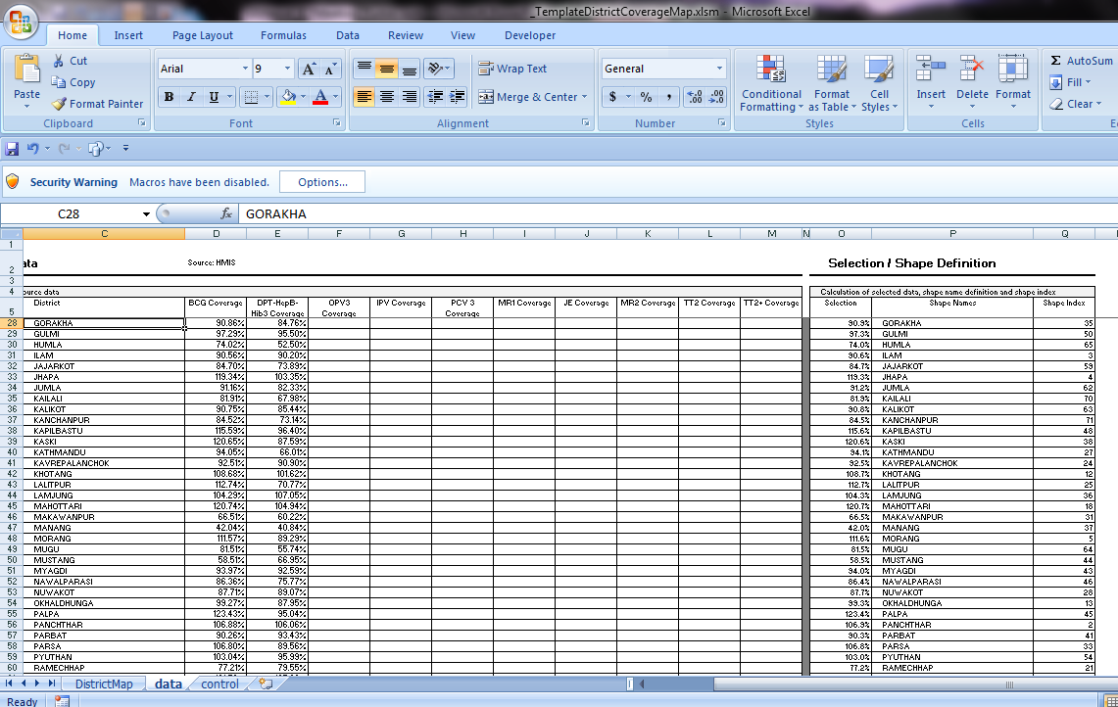
Coverage mapping tool (Excel)

Slide 19
Before designing a GIS based tool
  In-depth assessment of
    Trend of use of data
    Target group - District/national level/below district
    Synergy between data users and data providers
    Technical capacity of human resource
    Computer /wifi connectivity….

Slide 20
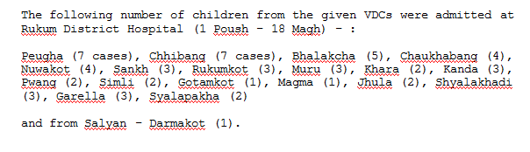
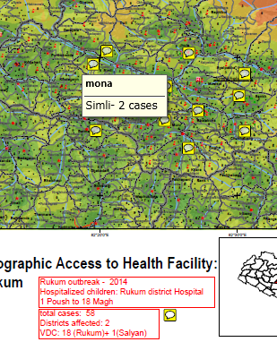
Rukum district diarrheal outbreak report

Slide 21
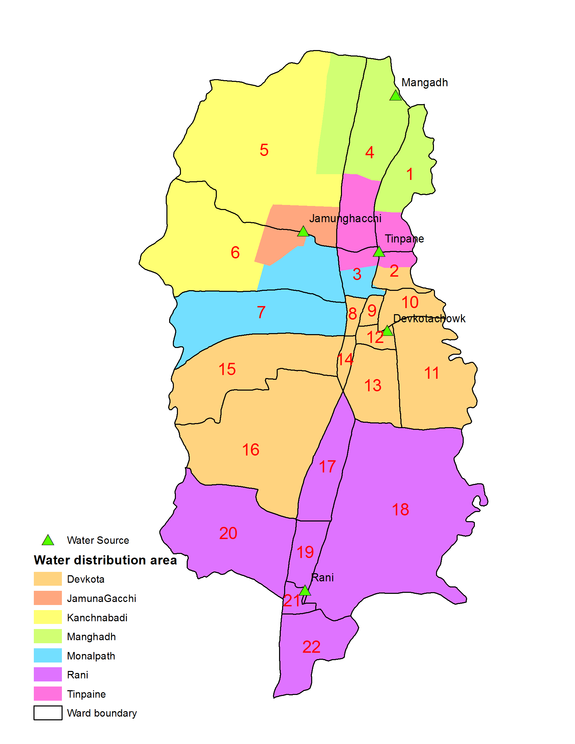
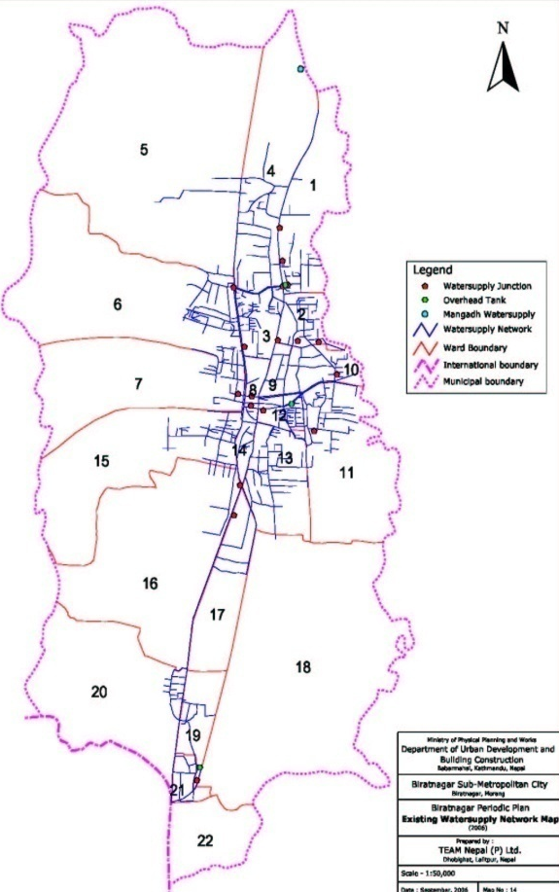
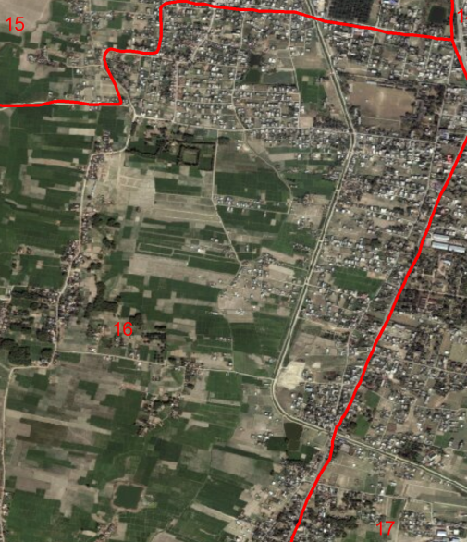
AJS Outbreak in Biratnagar
Spatial analysis

