Slide 1
Data standards for Cold chain equipment inventories
Richard Anderson
11 November 2014
Photo credit: PATH

Slide 2
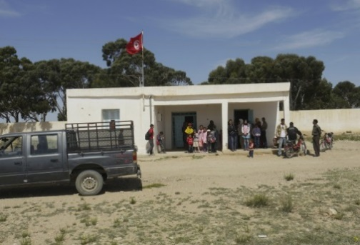
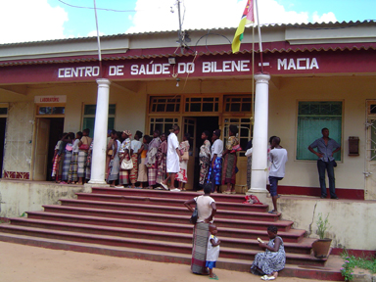
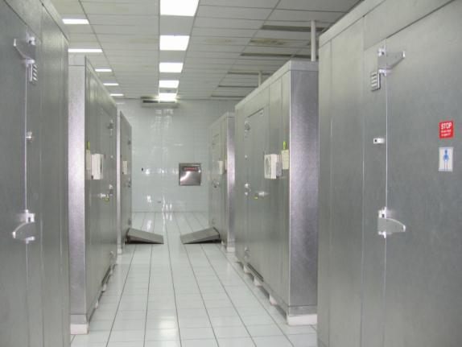
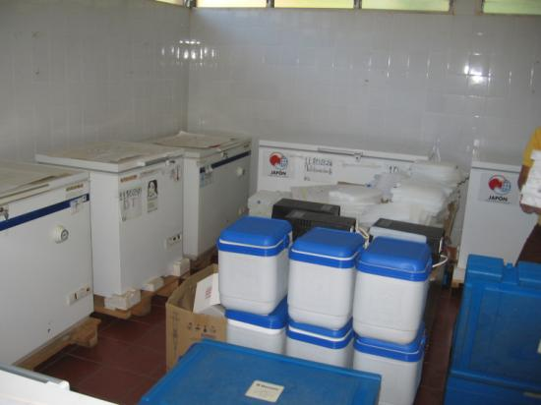
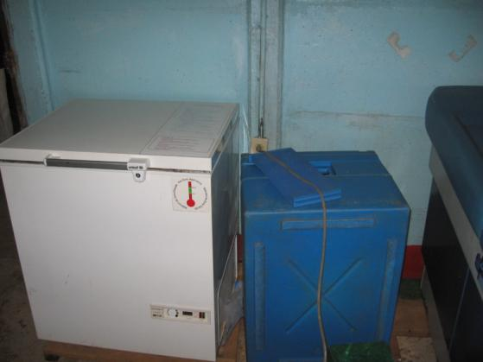
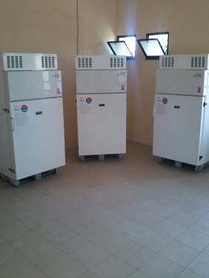
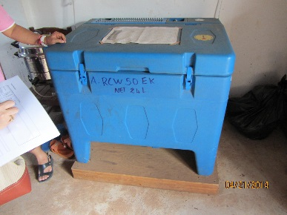
What is a Cold Chain Equipment Inventory (CCEI)?
Health facility data
Refrigerators, freezers, cold room, cold box data
Vaccine and equipment reference data

Slide 3
How can CCEI data be used?
Equipment management
Which facilities in my district have RCW42 EK refrigerators?
Equipment allocation
How do I distribute 50 new ILRs to the districts in my province?
Equipment maintenance
Where should I send my technician to conduct preventative maintenance on refrigerators?
Cold chain assessment
Does the country have adequate cold chain capacity to accommodate the introduction of Rotavirus vaccine in 2016?
Need quantification
How many refrigerators need to be purchased to replace equipment over 15 years old?
Supply chain re-engineering
What are the implication of shifting all regional vaccine stores to the zonal level?
Market shaping
What is the global demand for 15L cold storage devices at health facilities with no access to grid power?

Slide 4
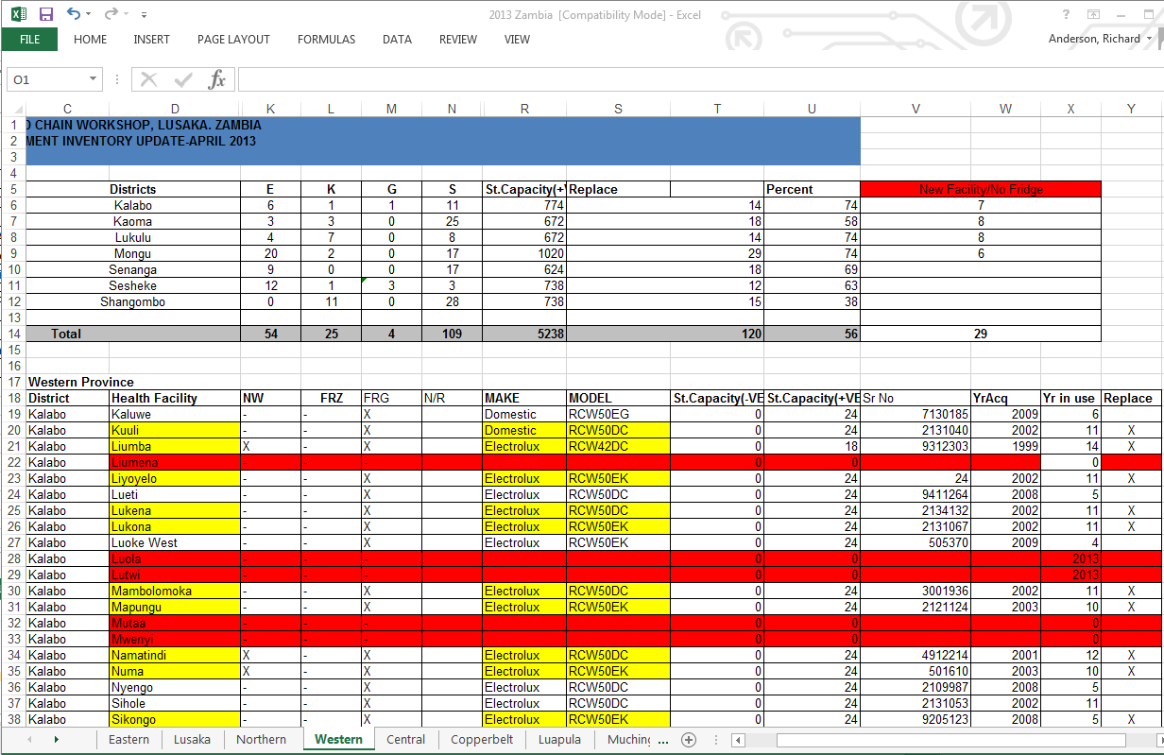
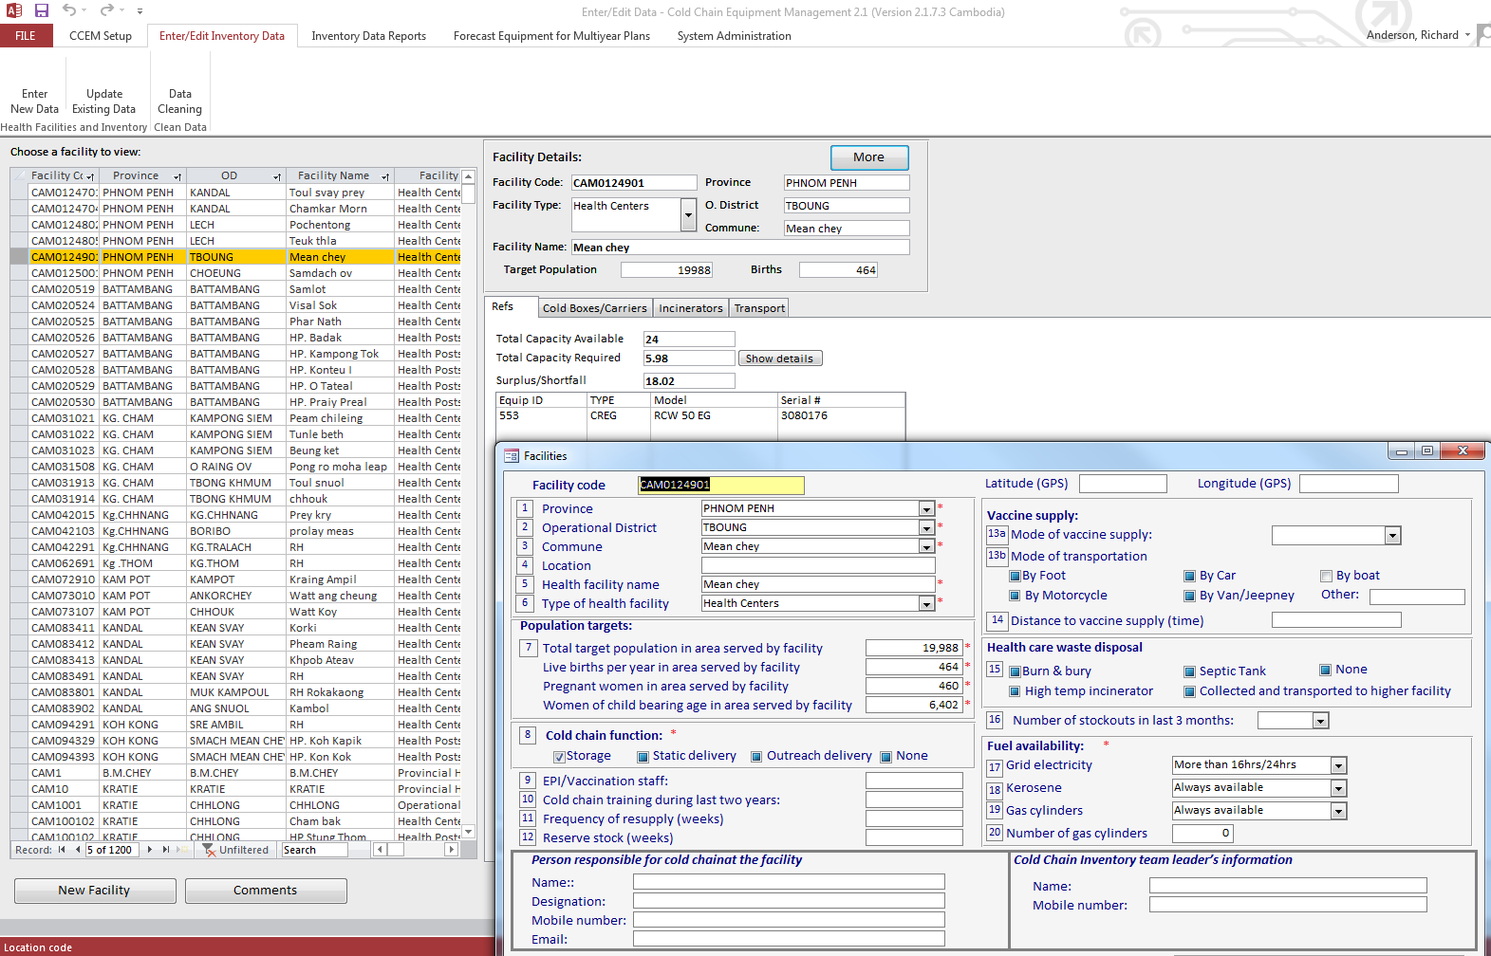
Architectures for CCEI
Unstructured spreadsheets
Structured spreadsheet tools
Stand alone PC applications
Web-based with database backend

Slide 5
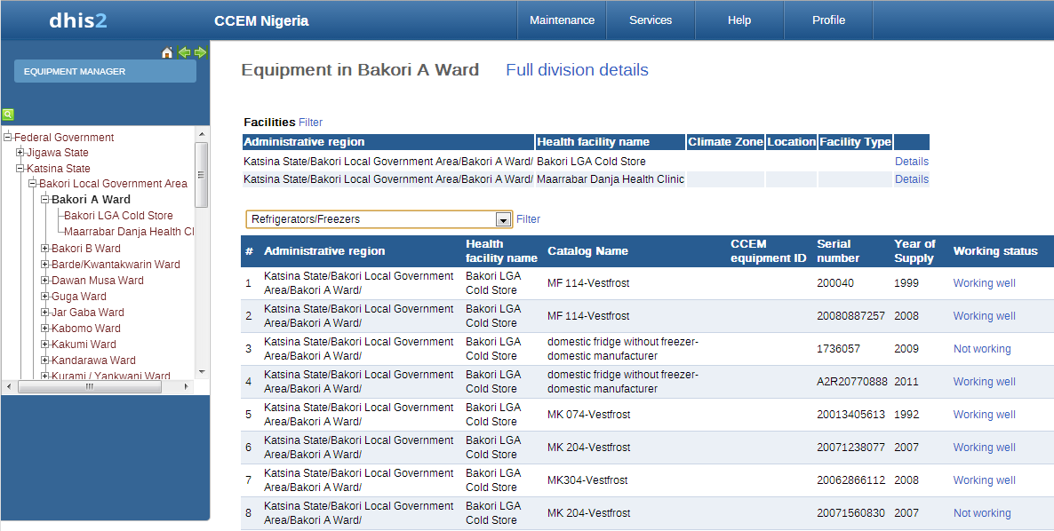
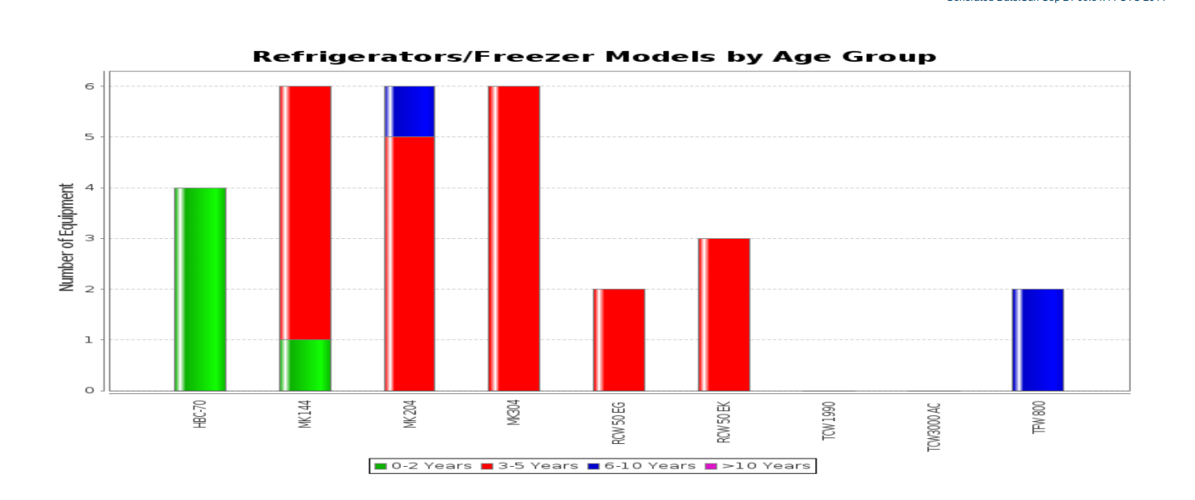
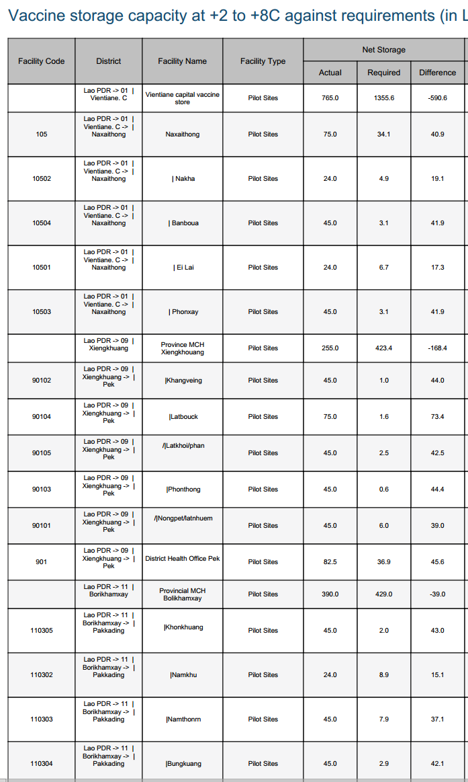
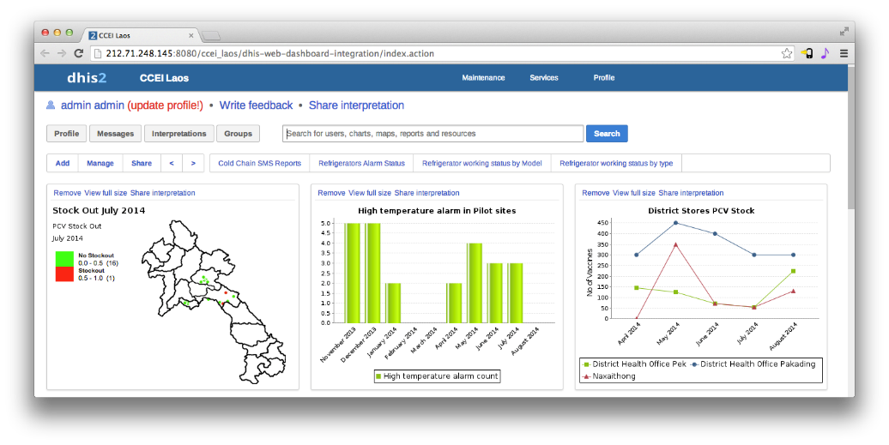
HMIS Integration
Goal: include CCEI as part of national HMIS
Platform: DHIS2
Status: Cold chain module developed as separate version of DHIS2 (2.14)

Slide 6
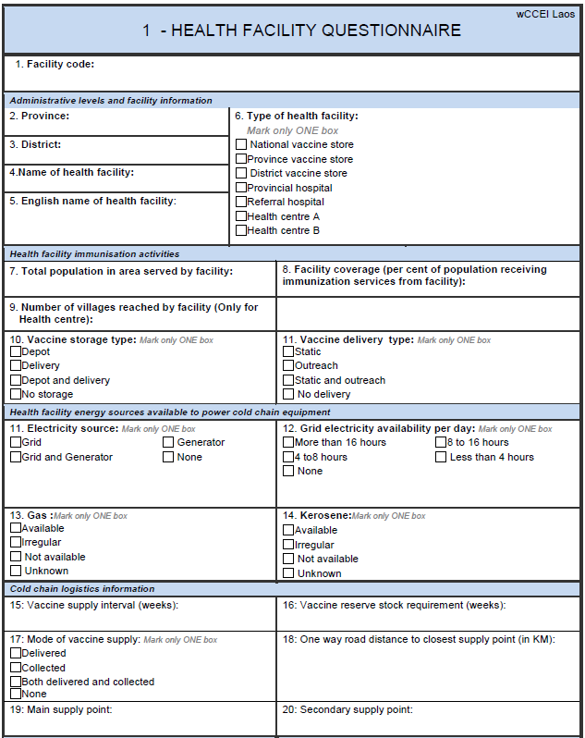
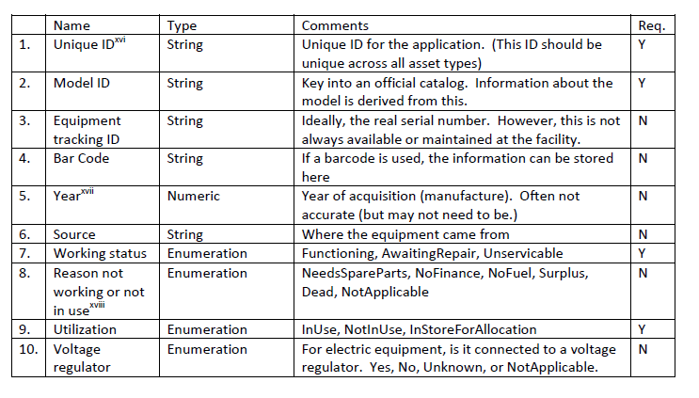
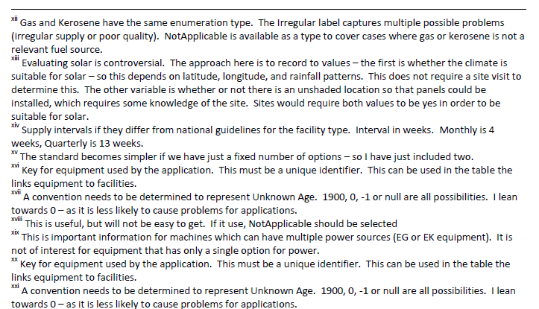
Data standards

Slide 7
Data migration
Experiences with cold chain inventories
Building an initial country inventory
Many different types of spread sheets
Different encodings, data and data fields
Multiple spellings and names
Different data sources
Moving data from MS Access application to DHIS2
Export data to excel
Map columns of data and transform encodings
Vlookup to re-establish data links
Develop import routines for DHIS2
Original
Datasets
Data Processor
Cleaned
Datasets
DB Pull
Transformation & Mapping Rules
Source datasets from systems
like DHIS2 and CCEM

Slide 8
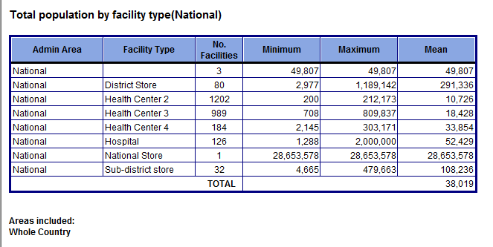
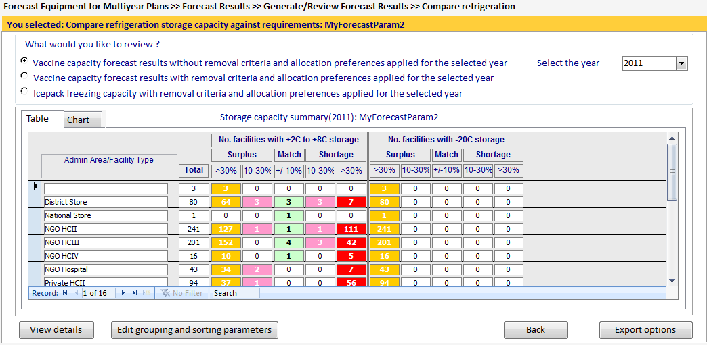
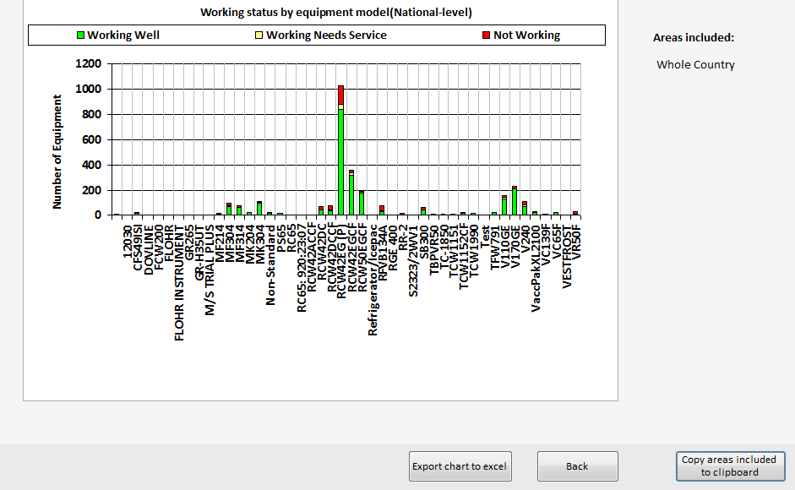
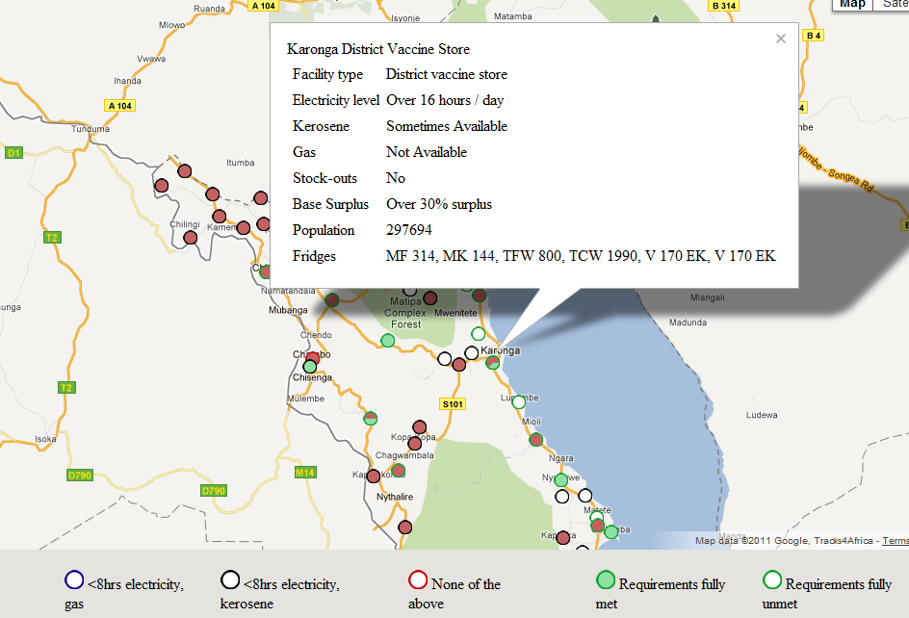
Tools for data use
Inventory is only valuable if it is used!
Challenge in maintaining software for multiple countries
Customizing reports
Analysis tools do not transfer between applications
Proposal
Develop cold chain inventory analysis tools based on data standard
Implement as browser based tools
Data could be local or remote (with access controls)

Slide 9
Conclusions
Multiple software approaches needed for CCEI
Key challenges
Moving data between applications
Combining and comparing different country data sets
Development of open data standards is the key to broadening the use of CCEI
Areas of future work:
Data migration problem for spreadsheet data
Analysis and modeling tools that are independent of the CCEI implementation.

