Slide 1
Albanian Immunization Information System (IIS)
Erida NELAJ, IPH
Silva BINO, IPH
Jan Grevendonk, WHO
Doriana Delija, AIRIS Solutions

Slide 2
Content
Why change?
How does it work?
Impact of IIS
Challenges and lessons learned
Next steps

Slide 3
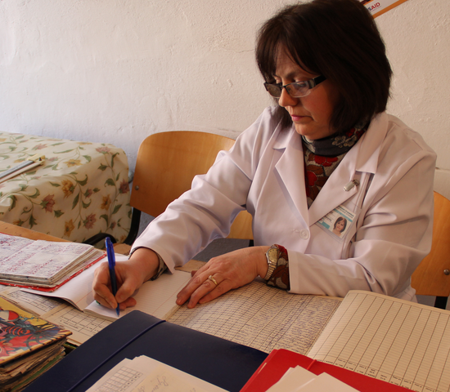
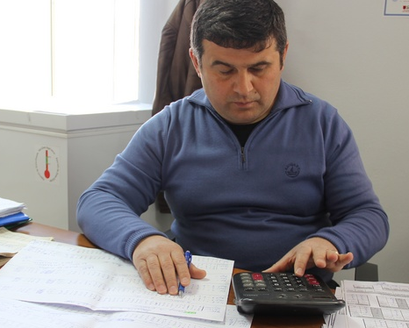
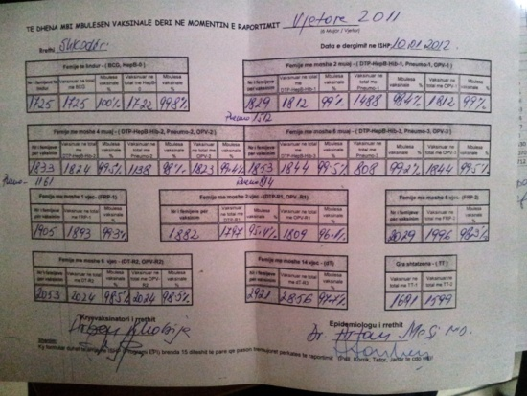
Why change?
Questions about data quality
Overall coverage data alone is not enough to manage program
Lack of timeliness of information
New expensive vaccines need to be managed better
Workload for nurses, district officers
No access to immunization records in other health centers, so no effective collaboration between nurses
Time consuming and not effective ways to find due vaccinations and migrating children

Slide 4
Process description
- Assessment and planning 2009
- Software development.
- Nurses training – beginning 2011
- Piloting in 24 HC in Shkoder district
- 2 phases (Testing Phase and Real Data Entering)
- All HC of the district of Shkoder are using IIS – from September 2011

Slide 5
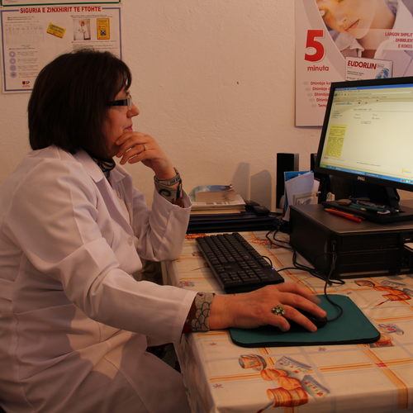
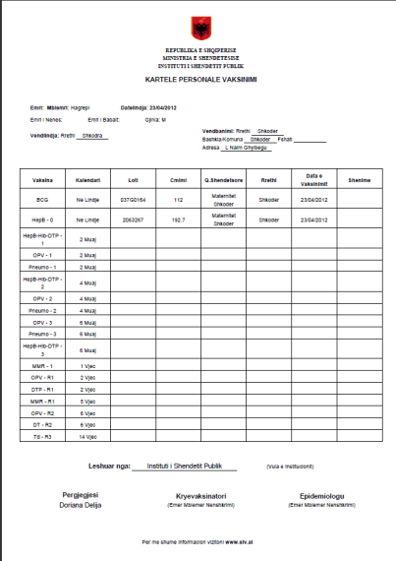
How does it work?
Track individual children’s schedules to:
Ensure timely vaccination of all registered children
Improve coverage data quality
Supply vaccine based on real demand
Learn reasons for non-vaccination
Track vaccine lots down to the child record

Slide 6
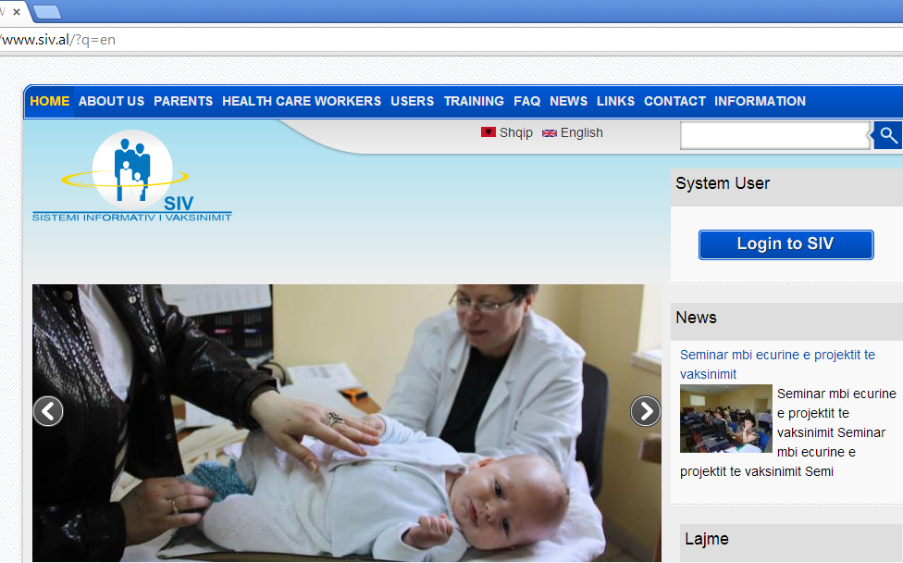
IIS - portal
Public access, advocacy, individual record

Slide 7
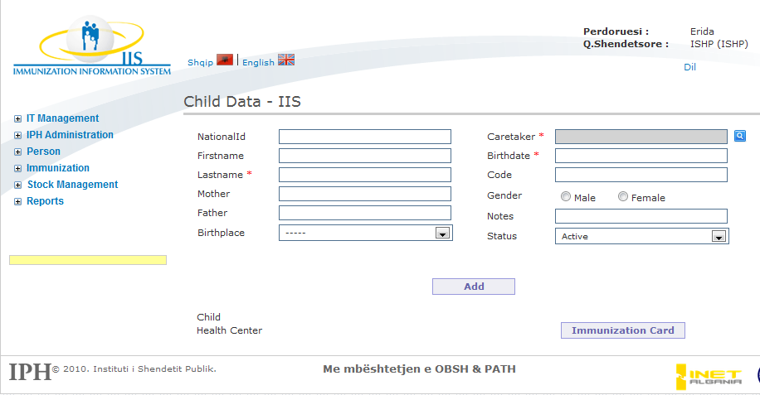
IIS – Child registration
Appointments are generated based on national schedule

Slide 8
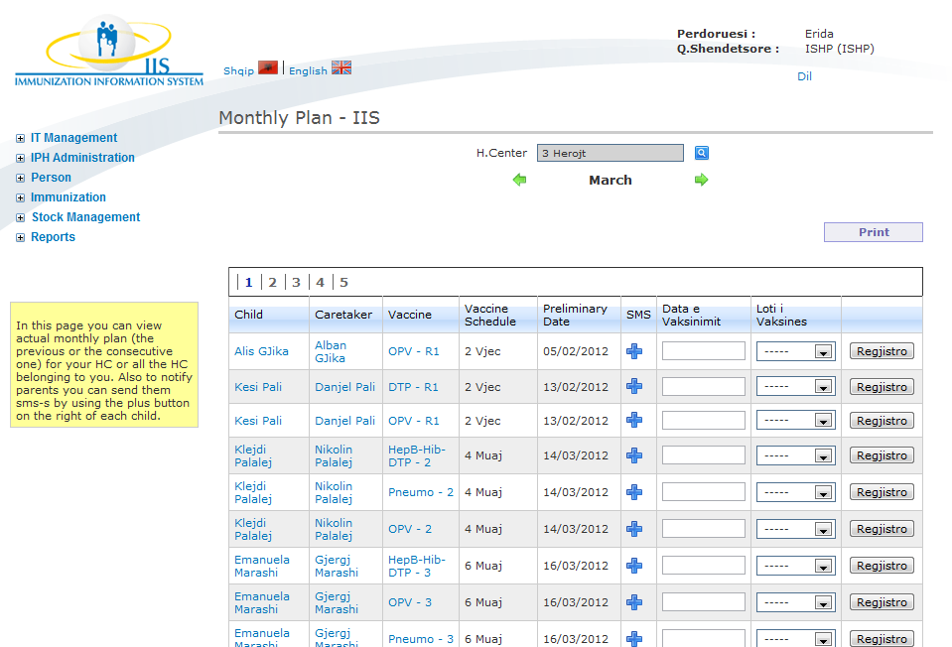
Monthly plan
One plan per health center / post: on PC, paper or phone.

Slide 9
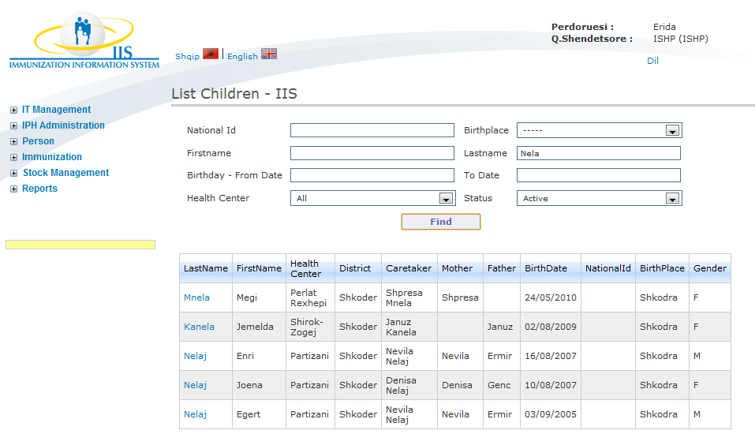
Find any child in Albania
ID number of caretaker, name, DOB, POB

Slide 10
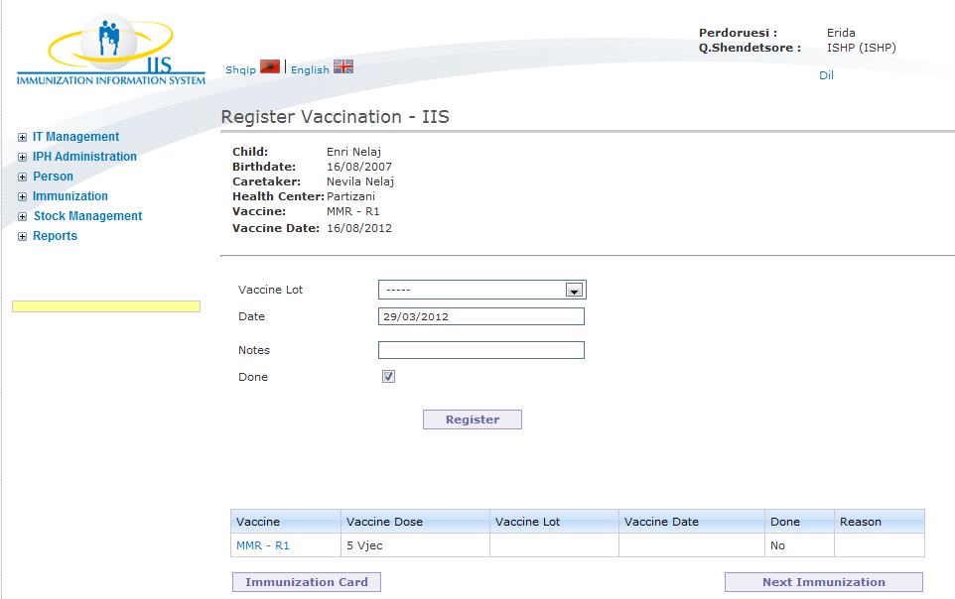
Immunization
Register lot, date and if applicable, reason why vaccination could not be done

Slide 11
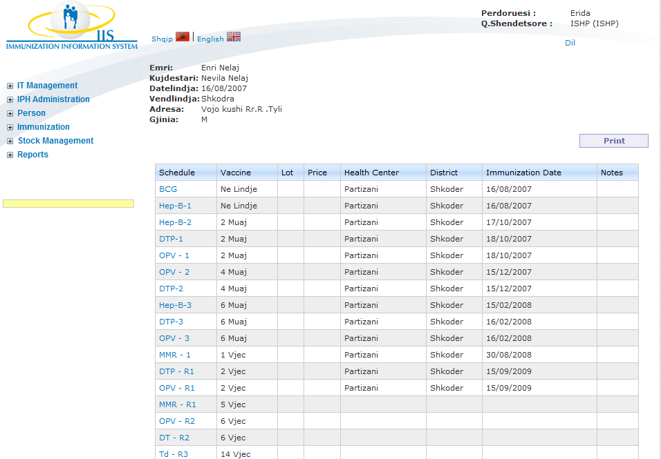
Immunization card
Can be also accessed by parents.

Slide 12
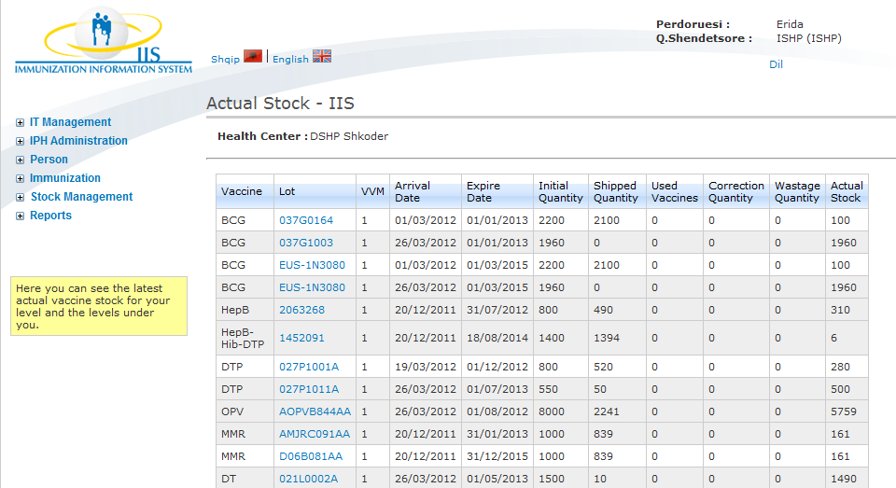
Stock management

Slide 13
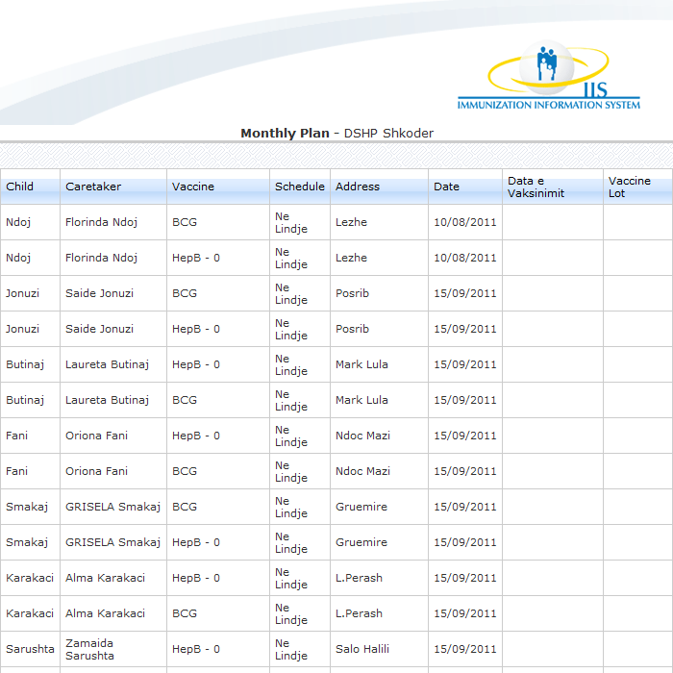
Vaccines are distributed together with the list of children to be vaccinated

Slide 14
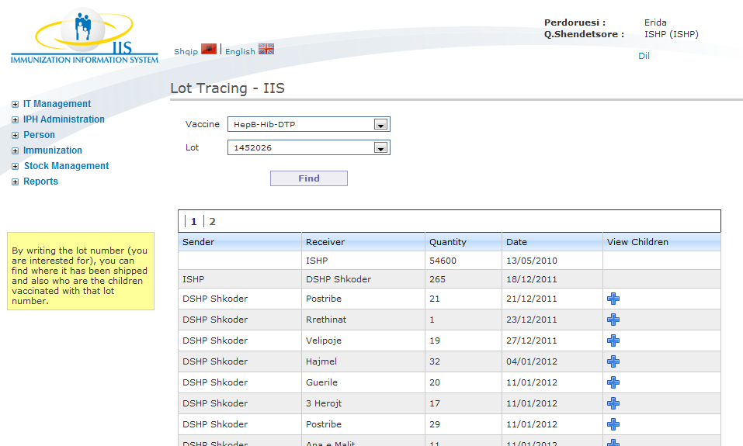
Lot tracing

Slide 15
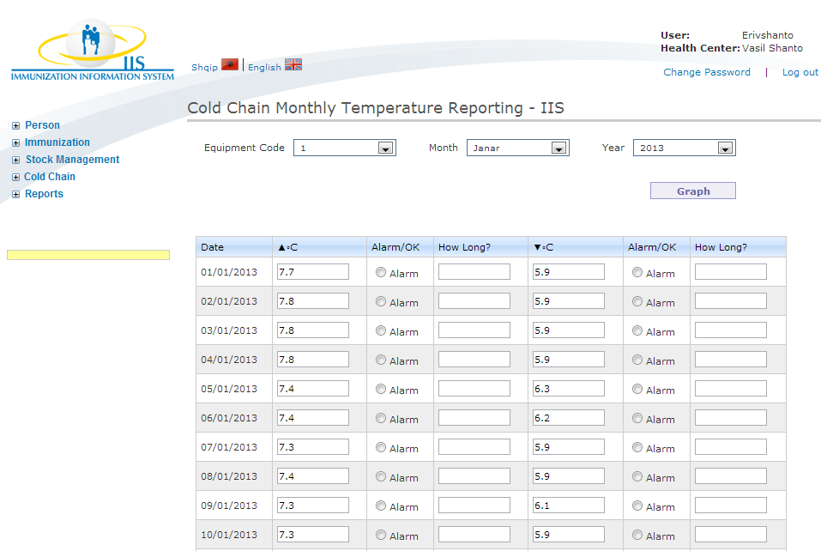
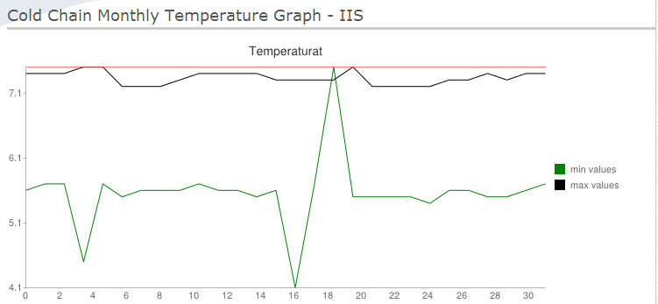
Cold chain

Slide 16
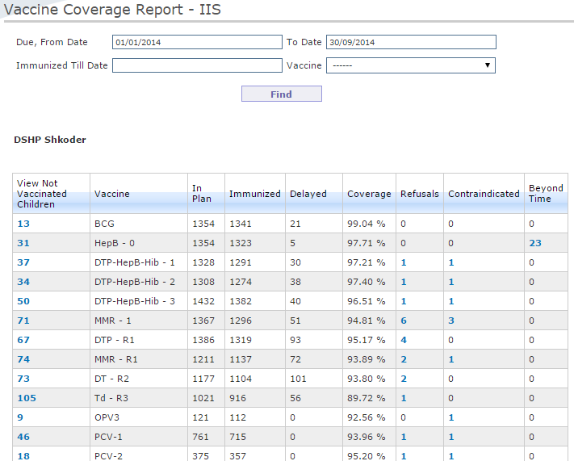
Reports

Slide 17
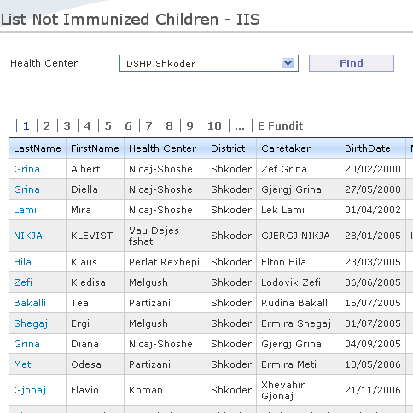
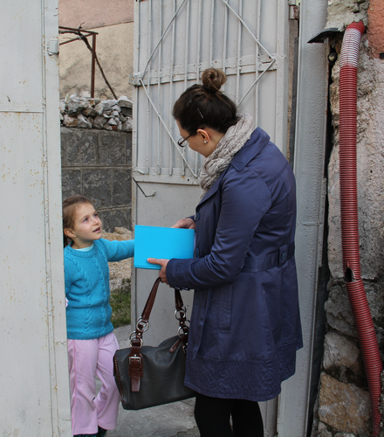
Beyond coverage: IIS tells nurses who are the 5% unvaccinated children

Slide 18
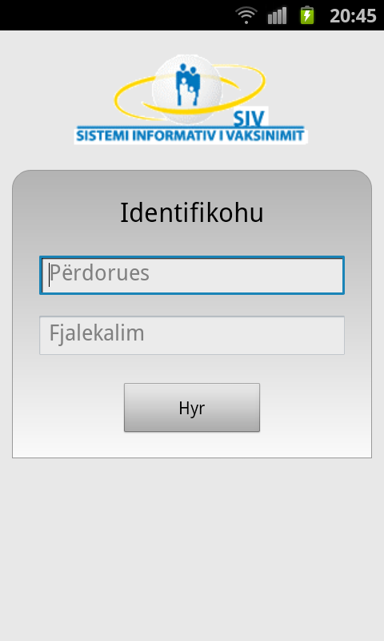
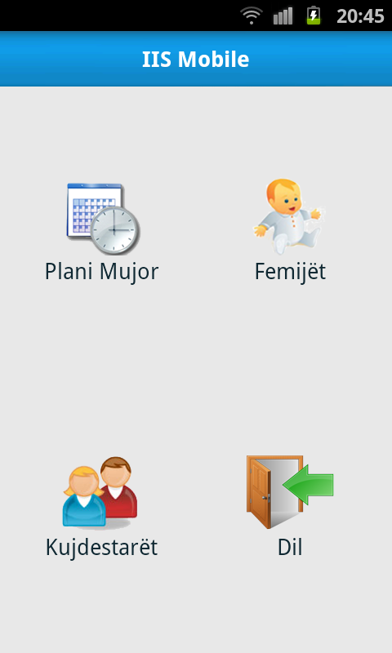

Slide 19
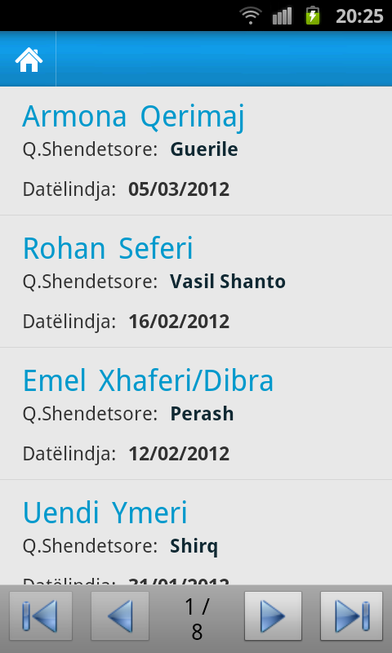
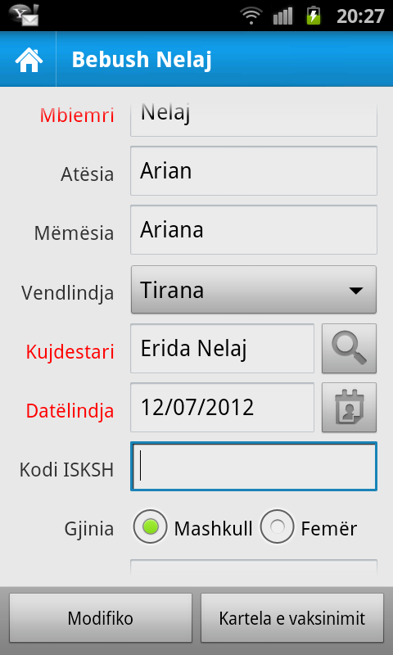
Plani mujor

Slide 20
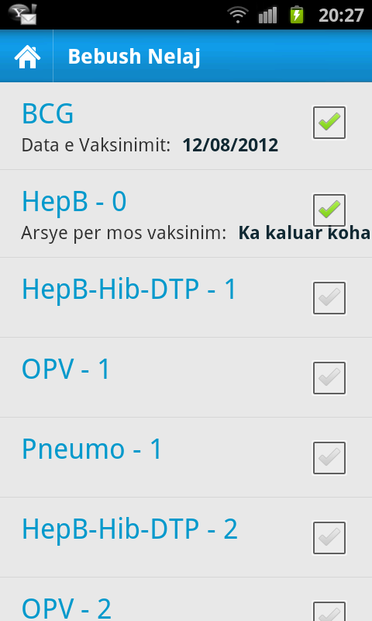
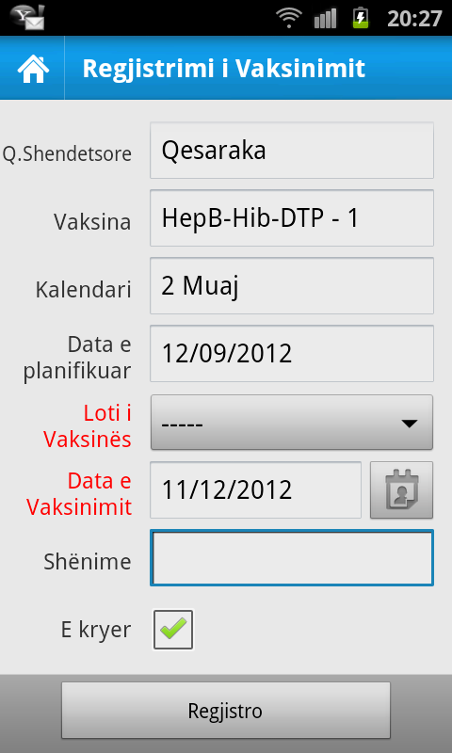

Slide 21
Lessons learned

Slide 22
1. Do not start from zero. Explore other’s experiences
But need knowledge sharing, tools and guidance.
Notes:
We consulted as much as we could but it was not easy to find guidelines and tools on how to built such a system. Maybe we did not look enough

Slide 23
2. Need for close collaboration between IT and health staff. That is not always easy

Slide 24
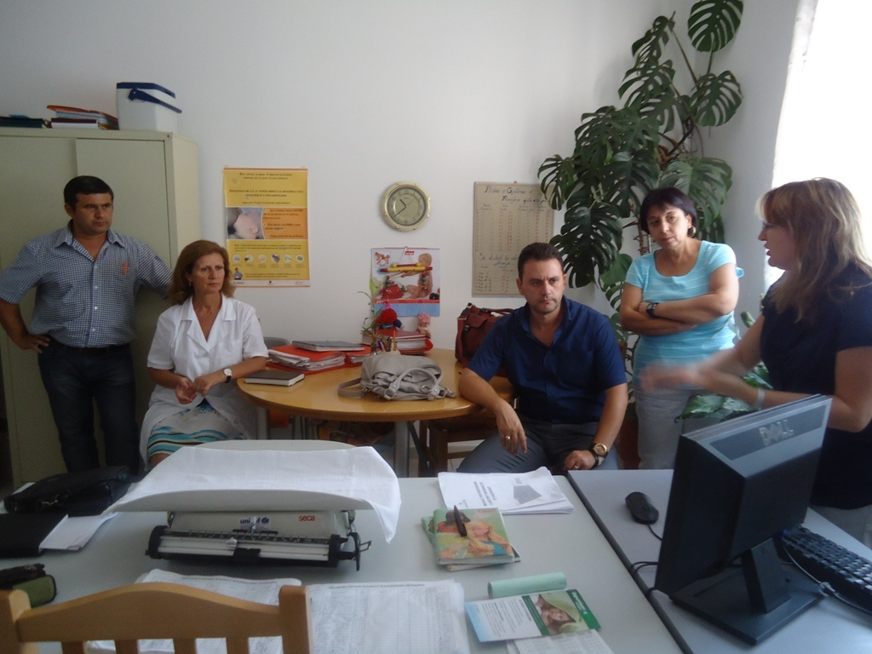
3. Need to involve doctors, nurses and other health staff in the process

Slide 25
4. New abilities mean new challenges
Notes:
We built an information system, but through this process we were looking for more options, we want it to be faster, better and pretty.
When we sow that we could have this car why we could not have the other one?

Slide 26
5. Nothing is impossible—never say never. (And trust staff)

Slide 27
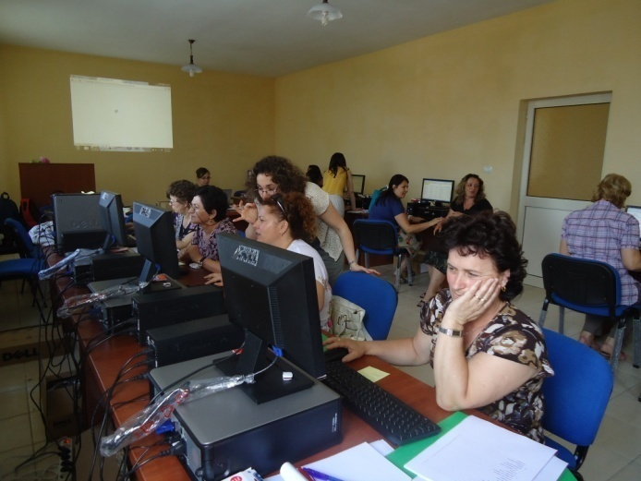
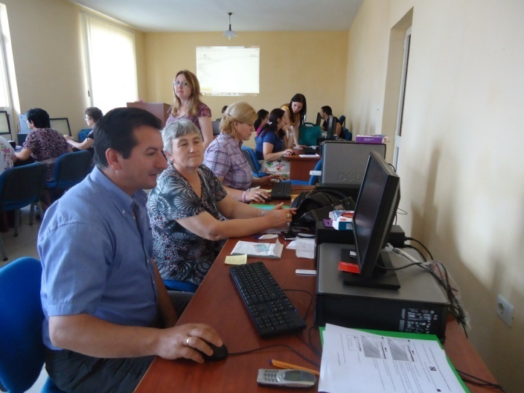
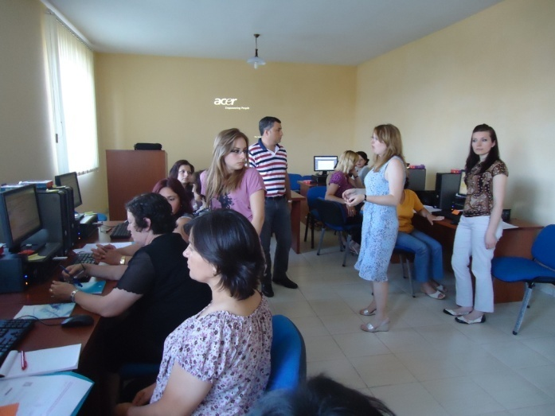
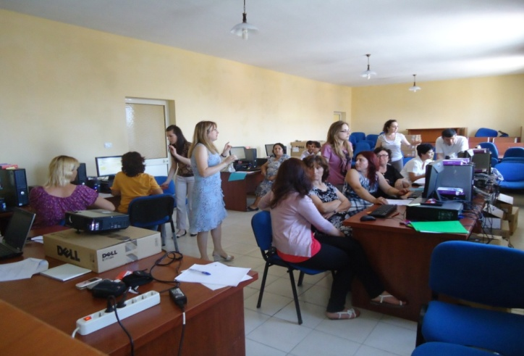
6. Train, retrain and train again Repetition is mother of all knowledge

Slide 28
Next steps and challenges
System improvements:
Mobile phone available but still not in use
Additional functionality (AEFI-investigation forms, automatically email notifications, etc)
Platform for development of other health information systems?
Scale-up and sustainability:
From pilot to integration into health system (Legal framework etc)
Scale up plan (3 to 5 years)
Practical barriers:
Computer literacy
Internet access
Funds for running costs

Slide 29
Thank you

