Slide 1
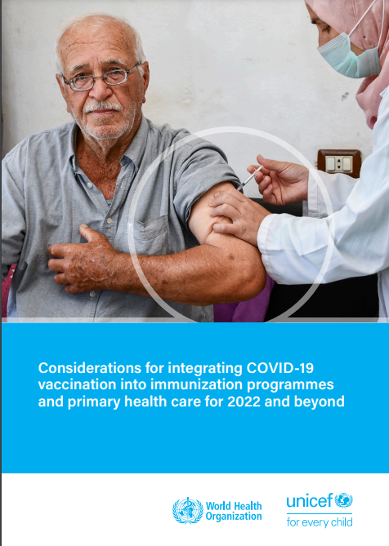
Considerations for integrating COVID-19 vaccination into immunization programmes and primary health care
April 2023
For more information and to download: https://www.who.int/publications/i/item/9789240064454

Slide 2
Considerations for integration gives programmatic and operational guidance on how to integrate COVID-19 vaccination into immunization, primary health care (PHC) and other health activities.
The primary audience includes public health planners, immunization programme managers (COVID-19 and/or EPI) and managers overseeing PHC programmes at national and subnational levels.
The guidance is also for global-, regional- and country-level stakeholders and partners working on immunization implementation, PHC and health system strengthening.
Introduction

Slide 3
Definition and principles of COVID19 integration
Benefits of integration
Implementation: The Four Steps
Available resources
Presentation outline

Slide 4
What is COVID-19 vaccination integration?
The partial or full adoption of COVID-19 vaccination into national immunization programme services, Primary Health Care and any other relevant health services with the overall aim of improving programme efficiency and sustainability, enhancing demand and improving user satisfaction, achieving and maintaining satisfactory coverage, and addressing inequities.
Overview
WHO/UNICEF Considerations for integrating COVID-19 vaccination into immunization programmes https://www.who.int/publications/i/item/9789240064454

Slide 5
Principles of integrating COVID-19 vaccination into immunization programmes and primary health care
 | Reach the most marginalized, isolated and unreached communities in rural and/or urban areas.
 | Provide individual/population-centred packages of essential health services and assure community participation and engagement.
 | Plan for different levels of the health system capacity and resources. Consider: feasibility accountability compatibility between interventions acceptability to individuals, caregivers, health workers and communities
 | Increase resources for integration to improve service delivery and performance with greater integration and fewer inequities by: reaching missed communities reaching high-risk and vulnerable groups in urban, rural and conflict areas and other contexts
Equity
People centred
Context specific
Optimized service coverage and equity

Slide 6
COVID-19 integration across health system building blocks
Health System Building Blocks
Use health systems building blocks to plan and coordinate full or partial COVID-19 integration.
Work with immunization programmes, PHC and the broader health system.
Promote greater demand, community engagement and evaluation to ensure the programme is meeting community needs.
Leadership and governance
Health systems financing
Demand and community engagement
Service delivery
Health workforce
Health information systems
Access to essential medicines (incl. quality vaccines)

Slide 7
Benefits of integration
Integration uses a people-centred approach to respond to people’s needs across the vaccination life course. Integrating services can:
Create efficiencies in delivery of health services (e.g., providing joint services; integrated training; screening for NCDs with COVID-19 vaccination)
Increase efficiencies in health governance functions (e.g., joint planning, program design, budgeting, monitoring, supply chain)
Increase immunization access to new populations outside of traditional schedule (e.g., co-administration for adults)
Capitalize on COVID-19 investments and lessons learned (e.g., SMS reminders, data tools, surveillance)
Overview
© WHO / Natalie Naccache

Slide 8
Integrated delivery supports the broader concept of life course approach for health
Pregnant Woman | Newborn | Infant | Second Year of Life | Child | Adolescent | Adult | Older Person
COVID-19 vaccination for vulnerable and high-risk populations across age groups
https://www.who.int/publications/i/item/WHO-2019-nCoV-Vaccines-SAGE-Roadmap
COVID-19 vaccination
COVID-19 vaccination
Pregnant woman
Newborn (<24 hours)
Infant (<1 year)
Second year of life
Child
Adolescent
Adult
Older Person
Tetanus toxoid containing vaccine (TTCV)
Seasonal influenza
BCG
Hep B-BD
DTPCV Measles Rubella / HepB / PCV Rotavirus / Hib / Polio
Japanese Encephalitis
Meningococcal
Rabies
Seasonal influenza
Typhoid / Yellow Fever
DTPCV booster
Measles
PCV3 (if 2+1 schedule)
Cholera Seasonal influenza
Hepatitis A Typhoid
Meningococcal Varicella
Mumps
Rabies
Diphtheria booster
Tetanus booster
Cholera
Rabies
Seasonal influenza
Typhoid
Diphtheria booster
HPV
Tetanus booster
Cholera
Dengue
Rabies
Seasonal influenza
Typhoid
–
Cholera
Dengue
Rabies
Seasonal influenza
–
Cholera
Rabies
Seasonal influenza

Slide 9
Considerations for Integrating COVID-19 Vaccination
High-level overview
STEP 1. Initiating/building on integration
Repurpose existing EPI-related or C-19 vaccination technical working groups
Conduct multisectoral consultations on potential C-19 vaccine integration
Conduct a situation analysis to assess national/sub-national level readiness for integration
Click here to access
STEP 2. Planning and developing country integration plan
Overview
Define national policy for C-19 booster doses, understand and map population in-scope and how integration will reach them, define other interventions & service delivery strategies to provide C-19 vaccination, and identify key actions or investments needed
STEP 3. Implementation and monitoring
The existing repurposed taskforce or new temporary group should oversee progress on implementation and monitoring of COVID-19 vaccination integration and define indicators for monitoring progress
Objective
STEP 4. Post-integration follow-up actions
Establish global principles and overall framework for COVID-19 integration, supporting countries define national objectives for integrating COVID-19 vaccination along all health system building blocks.
Define key implementation research questions on integrating C-19 vaccination, i.e. factors affecting integration, outcomes of different integrated approaches, effect on efficiency and cost effectiveness of C-19 vaccination
Addressed at
All levels of health-related MDAs incl. leadership across immunization and non-immunization topics
Source: https://www.who.int/publications/i/item/9789240064454
primary health care for 2022 and beyond

Slide 10
Step 1: Initiating/building on the integration process
Engage with ministry partners, immunization partners and PHC managers on the benefits of integration.
Use COVID-19 experience and innovations to strengthen other immunization services.
Work with different agencies/programmes/CSOs/community leaders to support integrated health services.
Conduct situational analysis of national and subnational level readiness for/status of COVID-19 vaccine integration.
Conduct research on community and health worker perceptions and acceptance of integrated services.

Slide 11
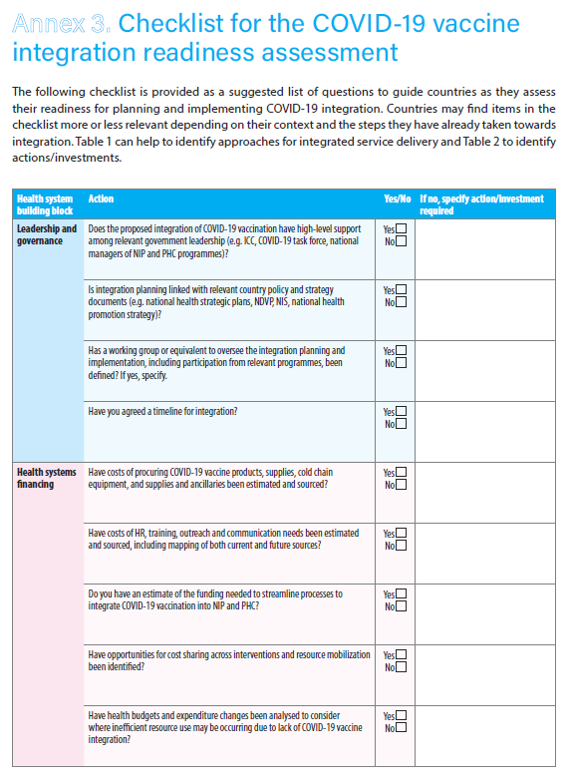
Situational Analysis: Using the Readiness assessment checklist – Annex 3
The Readiness Assessment Checklist provides a suggested list of questions for national and subnational managers to assess readiness for planning and implementing COVID-19 integration.
Questions are categorized by the WHO Health Systems Building Blocks
Leadership and governance
Health systems financing
Demand and community engagement
Service delivery
Health workforce
Health information systems
Access to essential medicines (including quality vaccines)
Monitoring and evaluation
The checklist lists actions toward integration and provides space for identifying actions/investments needed.
Countries will need to adapt it based on their overall progress towards integration.
Click here to access
Objective
Support countries identify specific technical actions which should be incorporated into the integration strategy and implemented in order to address potential gaps and challenges that have been identified in the diagnostic assessment

Slide 12
Initiating/building on the integration process – country experiences
STRENGTHENING REGULATORY CAPACITY
Philippines and Indonesia: Fast-tracked the process for emergency regulatory authorization, which could be capitalized for future emergency-related products.
PARTNERING WITH OTHER PROGRAMMES
The United Republic of Tanzania partnered with the HIV programme and with physicians treating NCDs to provide COVID-19 vaccination in the respective clinics along with clinical care.
INTEGRATING SOCIAL MOBILIZATION FOR COVID-19 WITH IDENTIFICATION OF MISSED CHILDREN
Iraq: community mobilizers for COVID-19 vaccination also check vaccination records to identify children who missed essential vaccination doses.
MULTI-INTERVENTION CAMPAIGNS
Nigeria plans multi-intervention campaigns to concurrently deliver measles vaccines, other essential vaccines and vitamin A to children and COVID-19 vaccination to adults.
Source: Country experiences with COVID-19 vaccination: Mainstreaming & integration with immunization programme services and PHC, 2022
primary health care for 2022 and beyond

Slide 13
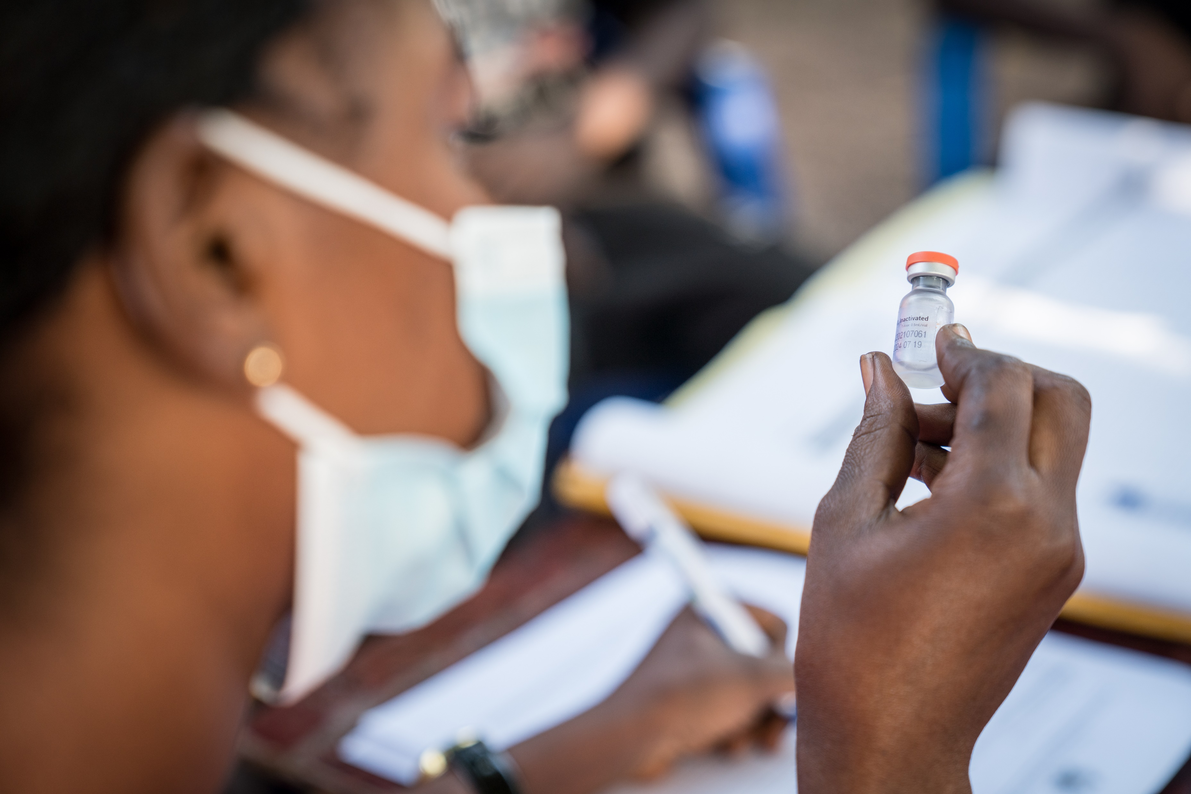
Step 2: Planning and preparatory phase: develop a COVID-19 vaccination integration plan
Pay attention to any changes to the national immunization plan, COVID-19 vaccination policy and booster dose requirements.
Identify delivery strategies where COVID-19 vaccination can be provided along with other services.
Build integration activities into existing COVID-19 plans, immunization strategies and other health plans.
Map (or build on previous mapping) high-risk groups, zero-dose populations, missed populations and how to reach them.
© WHO / Michael Duff

Slide 14
Planning and preparation for integration – country experiences
JOINT PLANNING
Colombia conducted joint planning for procurement and delivery of COVID-19 and other essential vaccines in their national immunization programme
INTEGRATION OF GOVERNANCE PROCESSES
India: Task forces in state/district/urban areas developed for monitoring polio data were integrated for EPI and are now starting to discuss COVID-19 vaccination.
INTEGRATED APPROACH TO COLD CHAIN CAPACITY PLANNING
Cambodia: Cold chain assessment and distribution for COVID-19 vaccine deployment was integrated with essential immunizations when planning cold chain capacity
Source: Country experiences with COVID-19 vaccination: Mainstreaming & integration with immunization programme services and PHC, 2022
primary health care for 2022 and beyond

Slide 15
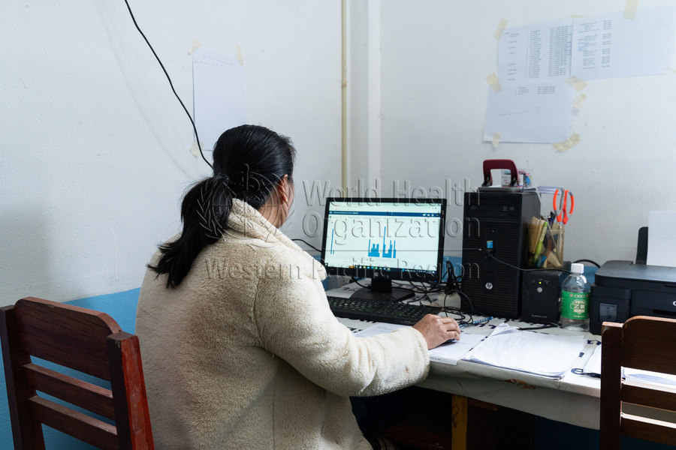
Step 3: Implementation and monitoring
Monitor progress based on national strategy, disease burden, WHO recommendations and booster doses. Potential indicators include:
COVID-19 vaccine coverage of primary series and booster dose by high-risk groups.
Positive and negative impacts of integrating COVID-19 vaccination into PHC and immunization programmes.
Existing indicators on immunization programmes and COVID-19 vaccination that are reported through regional and global reporting systems can be leveraged for this purpose (e.g., electronic Joint Reporting Form (eJRF).
©WHO/Enric Catala

Slide 16
Step 4: Post-integration follow-up actions
Help managers reach and sustain higher coverage through a continual performance improvement and feedback process.
Identify factors (enablers, barriers, capacity) and strategies to improve performance through implementation research. Potential questions:
Which factors affect integration at different levels of the health system?
What are the outcomes of different integrated approaches?
Are coverage levels of COVID-19 vaccination and other interventions maintained or increasing?
Conduct post-integration evaluation within the first six months after integration.
© WHO / Billy Miaron

Slide 17
Implementation and monitoring and post-integration – country experiences
​LEVERAGING DIGITAL DATA SYSTEMS
Lao People’s Democratic Republic will leverage The COVID-19 Vaccination Registry (CVR), based on the DHIS2 software module, to establish an electronic registry for essential immunization.
COMMUNITY INVOLVEMENT AND INTEGRATION OF VACCINATION WITH ROUTINE ANC SERVICES
Fiji used community feedback and established a dedicated Social Listening Subgroup under a multi-partner RCCE initiative to improve demand for routine immunization and COVID-19 vaccination.
COMPLIANCE WITH VACCINE SAFETY STANDARDS
Bolivia established mass COVID-19 vaccination campaign sites complying with AEFI technical standards for prevention and care that can be reproduced for other mass vaccination campaigns.
Source: Country experiences with COVID-19 vaccination: Mainstreaming & integration with immunization programme services and PHC, 2022
primary health care for 2022 and beyond

Slide 18
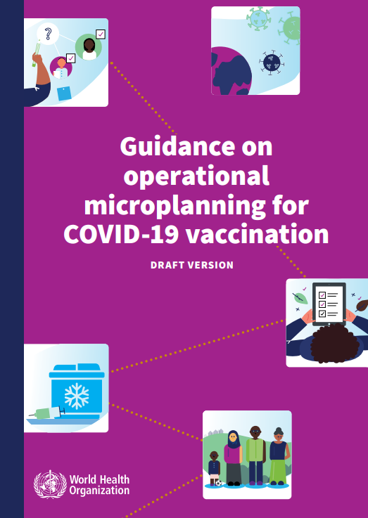
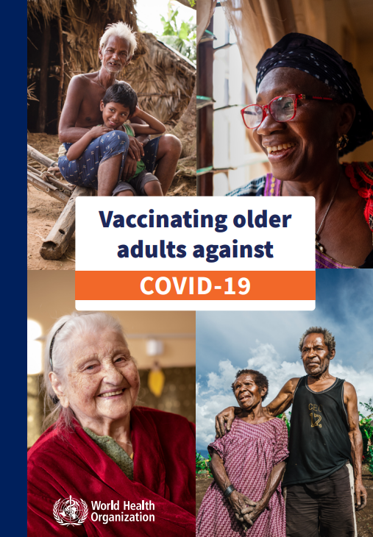
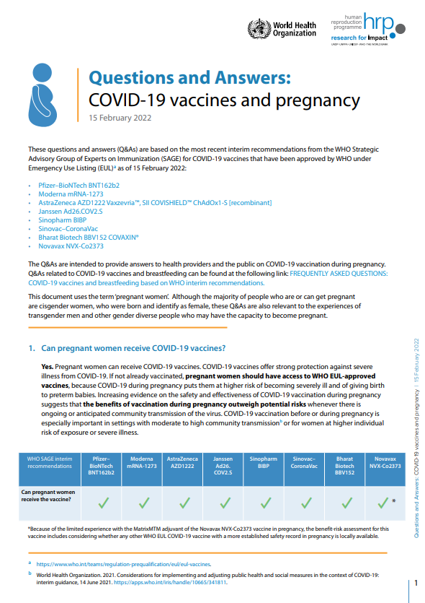
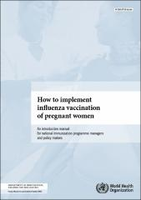
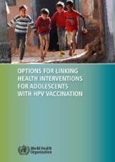
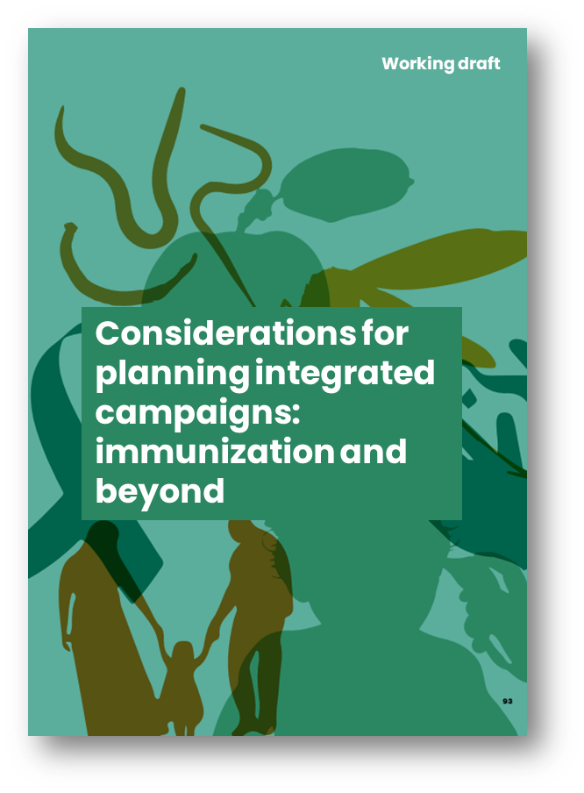
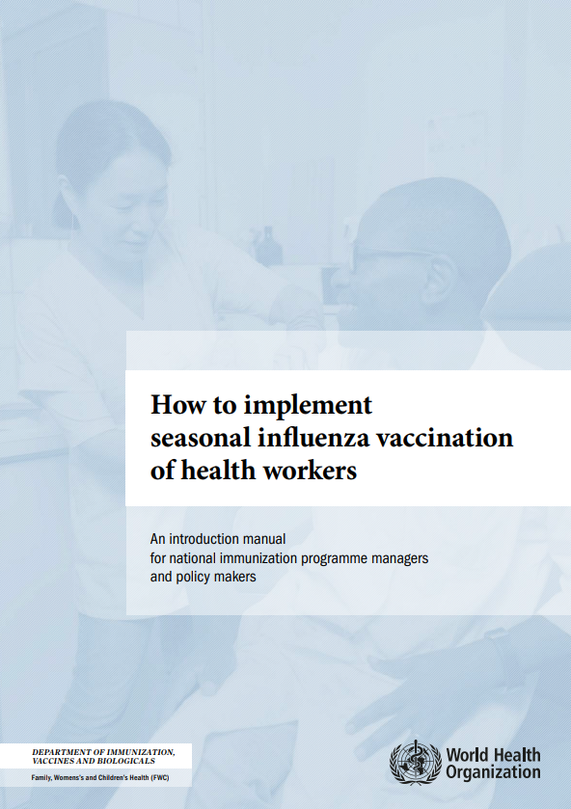
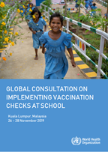
Additional materials | Available and upcoming resources on vaccination
As of April 2023
C-19 vax specific
Non-C-19 vax specific but relevant
Considerations for integrating COVID-19 vaccination into immunization programmes and primary health care for 2022 and beyond
Coming soon (revised version)
Guidance on operational microplanning for COVID-19 vaccination
Online training (OpenWHO) curriculum on Operational Microplanning for COVID-19 Vaccination
Training curriculum on Operational Microplanning for COVID-19 Vaccination
COMING SOON!
Vaccinating older adults against COVID-19
Questions and Answers: COVID-19 vaccines and pregnancy
DRAFT
FAQ how to integrate C-19 vax
Working Together: an integration resource guide for immunization services throughout the life course
Implementation guide for vaccination of health workers
How to implement seasonal influenza vaccination of pregnant women
Options for linking health interventions for adolescents with HPV vaccination
Under development
Considerations for planning integrated campaigns: immunization and beyond
How to implement seasonal influenza vaccination of health workers
Resource page for school-based immunization and vaccination checks
Protecting all against tetanus

Slide 19
Find lessons learned on the global compendium of country knowledge on COVID-19 vaccination https://www.who.int/news/item/19-04-2023-global-compendium-of-knowledge-on-covid-19 and share your own experiences.
Find updates COVID-19 guidance on the WHO Strategic Advisory Group of Experts in Immunization site https://www.who.int/groups/strategic-advisory-group-of-experts-on-immunization and the March 2023 Roadmap at https://www.who.int/publications/i/item/WHO-2019-nCoV-Vaccines-SAGE-Roadmap
Thank you

