Slide 1
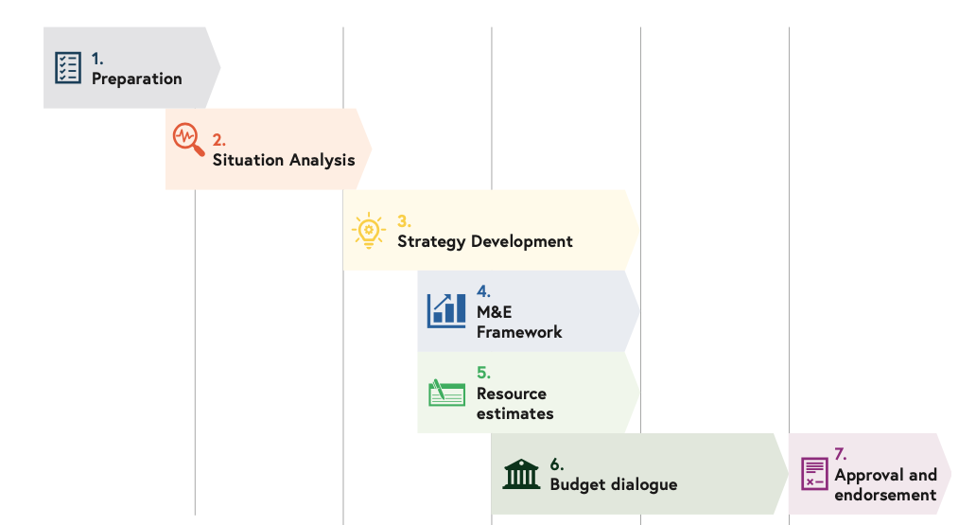







Participants
Preparation
3
Where you are in the process will determine what to prepare in advance of the workshop
Group 1:
You have not yet started the NIS process you are just beginning to organize as a team
Group 2:
You have begun the process of developing your NIS (team is set up, a situation analysis is ongoing)
Group 3:
You have begun the strategy development steps
09

Slide 2
Questions to prepare per each ‘type’ of participant
Preparation
3
Illustrative – for discussion only
Group One
Group Two
Group Three
What event triggers NIS development? (cMYP end?)
What other relevant country planning processes are underway?
How will you ensure linkages to any relevant Gavi or other donor related processes (FPP)?
Which ministries have you consulted with so far? And what is the plan for this?
How will you organize the team working on the NIS?
What challenges do you anticipate and how might these be mitigated?
How will you synchronise NIS with the National HSSP and ensure that health sector planning focal persons are fully engaged?
Are you able to leverage a recent EPI review? And/or a Coverage and Equity assessment?
Which other results of other relevant programme evaluations are available to consider?
What are the lessons learned from past plans/strategies?
How will you organize the stakeholders to develop a shared understanding of the environment for the next strategic period?
What challenges do you anticipate and how might these be mitigated?
How will you synchronise NIS with the National HSSP and ensure that health sector planning focal persons are fully engaged?
How will you organize this phase of the NIS development, especially at sub-national levels?
How will you set and prioritize objectives, build a strategy with coherent actions to achieve the objectives.
What are the Key opportunities, barriers and root causes to support future programming to respond and address these?
How will you assess feasibility, potential for impact, costs?
How will you synchronise NIS with the National HSSP and ensure that health sector planning focal persons are fully engaged?

Slide 3
Questions to respond to before the workshop (1)
Preparation
3
To submit to NIS team by 30 September
1. Preparation phase
When did you start/are you planning to start the NIS development?
What is the context? (FPP, other country planning processes?) What other relevant country planning processes are underway?
How will you organize the team working on the NIS? Have you identified a Coordinator? Have you selected a consultant to support the process? How will you organize the team working on the NIS?
Have you accessed NIS.COST?
What has worked well?
Whare the main challenges?

Slide 4
Questions to respond to before the workshop (2)
Preparation
3
To submit to NIS team by 30 September
2. Developing NIS Content
Have you done a desk review of available resources?
Can you build on a recent EPI Review and/or Coverage and Equity assessment? What are the lessons learned from past plans/strategies?
Have you done a Situation Analysis?
What are the lessons learned from past plans/strategies?
What has worked well?
Whare the main challenges?

Slide 5
Questions to respond to before the workshop (3)
Preparation
3
To submit to NIS team by 30 September
3. Stakeholder engagement
Have you done a mapping of the key stakeholder to engage with during the NIS development?
How will you synchronise NIS with the National HSSP and ensure that health sector planning focal persons are fully engaged?
Have you developed a stakeholder engagement plan?
How will you organize the stakeholders to develop a shared understanding of the environment for the next strategic period?
What mechanism will you use for collation of stakeholders input?
What has worked well?
Whare the main challenges?

Slide 6
Questions to respond to before the workshop (4)
Preparation
3
To submit to NIS team by 30 September
4. Strategy and Costing
How will you organize this phase of the NIS development, especially at sub-national levels?
Have you set and prioritised your objectives?
Have you identified key opportunities and barriers and their root causes?
Have you defined strategies to address root causes and effect change?
Have you developed an M&E Framework?
Have you estimated the resources needed to implement the NIS using NIS.COST?
What has worked well?
Whare the main challenges?

Slide 7
Questions to respond to before the workshop (5)
Preparation
3
To submit to NIS team by 30 September
5. Expectations from the workshop
What would you like to focus on during the workshop?
Where do you want to be in your NIS development by the end of the workshop?
Other comments?

Slide 8
Preparation requested of participants
Using the resources available, prepare a presentation following the proposed template and detailed questions
Send the presentation before 30 September to:
  petua@who.int
  fihmanj@who.int
  nis@who.int
Resources available here: www.technet-21.org/en/topics/national-immunization-strategy

