Slide 1


National Immunization Strategy (NIS)
Webinar Series
Information session #1 – Introduction & Overview
Thursday, 25 November (ENG)
Thursday, 2 December (FR)

Slide 2
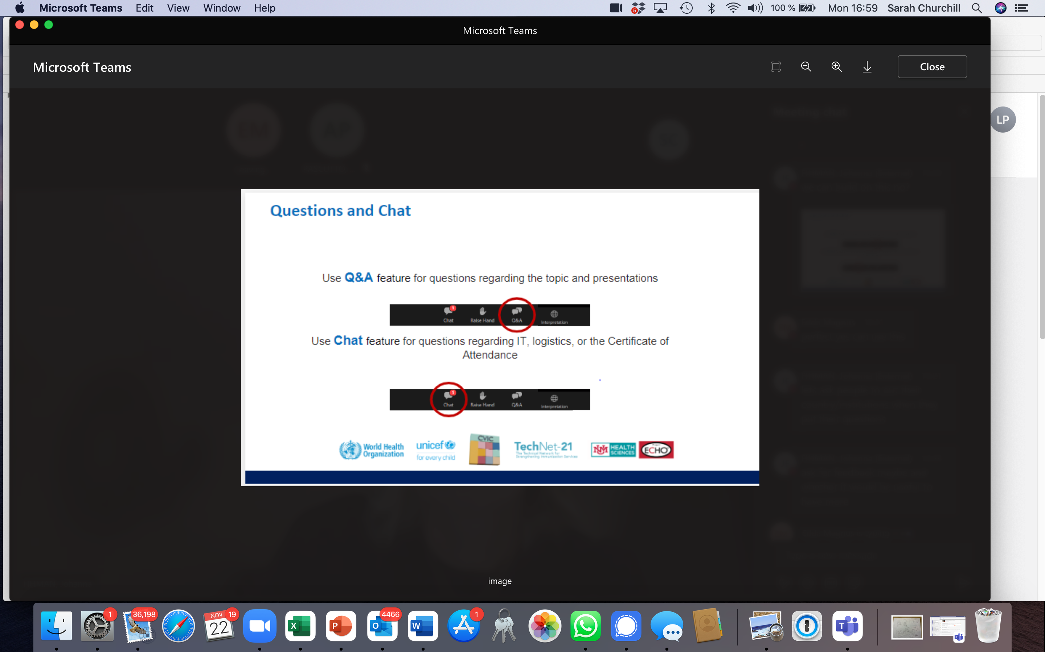
TechNet-21 Webinar tips
For questions on content, use the Q&A function
Presenters will respond to questions that are submitted via the Q&A
Please introduce yourself! (country, institution)
For technical support, use the chat function
Any questions regarding IT, logistics or a certificate of attendance should be submitted via the chat function.

Slide 3
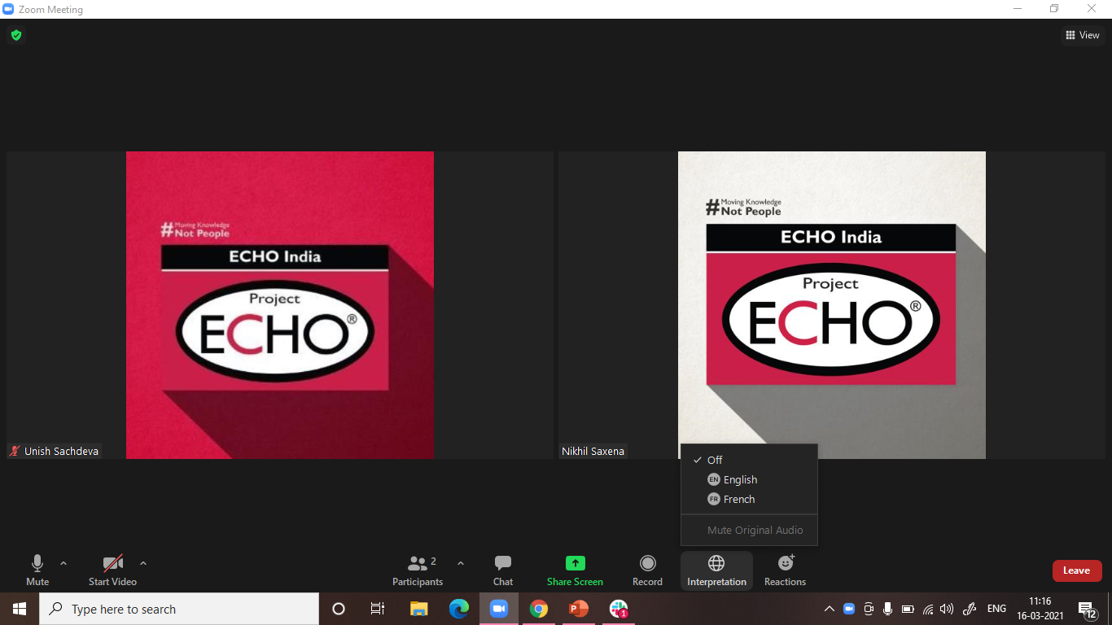
Interpretation
Interpretation in Mongolian is available by clicking Interpretation button.
Click on “Interpretation” and choose “Russian” (Zoom only supports a few languages). To hear the interpreted language only, click “Mute Original Audio”

Slide 4

NIS Webinar Series
#1 Introduction and Overview
Today’s session:
Introduction to the NIS in the context of IA2030
Overview of the guidance and new resources
Introduction to a new costing approach
Sharing of experiences to date
Johanna Fihman, Technical Officer; Global Access Team, IVB WHO/HQ
Nathalie Vande Maele, Health Economist, Global Access team, IVB/HQ
Amos Petu, Health Economist, Immunization Financing Sustainability, WHO East & Southern Africa Office
Eric Laurent, UNICEF
Today’s speakers:

Slide 5
Today’s discussion will focus on…
Outline of topics
1
Introducing the NIS in the context of IA2030 and COVID-19
2
When should countries develop their NIS?
3
Presentation of the NIS guidance
4
NIS and Covid-19 vaccination targets
5
Perspectives and early experiences from AFRO

Slide 6
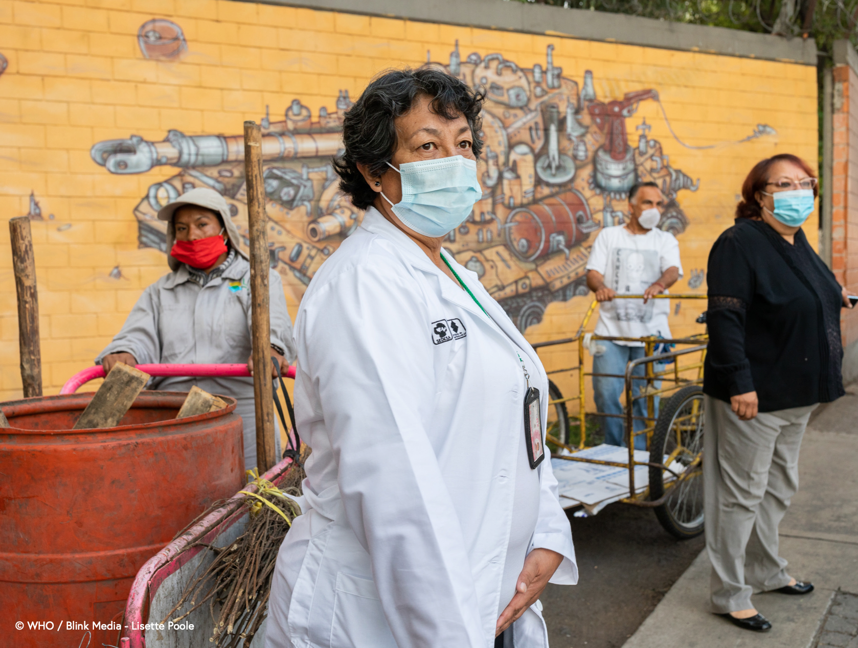
IA2030: an ambitious global strategy
Why NIS
1
To maximize the lifesaving impact of vaccines in this new era … the most important actions will be the responsibility of individual countries
By the end of the decade, IA2030 aims to:
  Reduce by 50% the number of children receiving zero vaccine doses
  Achieve 500 introductions of new or under-utilized vaccines in low- and middle-income countries
  Achieve 90% coverage for essential childhood vaccines
1
2
3

Slide 7
Strategic planning is essential particularly in the context of the Covid-19 pandemic
Why NIS
1
Why is strategic planning important?
COVID-19 has increased the pressure on countries:
  Economic forecasts worsened since the start of the pandemic
  LMICs will take longer (2026) to raise general government revenue to pre-pandemic level
Prioritization of resources is essential
Yet it is challenging
Longer term planning is at risk whilst countries respond to the emergency of the Covid-19 pandemic
C-19 vaccine introduction is putting additional strains on health systems

Slide 8


Why NIS
1
National Immunization Strategy Guidance builds on learnings from cMYP
And incorporates improvements aimed to strengthen the development process and improve the outcome.
Aligned
Owned
Aligned to IA2030 global strategy, regional frameworks and Gavi 5.0
Directional document based on national dialogue minimizes the need for external technical support.
Strategic and streamlined
Integrated
High-level strategic document Includes a streamlined costing approach that supports budget dialogue and financing.
Better integrated into national health sector planning and adapted to in-country processes. Shaped through consultation with broader scope of stakeholders.
Realistic
A negotiation process with Ministry of Health and Finance leads to an agreed resource envelope to fund key strategic priorities; framing realistic expectations.
09
Notes:
Stocktaking on cMYP (Mott MacDonald, July 2017)
Too little integration into the existing national system
Poor participation of financing & planning officers, NGOs, CSOs, others
Complex & burdensome process, resulting on reliance on TA
Often aspirational rather than pragmatic and not used for strategic planning and budgeting decision-making
Not adapted for multiple funding sources & costing of shared resources
No real impact on resource mobilization. Mainly used for Gavi applications

Slide 9
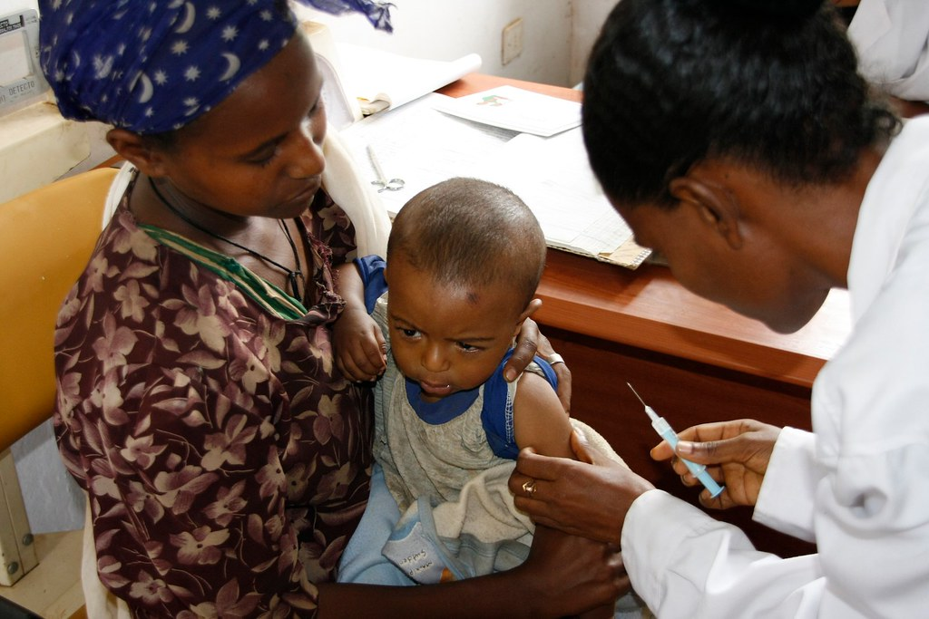
Timing for NIS
2
When should countries plan an NIS?
The development of a NIS can be triggered by:
The end of the period covered by the previous immunization plan (cMYP)
Any major change that requires to review and update priorities and available resources – including Covid-19
Possible need to align with funding request
This Photo by Unknown Author is licensed under CC BY

Slide 10
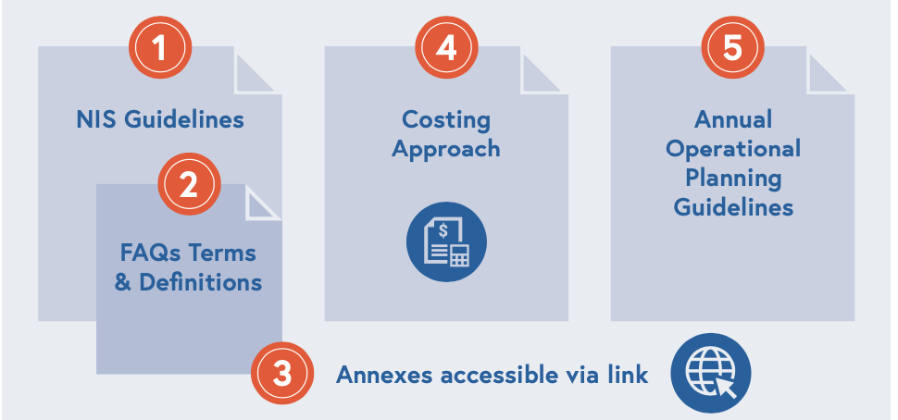
NIS Guidance
3
A package of NIS resources
Full NIS Package accessible via this link:
https://www.who.int/teams/immunization-vaccines-and-biologicals/vaccine-access/planning-and-financing/nis
Guidelines in English/French/Russian
1
NIS Guidelines: a step-by-step guide for country stakeholders on how to develop an NIS
NIS FAQs: further details and descriptions, including definitions of key concepts and terms
NIS Annexes: further supporting documents, including templates and country examples, regularly updated
NIS Costing Approach (NIS.COST): Google sheet application to support the estimation of NIS resource requirements. immunizationeconomics.org/unicef-niscost
Annual Operational Planning (AOP) guidelines: guidance and tools to support the transition from the NIS into actionable tasks. Available at: https://immunizationeconomics.org/unicef-national-planning-and-budgeting
2
3
4
5
09

Slide 11









Guidelines describe a 7-step process
NIS Guidance
3
 | 1. Preparation | NIS planning, team in place, stakeholder mapping complete and documentation available.
 | 2. Situation analysis | Consolidated situation analysis report discussed and agreed with stakeholders.
 | 3. Strategy development | NIS vision and consolidated 5 years objectives with interventions to achieve them.
 | 4. M&E Framework | NIS Monitoring and Evaluation Framework
 | 5. Resource estimates | Resource requirements estimated for the NIS by using NIS.COST.
 | 6. Budget dialogue | Consolidated budget for the NIS based on negotiations with government and external health partners.
 | 7. Approval and endorsement | Final version of NIS document with budget estimates is endorsed by the relevant country stakeholders.
4
M&E mechanism
7
Approval and endorsement

Slide 12
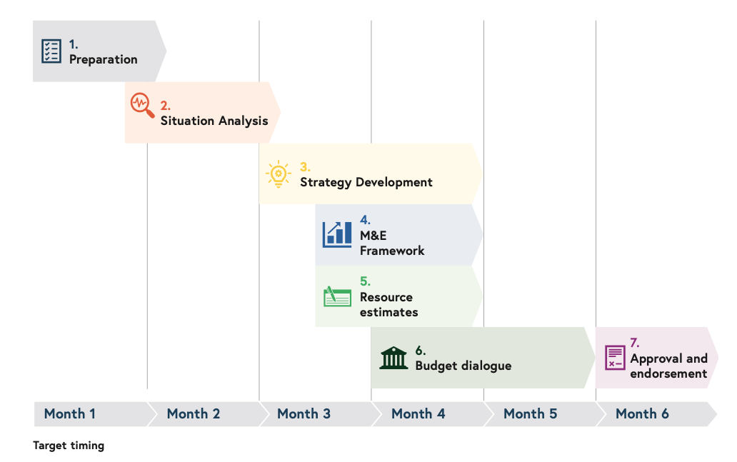
NIS Guidance
3
Step-by-step guidance
On how an NIS can be developed most effectively
Target timeline
For each step, guidance describes:
the process for completing the step, including possible roles and responsibilities across a team;
how the step contributes to developing the content of the NIS and reminders for efficient integration with the Health Sector Strategic Plan (HSSP);
a recommended set of tools and resources (with relevant links);
best practice tips gathered from country experiences that will continue to be collected over time.
09

Slide 13
NIS Resources
3
An initial set of annexes
Examples and templates will be added based on additional country experiences
Download from Dropbox:
https://www.dropbox.com/sh/jvhbduz6a4m4fay/AACcTEv38N-Wimph7_pkZjtEa?dl=0
Currently only available in English, French versions coming
Preparation | 1A | Terms of Reference for the NIS Development Team - key information to be included in the main content of the ToR(s) for the NIS development team.
 | 1B | Outline of Stakeholder Engagement Plan - how to plan and conduct stakeholder engagements.
 | 1C | Illustrative Outline of NIS Workplan
Situation analysis | 2A | Template Report for the Situation Analysis of Immunization Programme Performance
 | 2B | Conducting a systematic desk review as part of the situation analysis - a list of suggested information sources that support the systematic desk review.
Strategy development | 3 | IA2030 Strategic Priorities checklist - key focus areas that can be incorporated into the NIS
M&E Framework | 4 | Template for monitoring key performance indicators for NIS implementation
Approval and endorsement | 7A | Example of NIS Outline

Slide 14
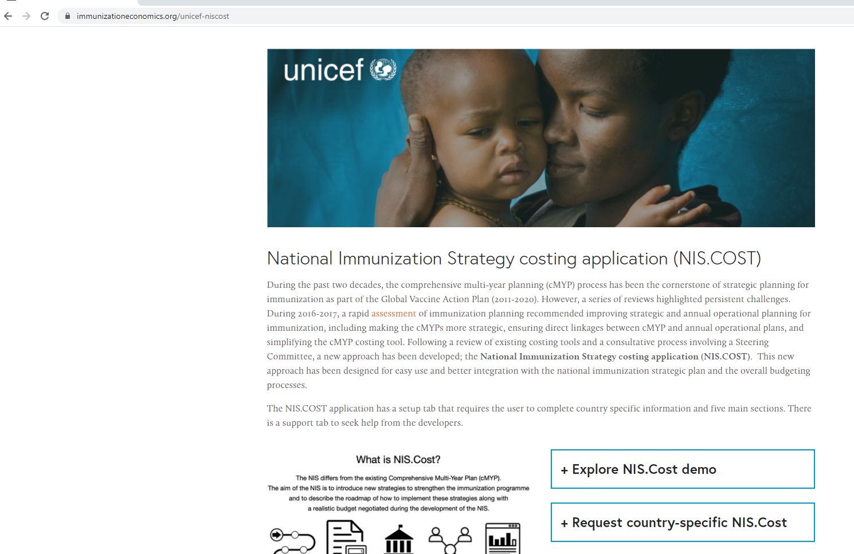
NIS Resources
3
A new costing application from UNICEF
NIS.Cost supports planning, costing and financing
A structured and simple approach:
  Supports the budget negotiation process during the NIS development
  Pre-populated for each country - countries express plans in line with national priorities and contexts
  Enables country teams to work on prioritization scenarios aligned to different resource levels
  Service desk function allows access to support in real time
  https://immunizationeconomics.org/unicef-niscost

Slide 15
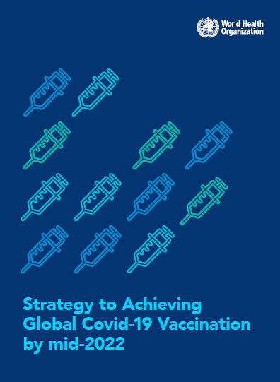
Covid-19 vaccination targets to be integrated in the NIS
4
NIS and Covid-19
WHO Global C-19 vaccination strategy urges all countries to establish updated national COVID-19 vaccination targets and plans
These define the dose requirements and financial and programmatic resource needs
Guidance document to be published on the WHO website
Countries will be asked to report on their Covid-19 vaccination targets through the COVAX Country Portal (CCP)

Slide 16
Perspectives from AFRO
3

Slide 17
Discussion
4

Slide 18
NIS Webinar Series
Opportunity to organise additional webinars topics in 2022 including:
Conducting a situation analysis
Budget negotiation step and NIS.COST training
M&E steps within NIS and aligned to IA2030
Gender considerations
Integration of immunization in national health plan
Let us know if there are other topics you wish to focus on :

Slide 19

Thank you
Additional Questions?
Email: NIS@who.int

