Slide 1


Slide 2
Forward-Looking Statements
This presentation contains forward-looking statements within the meaning of the Private Securities Litigation Reform Act of 1995. Words such as "may," "will," "expect," "plan," "anticipate" and similar expressions (as well as other words or expressions referencing future events or circumstances) are intended to identify forward-looking statements. Forward-looking statements contained in this presentation include statements about the progress, timing, clinical development and scope of clinical trials and the reporting of clinical data for the Company’s product candidates; the potential clinical benefit of the Company’s product candidates; and the timing and outcome of discussions with regulatory authorities. Each of these forward-looking statements involves risks and uncertainties. These statements are based on the Company’s current expectations and projections made by management and are not guarantees of future performance. Therefore, actual events, outcomes and results may differ materially from what is expressed or forecast in such forward-looking statements. Factors that may cause actual results to differ materially from these forward-looking statements are discussed in the Company’s filings with the U.S. Securities and Exchange Commission, including the "Risk Factors" sections contained therein. Except as otherwise required under federal securities laws, we do not have any intention or obligation to update or revise any forward-looking statements, whether as a result of new information, future events, changes in assumptions or otherwise.
.

Slide 3
Agenda
  Introduction to Ovid
  History of OV101
  How does OV101 work?
  What was the STARS Trial?
  What are the Results?
  What does this Mean?
  What are the Next Steps?
  Questions?

Slide 4


Ovid at a Glance: Goal to Build a Leading Company in Neurology
Company | Public Company based in NYC (OVID: NASDAQ) 55 employees Founded 2014
Focus on Angelman, Fragile X and rare forms of Epilepsy | >1 million patients Either no approved medicines or inadequate therapies available Novel, potentially first-in-class therapeutics
Broad pipeline: | Multiple programs in clinical development Novel compounds and mechanisms First potential medicine to treat Angelman syndrome
World-class global partnership: | Takeda Pharmaceuticals for OV935 in rare epilepsies Cost and Profit share agreement Ovid leads clinical development and commercialization in USA/EU
Q4 2018 Events: | Q4: OV101, End of Phase 2 meeting with FDA Q4: OV935, topline data Phase 1b/2a in Developmental Epileptic Encephalopathies Q4: Other studies underway and being initiated

Slide 5
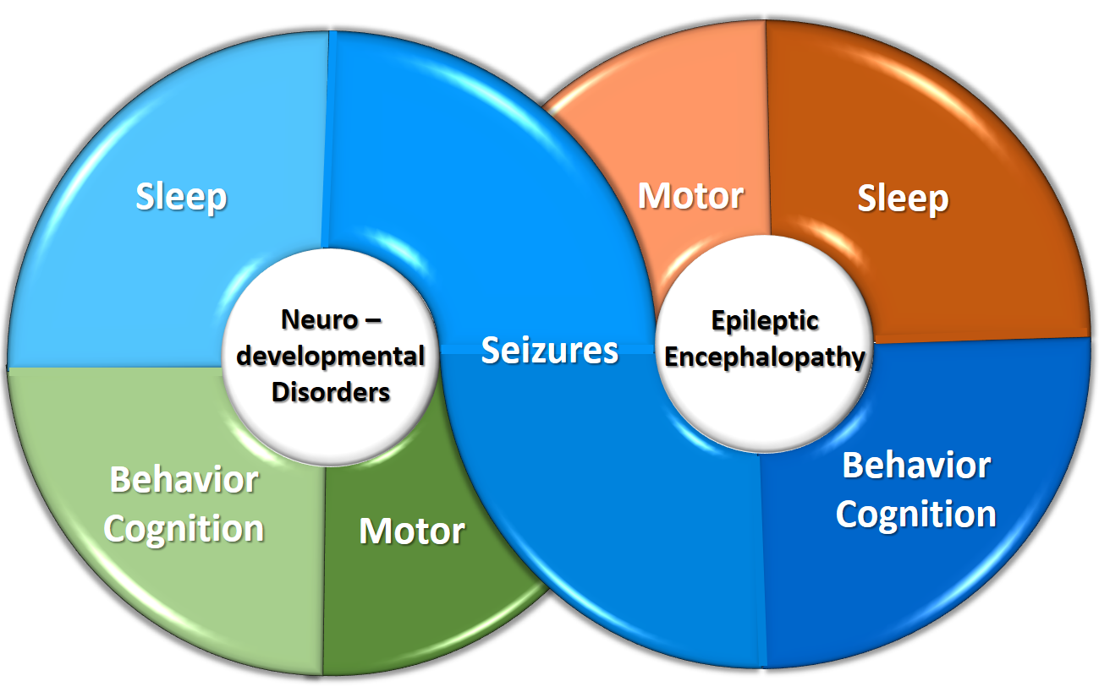
Our Focus: Rare Neurological Disorders which Share Common Symptoms
Our Intent: To make a difference in serious, lifelong disorders
Clear
Genetic
Mechanisms
Global
Clinical Impacts

Slide 6


Ovid’s Pipeline: 4 Years from Founding
RESEARCH
PRECLINICAL
PHASE 1
PHASE 2
PHASE 3
Angelman Syndrome
OV101
Oral
Adult and Adolescent
δ-selective GABA_{A}
receptor agonist
Orphan Drug & Fast Track Designations
Oral
Pediatric
δ-selective GABA_{A}
receptor agonist
Fragile X Syndrome
OV101
Oral
Adolescent
δ-selective GABA_{A}
receptor agonist
Orphan Drug & Fast Track Designations
Developmental and
Epileptic Encephalopathies
OV935*
Oral
Adult
CH24H inhibitor
Oral
Adolescent and Pediatric
CH24H inhibitor
Orphan Drug Designations for LGS & Dravet syndromes
ARCADE
Oral
Adolescent and Pediatric
CH24H inhibitor
ELEKTRA
Treatment-Resistant Epilepsy
OV329
Oral
GABA aminotransferase inhibitor
*Also known as TAK-935. Co-development program with Takeda Pharmaceutical Company Limited.

Slide 7
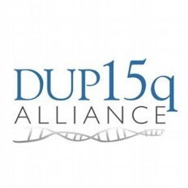
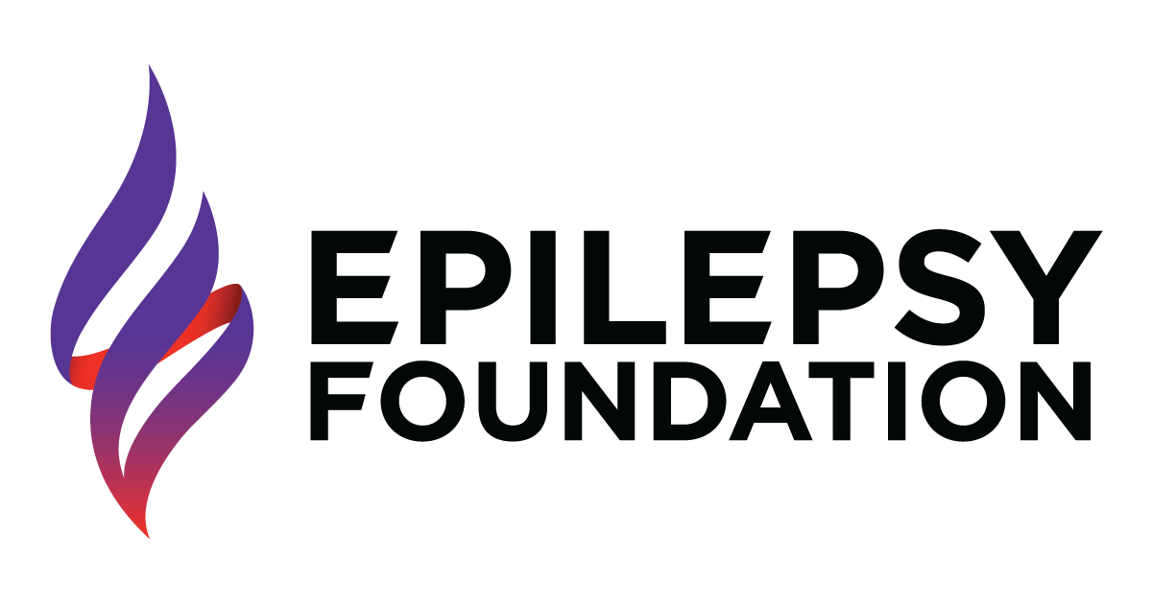



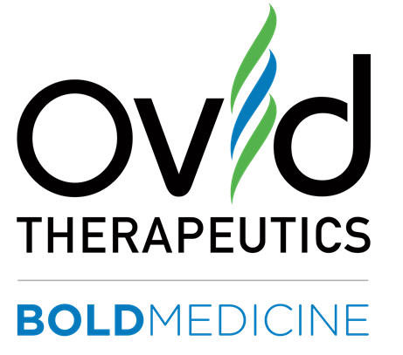













Our Approach: Partnerships About and With Patients and Families

Slide 8
Families are at the Center of All our Activities
Help Families to Advocate for Their Needs
Educate Regulatory Authorities
Design Clinical Development Program
Enact local and Regional Policies
Provide post-approval Support
Advise Policy Makers
Reach Those in Need
Help Physicians Understand Objective Clinical Need and Efficacy

Slide 9
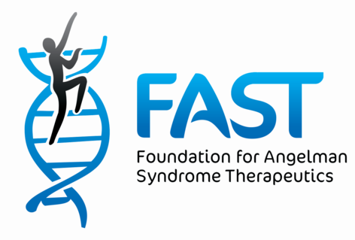
Ovid’s Intent: To Transform the Treatment Landscape for Angelman Syndrome
“Imagine if your child, or a loved one, could not walk or speak and had motor impairment, debilitating seizures and a sleep disorder. This is life today for many of people living with Angelman syndrome.”

Slide 10
Therapeutic Landscape for Angelman Today
Standard of Care: No current approved therapies
Likely Evolution
Today: Small Molecule to treat Global Symptoms, improve sleep & motor short term for all ages. May impact on behavior and cognition longer term
Mid-term: ASO: but may not achieve full coverage of all brain regions. Greater efficacy expected in young patients
Combination Therapy: Small Molecule & ASO targeting global improvements in all age groups
Long Term: Cautiously optimistic , Gene Therapy: BUT will require tight regulation of expression.
Notes:
Talking points:
No approved Therapies
Pipeline growing but long term
Speak to gene therapy challenges with UBE3A

Slide 11
  History of OV101

Slide 12
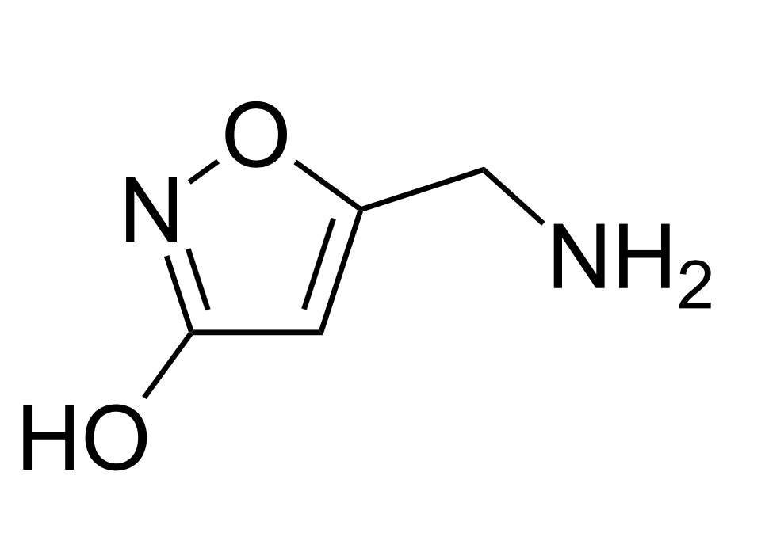
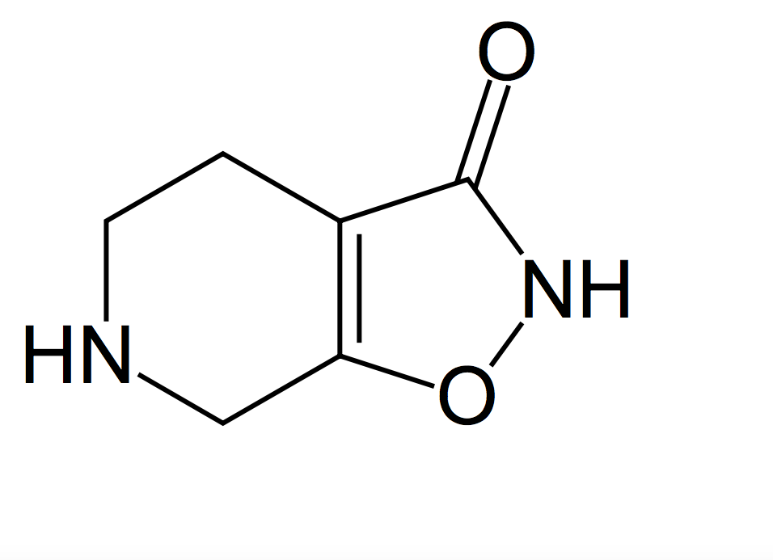
OV101: Origins
Professor Povl Krogsgaard-Larsen synthesized OV101 in 1977*
Mucimol
OV101
(Gaboxadol)
*https://en.wikipedia.org/wiki/Gaboxadol

Slide 13
OV101: History to 2007
1996
Sleep experts noted that gaboxadol (OV101) appeared to induce sleep as effectively as the industry standard, Ambien.
But unlike other sleep medicines there were several potentially relevant differences:
  Data supporting near normalization of sleep architecture (quality of sleep)
  Low risk tolerance
  Limited potential for next day tiredness
  No demonstration of interaction with alcohol
  Low risk of potential abuse
2007
Merck and Lundbeck complete clinical trials for insomnia
~ 1000 patients, >900 patient years of safety data
Terminated the program 2007 for commercial reasons

Slide 14
OV101: History to 2015
2007 – 2014
New information on role of extrasynaptic receptor in Angelman Syndrome
Scientists publish initial results showing OV101 can reverse some of the aspects of Angelman in mice
2015
Ovid Licenses OV101 from Lundbeck
Ovid meets with with Families and Family Organizations
Clinician, Families and others work with Ovid to get deeper understanding of Angelman
2016-2018
Ovid Designs, Carries out and completes STARS Phase 2 Trial
Multiple patents issue for OV101
Orphan Drug Designation
Fast Track Designation
August 2018 – First Positive Clinical Data for Angelman Syndrome in >50 years

Slide 15
  How does OV101 work?

Slide 16

Angelman Syndrome: Affects Every Cell in the Brain
The genetic change disrupts normal behavior of brain cells
A key physiological process, tonic Inhibition, does not function correctly*
The brain’s ability to correctly identify excitatory and inhibitory neural signals without being overloaded is affected
causing the typical symptoms associated with Angelman syndrome
*https://angelmansyndromenews.com/2018/08/17/tonic-inhibition-deregulation-potential-key-understanding-angelman/

Slide 17








Reduced GABA Levels Lead to Loss of Tonic Inhibition in Angelman Syndrome
Presynaptic Neuron
UBE3A deficiency
GABA production
GAT1 does not get ‘tagged’
Angelman
syndrome
GABA transporter (GAT1)
Increased GAT1
Increased GABA reuptake
GABA
Decreased extrasynaptic GABA levels
normal
abnormal
Decreased tonic inhibition
δ
δ
synaptic
Symptoms
extrasynaptic
HEALTHY
ABNORMAL
AS=Angelman syndrome; GABA=γ-aminobutyric acid; UBE3A=ubiquitin-protein ligase E3A.
1. Egawa K et al. Sci Transl Med. 2012;4:163ra157. doi:10.1126/scitranslmed.3004655. 2. Wu C, Sun D. Metab Brain Dis. 2015;30:367-379.
3. Bagni C et al. J Clin Invest. 2012;122:4314-4322.

Slide 18
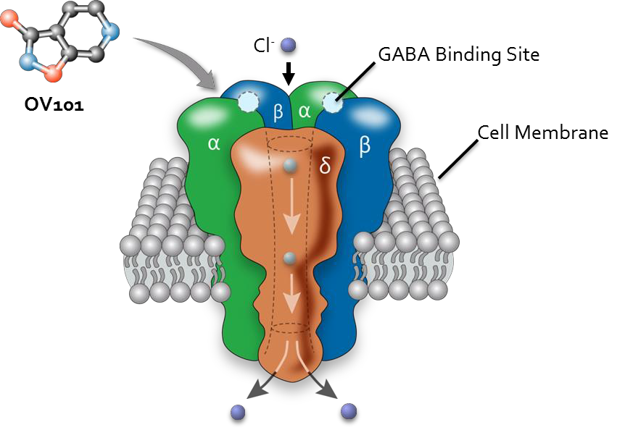
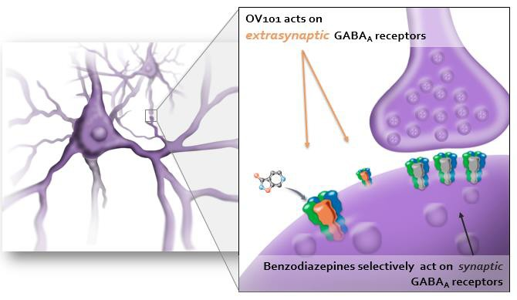
OV101: First-in-Class GABA_{A} Receptor Agonist with Potential to Restore Tonic Inhibition
Only δ-selective, extrasynaptic GABA_{A} receptor agonist in clinical development
Distinct from GABA allosteric modulators, as it functions when endogenous GABA is deficient
Potentiates tonic inhibition at low nM concentrations^{1,2}
Restores tonic inhibition in Angelman and Fragile X syndrome mouse models^{4,5,6}
¹Meera et al., J Neurophysiol. 2011; ²Belelli et al., J. Neurosci.2005; ³ Duguid et al. Journal of Neurosci. 2012 ⁴Olmos-Serrano et al. J. Neurosci. 2010; ⁵Egawa et al. Sci. Trans. Med. 2012⁶Olmos-Serrano et al. Dev. Neuro. 2011

Slide 19
Angelman’s: Key Clinical Domains
Global Symptoms
Sleep
Behavior
Motor
Cognition
Communication

Slide 20
  What was the STARS Trial?

Slide 21

OV101 in Angelman: Phase 2 Randomized, Double Blind, Placebo Controlled Trial
Orphan Drug and Fast Track designations
Trial Design:
n=88 (randomized)
Adults and adolescents (age 13-49 years)
12 sites in US, 1 site in Israel
Evaluated QD (15mg) and BID (15mg evening; 10mg morning) doses
Primary Endpoint:
Safety and tolerability of OV101 vs. placebo from baseline to week 12
Exploratory Endpoints:
Efficacy measures of OV101 vs. placebo for overall clinical change from baseline to week 12
Global function, behavior, sleep and motor
EEG, metabolomics and quality of life
First-ever industry-sponsored double-blind, placebo-controlled clinical trial in Angelman syndrome
.
Source: Ovid press release August 6, 2018. STARS Topline Phase 2 Data.
10

Slide 22
  What were the Results?

Slide 23

OV101 Results*: First Positive Clinical Data for Angelman Syndrome in >50 years
Primary Endpoint
OV101 Achieved the Primary Endpoint of Safety and Tolerability as Measured by Incidence of Adverse Events
Exploratory Endpoints:
OV101 has Clinical Effects in Adults and Adolescents Across Multiple Domains
  CGI-I
  Clinical Impression of Sleep domain
  Motor (Zeno walkway, BSID-III, PEDI-CAT, CHAQ)
  Behavior Tends
Sleep
Actigraphy
CGI - sleep
Global Improvement
CGI-I
Motor
Bayley
PEDI-CAT
CHAQ
PGI
Dosage
Observed Changes on Outcome Measures with 15 mg OV101 QD at 12 Weeks
*Biomarker data expected 2019: EEG, Metabolomics
Notes:
Talk over the actigraphy data, and the subgroup/responder analyses for Bayley, PEDICAT, CHAQ and PGI.
Improvement was observed in the Disability Index of the CHAQ as well as the PEDI-CAT gross
motor scores in OV101 QD group compared with placebo
Talk over- HIGHLIGHT EOP2 MEETING AND PRESENTATION AT AACAP

Slide 24
STARS Phase 2 Trial : Summary and Conclusions
STARS achieved primary endpoint of safety and tolerability: OV101 was well-tolerated with an overall favorable safety profile
In the in the OV101 15 mg QD treatment group vs. placebo the following was observed
Global functions: Statistically significant improvement seen in clinical global impression in the OV101 QD treatment group
Sleep: Reduction in latency to sleep onset and improvement in overall sleep
Motor: Motor domain changes noted in the BSID-III, PEDI-CAT, CHAQ Disability Index, and Zeno™ Walkway
Behavior: Improvements in communication, challenging behavior, and anxiety among patients who showed clinically meaningful improvement in CGI-I. However, no significant differences were found on the ABC-C and ADAMS.
Other Takeaways
Younger patients receiving single daily dose showed greater response
Data consistent with hypothesis that younger patients have greater treatment effect compared to older ages
Effect appears to persist over time from 6 to 12 weeks

Slide 25
  What does this Mean?

Slide 26
CGI-I and What it Means to You
Every individual with Angelman Syndrome is different.
All have different degrees of difficultly with sleep, communication, behavior, motor, epilepsy and other symptoms
Even when they share the exact same mutation of the UB3a gene.
  For example, some walk better, others communicate better, others sleep better, etc.
CGI-I is a tool used by Doctors to measure changes in these each patient individually.
A clinically meaningful change in an individual with AS could include improvements in anyone or all of these areas
  Sleep (e.g. reduced daytime sleepiness & latency to sleep onset),
  Behavior (e.g. increased vocalizations & awareness),
  Motor function (e.g. gross motor skills like walking more steadily or fine motor skills such as improved grip).

Slide 27
How to think about CGI-I
Before
During
Poor grip
Improved grip
Walks unsteadily
Walks more steadily
CGI-I allows the
Clinician to
measures all these
different changes
caused by
the treatment
Less aware
More aware
Sleep improved
Sleeps
poorly
Vocalizes Poorly
Improved Vocalization

Slide 28
  What are the Next Steps

Slide 29
OV101 Next Steps: Clinical
OUR GOAL IS TO SEEK TO HAVE OV101 APPROVED AS FAST AS POSSIBLE
USA, EU and Israel
  ELARA 1-year Extension Study: Q4 2018 initiated ELARA, an open-label extension study that will enable individuals with Angelman syndrome who completed any prior OV101 study to be eligible to receive the investigational medicine. The study will use once-daily dosing and will assess long term safety and tolerability in addition to efficacy measures
Other
  Early Access Program (EAP)
  Pediatric Studies
Notes:
Talk over the actigraphy data, and the subgroup/responder analyses for Bayley, PEDICAT, CHAQ and PGI.
Improvement was observed in the Disability Index of the CHAQ as well as the PEDI-CAT gross
motor scores in OV101 QD group compared with placebo
Talk over- HIGHLIGHT EOP2 MEETING AND PRESENTATION AT AACAP

Slide 30
OV101 Next Steps: Regulatory Path
OUR GOAL IS TO SEEK TO HAVE OV101 APPROVED AS FAST AS POSSIBLE
USA
  Met with FDA
EU
  Beginning Process
Israel
  Need assistance of the Patient organizations
  Working with Clinicians and Regulatory Consultants
  Intend to Meet with the MOH
Notes:
Talk over the actigraphy data, and the subgroup/responder analyses for Bayley, PEDICAT, CHAQ and PGI.
Improvement was observed in the Disability Index of the CHAQ as well as the PEDI-CAT gross
motor scores in OV101 QD group compared with placebo
Talk over- HIGHLIGHT EOP2 MEETING AND PRESENTATION AT AACAP

Slide 31
Values Underlie Everything We Do at Ovid
BoldMedicineTM defines the difference between drugs and medicine:
Medicine is about enhancing health and treating conditions that can challenge everyday life
Ovid is:
Executing on a clear vision, strategy and plan
Driving new and novel therapeutics for Angelman Syndrome and other important medical areas
Developing medicines with novel mechanisms of action
Building deep and lasting relationships with patients, families and foundations
Our Goal:
To make a Fundamental Difference to the lives of Patients and their Families

Slide 32
Our Thanks
On behalf of Ovid, I would like to thank all those who helped support the trial and to evaluate OV101 including:
  The Families and those with Angelman Syndrome who participated in the trial
  The Physicians, Study Coordinators, Nurses, Physiotherapists, Psychologists, EEG Technicians and Administrators who ran the trials
  The Israeli Angelman Syndrome Foundation
  Professor Kreiss, Prof. Ben Zeev, Dr. Heimer and the entire team at Sheba Medical Center
  For the first time in over 50 years we, together, have shown a positive effect of a compound on Angelman Syndrome. We are moving towards a cure.

Slide 33
  Questions?

