Slide 1
Infection control
Keeping others and yourself safe in a medical environment

Slide 2


INTRODUCTIONS

Slide 3
Did You Know?
1 in 10 patients get an infection while receiving medical care.
10%
https://www.who.int/infection-prevention/en/

Slide 4
Learning Objectives
WHAT
Identify steps of respiratory etiquette.
Recognize influenza symptoms.
WHEN
Indicate circumstances required for various hand hygiene protocols.
Identify when PPE is necessary.
WHY
State the importance of hand hygiene.
HOW
Describe hand hygiene protocols.
Distinguish ways infections are spread.

Slide 5
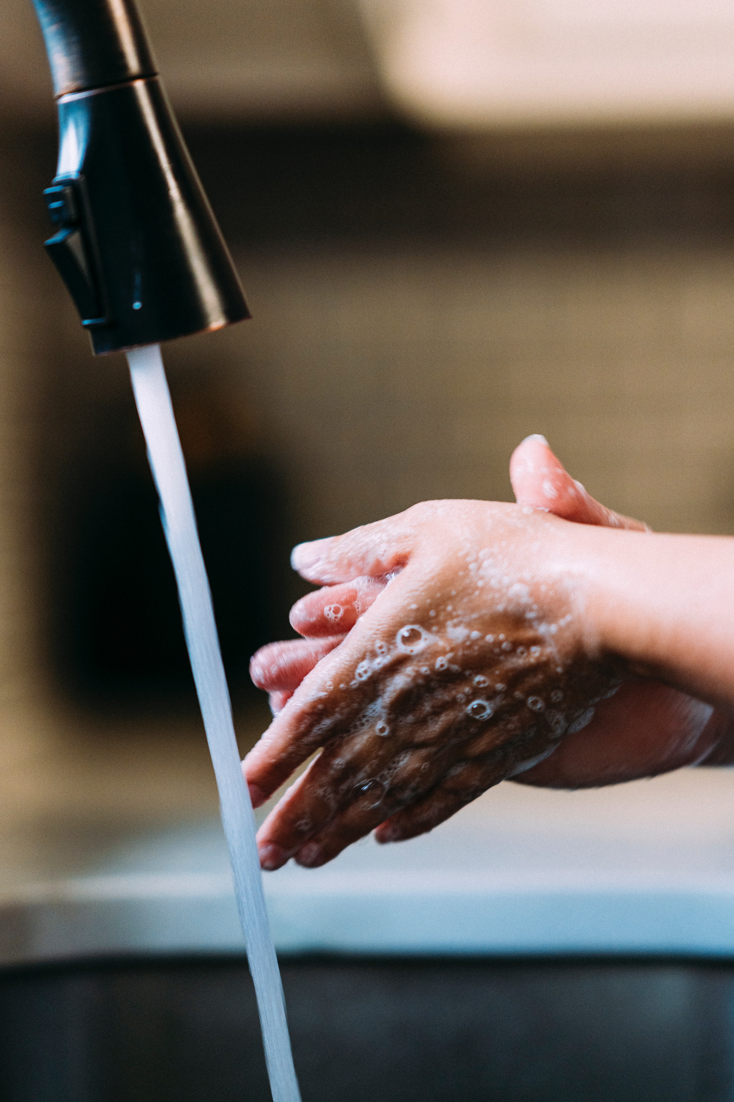
Hand Hygiene
Hand washing is the #1 way to prevent the spread of germs.

Slide 6
When do you wash your hands at work?
When entering and exiting a patient’s room.
Before and after having direct contact with a patient.
After contact with the environment, including medical equipment,
in the immediate vicinity of the patient.
Before and after wearing gloves.

Slide 7
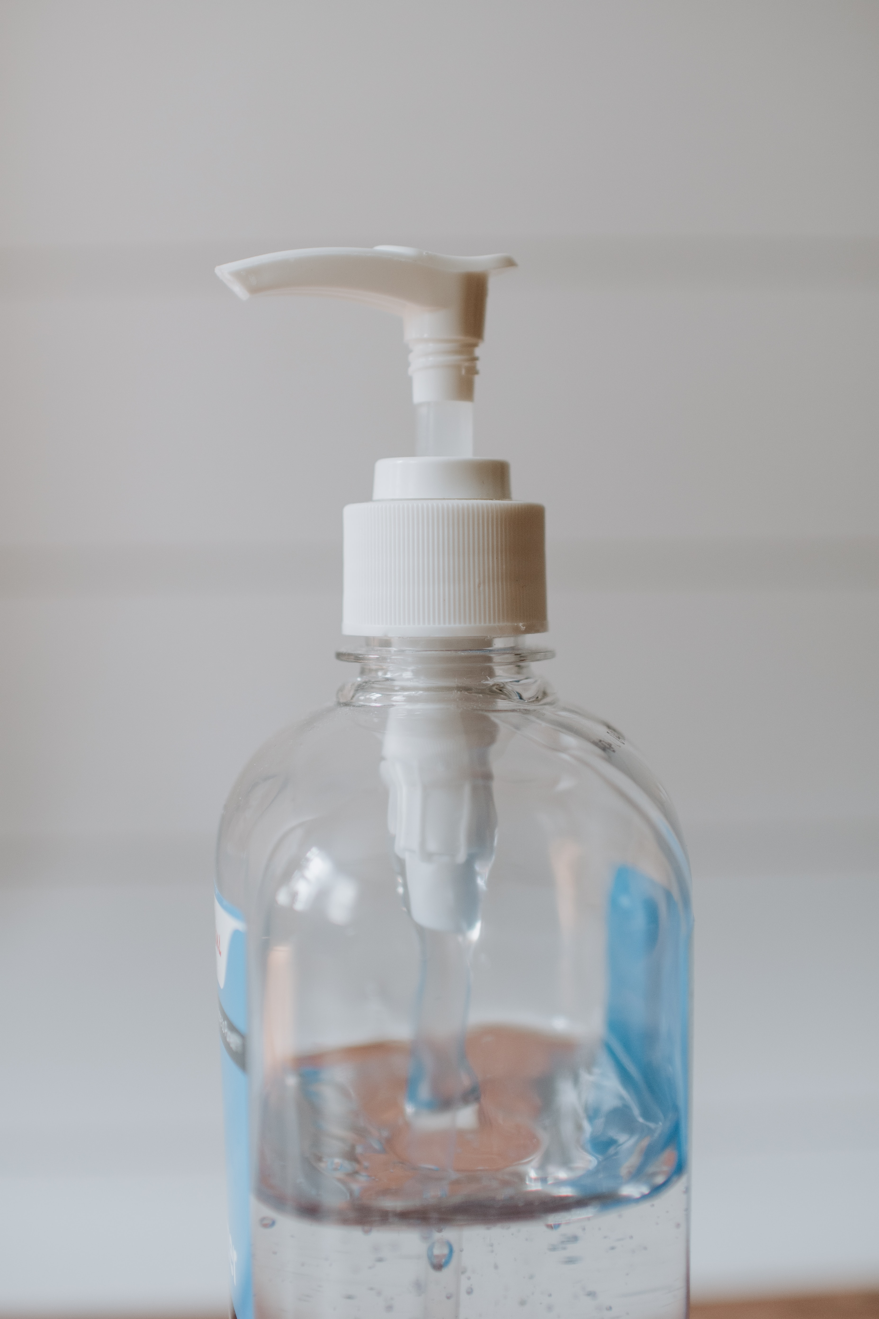
Hand washing protocols
SOAP AND WATER
ALCOHOL BASED HAND RUB
For routine decontamination of hands if:
When hands are visibly dirty or contaminated.
When visibly soiled with blood or other bodily fluids.
When caring for patients with clostridium difficile (c. diff) or norovirus.
hands are not visibly soiled.
patient does not have clostridium difficile (c. diff) or norovirus.

Slide 8
How to handwash
Soap and Water Protocol
1
  Wet hands with warm water.
2
  Obtain a moderate amount of soap on hands. Never use bar soap.
3
  Vigorously rub hands together beginning with palms and working between fingers and underneath the fingernails. The back of the hands and wrists also are very important.
4
  Scrub for at least twenty (20) seconds.
5
  Rinse hands thoroughly.
6
  Using a paper towel or hand dryer, dry hands adequately to prevent chapping.
7
  Turn water off with a paper towel to prevent contaminating hands by touching the faucet.

Slide 9


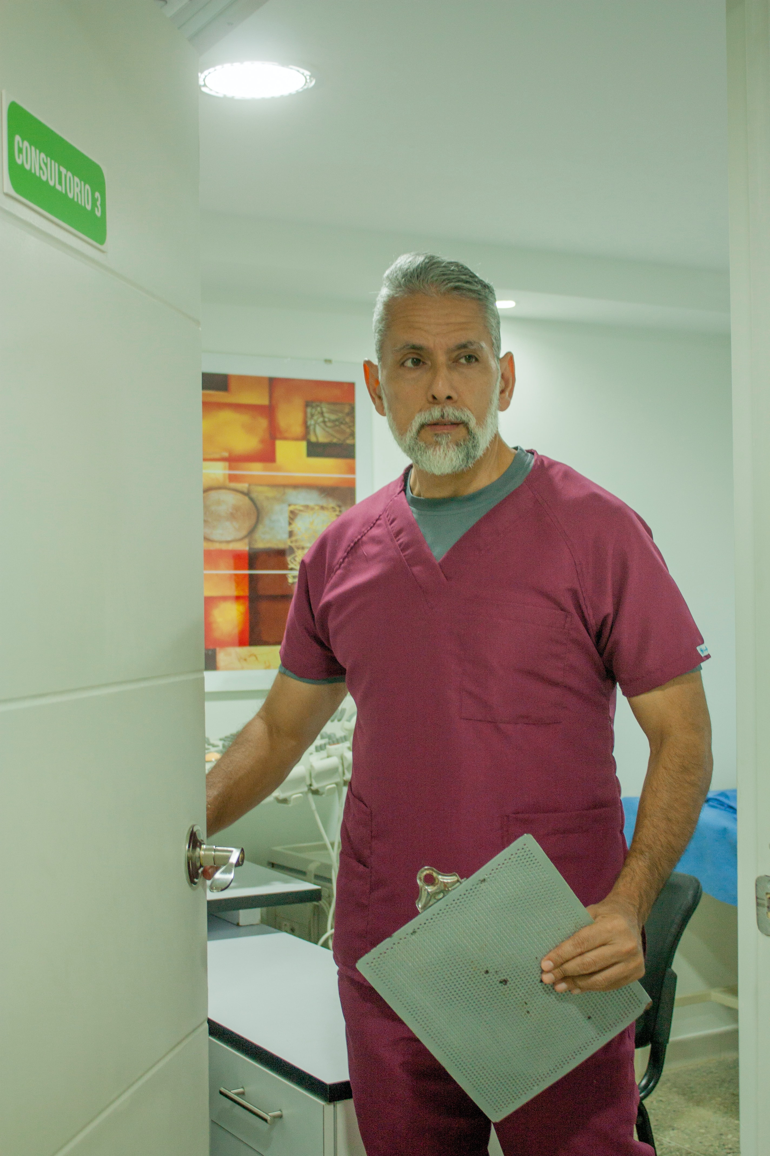
Knowledge Check
Scenario
You have washed your hands and started intake paperwork with a patient when you realize that you need a different clipboard. Quickly, you go into the hallway to switch clipboards at your station. Your hands appear to be clean and the patient is in for a routine check-up.
Question
Do you clean your hands before entering the room?
If so, which protocol would you utilize?

Slide 10
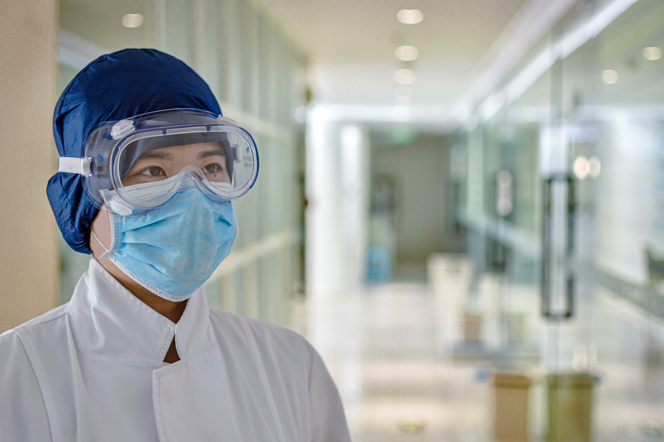
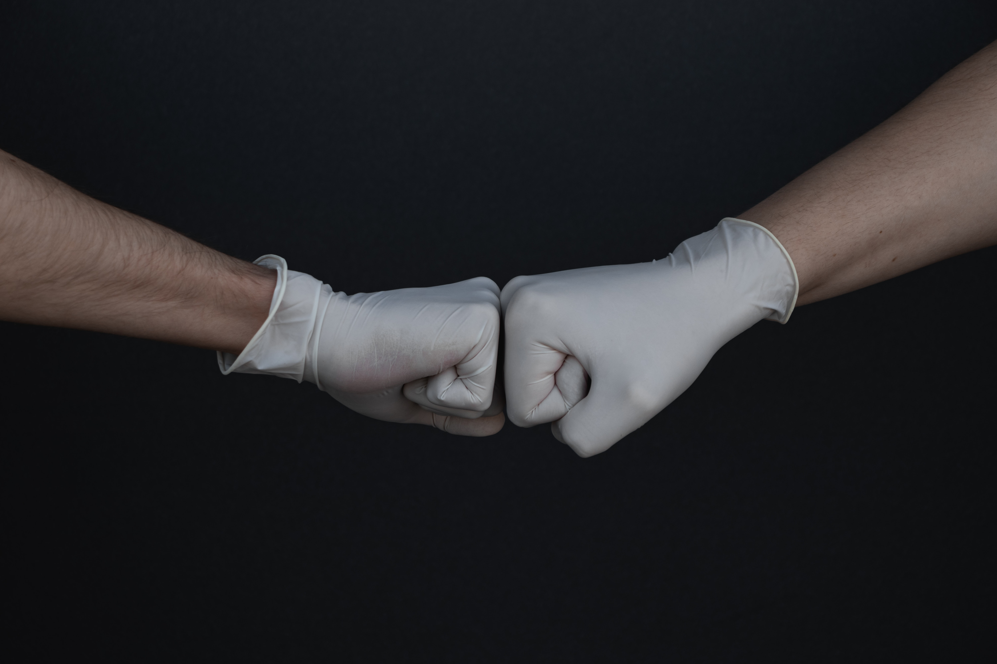
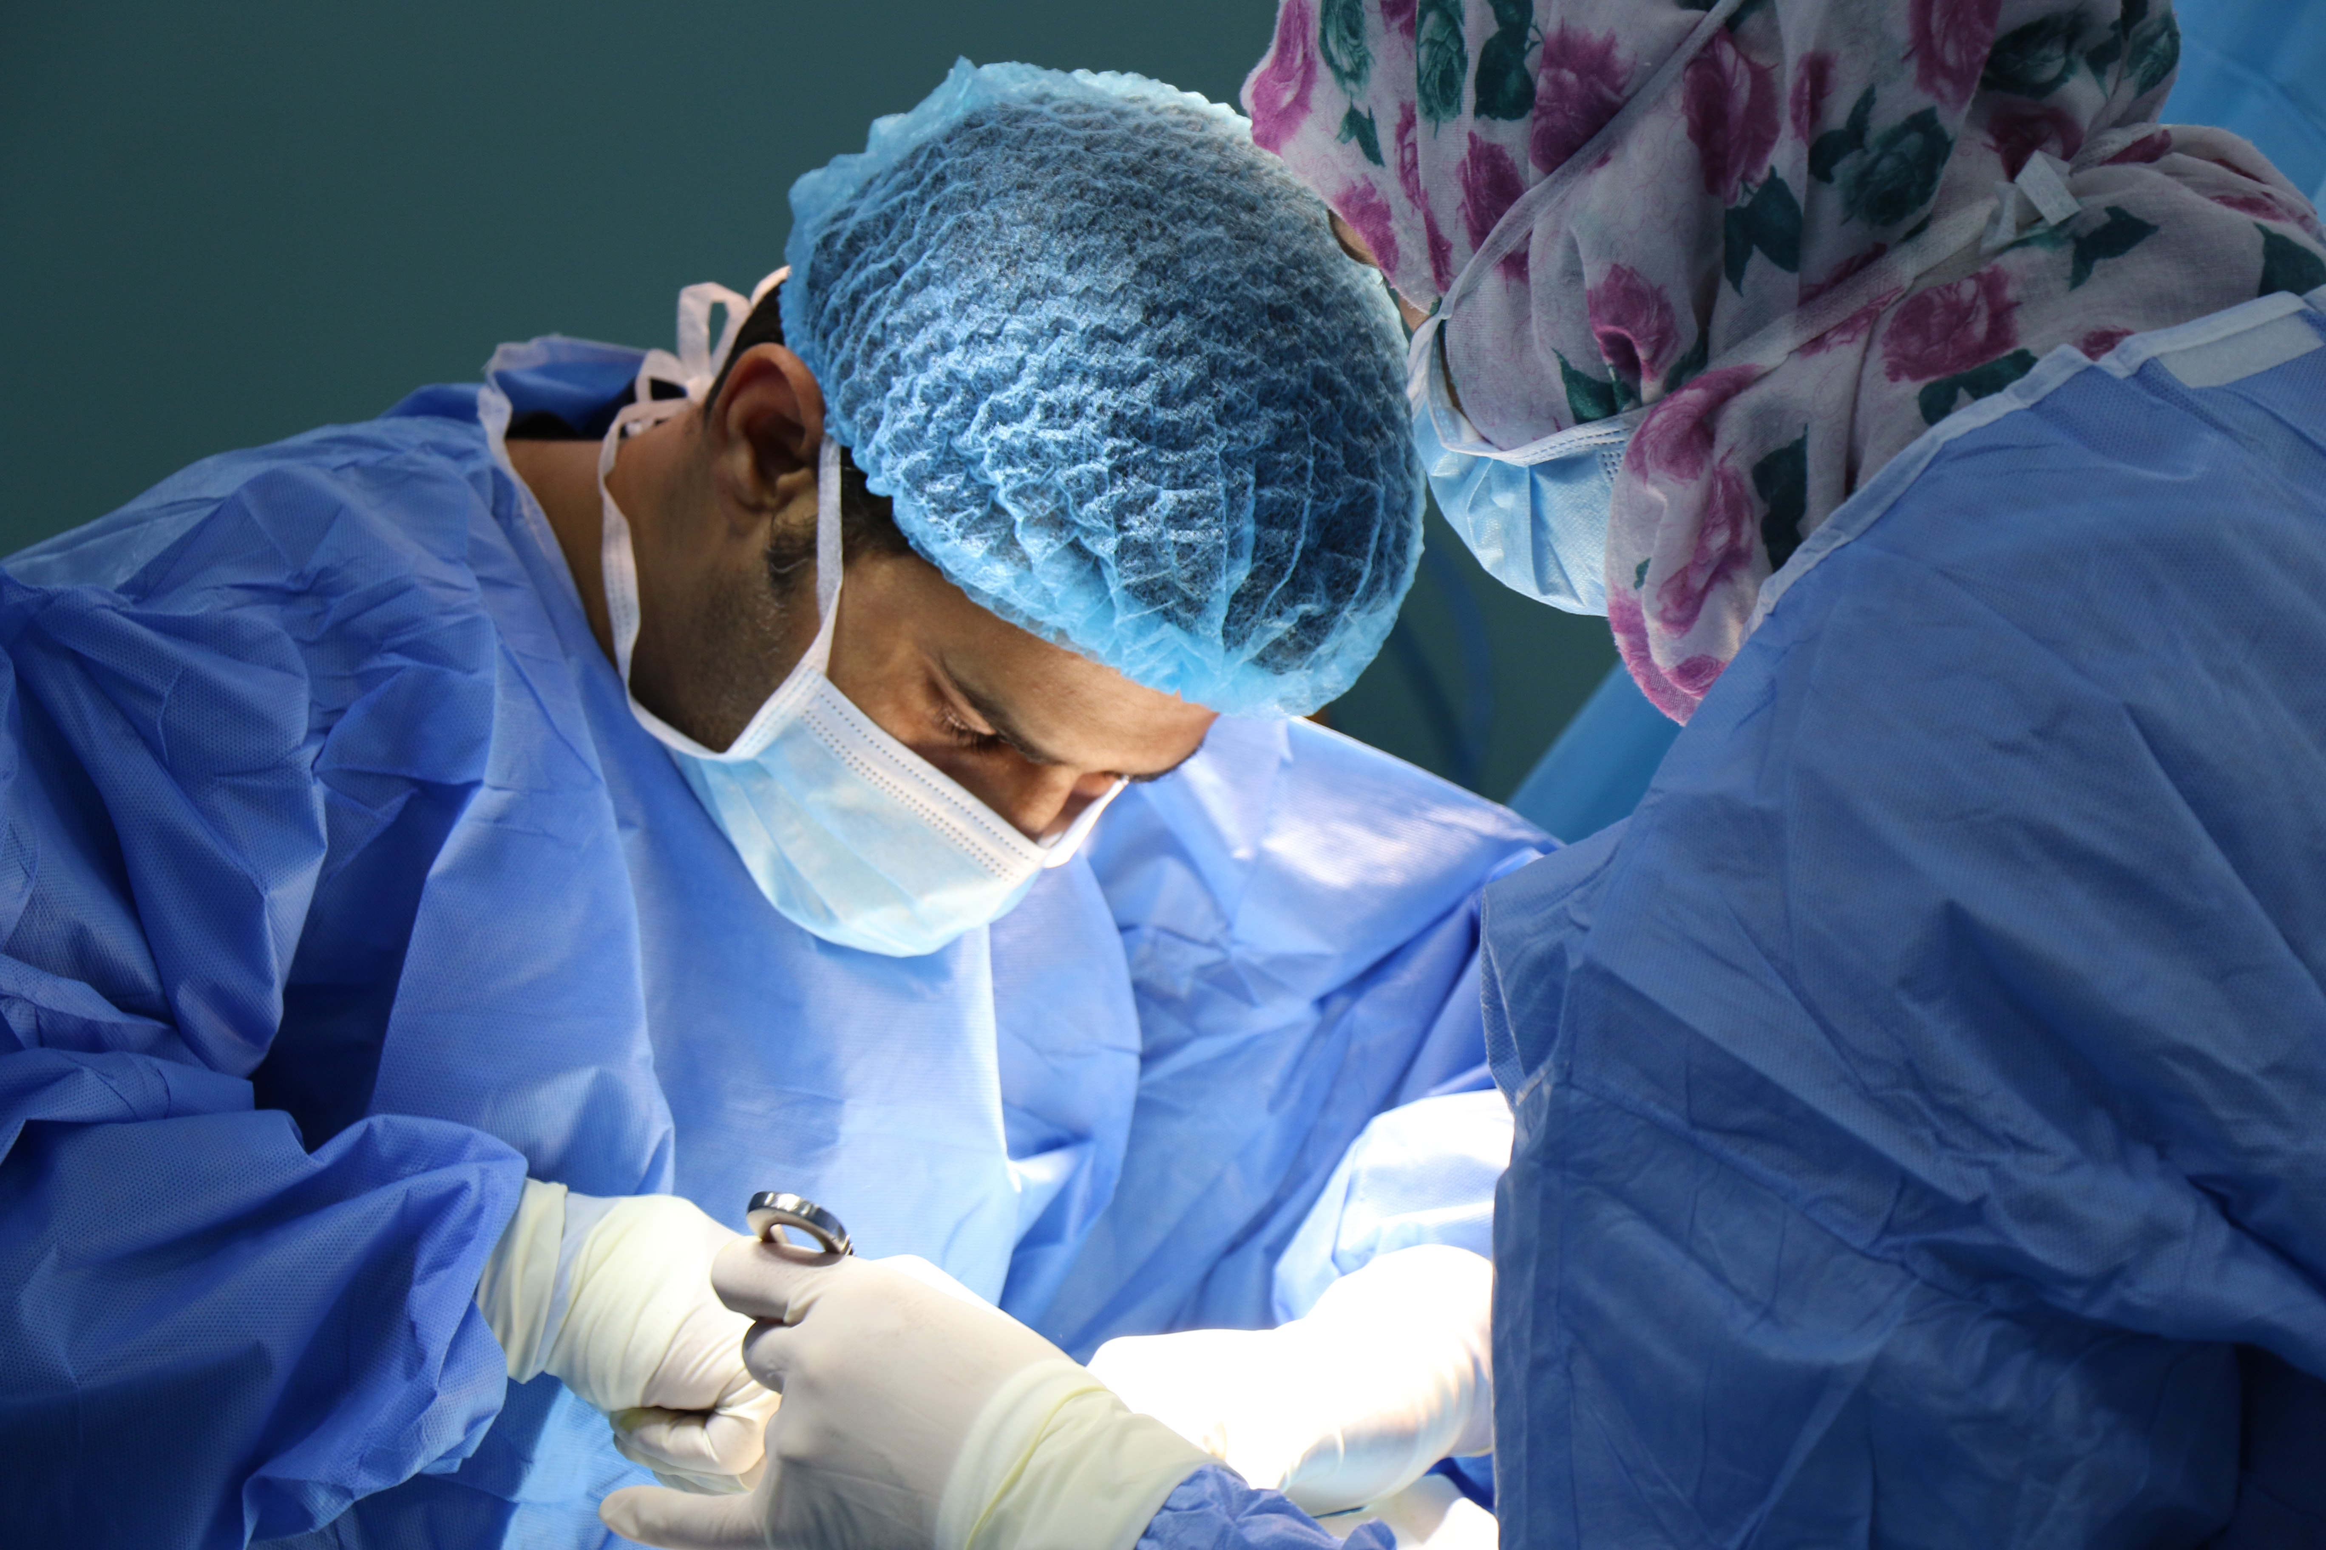
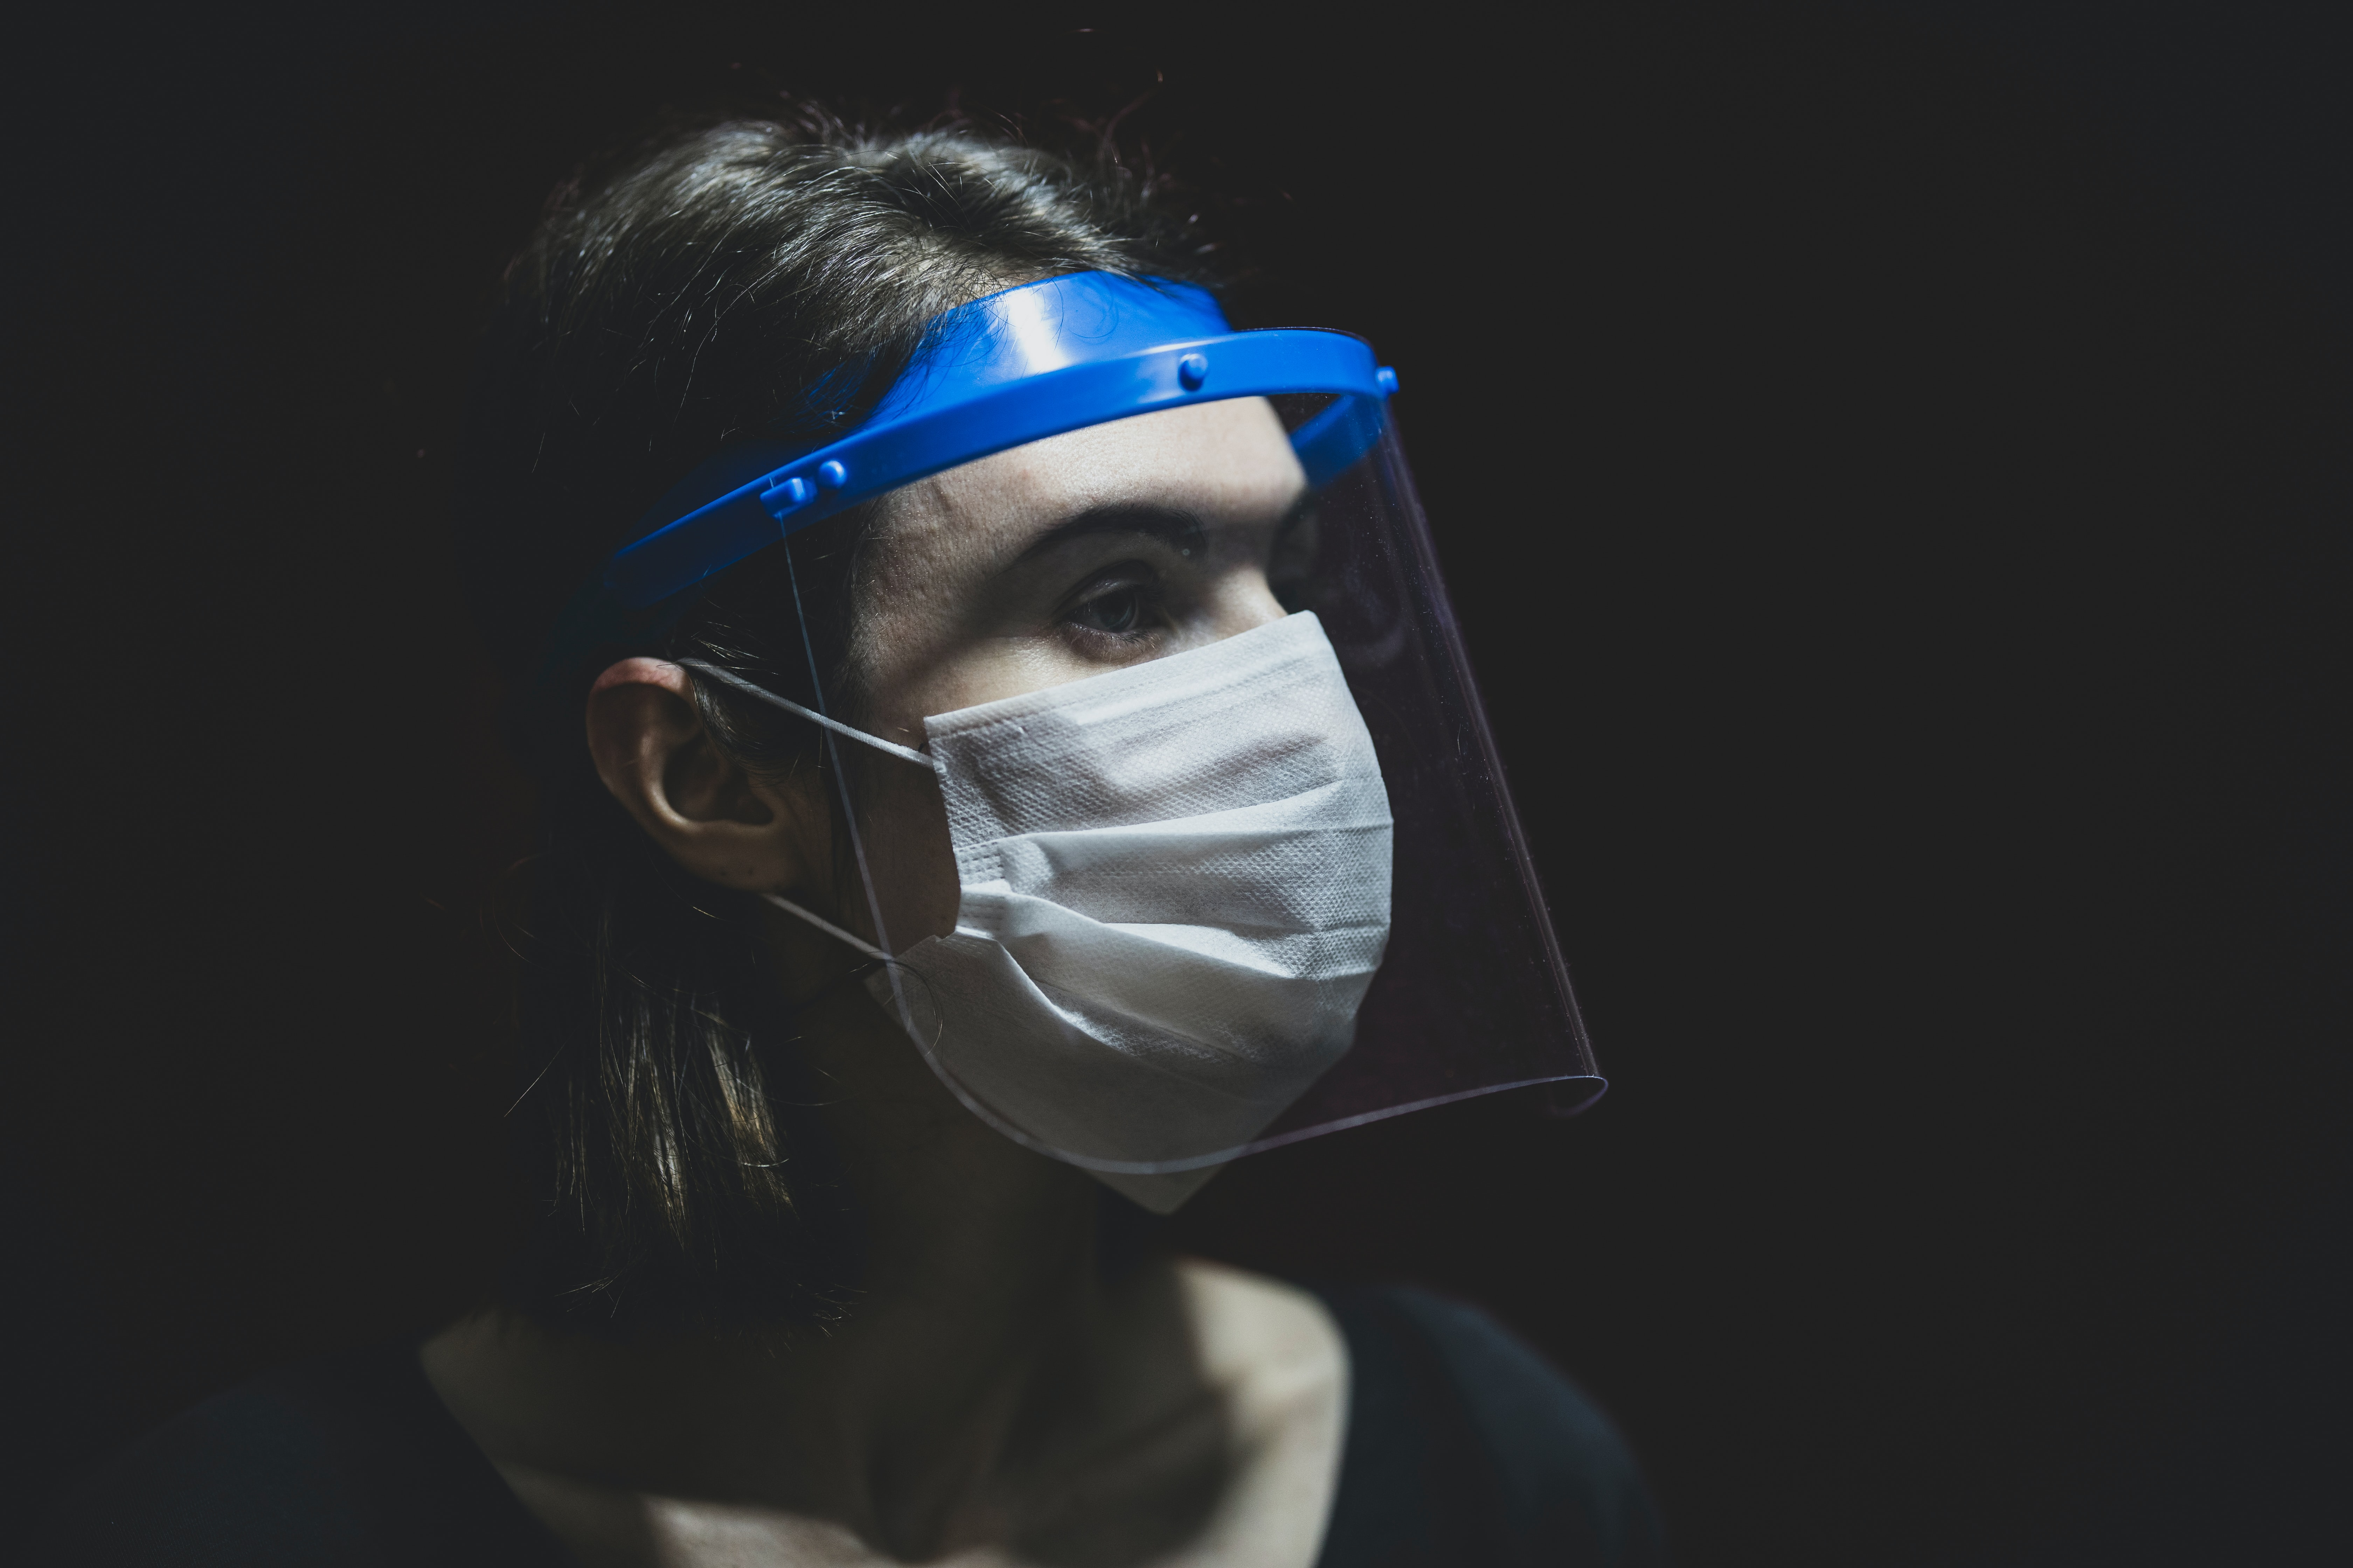
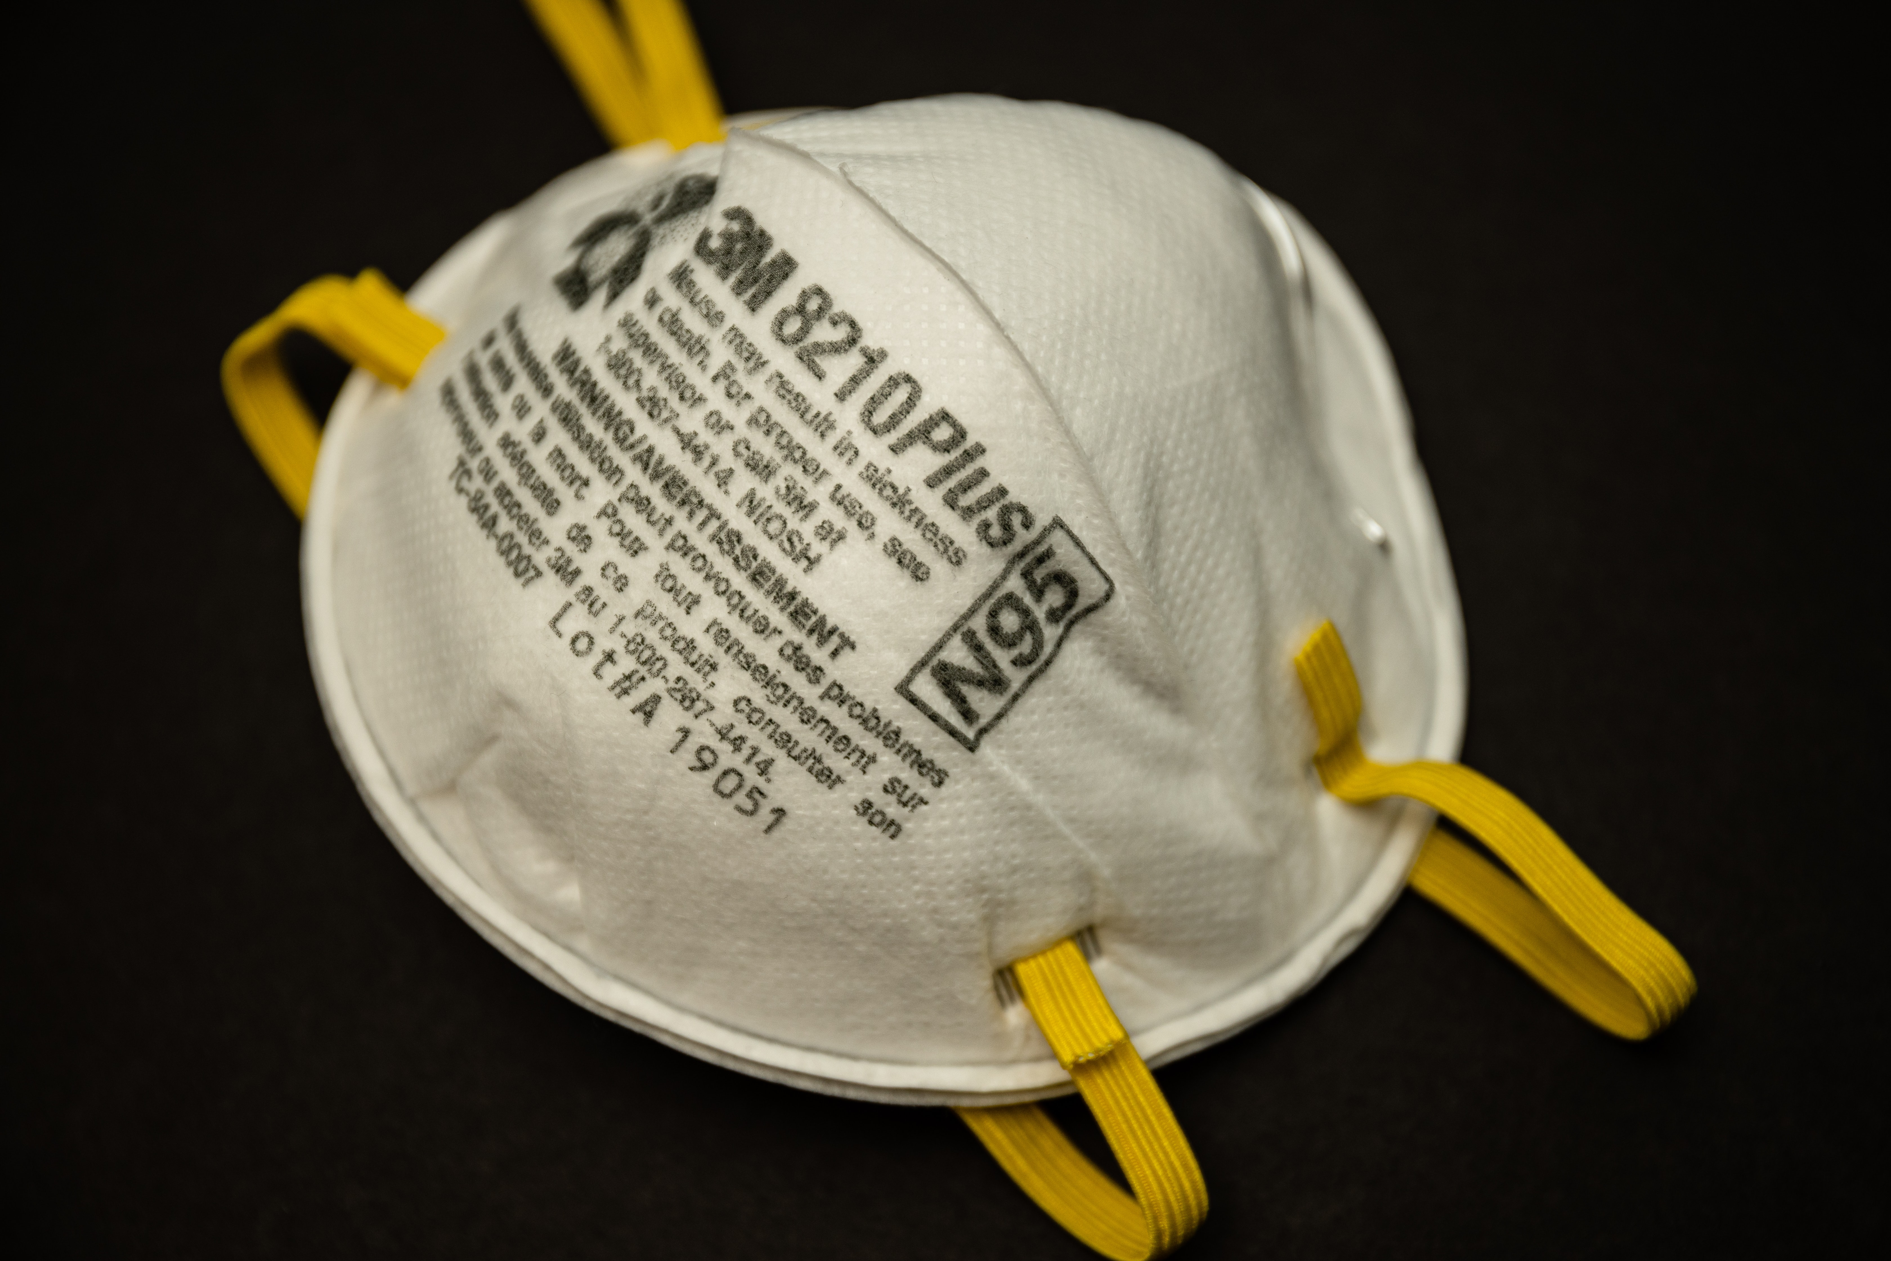
Personal Protective Equipment
PPE

Slide 11
When do you wear PPE?
Standard Precautions
  Blood and body fluids from ALL patients should be treated as if they are infectious.
Airborne Pathogens
  Tuberculosis, SARS, Measles, Airborne Pathogens
Bloodborne Pathogens
  Hepatitis B & C

Slide 12
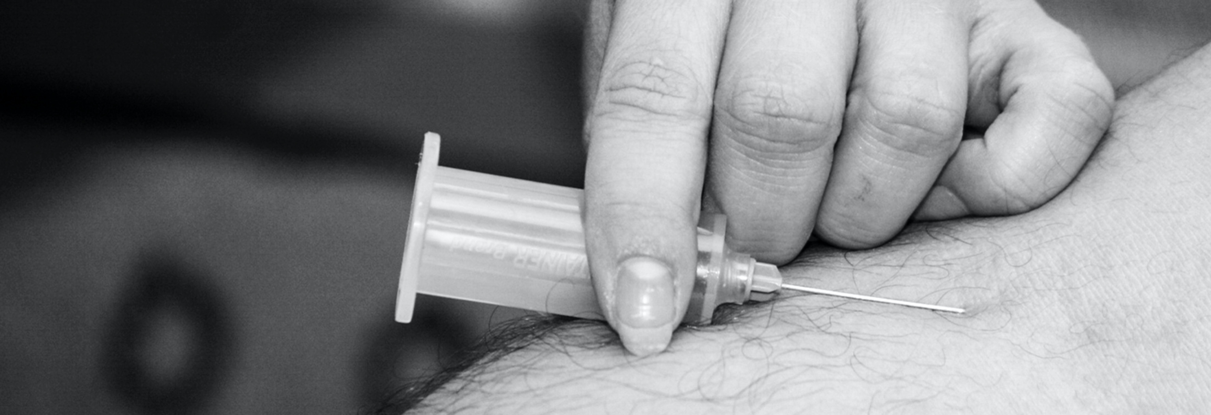
Knowledge check

Slide 13
Influenza
Fever
Headache
Chills
Draining or congested sinuses
Sore throat
Diarrhea
Vomiting
Fatigue
Muscle or body aches
Cough
symptoms

Slide 14
influenza Control
Timeline
Hand hygiene
Droplets
Contain secretions
Surface
Don’t
touch
The Spread
Etiquette

Slide 15
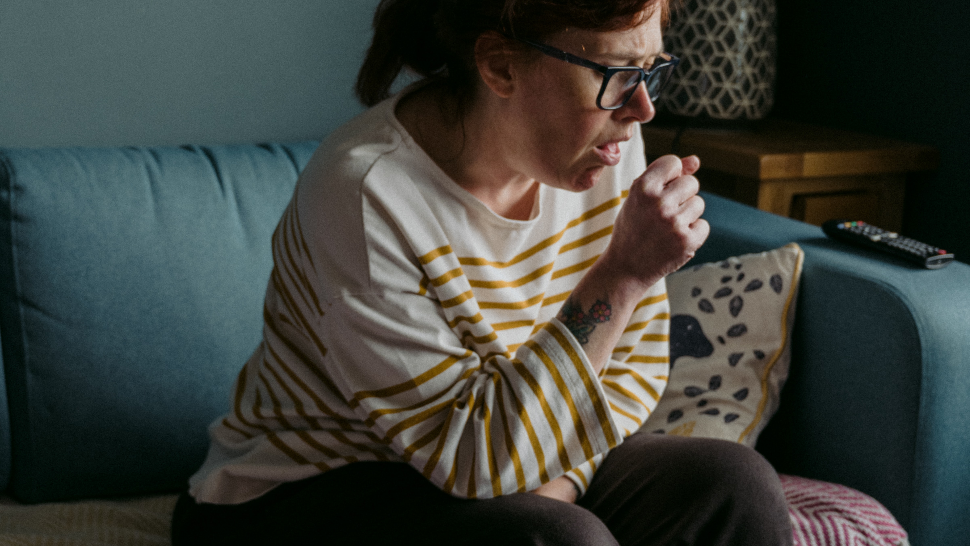
Knowledge Check

Slide 16
What
Respiratory etiquette steps
Influenza symptoms
When
Summary
Hand hygiene protocols
PPE
Why
Importance
How
Hand hygiene protocols
Infections spread

Slide 17
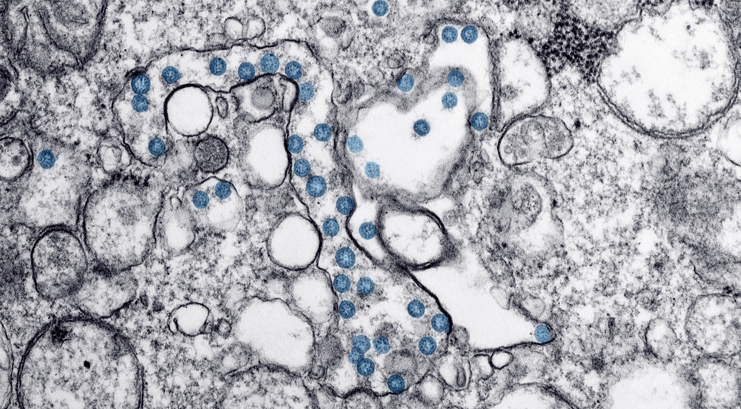
Q & A

Slide 18
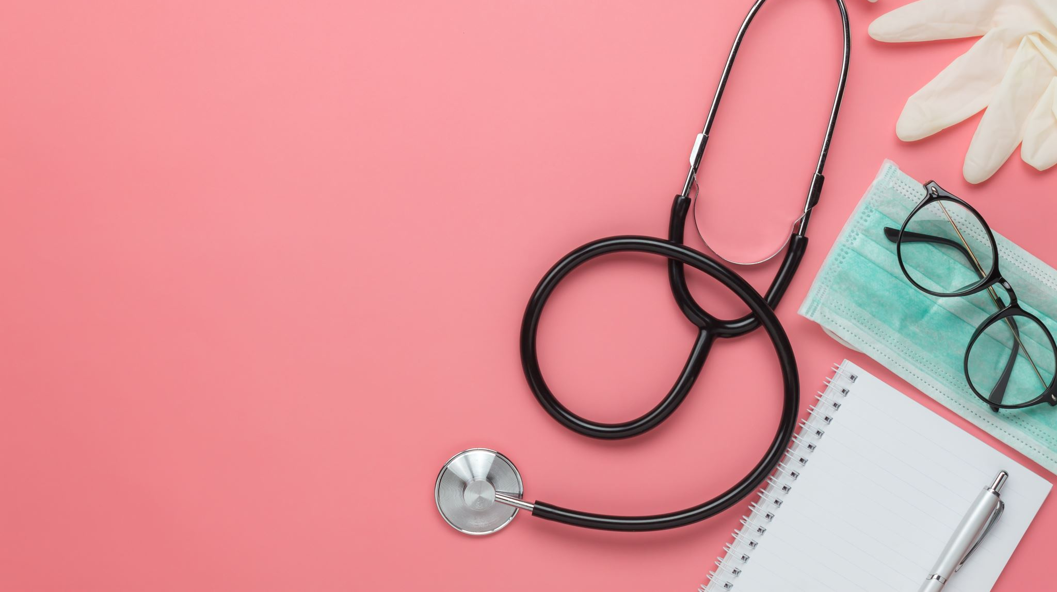
Thank
you

