Slide 1
Recruitment pack for:
Operations Support Officer
Mary’s Meals UK
February 2020

Slide 2
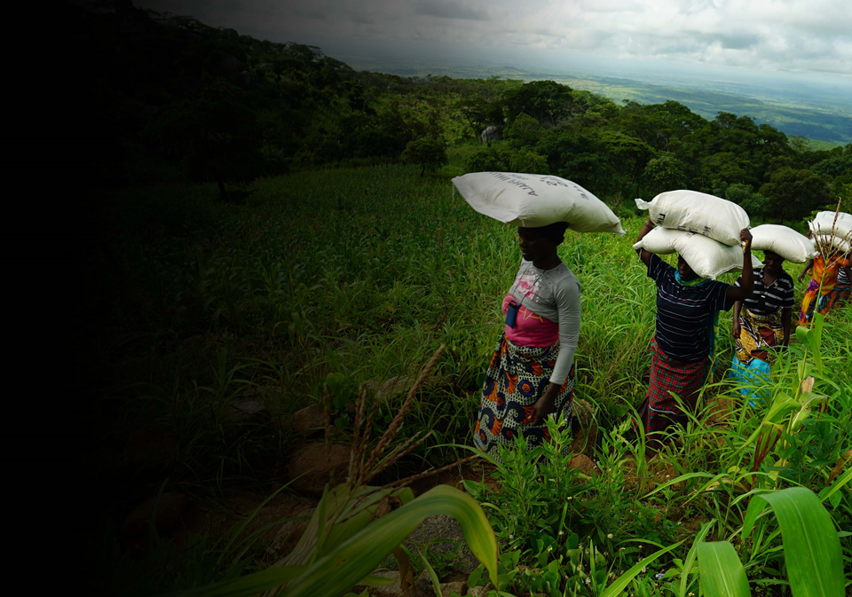
Recruitment pack contents
Welcome from our Executive Director
Our vision, mission and values
About the Mary’s Meals movement
About Mary’s Meals UK
Role outline and specification
Recruitment process information
3
5
7
9
11
16
2

Slide 3
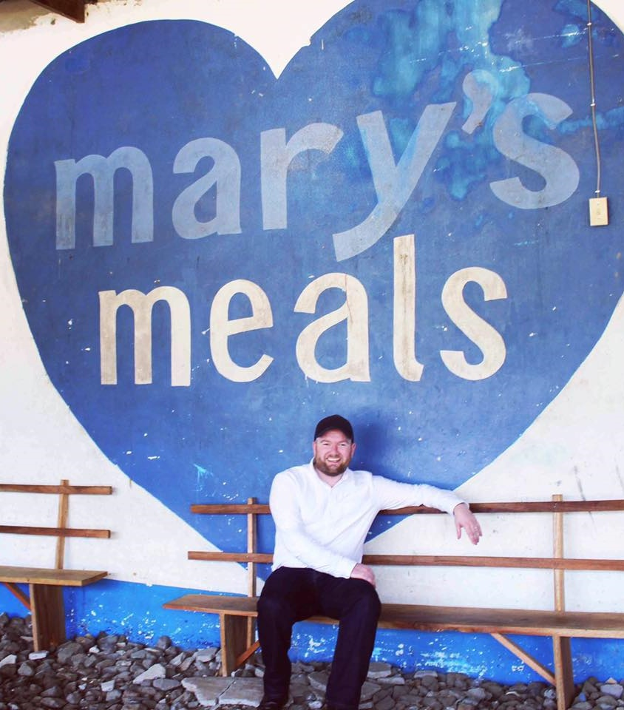
Welcome from our Executive Director
Thank you so much for your interest in joining the Mary’s Meals family. As you consider making an application for the role of Operations Support Officer with Mary’s Meals UK, I hope you find this pack helpful, encouraging and exciting.
In joining Mary’s Meals UK, you would become part of a global movement of people who will simply not accept that any child should go hungry in this world of plenty. We are passionately driven by our simple belief that every child in the world deserves an education – and enough to eat.
From small beginnings feeding just 200 Malawian children in 2002, we are now reaching 1,667,067 children across 18 ‘programme’ countries (including Malawi, Liberia, Zambia, Haiti, South Sudan and Syria) with a nutritious daily meal in school.
This meal not only meets the immediate needs of the hungry child, but it attracts children to the classroom where they can gain an all-important education. And we firmly believe that the children who are receiving Mary’s Meals today can grow up – better nourished and better educated – to become the men and women who will lift their communities out of poverty and end their reliance on aid.
3

Slide 4
Welcome from our Executive Director
But none of this would be possible without the incredible generosity of our supporters all over the world, who give freely of their time, money, skills and prayer. In Malawi alone, we have 80,000 volunteers who rise early each day to cook and serve Mary’s Meals to their children.
And, across Mary’s Meals’ dozen or so ‘national affiliate’ countries, in which we raise awareness and funds for our work (including the UK, USA, Austria, Germany, Ireland, Croatia and Canada) thousands of people amaze and inspire us every day with their ‘little acts of love’, spreading the word about Mary’s Meals in their local communities and raising money to feed more children.
The UK, where we received the first-ever donations for our work, remains the country in which Mary’s Meals raises the majority of its funds. And Mary’s Meals UK, the organisation I am privileged to lead, is responsible for continuing to tell our story across Scotland, England, Northern Ireland and Wales; engaging and inspiring more and more UK volunteers and donors; and driving forward the unrelenting growth of the Mary’s Meals movement on these shores.
We do this while working very closely and collaboratively with our colleagues at Mary’s Meals International, the organisation which co-ordinates the global movement and directly manages our school feeding programmes.
The Operations Support Officer will play a key role in contributing to the development of operational excellence by providing back-office support, developing systems and processes and implementing the health and safety management system.
With 61 million children out of school around the world and a further 66 million attending school so hungry they’re not able to concentrate and learn, our work is only just beginning.
Will you play a crucial part in shaping the future of Mary’s Meals UK, and with it, the lives of so many people who both contribute to and benefit from this incredible work of love, joy and hope?
I look forward to hearing your story.
Daniel Adams
Executive Director, Mary’s Meals UK
4

Slide 5
Our vision and mission
• Our vision is that every child receives one daily meal in their place of education and that all those who have more than they need, share with those who lack even the most basic things.
• Our mission is to enable people to offer their money, goods, skills, time, or prayer, and through this involvement, provide the most effective help to those suffering the effects of extreme poverty in the world’s poorest communities.
5

Slide 6
Our values
• We have confidence in the innate goodness of people.
• We respect the dignity of every human being and family life.
• We believe in good stewardship of the resources entrusted to us.
View Mary’s Meals’ full statement of values here: http://bit.ly/2oRy99Y
6

Slide 7
About the Mary’s Meals movement
Mary’s Meals is a global movement that sets up school feeding projects in some of the world’s poorest communities, where poverty and hunger prevent children from gaining an education.
Our idea is a simple one that works. We provide one daily meal in a place of learning in order to attract chronically poor children into the classroom, where they receive an education that can, in the future, be their ladder out of poverty.
The Mary’s Meals campaign was born in 2002 when Magnus MacFarlane-Barrow, from Dalmally in Argyll, visited Malawi during a famine and met a mother dying from AIDS. When Magnus asked her eldest son Edward what his dreams were in life, he replied simply: “I want to have enough food to eat and to go to school one day.”
That moment was a key part of the inspiration which led to the founding of Mary’s Meals, which began by feeding just 200 children in Malawi in 2002. Today, 18 years later, we feed 1,667,067 hungry children every school day across four continents. The average worldwide cost for us to feed a child for a whole school year is just £15.90.
Where Mary’s Meals is provided, there is a rise in school enrolment, attainment and attendance. Wherever possible, Mary's Meals uses locally grown food to support the local economy and help smallholder farmers.
We work extremely hard to keep our running costs low and to ensure that at least 93% of donations goes directly on our charitable activities. This is only possible because most of our work is done by an army of dedicated volunteers all over the world, who carry out lots of little acts of love on behalf of Mary’s Meals.
Having been inspired, in part, by our founder’s Catholic faith, this work is named in honour of Mary, the mother of Jesus, who brought up her own child in poverty. We consist of, respect and reach out to people of all faiths and none.
Counting on support from around the globe, Mary’s Meals has registered national affiliate organisations, which raise awareness of our work, in more than 18 countries around the world. Funds raised by affiliates, including from Mary’s Meals UK, are passed to Mary’s Meals International, the organisation which co-ordinates our movement and directly manages the delivery of our school feeding programmes.
7

Slide 8
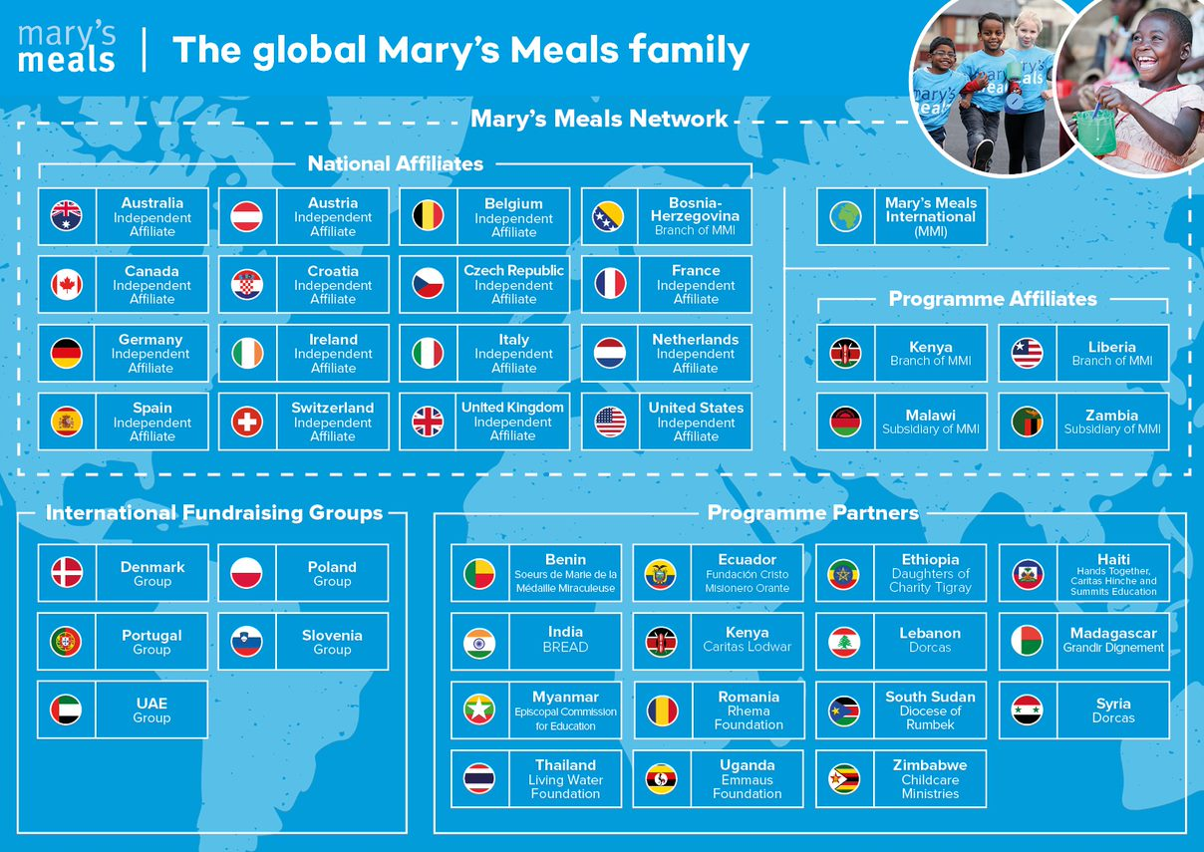
8

Slide 9
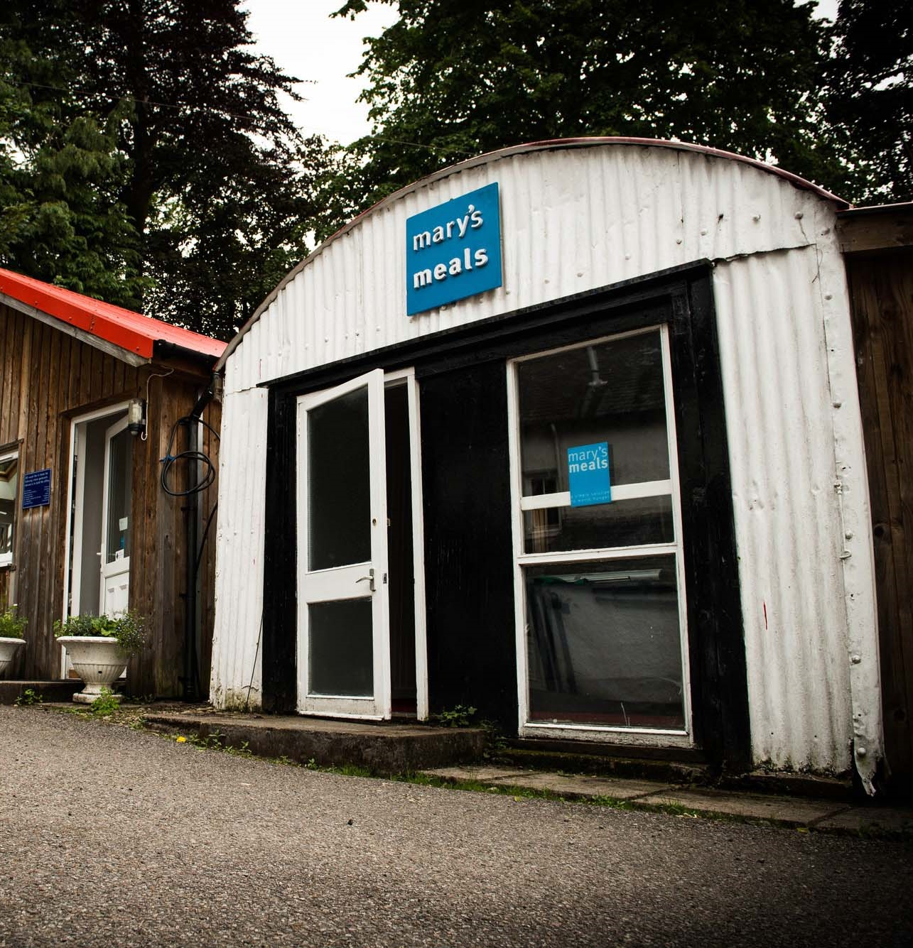
About Mary’s Meals UK
Mary’s Meals UK (or ‘MMUK’), a charity registered in Scotland, is the oldest entity in the Mary’s Meals family – the original organisation established as ‘Scottish International Relief’ in the early 1990s, when our founder and global CEO, Magnus MacFarlane-Barrow, first became involved in international aid during the Bosnian Conflict.
Back then, Magnus was a simple salmon farmer who, along with his family, decided to do something to help those who were suffering because of the war.
They relied heavily on the generosity of local people in their village of Dalmally in Argyll, who relentlessly donated food, blankets and other items of aid, which were then stored in the family shed, before being driven out by Magnus to Bosnia-Herzegovina.
Though our largest office is now in Glasgow, that same shed – which continues to be filled, metaphorically at least, with the generosity of our supporters – still serves as the headquarters of Mary’s Meals UK to this day.
9

Slide 10
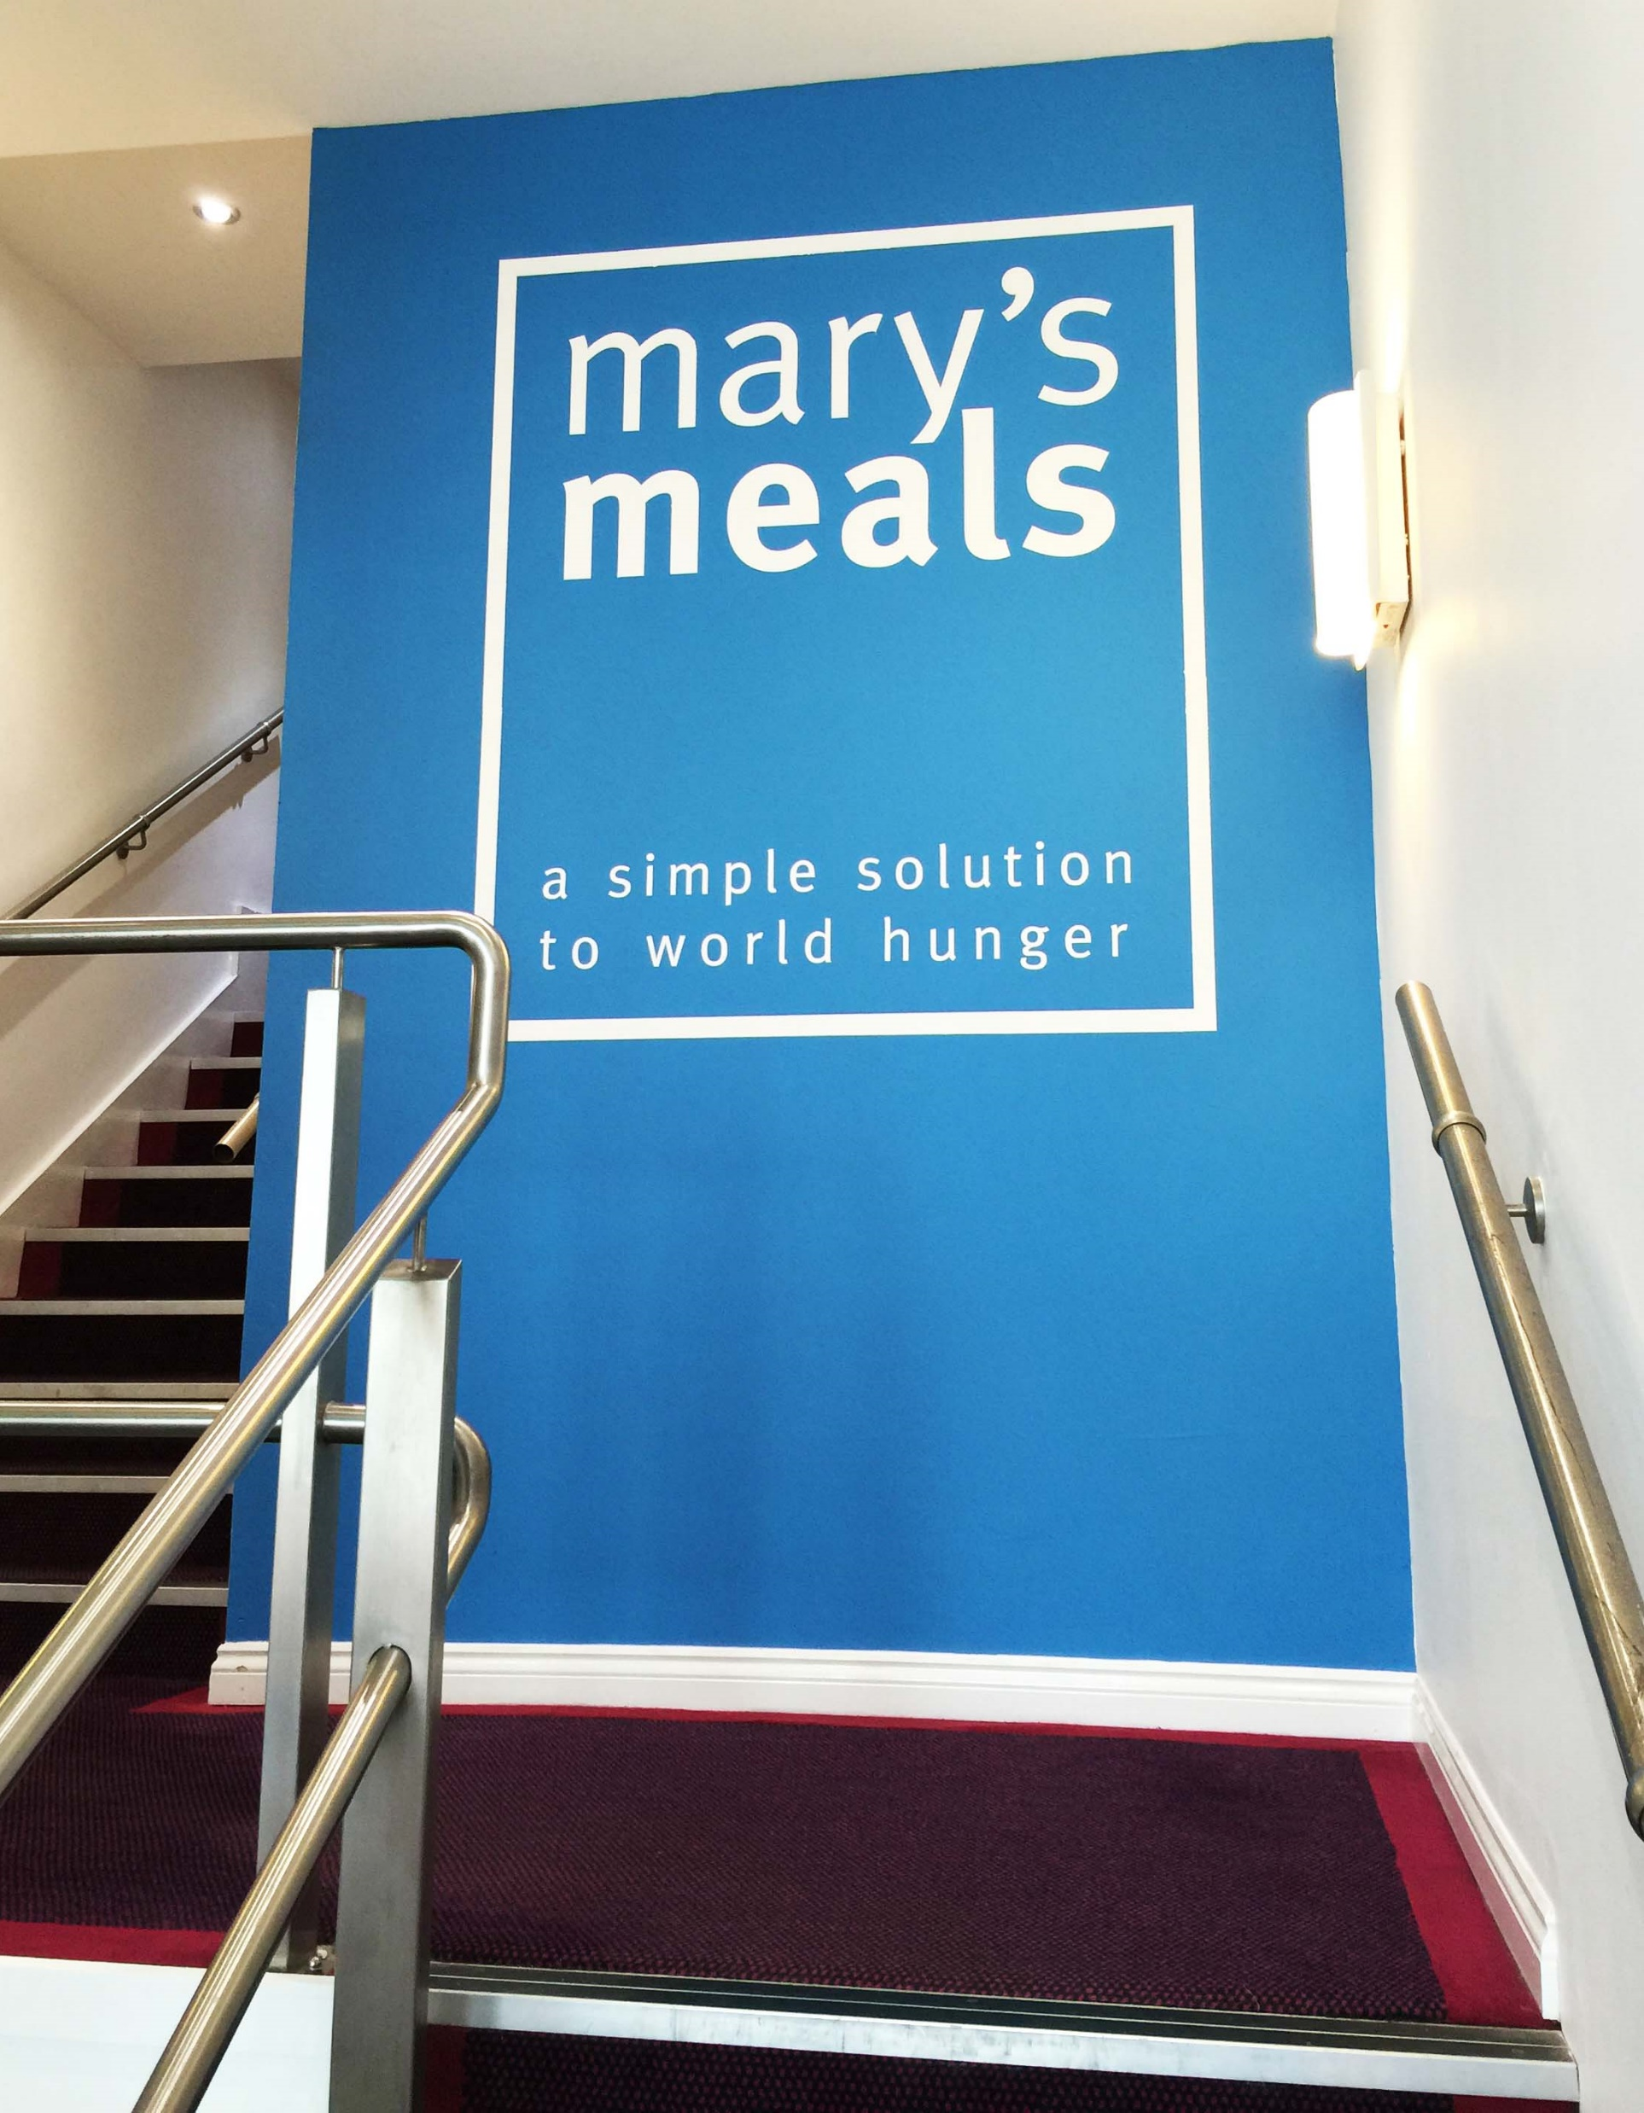
About Mary’s Meals UK
In January 2015, to recognise the incredible growth of the Mary’s Meals movement around the world and to facilitate future growth in new countries, another entity – Mary’s Meals International (or ‘MMI’) – was formed in the UK.
This new organisation assumed responsibility for directly delivering our programmes and for coordinating the growing number of Mary’s Meals organisations around the world, aimed at either awareness-raising or programme delivery.
This structural change saw Mary’s Meals UK become the global movement’s largest fundraising organisation and enabled it to focus even more passionately on its mission to tell our story across Scotland, England, Northern Ireland and Wales, and empower more people to help us reach the next hungry child by offering their money, goods, skills, time or prayer.
Today, Mary’s Meals UK raises awareness and funds under the direction of the Executive Director, and through the passion, commitment and dedication of our volunteers and staff, led by the Director of Communications, Director of Supporter Engagement and Income and the Director of Finance and Operations. The organisation currently has offices in Glasgow, Dalmally, Leeds, Liverpool, London and Belfast.
10

Slide 11
Role outline
Role title:
Location:
Contract:
Salary:
Benefits:
Reports to:
Key relationships:
Operations Support Officer
Office based, Glasgow
Full-time 37.5 hours per week, Permanent
c. 20,243 per annum
Flexible working, 34 days’ annual leave (including public holidays), and a non-contributory pension with employer contributions of 8%. For more information on what we offer, please visit: http://bit.ly/2F9lVlQ
Operations Officer
MMUK: Operations Manager, Shop Managers, Material Aid Officer, ITC Team, Head of Operations, Supporter Care team, MMUK teams, Volunteers
External: Supporters, Third party providers, MMI, other affiliates
Mary’s Meals UK
Operations team structure
Operations Manager
Retail Support Officer
Operations Support Assistant
Operations Support Officer
Cleaner
Communications Manager, London
Communications Manager, London
11

Slide 12
Duties and responsibilities
Provide support for the training of employees and volunteers in the shops.
Support colleagues to provide excellent customer service throughout.
Provide excellent communication with both internal and external customers.
Material Aid
Undertake agreed audits of the warehouse and communicate with colleagues on the timetable and type of audit, feeding back any identified non-compliance and required improvements.
Provide support for the training of employees and volunteers who operate material aid collections and loadings.
Role overview
To provide a back-office support function regarding facilities management, development of systems and processes, implementation of the health and safety management system, logistics and administration.
To contribute to the development of operational excellence that supports the growing awareness of the Mary’s Meals movement, building relationships and meeting expectations of internal and external stakeholders.
Key responsibilities
Retail
Support colleagues in the implementation of systems and processes.
Undertake agreed audits of the shops, communicate with colleagues on the timetable and type of audit and feedback any identified non-compliance or required improvements.
12

Slide 13
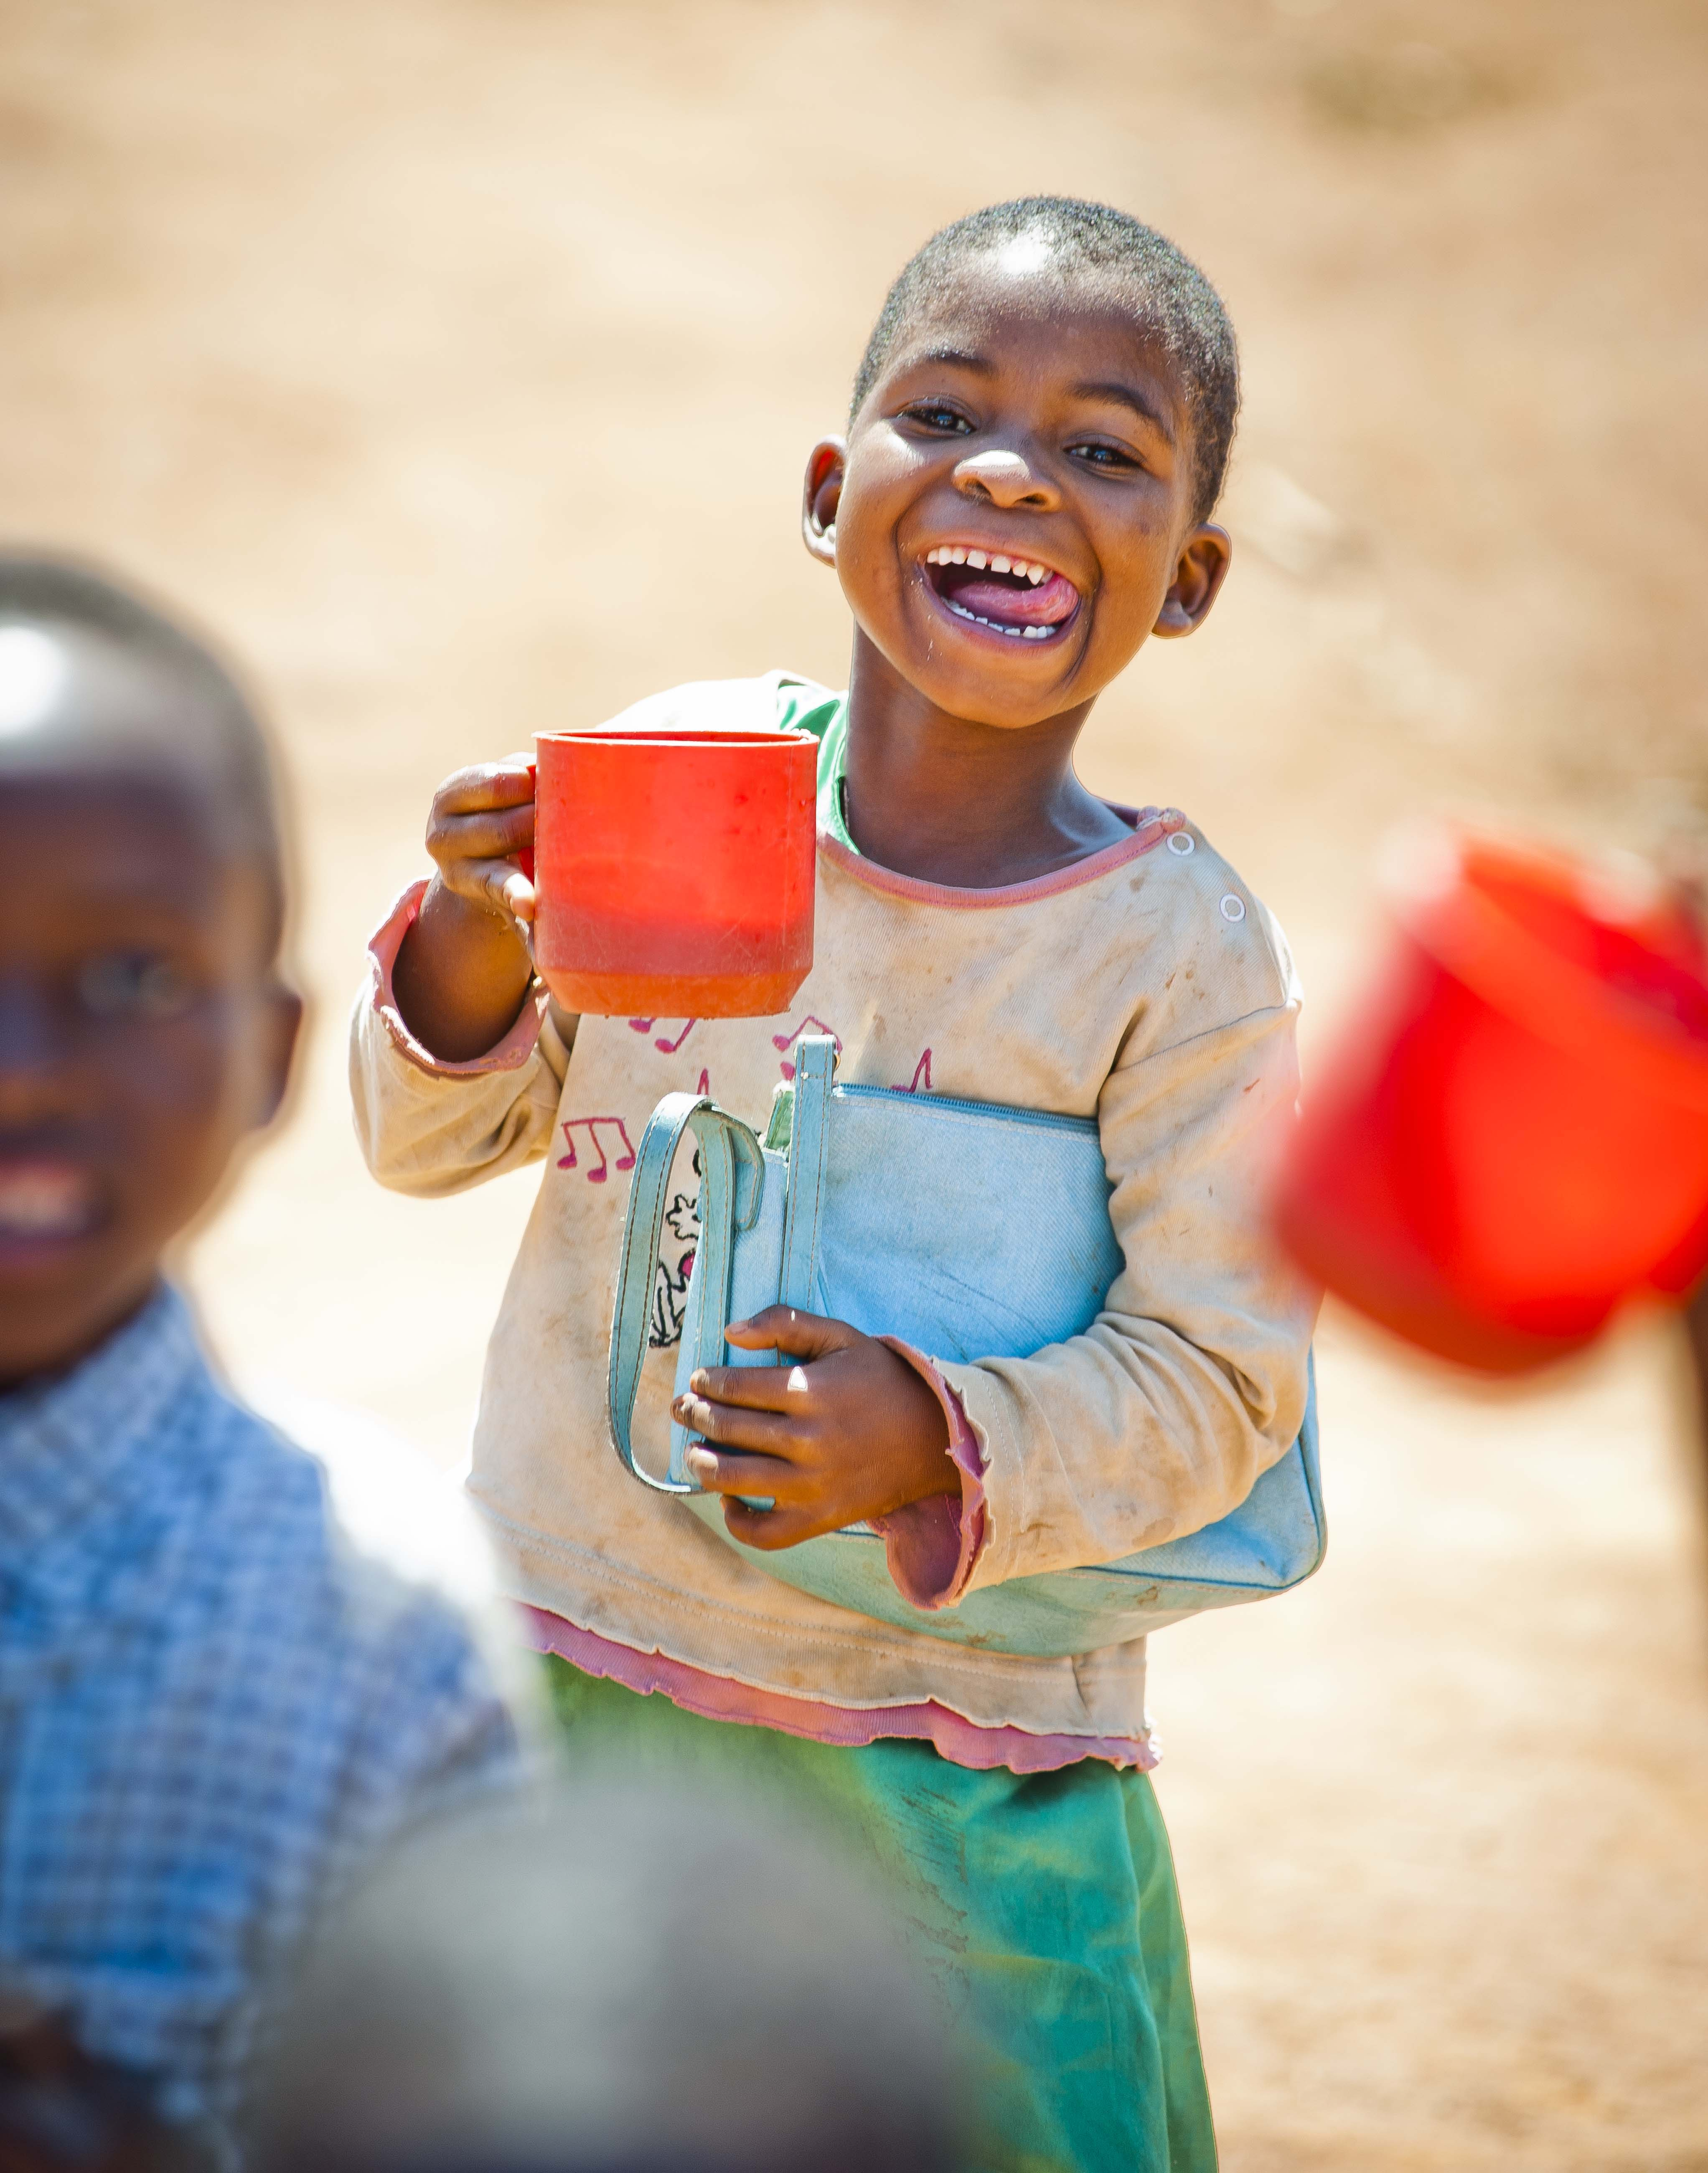
Duties and responsibilities
Key responsibilities
Facilities
Ensuring that basic facilities, such as water and heating, are well-maintained in our offices, shops and warehouse.
Maintain the system for repairs and maintenance and cleaning matters for offices, shops and warehouse. Liaise with colleagues to ensure the environment is in a suitable condition.
Liaise with colleagues to ensure the safety and security of our shops and warehouse premises.
Purchasing
Ensure all authorised purchase order requests are followed up and details are recorded on the appropriate system.
Management Information
Ensure retail and material aid information is retained and used in compliance with data protection.
13

Slide 14
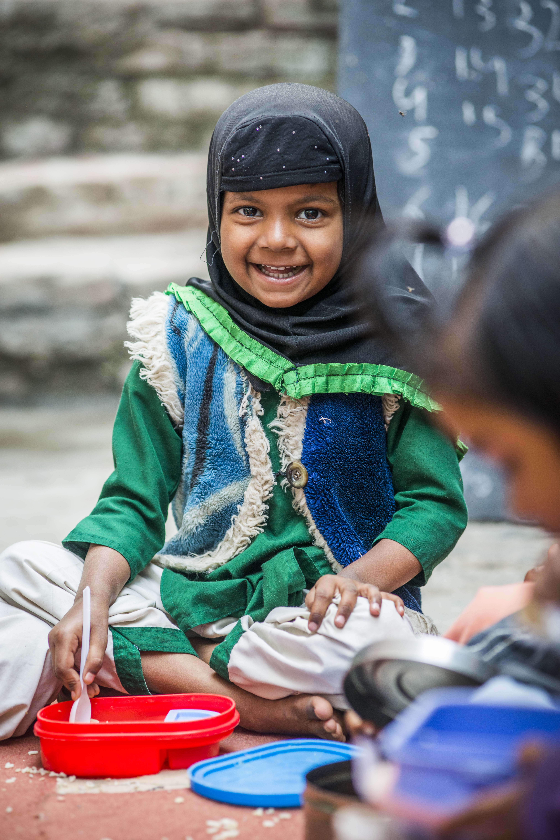
Duties and responsibilities
Key responsibilities
Health and Safety
Liaise with colleagues to ensure the health & safety policy, systems and procedures are implemented at all times in retail and material aid. These are put into practice and subject to review and assessment at regular intervals or as situations change.
Ensure systems are in place to enable the identification of hazards and risk assessments.
Ensure all information pertaining to health and safety issues and risk are recorded on the appropriate system and reported to the Operations Officer.
Self and team development
Identify opportunities for own development including keeping knowledge relevant and up to date.
Participate in Mary’s Meals monthly gathering, quarterly all staff days, and operations meetings.
14

Slide 15
Duties and responsibilities
Key responsibilities
Supporter Care
Provide a reception service.
Respond to telephone or personal enquires, either general or relating to all departments.
Log and respond to enquiries /correspondence using Salesforce to capture and manage enquiry resolutions in an agreed timescale.
Maintain and update filing and other information systems in line with policies and procedures, including data protection.
Organise all office purchases in line with policies and procedures.
Support the preparation for mail-outs.
Ensure thank you letters/emails are provided in the agreed timescale.
Liaise with supporter engagement team regarding requests for information and backpack collections.
14

Slide 16
Duties and responsibilities
Qualifications, skills and experience
Essential:
Previous retail experience.
Ability to solve problems and make decisions.
A keen eye for accuracy and detail.
Excellent communication skills with the ability to liaise with people at all levels, internally and externally.
Ability to manage conflicting demands and changing priorities.
Experience of supporting health & safety systems and procedures.
Commitment to employee ownership and engagement.
Able to work flexibly including working away from home, evening and weekends and overnight stays.
Experience of facilities operations.
Hold a clean driving licence and access to a car.
Desirable:
Previous property management.
Experience of using CRM systems.
Experience of working in the retail charity sector.
Experience in the use of office 365/SharePoint.
Experience of working between multi-site operations.
15

Slide 17
Mary’s Meals UK competencies
Mary’s Meals employees approach their role in line with our 7S competency model:
1. Self
I demonstrate resilience
I lead by example
I’m authentic and true to Mary’s Meals values
I develop myself and set stretching goals
2. Service
I have a vocational attitude to my work
I inspire hope in others
I build belief that even difficult challenges can be solved
I am committed to serving and enabling all who want to be part of the global movement
I work to ensure our future will be even better than our past
3. Simplicity
I communicate effectively
I follow clear decision-making criteria
I create plans that are easy to follow and contribute to organisational goals
I embrace inclusivity and diversity
I focus on delivering results
4. Stewardship
I pay attention to the things that matter most; (a) our physical resources; (b) our people
I nurture, develop and respect our relationships with external stakeholders
I deliver on my promises
I am happy to be held accountable and to hold others to account
5. Strategy
I have a point of view about the future
I know our stakeholders and see our priorities clearly
I help others to work in ways that have the greatest impact
I develop strategy and translate it into action
6. Strengthen
I contribute to a positive work environment
I support those around me
7. Success
I maintain my technical competence
I contribute to the success of my team
I ensure accountability
I embrace change
16

Slide 18
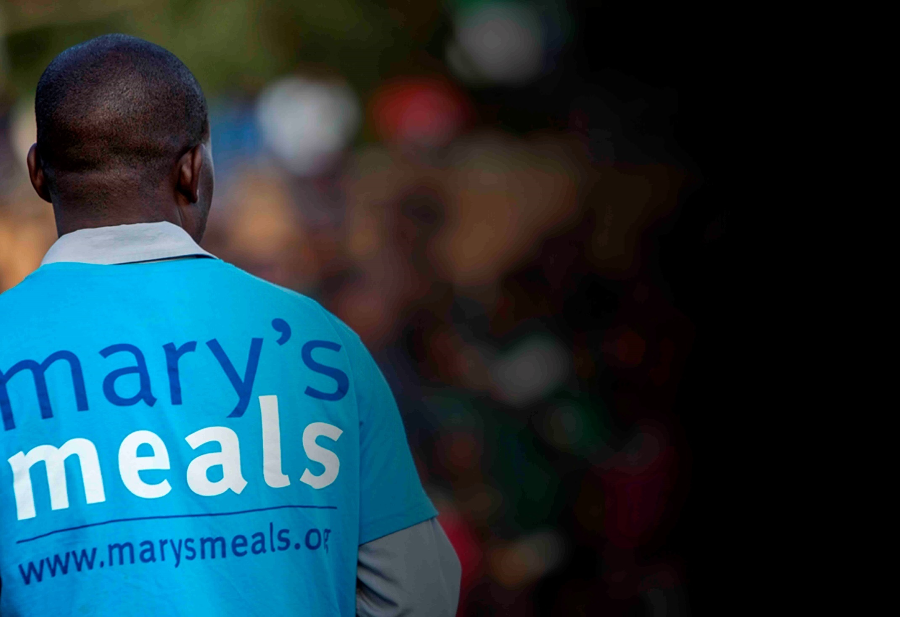
Recruitment process information
How to apply for this role
To apply for the role of Operations Support Officer at Mary’s Meals UK, please send a tailored CV and covering letter to: jobs@marysmeals.org
Your covering letter should make a compelling case for why you feel motivated to work for Mary’s Meals UK in this role, as well as giving a concise overview of your most relevant skills and experience, and should fill no more than two pages of A4.
Recruitment timescales
Closing date for applications:
28 February 2020
Please note: A second interview stage may be required.
17

Slide 19
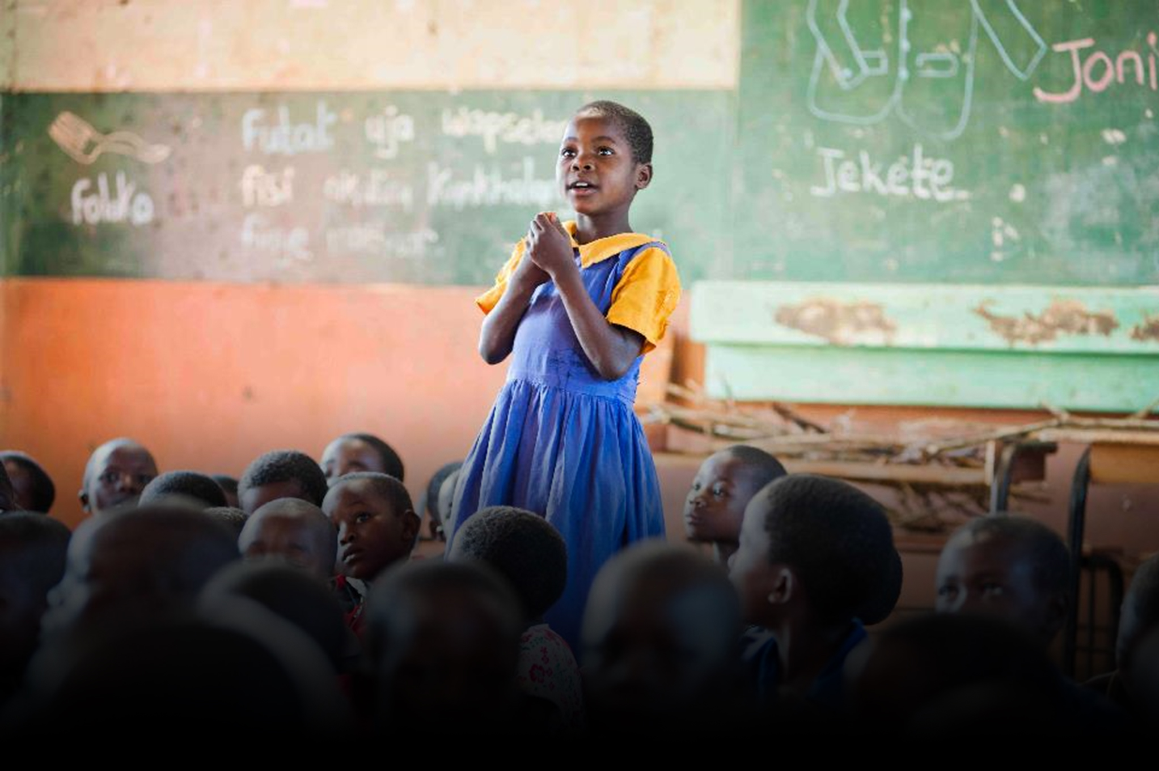
Mary’s Meals UK
Charity No. SC022140
Company No. SC265941
Tel: 0141 336 7094
Dalmally office
Craig Lodge
Dalmally, Argyll
PA33 1AR
Glasgow office
6 Claremont Centre
39 Durham Street, Glasgow
G41 1BS
London office
13 Hippodrome Place
Notting Hill, London
W11 4SF
“Together, let’s set out on this journey; one step at a time, one meal at a time, one child at a time.”
– Magnus MacFarlane-Barrow, Mary’s Meals founder

