Slide 1
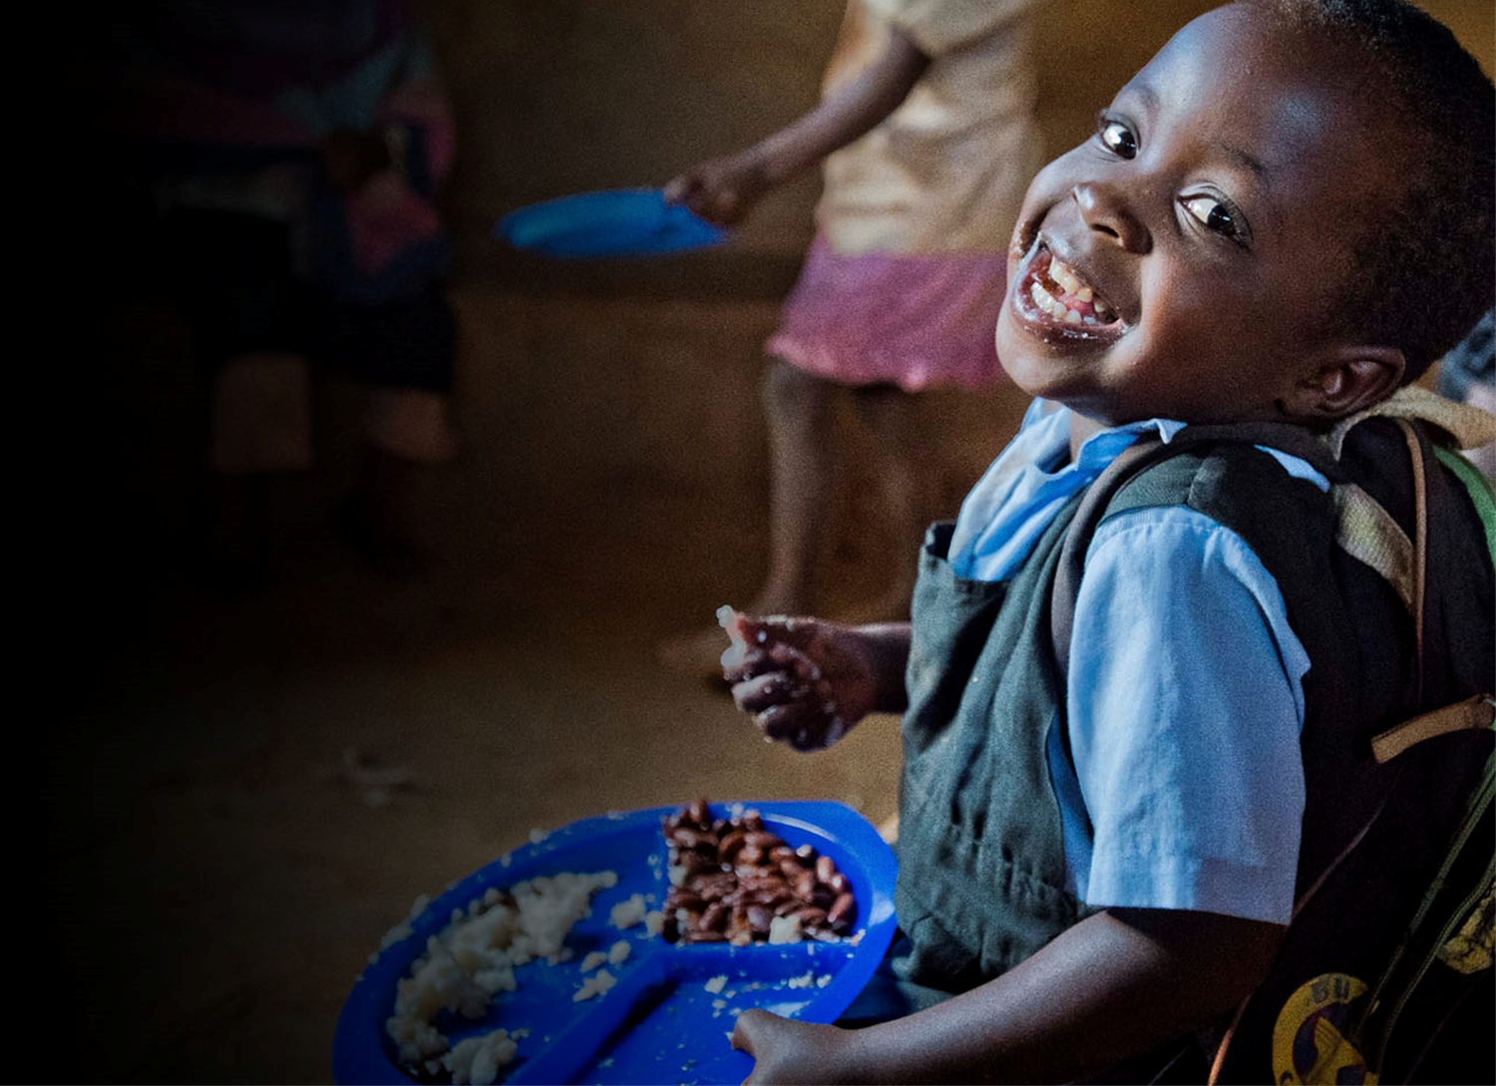
Recruitment pack for:
Head of Communications
Mary’s Meals UK
June 2020

Slide 2
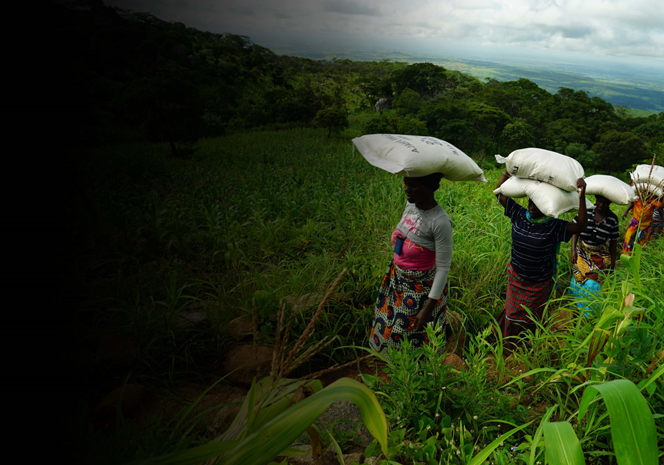
Recruitment pack contents
Welcome from our Executive Director
Our vision, mission and values
About the Mary’s Meals movement
About Mary’s Meals UK
Role outline and specification
Recruitment process information
3
5
7
9
11
16
2

Slide 3
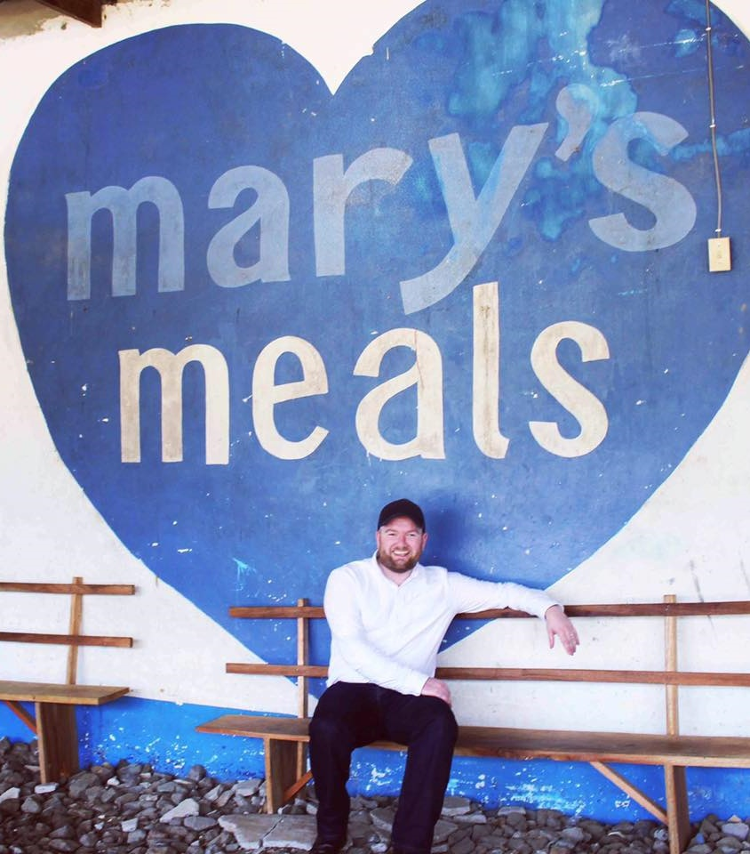
Welcome from our Executive Director
Thank you so much for your interest in joining the Mary’s Meals family. As you consider making an application for the role of head of communications with Mary’s Meals UK, I hope you find this pack helpful, encouraging and exciting.
In joining Mary’s Meals UK, you would become part of a global movement of people who will simply not accept that any child should go hungry in this world of plenty. We are passionately driven by our simple belief that every child in the world deserves an education – and enough to eat.
From small beginnings feeding just 200 Malawian children in 2002, we normally reach 1.6 million children across 19 ‘programme’ countries (including Malawi, Liberia, Zambia, Haiti, South Sudan and Syria) with a nutritious daily meal in school.
This meal not only meets the immediate needs of the hungry child, but it attracts children to the classroom where they can gain an all-important education. With the Covid-19 pandemic closing schools around the world and homes becoming places of learning, we have worked with local communities and governments to adapt our programme, so that almost all the children who normally receive our meals can now do so at home.
3

Slide 4
Welcome from our Executive Director
But none of this would be possible without the incredible generosity of our supporters all over the world, who give freely of their time, money, skills and prayer..
And, across Mary’s Meals’ dozen or so ‘national affiliate’ countries, in which we raise awareness and funds for our work (including the UK, USA, Austria, Germany, Ireland, Croatia and Canada) thousands of people amaze and inspire us every day with their ‘little acts of love’, spreading the word about Mary’s Meals in their local communities and raising money to feed more children.
The UK, where we received the first-ever donations for our work, remains the country in which Mary’s Meals raises the majority of its funds. And Mary’s Meals UK, the organisation I am privileged to lead, is responsible for continuing to tell our story across Scotland, England, Northern Ireland and Wales; engaging and inspiring more and more UK volunteers and donors; and driving forward the unrelenting growth of the Mary’s Meals movement on these shores.
We do this while working very closely and collaboratively with our colleagues at Mary’s Meals International, the organisation which co-ordinates the global movement and directly manages our school feeding programmes.
The head of communications is a vital role for Mary’s Meals as we continue to develop and grow our grassroots support base across the UK.
The role is responsible for sharing compelling and uplifting stories, of the children who eat Mary’s Meals and the supporters who make this possible, with a wide range of external audiences including the UK media.
With 59 million primary school-age children out of school around the world and a 73 million attending school so hungry they’re not able to concentrate and learn, our work is only just beginning. Will you play a crucial part in shaping the future of Mary’s Meals UK, and with it, the lives of so many people who both contribute to and benefit from this incredible work of love, joy and hope?
I look forward to hearing your story.
Daniel Adams
Executive Director, Mary’s Meals UK
4

Slide 5
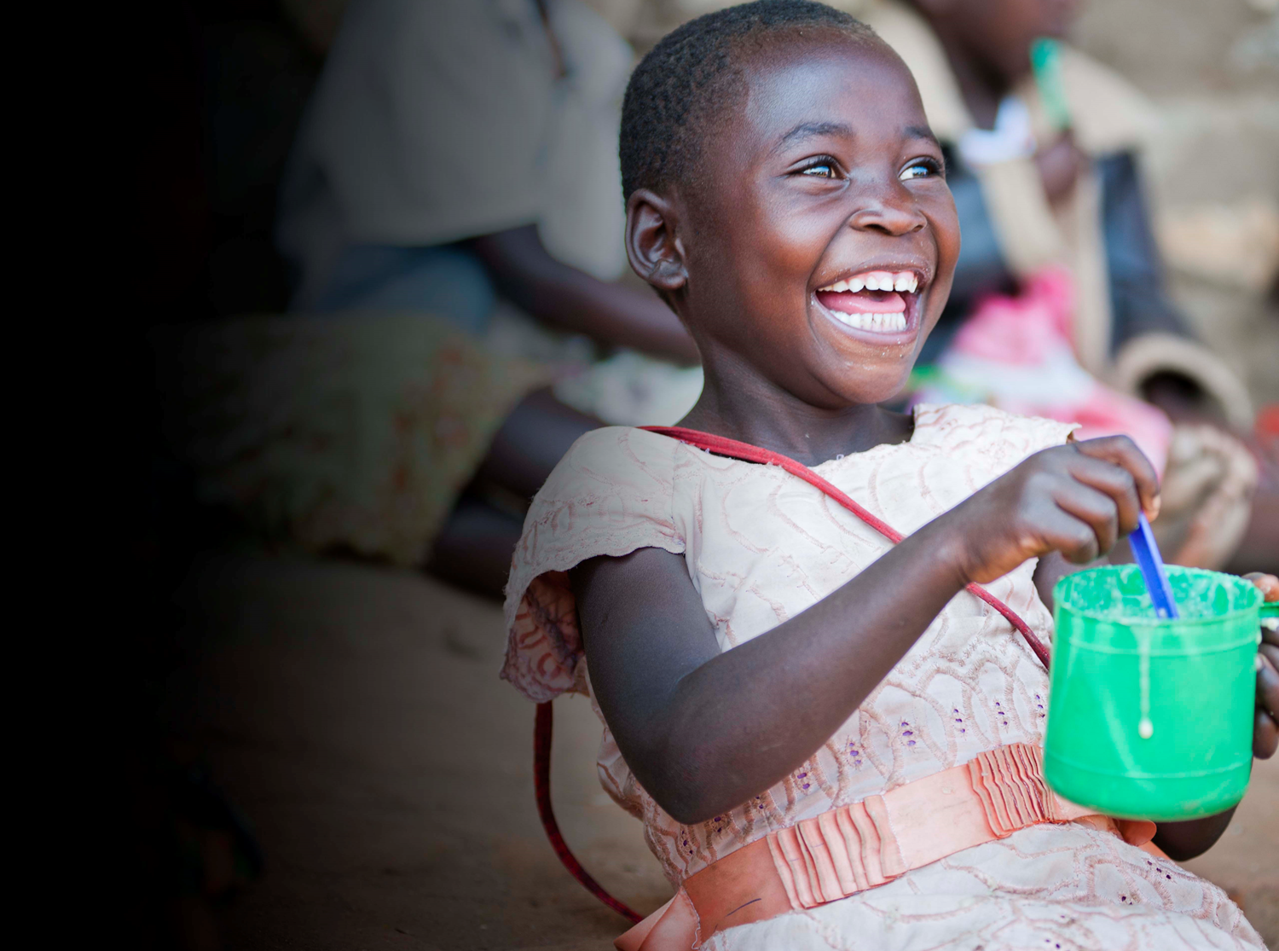
Our vision and mission
• Our vision is that every child receives one daily meal in their place of education and that all those who have more than they need, share with those who lack even the most basic things.
• Our mission is to enable people to offer their money, goods, skills, time, or prayer, and through this involvement, provide the most effective help to those suffering the effects of extreme poverty in the world’s poorest communities.
5

Slide 6
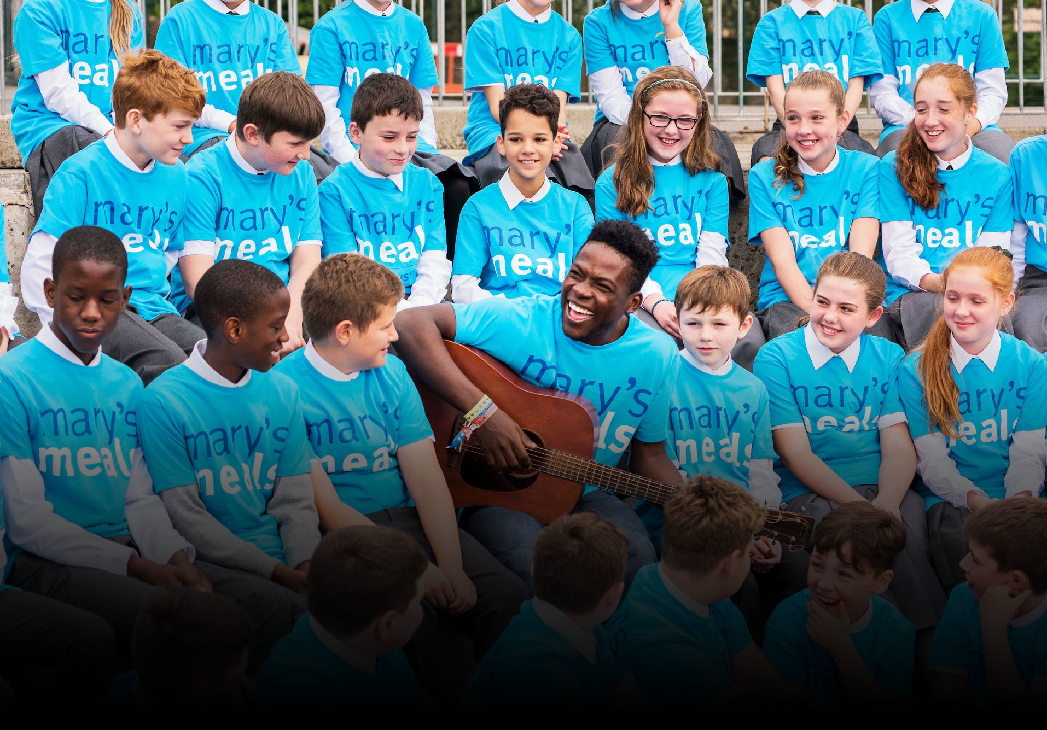
Our values
• We have confidence in the innate goodness of people.
• We respect the dignity of every human being and family life.
• We believe in good stewardship of the resources entrusted to us.
View Mary’s Meals’ full statement of values here: http://bit.ly/2oRy99Y
6

Slide 7
About the Mary’s Meals movement
Mary’s Meals is a global movement that sets up school feeding projects in some of the world’s poorest communities, where poverty and hunger prevent children from gaining an education.
Our idea is a simple one that works. We provide one daily meal in a place of learning in order to attract chronically poor children into the classroom, where they receive an education that can, in the future, be their ladder out of poverty.
The Mary’s Meals campaign was born in 2002 when Magnus MacFarlane-Barrow, from Dalmally in Argyll, visited Malawi during a famine and met a mother dying from AIDS. When Magnus asked her eldest son Edward what his dreams were in life, he replied simply: “I want to have enough food to eat and to go to school one day.”
That moment was a key part of the inspiration which led to the founding of Mary’s Meals, which began by feeding just 200 children in Malawi in 2002. Today, 18 years later, we normally feed 1.6 million hungry children every school day across four continents. The average worldwide cost for us to feed a child for a whole school year is just £15.90.
Where Mary’s Meals is provided, there is a rise in school enrolment, attainment and attendance. Wherever possible, Mary's Meals uses locally grown food to support the local economy and help smallholder farmers.
We work extremely hard to keep our running costs low and to ensure that at least 93% of donations goes directly on our charitable activities. This is only possible because most of our work is done by an army of dedicated volunteers all over the world, who carry out lots of little acts of love on behalf of Mary’s Meals.
Having been inspired, in part, by our founder’s Catholic faith, this work is named in honour of Mary, the mother of Jesus, who brought up her own child in poverty. We consist of, respect and reach out to people of all faiths and none.
Counting on support from around the globe, Mary’s Meals has registered national affiliate organisations, which raise awareness of our work, in more than 19 countries around the world. Funds raised by affiliates, including from Mary’s Meals UK, are passed to Mary’s Meals International, the organisation which co-ordinates our movement and directly manages the delivery of our school feeding programmes.
7

Slide 8
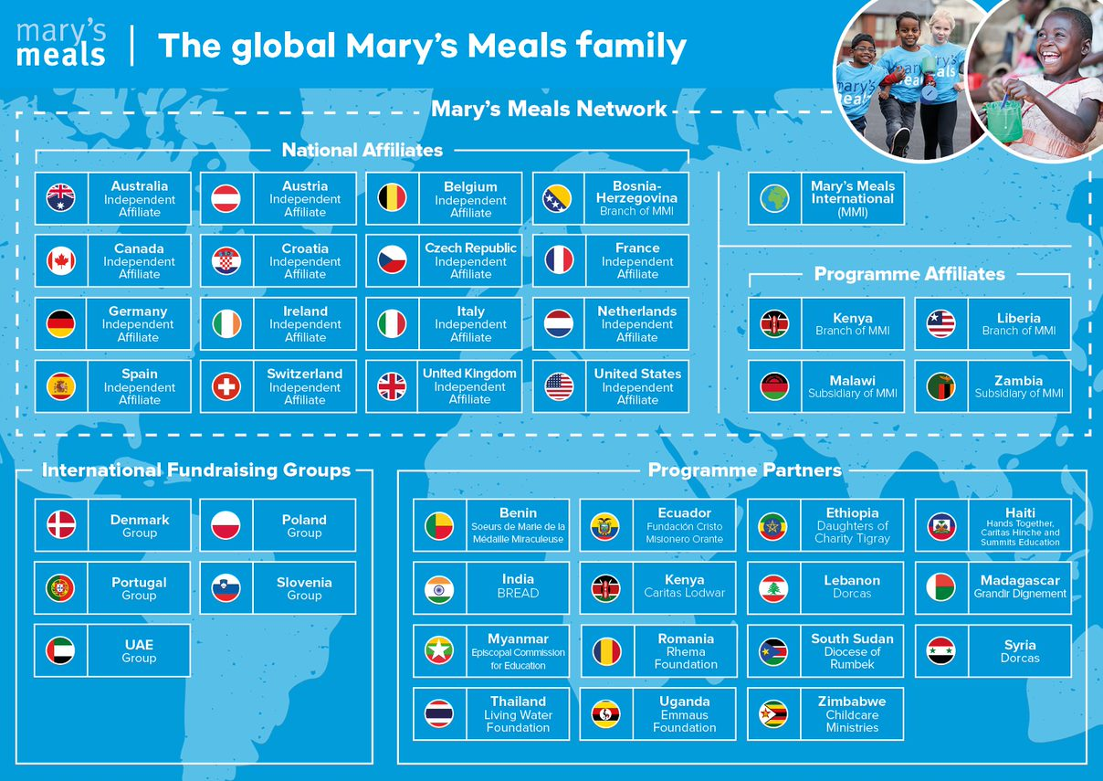

Slide 9
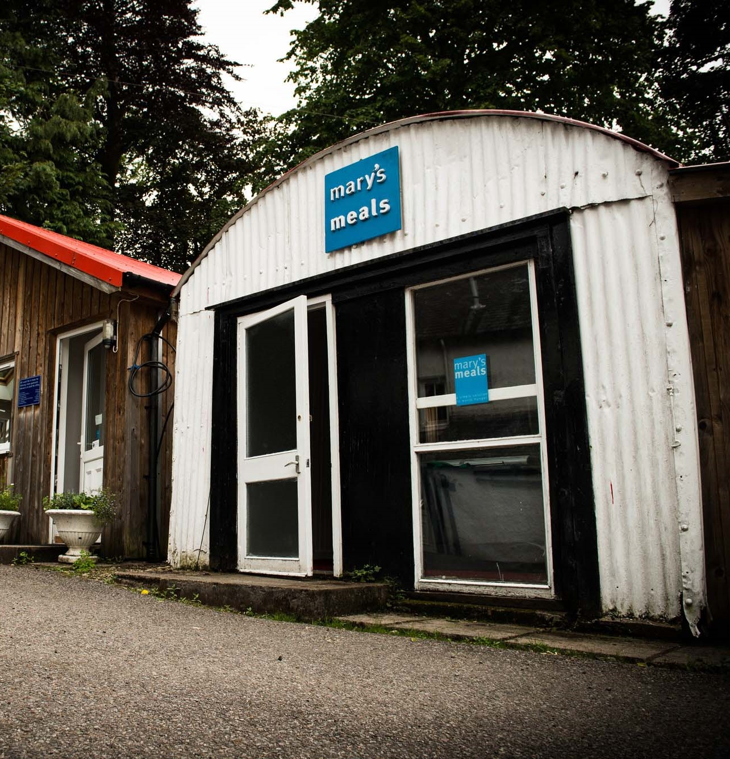
About Mary’s Meals UK
Mary’s Meals UK (or ‘MMUK’), a charity registered in Scotland, is the oldest entity in the Mary’s Meals family – the original organisation established as ‘Scottish International Relief’ in the early 1990s, when our founder and global CEO, Magnus MacFarlane-Barrow, first became involved in international aid during the Bosnian Conflict.
Back then, Magnus was a simple salmon farmer who, along with his family, decided to do something to help those who were suffering because of the war.
They relied heavily on the generosity of local people in their village of Dalmally in Argyll, who relentlessly donated food, blankets and other items of aid, which were then stored in the family shed, before being driven out by Magnus to Bosnia-Herzegovina.
Though our largest office is now in Glasgow, that same shed – which continues to be filled, metaphorically at least, with the generosity of our supporters – still serves as the headquarters of Mary’s Meals UK to this day.
9

Slide 10
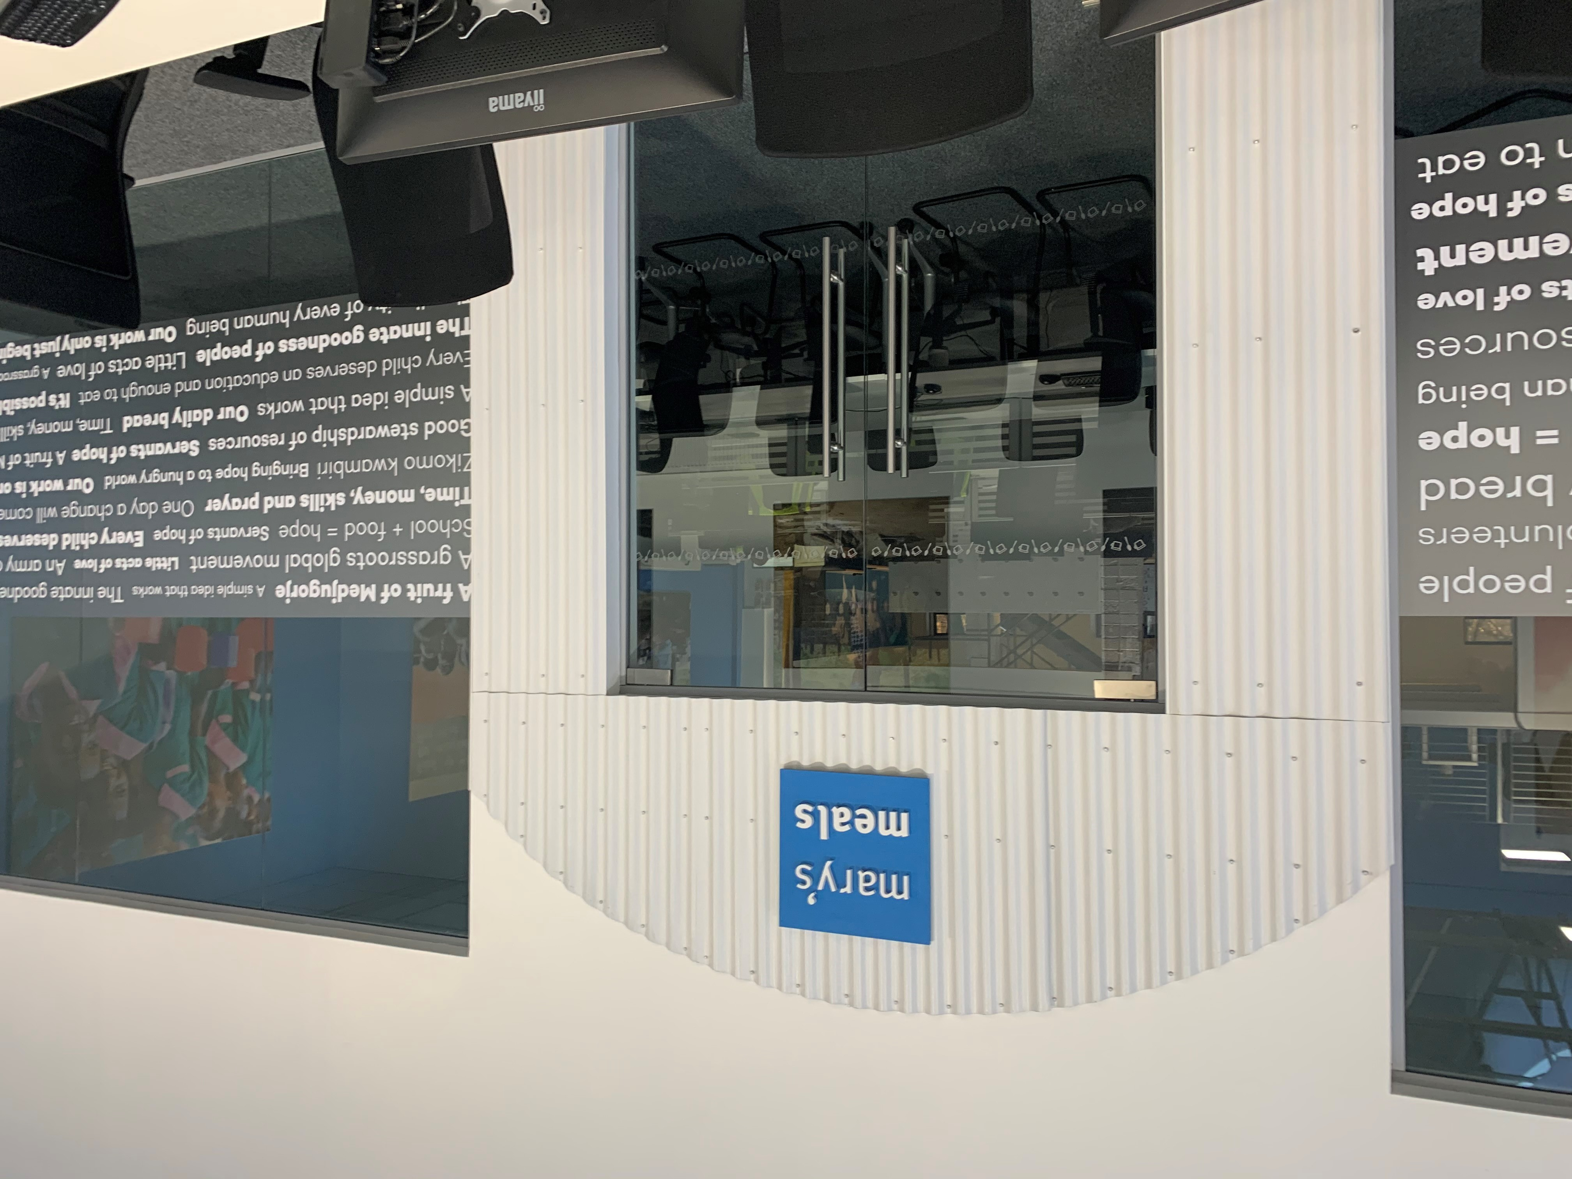
About Mary’s Meals UK
In January 2015, to recognise the incredible growth of the Mary’s Meals movement around the world and to facilitate future growth in new countries, another entity – Mary’s Meals International (or ‘MMI’) – was formed in the UK.
This new organisation assumed responsibility for directly delivering our programmes and for coordinating the growing number of Mary’s Meals organisations around the world, aimed at either awareness-raising or programme delivery.
This structural change saw Mary’s Meals UK become the global movement’s largest fundraising organisation and enabled it to focus even more passionately on its mission to tell our story across Scotland, England, Northern Ireland and Wales, and empower more people to help us reach the next hungry child by offering their money, goods, skills, time or prayer.
Today, Mary’s Meals UK raises awareness and funds under the direction of the Executive Director, and through the passion, commitment and dedication of our volunteers and staff, led by the Director of Communications, Director of Supporter Engagement and Income, and the Director of Finance and Operations. The organisation currently has offices in Glasgow, Dalmally, Leeds and London.
10

Slide 11
Role outline
Role title:
Location:
Contract:
Salary:
Benefits:
Reports to:
Direct reports:
Key relationships:
Head of Communications
Glasgow (but will consider remote working from anywhere in the UK)
Full-time, one-year fixed term contract for maternity cover.
c. £43,223 per annum
Flexible working, 34 days’ annual leave (including public holidays), and a non-contributory pension with employer contributions of 8%. For more information on what we offer, please visit: http://bit.ly/2F9lVlQ
Director of Communications
Communications Manager
Visual Communications Manager
MMUK:
Executive Director
MMUK Board & leadership team
MMUK Extended Leadership team
MMI:
Affiliate staff and volunteers
Mary’s Meals UK
Communications team structure
Director of Communications
Head of Communications
Communications
Manager
Visual Comms Manager
Comms Officer
x1
Comms Officer
x2
11

Slide 12
Duties and responsibilities
Oversee the creation and implementation of UK campaigns (in close collaboration with the global communications team, where relevant).
Develop and implement engaging communication activities with existing supporters and identify creative ways to reach out to new audiences.
Work closely with the UK supporter engagement team to ensure consistency of Mary’s Meals’ messages and materials, creating resources where required.
Proactively identify opportunities to raise awareness of Mary’s Meals across all media, including press, broadcast and specialist titles.
Develop and maintain excellent working relations with press and communication partners.
Arrange media interviews and manage overseas visits to project countries when required.
Support and identify media partnership or appeal opportunities to help raise awareness of Mary’s Meals’ mission.
Work flexibly and respond effectively to any reactive media enquiries or unplanned situations, including responding to media enquiries out of hours when necessary.
Oversee/approve production of media releases/statements, supporter communications, and video and features material.
Lead on copywriting and design of publications for the UK supporter base, including managing freelancers.
Develop and implement digital engagement plans for UK supporters including the development of UK social media channels and email marketing.
Develop work around using Salesforce as a marketing tool for UK supporters.
Take responsibility for the management of the UK website, ensuring content is up to date and relevant.
Role overview
To raise awareness of our work within the UK to attract new supporters, develop relationships with existing supporters, and to ensure the values of the organisation are upheld and promoted in all communications activities.
Responsible for managing the communications team, which may also include volunteers.
Reporting to the director of communications, you will be comfortable working at a senior level to achieve success and will be experienced at managing relationships at all levels. The communications team lead on mass marketing activities (including campaigns) and the supporter engagement team focus on building personal and local relationships, to ensure as many people as possible can hear about and engage with our work. It will be important to develop good working relationships with the head of grassroots engagement and the head of major giving and partnerships, in particular.
Key responsibilities
Development and implementation of Mary’s Meals’ communications strategy in the UK.
Ensure all activity takes place in line with our values.
Direct line management of members of the communications team, monitoring and evaluating work and leading the team’s development.
Manage the consistent implementation of Mary’s Meals brand, key messages and style guide in UK communications activities.
Lead on direct mail for UK supporters, including testing and learning as part of the ongoing mass marketing strategy.
12

Slide 13
Qualifications, experience and skills
Qualifications
• Degree level education in a relevant discipline or equivalent professional experience
Experience
At least five years’ experience working within a senior PR/Communications role
Proven ability and experience of managing and developing the capabilities of driven, bright and diverse teams
Track record of developing and implementing effective communication strategies and activity plans
Experience of working in a fast-paced communications environment
Sound experience, and willingness to, work ‘hands on’ as part of a small team, in a supportive, flexible and friendly manner
Experienced in media relations and nurturing media contacts
Proven and demonstrable experience of editing and producing publications
Experience of working with direct marketing materials
Experience of working with digital communications channels including websites, social media channels and email marketing
Skills
A practical and pragmatic person able to exercise initiative and sound judgement
Excellent written and verbal communication skills, including a demonstrated ability to write engaging, clear and concise copy
Ability to manage a complex workload and juggle multiple priorities, ensuring deadlines are met
A credible and reliable person who can influence or persuade at all levels
A keen eye for accuracy and detail
Strong organisational, planning and project management skills
Organised self-starter with the ability to work to minimal supervision and able and willing to refer or consult when necessary
Ability to demonstrate knowledge of a broad range of communication activities – media, websites, publications, social media, email communication etc
Resilient, flexible and self-motivated
Good demonstrable understanding of the charity sector
Ability to demonstrate creativity, initiate ideas and bring them to fruition
Excellent writing skills
Computer literate with good MS office skills
Excellent interpersonal skills including the ability to liaise at all levels within the organisation and externally
Detailed knowledge of briefing photographers, printers, designers and other suppliers
14

Slide 14
Mary’s Meals UK manager competencies
Managers at Mary’s Meals approach their role in line with our 7S competency model:
1. Self
I build and demonstrate resilience
I lead by example
I’m authentic and true to Mary’s Meals values
I develop myself and set stretching goals
2. Service
I have a vocational attitude to my work
I inspire hope in others
I build belief that even difficult challenges can be solved
I am committed to serving and enabling all who want to be part of the global movement
I work to ensure our future will be even better than our past
3. Simplicity
I communicate effectively
I follow clear decision-making criteria
I create plans that are easy to follow and contribute to organisational goals
I embrace inclusivity and diversity
I focus on delivering results
4. Stewardship
I pay attention to the things that matter most; (a) our physical resources; (b) our people
I nurture, develop and respect our relationships with external stakeholders
I deliver on my promises
I am happy to be held accountable and to hold others to account
5. Strategy
I have a point of view about the future
I know our stakeholders and see our priorities clearly
I help others to work in ways that have the greatest impact
I develop strategy and translate it into action
6. Strengthen
I create a positive work environment
I increase the capabilities of my team
I help people manage their careers
I find and develop next-generation talent
7. Success
I ensure my team is technically competent and always developing
I build high performing teams
I ensure accountability
I am a catalyst for change
15

Slide 15
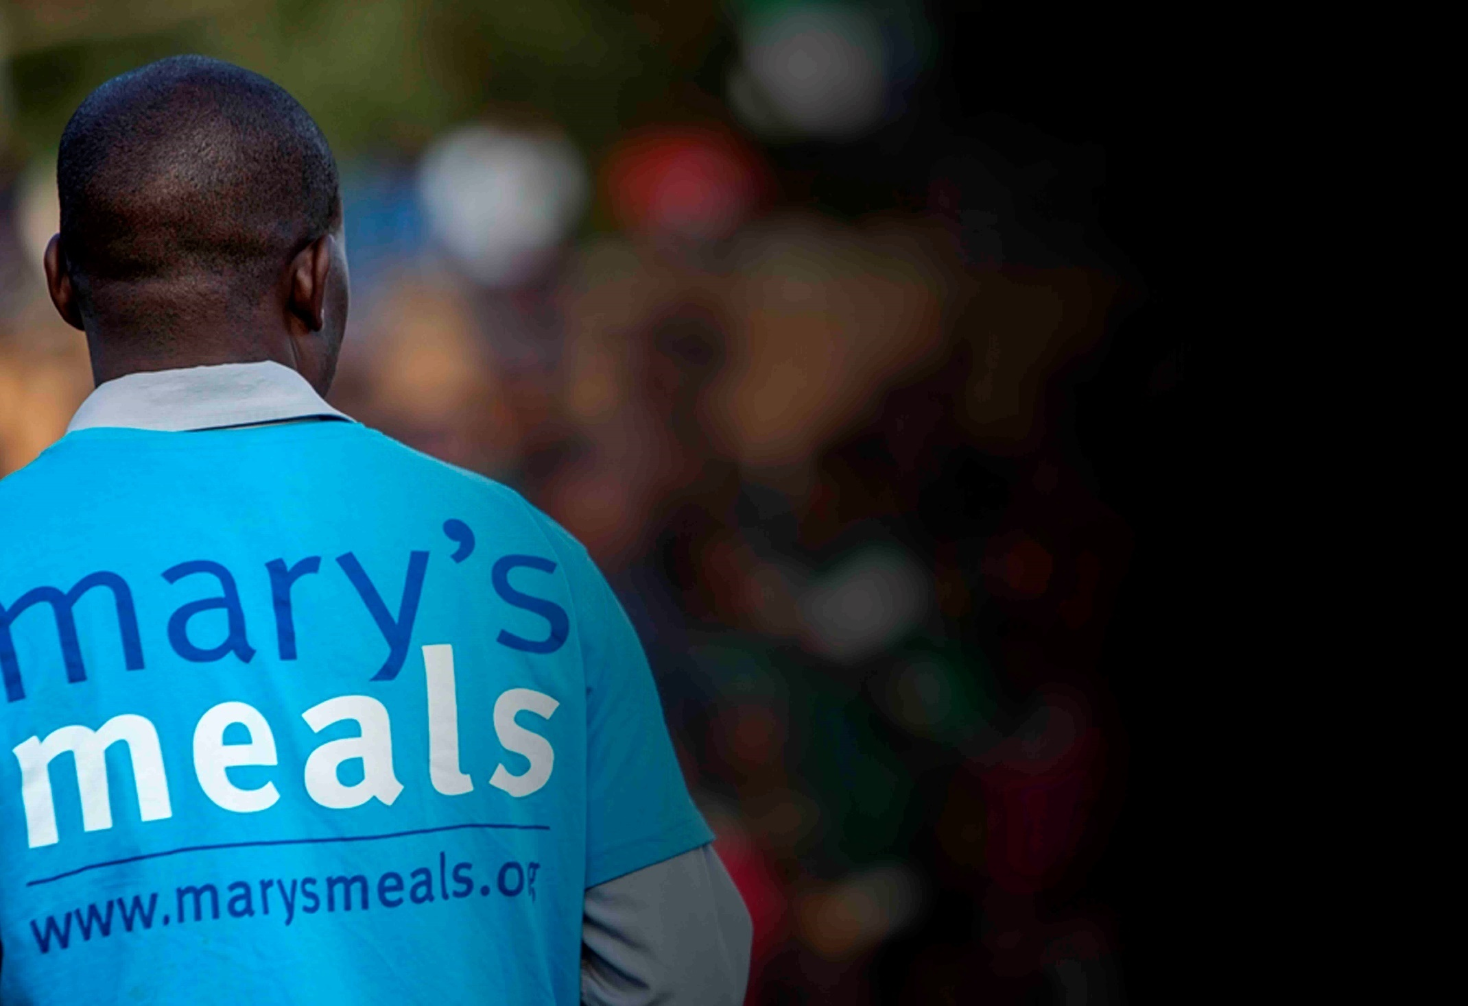
Recruitment process information
How to apply for this role
To apply for the role of Head of Communications at Mary’s Meals UK, please send a tailored CV and covering letter to: Annette.reid@marysmeals.org
Your covering letter should make a compelling case for why you feel motivated to apply for this role within Mary’s Meals UK, as well as giving a concise overview of your most relevant skills and experience, and should fill no more than two pages of A4.
Recruitment timescales
Closing date for applications:
Friday 10th July 2020
16

Slide 16
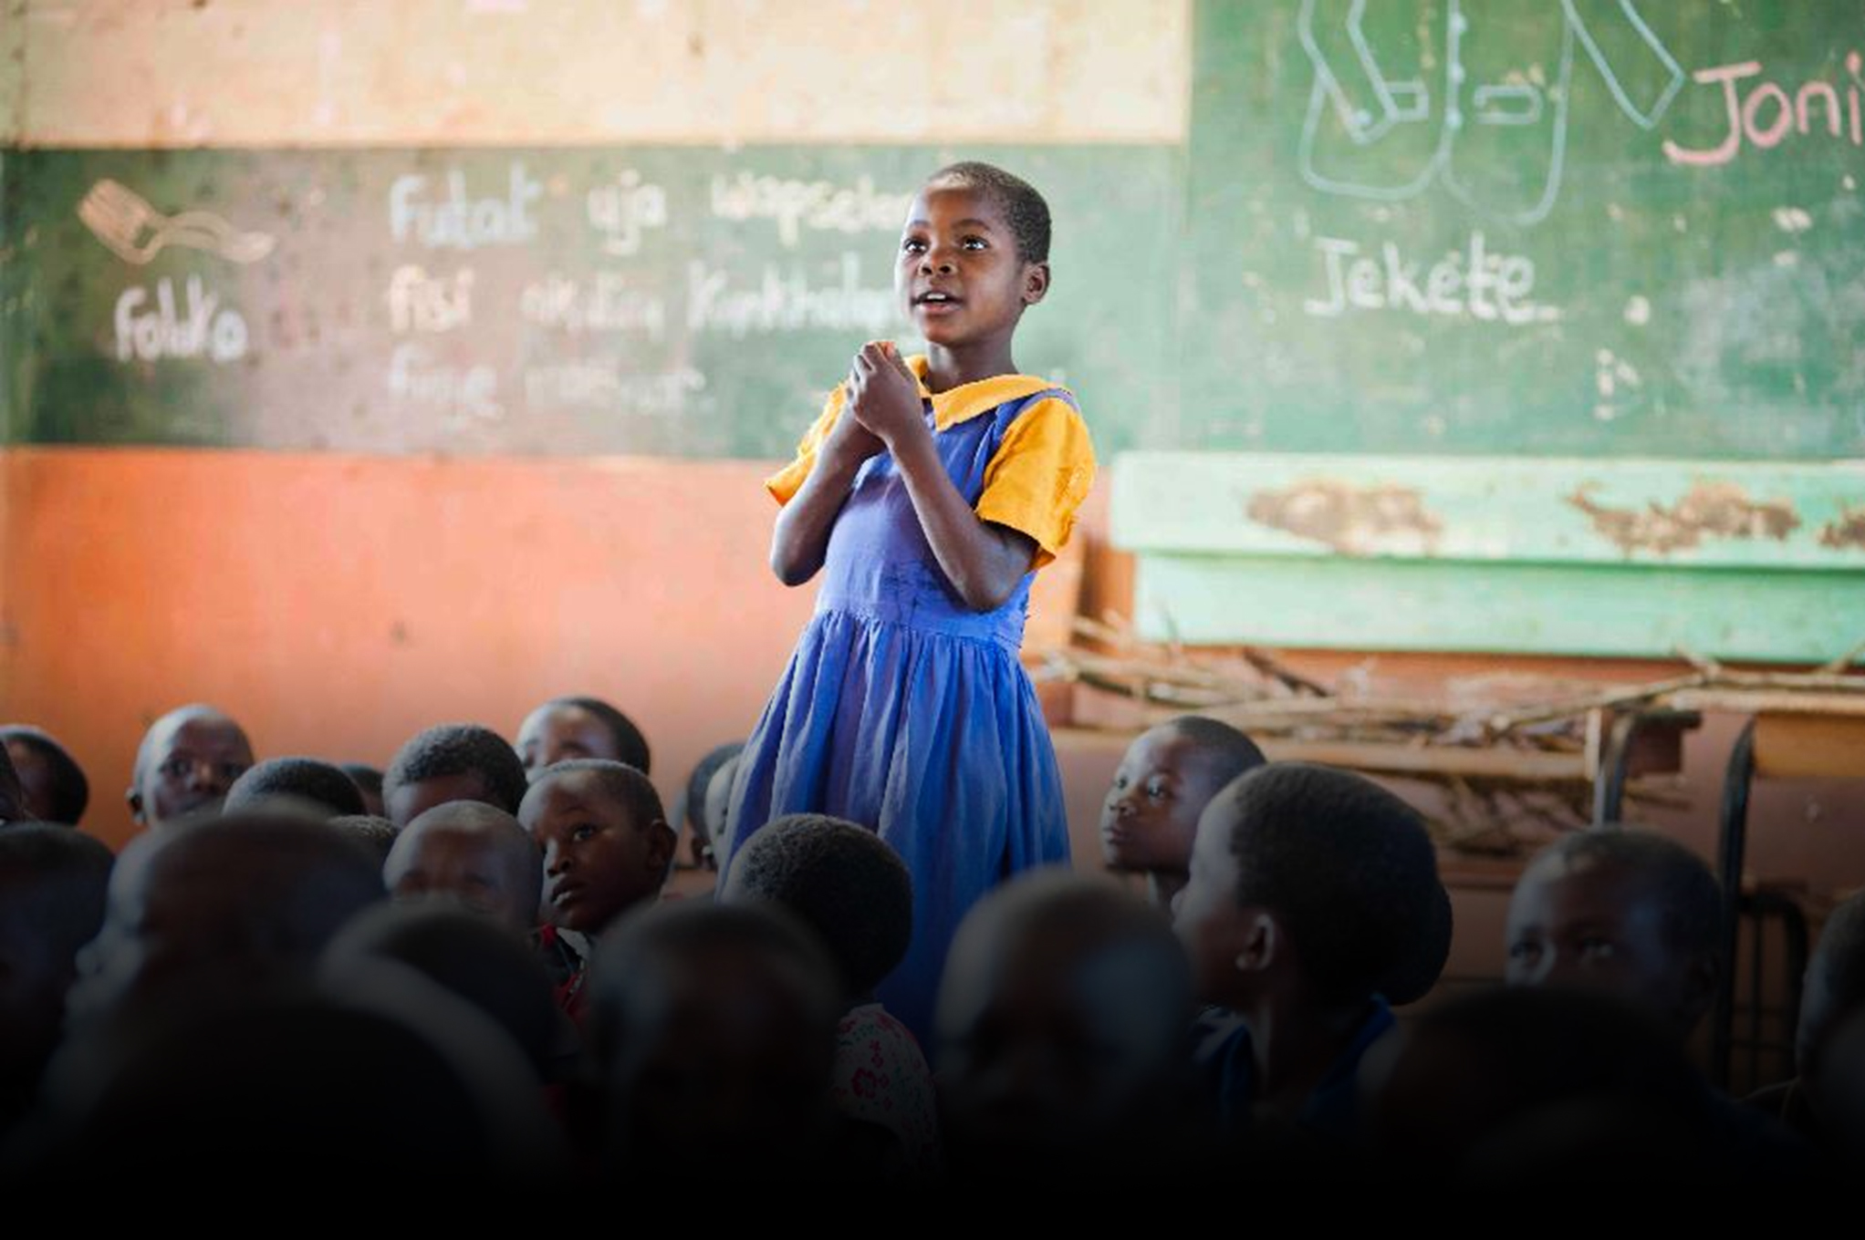
Mary’s Meals UK
Charity No. SC022140
Company No. SC265941
Tel: 0141 336 7094
Dalmally office
Craig Lodge
Dalmally, Argyll
PA33 1AR
Glasgow office
10-13 Claremont Centre
39 Durham Street, Glasgow
G41 1BS
London office
13 Hippodrome Place
Notting Hill, London
W11 4SF
“Together, let’s set out on this journey; one step at a time, one meal at a time, one child at a time.”
– Magnus MacFarlane-Barrow, Mary’s Meals founder

