Slide 1



Recruitment pack for:
Data Analyst
Mary’s Meals UK
March 2021

Slide 2

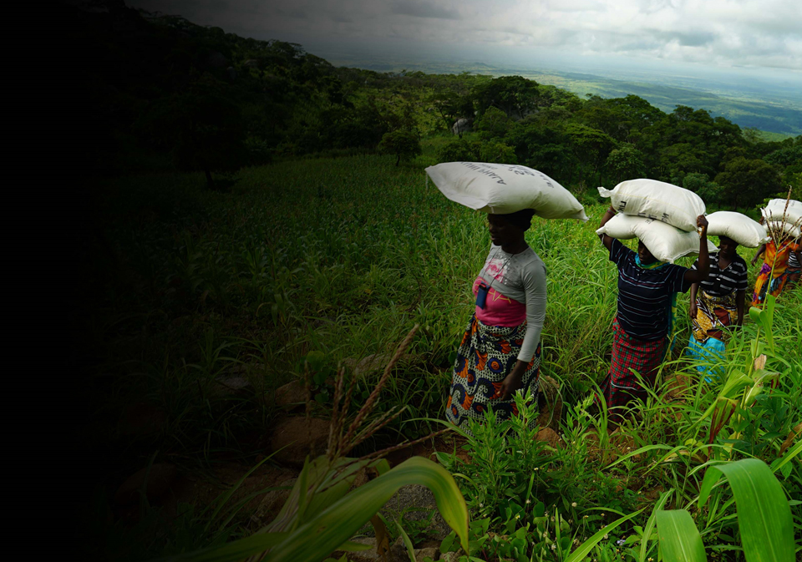
Recruitment pack contents
Welcome from our 3
Executive Director
Our vision, mission 5
and values
About the Mary’s Meals 7
movement
About Mary’s Meals UK 9
Role outline 11
and specification
Recruitment process 16
information
2

Slide 3
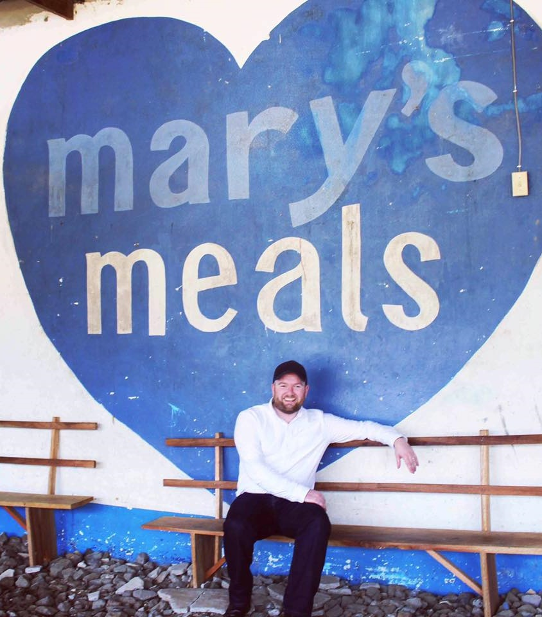
Welcome from our Executive Director
Thank you so much for your interest in joining the Mary’s Meals family. As you consider making an application for the role of Data Analyst with Mary’s Meals UK, I hope you find this pack helpful, encouraging, and exciting.
In joining Mary’s Meals UK, you would become part of a global movement of people who will simply not accept that any child should go hungry in this world of plenty. We are passionately driven by our simple belief that every child in the world deserves an education – and enough to eat.
From small beginnings feeding just 200 Malawian children in 2002, we are now reaching 1,667,067 children across 19 programme countries (including Malawi, Liberia, Zambia, Haiti, South Sudan, and Syria) with a nutritious daily meal in school.
This meal not only meets the immediate needs of the hungry child, but it attracts children to the classroom, where they can gain an all-important education. And we firmly believe that the children who are receiving Mary’s Meals today can grow up – better nourished and better educated – to become the men and women who will lift their communities out of poverty and end their reliance on aid.
3

Slide 4

Welcome from our Executive Director
None of this would be possible without the incredible generosity of our supporters all over the world, who give freely of their time, money, skills, and prayer. In Malawi alone, we have 80,000 volunteers who rise early each day to serve Mary’s Meals to children in their community.
And, across Mary’s Meals’ dozen or so ‘national affiliate’ countries, in which we raise awareness and funds for our work (including the UK, USA, Austria, Germany, Ireland, Croatia and Canada), thousands of people amaze and inspire us every day with their ‘little acts of love’, spreading the word about Mary’s Meals in their local communities and raising money to feed more children.
The UK, where we received the first-ever donations for our work, remains the country in which Mary’s Meals raises the majority of its funds. And Mary’s Meals UK, the organisation I am privileged to lead is responsible for continuing to tell our story across Scotland, England, Northern Ireland and Wales; engaging and inspiring more and more UK volunteers and donors; and driving forward the unrelenting growth of the Mary’s Meals movement on these shores.
We do this while working very closely and collaboratively with our colleagues at Mary’s Meals International, the organisation which co-ordinates the global movement and directly manages our school feeding programmes.
The Data Analyst will work collaboratively with the various functions in MMUK to support the development of data management, reporting, insights as well as supporting the development, adoption and implementation of the CRM system.
With 59 million children out of school around the world and a further 73 million attending school so hungry, they’re unable to concentrate and learn, our work is only just beginning. Will you play a crucial part in shaping the future of Mary’s Meals UK and, with it, the lives of so many people who both contribute to and benefit from this incredible work of love, joy, and hope?
I look forward to hearing your story.
Daniel Adams
Executive Director, Mary’s Meals UK
4

Slide 5

Our vision and mission
• Our vision is that every child receives one daily meal in their place of education and that all those who have more than they need, share with those who lack even the most basic things.
• Our mission is to enable people to offer their money, goods, skills, time, or prayer, and through this involvement, provide the most effective help to those suffering the effects of extreme poverty in the world’s poorest communities.
5

Slide 6

Our values
• We have confidence in the innate goodness of people.
• We respect the dignity of every human being and family life.
• We believe in good stewardship of the resources entrusted to us.
View Mary’s Meals’ full statement of values here: Statement of Values
6

Slide 7
About the Mary’s Meals movement
Mary’s Meals is a global movement that sets up school feeding projects in some of the world’s poorest communities, where poverty and hunger prevent children from gaining an education.
Our idea is a simple one that works. We provide one daily meal in a place of learning in order to attract chronically poor children into the classroom, where they receive an education that can, in the future, be their ladder out of poverty.
The Mary’s Meals campaign was born in 2002 when Magnus MacFarlane-Barrow, from Dalmally in Argyll, visited Malawi during a famine and met a mother dying from AIDS. When Magnus asked her eldest son Edward what his dreams were in life, he replied simply: “I want to have enough food to eat and to go to school one day.”
That moment was a key part of the inspiration which led to the founding of Mary’s Meals, which began by feeding just 200 children in Malawi in 2002. Today, 19 years later, we feed 1,667,067 hungry children every school day across four continents. The average worldwide cost for us to feed a child for a whole school year is just £15.90.
Where Mary’s Meals is provided, there is a rise in school enrolment, attainment and attendance. Wherever possible, Mary's Meals uses locally grown food to support the local economy and help smallholder farmers.
We work extremely hard to keep our running costs low and to ensure that at least 93% of donations goes directly on our charitable activities. This is only possible because most of our work is done by an army of dedicated volunteers all over the world, who carry out lots of little acts of love on behalf of Mary’s Meals.
Having been inspired, in part, by our founder’s Catholic faith, this work is named in honour of Mary, the mother of Jesus, who brought up her own child in poverty. We consist of, respect and reach out to people of all faiths and none.
Counting on support from around the globe, Mary’s Meals has registered national affiliate organisations, which raise awareness of our work, in more than 19 countries around the world. Funds raised by affiliates, including from Mary’s Meals UK, are passed to Mary’s Meals International, the organisation which co-ordinates our movement and directly manages the delivery of our school feeding programmes.
7

Slide 8
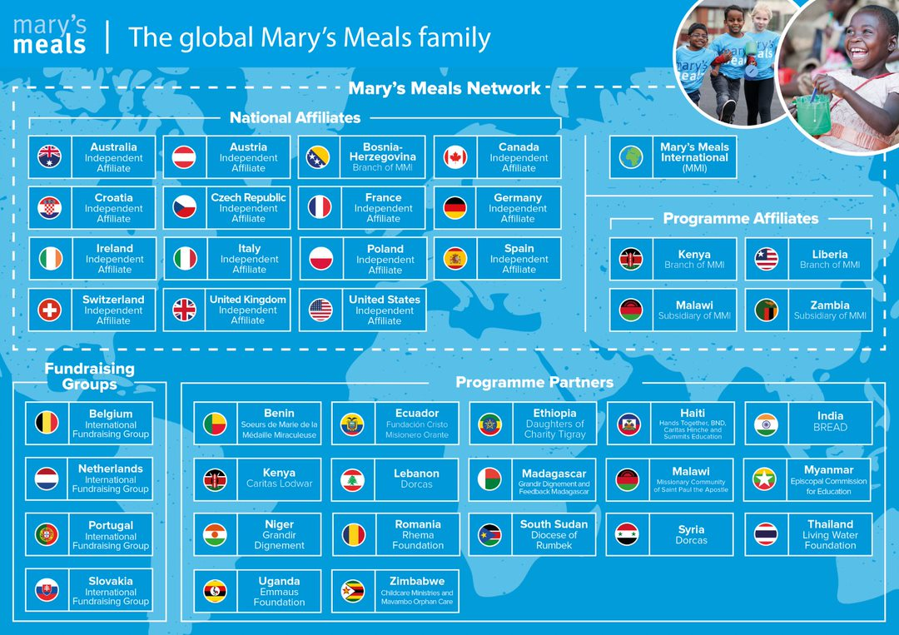
8

Slide 9
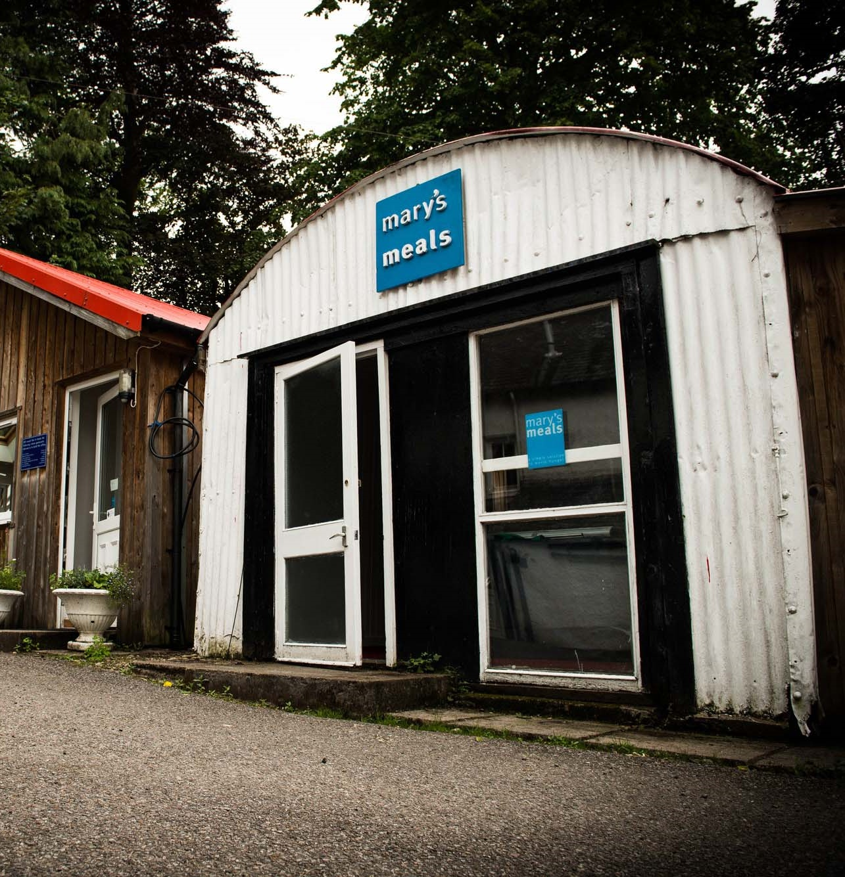
About Mary’s Meals UK
Mary’s Meals UK (or ‘MMUK’), a charity registered in Scotland, is the oldest entity in the Mary’s Meals family – the original organisation established as Scottish International Relief in the early 1990s, when our founder and global CEO, Magnus MacFarlane-Barrow, first became involved in international aid during the Bosnian Conflict.
Back then, Magnus was a simple salmon farmer who, along with his family, decided to do something to help those who were suffering because of the war.
They relied heavily on the generosity of local people in their village of Dalmally in Argyll, who relentlessly donated food, blankets and other items of aid, which were then stored in the family shed, before being driven out by Magnus to Bosnia-Herzegovina.
Though our largest office is now in Glasgow, that same shed – which continues to be filled, metaphorically at least, with the generosity of our supporters – still serves as the headquarters of Mary’s Meals UK to this day.
9

Slide 10
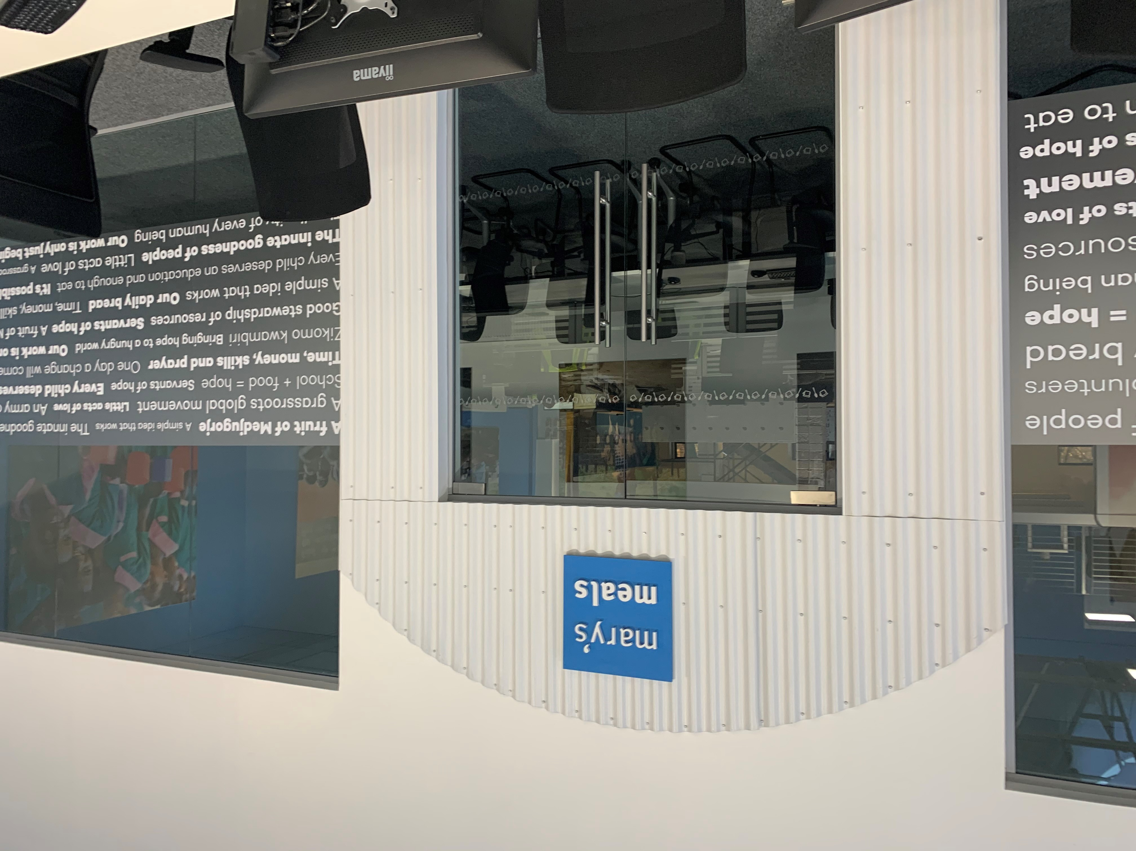
About Mary’s Meals UK
In January 2015, to recognise the incredible growth of the Mary’s Meals movement around the world and to facilitate future growth in new countries, another entity – Mary’s Meals International (or ‘MMI’) – was formed.
This new organisation assumed responsibility for directly delivering our programmes and for coordinating the growing number of Mary’s Meals organisations around the world, aimed at either awareness-raising or programme delivery.
This structural change saw Mary’s Meals UK become the global movement’s largest fundraising organisation and enabled it to focus even more passionately on its mission to tell our story across Scotland, England, Northern Ireland and Wales, and empower more people to help us reach the next hungry child by offering their money, goods, skills, time or prayer.
Today, Mary’s Meals UK raises awareness and funds under the direction of the Executive Director, and through the passion, commitment and dedication of our volunteers and staff, led by the Director of Communications, Director of Supporter Engagement and Income, and the Director of Finance and Operations. The organisation currently has offices in Glasgow, Dalmally and London.
10

Slide 11
Role outline
Role title: Data Analyst
Location: Any UK location (Occasional travel to Glasgow required)
Contract: Full-time, 37.5 hours per week
Salary: c. £27,000 per annum
Benefits: Flexible working, 34 days’ annual leave
(including public holidays), and a
non-contributory pension with employer contributions of 8%. For more information on what we offer, please visit: http://bit.ly/2F9lVlQ
Reports to: Data Insights Manager
Key relationships:
Internal: Head of Operations,
Leadership team, Finance & Operation Managers Supporter Engagement & Supporter Care Managers MMUK teams
External: MMI IT
MMI CRM team Third party providers
Mary’s Meals UK
Operations team structure
Director of Finance and Operations
Head of Operations
Data Insights Manager
Data Insights Officer
Data Analyst
11

Slide 12

Duties and responsibilities
Role overview
The Data Analyst will work across directorates to support the Data Insights Manager with GDPR compliance and reporting. This includes leading on data governance and compliance, data collection, analysis and report writing to support and influence the strategic direction of the organisation through producing analysis of internal and external data.
Key Activities
Analytics, Management Information and Reporting
Produce analysis, reports and dashboards for strategic KPI’s
Produce analysis of data on trends and areas for organisational development and improvement as directed
Produce reports and dashboards for operational managers and their teams
Interpret data and analyse results and prepare reports on findings for a range of audiences
Analyse and produce data for mailing lists as defined by the Communications team, within an agreed timescale
Data Management
Support the operationalisation of data governance, data quality and other controls to sustain the integrity of data for the organisation.
Support the implementation and administration of data collection policies and methods.
Participate in the development of standards upon which collection of data are based/measured and ensure that these standards are always met
Participate in the development of data collection methods that are individually relevant to any project being embarked upon by the organisation
Undertake frequent audits of data and ensure all data is cleansed and validated, as required
12

Slide 13
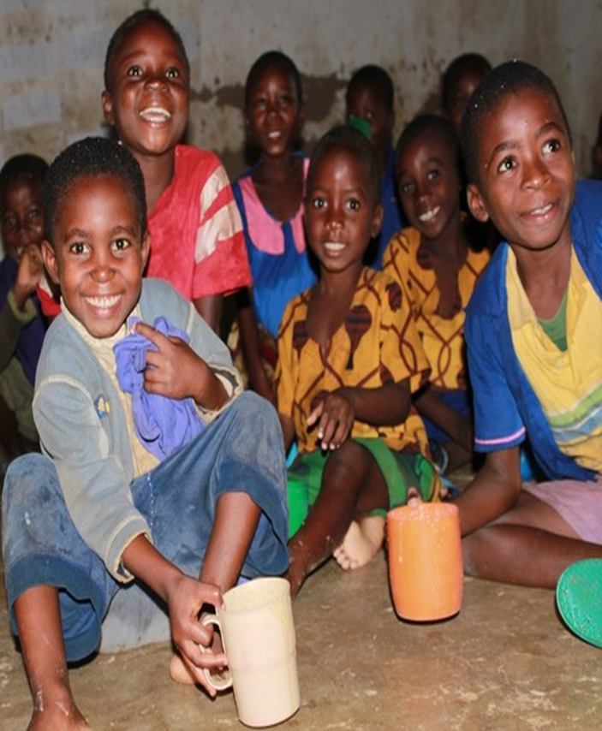
Duties and responsibilities
CRM
Providing advice and assistance for reporting of Salesforce incidents tickets and to monitor and provide weekly reporting on progress.
Participate in UAT and/or support the internal stakeholders to progress with UAT
Participate in supporting the development of CRM projects and provide weekly reporting on progress
Management of self
Participate in personal development reviews including identifying any learning/training needs.
Continue to identify opportunities for own development including keeping knowledge up to date and relevant.
Communicate effectively and accept personal responsibility.
Participate in Mary’s Meals 1-2-1’s, monthly gatherings, quarterly all staff days and Operations away days.
12

Slide 14

Qualifications, experience and skills
Essential
Excellent understanding of relational databases
A practical, pragmatic person with good analytical skills and a logical approach to problem solving.
Knows, understands and can demonstrate the ability to lead sustained improvement in standards of data management, data control, data protection and resources.
A keen eye for accuracy and detail.
Has proven ability to plan projects and manage change to secure the improvement of resources and systems.
Excellent communication skills with the ability to liaise with staff and volunteers at all levels.
Is able to analyse data and use the information to support strategic planning and objective setting.
Has high level of skills in the use of Excel to manipulate, analyse and create reports on data.
Can explain data analysis to non-technical teams.
Experience in the use of Office 365 including SharePoint investment.
Desirable
Experience of using CRM systems
Experience of working in the charity sector.
Experience of migration from a shared drive file system to a document management solution providing version control and file level access permissions.
13

Slide 15

Mary’s Meals UK competencies
All Mary’s Meals UK employees approach their role in line with our 7S competency model:
1. Self
I build and demonstrate resilience
I lead by example
I’m authentic and true to Mary’s Meals values
I develop myself and set stretching goals
2. Service
I have a vocational attitude to my work
I inspire hope in others
I build belief that even difficult challenges can be solved
I am committed to serving and enabling all who want to be part of the global movement
I work to ensure our future will be even better than our past
3. Simplicity
I communicate effectively
I follow clear decision-making criteria
I create plans that are easy to follow and contribute to organisational goals
I embrace inclusivity and diversity
I focus on delivering results
4. Stewardship
I pay attention to the things that matter most;
(a) our physical resources; (b) our people
I nurture, develop and respect our relationships with external stakeholders
I deliver on my promises
I am happy to be held accountable and to hold others to account
5. Strategy
I have a point of view about the future
I know our stakeholders and see our priorities clearly
I help others to work in ways that have the
greatest impact
I develop strategy and translate it into action
6. Strengthen
I contribute to a positive work environment
I support those around me
7. Success
I maintain my technical competence
I contribute to the success of my team
I ensure accountability
I embrace change
14

Slide 16
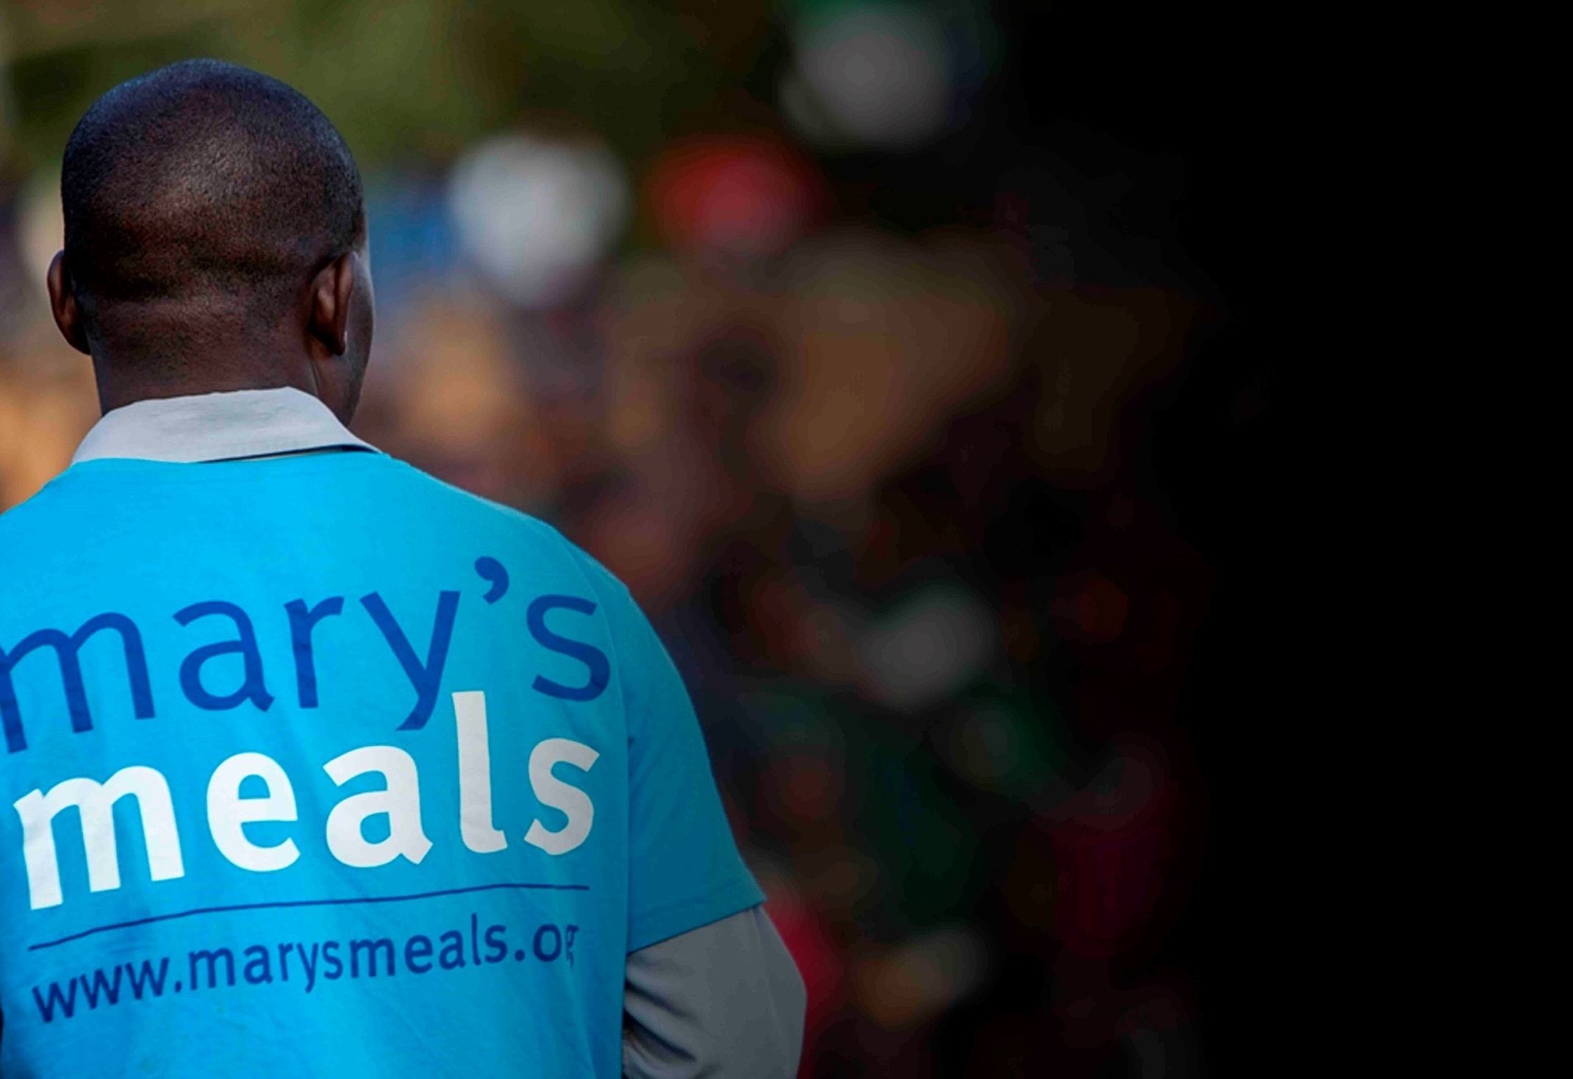
Recruitment process information
How to apply for this role
To apply for the role of Data Analyst at Mary’s Meals UK, please send a tailored CV and covering letter to: Jobs@marysmeals.org
Your covering letter should make a compelling case for why you feel motivated to apply for this role within Mary’s Meals UK, as well as giving a concise overview of your most relevant skills and experience, and should fill no more than two pages of A4.
Recruitment timescales
Closing date for applications:
22nd March 2021
Please note: A second interview stage may be required
15

Slide 17

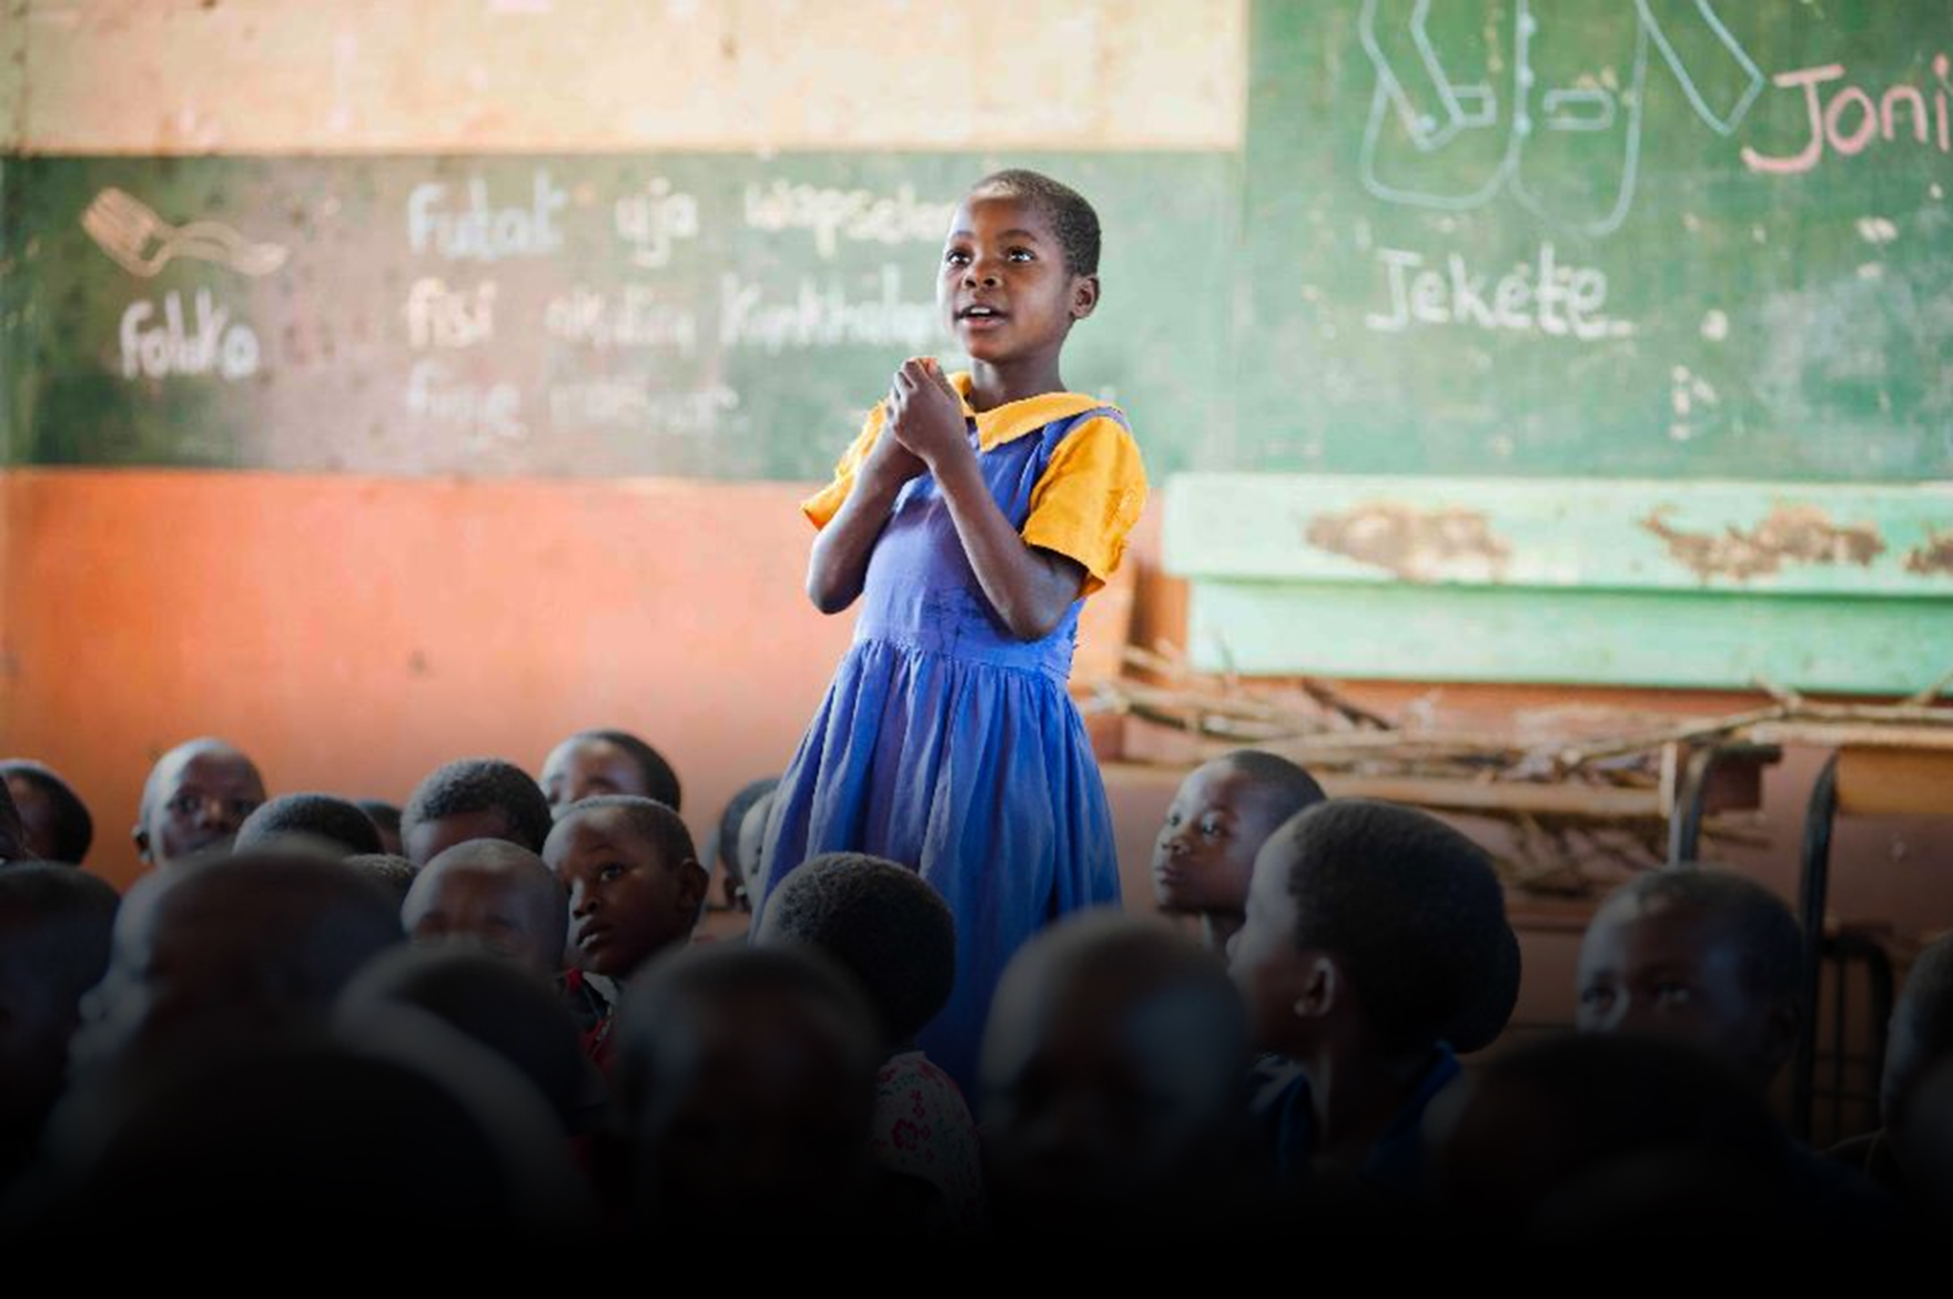
Mary’s Meals UK
Charity No. SC022140
Company No. SC265941
Tel: 0141 336 7094
Dalmally office
Craig Lodge
Dalmally, Argyll
PA33 1AR
Glasgow office
Unit 6 Claremont Centre
39 Durham Street, Glasgow
G41 1BS
London office
13 Hippodrome Place
Notting Hill, London
W11 4SF
“Together, let’s set out on this journey; one step at a time, one meal at a time, one child at a time.”
– Magnus MacFarlane-Barrow, Mary’s Meals founder

