Slide 1


Slide 2
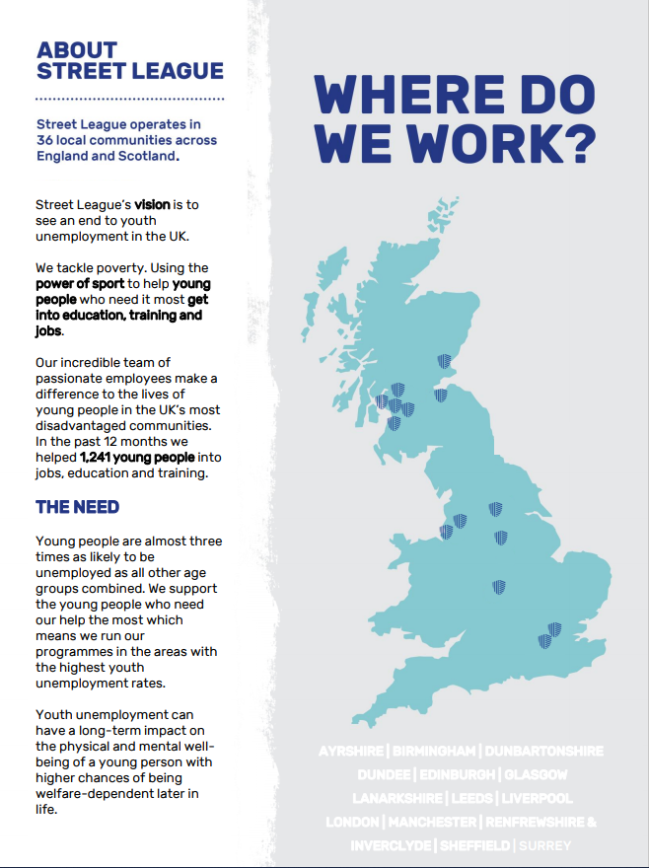

Slide 3
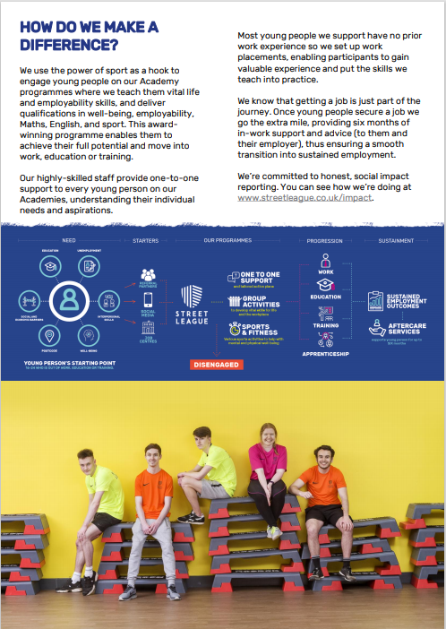

Slide 4

JOB DESCRIPTION
POST TITLE: Progressions Coordinator
REPORTS TO: Operations Manager
CONTRACT: 1 Year Fixed Term, Full Time (36.25 hours per week)
LOCATION: Renfrewshire & Inverclyde
SALARY: £ 23,000 - £26,500
Summary of Post
The Progressions Coordinator works in partnership with their delivery partner (Youth & Community Coach) in delivering and administering Street League’s core programmes in their specific local areas.
You will be responsible for securing employment, education and training opportunities for Street League participants and supporting them to progress. You will be responsible for the delivery of Street League’s Academy, in which you will deliver group employability and personal development workshops and qualifications. You will establish and maintain partnerships with referral agencies and develop further partnerships with employers or colleges in order to secure suitable opportunities for our participants. Monitoring and reporting are essential to this role.
Main Duties and Responsibilities:
Progression
Overall accountability for participant’s progression into employment, education or training
Overall accountability for identifying work experience opportunities and supporting participants within work experience, employment, education or training by providing aftercare.
To network with external organisations such as colleges, job centres, careers centres, employers, community groups and other relevant organisations to source and secure employment, education and/or training opportunities for Street League participants. Also using social media and local media to raise awareness of Street League’s work, with support and training provided by our Communications team.
Overall accountability for soft skills analysis, overcoming barriers and assisting participants to draw up action plans. Undertaking an appropriate initial assessment with each participant using a variety of tools and methods that assist in identifying the needs of the participant.
Shared responsibility for inputting and maintaining M&E (monitoring and evaluation) information by capturing daily attendance, personal development information, outcomes and sustainment and to produce reports as required
Overall accountability for meeting delivery team targets in relation to recruitment, retention and outcomes
Delivery
Overall accountability for the preparation, administration and delivery of the Street League Academy and progression service
To work closely with Coaching staff in the delivery of Street Leagues core activity programmes
Delivery of a complete employability service including job searching strategies, interview techniques, job applications, etc. and delivering group employability and personal development workshops
Shared responsibility in the recruitment, supervision, organisation and training of sessional coaches, volunteers and apprentices
To contribute to the development and implementation of Street League’s Practice Framework and to update, develop and share sessions or workshops that are relevant to Street League contracts and funding streams
Administration/Other
Responsibility for completing all necessary paperwork for each participant on academies including organising travel expenses, timesheets, training allowances, etc. in line with SDS contractual requirements
Shared responsibility for health and safety, ensuring that risk assessments are carried out on all venues in which Street League activity takes place and that health and safety procedures and policies are adhered to

Slide 5
JOB DESCRIPTION (contin.)
Main Duties and Responsibilities (continued):
Shared responsibility for the appropriate referral or signposting of participants to agencies for specialist help who require additional support needs such as housing, addiction, etc.
Keeping up to date with labour market information, legislation, professional and academic developments
General
Responsibility and diligence around issues or incidents which may make activity non-inclusive for participants and carrying out the necessary procedures in identifying and dealing with any safeguarding or child protection, diversity or health & safety issues
To promote equal opportunities at all time in line with Street League’s Equal Opportunities, Equality and Diversity Policy
A flexible approach to the working pattern will be required, as there may at times be a requirement to work outside the normal working week, however sufficient advance notice will given
This post holder will be based within the Paisley Office but primary duties will be carried out across Renfrewshire & Inverclyde
This job description is current at the date of issue. As and when the work of Street League develops or changes so the areas of responsibility may be subject to change, and the job description reviewed. Such changes would in the first instance be made in consultation with the post holder.
Employee Signature ……………………………………
Print ……………………………………
Date ……………………………………
Line Manager Signature ……………………………………
Print ……………………………………
Date …………………………………….

Slide 6
PERSON SPECIFICATION
Street League has developed the use of selection criteria to aid objective recruitment in line with the Equal Opportunities policy.
Personal Characteristics
The Progressions Coordinator is a dynamic individual who enjoys working in an exciting and challenging, but rewarding environment. Street League is a growing organisation and requires staff who can think on their feet, willing to accept change and are committed to continuing their professional development. There will be opportunities to work on tasks and projects that are outside the job description and the successful candidate will be enthusiastic and committed to supporting the overall aims and objectives of Street League.
Experience
Experience of working with challenging participants, challenging behaviour, and those with low self esteem, in particular 16-25 year olds not in education, employment or training.
Experience of delivering qualifications, education or employability sessions
Experience of delivering group work sessions as well as working on a 1-2-1 basis with participants
Experience of working in an environment where safeguarding and child protection is of high importance
Experience of working to targets, implementing monitoring and recording systems
Experience of delivering programmes that are focussed on soft skills, mentoring and employability
Knowledge and understanding
A knowledge and understanding of the third sector and related agencies
A knowledge of voluntary and career pathways for Street League participants
A knowledge of suitable training and education programmes for Street League participants
An understanding of the barriers that face Street League’s client group and local authority and government response to these social challenges
Skills and abilities
The ability to organise and to be self-motivated
A willingness to undertake continuous personal development
The ability to communicate effectively both orally and in writing and to be fully competent in the use of Microsoft Office programs and relevant M&E systems/data capture
To have a confident and calm approach to problems and an ability to use initiative in finding solutions
At least a GSCE level literacy or numeracy (or equivalent) and the ability to be innovative in the use of existing skills and abilities to deliver literacy and numeracy to Street League participants
Qualifications
Appropriate degree/diploma in Community Development, Social Care, Community Learning Development, Teaching or Training, however exceptions will be made for candidates demonstrating a high level of experience
An appropriate assessor qualification is desirable
Applicants should hold a full clean driving licence with own car

Slide 7
