Slide 1


Slide 2
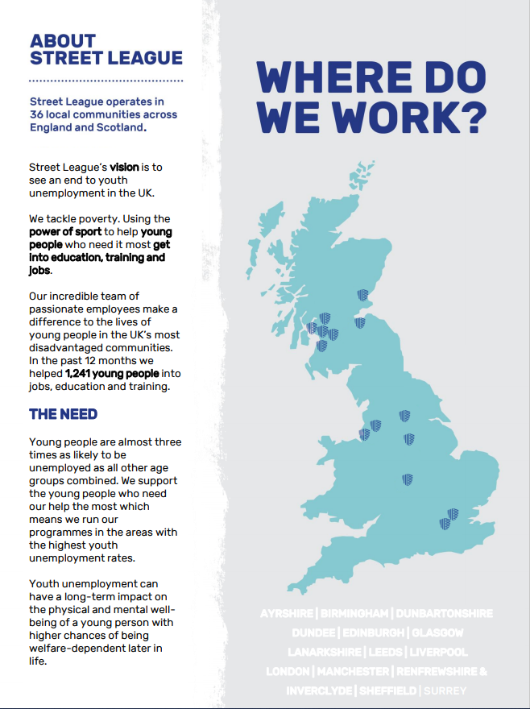

Slide 3


Slide 4

JOB DESCRIPTION
POST TITLE: Functional Skills Tutor
REPORTS TO: Birmingham Operations Manager
LOCATION: Birmingham
CONTRACT: Permanent
SALARY: £23,000 - £26,500
Summary of Post
You will be responsible for planning, delivering and developing our functional skills curriculum (Maths and English) for our participants progressing them from their initial assessment level to at least one level higher as part of Street League’s Academy programme (10-20 weeks). You will have overall responsibility for ensuring that young people are retained on the course and achieve their functional skills qualifications.
Main Duties and Responsibilities:
Deliver classroom-based & online digital sessions delivering Functional Skills English and Maths up to Level 2 to Street League’s participants as well as providing additional one-to-one support if required.
Carry out and effectively interpret a range of initial assessment and diagnostic tools in order to determine existing level of participants.
Devising learner journeys/action plans taking into consideration various learning styles and individual learner needs.
Working in partnership with the Contracts & Quality team to develop schemes of work and lesson plans as well as contributing to the on-going creation and development of new and innovative training materials/resources.
Liaising with colleagues to offer learners the best possible progression route for further education, apprenticeships and employment.
During non-academy times, you will contribute to the achievement of team objectives by administering and invigilating resits as well as contributing towards the achievement of the full set of qualifications that our participants take part in.
Ensuring all delivery meets quality and performance standards set by Street League’s Contracts & Quality team.
Achieving contractual and internal success and retention rates for accredited Maths and English qualifications
Supporting the administration of the learning aims, including marking, assessment and contributing to the internal and external verification processes as required
Contributing to the enrolment of new learners if required.
Scheduling of exams as required
Attending curriculum working groups where necessary and delivering workshops and training sessions to operations staff in order for them to achieve their own level 2 qualifications in Maths and English and improve their delivery of functional skills

Slide 5
JOB DESCRIPTION (contin.)
Main Duties and Responsibilities (continued):
Responsibility for sharing good practice and contributing to the overall quality improvement activities.
Administrating and completing paperwork associated with programme within required timescales.
Keeping up to date with any awarding organisation changes and requirements
To actively promote and implement Street League’s Equal Opportunities policy within all aspects of the post.
A flexible approach to the working pattern will be required, as there will at times be a requirement to work outside the normal working week, however sufficient advance notice will given
To undertake other duties as required by your line manager.
This role will be based in Birmingham
This job description is current at the date of issue. As and when the work of Street League develops or changes so the areas of responsibility may be subject to change, and the job description reviewed. Such changes would in the first instance be made in consultation with the post holder.
Employee Signature ……………………………………
Print ……………………………………
Date ……………………………………
Line Manager Signature ……………………………………
Print ……………………………………
Date …………………………………….

Slide 6
PERSON SPECIFICATION
Street League has developed the use of selection criteria to aid objective recruitment in line with the Equal Opportunities policy.
Personal Characteristics
The Functional Skills Tutor is a dynamic and engaging individual who enjoys working in a targeted environment, whilst upholding the values of Street League. They have a clear commitment to continuous improvement in relation to the quality of learning and assessment .They are committed to supporting young people to achieve their qualifications and are innovative in their approach, enthusiastic and motivated to support success for our participants and staff.
Experience
Experience of working with young people and ‘vulnerable groups’.
Experience of working in a team in a community education, development or employability setting.
Knowledge and understanding
Knowledge and understanding of Ofsted inspections
A comprehensive knowledge of career pathways and of voluntary, academic and training opportunities for participants.
A knowledge of the Third Sector, voluntary organisations and their role in relation to community and National Government.
Skills and abilities
The ability to plan, develop and deliver Functional Skills up to Level 2 in Maths & English
The ability to effectively interpret a range of initial assessment and diagnostic tools
Excellent delivery in all internal and external inspections, monitoring visits and observations
A flexible approach to work, resilient and willing to accept change
Robust classroom management skills
The ability to communicate effectively both orally and in writing.
To have a confident and calm approach to problems and an ability to use initiative in finding solutions.
Excellent literacy and numeracy skills.
Good organisational and administrative skills
Qualifications
Level 3 Award in Education & Training is desirable

Slide 7
