Slide 1


Slide 2
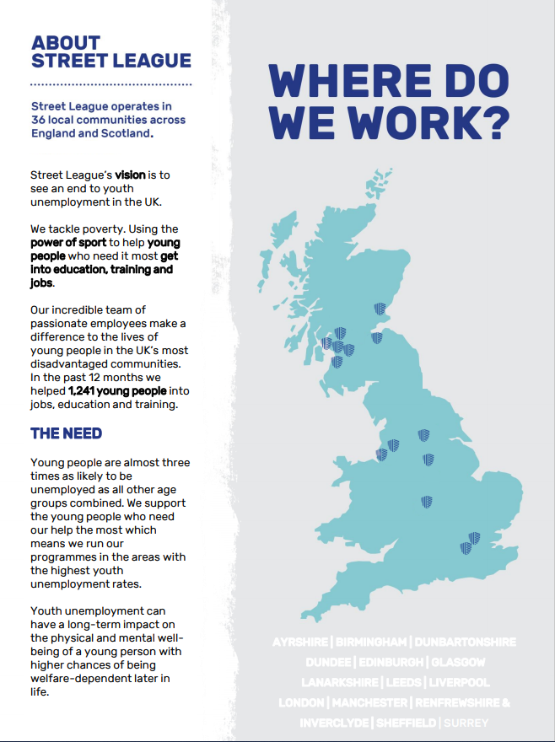

Slide 3


Slide 4

JOB DESCRIPTION
POST TITLE: Business Manager (Apprenticeships)
REPORTS TO: Modern Apprenticeships Manager
LOCATION: Paisley
CONTRACT: Permanent, Full time (36.25 hours per week)
SALARY: £35,000 - £39,500
Summary of Post
Responsible for the development, delivery and management of a targeted Apprenticeship strategy for Street League. You will account manage existing relationships covering Scottish regions and will engage, qualify interest, develop and manage new relationships with employers who will partner with Street League to deliver Apprenticeships. The senior team will set out an approach to develop relationships with targeted industries/companies with national/regional profiles.
The post holder will liaise with teams and colleagues across Street League’s departments to help develop and implement a Scotland-wide strategy that will create a portfolio of Apprenticeship options for Street League participants.
Main Duties and Responsibilities:
You will be responsible for personally securing Service Level Agreements with target companies for delivery of MAs in selected industries.
You will be required to achieve a specified number of relationships year-on-year to contribute to Street League's overall MA strategy for growth.
You will seek new opportunities and develop new company partnerships including the planning and delivery of all proposals and presentations on Modern Apprenticeships, with relevant financial information including employer incentive schemes.
You will identify an on-going pipeline of new company Modern Apprenticeship prospects in Scotland.
You will be involved in developing budgets for potential partnerships, managing these budgets and reporting income forecasts to the Managing Director and Finance Director.
You will implement a coordinated approach to maximise any additional opportunities that arise from company partnerships and refer those opportunities to our Operations Managers, Head of Contracts & Quality or Commercial Team.
You will act as an ambassador for Street League networking to raise the profile of the charity within the corporate or voluntary sectors.
You will be responsible for managing all potential MA ‘company accounts’ in Scotland.
You will be responsible for tracking all partnerships and leads through a database management system.
You will work closely with the Head of Contracts (based in Paisley) to ensure the efficient administration and financial management of any future Apprenticeship programme.
To actively promote and implement Street League’s Equal Opportunities policy within all aspects of the post.
A flexible approach to the working pattern will be required, as there may at times be a requirement to work outside the normal working week, however sufficient advance notice will given.
To undertake other duties as required by line manager.

Slide 5
PERSON SPECIFICATION
Street League has developed the use of selection criteria to aid objective recruitment in line with the Equal Opportunities policy.
Experience
Significant experience of working within the Employability and Training sector with knowledge and understanding of SDS, DWP, SQA and Modern Apprenticeships.
Significant account management and project planning experience.
Experience in strategic planning and the setting and achievement of ambitious targets, with an entrepreneurial attitude to business growth
Proven experience of building business relationships with a wide variety of contacts
Experience of having worked well as a team player with strong communications skills
Knowledge & Understanding
A thorough understanding of the Modern Apprenticeship Scheme and the development of Service Level Agreements.
Skills & Abilities
A passion for changing the lives of young people from disadvantaged backgrounds
Established networks in the corporate sector and the ability to leverage these for the benefit of Street League
Excellent communication, stakeholder engagement, relationship building, project management and negotiation skills
A strong understanding of the fundraising arena and of issues and innovations within philanthropy at a local and a national level, with specific expertise in growing income through a range of approaches is desirable
Creative thinking and a proactive approach
A collaborative team player, with the ability to inspire confidence and trust from colleagues and funders and to work well with the senior management team
Experience of working effectively within a team to meet the demands of the entire organisation is desirable
Strong business acumen and financial literacy with an ability to assess and manage complex budgets is desirable
Evidence of having investigated and delivered new initiatives, and the development of best practice is desirable
Qualifications
Fundraising, Marketing or Business qualification is desirable
This post holder will be based within the Paisley office but primary duties will be carried out across Scotland.
This job description is current at the date of issue. As and when the work of Street League develops or changes so the areas of responsibility may be subject to change, and the job description reviewed. Such changes would in the first instance be made in consultation with the post holder.
Employee Signature ……………………………………
Print ……………………………………
Date ……………………………………
Line Manager Signature ……………………………………
Print ……………………………………
Date …………………………………….

Slide 6
