Slide 1

BUSINESS PLAN AND SOCIAL VALUE STATEMENT 2021-24
BOARD PRESENTATION
23rd SEPTEMBER 2021

Slide 2
WHAT THE BUSINESS PLAN COVERS
What is Fuse?
Our Community
The Strategic Context for our Work
OUR STATEMENT OF SOCIAL VALUE
Purpose, Mission and Vision
Our Values
Our Priorities for the Next Three Years
Objectives – What we aim to Deliver
The Fuse Team
Partners
Developing Fuse
Financial Strategy
Managing Risks
Notes:
According to an Ofcom report in 2015, people living in Shettleston had the poorest uptake of broadband and were described as the most digitally excluded in the UK.
We also identified Climate Challenge as being an important theme for Fuse going forward.
Providing access to the things that help them to progress toward chosen careers, aspire, have choice, improve educational attainment, increase skills

Slide 3
FUSE –
THE STORY SO FAR
2009
Fuse opens its doors as a diversionary venue
Significant development of services and venue
5-year business plan developed (refreshed in 2018) with a focus on Participation, Life Skills and Employability and Issues, supported by a focus on attainment
Covid pandemic disrupts services and leads to a stronger focus on digital delivery, whilst creating additional needs in the community; Fuse weathers the storm well
?
2009-16
2016
2020
2021+
Notes:
Equity – what we do at Fuse is all about creating equitable access and opportunity for young people. Bridge the gap between them and their more privileged peers in more affluent areas of the city.
According to an Ofcom report in 2015, people living in Shettleston had the poorest uptake of broadband and were described as the most digitally excluded in the UK.
We also identified Climate Challenge as being an important theme for Fuse going forward.
Providing access to the things that help them to progress toward chosen careers, aspire, have choice, improve educational attainment, increase skills

Slide 4
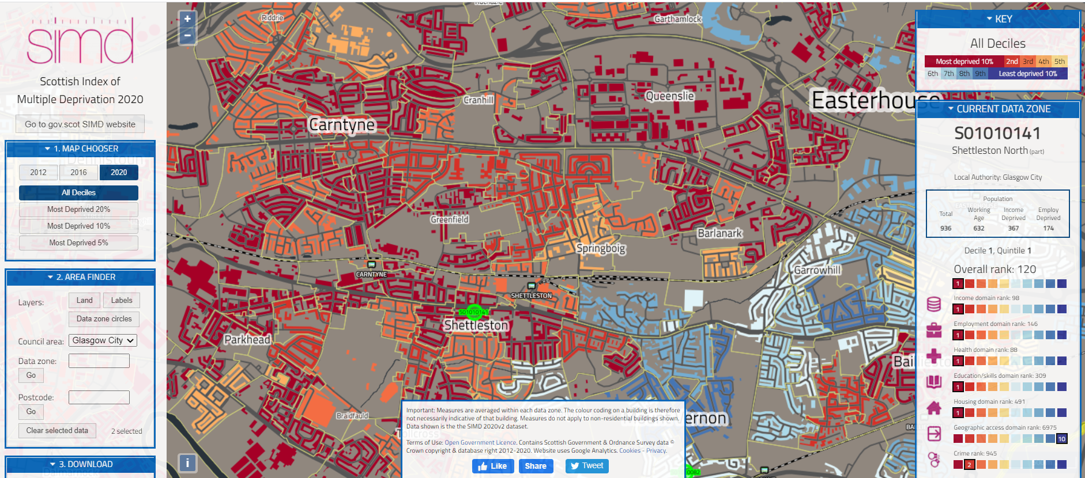

Slide 5
SERVICE USERS BY SIMD

Slide 6
OUR COMMUNITY
But also the stories that the figures don’t always tell……..
Bullying
Discriminatory behaviour
Alcohol, smoking and drugs
Diet
Mental health and wellbeing
Lack of role models
Lack of confidence
Limited aspirations
Social isolation
Digital exclusion
Notes:
Equity – what we do at Fuse is all about creating equitable access and opportunity for young people. Bridge the gap between them and their more privileged peers in more affluent areas of the city.
According to an Ofcom report in 2015, people living in Shettleston had the poorest uptake of broadband and were described as the most digitally excluded in the UK.
We also identified Climate Challenge as being an important theme for Fuse going forward.
Providing access to the things that help them to progress toward chosen careers, aspire, have choice, improve educational attainment, increase skills

Slide 7
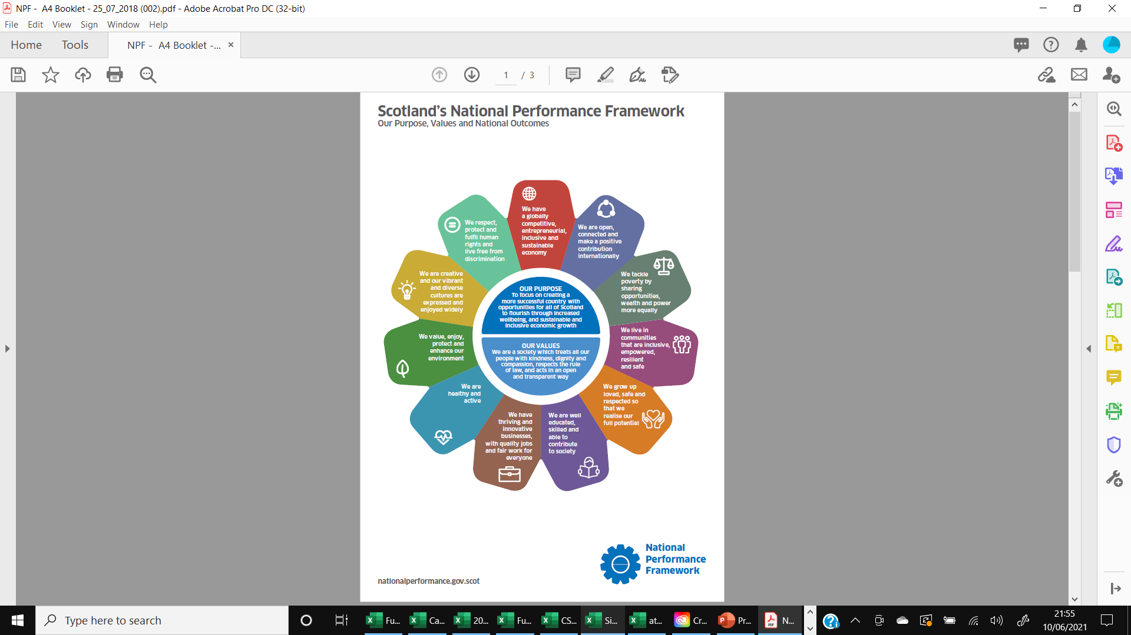

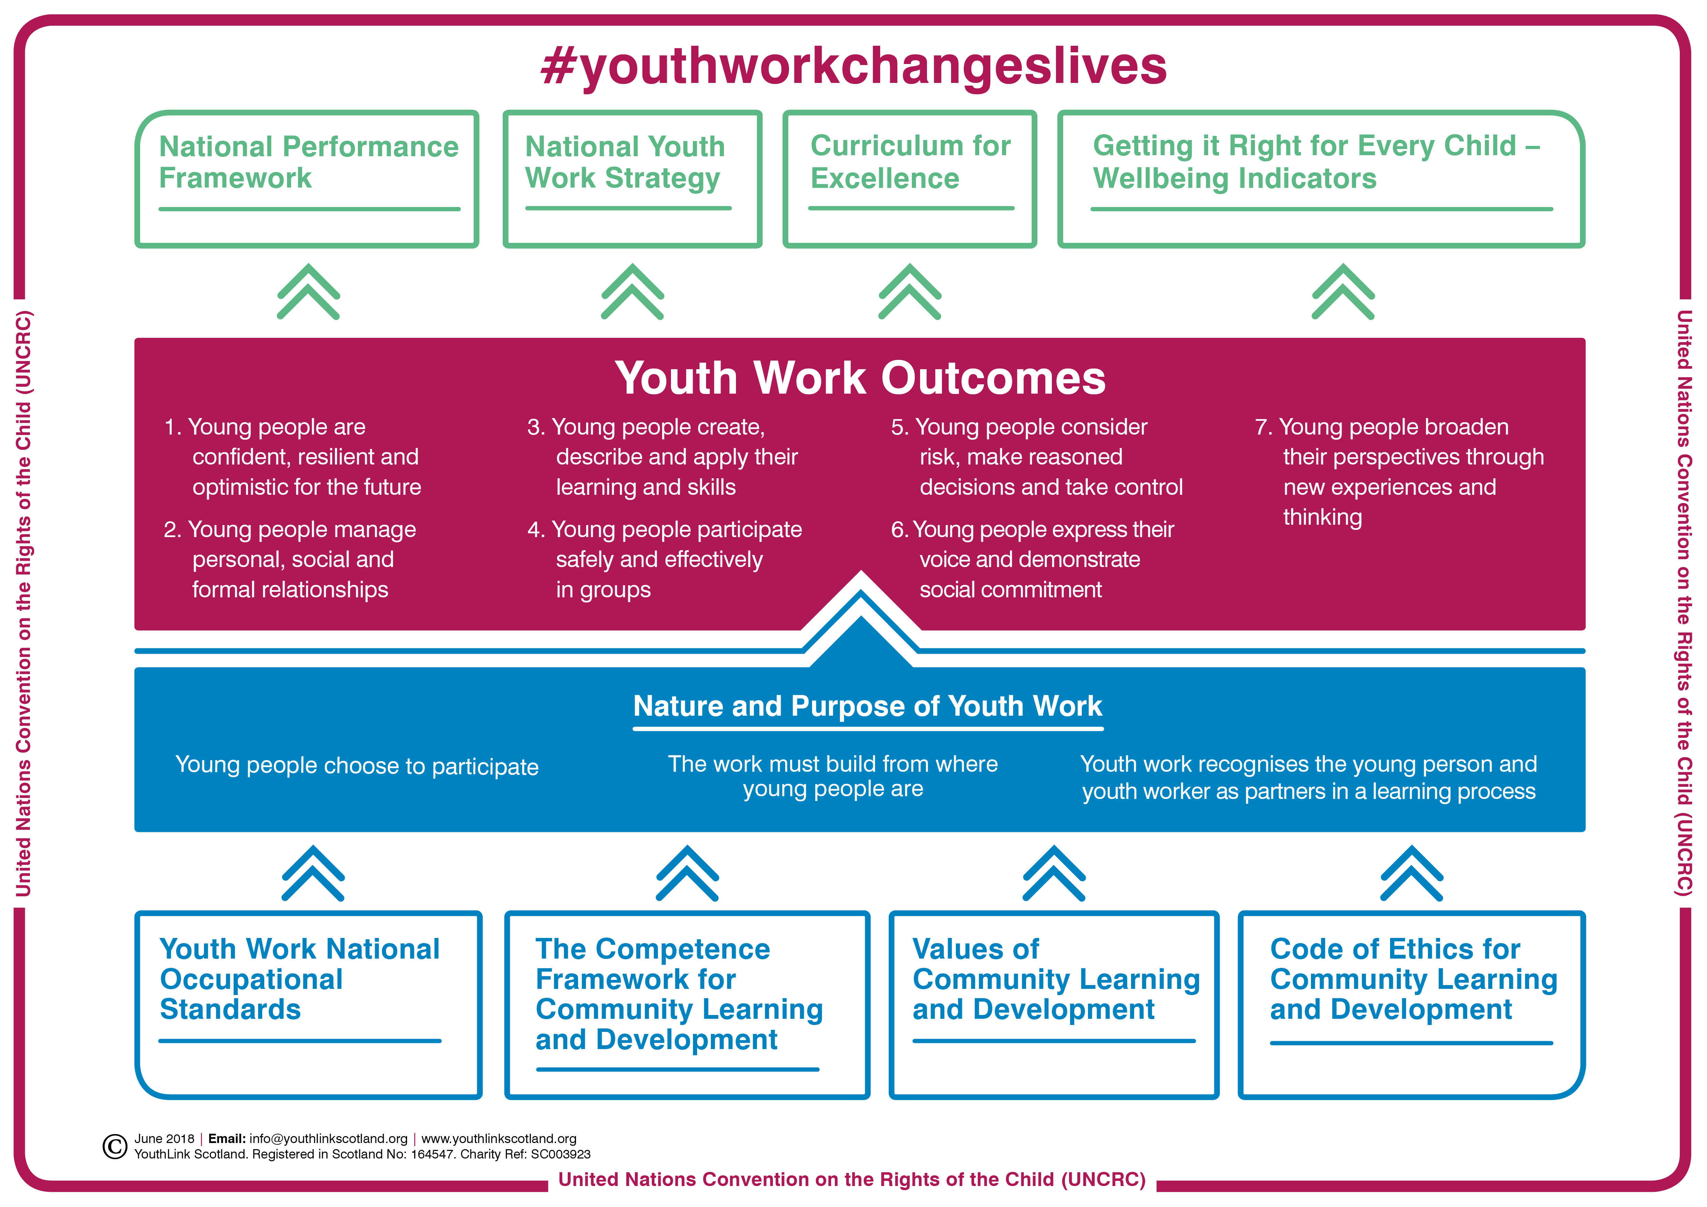
STRATEGIC CONTEXT
Notes:
Equity – what we do at Fuse is all about creating equitable access and opportunity for young people. Bridge the gap between them and their more privileged peers in more affluent areas of the city.
According to an Ofcom report in 2015, people living in Shettleston had the poorest uptake of broadband and were described as the most digitally excluded in the UK.
We also identified Climate Challenge as being an important theme for Fuse going forward.
Providing access to the things that help them to progress toward chosen careers, aspire, have choice, improve educational attainment, increase skills

Slide 8
SOCIAL VALUE
“What is social value? Social value is the quantification of the relative importance that people place on the changes they experience in their lives. Some, but not all of this value is captured in market prices. It is important to consider and measure this social value from the perspective of those affected by an organisation’s work.
Examples of social value might be the value we experience from increasing our confidence, or from living next to a community park. These things are important to us, but are not commonly expressed or measured in the same way that financial value is.”

Slide 9
Delivering Social Value
Inputs
Outputs
Outcomes
These are the human and financial resources expended in delivering our activities, projects and programmes
These are the direct quantifiable deliverables from this (usually measures of engagement and participation)
This is the difference that our activities make to our service users, their families and their communities
Notes:
The job advert – the job description

Slide 10
INPUTS
£403,675
Fuse expenditure in 2019/20 (after depreciation) – this is increasing as we expand services
£311,843
People expenditure accounts for 77% of the total
Notes:
According to an Ofcom report in 2015, people living in Shettleston had the poorest uptake of broadband and were described as the most digitally excluded in the UK.
We also identified Climate Challenge as being an important theme for Fuse going forward.
Providing access to the things that help them to progress toward chosen careers, aspire, have choice, improve educational attainment, increase skills

Slide 11
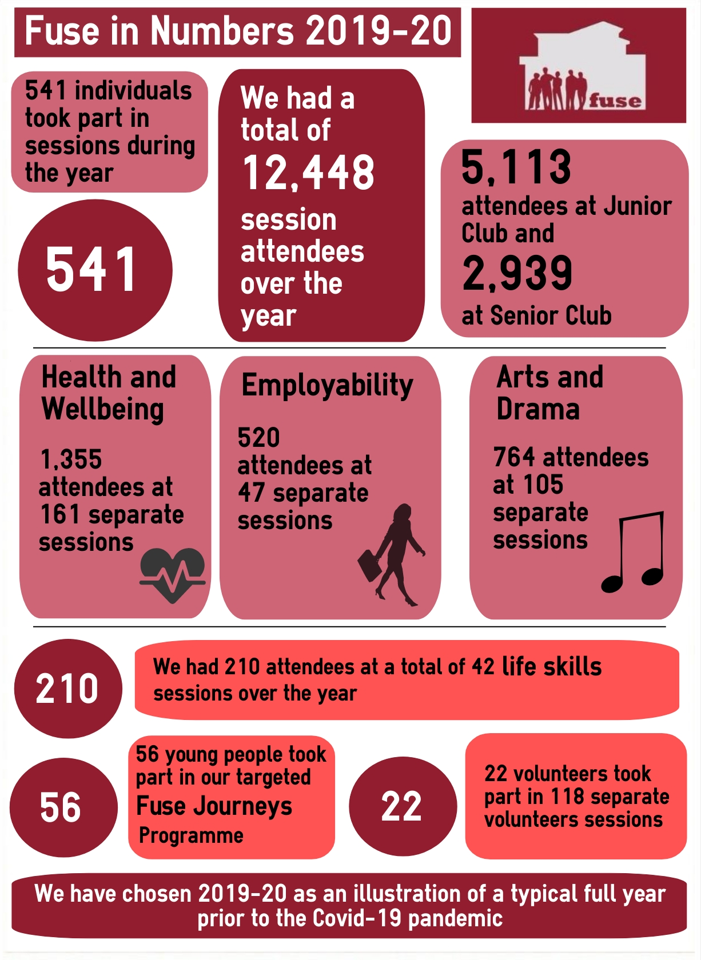
OUTPUTS
Notes:
Equity – what we do at Fuse is all about creating equitable access and opportunity for young people. Bridge the gap between them and their more privileged peers in more affluent areas of the city.
According to an Ofcom report in 2015, people living in Shettleston had the poorest uptake of broadband and were described as the most digitally excluded in the UK.
We also identified Climate Challenge as being an important theme for Fuse going forward.
Providing access to the things that help them to progress toward chosen careers, aspire, have choice, improve educational attainment, increase skills

Slide 12
“HARD” EXAMPLES OF SOCIAL VALUE OUTCOMES
£250,000
This is the estimated after tax expenditure on Fuse wages, which can then be spent in the local economy
£182,527
This is the approximate amount that families would have had to pay for childcare for the time that their children spent at Fuse in 2019 / 20
As we go forward, we want to get better at identifying these “hard” measures from the activities we deliver – e.g. reduced waste and consumption
Notes:
Equity – what we do at Fuse is all about creating equitable access and opportunity for young people. Bridge the gap between them and their more privileged peers in more affluent areas of the city.
According to an Ofcom report in 2015, people living in Shettleston had the poorest uptake of broadband and were described as the most digitally excluded in the UK.
We also identified Climate Challenge as being an important theme for Fuse going forward.
Providing access to the things that help them to progress toward chosen careers, aspire, have choice, improve educational attainment, increase skills

Slide 13
THE OUTCOMES FOR OUR YOUNG PEOPLE

Slide 14
WE ARE VALUED BY THE COMMUNITY AND SERVICE USERS
92%
Proportion in community survey that say youth work is “very important”
Proportion of those aware of Fuse who consider us a “valuable facility for Shettleston” – 74% are aware
Proportion of young people that rate Fuse as “very good” – others say “good”
Proportion of young people who have a positive view of Fuse staff
100%
81%
98%
Notes:
Equity – what we do at Fuse is all about creating equitable access and opportunity for young people. Bridge the gap between them and their more privileged peers in more affluent areas of the city.
According to an Ofcom report in 2015, people living in Shettleston had the poorest uptake of broadband and were described as the most digitally excluded in the UK.
We also identified Climate Challenge as being an important theme for Fuse going forward.
Providing access to the things that help them to progress toward chosen careers, aspire, have choice, improve educational attainment, increase skills

Slide 15
PURPOSE, MISSION, VISION
To deliver an inspiring, engaging and supportive environment for young people and the wider community, working with them to build their aspirations and to help them develop the confidence and skills to be successful in life.
To be an organisation valued by the Shettleston community, and respected nationally, as providing innovative and developmental youth and community development work, which delivers tangible outcomes for service users and the community.
To help young people and the wider Shettleston community maximise their potential and to overcome any factors that limit that potential.
PURPOSE
WHY the organisation does what it does
MISSION
WHAT the organisation does in pursuit of its purpose
VISION
WHERE the organisation is going and what the future looks like
Notes:
The job advert – the job description

Slide 16
OUR VALUES
Working Together
Developmental
Fun and Engaging
Supporting
Inclusive
Notes:
Equity – what we do at Fuse is all about creating equitable access and opportunity for young people. Bridge the gap between them and their more privileged peers in more affluent areas of the city.
According to an Ofcom report in 2015, people living in Shettleston had the poorest uptake of broadband and were described as the most digitally excluded in the UK.
We also identified Climate Challenge as being an important theme for Fuse going forward.
Providing access to the things that help them to progress toward chosen careers, aspire, have choice, improve educational attainment, increase skills

Slide 17
Equity
“EQUITY is a further central value that underpins everything we do at Fuse. We are all about creating equitable access and opportunity for young people and for the community as a whole, bridging the gap between young people in Shettleston and their peers in more affluent areas of Glasgow, Scotland and the UK.”

Slide 18


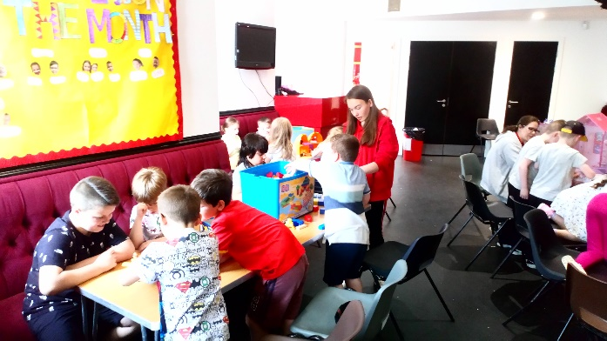



PRIORITIES
Mental Health
Participation
Life skills
Climate
Attainment
Digital
Notes:
The job advert – the job description

Slide 19
OBJECTIVES
High level quantifiable organisation-wide objectives
Output
Objectives
e.g. individuals supported, session attendances
e.g. qualifications, positive destinations, personal outcomes from service user feedback
Outcome
Objectives
Organisational
Objectives
e.g. awareness, satisfaction, governance
Financial
Objectives
e.g. surplus, reserves
Notes:
According to an Ofcom report in 2015, people living in Shettleston had the poorest uptake of broadband and were described as the most digitally excluded in the UK.
We also identified Climate Challenge as being an important theme for Fuse going forward.
Providing access to the things that help them to progress toward chosen careers, aspire, have choice, improve educational attainment, increase skills

Slide 20
THE FUSE TEAM
Board
Setting the overall direction and providing scrutiny and good governance
Ensuring effective delivery, developing new services, building partnerships, ensuring Fuse is properly resourced and planning for the future
Management
Delivering high quality services in line with our values and helping to demonstrate the value of what we do
Staff Team
Notes:
According to an Ofcom report in 2015, people living in Shettleston had the poorest uptake of broadband and were described as the most digitally excluded in the UK.
We also identified Climate Challenge as being an important theme for Fuse going forward.
Providing access to the things that help them to progress toward chosen careers, aspire, have choice, improve educational attainment, increase skills

Slide 21
PARTNERS
e.g. College, JBG, SHA
e.g. Bike Station, SHA, other youth providers
Advisers and mentors
Service delivery partners
Networks
Funders
e.g. GNESYA, GSEN, informal networks
Multiple funders referenced in business plan
Notes:
According to an Ofcom report in 2015, people living in Shettleston had the poorest uptake of broadband and were described as the most digitally excluded in the UK.
We also identified Climate Challenge as being an important theme for Fuse going forward.
Providing access to the things that help them to progress toward chosen careers, aspire, have choice, improve educational attainment, increase skills

Slide 22

We need to continue to develop Fuse as an organisation in a number of ways…..
Putting the right management team in place
Developing and involving our people
Developing new services and ways of working with young people and the wider community
Building the partnerships that we need
Continuing to actively develop earned income opportunities as we emerge from Covid
Continually seeking additional funding opportunities that are consistent with our priorities
Building awareness and understanding of Fuse
Adopting a co-production focus with our young people
Ensuring we evidence what we do and its benefits
DEVELOPING FUSE
Notes:
Equity – what we do at Fuse is all about creating equitable access and opportunity for young people. Bridge the gap between them and their more privileged peers in more affluent areas of the city.
According to an Ofcom report in 2015, people living in Shettleston had the poorest uptake of broadband and were described as the most digitally excluded in the UK.
We also identified Climate Challenge as being an important theme for Fuse going forward.
Providing access to the things that help them to progress toward chosen careers, aspire, have choice, improve educational attainment, increase skills

Slide 23
Like any organisation, Fuse needs to recognise the risks it faces and be confident that it is doing the right things to mitigate these risks…..
Failure to secure the identified funding required
Inability to recruit necessary staff or loss of key staff due to uncertainty over funding
Loss of partner and stakeholder support
Renewal of lease
Reputational risk arising from failure of service or similar
Mitigating THE RISKS
Notes:
Equity – what we do at Fuse is all about creating equitable access and opportunity for young people. Bridge the gap between them and their more privileged peers in more affluent areas of the city.
According to an Ofcom report in 2015, people living in Shettleston had the poorest uptake of broadband and were described as the most digitally excluded in the UK.
We also identified Climate Challenge as being an important theme for Fuse going forward.
Providing access to the things that help them to progress toward chosen careers, aspire, have choice, improve educational attainment, increase skills

Slide 24
FINANCIAL STRATEGY
Staff Costs (Funded)
These items are funded through specific funding bids, with resources specifically allocated for this purpose.
Project Costs (Funded)
Staff Costs
(Unfunded)
Funding has to be found each year for these items through a combination of direct funding of core costs, contributions to overheads from funding bids and income that we earn from contracts and lets
Overhead and Other Costs
(Unfunded)
Fuse is now in a good financial position, with strong cashflow and a good funding mix. However, we need to continue to develop new services, and deliver existing commitments, to ensure that we maintain this, whilst ensuring that we have the funding to maintain an adequate level of reserves.
Notes:
According to an Ofcom report in 2015, people living in Shettleston had the poorest uptake of broadband and were described as the most digitally excluded in the UK.
We also identified Climate Challenge as being an important theme for Fuse going forward.
Providing access to the things that help them to progress toward chosen careers, aspire, have choice, improve educational attainment, increase skills

