Slide 1
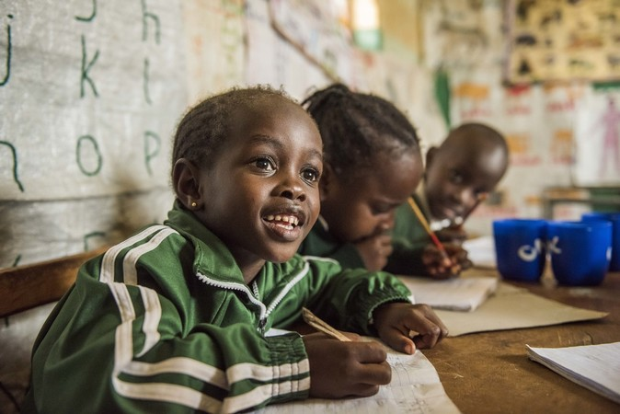
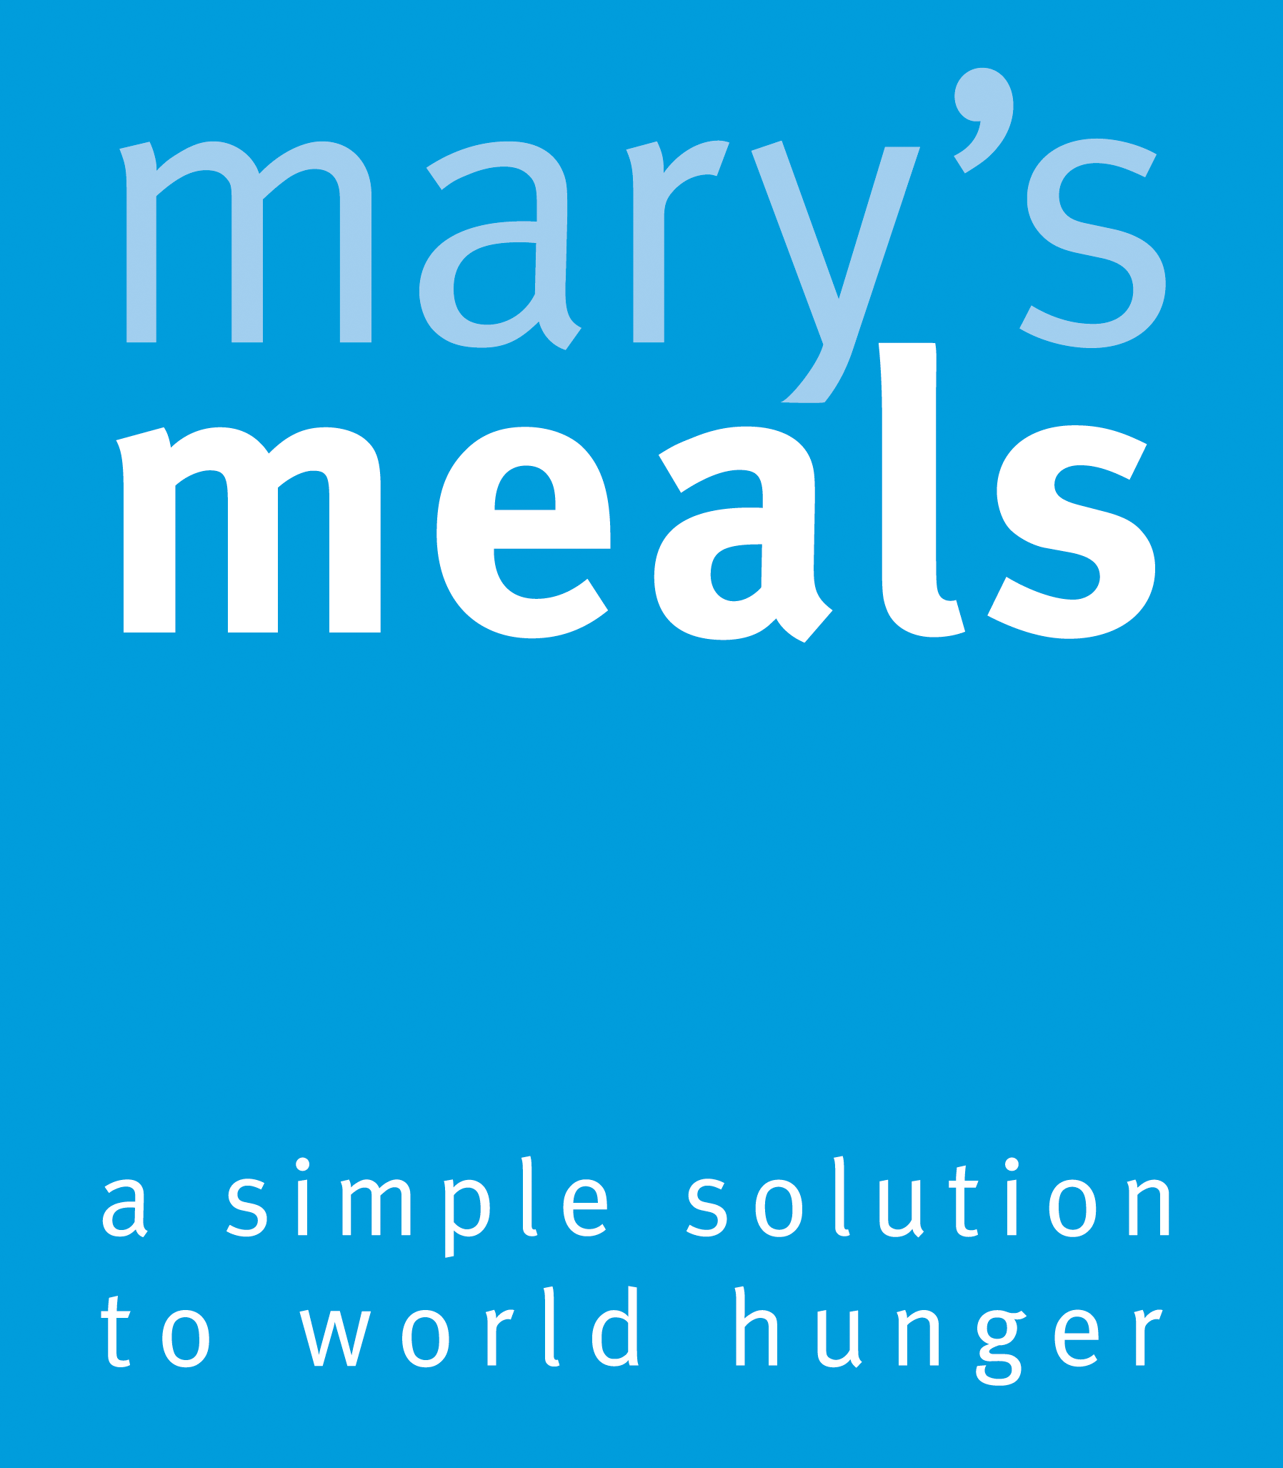


Recruitment pack for:
Major Giving and Partnerships Manager - Part Time, job share
Mary’s Meals UK
March 2022

Slide 2

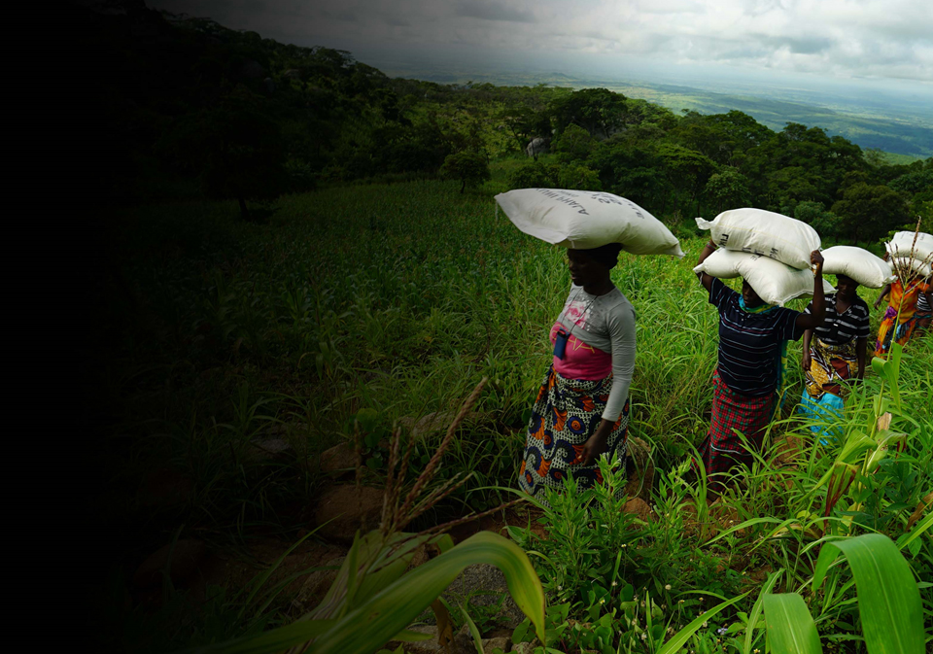
Recruitment pack contents
Welcome from our 3
Executive Director
Our vision, mission 5
and values
About the Mary’s Meals 7
movement
About Mary’s Meals UK 9
Role outline 11
and specification
Recruitment process 16
information
2

Slide 3
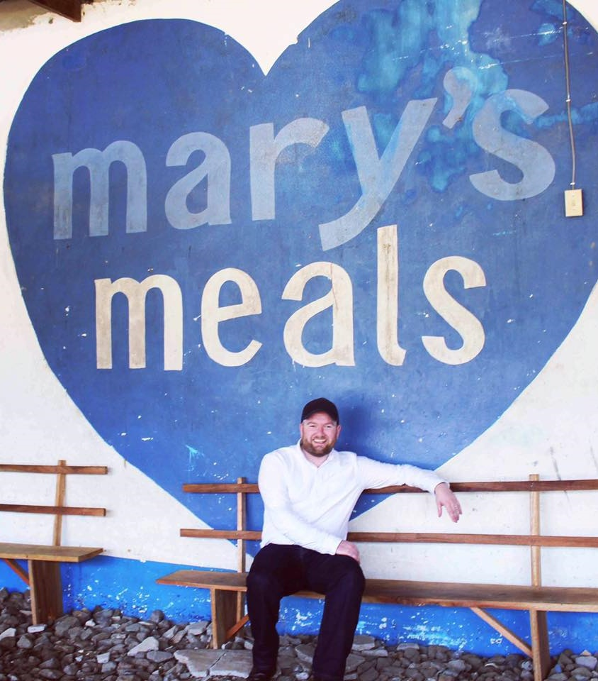
Welcome from our Executive Director
Thank you so much for your interest in joining the Mary’s Meals family. As you consider making an application for the role of Major Giving and Partnerships Manager with Mary’s Meals UK, I hope you find this pack helpful, encouraging and exciting.
In joining Mary’s Meals UK, you would become part of a global movement of people who will simply not accept that any child should go hungry in this world of plenty. We are passionately driven by our simple belief that every child in the world deserves an education – and enough to eat.
From small beginnings feeding just 200 Malawian children in 2002, we are now reaching 2,058,099 children across 20 programme countries (including Malawi, Liberia, Zambia, Haiti, South Sudan and Syria) with a nutritious daily meal in school.
This meal not only meets the immediate needs of the hungry child, but it attracts children to the classroom, where they can gain an all-important education. And we firmly believe that the children who are receiving Mary’s Meals today can grow up – better nourished and better educated – to become the men and women who will lift their communities out of poverty and end their reliance on aid.
3

Slide 4

Welcome from our Executive Director
None of this would be possible without the incredible generosity of our supporters all over the world, who give freely of their time, money, skills and prayer. In Malawi alone, we have 80,000 volunteers who rise early each day to serve Mary’s Meals to children in their community.
And, across Mary’s Meals’ dozen or so ‘national affiliate’ countries, in which we raise awareness and funds for our work (including the UK, USA, Austria, Germany, Ireland, Croatia and Canada), thousands of people amaze and inspire us every day with their ‘little acts of love’, spreading the word about Mary’s Meals in their local communities and raising money to feed more children.
The UK, where we received the first-ever donations for our work, remains the country in which Mary’s Meals raises the majority of its funds. And Mary’s Meals UK, the organisation I am privileged to lead, is responsible for continuing to tell our story across Scotland, England, Northern Ireland and Wales; engaging and inspiring more and more UK volunteers and donors; and driving forward the unrelenting growth of the Mary’s Meals movement on these shores.
We do this while working very closely and collaboratively with our colleagues at Mary’s Meals International, the organisation which co-ordinates the global movement and directly manages our school feeding programmes.
The Major Giving and Partnerships Manager is responsible for coordinating the development of key relationships and opportunities with major donors, charitable trusts and corporate supporters, creating tangible and visible results to sustain and grow our school feeding programmes.
With more than 58 million children out of school around the world and a further 73 million attending school so hungry they’re unable to concentrate and learn, our work is only just beginning. Will you play a crucial part in shaping the future of Mary’s Meals UK and, with it, the lives of so many people who both contribute to and benefit from this incredible work of love, joy and hope?
I look forward to hearing your story.
Daniel Adams
Executive Director, Mary’s Meals UK
4

Slide 5

Our vision and mission
• Our vision is that every child receives one daily meal in their place of education and that all those who have more than they need, share with those who lack even the most basic things.
• Our mission is to enable people to offer their money, goods, skills, time, or prayer, and through this involvement, provide the most effective help to those suffering the effects of extreme poverty in the world’s poorest communities.
5

Slide 6

Our values
• We have confidence in the innate goodness of people.
• We respect the dignity of every human being and family life.
• We believe in good stewardship of the resources entrusted to us.
View Mary’s Meals’ full statement of values here: Statement of Values
6

Slide 7
About the Mary’s Meals movement
Mary’s Meals is a global movement that sets up school feeding projects in some of the world’s poorest communities, where poverty and hunger prevent children from gaining an education.
Our idea is a simple one that works. We provide one daily meal in a place of learning in order to attract chronically poor children into the classroom, where they receive an education that can, in the future, be their ladder out of poverty.
The Mary’s Meals campaign was born in 2002 when Magnus MacFarlane-Barrow, from Dalmally in Argyll, visited Malawi during a famine and met a mother dying from AIDS. When Magnus asked her eldest son Edward what his dreams were in life, he replied simply: “I want to have enough food to eat and to go to school one day.”
That moment was a key part of the inspiration which led to the founding of Mary’s Meals, which began by feeding just 200 children in Malawi in 2002. Today, 20 years later, we feed 2,058,099 hungry children every school day across four continents. The average worldwide cost for us to feed a child for a whole school year is just £15.90.
Where Mary’s Meals is provided, there is a rise in school enrolment, attainment and attendance. Wherever possible, Mary's Meals uses locally grown food to support the local economy and help smallholder farmers.
We work extremely hard to keep our running costs low and to ensure that at least 93% of donations goes directly on our charitable activities. This is only possible because most of our work is done by an army of dedicated volunteers all over the world, who carry out lots of little acts of love on behalf of Mary’s Meals.
Having been inspired, in part, by our founder’s Catholic faith, this work is named in honour of Mary, the mother of Jesus, who brought up her own child in poverty. We consist of, respect and reach out to people of all faiths and none.
Counting on support from around the globe, Mary’s Meals has registered national affiliate organisations, which raise awareness of our work, in 20 countries around the world. Funds raised by affiliates, including from Mary’s Meals UK, are passed to Mary’s Meals International, the organisation which co-ordinates our movement and directly manages the delivery of our school feeding programmes.
7

Slide 8
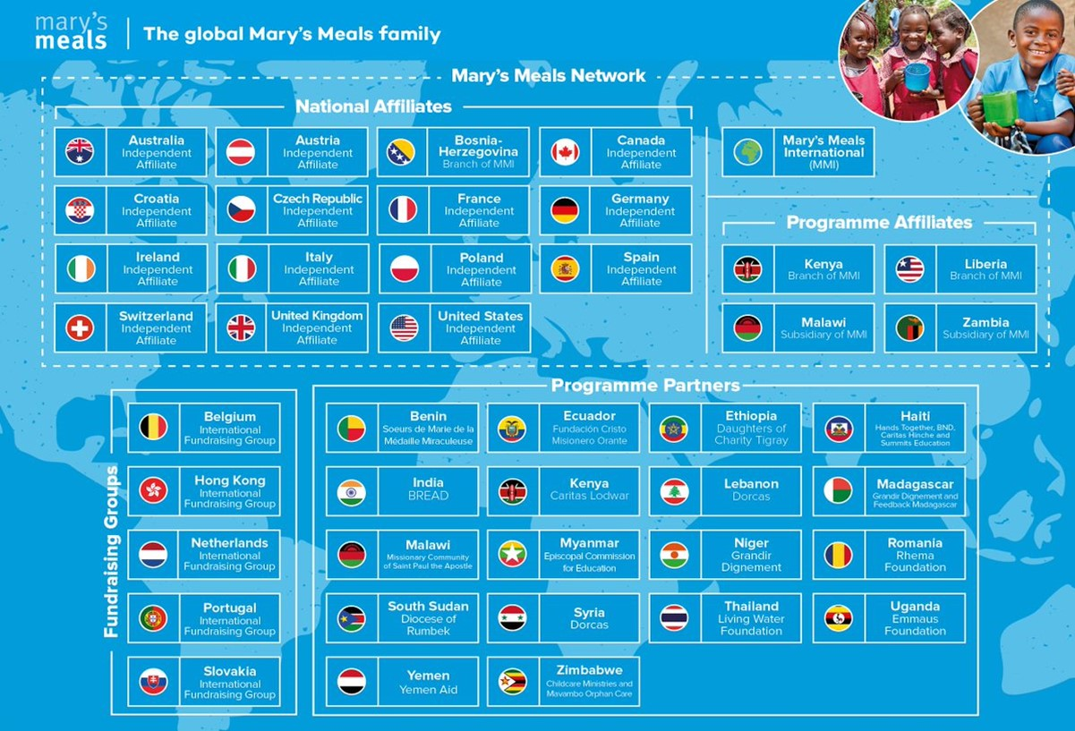
8

Slide 9
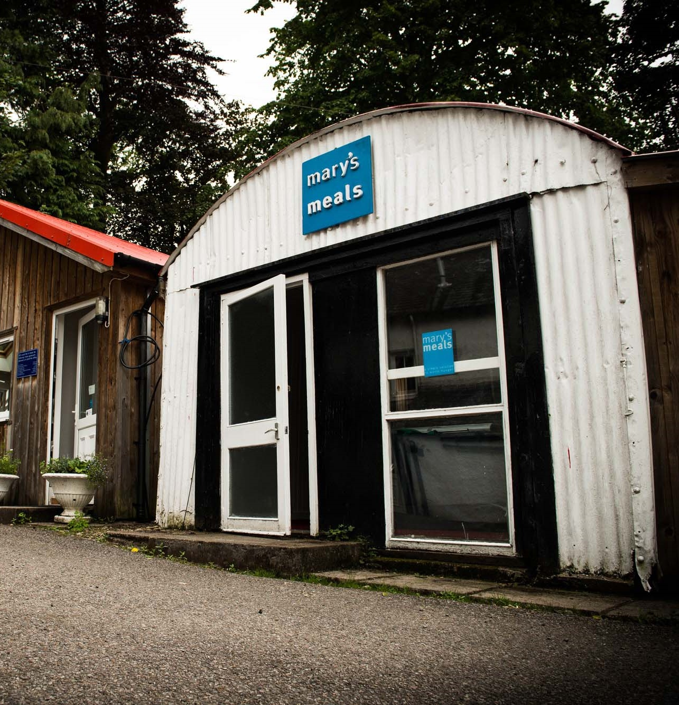
About Mary’s Meals UK
Mary’s Meals UK (or ‘MMUK’), a charity registered in Scotland, is the oldest entity in the Mary’s Meals family – the original organisation established as Scottish International Relief in the early 1990s, when our founder and global CEO, Magnus MacFarlane-Barrow, first became involved in international aid during the Bosnian Conflict.
Back then, Magnus was a simple salmon farmer who, along with his family, decided to do something to help those who were suffering because of the war.
They relied heavily on the generosity of local people in their village of Dalmally in Argyll, who relentlessly donated food, blankets and other items of aid, which were then stored in the family shed, before being driven out by Magnus to Bosnia-Herzegovina.
Though our largest office is now in Glasgow, that same shed – which continues to be filled, metaphorically at least, with the generosity of our supporters – still serves as the headquarters of Mary’s Meals UK to this day.
9

Slide 10
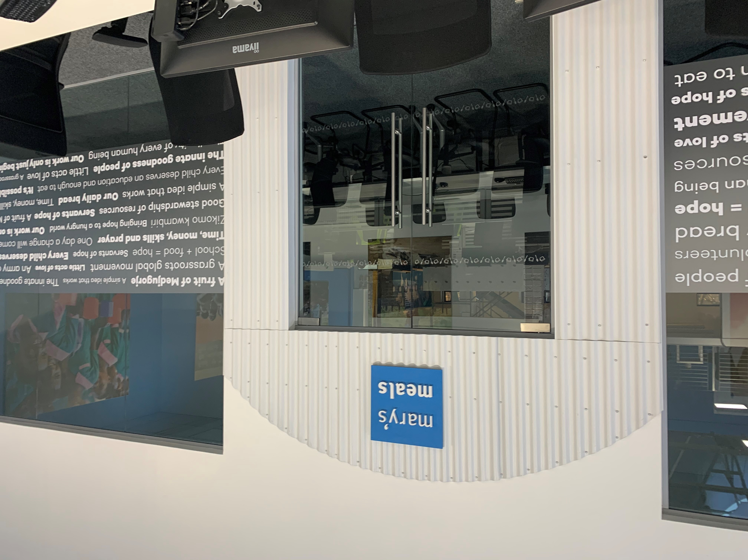
About Mary’s Meals UK
In January 2015, to recognise the incredible growth of the Mary’s Meals movement around the world and to facilitate future growth in new countries, another entity – Mary’s Meals International (or ‘MMI’) – was formed.
This new organisation assumed responsibility for directly delivering our programmes and for coordinating the growing number of Mary’s Meals organisations around the world, aimed at either awareness-raising or programme delivery.
This structural change saw Mary’s Meals UK become the global movement’s largest fundraising organisation and enabled it to focus even more passionately on its mission to tell our story across Scotland, England, Northern Ireland and Wales, and empower more people to help us reach the next hungry child by offering their money, goods, skills, time or prayer.
Today, Mary’s Meals UK raises awareness and funds under the direction of the Executive Director, and through the passion, commitment and dedication of our volunteers and staff, led by the Director of Communications, Director of Supporter Engagement and Income, and the Director of Finance and Operations. The organisation currently has offices in Glasgow, Dalmally and London and works to a hybrid working practice of 3 days at home, 2 days in office.
10

Slide 11
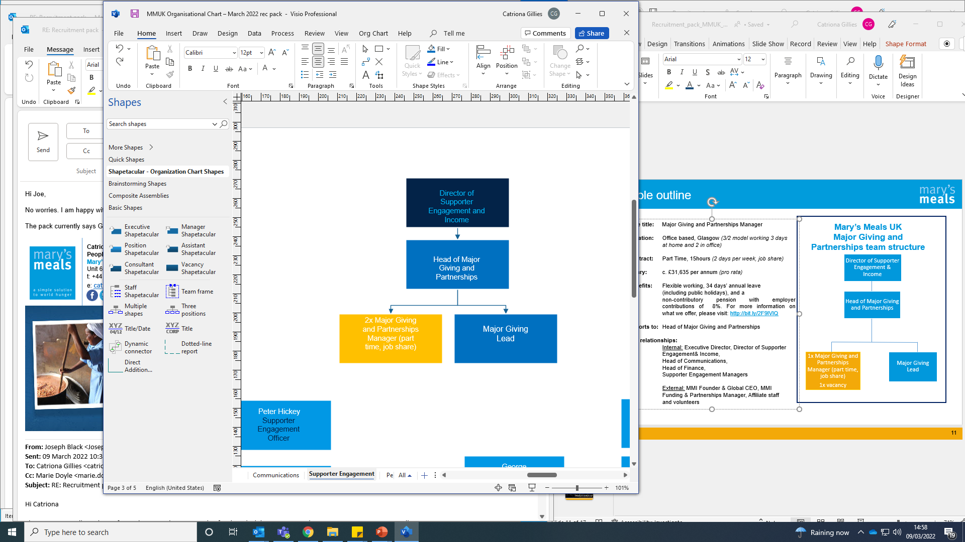
Role outline
Role title: Major Giving and Partnerships Manager
Location: Office based, Glasgow (hybrid working model) or home-working from anywhere in the UK
Contract: Part Time, 15hours (2 days per week, job share)
Salary: c. £32,585 per annum (pro rata)
Benefits: Flexible working, 34 days’ annual leave
(including public holidays), and a
non-contributory pension with employer contributions of 8%. For more information on what we offer, please visit: http://bit.ly/2F9lVlQ
Reports to: Head of Major Giving and Partnerships
Key relationships:
Internal: Executive Director, Director of Supporter Engagement& Income,
Head of Communications,
Head of Finance,
Supporter Engagement Managers
External: MMI Founder & Global CEO, MMI Funding & Partnerships Manager, Affiliate staff and volunteers
Mary’s Meals UK
Major Giving and Partnerships team structure
11

Slide 12
Duties and responsibilities
Work closely with the Mary’s Meals UK Communications and Mary’s Meals International Funding and Partnerships team to develop a suite of relevant materials for UK donor engagement
Trusts and Foundations
Plan and organise a calendar of relevant and timely approaches to major trusts and foundations
Develop personalised relationships with existing trusts and foundations to help nurture and deepen their support
Work with Mary’s Meals International’s Funding and Partnerships team to deliver effective grant management for current donors and engaging proposals and applications for potential donors
Corporate Giving
Devise and implement a successful giving programme from the corporate sector to include affinity partnerships, cause related marketing partnerships, charity of the year adoptions and corporate charitable trust and foundation giving
Form meaningful strategic partnerships with corporates, which generate broad awareness-raising and complement our grassroots focus
Role overview
Reporting to the Head of Major Giving and Partnerships, the Major Giving and Partnerships Manager will be an excellent influencer and fundraiser with the ability to convert significant potential into growth.
Principal duties
Fundraising and Major Donors
Work with the Head of Major Giving and Partnerships to develop and deliver a major donor fundraising strategy
Coordinate a portfolio of existing major donors by supporting funding relationship managers to strengthen relationships and further nurture support
Build and steward relationships with new supporters who are capable of making significant gifts to Mary’s Meals
Consider a range of research projects, events and opportunities to identify potential donors and develop appropriate strategies to attract new major gifts
As required, plan and organise opportunities for donors to visit Mary’s Meals programmes and experience our work first-hand
12

Slide 13
Duties and responsibilities
Steward and strengthen existing corporate relationships to forge long-term mutually beneficial partnerships
Create and develop proposals and presentations to attract new multi-year business income
Work alongside the Communications team to build communications plans in support of key corporate relationships
Financial Management and Data Analysis
Work with the Head of Major Giving and Partnerships to set income and expenditure budgets for the Partnerships Fundraising team
Maintain accurate records, analysing financial and non-financial data to monitor and improve performance and mitigate risk
Produce regular reports which measure the impact of key areas of work against pre-agreed goals – identifying strengths, weaknesses and areas for development
Relationship Management and Supporter Care
Develop and manage appropriate processes and procedures to maintain and increase our level of supporter engagement
Ensure the timely delivery of tailored stewardship plans to maximise income generation and awareness-raising
Act as an ambassador of Mary’s Meals at public engagements and supporter events and, where necessary, deliver speeches or presentations to a wide range of audiences
General Duties
Support the work of fellow Supporter Engagement team members
Participate fully in the day-to-day work of the organisation, taking a flexible approach to general administrative and support tasks
Travel throughout the UK, working varying hours on occasion
13

Slide 14

Qualifications, experience and skills
A degree or equivalent professional experience in a relevant discipline
Experience of major donor and/or corporate fundraising
Experience of identifying and cultivating new business approaches
Experience of account management
Experience of managing a staff team
Demonstratable evidence of devising, leading and delivering on complex projects with multiple stakeholders
Ability to think strategically and manage a large and complex workload
Excellent prioritisation and organisational skills – the ability to set up, manage and complete projects
Team player who possesses a warm and engaging personality and excellent interpersonal skills
Excellent negotiator/influencer able to foster and develop working relationships
Diplomatic and tactful approach with a proven ability to communicate well with a broad range of people
Excellent written and communication skills
Excellent analytical skills to evaluate activity – able to manage processes and data effectively to allow effective targeting
A commitment to Mary’s Meals vision, mission and values
Good IT skills
14

Slide 15

Mary’s Meals UK manager competencies
Managers at Mary’s Meals UK approach their role in line with our 7S competency model:
1. Self
I build and demonstrate resilience
I lead by example
I’m authentic and true to Mary’s Meals values
I develop myself and set stretching goals
2. Service
I have a vocational attitude to my work
I inspire hope in others
I build belief that even difficult challenges can be solved
I am committed to serving and enabling all who want to be part of the global movement
I work to ensure our future will be even better than our past
3. Simplicity
I communicate effectively
I follow clear decision-making criteria
I create plans that are easy to follow and contribute to organisational goals
I embrace inclusivity and diversity
I focus on delivering results
4. Stewardship
I pay attention to the things that matter most;
(a) our physical resources; (b) our people
I nurture, develop and respect our relationships with external stakeholders
I deliver on my promises
I am happy to be held accountable and to hold others to account
5. Strategy
I have a point of view about the future
I know our stakeholders and see our priorities clearly
I help others to work in ways that have the
greatest impact
I develop strategy and translate it into action
6. Strengthen
I create a positive work environment
I increase the capabilities of my team
I help people manage their careers
I find and develop next-generation talent
7. Success
I ensure my team is technically competent and developing
I build high performing teams
I ensure accountability
I am a catalyst for change
15

Slide 16
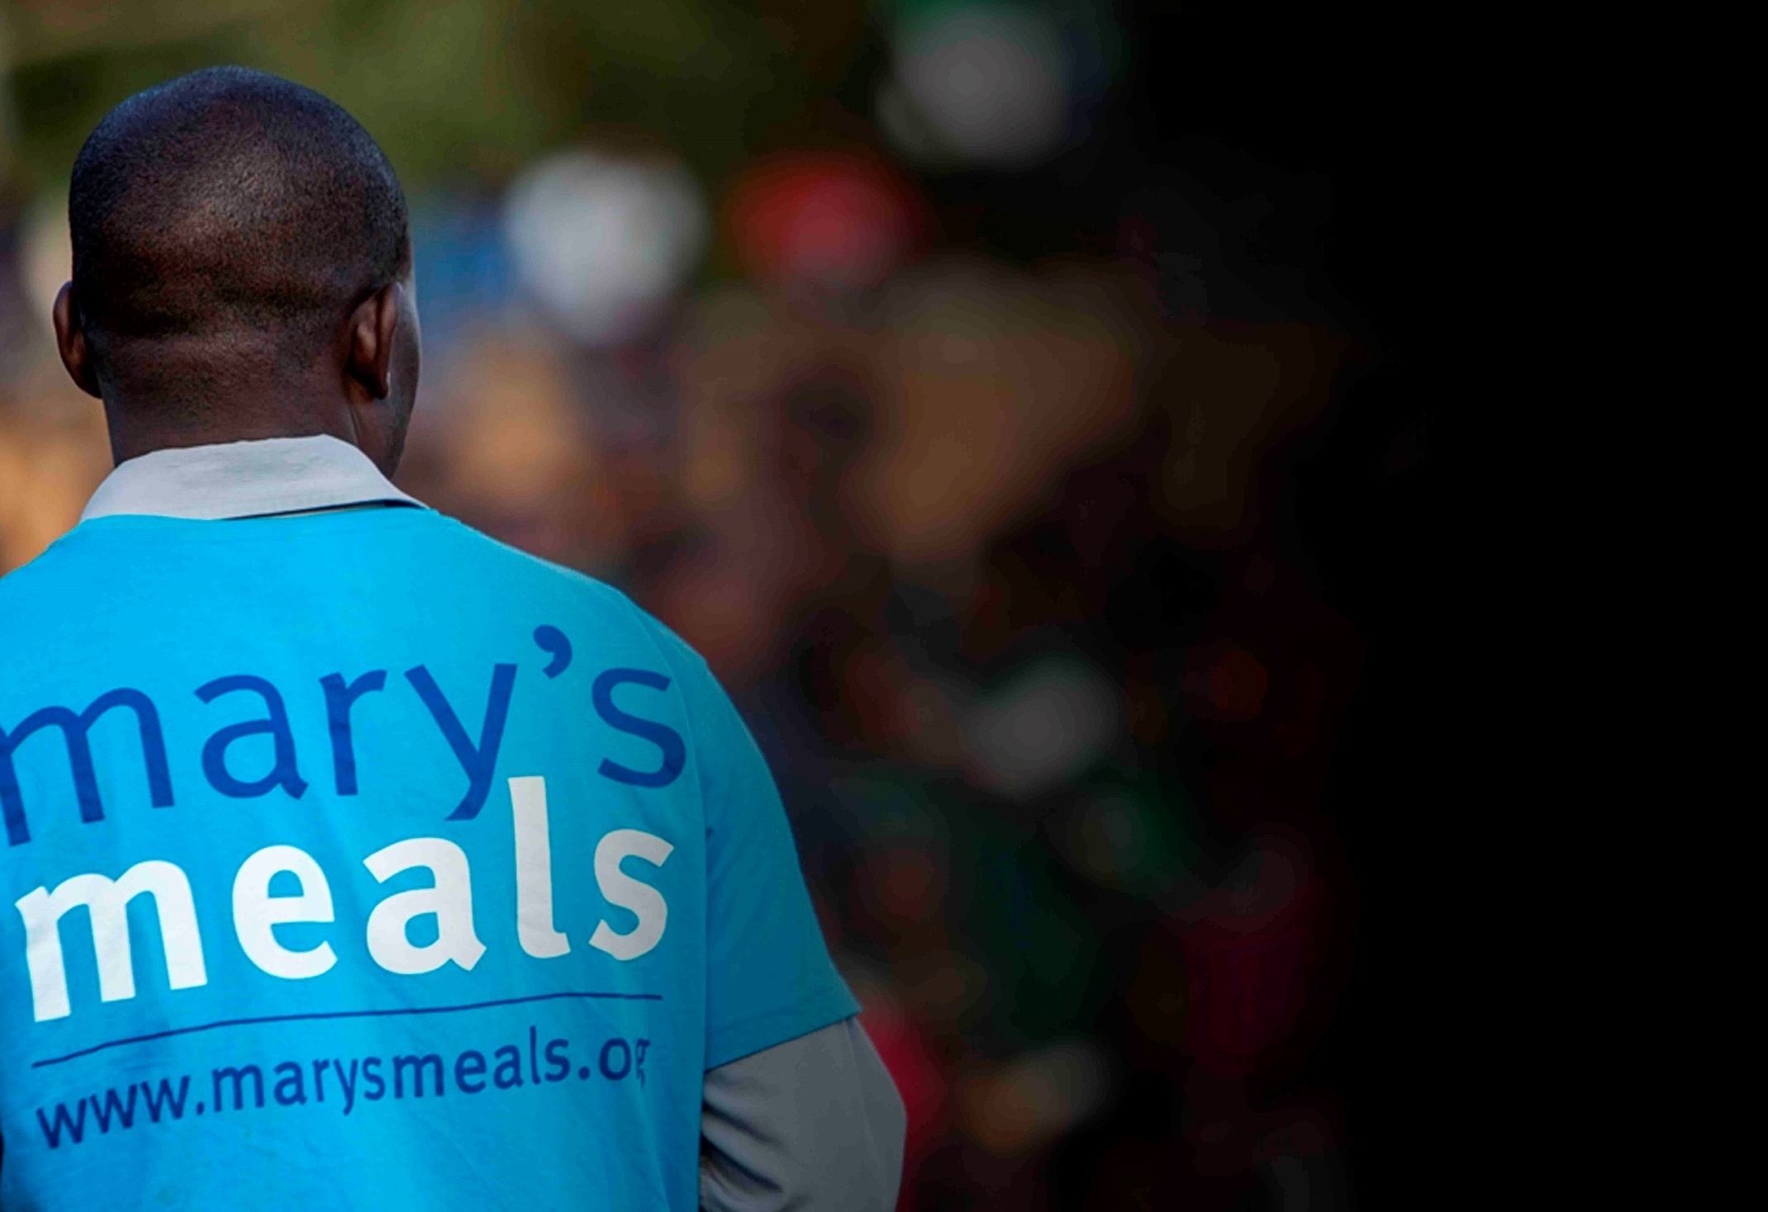
Recruitment process information
How to apply for this role
To apply for the role of Major Giving and Partnerships Manager at Mary’s Meals UK, please send a tailored CV and covering letter to: Jobs@marysmeals.org
Your covering letter should make a compelling case for why you feel motivated to apply for this role within Mary’s Meals UK, as well as giving a concise overview of your most relevant skills and experience, and should fill no more than two pages of A4.
Recruitment timescales
Closing date for applications:
Monday 28th March
Please note: If you have any special requirements or adjustments before an interview, please let us know.
A second interview stage may be required.
16

Slide 17

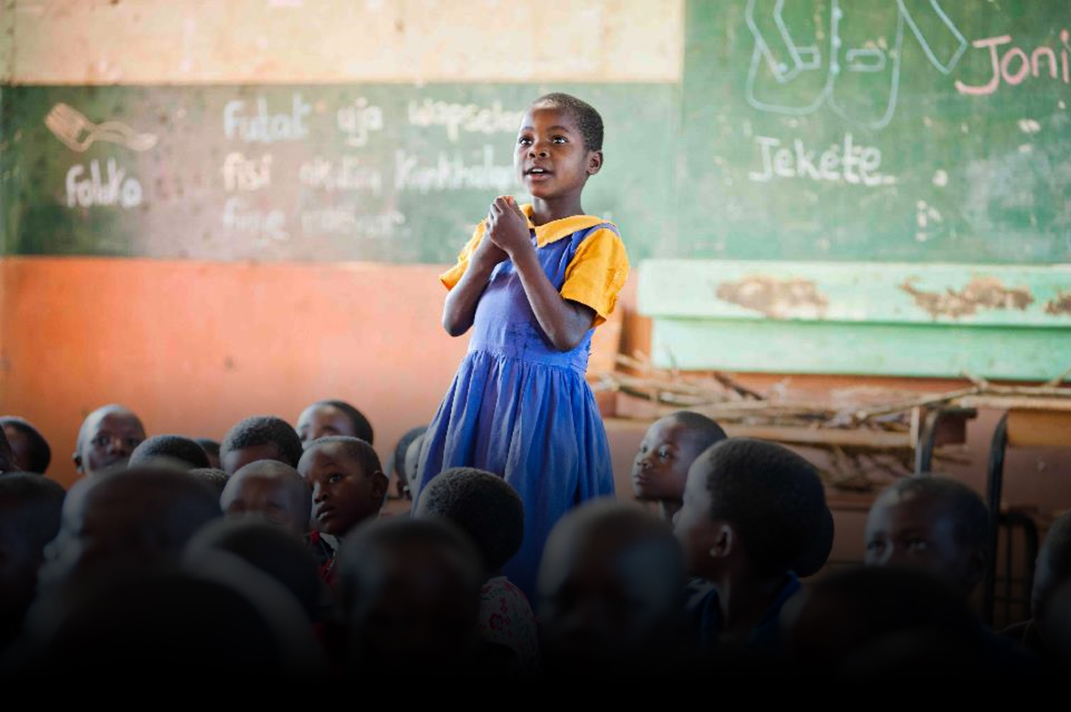
Mary’s Meals UK
Charity No. SC022140
Company No. SC265941
Tel: 0141 336 7094
Dalmally office
Craig Lodge
Dalmally, Argyll
PA33 1AR
Glasgow office
Unit 6 Claremont Centre
39 Durham Street, Glasgow
G41 1BS
London office
13 Hippodrome Place
Notting Hill, London
W11 4SF
“Together, let’s set out on this journey; one step at a time, one meal at a time, one child at a time.”
– Magnus MacFarlane-Barrow, Mary’s Meals founder

