Slide 1



Head of Fundraising
Recruitment Pack
March 2022

Slide 2


Hello.
Thank you for taking the time to check out this significant Christian leadership opportunity with SU Scotland.
Our shared vision is to see every child and young people in Scotland exploring the Bible and responding to the significance of Jesus.
We’re probably best known for our work in schools, with churches and in SU centres, not to mention our dynamic programme of holidays and camps for children in P5 through to S6 where we say to every child and young person, “You belong here.”
This newly-created, strategically important Head of Fundraising role offers a phenomenal opportunity to drive a step change in our fundraising efforts to underpin our ambitious strategic goals. Over the next three years, our vision is to see the numbers of connections grow from around 2% of Scotland’s 700,000 children and young people to 5% or more by God’s grace.
Please enjoy reading through the enclosed recruitment pack and if you have questions about the role prior to applying, please let me know.
Meantime, be assured of our prayers for you and others giving serious consideration to whether this could be the right thing for you.
Here’s to supporting ground-breaking ministry developments in the very near future and many thousands more young lives transformed by hearing and knowing of God’s love for them!
Lisbeth
Lisbeth Macmillan
CFO
Lisbeth.macmillan@suscotland.org.uk
“We will tell the next generation
about the glorious deeds of the Lord.”
Psalm 78:4 NLT

Slide 3

About SU Scotland
About SU Scotland
Scripture Union Scotland is part of the worldwide family of Scripture Union movements that began in the nineteenth century and now operate in over 130 countries across the world.
We are a Christian charity working in partnership with local churches and other organisations. More than 2,000 volunteers are involved in helping to run our activities, together with around 100 staff and associate workers.
Our SU Holidays and weekends are the place to be for high energy activities, music, crafts, friends, fun, camping and a whole lot more with Magnitude Festival adding a dynamic new dimension to the mix
Our residential centres are places of adventure, escape, discovery and hope, hosting thousands of school pupils on residential breaks each year
We work in schools - throughout the academic year, SU workers and volunteers contribute to the curriculum in many of Scotland’s schools.
Our discipleship programme helps young people to grow, learn, explore and develop leadership skills
We partner with churches across Scotland, helping them realise their vision for mission and evangelism

Slide 4

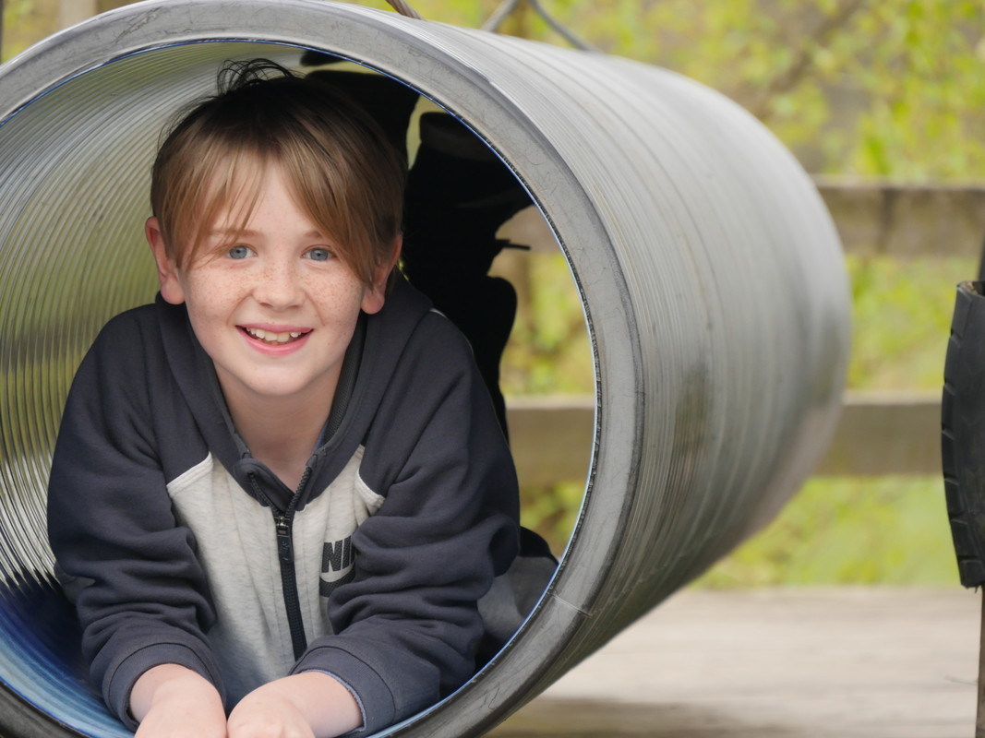
Our vision and values
Our vision and values
Our vision is to see every child and young person in Scotland exploring the Bible and responding to the significance of Jesus.
Everything we do is governed by two core values: dependence on God and deepening relationships.
We love to see children and young people:
Feeling valued and accepted in every encounter with SU Scotland - being able to express their views, engage with others, and grow in confidence as they recognise and develop their abilities.
Exploring the key stories and events from the Bible, reading and studying the Bible on their own and with others, and growing in their understanding of God and what it means to follow him.
Having opportunities to learn about Jesus, making the decision to follow Jesus, and having the confidence to reflect this in their choices, attitudes and actions.

Slide 5

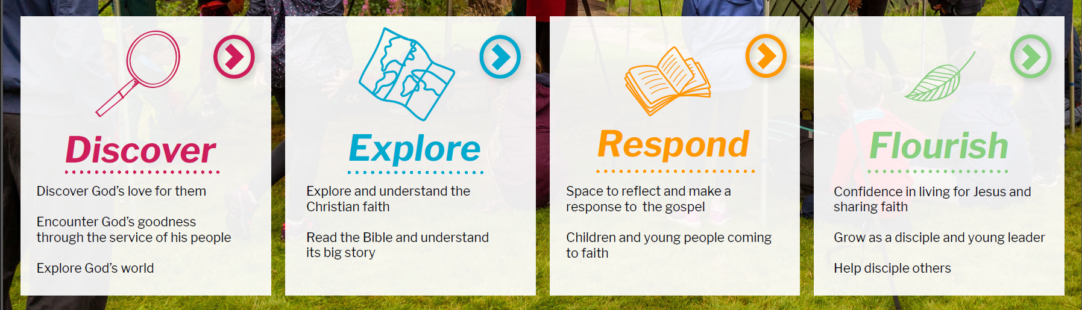
Our strategy for 2021-24
1 Vision
Our vision is to see every child and young person in Scotland exploring the Bible and responding to the significance of Jesus.
2 Values
Dependence on God
Deepening Relationships
3 Priorities
Rebuild – we will reimagine and rebuild activities following the impact of COVID-19
Focus – we are focusing and expanding in key areas:
  Digital – creating resources and events to connect with children and young people where they are and mining data for actionable insights
  Ministry @ Margins – increasing provision for disadvantaged groups and those with additional support needs
Invest – we are investing in enabling young people to become confident followers of Jesus and future leaders
4 Outcomes for children and young people

Slide 6
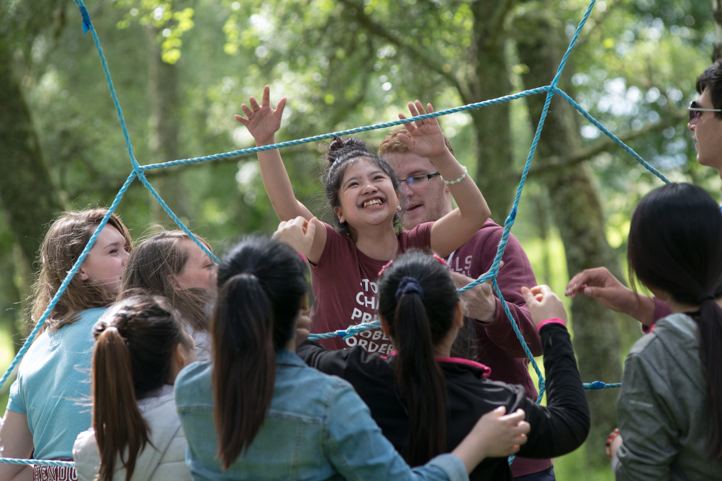
Key aspects of the role
Devise and drive strategy for fundraising – including growing the team
Nurture and grow supporter base – particularly with major donors and regular giving
Foster a healthy data capture and analysis mindset across all fundraising activities
Drive strategy
Nurture existing relationships
Maximise data insights

Slide 7
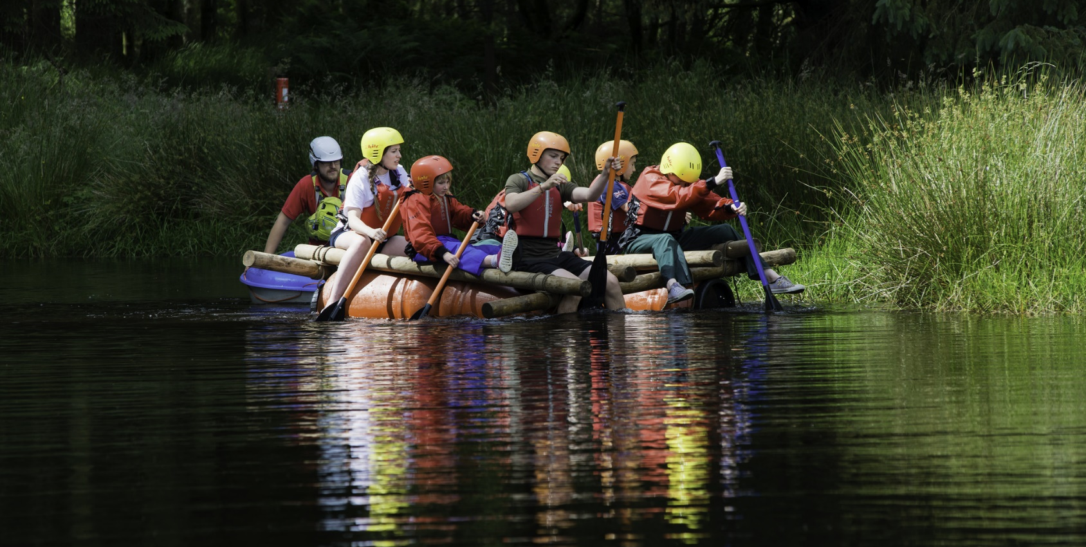
How this role fits in
SU Scotland
Chief Financial Officer
Finance Manager
Head of Fundraising
Fundraising
Team
CEO
Other Directors

Slide 8
Job overview
Job Title: Head of Fundraising
Salary: £36,747 – 39,858 per annum, plus generous employer pension contributions and life assurance
Location: Hybrid work from home/nearest SU Office
Contract: Full-time
Managed by: CFO
Responsibility for: Fundraising and Support Development
Key relationships: Wider Leadership Team, Trustees, Donors, Trusts, grant making bodies, churches and volunteers

Slide 9
Key result areas
Develop and implement a new fundraising strategy to support the organisation’s strategic priorities – building on existing strengths and expanding our reach into new sources of funding
Build a team to drive increased levels of giving across individuals, churches, trusts and grant bodies to support the strategy delivery
Nurture and grow our regular supporter base to deepen their connection with our work and grow future donations
Oversee the creation of a major donor programme to engage key supporters with specific areas of our activities to create recurring and ongoing support
Apply excellence in fundraising management through the implementation of advanced processes, channel and data management and departmental performance management techniques

Slide 10
Tasks and responsibilities
Spiritual Leadership
As a practising Christian, to demonstrate commitment to the SU Scotland ethos, modelling Christian lifestyle, values and work practices to staff and volunteers alike.
Demonstrate continual reliance on God through active participation and leadership of prayer and Bible teaching in staff meetings and corporate Staff Prayer and worship together
Model godly leadership in all aspects of character and conduct by consistently demonstrating Christ-likeness in attitudes and behaviour at work.
Take responsibility for ensuring that staff development policies and practices are implemented for all members of staff within the team, including facilitating development reviews for each direct report.
Pursue and maintain a Christian faith through ongoing personal spiritual development and a relationship with God.
Provide support and spiritual encouragement to staff and colleagues, in line with Biblical principles in keeping with SU Scotland’s ethos, statement of faith and associated understandings.
This role is a core member of the Wider Leadership Team which brings together heads of all the sub-departments on a regular basis.

Slide 11
Tasks and responsibilities
Fundraising and Support Development
Oversee and drive future growth from the existing position of c£2.5m of donations and grants per annum
Bring strategic leadership and energy to ensuring that a rolling fundraising strategy is developed and reviewed, providing for the growing financial needs of the charity
Develop and manage all aspects of a fully integrated range of fundraising activities which optimise the return on investment, deploying tactics from across the entire marketing mix
Drive new approaches in key areas including major donor management and recurring donations - seeking to increase the connection our donors have with the organisation for longer term relationships
Demonstrate an understanding of SU Scotland’s caring approach to supporters while also bringing data-driven decision-making approaches to all activities to maximise the return
Work closely with colleagues in communications teams to ensure that our support raising messages are clear and refined
Enjoy leading the team to success in the following areas: -
  growth in the donor base of the organisation – including assessing donor acquisition, management and retention approaches
  ensure gift income from individuals, churches and trusts is maximised;
  a range of fundraising activities – appeals, trust applications, donor communications, team support raising, event management, legacies, social media and partnerships
  ensure there is a strong commitment to support-raising across the whole staff team
  foster a strong ethos and culture of supporter care
Manage the activity through CRM, KPIs, financial budgets, project management and fundraising methodologies

Slide 12
Other requirements
Support raising
Building partnerships with existing and potential supporters to encourage prayer, giving and volunteer support for the wider ministry of SU Scotland. The means of doing this will be tailored according to the nature of your role and personal circumstances and an action plan agreed with your manager
In common with all SUS staff members:
Further the aims and activities of Scripture Union Scotland
Undertaking professional development through active participation in annual work appraisals, supervision and internal or external training as required or individually identified.
Attendance and full involvement at the annual staff residential conference and other staff days as they arise, taking part in planning and/or delivering activities/sessions as required
Taking part in other Scripture Union activities where appropriate.
Demonstrating commitment to the SU Scotland ethos, vision, values and work practices, and the wider ministry of SU in Scotland and beyond.
The above list is intended to give an indication of the range of duties for the role. Other tasks/responsibilities, appropriate to the remit, will be expected as required.
Occupational Requirement
An Occupational Requirement applies in terms of the Equality Act (part 1, schedule 9). This post requires the occupant to have a personal faith in Jesus Christ as Saviour and Lord and to believe the Bible to be fully trustworthy, in all that it affirms, and the highest authority for faith and life in keeping with SU Scotland’s statement of faith. These principles require to be applied alongside the professional skills required in this role.

Slide 13
What are we looking for?
CRITERIA | ESSENTIAL | DESIRABLE
Character
Committed to the servant leadership model of influencing others and getting things done | ✓
Passionate about sharing the gospel with people of all ages | ✓
A Christian with spiritual maturity – able to provide spiritual leadership(including staff devotional times). | ✓
A practising Christian whose lifestyle is in keeping with SU Scotland’s ethos and statement of fait | ✓
Competence and Education
At least 5 years’ fundraising experience in a senior fundraising role | ✓
Track record of delivering consistent growth in funds raised across a range of sources in support of an organisational strategy | ✓
Membership of the Chartered Institute of Fundraising | ✓
Degree level or equivalent |  | ✓
Experience of managing and developing successful working relationships across all levels of an organisation with adaptability to work on own initiative but also as a member of cross-functional teams | ✓
Demonstrates the capacity to operate at a senior level representing the organisation professionally to key stakeholders | ✓
Wide and strong established network within the Scottish Christian community |  | ✓
Capable of multi-tasking with a proven track record of delivery on agreed objectives | ✓
Evidence of strong personal commitment to continuous personal development and to championing the ongoing development of colleagues | ✓
Outstanding levels of computer literacy | ✓
Excellent numeracy, literacy and communication skills | ✓
Involvement in communications-related functions |  | ✓
Chemistry
Strong people and team leadership skills demonstrated by ability to work professionally with and develop a wide range of staff and volunteers | ✓
Gifted team leader with the ability to develop a flourishing team | ✓
Self-aware team player with high levels of emotional intelligence | ✓
Other
Own transport and a full current driving licence (D1 preferred) |  | ✓
Able to demonstrate knowledge and understanding of Scripture Union Scotland | ✓

Slide 14
Terms and conditions
HOURS
The post is full time, working 37.5 hours per week.
PROBATIONARY PERIOD
The first three months of your employment will be probationary. Your performance will be reviewed throughout this period. If your performance is satisfactory at the end of this period, your appointment will be confirmed. The employer reserves the right to extend your probationary period.
TERMINATION OF EMPLOYMENT
During the probationary period the notice required to be given either by you or Scripture Union Scotland to terminate your employment is one week.
Except during the probationary period, the length of notice which you are obliged to give the company to terminate your employment is twelve weeks.
Except during the probationary period, the length of notice which you are entitled to receive from the employer to terminate your employment is four weeks until you have been continuously employed for five years. Thereafter, you will be entitled to one further week’s notice for each completed year of service up to a maximum of twelve weeks.
Your employment may be terminated summarily in the event of a breach of contract by you that warrants summary dismissal.
SALARY
£36,747 – 39,858 (dependent on experience) per annum. New appointees are normally placed at the starting peg point unless there are exceptional circumstances. You will be paid in arrears on a monthly basis, on or before the 28th of each month.
PENSION ARRANGEMENTS
SU Scotland operates a Group Personal Pension Scheme for employees over 18 and under 75 years of age. An employer’s contribution of between 5% and 9% of total pensionable salary will be paid (the actual amount depending on your level of employee’s contribution.)
LIFE INSURANCE COVER
Life insurance cover of three times your annual salary is provided, with the premium being paid for by SU Scotland.
HOLIDAYS
The holiday year runs from 1 April to 31 March. Annual leave entitlement for a full-time post is 33 days paid holiday (this amount is inclusive of entitlement to local and national holidays). Annual leave entitlement for part-time and fixed term staff is pro-rata. Annual leave entitlement will increase with length of service.

Slide 15

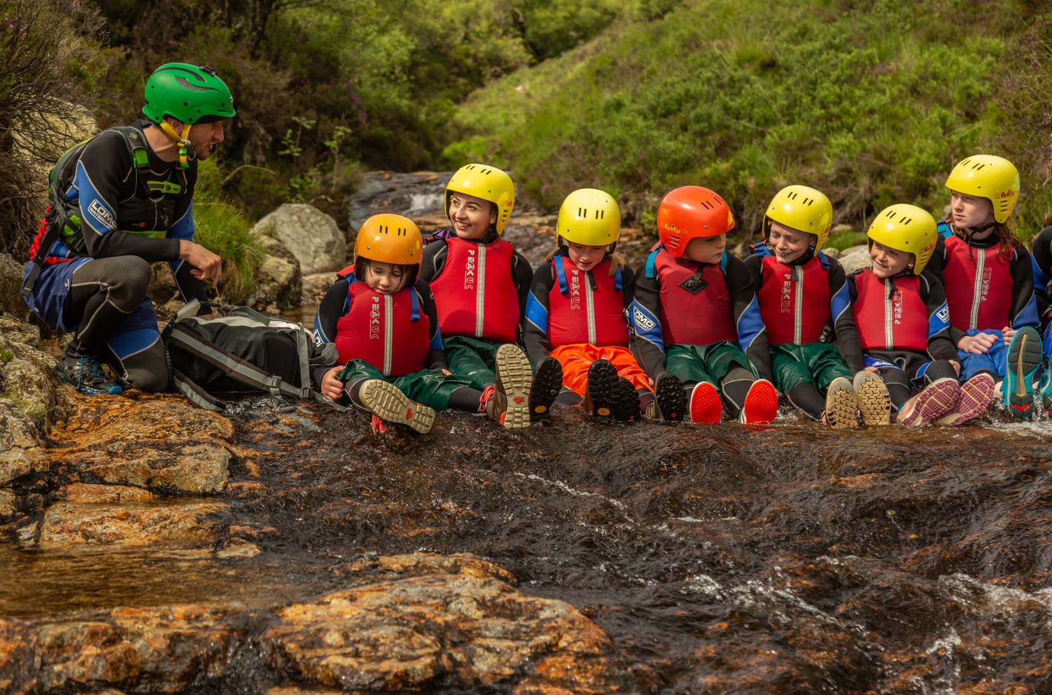
Possible next steps...
If you feel this role is something that God may be calling you to apply for:
  For general questions about the role, please email
  lisbeth.macmillan@suscotland.org.uk
  Download your application (Word docs) from our job page
  Submit your completed forms through the application portal or by email to hr@suscotland.org.uk before the closing date – Monday 18 April 2022 at 4pm
  Interviews – 26 April 2022
Thanks for your interest!
www.suscotland.org.uk | @suscotland
Scottish Charity SC011222

