Slide 1
Blue Triangle
Board Member
Candidate Information pack
April 2022

Slide 2
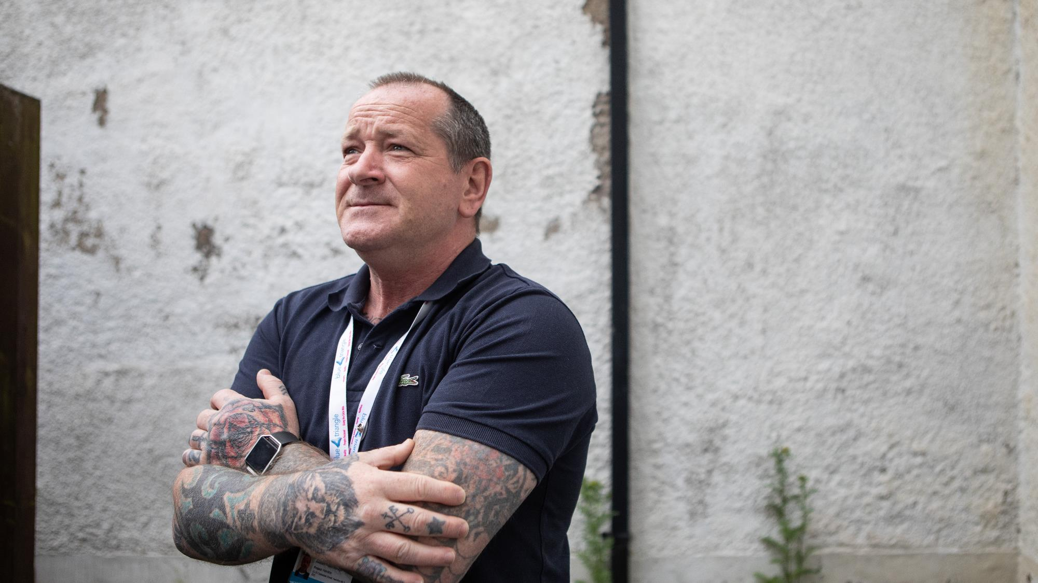
Contents
Welcome from Iain Macfarlane, CEO
About Blue Triangle
Our Future Plans
About the Role
How to Apply

Slide 3
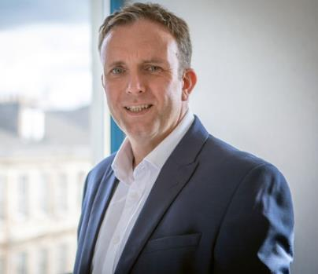
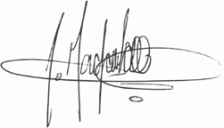
Welcome from
Iain Macfarlane, CEO
I was appointed as CEO in September 2020 and I am continually impressed and humbled by the services and projects led and delivered by our teams across Scotland. It can be overwhelming to see the difference we make and how we build innovative partnerships to ‘Empower People to Thrive.’
Every person we support is amazing, and we’re there to do our bit to unlock their potential. Social care must be viewed as an investment and a springboard to a better future, not as a safety net to catch people in crisis.
As we have all experienced over the last 18 months, we know that society doesn’t stand still, and challenges can come from all directions. Our services have been needed more than ever before. We continued to support over 400 people during lockdown, and often we were the only service in many communities with our doors open. We had so many people reaching out for support, which for us is the norm as we’re simply there for the next person who walks in the door.
We operate at the intersection of social care and social justice, where complex interdependencies across homelessness, addiction, offending, trauma, abuse, and fragile mental health are the reality.
When assessing who we are as an organisation, we have complex financial metrics, we have critical processes and protocols, and we have an array of success measures. However, the one thing that makes this organisation what it is, is our people. Whether formally, informally, internal, or external, the one constant positive I hear is how our people will do extra, help more and support further. This is why during 2021 we have been celebrating our #AmazingPeople, both our staff and the people we support.
We are transforming the organisation from the inside out, and we are now building our Senior Leadership Team to work alongside me to deliver our ambitious strategy for diversification and growth, bringing new ideas to achieve the step changes in outcomes we all know are possible
I am fortunate to be supported by an experienced and wonderful Board who are as keen as I am to see the organisation grow and flourish, and most importantly, deliver for the people across Scotland who need some hope, to feel loved, and to be empowered more than most.
I want to work with people who bring their proven professional experience, who are passionate about making a lasting impact and who can be bold, radical, and courageous.
Iain Macfarlane
Chief Executive Officer

Slide 4
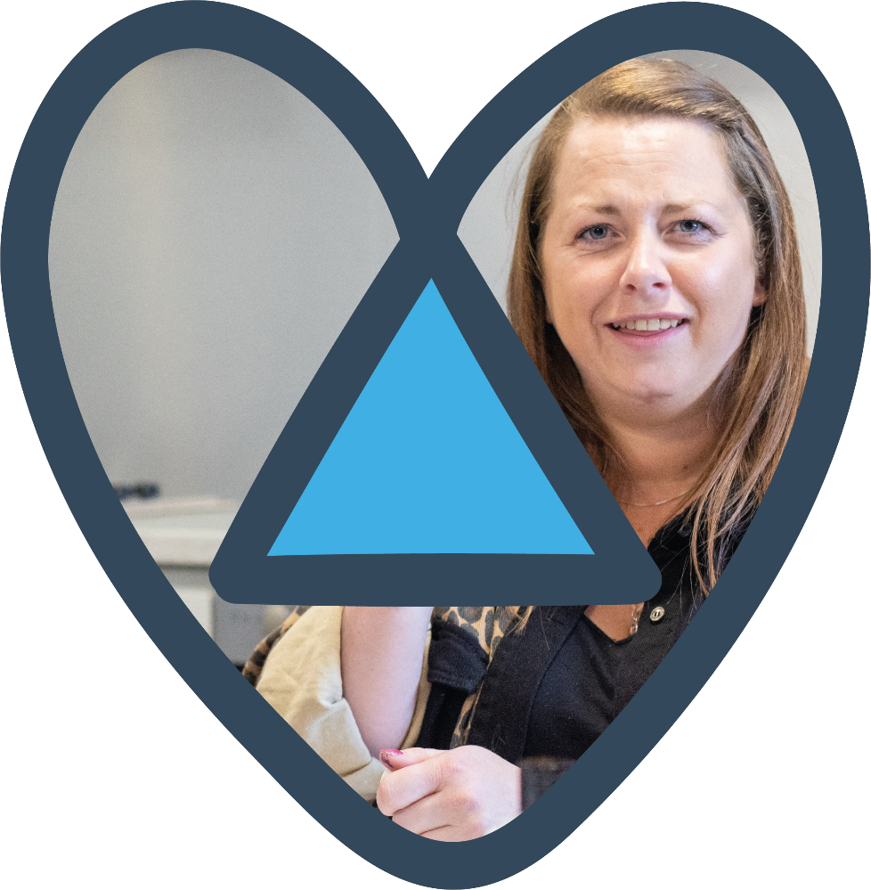

About Blue Triangle
Blue Triangle has been operating at the intersection of Social Care and Social Justice in Scotland since 1974. We are unique as a national registered care provider, registered social landlord, and registered charity.
We deliver over 30 services, in 9 local authority areas, supporting over 400 people every day.
Over 90% of the people we support have ACEs (adverse childhood experiences) or have experienced adult trauma;
over 80% have lived or living experience of addiction;
over 70% have a history of repeat homelessness; and
over 60% have a history of repeat offending.
Our Vision is for a country where everyone is able to access person-centred support, whenever, and for however long, they need it.
Our Mission is to Empower People to Thrive
Our Foundations are Love & Hope, and our Values are being Kind, Passionate, & Creative.
We believe in the power of recovery, social renewal, positive connections, and the opportunity to thrive – it does not matter where you come from, but where you’re going as your past does not define who you are today.
We are a homelessness organisation in name only – we love, nurture, and empower every person who comes through the door, seeing them, not all their ‘stuff’ – but recognising it comes with them! After all, homelessness is a point in time, not a condition – the underlying causes can be many, complex, and interdependent – everyone’s story is different, so we are person-centred and trauma-informed in all we do.

Slide 5
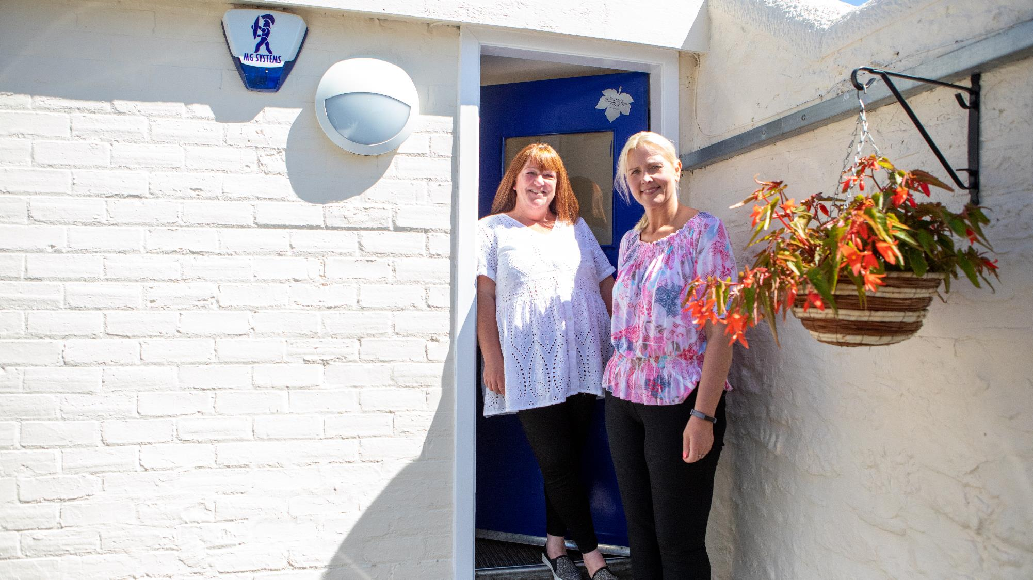
Our Future
Plans
We need to:
drive forward our transformation programme, ensuring we deliver our Organisational Strategy and achieve our Mission, by having the necessary overview of progress of our interdependent Service, People, Property, and Digital strategies, investment cases, and delivery plans across our portfolio.
remove bureaucracy and operational inefficiencies, ensuring we are releasing time to support our amazing staff teams. Measuring the right things and nurturing a culture of continuous service improvement.
empower our people, delegating authority to the front line, allowing them to contribute to the development of new services and to driving service excellence across the organisation.
roll out personal development frameworks, equipping our staff with the tools to grow professionally and embark on new specialist career pathways. We need to build on our progressive staff-side relationships, refreshing our job evaluation scheme and making Blue Triangle not only an amazing place to work, but to build a career.
Social Care and Social Justice in Scotland requires significant transformation. At Blue Triangle we have a unique blend of assets to bring to the table to drive the improvements in human, social, and economic outcomes that are so badly needed.
We want to be best in class and be trailblazers in what we do. As well as our own metrics, evaluations and measures, we will use Investors in People and EFQM to ensure we are planning, delivering and continually improving.

Slide 6

About The Role
We are moving into a period of transformational change and exciting opportunities that will embrace government aspirations and build on how we empower and serve our communities. By being progressive and forward thinking we are committed to providing services that meet the changing needs of society.
To enhance our Board leadership we are seeking Board Members with particular skills in:
Finance and/or accounting
Housing Association experience (IT and/or People)
As a member of the Board you will join a team that shares a passion for supporting the people we serve, and advancing the message and capacity of Blue Triangle. You will have collective responsibility for strategy, governance, and oversight and work collaboratively with the Executive Management Team to formulate and deliver our organisation’s strategic goals.
We are seeking active and engaged members of the Board who will bring with them self-motivation, time and dedication but most importantly the passion, values and drive to the role to help us make a difference to the lives of those who use our services. We would like to hear from people with a variety of backgrounds, who can bring different conversations and skills to our organisation.
Previous experience on a board is not required.
Board Membership is a rewarding volunteer role and while not remunerated, expenses are reclaimable. The time commitment for board members attendance is 8-10 meetings per year, plus an annual away day. We also encourage board members to provide additional time to support specific tasks or initiatives and to provide a sounding board to our team and other Board members. Meetings are normally located in Glasgow but can be attended both in person and online virtually.

Slide 7
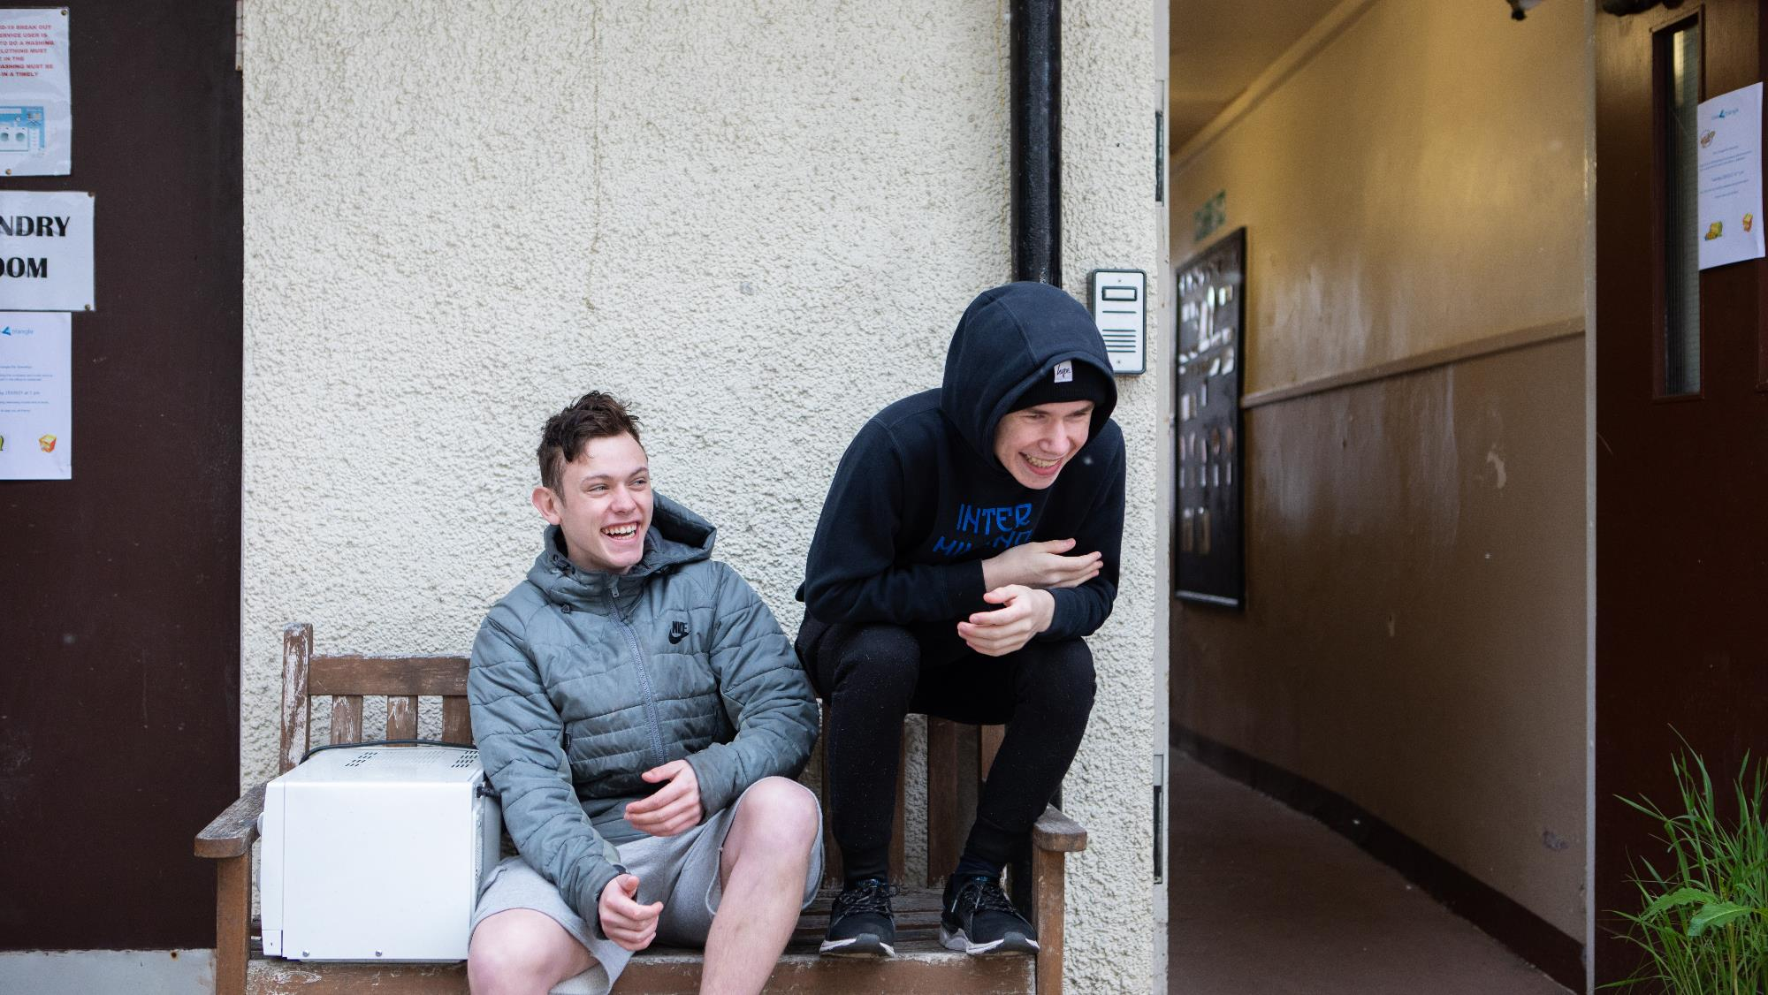
How to Apply
To apply please send your CV and a letter of motivation by e-mail, to: recruitment@bluetriangle.org.uk
Closing date for submissions: 22nd April 2022

Slide 8
