Slide 1


Communications and Engagement Manager
Candidate Information Pack
June 2022

Slide 2
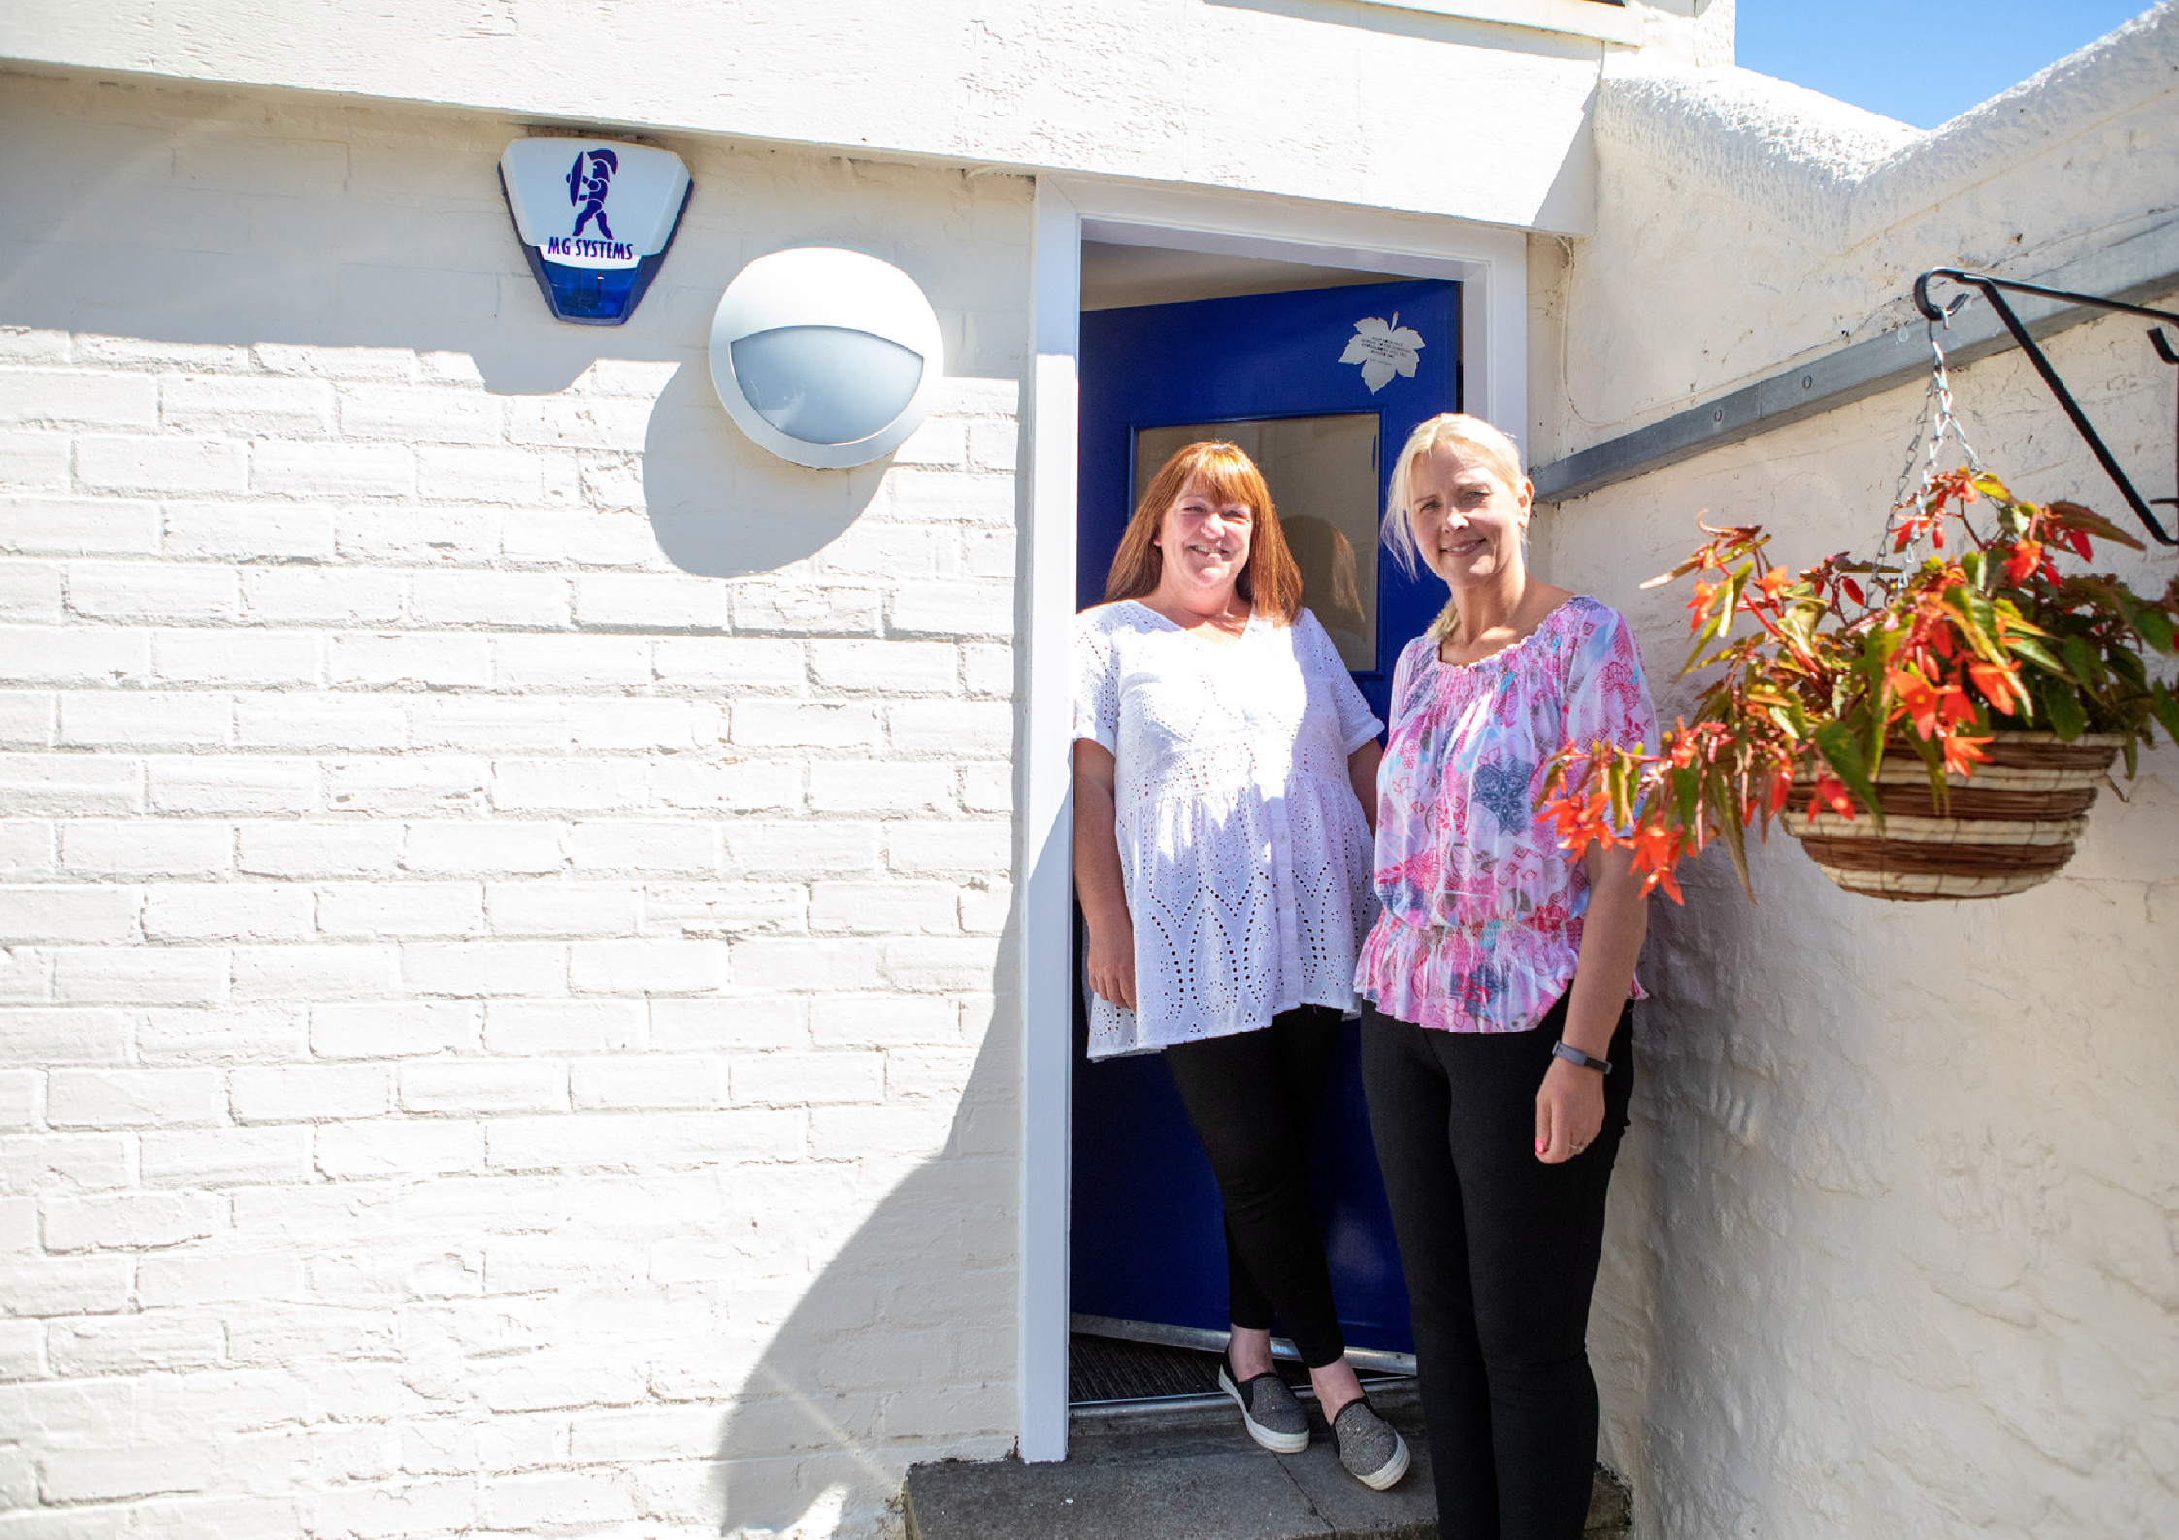
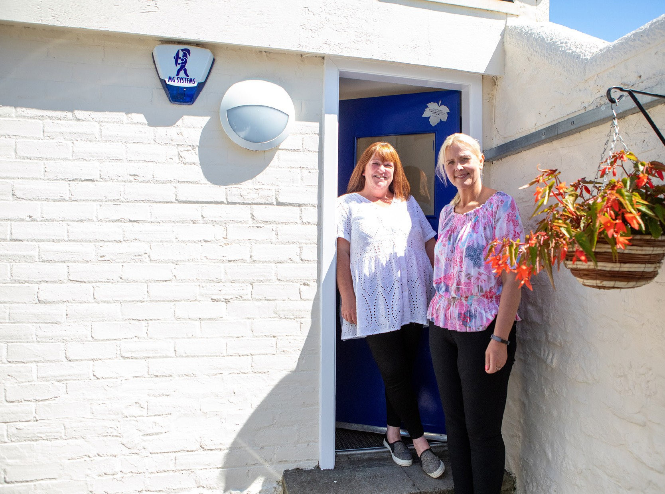

Contents
Welcome from Iain Macfarlane, CEO About Blue Triangle
Our Future Plans Organisational Chart
About the Role
How to Apply
03
05
06
07
09
13

Slide 3
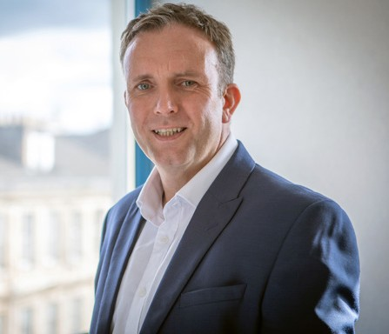

Welcome from
Iain Macfarlane, CEO
Thank you for your interest in joining Blue Triangle. Visit Iain’s welcome video.
I was appointed as CEO in September 2020 and I am continually impressed and humbled by the services and projects led and delivered by our teams across Scotland. It can be overwhelming to see the difference we make and how we build innovative partnerships to ‘Empower People to Thrive.’ Every person we support is amazing, and we’re there to do our bit to unlock their
potential. Social care must be viewed as an investment and a springboard to a better future, not as a safety net to catch people in crisis.
As we have all experienced over the last 18 months, we know that society doesn’t stand still, and challenges can come from all directions. Our services have been needed more than ever before. We continued to support over 400 people during lockdown, and often we were the only service in many communities with our doors open, so we had so many people reaching out for support, which for us is the norm as we’re simply there for the next one who walks in the door.
We operate at the intersection of social care and
social justice, where complex interdependencies across homelessness, addiction, offending, trauma, abuse, and fragile mental health are the reality.
Every day we nurture, support, and empower young people and adults, many of whom have been trapped in a system that tries to fix them, issue by issue.
When assessing who we are as an organisation, we have complex financial metrics, we have critical processes and protocols, and we have an array of success measures, however, the one thing that makes this organisation what it is, is our people. Whether formally, informally, internal, or external, the one constant positive I hear is how our people will do extra, help more and support further. This is why during 2021 we have been celebrating our #AmazingPeople, both our staff and the people we support.
We are transforming the organisation from the inside out, and we are now building our Senior Leadership Team to work alongside me to deliver our ambitious strategy for diversification and growth, bringing new ideas to achieve the step changes in outcomes we all know are possible. I am fortunate to be supported by an experienced and wonderful Board who are as keen as I am to see the organisation grow and flourish, and most importantly, deliver for the people across Scotland who need some hope, to feel loved, and to be empowered more than most.
I want to work with people who bring their proven professional experience, who are passionate about making a lasting impact and who can be bold, radical, and courageous.
Iain Macfarlane
Chief Executive Officer
03

Slide 4
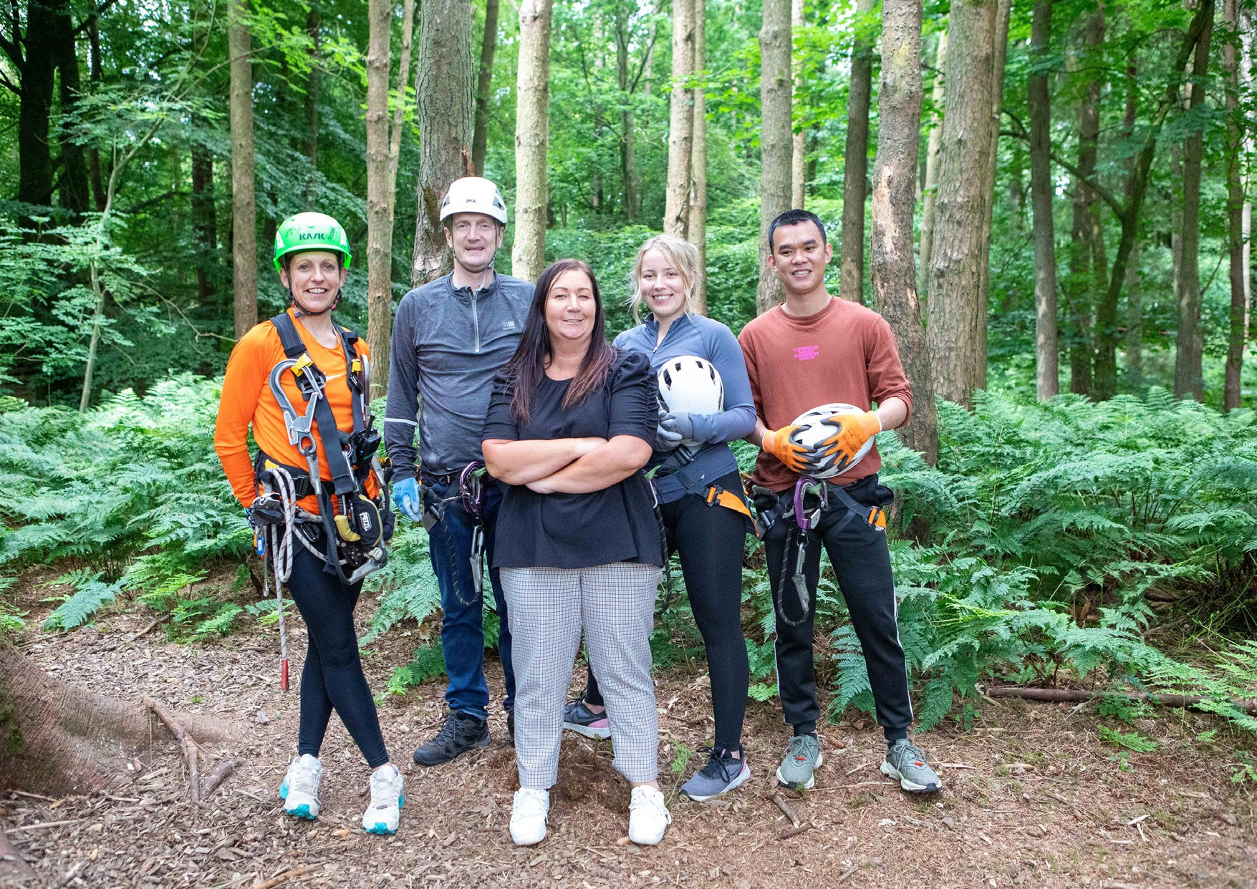

Slide 5
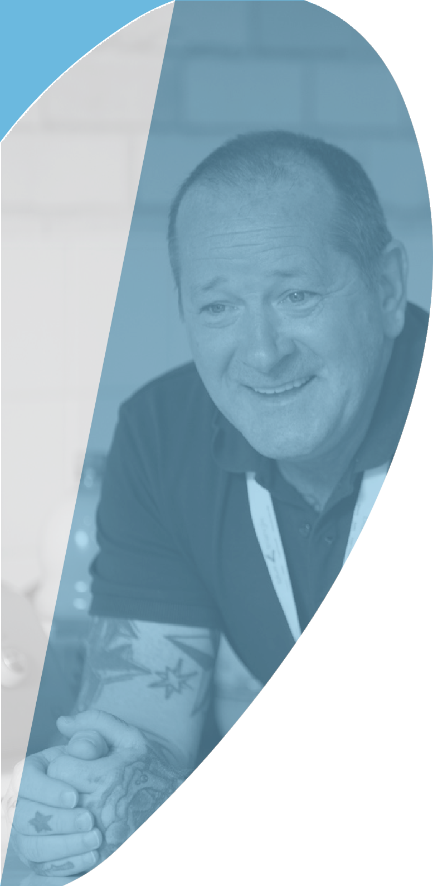

About Blue Triangle
Why not watch our Homelessness & Hope and Mental Health, Support & Hope videos produced by two of our fantastic support workers.
Blue Triangle has been operating at the intersection of Social Care and Social Justice in Scotland since 1974. We are unique as a national registered care provider, registered social landlord, and registered charity.
We deliver over 30 services, in 9 local authority areas, supporting over 400 people every day. Over 90%
of the people we support have ACEs (adverse childhood experiences) or have experienced adult trauma; over 80% have lived or living experience of addiction; over 70% have a history of repeat homelessness; and over 60% have a history of repeat offending.
Our Vision is for a country where everyone is able
to access person-centred support, whenever, and for however long, they need it.
Our Mission is to Empower People to Thrive – whatever that means to them.
Our Foundations are Love & Hope, and our Values are being Kind, Passionate, & Caring.
We believe in the power of recovery, social renewal, positive connections, and the opportunity to thrive – it does not matter where you come from, but where you’re going as your past does not define who you are today.
We are a homelessness organisation in name only – we love, nurture, and empower the next one who comes through the door, seeing them, not all their ‘stuff’ – but recognising it comes with them! After all, homelessness is a point in time, not a condition –
the underlying causes can be many, complex, and interdependent – everyone’s story is different, so we are person-centred and trauma-informed in all we do.
To learn more please watch this video
05

Slide 6

Our Future Plans
Head of Development, People and Transformation
We need to build on our progressive staff-side relationships, refreshing our job evaluation scheme and making Blue Triangle not only an amazing place to work, but to build a career.
We need to
drive forward our transformation programme, ensuring we deliver our Organisational Strategy and achieve our Mission, by having the necessary grip across our portfolio, including our interdependent Service, People, Property, and Digital strategies, investment cases, and delivery plans.
remove all bureaucracy and operational inefficiencies, ensuring we are releasing time to support our amazing staff teams. We need to measure the right things and nurture a culture of continuous service improvement.
empower our people, delegating authority to the front line, allowing them to contribute to the development of new services and to driving service excellence across the organisation.
roll out personal development frameworks, equipping our staff with the tools to grow professionally and embark on new specialist career pathways. We need to build on our progressive staff-side relationships, refreshing our job evaluation scheme and making Blue Triangle not only an amazing place to work, but to build
a career.
Social Care and Social Justice in Scotland requires significant transformation. At Blue Triangle we have a unique blend of assets to bring to the table to drive the improvements in human, social, and economic outcomes that are so badly needed.
We want to be best in class and be trailblazers in what we do. As well as our own metrics, evaluations and measures, we will use Investors in People and EFQM to ensure we are planning, delivering and continually improving.
06

Slide 7
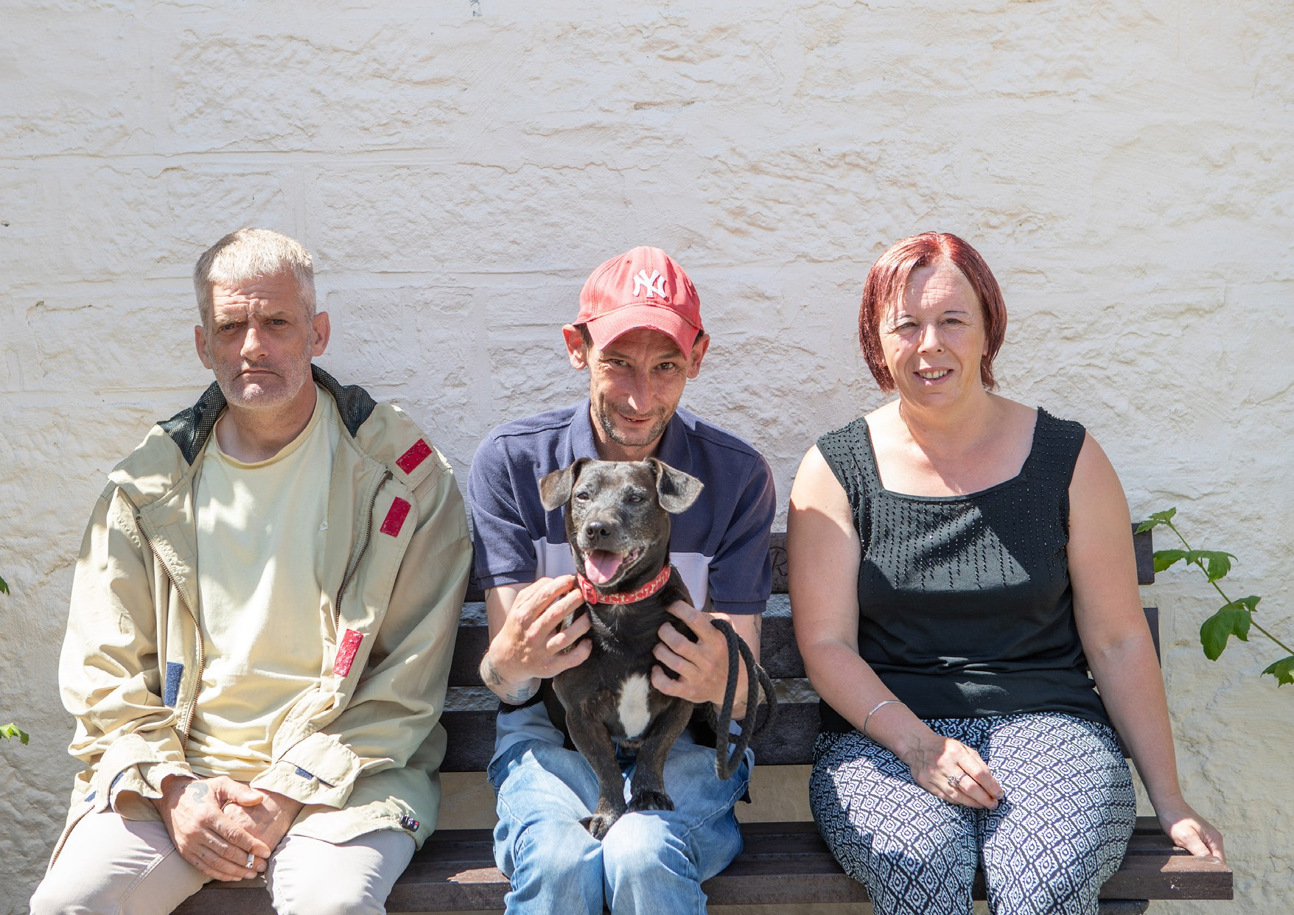

Slide 8

Advertisement
Communications and Engagement Manager
Glasgow (flexible working)
£ £33,416 - £35,175
Blue Triangle has been operating at the intersection of Social Care and Social Justice in Scotland since 1974. We are unique as a national registered care provider, registered social landlord, and registered charity.
To lead all of Blue Triangle’s activities across communications, engagement, and service experience. This is a portfolio role that requires creativity and leadership across external and internal communications, brand awareness and impact, public profile, internal and external engagement campaigns, and having oversight of the experience of interacting with BT from the perspective of the people we support, our staff, our customers, our partners, our applicants, our volunteers, our regulators, our supporters, and the public.
The role will require joint working with other teams and people across BT to deliver success, and external partners may also require to be engaged to provide expertise in certain areas, as we seek to build our internal capabilities.
This is a critical role as BT starts to ‘land’ and ‘embed’ our new Organisational Strategy and radically change the perception of who we are, what we do, and the experience of interacting with BT. It is vital we engage, excite, and improve the ‘BT experience’ for the people we support, our staff, our customers, our partners, our applicants, our volunteers, our regulators, our supporters, and the public.
You’ll take ownership of the communications and engagement within Blue Triangle and will have strong knowledge in building a strong presence within the community.
If you’re excited to learn more, please contact Jonathan Hempsey by email at jhempsey@bluetriangle.org.uk
Applications in the form of a tailored CV and covering letter, highlighting your skills and experience pertinent to the role, should arrive no later than midnight 13th June 2022

Slide 9

The Role
Communications and Engagement Manager
The Role
Strategic & Market Scanning: Have an appropriate understanding of the changing policy and strategic landscape in social care, working with the CEO and SLT to differentiate our message and market position, bringing insights from how other organisations are positioned and what they are saying. Ensuring we leverage our unique position as a national RSL, registered care provider, and registered charity.
Communications & Engagement Strategy: Work with the CEO to develop a Communications & Engagement Strategy for BT, that demonstrates how this portfolio of activities will help deliver and embed our Organisational Strategy, proposing areas of investment required to make this as impactful as we require.
External Profile & Communications: Manage our external marketing and communications activities, using multi-media channels and driving priority campaigns that we are taking to market. This not only includes refreshing impactful content on our web site, but managing consistent messaging across all social media channels, via Points of View, and via broadcast and written press outlets. It is vital we are out there, we are heard, and we are influencing the social care agenda across Scotland.
Internal Communications: Manage our approach to internal communications, making changes and introducing new creative ways of sharing the right information with all internal stakeholders. Propose new channels (intranet+) and work with other teams to better utilise digital technology to keep staff informed and invite them to be involved with initiatives across BT including our Design Groups and service development activities.
Supported People Engagement: Manage our engagement approach and plan for offering activities and positive connections for the people we support, identifying partnership organisations to help us offer varied activity pathways to empower people to thrive.
Surveys: Lead a review and rationalisation of how and why we complete surveys across BT. Develop a coordinated approach to how we source not only feedback but ideas for improvement from the people we support and from staff and how we capture their views/perspectives on the changes we are making across the organisation whether at a strategy level or in specific areas such as learning and development.
Brand Presence & Amplified Voice: Ensure BT is visible where we should be visible and that our voice is heard, doing this through memberships, conference attendance/speaking slots, conference/event sponsorship, white papers/point of view publication, press articles, broadcast media appearances, etc, using networks and retained partners to open all possible doors.

Slide 10
The Role
Communications and Engagement Manager
Volunteering Programmes: Work with the CEO and SLT to put in place the foundations for lived experience/peer supported volunteering and public volunteering across appropriate BT services, including links into our emerging Connected Community Models in each local authority area. For this activity, regular review points will be put in place to consider when dedicated resource should be allocated at this critical activity – volunteers will be key to the successful delivery of our Organisational Strategy.
Culture Change: Support the CEO and SLT in embedding culture change across BT, by helping to promote the appropriate language and tone in all communication, whether verbal or written, and by creating visually impactful environments that bring our brand to life in all of our service locations, including central support. Corporate Communications: Lead on development of all corporate communications, including our Annual Report. Bring creativity and ideas to ensure we explore all multi-media options for getting our message out there.
Bid Management: Support our Funding Bid and Tender Management activities by building a bank of Credentials, Case Studies, Stories of Hope, and Feedback from people we support, customers, partners, and other stakeholders.
Brand Presence & Amplified Voice: Ensure BT is visible where we should be visible and that our voice is heard, doing this through memberships, conference attendance/speaking slots, conference/event sponsorship, white papers/point of view publication, press articles, broadcast media appearances, etc, using networks and retained partners to open all possible doors.
Customer Experience: Lead on BT’s approach to improving the experience for all our customers in interacting with BT, whether the people we support, our staff, our customers, our partners, our applicants, our volunteers, our regulators, our supporters, or the public. Promote a clear customer experience perspective as we shape our continuous improvement activities, helping to ensure we achieve our service excellence goals.
Corporate Communications: Lead on development of all corporate communications, including our Annual Report. Bring creativity and ideas to ensure we explore all multi-media options for getting our message out there.
Bid Management: Support our Funding Bid and Tender Management activities by building a bank of Credentials, Case Studies, Stories of Hope, and Feedback from people we support, customers, partners, and other stakeholders.

Slide 11
Person Specification
Communications and Engagement Manager
Person Specification
educated to degree level.
appropriate specialist training and qualifications to complete the delivery of the role scope as outlined (either gained or willing to complete).
excellent communication skills, both verbal and written.
adept at writing content for web site, campaigns, marketing collateral, and white papers/points of view.
experience in preparing press releases and working with media desks to get traction in written press and broadcast media.
multi-channel communications experience, driving consistent campaign-based messaging across multiple platforms to maximise engagement impact.
be solution-focused, able to think creatively, to join the dots, and to carry gravitas to build networks and partnerships
supporting cultural change through effective communication and engagement approaches.
understanding of customer experience methods and how to incorporate into a framework for continuous service improvement.
leading a Communications Work Stream as part of a programme of work, whilst balancing this with business-as-usual communications, engagement, and experience improvement activities.
to represent the CEO and BT with key stakeholders and partner organisations, doing so humbly and living out our values.
Communication skills
Autonomy and decision making
Responsible for overseeing the work of others
Responsible for financial resources
Responsible for data and information
Responsible for service users and other people
Analytical thinker and problem solver

Slide 12
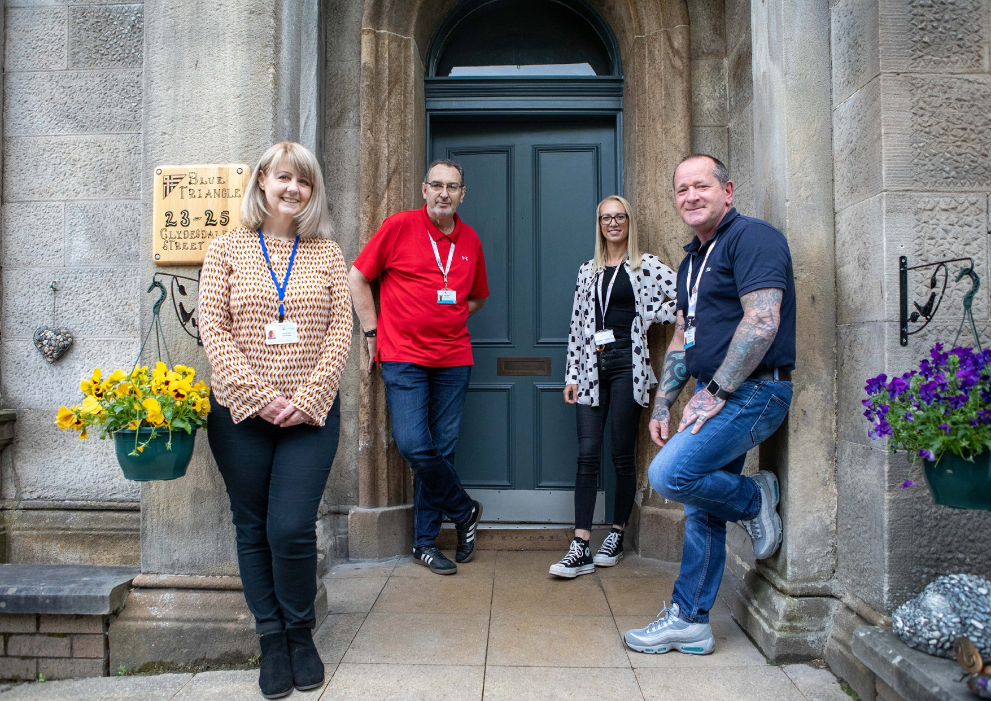

Slide 13
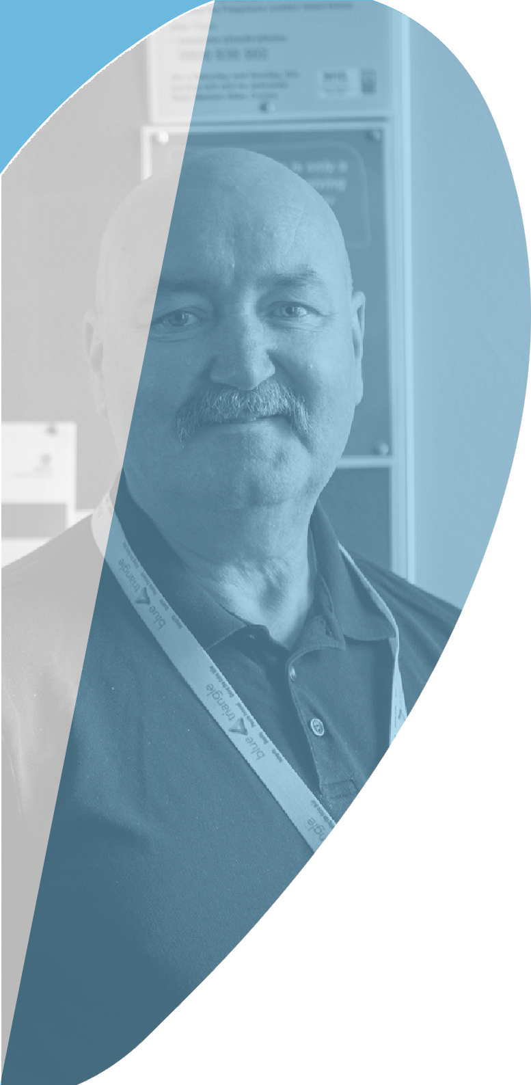
How to Apply
To apply please send your tailored CV and covering letter by e-mail, to: recruitment@bluetriangle.org.uk
Please note that the covering letter should be no more than 2 pages of A4 and should summarise your relevant skills and experience and motivations for applying and working for Blue Triangle. It is therefore an important part of the application and will be used as part of our selection process.
If you would like a confidential, informal discussion then please contact
Blue Triangle’s stakeholders, partners and customers come from all walks of life and all aspects of society and we want to reflect this in our organisation. We want to hire great people from a wide variety of backgrounds. Please let us know if there is anything in particular which would help with your application, should there be any adjustments you wish to make, or anything you would want us to be made aware of.
Closing date for applications
Midnight Monday 13th June 2022
Benefits:
£competitive
Flexible working
Interview Information:
Candidates shortlisted for interview will be contacted within 7 days after the closing date
19

Slide 14


