Slide 1


Development Partner
Candidate Information Pack
April 2022

Slide 2
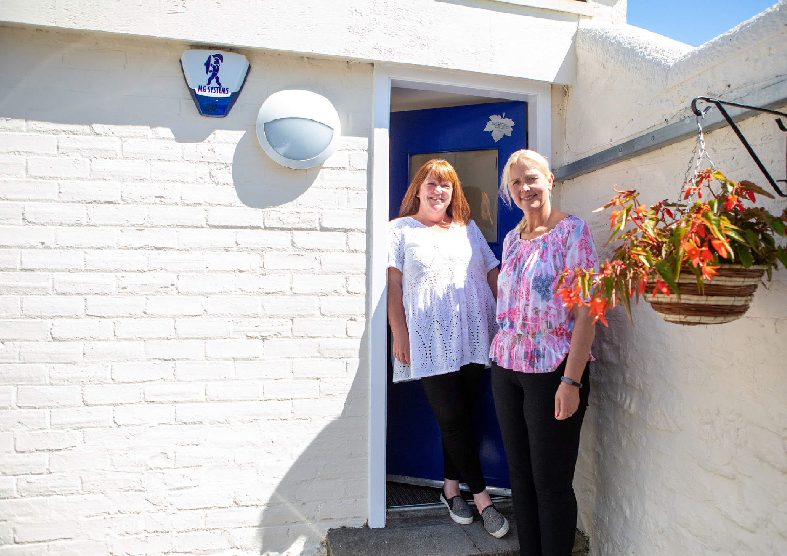
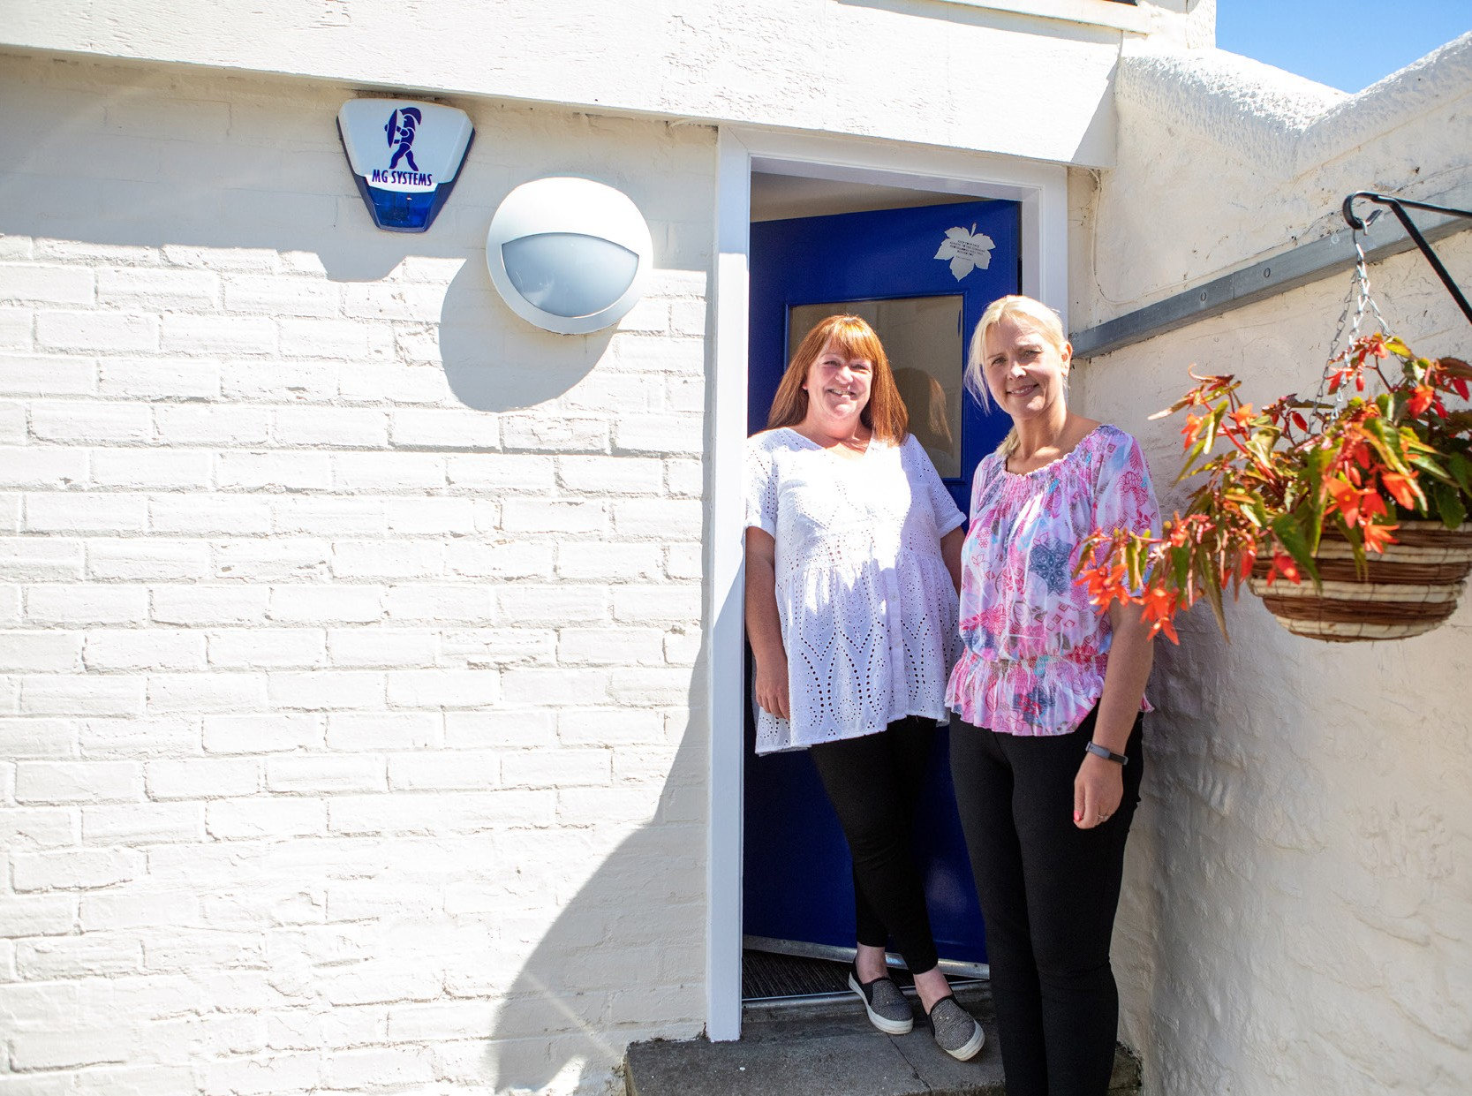

Contents
Welcome from Iain Macfarlane, CEO About Blue Triangle
Our Future Plans Organisational Chart
About the Role
How to Apply
03
05
06
07
09
13

Slide 3
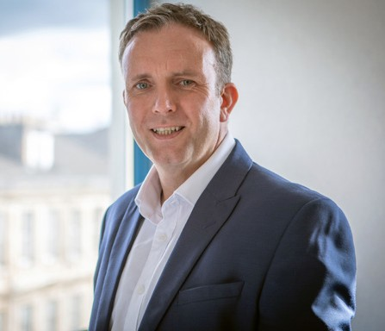

Welcome from
Iain Macfarlane, CEO
Thank you for your interest in joining Blue Triangle. Visit Iain’s welcome video.
I was appointed as CEO in September 2020 and I am continually impressed and humbled by the services and projects led and delivered by our teams across Scotland. It can be overwhelming to see the difference we make and how we build innovative partnerships to ‘Empower People to Thrive.’ Every person we support is amazing, and we’re there to do our bit to unlock their
potential. Social care must be viewed as an investment and a springboard to a better future, not as a safety net to catch people in crisis.
As we have all experienced over the last 18 months, we know that society doesn’t stand still, and challenges can come from all directions. Our services have been needed more than ever before. We continued to support over 400 people during lockdown, and often we were the only service in many communities with our doors open, so we had so many people reaching out for support, which for us is the norm as we’re simply there for the next one who walks in the door.
We operate at the intersection of social care and
social justice, where complex interdependencies across homelessness, addiction, offending, trauma, abuse, and fragile mental health are the reality.
Every day we nurture, support, and empower young people and adults, many of whom have been trapped in a system that tries to fix them, issue by issue.
When assessing who we are as an organisation, we have complex financial metrics, we have critical processes and protocols, and we have an array of success measures, however, the one thing that makes this organisation what it is, is our people. Whether formally, informally, internal, or external, the one constant positive I hear is how our people will do extra, help more and support further. This is why during 2021 we have been celebrating our #AmazingPeople, both our staff and the people we support.
We are transforming the organisation from the inside out, and we are now building our Senior Leadership Team to work alongside me to deliver our ambitious strategy for diversification and growth, bringing new ideas to achieve the step changes in outcomes we all know are possible. I am fortunate to be supported by an experienced and wonderful Board who are as keen as I am to see the organisation grow and flourish, and most importantly, deliver for the people across Scotland who need some hope, to feel loved, and to be empowered more than most.
I want to work with people who bring their proven professional experience, who are passionate about making a lasting impact and who can be bold, radical, and courageous.
Iain Macfarlane
Chief Executive Officer
03

Slide 4
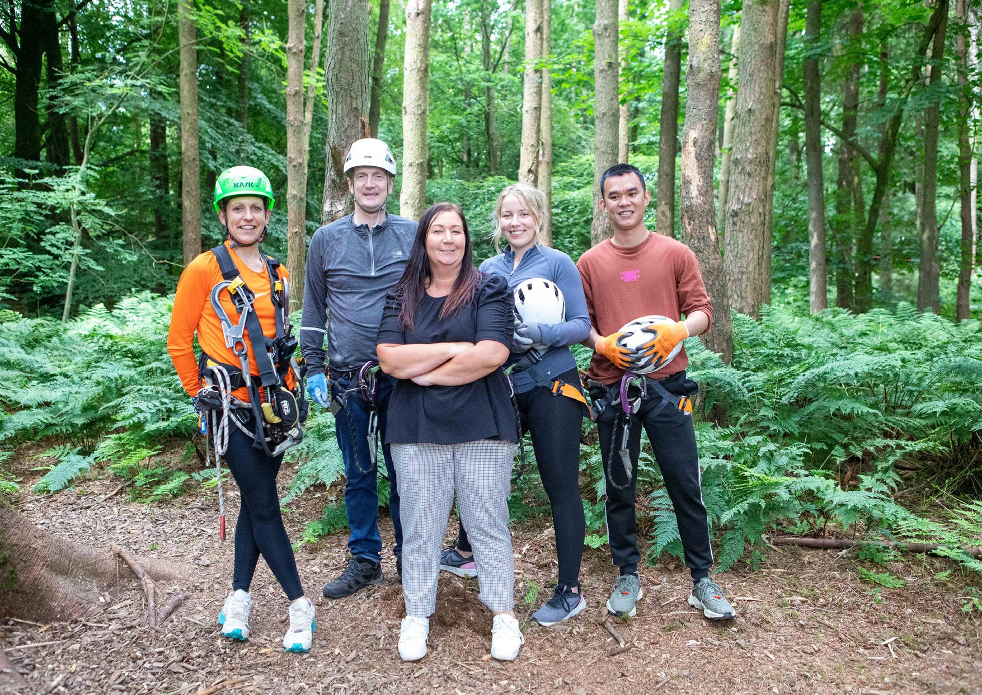

Slide 5
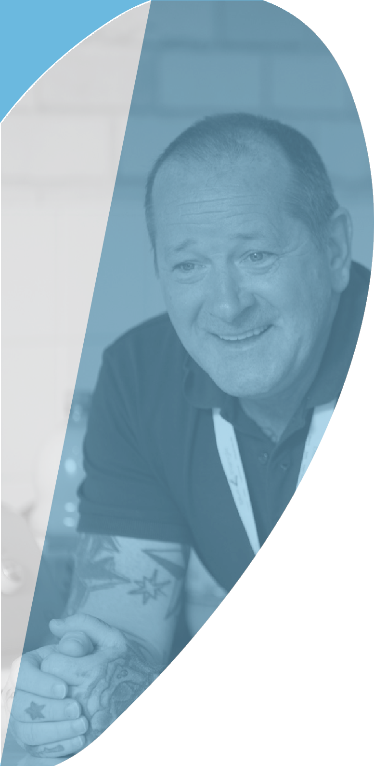

About Blue Triangle
Why not watch our Homelessness & Hope and Mental Health, Support & Hope videos produced by two of our fantastic support workers.
Blue Triangle has been operating at the intersection of Social Care and Social Justice in Scotland since 1974. We are unique as a national registered care provider, registered social landlord, and registered charity.
We deliver over 30 services, in 9 local authority areas, supporting over 400 people every day. Over 90%
of the people we support have ACEs (adverse childhood experiences) or have experienced adult trauma; over 80% have lived or living experience of addiction; over 70% have a history of repeat homelessness; and over 60% have a history of repeat offending.
Our Vision is for a country where everyone is able
to access person-centred support, whenever, and for however long, they need it.
Our Mission is to Empower People to Thrive – whatever that means to them.
Our Foundations are Love & Hope, and our Values are being Kind, Passionate, & Caring.
We believe in the power of recovery, social renewal, positive connections, and the opportunity to thrive – it does not matter where you come from, but where you’re going as your past does not define who you are today.
We are a homelessness organisation in name only – we love, nurture, and empower the next one who comes through the door, seeing them, not all their ‘stuff’ – but recognising it comes with them! After all, homelessness is a point in time, not a condition –
the underlying causes can be many, complex, and interdependent – everyone’s story is different, so we are person-centred and trauma-informed in all we do.
To learn more please watch this video
05

Slide 6

Our Future Plans
Head of Development, People and Transformation
We need to build on our progressive staff-side relationships, refreshing our job evaluation scheme and making Blue Triangle not only an amazing place to work, but to build a career.
We need to
drive forward our transformation programme, ensuring we deliver our Organisational Strategy and achieve our Mission, by having the necessary grip across our portfolio, including our interdependent Service, People, Property, and Digital strategies, investment cases, and delivery plans.
remove all bureaucracy and operational inefficiencies, ensuring we are releasing time to support our amazing staff teams. We need to measure the right things and nurture a culture of continuous service improvement.
empower our people, delegating authority to the front line, allowing them to contribute to the development of new services and to driving service excellence across the organisation.
roll out personal development frameworks, equipping our staff with the tools to grow professionally and embark on new specialist career pathways. We need to build on our progressive staff-side relationships, refreshing our job evaluation scheme and making Blue Triangle not only an amazing place to work, but to build
a career.
Social Care and Social Justice in Scotland requires significant transformation. At Blue Triangle we have a unique blend of assets to bring to the table to drive the improvements in human, social, and economic outcomes that are so badly needed.
We want to be best in class and be trailblazers in what we do. As well as our own metrics, evaluations and measures, we will use Investors in People and EFQM to ensure we are planning, delivering and continually improving.
06

Slide 7
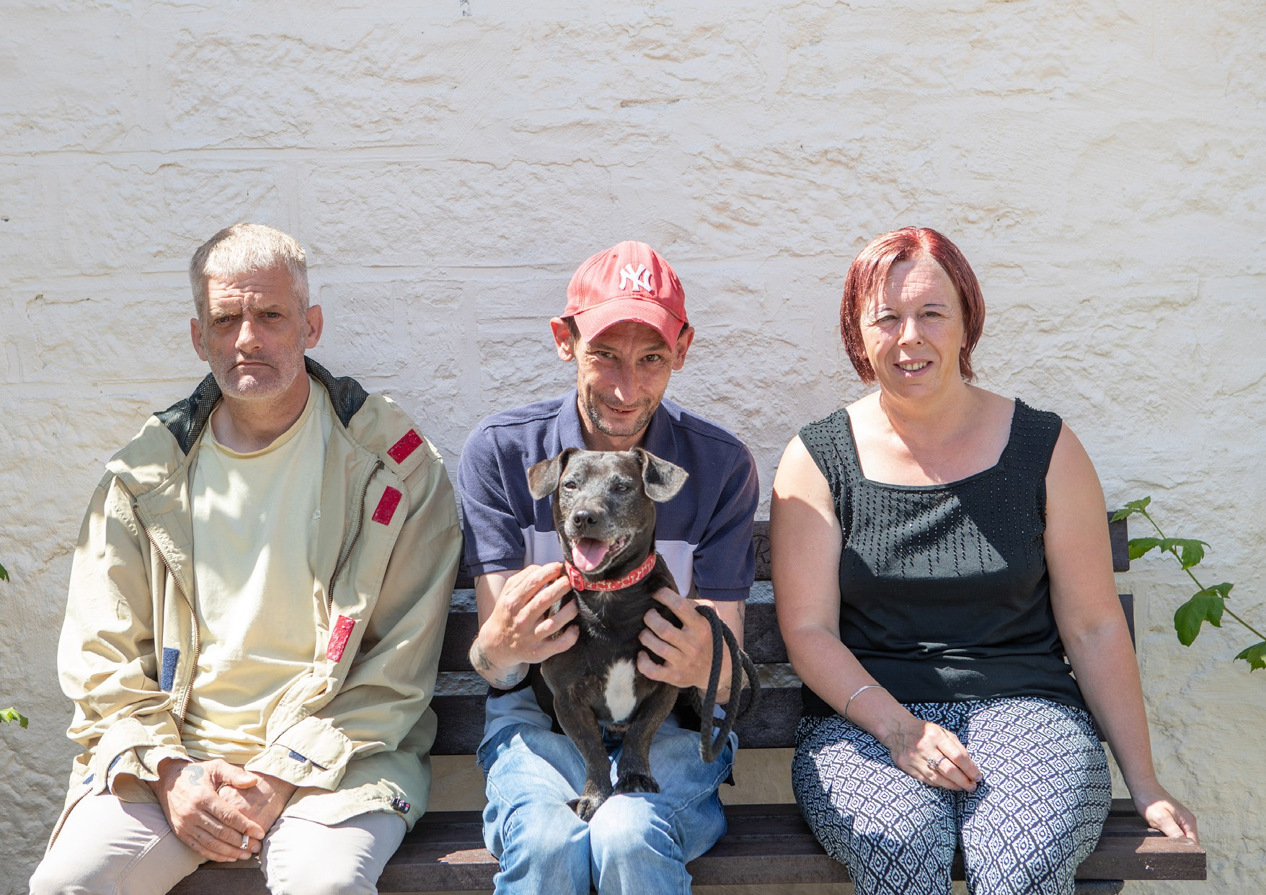

Slide 8

Advertisement
Development Partner
Glasgow (flexible working)
£Competitive
Blue Triangle has been operating at the intersection of Social Care and Social Justice in Scotland since 1974. We are unique as a national registered care provider, registered social landlord, and registered charity.
We are looking for a Development Partner to join our small but mighty Development team, where we aspire to put people and their experience at the heart of everything we do.
As an integral part of the Team, you will have a positive, can-do approach to contribute to our team. The role is varied and fast paced where no two days are the same so requires you to manage several streams of work and priorities. This is a great opportunity for someone looking to develop a career in Business Development and to get fully involved in all aspects, activities and projects.
You should be well organised, able to prioritise tasks, have a strong attention to detail, ability to work at pace, and able to deal with information in a confidential manner.
Ideally you will have Business Development experience, however this is not essential for the right candidate as full training will be given. What is really important is that you align with our culture and values and you have a positive ‘can do’ mindset.
Good practical experience of Microsoft Office applications is advantageous, along with the requirement for excellent oral and written communication skills. This role is suited to you if you are motivated to work as part of a team, to take ownership of your responsibilities and to deliver at pace.
In return, we can provide opportunities to allow you to progress and develop your skills.
We also offer generous annual leave, a contributory pension scheme, life assurance and an employee assistance programme.
For a full job description and person specification, please visit www.btha.org.uk/items/BTHA-Jobs.
To apply, please submit your CV and a covering letter on how you would fulfil the criteria for the post, with the reference to recruitment@bluetriangle.org.uk by 12 midnight on 8th May 2022

Slide 9

The Role
Development Partner
PURPOSE OF THE JOB
The Development Business Partner will deliver a variety of business development activities across the business, significantly contributing to new opportunities and funding streams aligned to our mission and strategic growth plans. With sound knowledge of the commissioning landscape the Development Business Partner is integral to the acquisition of new services through effective bid management and procurement activities. The post holder will scope, design, plan and implement services and engage with teams across all functions, managing stakeholder expectations throughout all phases of project execution.
Through a positive and proactive attitude, you build internal relationships for the greater good of your project and Blue Triangle’s services
You are a commercially minded individual with the acumen to develop sustainable solutions and services, who knows what good looks and is driven by a strong desire to exceed expectations
A great team player: you want to be part of a team that works hard, supports each other and above all has fun along the way.
You have experience of partnering business leaders, and understand what great looks like
You are comfortable operating in an environment where ready-made processes don’t always exist – you can navigate ambiguity and ensure you spot and respond to opportunities for improvement
You have a proven track record and can evidence personal drive and commitment to engage others through in change initiatives
You’re up for doing things differently and trying (almost) everything once
You are degree qualified (or relevant work experience) with a high learning ability and an interest in continuous professional development
PERSON SPECIFICATION DETAILS
You have excellent literacy skills, a keen eye for detail, can bring a story to life and translate information from various formats into concise bids or reports.
You thrive in a diverse role, where no day will be the same, and can manage multiple projects and bids simultaneously, juggling conflicting priorities
A natural and confident communicator and facilitator, you engage your project teams with a balance of credibility and charisma
With strong project management skills, you’re able to take a concept and develop a project delivery plan, identifying key milestones and see projects through to business as usual with experience of risk mitigation and troubleshooting issues as they arise

Slide 10
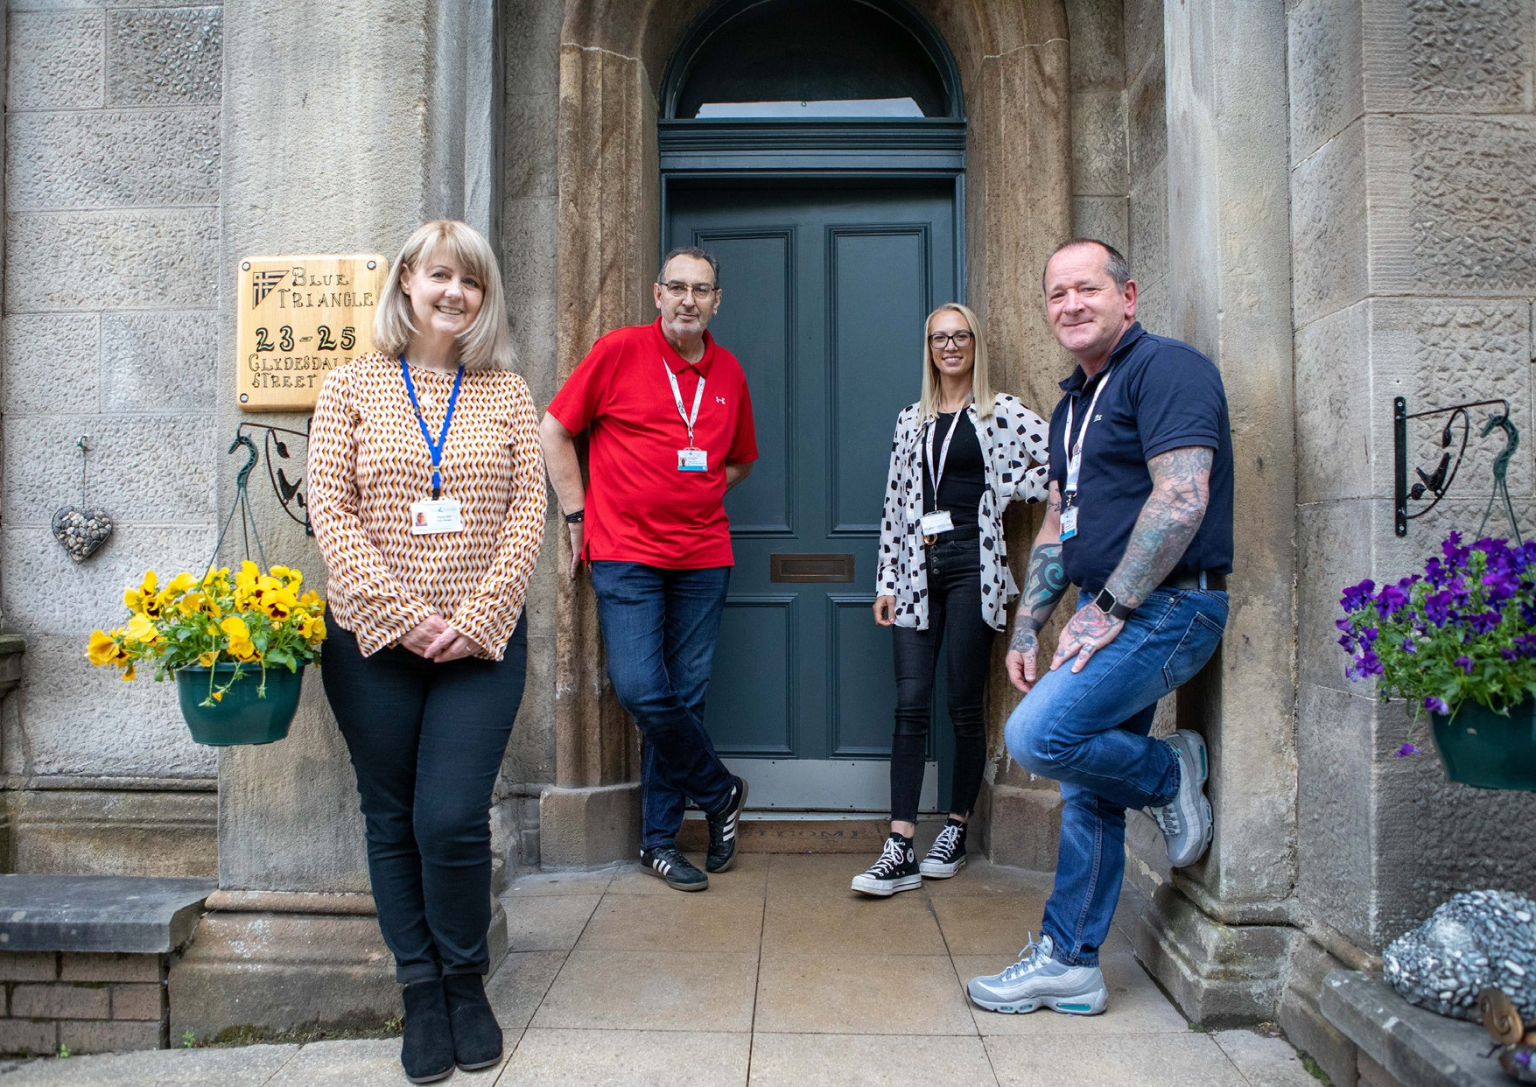

Slide 11
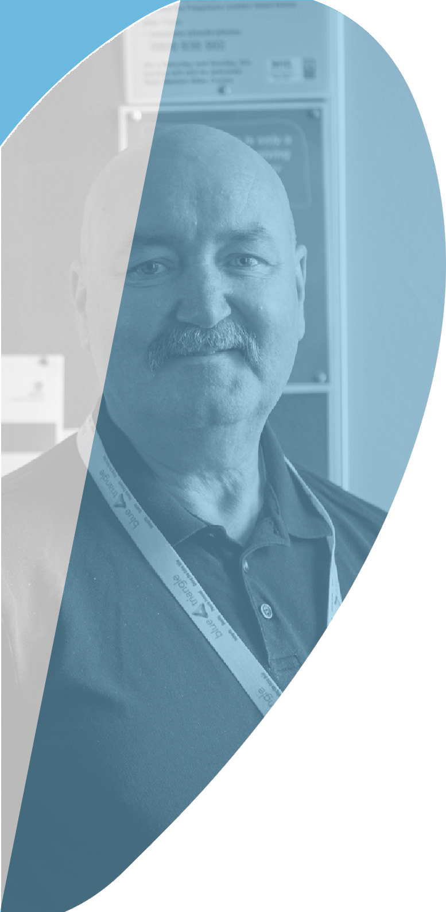
How to Apply
To apply please send your tailored CV and covering letter by e-mail, to: recruitment@bluetriangle.org.uk
Please note that the covering letter should be no more than 2 pages of A4 and should summarise your relevant skills and experience and motivations for applying and working for Blue Triangle. It is therefore an important part of the application and will be used as part of our selection process.
If you would like a confidential, informal discussion then please contact
Blue Triangle’s stakeholders, partners and customers come from all walks of life and all aspects of society and we want to reflect this in our organisation. We want to hire great people from a wide variety of backgrounds. Please let us know if there is anything in particular which would help with your application, should there be any adjustments you wish to make, or anything you would want us to be made aware of.
Closing date for applications
12 Nomidnight on, 8th May 2022
Benefits:
£35,000 - £38,000 DOE
Flexible working
19

Slide 12


