Slide 1
Temporary - Project Worker Nights Viewpark
Candidate Information Pack
August 2022

Slide 2
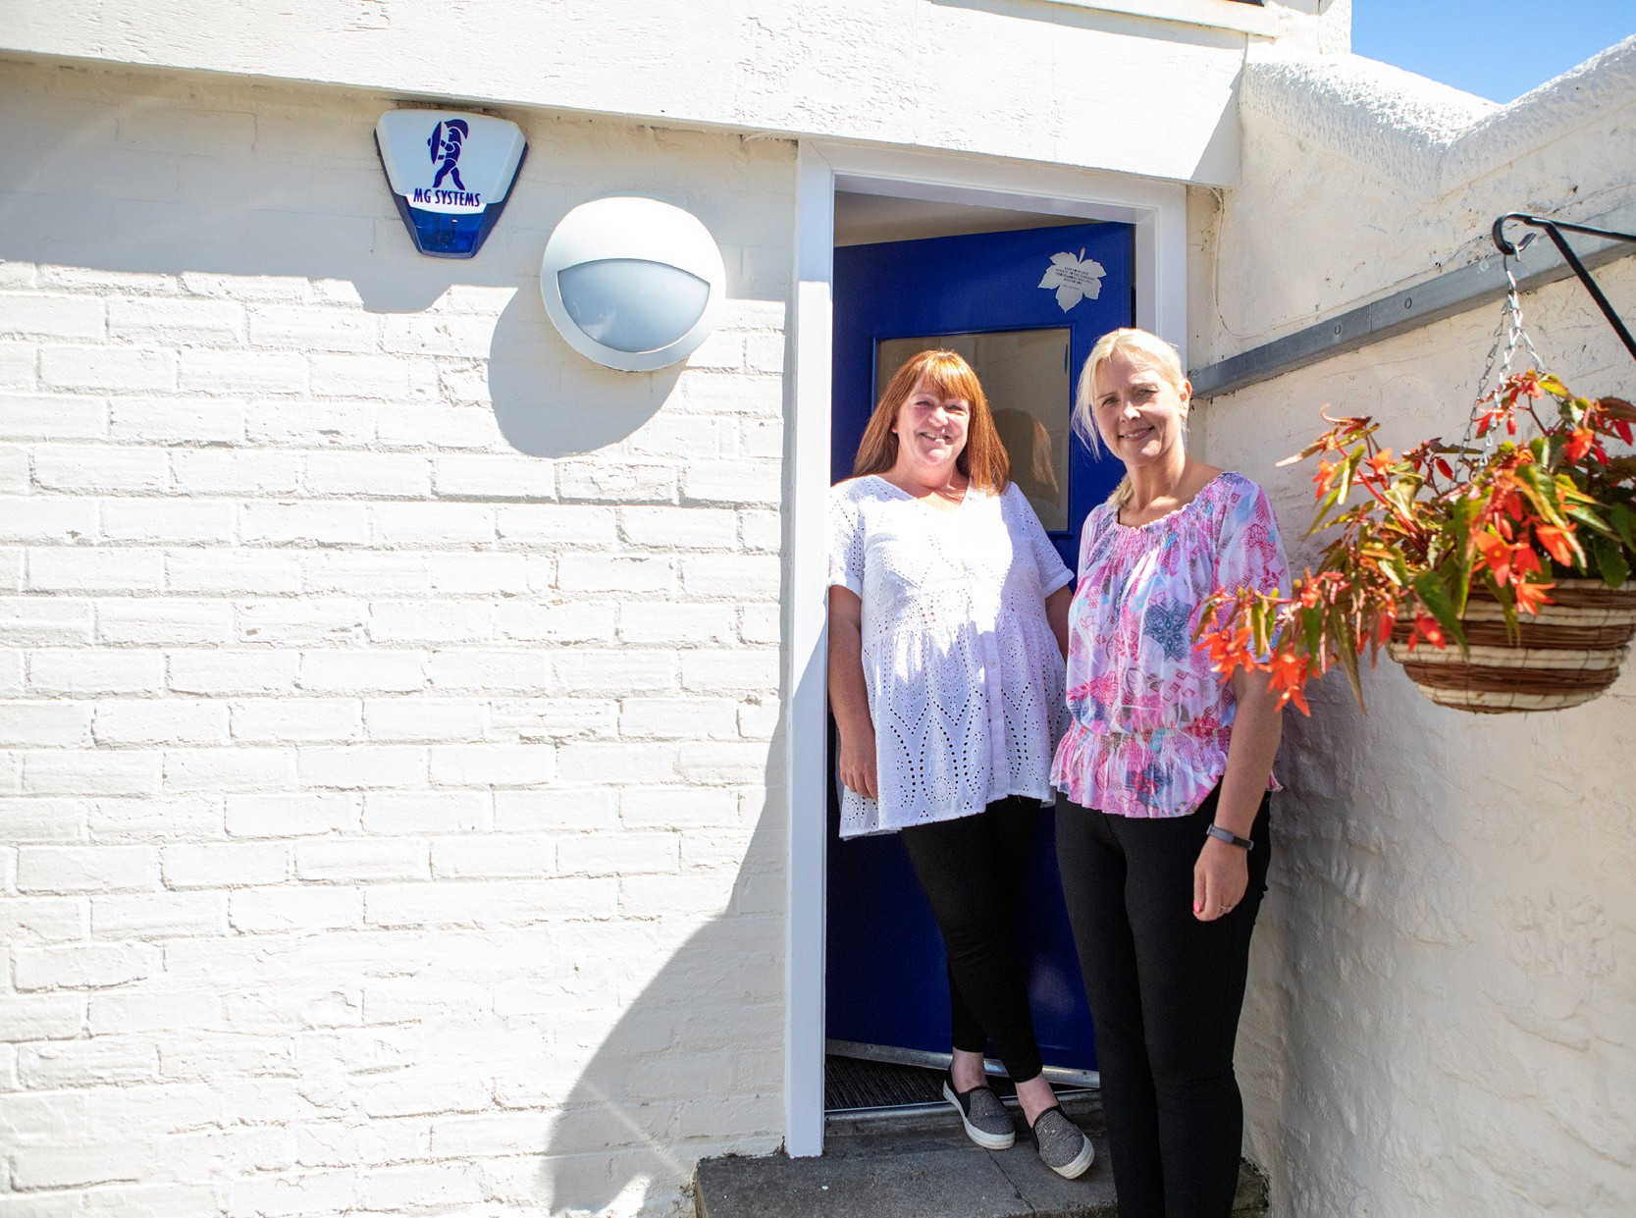
Contents
Welcome from Iain Macfarlane, CEO About Blue Triangle
Our Future Plans Organisational Chart
About the Role
How to Apply
03
05
06
07
09
13

Slide 3
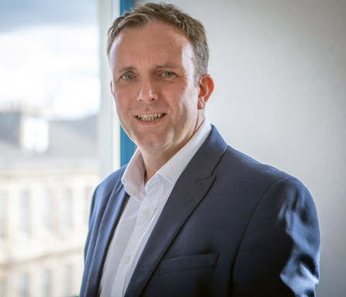
Welcome from
Iain Macfarlane, CEO
Thank you for your interest in joining Blue Triangle.
I was appointed as CEO in September 2020 and I’m continually impressed and humbled by the services and projects led and delivered by our teams across Scotland. It can be overwhelming to see the difference we make and how we build innovative partnerships to achieve our Mission to ‘Empower People to Thrive’.
Every person we support is amazing, and we’re there to do our bit to unlock their potential, by bringing hope and love as the foundations for everything we do.
We can only do this by recruiting people who are passionate about changing lives and seeing everyone move on beyond their current circumstances. This is true for everyone who works in Blue Triangle as we all have a key role in ensuring we are there for the next person who walks in the door, whether working in our Accommodation Services, Community Services, or in Central Support.
We firmly believe that social care must be viewed as an investment and a springboard to a better future, not as a safety net to catch people in crisis.
We operate at the intersection of social care and social justice, where complex interdependencies across homelessness, addiction, offending, trauma, abuse, and fragile mental health are the reality.
We do all we can to be Trauma-Informed, Person-Centred, and Wellbeing-Focused, seeing the whole person and being there for them no matter what.
Through our Connected Communities we bring positive connections and lasting relationships to people who have often been trapped in a system that tries to fix them issue by issue. No one’s past defines who they are today and we only want to see people stepping out and being part of their local communities as active and thriving citizens.
Over the past 12 months we’ve been investing in transforming who we are and what we do, and this is a on-going journey, as we’ll continually evolve to the changing needs of society to ensure we’re doing our bit to nurture, support, and empower as many people as possible across Scotland.
It’s knowing that we’re making a difference in a very real way that motivates me to do what I do, and we want to attract people who share our passion for transforming lives, regardless of the role you want to play in Blue Triangle – we are all part of one team and we all have a role in bringing hope and love to those who need it most.
Iain Macfarlane
Chief Executive Officer
03

Slide 5
About Blue Triangle
Why not watch our Homelessness & Hope and Mental Health, Support & Hope videos produced by two of our fantastic support workers.
Blue Triangle has been operating at the intersection of Social Care and Social Justice in Scotland since 1974. We are unique as a national registered care provider, registered social landlord, and registered charity.
We deliver over 30 services, in 9 local authority areas, supporting over 400 people every day. Over 90%
of the people we support have ACEs (adverse childhood experiences) or have experienced adult trauma; over 80% have lived or living experience of addiction; over 70% have a history of repeat homelessness; and over 60% have a history of repeat offending.
Our Vision is for a country where everyone is able
to access person-centred support, whenever, and for however long, they need it.
Our Mission is to Empower People to Thrive – whatever that means to them.
Our Foundations are Love & Hope, and our Values are being Kind, Passionate, & Caring.
We believe in the power of recovery, social renewal, positive connections, and the opportunity to thrive – it does not matter where you come from, but where you’re going as your past does not define who you are today.
We are a homelessness organisation in name only – we love, nurture, and empower the next one who comes through the door, seeing them, not all their ‘stuff’ – but recognising it comes with them! After all, homelessness is a point in time, not a condition –
the underlying causes can be many, complex, and interdependent – everyone’s story is different, so we are person-centred and trauma-informed in all we do.
To learn more please watch this video
05

Slide 6
Our Future Plans
We need to build on our progressive staff-side relationships, refreshing our job evaluation scheme and making Blue Triangle not only an amazing place to work, but to build a career.
We need to
drive forward our transformation programme, ensuring we deliver our Organisational Strategy and achieve our Mission, by having the necessary grip across our portfolio, including our interdependent Service, People, Property, and Digital strategies, investment cases, and delivery plans.
remove all bureaucracy and operational inefficiencies, ensuring we are releasing time to support our amazing staff teams. We need to measure the right things and nurture a culture of continuous service improvement.
empower our people, delegating authority to the front line, allowing them to contribute to the development of new services and to driving service excellence across the organisation.
roll out personal development frameworks, equipping our staff with the tools to grow professionally and embark on new specialist career pathways. We need to build on our progressive staff-side relationships, refreshing our job evaluation scheme and making Blue Triangle not only an amazing place to work, but to build
a career.
Social Care and Social Justice in Scotland requires significant transformation. At Blue Triangle we have a unique blend of assets to bring to the table to drive the improvements in human, social, and economic outcomes that are so badly needed.
We want to be best in class and be trailblazers in what we do. As well as our own metrics, evaluations and measures, we will use Investors in People and EFQM to ensure we are planning, delivering and continually improving.
06

Slide 7
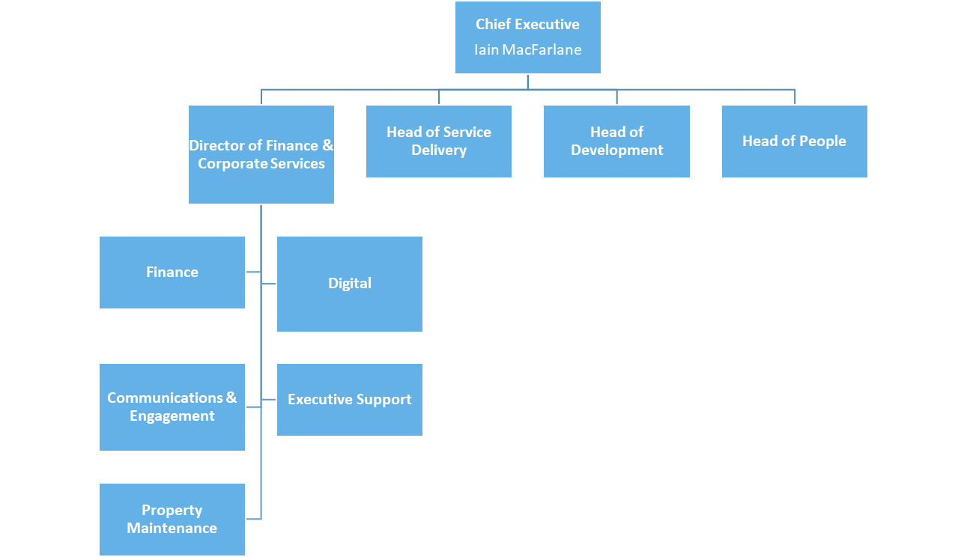
Our Structure
06

Slide 8
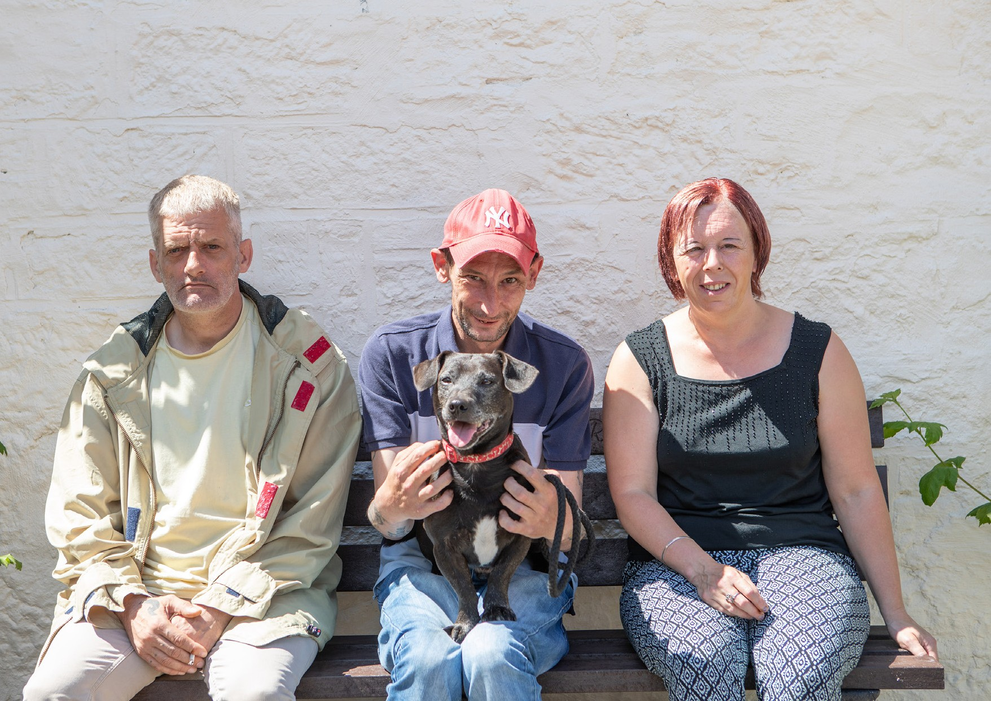

Slide 9
Temporary until August 2023 Project Worker Nights - 28 hrs per week
Viewpark
£22,476 - £23,642 pro rata
Blue Triangle has been operating at the intersection of Social Care and Social Justice in Scotland since 1974. We are unique as a national registered care provider, registered social landlord, and registered charity.
We are looking for an enthusiastic individual who shares our values (Kind, Passionate and Creative) to join our Viewpark service accommodating and supporting people experiencing homelessness and empowering them to thrive.
The successful candidate will be expected to provide a meaningful support service to identified individuals who live in the project and/or in the community. You will provide a quality service tailored to the assessed needs of each individual by identifying, planning and facilitating support to enable appropriate move-on options for each service user. You will use all of your knowledge and experience to help service users build their life skills and prepare for independent living.
PURPOSE OF THE JOB
Reporting to the Manager you will work as part of a team providing a safe, secure, supported accommodation unit for homeless people.
To provide a quality service compatible to the assessed needs of each individual.
To identify, plan and facilitate the process of securing appropriate move on accommodation options for each resident, including the security of tenure

Slide 10
The Role
Temporary Project Worker Nights – 28 hrs per week
The Role
1. The Project Worker will be employed by the Association to assist the Project Manager in providing a quality service to residents within the Project.
2. To ensure that minimum standards of health, safety and hygiene are both established and maintained in all communal areas, both internal and external to building. This includes the monitoring of regular cleaning duties and maintenance of grounds and the cleaning of void flats.
3. To maintain appropriate recording procedures for all issues relating to the operation of the unit, includes financial transactions, incident reports, building repairs, etc.
4. To regularly consult with unit residents on possible developments and/or changes in service delivery and devise and operate systems and structures which both promote models of good practice and encourage resident comment.
5. To ensure all residents are aware of their rights and responsibilities in being accommodated at the unit.
6. To liaise with any other professionals and agencies involved in provision of the support function to the residents.
7. To provide assistance with the residents' general financial management, including the registering of all benefit applications both personal and housing related
8. To undertake regular inspections of the building, facilitating the co-ordination of cyclical and remedial repairs. This may result in the undertaking of minor repairs and/or appropriate redecoration, together with giving access to and supervising the work of trade’s people as required.
9. To supervise residents' behaviour’ as part of the process of maintaining the safety and security of the accommodation, and preventing damage to the property.
10. To actively participate in the staff supervision process, meeting regularly and on a planned basis with your own supervisor.
11. To actively participate in the Association's Staff Appraisal system, including Agreement to undertake any identified training programme
12. To ensure that the building security, this may include shifts at night-time, is effectively managed through personal observation, general awareness and routine checks.

Slide 11
Person Specification Temporary Project Worker Nights – 28 hrs per week
Person Specification
CRITERIA ESSENTIAL
Qualifications / Education HNC/SVQ Level 3 Social Care
Knowledge Working with homeless people
Working with people who have been looked after and accommodated by local authorities Drug and alcohol awareness Homelessness legislation
Residential client group
Homelessness and its effects
Levels of vulnerability of client group
Experience Team Working
Working with vulnerable people
Working with addiction issues
Working with challenging behaviour
Key working
Skills / Abilities Effective written and verbal communication
Appropriate assertiveness
Ability to work under pressure
Ability to develop and sustain relationships
Ability to motivate people using process
Computer literacy
Personal Qualities Personal values consistent with social care
Flexible, adaptable and reliable
Friendly, calm and personable
Patient, resilient and tolerant
Sense of humour

Slide 12
