Slide 1
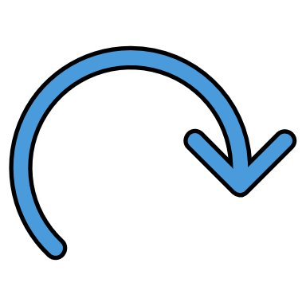
How to Create Recurring Events on Google Calendar
Designed by Laura Mintert

Slide 2
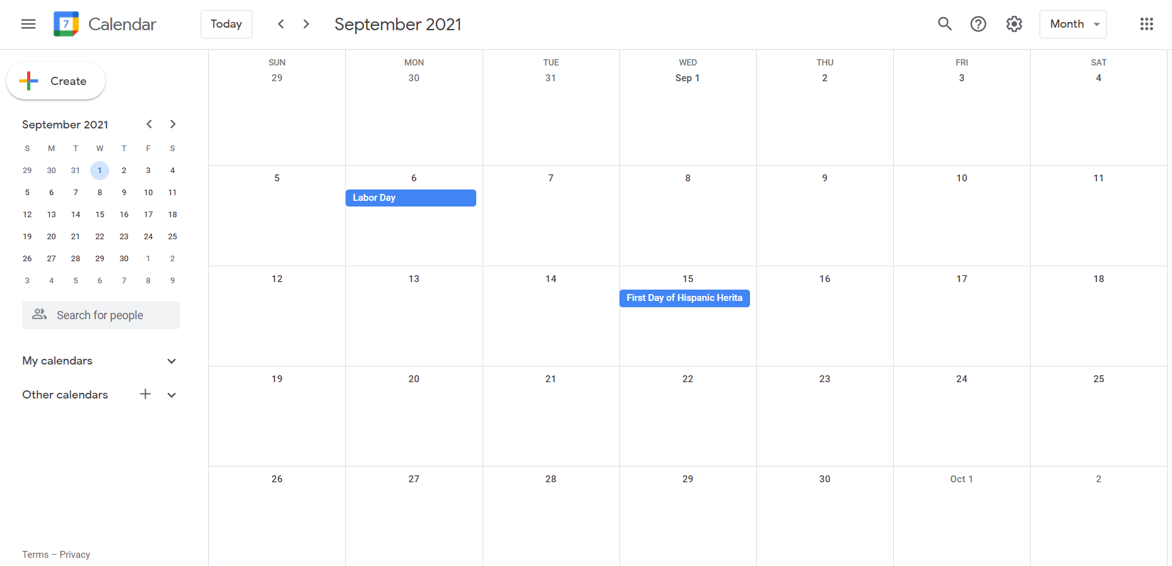
Click to create your event

Slide 3
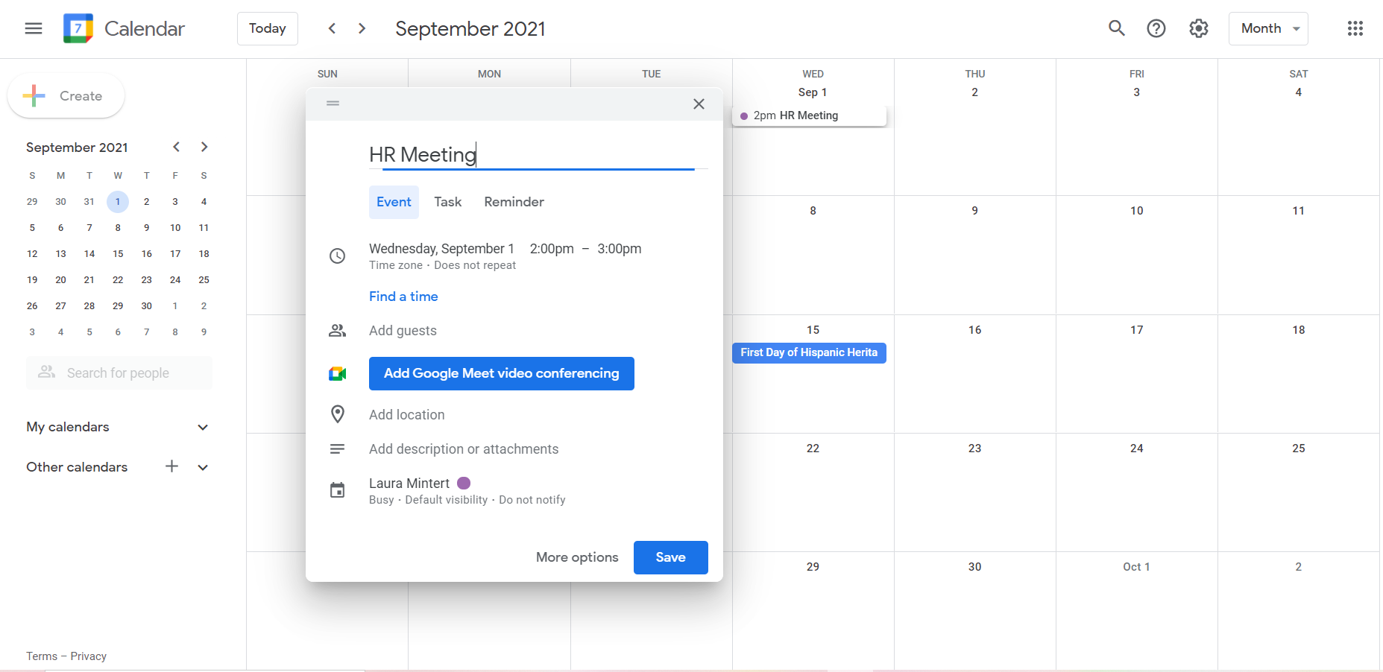
Title your event

Slide 4
Choose date and time

Slide 5
Click the drop-down carrot

Slide 6
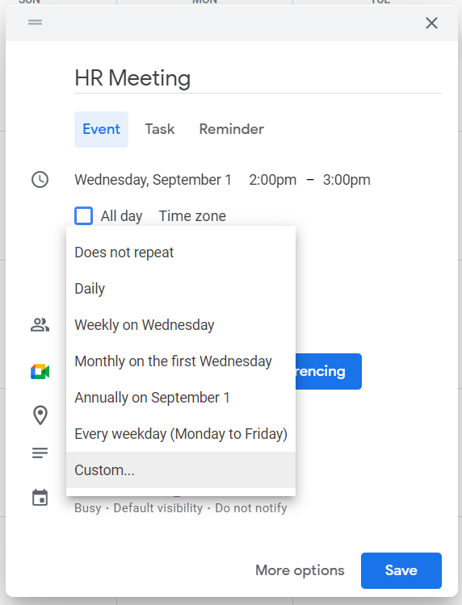
Choose event recurrence

Slide 7
If none fit, choose the custom recurrence menu

Slide 8
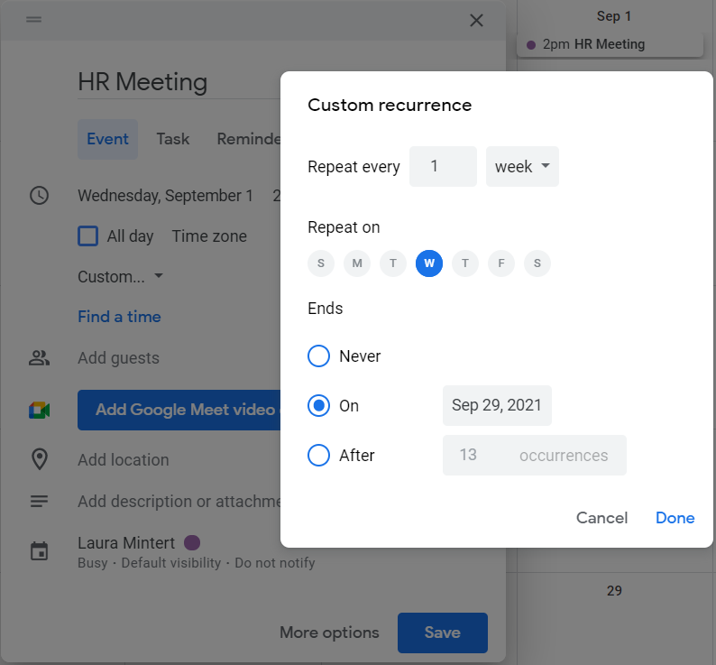

Slide 9
Choose how many weeks in between your event repeats

Slide 10
Choose the days your event repeats on

Slide 11
Select when your event will end

Slide 12
Your event will repeat with no ending date

Slide 13
Your event will end on a selected date

Slide 14
Your event will end after a custom number of occurrences

Slide 15
Click “Done” to save

Slide 16
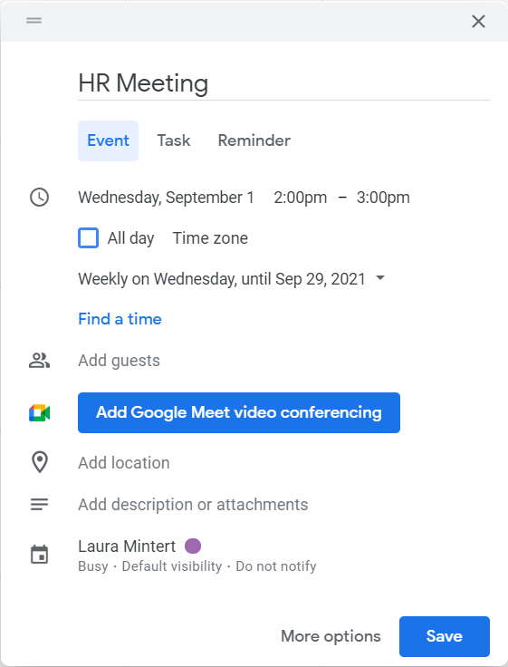
Finish editing your event

Slide 17
Add meeting attendees

Slide 18
If virtual, add a Google Meet link

Slide 19
Tell attendees where the event takes place

Slide 20
Insert attachments for the event, or any other important info

Slide 21
Choose which calendar your event belongs to and change notification settings

Slide 22
Once satisfied, click “Save”

Slide 23
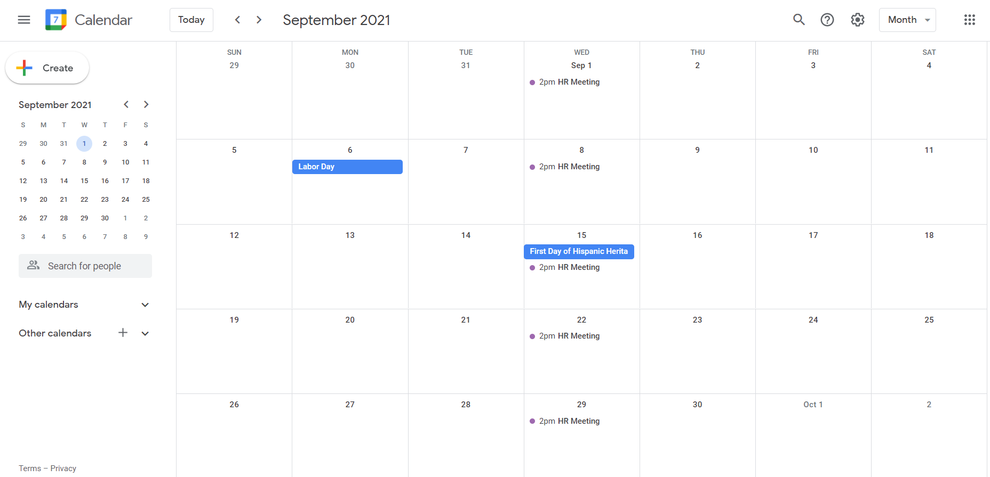

Slide 25
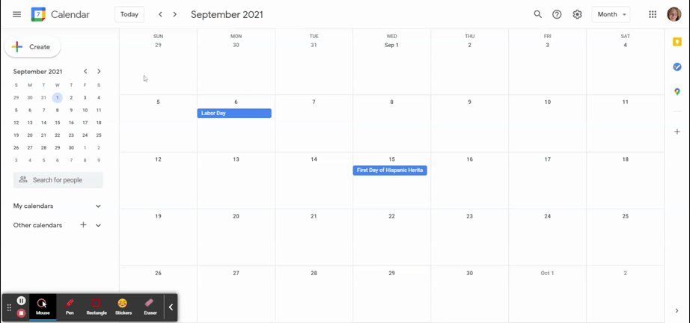
Review

