Slide 1
GLOBAL PEACE INITIATIVE
MAHARISHI VEDIC PANDITS FOR WORLD PEACE
GLOBAL PEACE INITIATIVE
Notes:
Just read the slide.

Slide 2
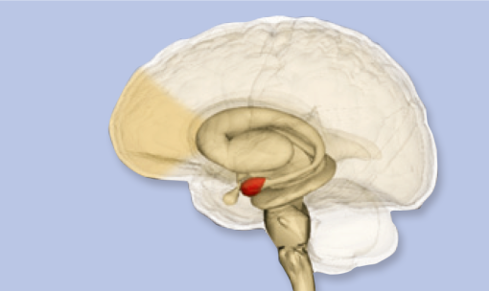
The TRANSCENDENTAL MEDITATION
technique reduces stress
and improves
brain functioning
Prefrontal
Cortex
Brain structure
Amygdala
GLOBAL PEACE INITIATIVE
Notes:
How we perceive and respond to the environment is governed by the brain:
• Whether a situation is seen as threatening or safe depends on the degree of excitation of the amygdala or “fear centre.”
• The ability to control impulsive, violent behaviour depends on the development of the prefrontal cortex – the “higher brain” – which governs higher executive functioning, such as impulse.

Slide 3
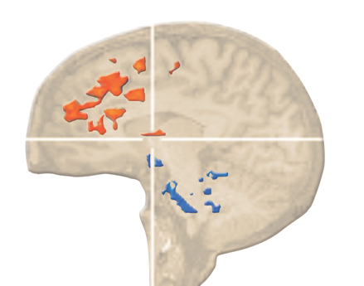
Improved brain functioning
Decreased amygdala activity
Increased prefrontal cortex activity
Transcendental Meditation practice deactivates the amygdala and surrounding sub cortical structures [blue] and stimulates activity in the prefrontal cortex [orange].
GLOBAL PEACE INITIATIVE
Notes:
fMRI: Restoration of balanced brain functioning. Chronic and/ or traumatic stress shuts down the prefrontal cortex or “higher brain” and causes chronic excitation of the amygdala “fear center”. TM practice deactivates the amygdala and surrounding subcortical structures (blue) and stimulates activity in the prefrontal cortex (orange) and through that, fosters higher moral behavior.

Slide 4
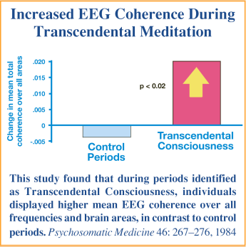
Brainwave coherence during the
Transcendental Meditation technique
– as seen in parallel with the
Unified Field of all the Laws of Nature
Increased EEG coherence during Transcendental Meditation
Changes in mean total
coherence over all areas
Control
periods
Transcendental
Consciousness
This study found that during periods identified
as Transcendental Consciousness, individuals displayed higher mean EEG coherence over all frequencies and brain areas, in contrast to control periods. Psychosomatic Medicine 46: 267–276,1984
GLOBAL PEACE INITIATIVE
Notes:
Brain researchers have found that during practice of the Transcendental Meditation (TM) technique, the brain becomes more coherent and integrated, and that this heightened efficiency of brain functioning grows over time through twice-daily practice – even outside of meditation – improving mental performance and overall health. The TM technique provides the individual with the experience of a unique, fourth major state of consciousness (distinct from waking, dreaming, or sleep states of consciousness) – a state of deep physiological relaxation and heightened mental alertness. Transcendental Meditation reduces stress and improves individual behaviour.
Modern physics has located more unified levels of nature’s functioning at smaller time and distance scales, culminating in the discovery of the unified field (“superstring field”) at the foundation of the universe. The Transcendental Meditation and more advanced TM-Sidhi programme provides direct experience of quieter, deeper levels of thought – culminating in the experience of the unified field at the basis of mind and matter. Group practice powerfully stimulates this universal, unified field of collective consciousness, creating a demonstrable, coherent influence throughout society.
Transcendental consciousness is the Unified Field of consciousness, which is a unified field of all the Laws of Nature. This Unified Field is unbounded awareness, because you experience only yourself without any other thought. When you contact this unified field on a regular basis, your daily life becomes infused with Transcendental Consciousness. Your life is then lived in accord with Natural Law, resulting in more energy and creativity. Your life begins to flourish on all levels. Problems start to disappear and you experience more happiness. Intelligence increases and memory improves. Your immune-system becomes stronger, giving better resistance to disease. You enjoy better and more harmonious relationships and life as a whole becomes more enjoyable.
Theoretical and empirical investigation reveals that the unified field is fundamentally a field of consciousness. The fundamental qualities of the unified field – intelligence, dynamism, and self-awareness (i.e. “self-referral” - the non-Abelian property of self-interaction) – are the defining characteristics of consciousness.
Extensive published research further demonstrates that human consciousness can directly access and experience the unified field in the most expanded state of human awareness, known as “pure consciousness.” This experience of the unified field – pure consciousness – constitutes a fourth major state of human consciousness, physiologically and subjectively distinct from waking, dreaming, and deep sleep. This experience is marked by the onset of global EEG coherence and increased alpha power, indicating maximum orderliness of brain functioning and utilisation of the total brain.

Slide 5
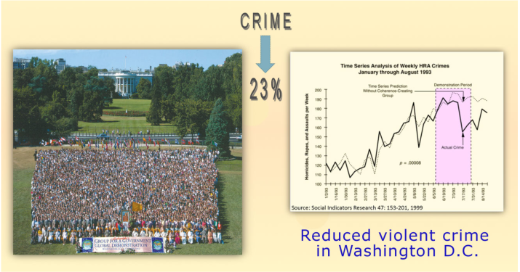
Group meditation reduces social stress
Demonstration project – Washington DC
Crime
23%
Reduced violent crime
in Washington DC
GLOBAL PEACE INITIATIVE
Notes:
More than 4,000 advanced meditation experts gathered in Washington, D.C., during the summer of 1993 to scientifically demonstrate the effect of the Brain-Based Approach to Peace on reducing violent crime in the U.S. capital city. Fulfilling predictions lodged in advance, crime decreased more than 23 per cent during the demonstration project (p < 10-8), according to research published in the peer-reviewed scientific journal, Social Indicators Research.
Or this:
In the summer of 1993, 4 000 individuals gathered in Washington, D.C., to see if practicing the Transcendental Meditation technique in groups for two months would affect the crime rate. Dr. John Hagelin, a quantum physicist, predicted that the crime rate would drop by at least 20%. The chief of police went on the evening news and said that it would take a snow blizzard in the middle of summer to accomplish that.
Yet, after two months, public records showed that the crime rate dropped 23%. Since most people’s paradigm about the nature of reality is based upon classical mechanics, this experimental result seems unlikely. However, from a quantum perspective, the Washington, D.C., study follows the same principles as the Meissner Effect and was described centuries ago in the Yoga Sutras – “In the vicinity of yoga, hostile tendencies are eliminated.”
In a time series analysis the percentual change of crime (murder, homicide, robbery and rape) was correlated to the size of the coherence creating group.
The maximal decrease was 23,3% in the last two weeks of the project; when compared to the expected increase for this period of time, the decrease was 30,4%.
The effect was increasing with the duration of the project and lasted for up to 8 weeks after the project.

Slide 6
MAHARISHI EFFECT
creating an invincible amour for the nation
NATIONAL ARMOR
The Maharishi Effect
creates an invincible border
that makes the nation
impenetrable to any harmful
influence from the outside
CULTURAL INTEGRITY
INTERNAL
COHERENCE
Scientific research shows that 1% of the population practicing Transcendental Meditation reduces crime rate, accidents, and hospital admissions and increases positive trends.
GLOBAL PEACE INITIATIVE
Notes:
An invincible border that makes the nation impenetrable to any harmful influence from the outside. The Maharishi Effect refers to the growth of harmony in society resulting from the practice of Maharishi’s Vedic Technology – the technology of Natural Law – by a small fraction of the population. When the influence of coherence generated by this technology reaches sufficient intensity, an integrated national consciousness is created. This in turn strengthens the cultural integrity of the nation by promoting life in accord with Natural Law. The result is the development of self-sufficiency and an invincible armor for the nation, which automatically repels any negative influence coming from outside. Thus, the integrated state of national consciousness created by the Maharishi Effect produces a ‘Meissner Effect’ for the nation, rendering it impenetrable to external disorder.

Slide 7
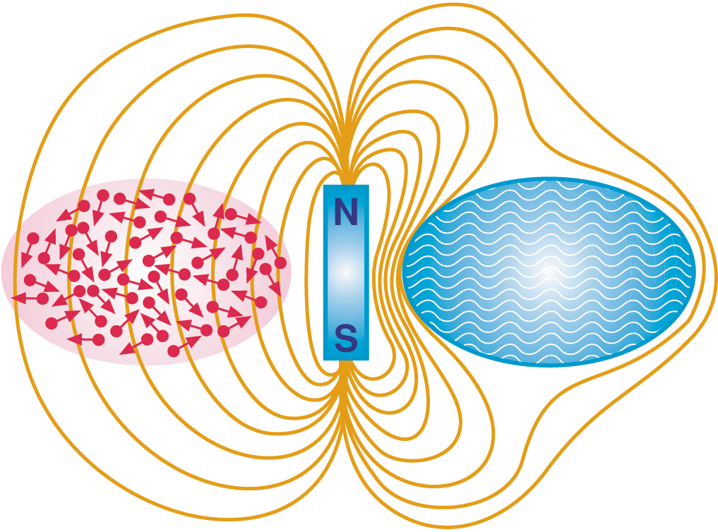
The Meissner Effect
An example of invincibility in the
Quantum Physics of Superconductivity
Ordinary
conductor
Super-
conductor
GLOBAL PEACE INITIATIVE
Notes:
ORDINARY CONDUCTOR In an ordinary electrical conductor, incoherent, disordered electrons allow penetration by an external magnetic field.
SUPERCONDUCTOR In a superconductor, coherent collective functioning of the electrons spontaneously excludes an external magnetic field and maintains its impenetrable status. This example of invincibility is not unique in Nature; parallel phenomena of invincibility can be found in many aspects of the physical and biological sciences. In each case, it is found that the ability of the system to resist disorder is always based on coherent collective functioning.

Slide 8
The Extended Maharishi Effect
and the Global Maharishi Effect
Several thousand peace-creating experts
can effectively reduce social stress for the whole world
GLOBAL PEACE INITIATIVE
Notes:
The Extended Maharishi Effect dicovered in 1978 is the square root of one percent of the population practicing the Transcendental Meditation and TM-Sidhi programme together in one place. This produces coherence in collective consioucness, promoting positive and progressive trends in society.
The square root of 1% of the global population is sufficient to reduce societal stress. Stress in the collective consciousness not only fuels terrorism and war, it also breeds crime, economic instability, and governmental incoherence. By reducing social stress, large groups of peace-creating experts have been shown to profoundly benefit society in each of these areas.
Research has shown that groups of individuals practising Yogic Flying – all enjoying significantly high brainwave coherence – create coherence in collective consciousness and generate a unifying and integrating effect in the life of society. This results in a decrease of negative trends throughout society – such as crime, accidents, and sickness – and an increase in positive social, economic, and political trends. Scientific studies on this phenomenon have demonstrated that a group of at least 9,000 individuals practising Yogic Flying can produce this coherence-creating effect on a global scale, reducing violent and negative trends worldwide.
The Transcendental Meditation-Sidhi programme (TM-Sidhi programme)
During the Transcendental Meditation technique, the active mind becomes settled like a lake with waves that have become completely smooth and silent. During the Transcendental Meditation-Sidhi programme, the settled mind begins to be active within itself – like creating tiny ripples on that smooth surface, which spread to reach the farthest shore. The Transcendental Meditation technique allows the active mind to settle down and experience its most silent level – Transcendental Consciousness. The TM-Sidhi programme trains the mind to function from this settled level of silence, making thought and action most powerful and most easily fulfilled. Scientific research has established that the TM-Sidhi programme cultures a profound integration of brain functioning (EEG coherence), promoting an optimal state of brain functioning that provides the basis for the unfoldment of an individual’s full creative intelligence.
Yogic Flying
The most powerful aspect of the TM-Sidhi programme is called Yogic Flying. During the first stage of Yogic Flying, the body lifts up and moves forward in short hops. Internally, the experience is accompanied by a feeling of exhilaration, lightness, and bubbling bliss.
During Yogic Flying research shows significant positive correlations between the abundance of alpha EEG coherence in four regions of the brain and the experience of Transcendental Consciousness. This coherence and integration of brain functioning is maximum at the moment the body lifts into the air.
When Yogic Flying is practiced in a group, this influence of coherent brain functioning creates a positive and harmonious influence in the environment, reducing negative tendencies and promoting positive, harmonious trends in all areas of society.
The Extended Maharishi Effect dicovered in 1978 is the square root of one percent of the population practicing the Transcendental Meditation and TM-Sidhi programme together in one place. This produces coherence in collective consioucness, promoting positive and progressive trends in society.
The square root of 1% of the global population is sufficient to reduce societal stress. Stress in the collective consciousness not only fuels terrorism and war, it also breeds crime, economic instability, and governmental incoherence. By reducing social stress, large groups of peace-creating experts have been shown to profoundly benefit society in each of these areas.
Research has shown that groups of individuals practising Yogic Flying – all enjoying significantly high brainwave coherence – create coherence in collective consciousness and generate a unifying and integrating effect in the life of society. This results in a decrease of negative trends throughout society – such as crime, accidents, and sickness – and an increase in positive social, economic, and political trends. Scientific studies on this phenomenon have demonstrated that a group of at least 9,000 individuals practising Yogic Flying can produce this coherence-creating effect on a global scale, reducing violent and negative trends worldwide.
The Transcendental Meditation-Sidhi programme (TM-Sidhi programme)
During the Transcendental Meditation technique, the active mind becomes settled like a lake with waves that have become completely smooth and silent. During the Transcendental Meditation-Sidhi programme, the settled mind begins to be active within itself – like creating tiny ripples on that smooth surface, which spread to reach the farthest shore. The Transcendental Meditation technique allows the active mind to settle down and experience its most silent level – Transcendental Consciousness. The TM-Sidhi programme trains the mind to function from this settled level of silence, making thought and action most powerful and most easily fulfilled. Scientific research has established that the TM-Sidhi programme cultures a profound integration of brain functioning (EEG coherence), promoting an optimal state of brain functioning that provides the basis for the unfoldment of an individual’s full creative intelligence.
Yogic Flying
The most powerful aspect of the TM-Sidhi programme is called Yogic Flying. During the first stage of Yogic Flying, the body lifts up and moves forward in short hops. Internally, the experience is accompanied by a feeling of exhilaration, lightness, and bubbling bliss.
During Yogic Flying research shows significant positive correlations between the abundance of alpha EEG coherence in four regions of the brain and the experience of Transcendental Consciousness. This coherence and integration of brain functioning is maximum at the moment the body lifts into the air.
When Yogic Flying is practiced in a group, this influence of coherent brain functioning creates a positive and harmonious influence in the environment, reducing negative tendencies and promoting positive, harmonious trends in all areas of society.

Slide 9
SCIENCE
Dr Hagelin
WHAT IS MAHARISHI YAGYA?
The full length plus short version of the Hagelin video 'What is Maharishi Yagya’
are hosted on Vimeo on private settings. You can watch both on the English material site.
Here is the link with an anchor:
https://material.vedicpandits.org/english-material/#PPT_Videos
Notes:
Click to add a note

Slide 10
The formula for World Peace
‘In the vicinity of Yoga
(unity – transcendental consciousness)
hostile tendencies are eliminated.’
– Maharishi Patanjali
GLOBAL PEACE INITIATIVE
Notes:
Since most people’s understanding of reality is based upon classical mechanics, these results seem unlikely. However, from a quantum perspective, the Washington, D.C., study follows the same principles as the Meissner Effect and was described long ago by Maharishi Patanjali in the Yoga Sutras: “In the vicinity of yoga, hostile tendencies are eliminated.”

Slide 11
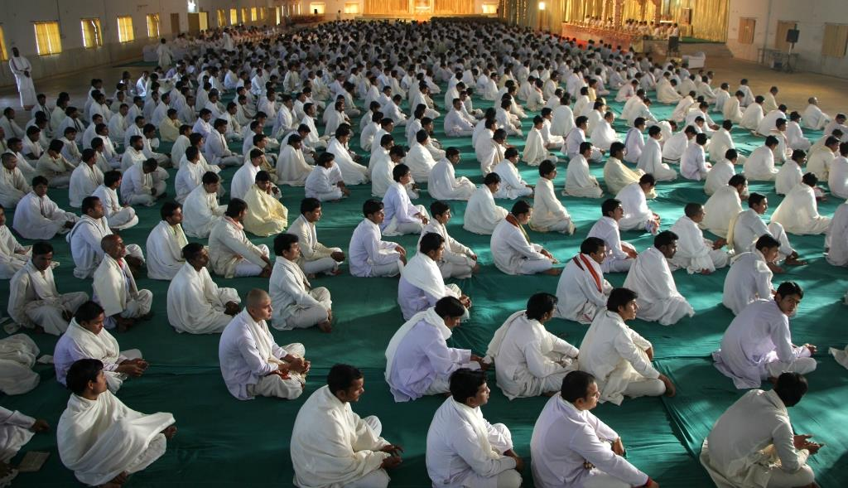
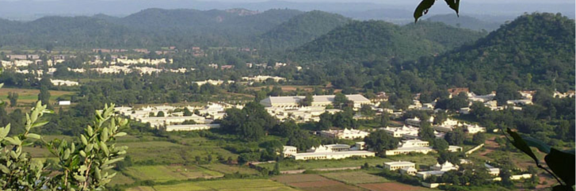
Maharishi Vedic Pandits
– a peace creating group in the centre point of India
GLOBAL PEACE INITIATIVE
Notes:
Veda is the totality of Natural Law, and it is the source of all branches of knowledge, of all sciences and cultural traditions.
Vedic knowledge is independent of time and can never be lost, because it has its holistic basis in the unmanifest transcendental field of life. Veda is that Total Knowledge which is the inner reality of everyone’s life.
Although this knowledge is now found in books, it is primarily an oral tradition, preserved throughout time by the Vedic families of India whose hereditary role was to be the custodians of this knowledge.
The Global Peace Initiative draws upon the ancient knowledge and technologies of the Vedic tradition, though lost to the world was preserved in certain regions of India and restored in its entirety by Maharishi. Vedic comes from the word Veda, which is the Sanskrit word for knowledge. The Vedas are known to be mankind’s oldest records of knowledge.
The Vedic tradition is, perhaps, the most ancient and respected source of knowledge about consciousness and the development of human potential.
Over thousands of years, the sages of this revered tradition researched the heights of human potential and cognised the means to make this potential a living reality for everyone.
The Vedic tradition holds that regular experience of Transcendental Consciousness – termed Samadhi in Vedic texts – fuels the growth of human potential to higher states of consciousness ultimately leading to enlightenment.
Furthermore, the Vedic texts state that the experience of this unified level of consciousness by groups of individuals has widespread benefits for society.
The Vedic tradition is primarily an oral tradition.
For millennia the Vedic wisdom was orally transmitted from father to son and from teacher to student within select groups of families, whose hereditary role it was to be the custodians of this knowledge.
The sons of these Vedic families are the Vedic Pandits who in ancient times would devote themselves from an early age to mastery of meditation and the recitation of the Vedas. Out of respect for this ancient tradition, the United Nations Education Scientific and Cultural Organization (UNESCO) named the oral recitation of the Veda and Vedic literature an “intangible heritage of humanity”.
Over the past 50 years, Maharishi Mahesh Yogi – considered one of the greatest scholars and teachers of the Veda and Vedic literature in recent history – restored this knowledge and its complete practice among its traditional custodians – Vedic Pandits.
Maharishi further developed a systematised curriculum for the training of Vedic peace-creating experts, which is unsurpassed anywhere in India for its quality of education. As a result, experts who have received their training under the system developed by Maharishi receive the title ‘Maharishi Vedic Pandits’. They receive a MA degree.

Slide 12
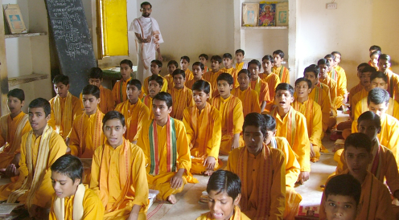
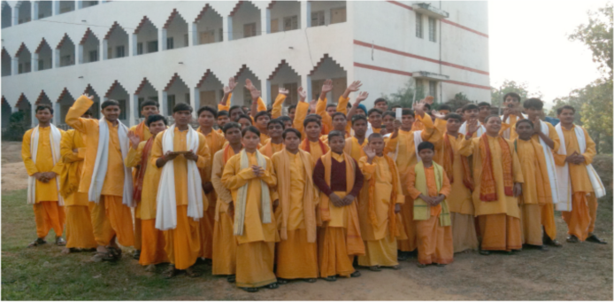
Reviving the Vedic Pandit tradition
through structured training programmes
________________________________________________________________
Pandits learning at a local school for 10-15-year-old Brahmin boys
Daily routine in the regional training centres
GLOBAL PEACE INITIATIVE

Slide 13
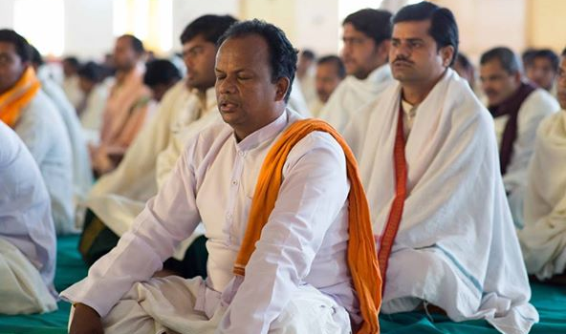
What are the Pandits doing?
YOGA
Technology of Consciousness – Transcendental Meditation and
TM-Sidhi Programme including Yogic Flying and…
YAGYA
The recitation of the traditional Vedic verses in groups
The preservation and implementation of the ancient Vedic life-supporting technologies that UNESCO (United Nations Education Scientific and Cultural Organisation) has officially described as an “intangible heritage of humanity”
GLOBAL PEACE INITIATIVE
Notes:
Yagya is a time-honoured Vedic technology for the prevention of problems and the promotion of success and good fortune.
Yagya involves the application of specific prescribed sounds extracted from the Vedas, through recitation on a fine level of awareness by trained Vedic experts to achieve a specific effect: for example, to eliminate obstacles or defuse impending dangers, or to promote health, financial success – even world peace.
The role of the actions performed by the Pandits
The actions performed physically by Maharishi Vedic Pandits during the Yagya recitations are like tiny seeds planted in the rich field set forth by their alert transcendental consciousness and perfect pronunciation of sound.
The specific actions are not important in themselves but correspond with the intention of each section of recitation. They are like a small sample symbol to bring to mind, to remind the Pandit of the exact ‘flavour’ of the much bigger, far-reaching intended transformational effect – the purpose or Sankalpa of the Yagya.
For example, the fullness and sweetness of a single fruit held and seen by the Pandit brings to mind the universal quality of fullness and sweetness.
The attention and intention are alive at each point – what you put your attention on grows!
Yagyas are like normal courtesies – ‘As you sow, so shall you reap’ is a common understanding of people everywhere. If we want to have the favour of the impulses of natural law that govern life at different levels, we offer our favour to them.

Slide 14
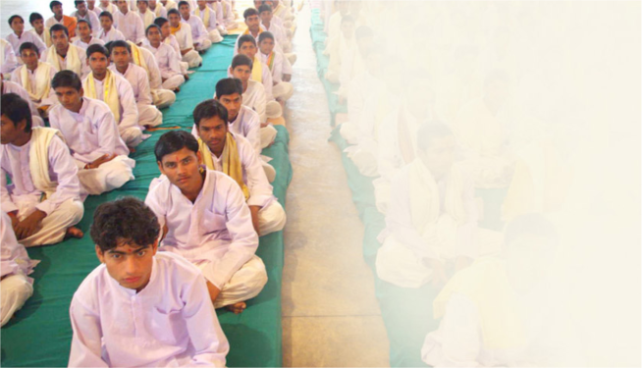
1987-1990 Maharishi trained and assembled
7,000 Vedic Pandits near New Delhi
Cessation of conflicts worldwide
Berlin Wall fell in 1989
End of Cold War - Ronald Reagan: ‘Another time, another era’, May 31, 1988 (when visiting Moscow)
Iran-Iraq war ends August 1988 (8 years)
Soviet war in Afghanistan ends 1989 (9 years)
GLOBAL PEACE INITIATIVE
Notes:
The Berlin Wall was a barrier constructed in 1961 by the German Democratic Republic (GDR, East Germany), that completely cut off West Berlin from surrounding East Germany and from East Berlin. It served to prevent the massive emigration and defection that marked Germany and the communist Eastern Bloc during the post-World War II period. On 9 November 1989 the East German government announced that all GDR citizens could visit West Germany and West Berlin. Crowds of East Germans crossed and climbed onto the wall, joined by West Germany on the other side in a celebratory and euphoric atmosphere.
The Cold War (1947 – 1991) was a sustained state of political and military tension between powers in the Western Bloc, dominated by the United States with NATO among its allies, and powers in the Eastern Bloc, dominated by the Soviet Union along with the Warsaw Pact. This began after the success of their temporary wartime alliance against Nazi Germany, leaving the USSR and the US as two superpowers with profound economic and political differences. It was named Cold War, as the two major powers never met in direct military combat. Cycles of relative calm would be followed by high tension, which could have led to world war. In the 1980s, pressures for national independence grew stronger in Eastern Europe. Eventually, in 1989, all the satellite states broke free from Moscow within weeks in a peaceful wave of revolutions.
Apartheid (from Afrikaans “the status of being apart”) was a system of racial segregation enforced through legislation by the National Party governments of South Africa (ruling from 1984 to 1994), under which the rights of the majority black inhabitants of South Africa were curtailed and white supremacy was maintained. In 1990 President Frederik Willem de Klerk began negotiations to end apartheid, culminating in multi-racial democratic elections in 1994, which were won by the African National Congress under Nelson Mandela. Although the end of Apartheid is widely regarded as arising from the 1994 democratic general elections, the official abolishment occurred in 1990.
Cessation of conflicts worldwide, e.g. (in addition to the ones already mentioned in the slide):
June 1988: spontaneous 100 000 strong mass night-singing demonstration in Estonia, giving name to the Singing Revolution (November 1988: Estonian Sovereignty Declaration) / August 1989: Two million indigenous people of Estonia, Latvia and Lithuania join hands to demand freedom and independence, forming an uninterrupted 600 km human chain called the Baltic Way
Vietnam withdraws its troops from the State of Cambodia in 1989, ending an 11-year occupation
December 1990: Jean-Bertrand Aristide is elected president of Haiti, ending 3 decades of military rule
In 1991: End of the Eritrean War of Independence (1961 – 1991)
November 1991: China and Vietnam restore diplomatic relations after a 13-year rift which followed 1979’s Sino-Vietnamese War
(source: Wikipedia.org)

Slide 15
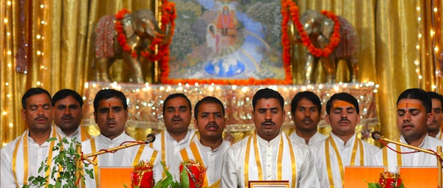
11-day
National Yagyas
for countries
1-day
Special Yagyas
for individuals
Increase good fortune
and help prevent problems
for an entire nation
Bring the blessings of Nature
to yourself, your family,
and the world
GLOBAL PEACE INITIATIVE
Notes:
The Maharishi National Yagya programme is a powerful application of the technology of Maharishi Yagya on a national scale to prevent problems and improve the fortune of an entire nation.
National Yagyas involve especially large groups of Maharishi Vedic Pandits located at the Brahmasthan (the geographic center) of India.
These National Yagyas continue over many days or even weeks, depending on the size of the desired effect and the magnitude of the problem being averted or defused – for example a natural disaster, violent outbreak, or severe economic downturn.
Every donation of the Global Monthly Donor Programme goes toward a National Yagya.
Larger total donations = more powerful National Yagyas
Experiences of donating to the Maharishi Vedic Pandits and National Yagyas:
“We have enjoyed greater success in our business and a real connectedness with Natural Law. This is another great gift and opportunity from Maharishi that we now consider to be an essential part of our business.” – D.G., Vero Beach, FL
“The National Yagya programme is changing my life. There is so much ease in activity now. God bless all the Maharishi Vedic Pandits. I am now a member of the Monthly Giving Circle. It is well worth every penny.” – M.E., Ojo Calliente, NM
“Whenever I donate to the Brahmananda Saraswati Foundation, I have the feeling of making an offering to the deepest value of my Self. This is my country, my world, my universe. Offering support to them immediately comes back to me on the finest feeling level and beyond.”
“She started to donate on June 2012. Then something happened very good to her. It was her dream to get her retirement pension from the government and also keep going to work in her current job. She told me that it happened very easily and quickly to get the salary from the government without losing her current job. She believes that she received a proper support from Nature because of her donation for Pandits.” Ambassador of Turkey
Like all Maharishi Yagyas, Special Yagyas are primarily a means of creating peace and prosperity for our world family. Additionally, they celebrate the donors who sponsor them, enlivening the blessings of Nature for them and their family in different areas of life.
Birthday, Wedding, Wedding Anniversary, and Newborn Child Yagyas are performed at key, transitional times when specific, supportive Laws of Nature are particularly lively and accessible.
Well-Being Yagyas can be sponsored at any time and can be performed as many times as you wish throughout the year, even monthly. When donating, you select your preferred date for the Well-Being Yagya.
These Special Yagyas can be sponsored on behalf of oneself, for family members, or for friends.
Every one of these important Yagya performances stirs life deeply—from the fundamental level of the unified field itself. In doing so, they not only uplift the individual, they also help dissolve disharmony and promote peace and progress throughout society.
Special Yagyas are designed to bring the greatest support possible from these Laws of Nature at the exact time when they are most lively.
The online ‘Sponsorship Request form’ is simple. It usually takes about 10 minutes to fill out. You will need your birth time and your birth city.
People are doing Special Yagyas for their mothers, fathers, and children. Some families are ordering Birthday Yagyas for everyone in a family at the same time. The following experiences are from a Special Yagya participant. “My body, emotions and daily activities seem more fluid and easier from the Yagya. Even the most challenging situations, whether personal or with work or family, seemed to sort themselves out effortlessly. This is life as it was meant to be.” M.H.
Sponsorship Amounts start at $1,000 for a Birthday Yagya.
Birthday, Well-Being and Newborn Child: $1,000 $2,500 $5,000 $10,000
Wedding and Wedding Anniversary: $1,500 $3,000 $6,000, $10,000
The number of Vedic Pandits performing each Special Yagya will increase in the higher donation levels, making them significantly more powerful.

Slide 16
RECITATION
Maharishi Vedic Pandits
https://vedicpandits.org/ganesh-recitation/
OR
https://vedicpandits.org/recitation-clips-for-newsletters/#ganesh

Slide 17
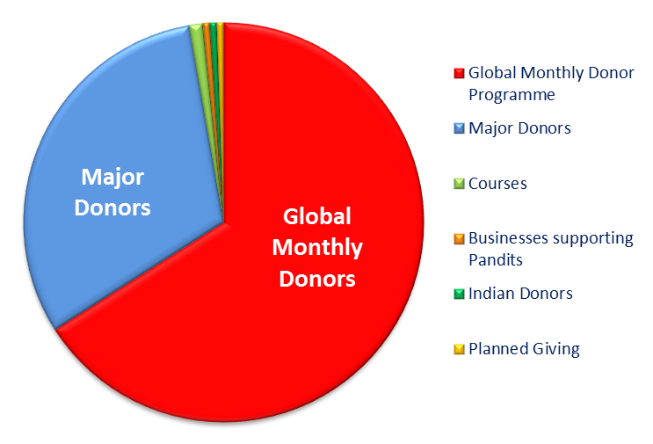
How can the goal be achieved?
Global Monthly Donors
Major Donors
Major
Donors
Courses
Global Monthly Donors
Businesses supporting Pandits
Indian donors
Planned giving
GLOBAL PEACE INITIATIVE
Notes:
Just read the different approaches
Major Donors: Donations from 15,000 $ up
Courses: Income from courses at the Brahmasthan of India
Businesses supporting Pandits through:
- Monthly donations
- Annual Dividends to Brahmananda Saraswati Foundation
- Grants of stock to Brahmananda Saraswati Foundation
Planned Giving: e.g. bequests and last will pension funds
If anyone has any questions about Planned Giving and Businesses supporting Pandits please refer to our website: https://vedicpandits.org/donate, use the contact us tab there and send an email to: vedicpandits@maharishi.net; or feel free to contact Dr. Larry Chroman at lchroman108@gmail.com.
Other ways to help support the Maharishi Vedic Pandits:
- Donations of items such as real estate, stocks, bonds, jewellery, valuable collections such as stamp or coins
- Gifts of life insurance policies and retirement accounts

Slide 18
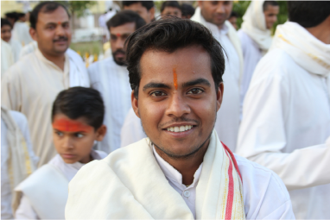
The Global Monthly Donor Programme
– an initiative of Brahmananda Saraswati Trust/BST (Holland)
Brahmananda Saraswati Foundation/BSF (USA) Both are non-profit organisations
Engages all the Governors, Sidhas and Meditators in a united campaign for world peace.
It allows everyone to participate on a regular basis
at whatever level is comfortable for them.
GLOBAL PEACE INITIATIVE
Notes:
Both organisation are non-profit organisations and donations are tax-deductible. Their mission is to provide funding for the training and support of the peace-creating experts in India and to establish a permanent endowment that will ensure their on-going support.
This includes overseeing a worldwide fundraising programme, receiving donations, and managing the investment of the endowment fund.
The Foundation directs and monitors all disbursements to its managing partners in India (Maharishi Veda Vigyan Vishwa Vidya Peeth [MVVVVP]) to ensure that the goals of the project are achieved.
Both organisations have the same executive management structure.

Slide 19
What are we creating?
Permanent World Peace from the fundamental level of consciousness
The implementation of the ancient oral Vedic life-supporting technologies
Ongoing training and stable livelihood of the Vedic Pandits
Restoration of the cultural integrity of many thousands of Indian families
Global unity – over 80 countries participating in mutually beneficial coherence-creating programmes
GLOBAL PEACE INITIATIVE

Slide 20
HOW TO FIND OUT MORE?
WEBSITES
Vedicpandits.org
Vedicpandits.org/special-yagya
Maharishiindiacourses.com
Materials.vedicpandits.org
Maharishivedaapp.com
Contact: Vedicpandits.org/contact
Email: aro@maharishi.net
GLOBAL PEACE INITIATIVE

Slide 21
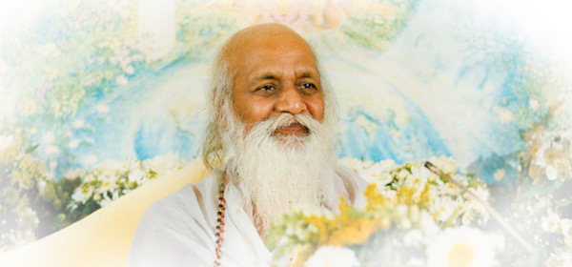
Jai Guru Dev
‘Yogic Flying and Yagyas are the only thing that will effectively uphold world consciousness on an eternal level of invincibility. I want to engage from now on as large numbers of Vedic Pandits as possible, but I have to be careful that once I engage them, the funds will be there to continue to support them. The only wise thing to do now, is to establish homes of Vedic knowledge because the Vedic vibrations of the performances of the Vedic Pandits have been established to motivate life according to Natural Law for the whole world and to usher in a new golden destiny of the human race.’ – Maharishi
GLOBAL PEACE INITIATIVE

Slide 22
THE END
(A few optional advanced slides follow)

Slide 23
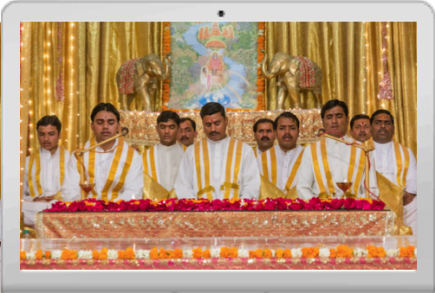
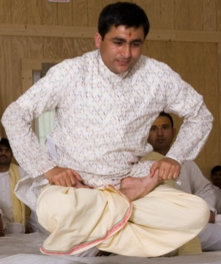
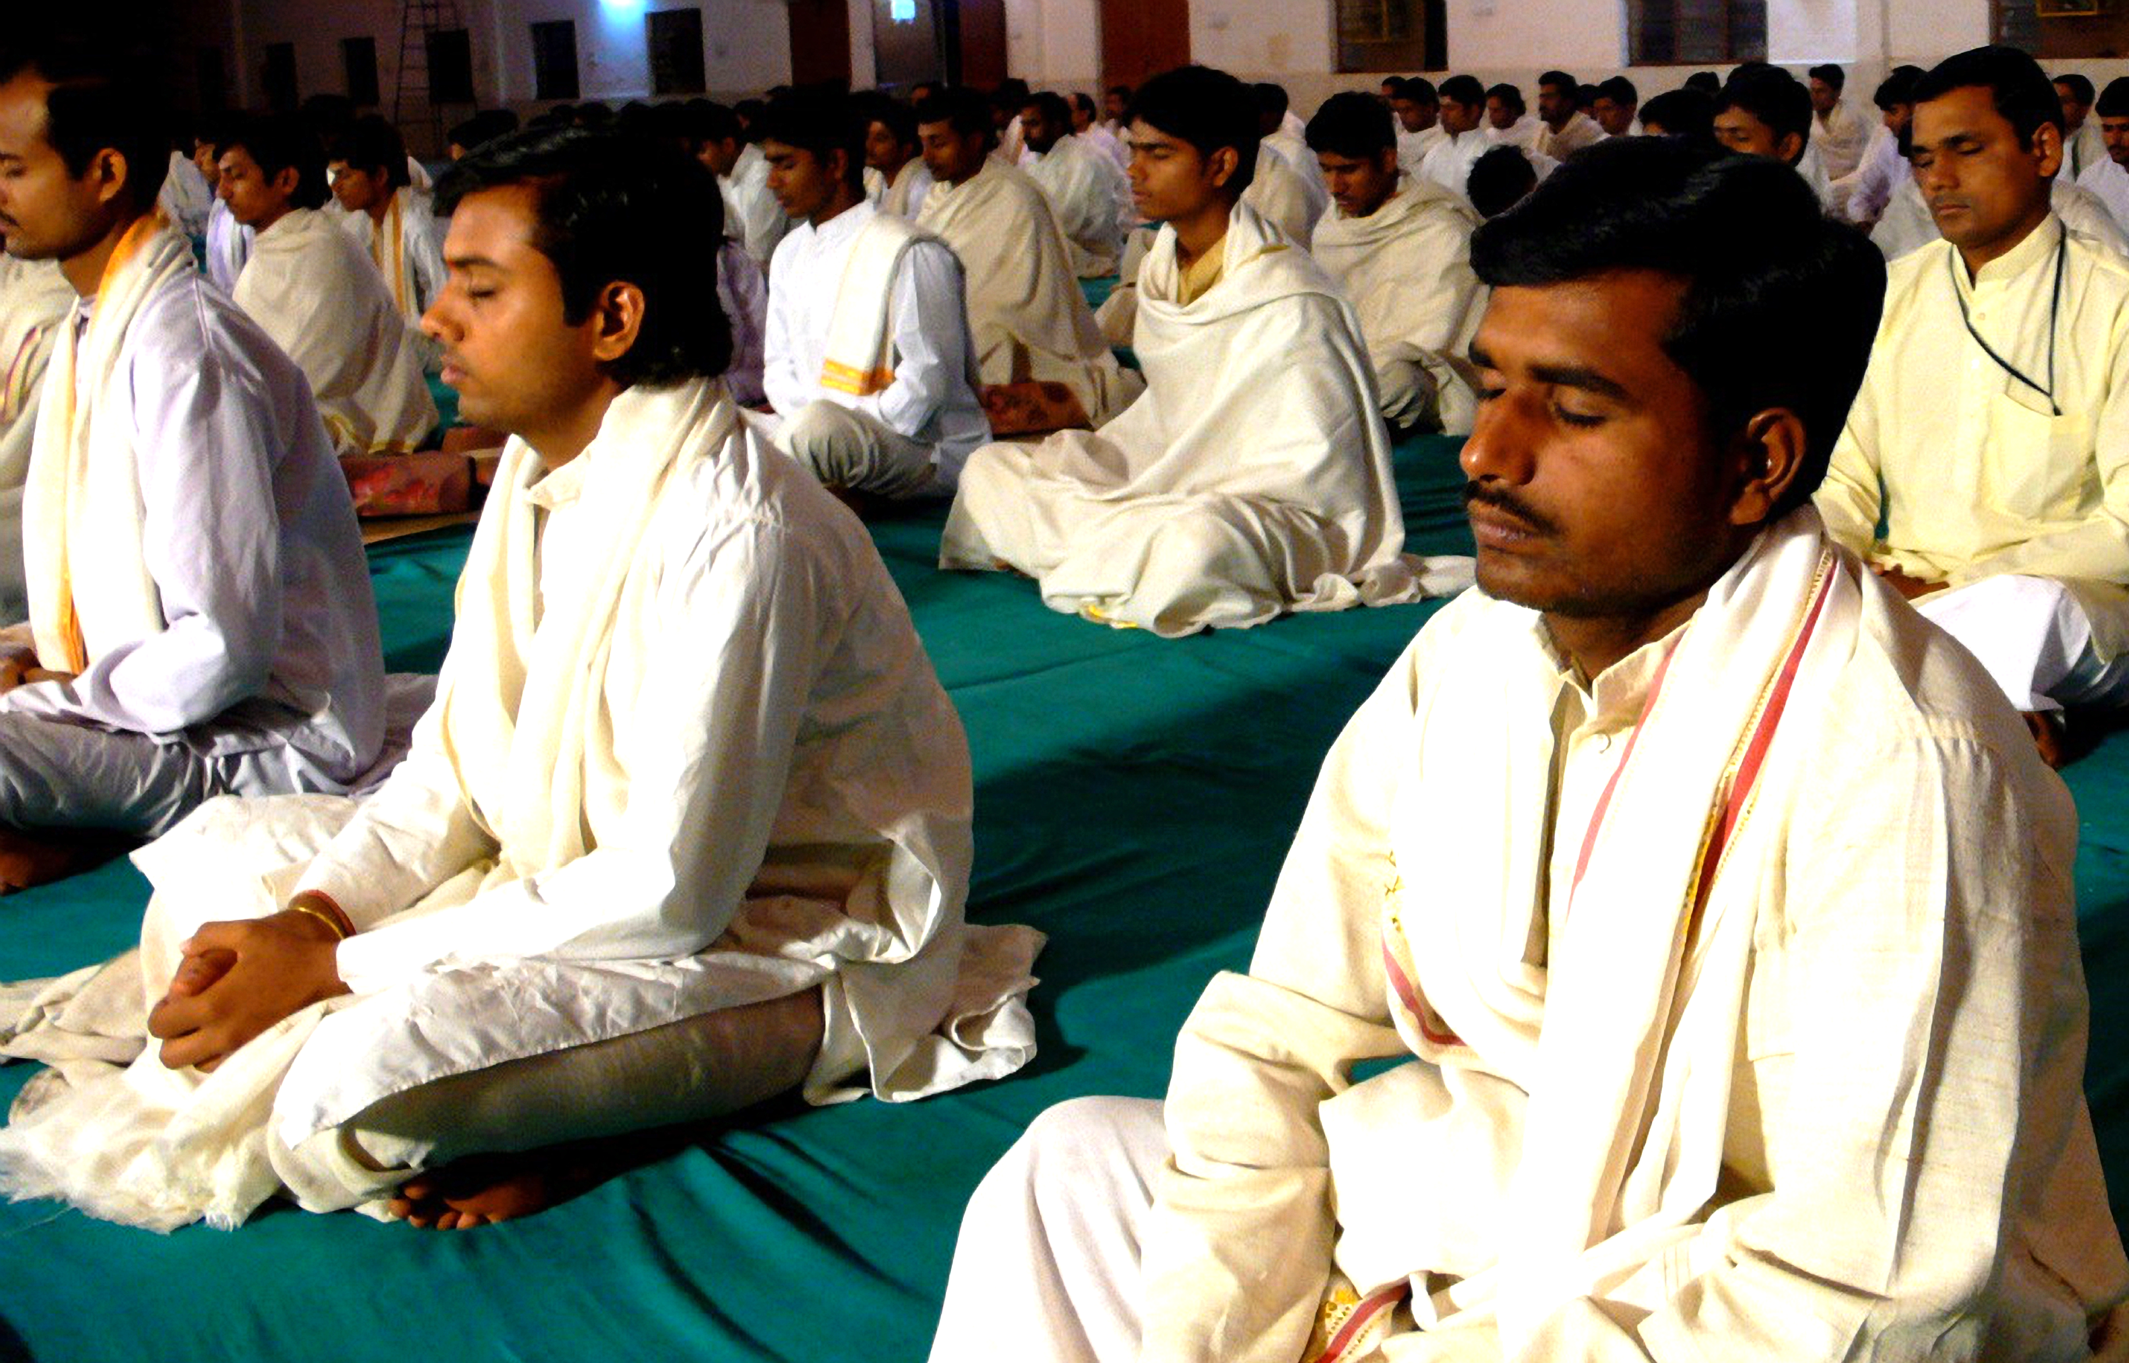
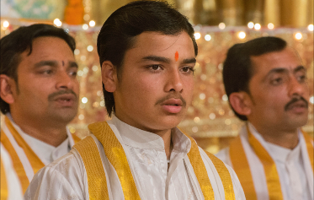
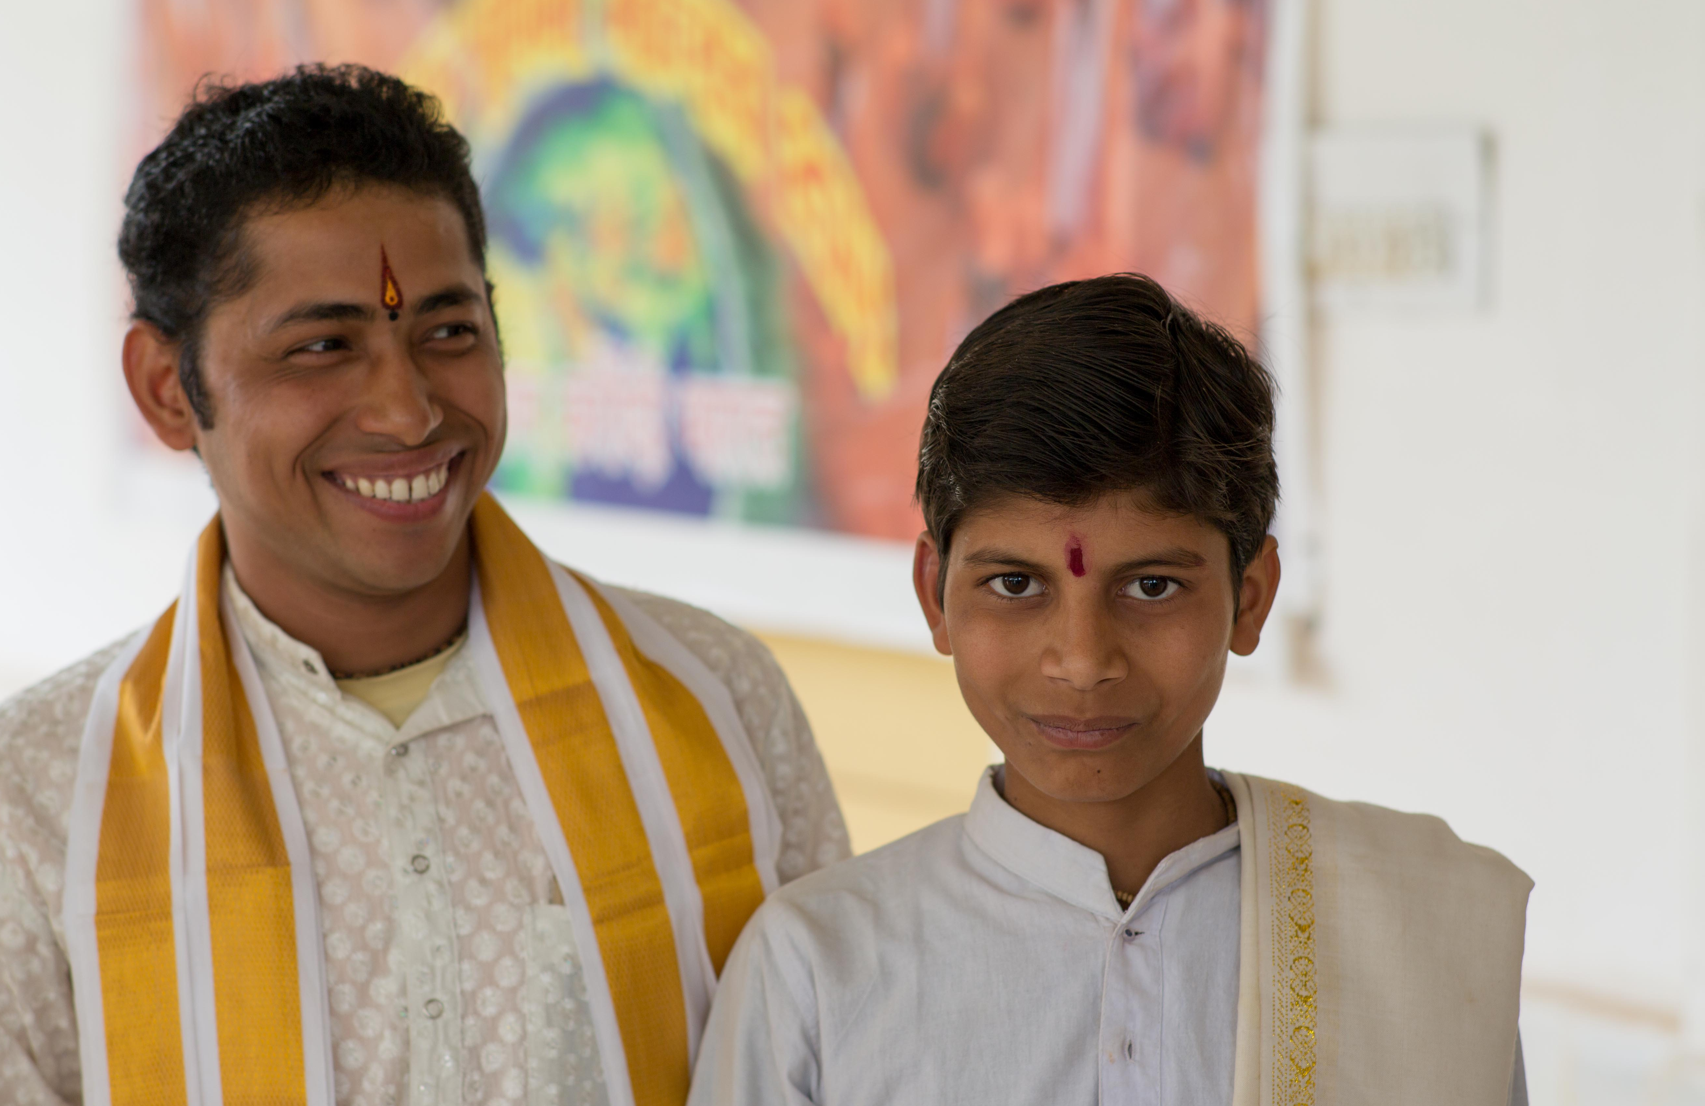
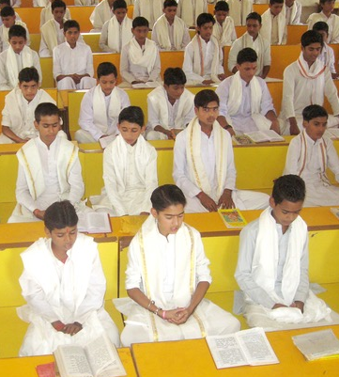
What is the only reason we have Maharishi Vedic Pandits…?
Here… there… and… everywhere… ?
Vedic events on channel
Brahmasthan & other campuses
Yoga/transcending in groups
National, Special, Other Yagyas
Generation to generation
Vedic Pandits in training
…is due to the support of regular monthly donors… 5,500 dear people from all over the world!
GLOBAL PEACE INITIATIVE
Notes:
Fortunately, we are pursuing many approaches to achieve this goal, including major donor support, associated course fees, donations from businesses, and planned giving. But by far the greatest support comes from thousands of individuals participating in the Global Monthly Donor Programme.
This monthly programme allows donors to give at whatever level is comfortable for them. It spreads the funding over many individuals so that we can all together support world peace without any stress or strain, ensuring that no-one person feels it is a burden.
Groups and individuals can also participate by supporting the Maharishi Vedic Pandits through National Yagyas for their countries and Special Yagyas for important events, such as birthdays and weddings. These valuable donations support the Pandits and ensure we move closer to our goal every day.

Slide 24
Why do the Maharishi Vedic Pandits have the following amenities…?
Here… there… and… everywhere… ?
• Vastu housing and basic needs
• Yagya halls and Mandaps
• Maintenance of infrastructure
• Gardens, recreation, education
• Kitchens and ideal meals
• Flying rooms and all facilities
…is due to the support of regular monthly donors… 5,500 dear people from all over the world!
GLOBAL PEACE INITIATIVE
Notes:
Fortunately, we are pursuing many approaches to achieve this goal, including major donor support, associated course fees, donations from businesses, and planned giving. But by far the greatest support comes from thousands of individuals participating in the Global Monthly Donor Programme.
This monthly programme allows donors to give at whatever level is comfortable for them. It spreads the funding over many individuals so that we can all together support world peace without any stress or strain, ensuring that no-one person feels it is a burden.
Groups and individuals can also participate by supporting the Maharishi Vedic Pandits through National Yagyas for their countries and Special Yagyas for important events, such as birthdays and weddings. These valuable donations support the Pandits and ensure we move closer to our goal every day.

Slide 25
A remarkably successful approach
The greatest support comes from thousands of individuals worldwide participating in the Global Monthly Donor Programme.
Donors give a modest comfortable absolutely regularly – any amount they would not miss!
Groups and individuals can also participate by supporting the Maharishi Vedic Pandits through National Yagyas for their countries and Special Yagyas for important events, such as birthdays and weddings. These valuable donations support the Pandits and ensure we move closer to our immediate goal of 9000 Maharishi Vedic Pandits.
GLOBAL PEACE INITIATIVE
Notes:
Fortunately, we are pursuing many approaches to achieve this goal, including major donor support, associated course fees, donations from businesses, and planned giving. But by far the greatest support comes from thousands of individuals participating in the Global Monthly Donor Programme.
This monthly programme allows donors to give at whatever level is comfortable for them. It spreads the funding over many individuals so that we can all together support world peace without any stress or strain, ensuring that no-one person feels it is a burden.
Groups and individuals can also participate by supporting the Maharishi Vedic Pandits through National Yagyas for their countries and Special Yagyas for important events, such as birthdays and weddings. These valuable donations support the Pandits and ensure we move closer to our goal every day.

Slide 26
Maharishi Vedic Pandits
– represented at MERU, Holland
for international events
Open Yagya Day – Invincible Europe Day – usually first Saturday of the month
in MERU Holland – attend in person or connect online – live recitation and knowledge
Apply at www.meruvlodrop.org
GLOBAL PEACE INITIATIVE
Notes:
Click to add a note

Slide 27
Spare blank slide with corporate ID
GLOBAL PEACE INITIATIVE

