Slide 1


Farm to Early Care
Provider Training

Slide 2
Outline
9:00-9:20am – Introductions
9:20-9:50am - What is Farm to Early Care and why does it matter?
9:50am - Bathroom break & leave for farmers market
11:00-11:30am – Farmers market recap
11:30-11:45am – CACFP Brief
11:45-12:30pm - Lunch and learn – Where to start?
Break
12:40-1:00pm – Example activity
1:00-1:30pm – Example cooking lesson
1:30-1:45pm - Resources
1:45-2:00pm – Wrap up
Notes:
Introductions (20 minutes)
Show of hands who is in the room – in-home child care / center / other
Introductions / ice breaker: Tell each other who you are, what kind of provider you are (in home or center), and tell the group about your favorite childhood food memory

Slide 3
Learning Objectives
Identify where and describe how to purchase local food for child care meals and snacks
Describe the benefits of purchasing local food as it relates to the health of children, families, communities, and local producers
Describe ways to incorporate local foods into healthy recipes for meals and snacks
Identify food safety procedures to follow when sourcing, serving, and preserving farm fresh foods.
Describe ways to engage children in learning about food, nutrition, and agriculture through activities and curriculum
Identify additional resources for supporting Farm to Early Care activities

Slide 4
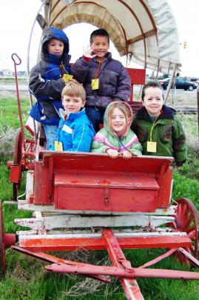
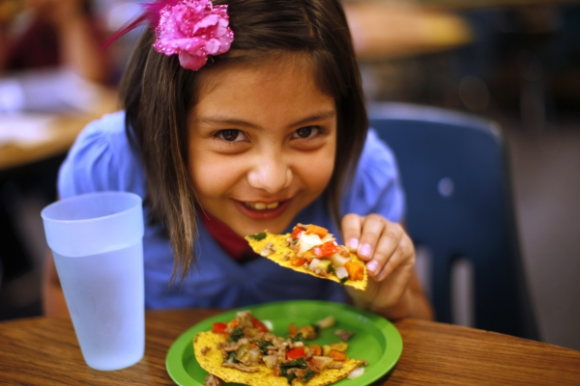
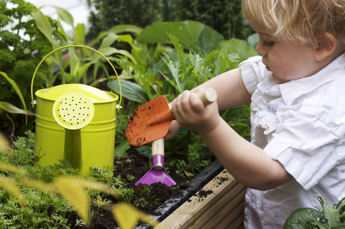
What is Farm to Early Care?
Farm to early care is a nationwide movement. It has the same tenets as Farm to School, focusing on young children (0-5):
Local food purchasing
Food and agriculture education
Gardening
.
Buy – Eat – Teach
Notes:
First: Child Care means more than just home and center based child care, but anywhere where early childhood care or education takes place – includes preschool and Head Start
Farm to Child Care is not a set program with specific activities to follow, but rather a collection of kinds of activities, which we will discuss.
Three parts of Farm to Child Care:
Using locally grown foods in meals and snacks
Local food themes included in curriculum and activities
- arts and crafts, stories, games, and activities that include nutrition, agriculture, gardening, environmental stewardship
Field trips to farmers markets and farms
From Farm to Preschool website:
Farm to Preschool is a natural expansion of the national farm to school model and encompasses a wide range of programs and activities. Farm to Preschool serves the full spectrum of child care delivery: preschools, Head Start, center-based, programs in K-12 school districts, nurseries and family home care facilities.
Its goals are multi-level and include: influencing the eating habits of young children while their preferences are forming; creating healthy lifestyles through good nutrition and experiential opportunities such as gardening; improving healthy food access at home and within the community; and ultimately influencing policies to address the childhood obesity epidemic through a local food lens. Program activities can take an environmental and systems change approach by serving preschoolers, teachers and child care providers, parents and family members, as well as communities.
Program components can include the following: sourcing local foods in school snacks and meals; promoting and increasing access to local foods for providers and families; offering nutrition and/or garden-based curricula; school gardening; in-class food preparation and taste testing; field trips to farms, farmers’ markets and community gardens; parent workshops; implementing preschool wellness policies which address Farm to Preschool principles; and influencing policies at the local, state or national level.

Slide 5
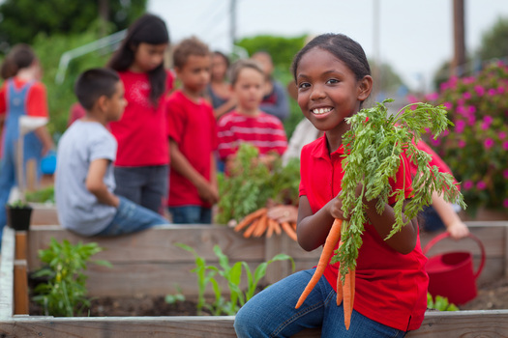
Why Farm to Early Care?
Lessons learned from Farm to School
Good for Children
Notes:
Children Benefit from healthier eating habits:
Eat more fruits and vegetables at school and home
Decrease in preference for and consumption of less healthy foods(like soda and chips)
Greater willingness to try new foods and healthier options
Ask their families to make healthier purchases at the grocery store
Increased knowledge and understanding of fruits and vegetables, healthy eating, gardening, agriculture/food system, the environment, the food system, and seasonality
Improved overall social skills, self-esteem, and classroom behavior
*Citation: National Farm to School Network. (Updated 2020). The Benefits of Farm to School. Retrieved from: http://www.farmtoschool.org/Resources/BenefitsFactSheet.pdf

Slide 6
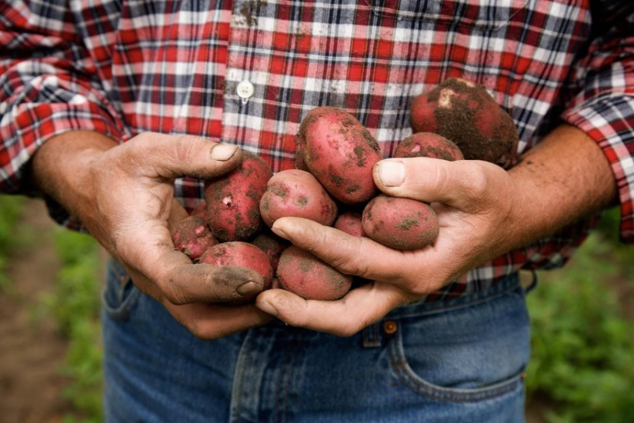
Why Farm to Early Care?
Good for Farmers
Notes:
Farmers benefit:
Opens new markets for farmers, ranchers, fishers, food processors and manufacturers
Opportunity to educate children on where their food comes from
Positive relationships with schools/daycares, children, and communities
New markets for farm products
Increased reliability of sales
Shortened supply chain => local control, transparency, and potential environmental benefits
Fact: According to the most recent USDA farm to school census, MN school districts invested $12.3 million in local food, spending an average of approximately 13% of their budgets on local products.
*Citations:
National Farm to School Network. (2020). The Benefits of Farm to School. Retrieved from: http://www.farmtoschool.org/Resources/BenefitsFactSheet.pdf
USDA. Farm to School Census: Minnesota. Retrieved from:https://farmtoschoolcensus.fns.usda.gov/find-your-school-district/minnesota

Slide 7
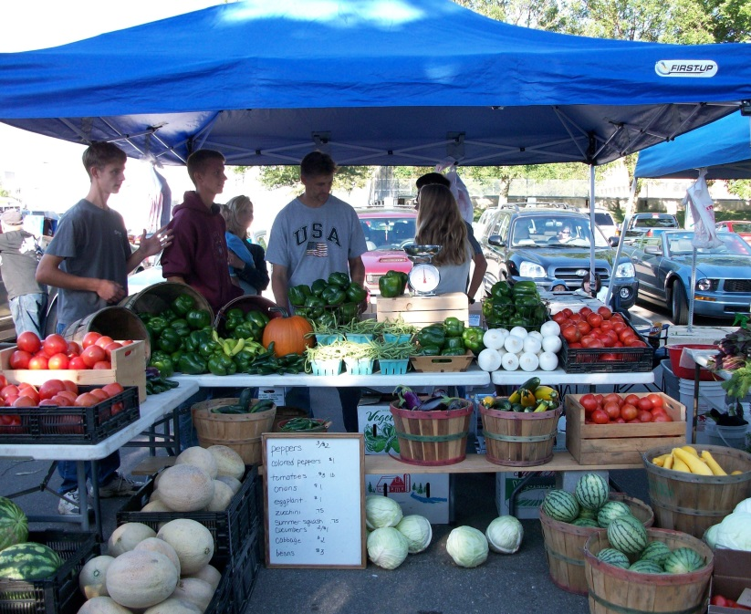
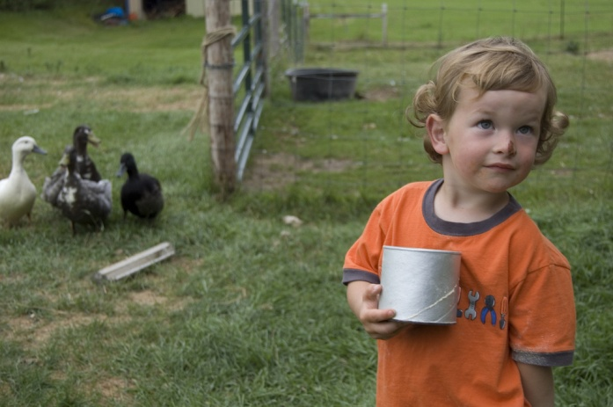
Why Farm to Early Care?
Good for Communities
Notes:
Schools benefit:
Increased student meal participation = increased revenue (average +9%)
Improved food service staff motivation and morale
Increased knowledge and interest in local food preparation, seasonal recipes
Strengthened relationships between food service staff and teachers
Positive changes in teacher’s diets, lifestyles, and attitudes about integrating farm to school related information into curriculum
Parents benefit:
Use more healthy foods in family meals and snacks
More confident in guiding children to make healthier choices
Develop better shopping habits with increased purchasing of healthy and local foods
Community-at-large benefits:
Increased community-wide awareness and interest in purchasing and supporting local foods
Increased economic activity
🡪 each $1 invested into F2S stimulates an additional
$2.16 of local economic activity via the multiplier effect
Strengthened state food economy
Improved household food security
Creation and maintenance of jobs
🡪 for every job created by school district purchasing of local foods, additional activity would create another 1.67 jobs in the community
*Citation: National Farm to School Network. (2020). The Benefits of Farm to School. Retrieved from: http://www.farmtoschool.org/Resources/BenefitsFactSheet.pdf

Slide 8
Why Farm to Early Care?
Perfect age
Improve ability to learn and grow
Experiential learning
Spend majority of time in daycare
More reliant on parents and caregivers
Year-round care
Notes:
Perfect age:
According to a study by Birch, L., children's food and taste preferences develop most rigorously between the ages of three and five, and these younger children are more willing to try new foods than older children, which presents an opportunity to introduce a wide variety of foods, textures, and flavors of healthy foods.
Attitudes towards foods that are shaped at this time in life are strong determinants of later eating behaviors;
Perfect window of opportunity for parents and caregivers to positively influence the development of food habits, preferences, attitudes, and beliefs that will last the entire life.
Preschoolers suffer from high rates of obesity and low consumption of fruits and vegetables;
Improve ability to learn:
Healthy diets among children can improve their ability to learn. Numerous studies demonstrate the link between nutrition and cognitive development in young children (Berkenkamp & Mader), so this is the critical time to provide the best fuel for growing bodies and minds.
Experiential learning:
Farm to Early Care programs also provide an opportunity for integrating experiential learning opportunities. They get to experience how food grows, how it looks, tastes, feels, sounds, and smells. Bringing the local food connection to life for children through activities and games can help reinforce the message by allowing children to take ownership of the concept of healthy eating and food values.
There is more flexibility with programming/curriculum in early care environments, so providers are generally able to test out these experiential learning opportunities
Majority of time in daycare:
Many preschoolers consume the majority of their daily nutrients in childcare. Farm to Early Care presents an opportunity to positively influence how children eat and how they understand and value food before they reach kindergarten.
More reliant on parents and caregivers:
More so than any other age group, they rely on parents and caregivers to create their food and activity environments
Don’t have much say in where, when, and what they eat – caregivers can capitalize on their responsibility to provide healthy and positive eating environments
Additional notes from “Got Dirt” and “Got Veggies”:
“Improve kids’ environments, which includes where they live, learn, and play. Putting in a garden at an early childhood site is certainly changing their environment, as is offering more fruits and vegetables with meals and snacks. When we change environments to support healthier eating and physical activity, we increase the likelihood that better choices can be made.”
“When youth tend their food from seed to harvest, they are more adventurous about eating fresh fruits and vegetables. In the garden, children eagerly snack on a wide range of homegrown treats—such as spring garlic, broccoli, cucumbers, cherry tomatoes, and kohlrabi. By teaching young people how to grow their own food, they are introduced to the ultimate local food system. These types of garden learning opportunities have the power to change the way that youth commonly experience food.”
*Sourced Cited:
1) Leann L. Birch, “Development of Food Preferences,” Annual Review of Nutrition, (July 1999): Vol. 19:41–62.
2) Berkenkamp, J. & Mader, L. (June 2012). "Farm to Childcare: Opportunities and Challenges for Connecting Young Children with Local Foods and Farmers." Institute for Agriculture and Trade Policy.

Slide 9
Let’s go to the
Farmers Market!

Slide 10
Farmers Market Recap
Group sharing – what did you find out?
Discussion:
  What is one fun activity you could do with kids at the farmers market?
  What is something you expected and did see at the farmers market?
  What is something that surprised you or you didn’t expect to encounter during the farmers market visit?
Notes:
Any other comments/questions about the farmers market?

Slide 11
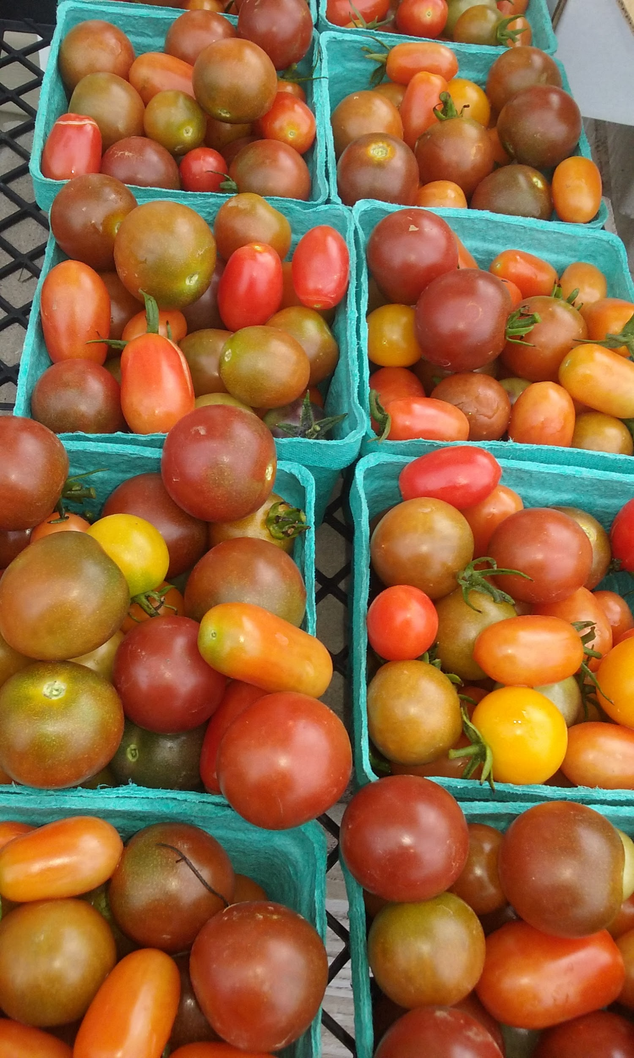
Child and Adult Care
Food Program
CACFP meal pattern requirements include a focus on:
  whole grains
  fruits and vegetables
  low-fat and non-fat diary
  lean protein foods
USDA provides guidance, training, and technical assistance on creating a healthy child care environment including physical activity and reducing screen time
  Water is available and accessible throughout the day
Notes:
Healthy, Hunger Free Kids Act
USDA to develop CACFP meals and snacks in child care settings updated meal pattern and nutrition standards for CACFP meals and snacks in child care settings that are consistent with the Dietary Guidelines, current relevant science, and recommendations from appropriate, authoritative agencies or organizations.
New meal pattern to encourages participating child care centers and family child care homes to offer healthier meals and snacks with an emphasis on increasing the consumption of whole grains, fruits and vegetables, and low-fat and non-fat diary and lean protein foods, and to provide opportunities for adequate physical activity
Farm to Early Care activities can be very helpful for meeting the new fruit and vegetable regulations.

Slide 12
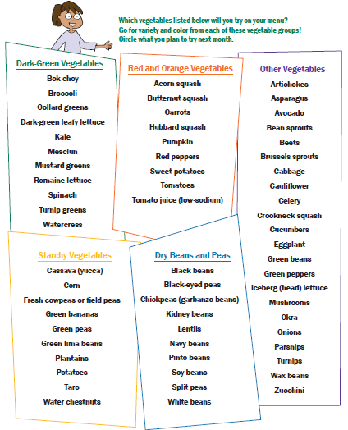
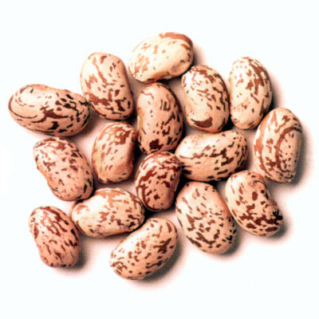
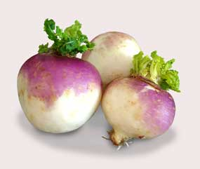
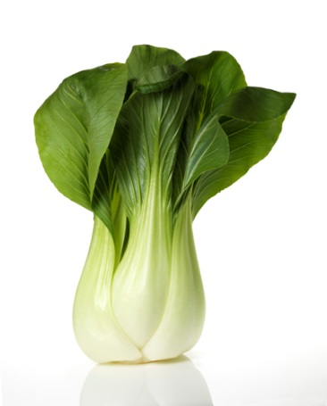
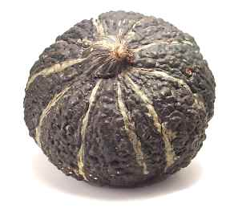
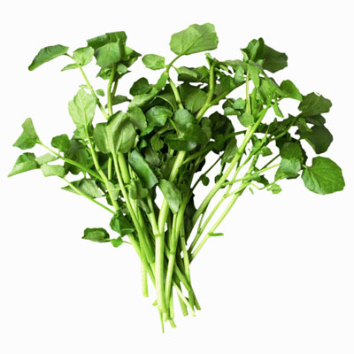
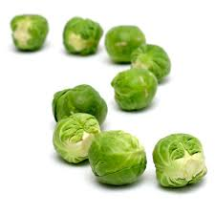
Vegetable Subgroups
Notes:
CACFP Best Practices recommends serving at least one serving per week of each of these 5 vegetable subgroups.
Look for zucchini – notice it is not listed in dark green. What seems to be the pattern of the dark green category?
Can the group ID the vegetables pictures?
Top left – Turnips (other category)
Middle left – Hubbard Squash (red/orange category – orange on the inside)
Bottom left – Watercress (dark green category) – in the mustard family (cruciferae) (radish is here too)
Top right – pinto beans (dry beans and peas category)
Middle right – bok choy (dark green category)
Bottom right – brussels sprouts (other category)

Slide 13
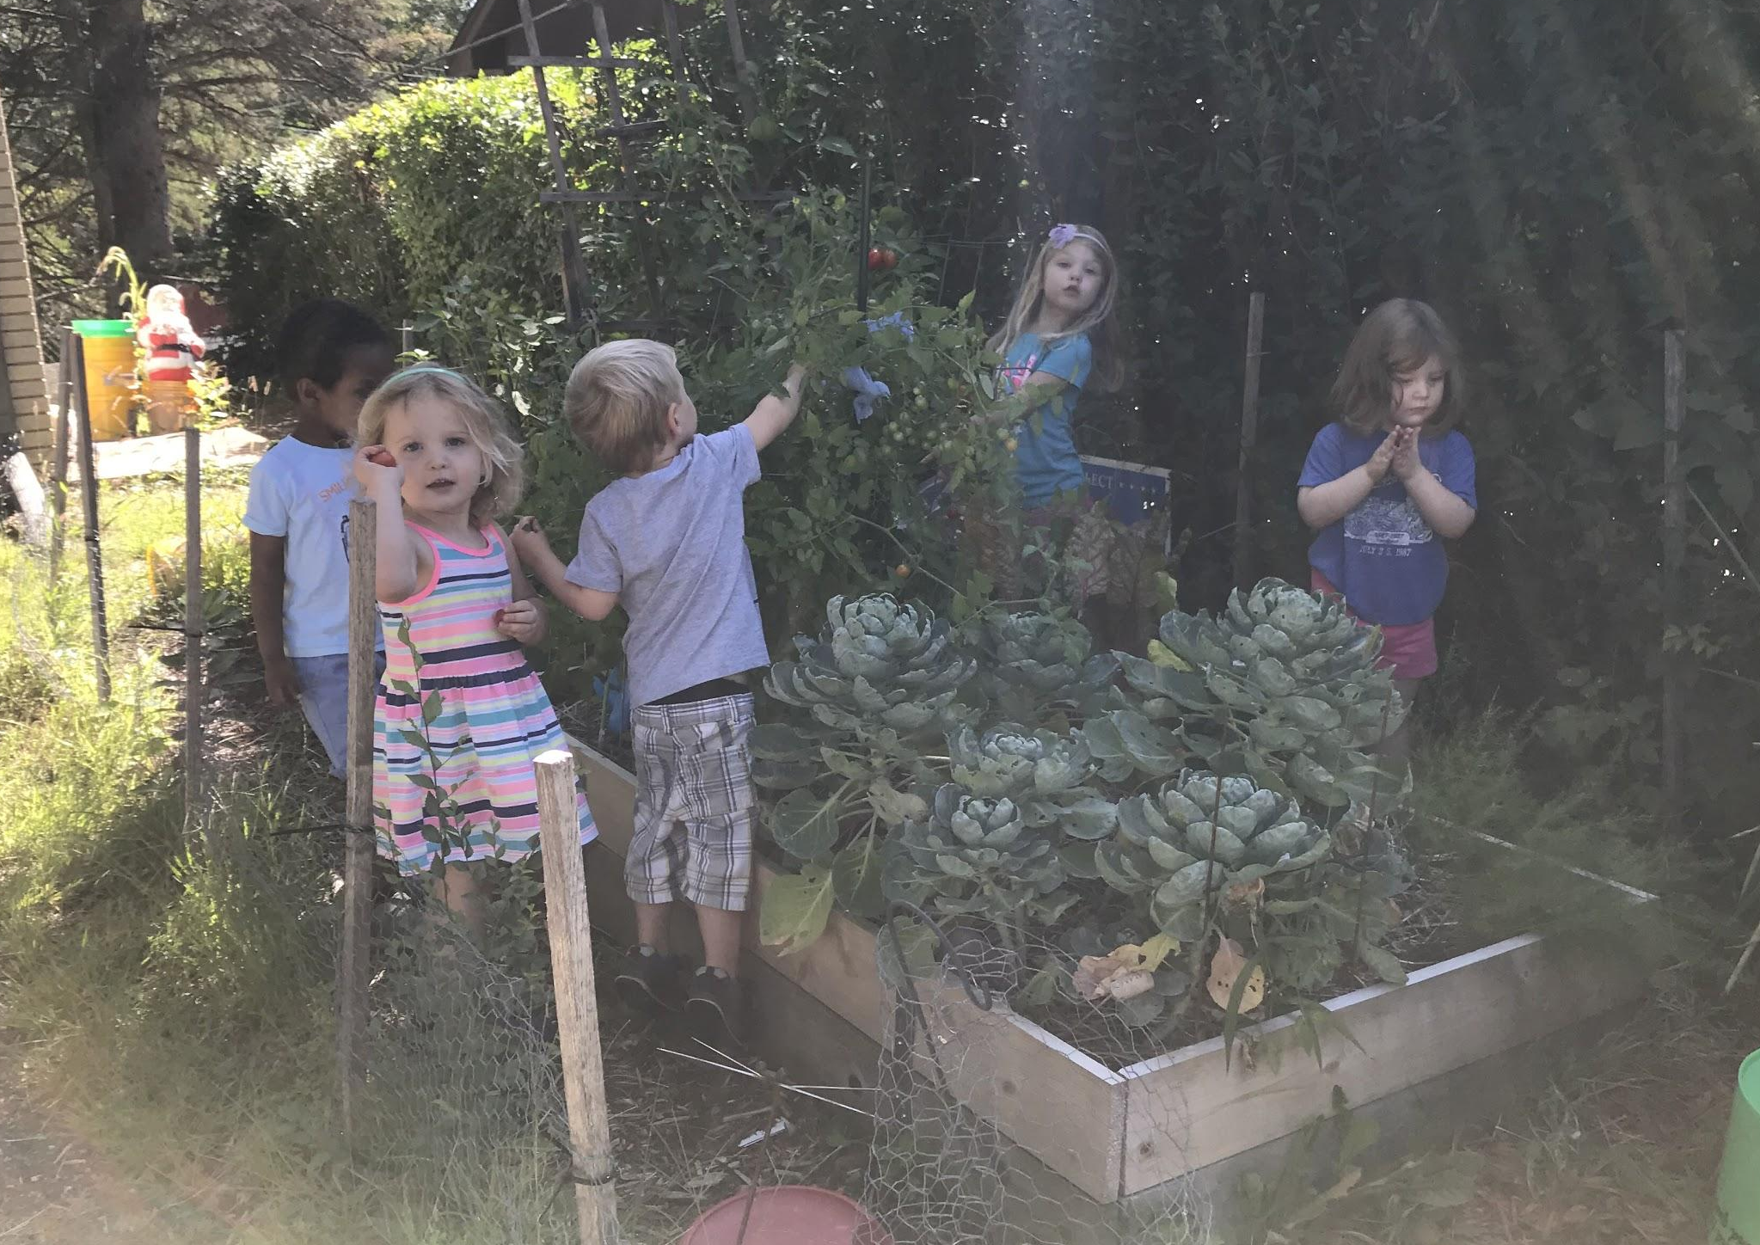
Main Components
Local food purchasing
Gardening
Food and Agricultural education

Slide 14
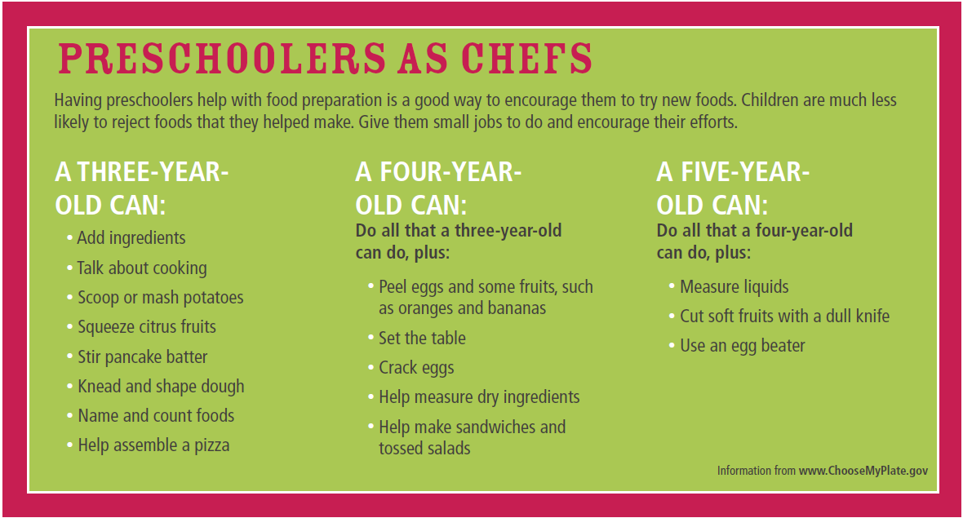
Kid Friendly Recipes
Let’s make some kid-friendly meals and snacks!
Notes:
Recipe demo: Opa! Veggie Pizzas! (INTRODUCE OTHER RECIPE IDEAS in FOLDERS)
Preparing recipes together:
- helps children develop fine motor skills
- practice taking turns
- using table manners
- handling food safely
- learning proper use of tools such as plastic knives, graters, and rolling pins
Can talk about FOOD SAFETY here - emphasize teaching kids food safety
- Hand washing - single most effective means of preventing the spread of bacteria and viruses which can cause infections and foodborne illness
- Vegetable and fruit washing
- Cross contamination
- Potentially hazardous foods
- Refrigerator storage order
- Left over food storage guidelines
- most meat: 3-4 days (gravy 1-2 days)
- general: 4-7 days (including day prepared)
- raw meat: 24 hours to cook, then 2 days
- Temperature danger zone (40-140)
- Meat cooking temps / thawing meat / egg shells
- Potential food safety hazards
- Diarrhea diapers
- Pets
- Toys
- Sick kids/staff

Slide 15
Incorporate Local Foods into Meals and Snacks
Where can I buy local foods for my childcare program?
Farmers markets
Roadside stands
Local farms (U-pick or farm stores)
CSA shares
Local grocery store or co-op
Child care garden (grow your own!)
MN Grown directory
Notes:
CSAs – many people find CSA membership to be a great way to learn about and try new fruits and vegetables. Because each box is unique and full of surprises, it challenges members to be creative with new recipes! Many CSA farms offer recipes and tips for how to prepare each week’s box of produce, especially the produce that might be new to their members. Think how exciting the “box opening” will be for your child care kids! This method also creates financial stability for the farmer – paying up front creates a nice cushion of support for the season.
General advice= Start small
E.g., fruit. Whole fruit requires no extra processing, is easily added as a side dish or healthy dessert without having to change the main menu
First step= Review menus/regulations
Review center menus, find out what they serve and how, where do they make their purchases, who is their main supplier (may vary much from rural to urban, large to small). Identify the lowest hanging fruit. If you live in OR or WA, you may want to start with pears or apples since we grow so many here
Shortlist of Seasonal Swap Out Options. Pick a handful of items you’re regularly buying and have a local farmer or distributor identify which are regionally available. Swap those handful of items for locally-grown goods while they’re in season. Start with a focused and manageable short list of produce.
Highlight One Component of the Menu. Choose one component of your menu to feature local produce. For instance, you can create a Seasonal Salad Bar, Local Fruit Bar, or Local Lunch of the Week.
Decide on a model that fits best, and that will guide next steps:
Centers/preschools - Meet with your distributor If they use a large distributor, find out what they may already be purchasing locally and what may be available, many distributors may already have a local preferencing option
Engage Your Distributor. Tell your distributor of your interest in purchasing local and regional food. Ask them to label local items and ask them to expand these options. They may be very happy to accommodate your request. In addition, you may be surprised to find that your school already purchases some local products.
Identify and visit nearby distributors, farms, or food processors (“adult field trips”) – go to NEXT SLIDE
closest to the centers you work with. Organize field trips to visit the sites and build relationships. [May also be able to visit these in the future for field trips with the kids.]
Commit To Communicate with Farmers. May not be used to the conventions.
Communicate your expectations to the farmer who can then consider adjusting their practices if you demonstrate committment (e.g., varied sizes, overripe, cleaner).
Be Flexible. This is Different. While communicating your essential expectations is recommended, it is also important to consider which conventions you can live without.
(For instance, while you may be used to having all your peaches the same exact size, is that really necessary for all your recipes?)
Remaining flexible with sizing and coloring can be a huge help to working with local farmers.
Potential Challenge 🡪Too much $$
Set Financial Guidelines. Consider setting a maximum dollar or cost per serving amount, or approve the cost for a short-list of items. Rough estimate for a basket of items is 20% increase. Spending more on local food is about investing in a healthier, more sustainable, equitable & better tasting food system.
Remember that buying at the height of the season reduces the cost, so you’ll want to make sure menu is aligned with local seasonality.
START SMALL: can literally choose one item to highlight one day/month

Slide 16
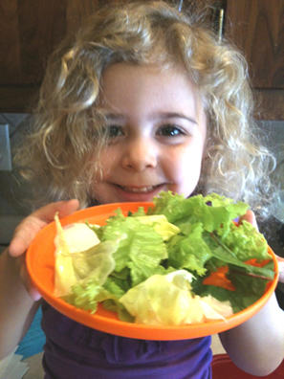
Incorporate Local Foods into Meals and Snacks
Introducing new foods:
Create a positive environment
Cater to their preferences
Role model
Start with small portions
Help, don’t hinder phrases
Keep offering new foods
Remember the division of responsibility
Notes:
Introducing new foods to children, dealing with picky eaters:
Positive environment – don’t make eating a chore, and avoid rewarding good behavior or a clean plate with foods of any kind. Especially avoid forcing a child to finish the “healthy foods” to get to their dessert or sweets – this can make the healthy food seem like punishment and force the child to eat when they are full
Cater to their preferences – serve the new food with something that is already familiar to them, and they already like. Prepare new foods similarly to dishes they already like (use same spice/flavor profiles)
Role model – eat the same meal/snack as the children, and avoid eating unhealthy foods/beverages around them. They will be much more likely to eat the healthy options if you do as well.
Two bite club - create a routine that everyone should try and taste new foods offered at your center. It’s the rule at your table. However, do not force them to finish more than they want. Make sure they take two bites to make sure they don’t like it (think of orange juice after brushing your teeth)
Start with small portions - put a very small portion on the plate to try (like two peas). Young children may be concerned that they won’t like the new food, so help them by putting a small amount on their plates – it looks less overwhelming
Keep offering new foods - it can take 5-15 tries for a child to accept a new food.
Ellyn Satter’s Division of responsibilities between providers and kids:
Providers decide when, where, and what kids eat. Kids decide how much and whether
Parent/caregiver’s feeding jobs:
Choose and prepare the food
Provide regular meals and snacks
Make eating times pleasant
Show children what they have to learn about food and mealtime behavior
Be considerate of children’s food inexperience without catering to likes and dislikes
Let children grow up to get bodies that are right for them
Children's eating jobs:
Children will eat
They will eat the amount they need
They will learn to eat the food their parents eat
They will grow predictably
They will learn to behave well at mealtime

Slide 17
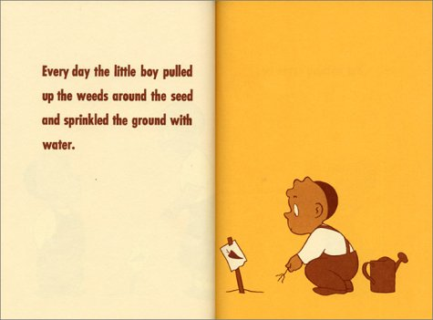
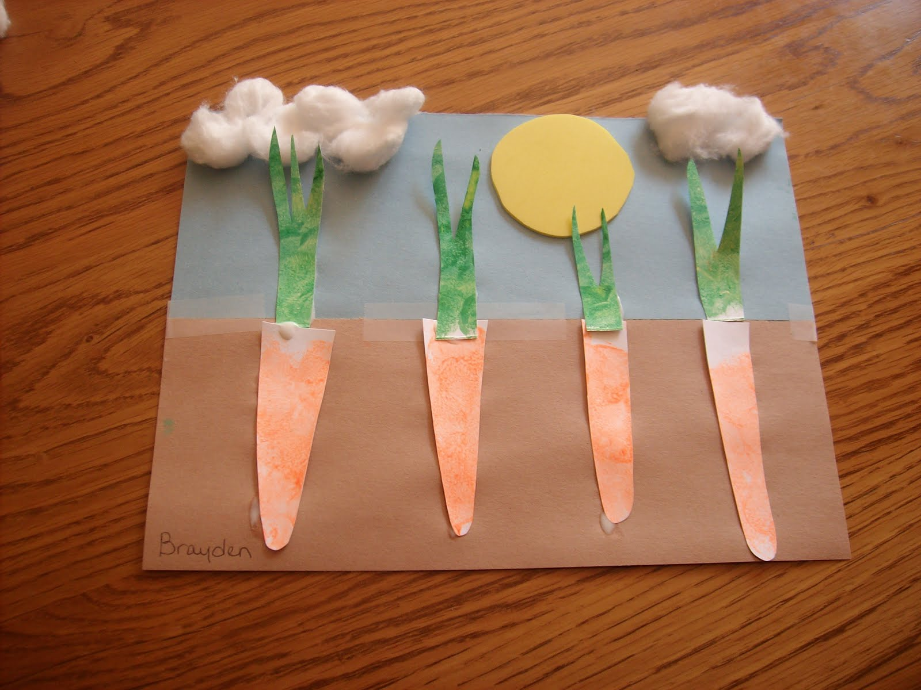
Food and Agricultural Education
Incorporate local food themes into child care curriculum and activities
Notes:
This is key – providing activities that focus on nutrition, gardening, and agriculture themes creates buy-in through fun games and activities. Kids are much more likely to want to try something if they have participated in some sort of activity that involves that new food.
Try offering the new food outside the meal time – let them touch, smell, and see them inside and out before asking kids to taste them. You can make it a classroom lesson (describe how they look and feel) and then have children who are interested in trying the new food take a taste and share their perceptions. This method creates a desirability to try the new food, and puts less pressure on the children to try something completely foreign at meal/snack time.
Explain some lessons from Got Dirt?, Grow it! Try it! Like it!, or other resources

Slide 18
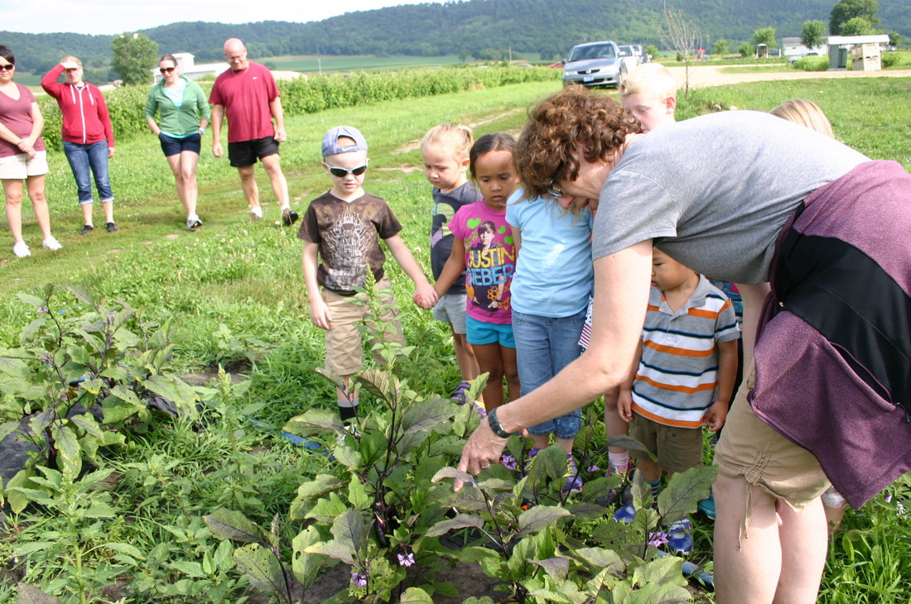
Gardening and Field Trips!
Start to grow something on your site or in your windows, and when possible, take field trips to the farm or farmers market!
Farm Tour at Featherstone Farm – Rushford, MN
Notes:
Gardening – includes backyard gardening and container gardening (can do in the winter)
Promotes exploration and discovery
Great fit with experiential education
Motivates and increases physical activity
Share some of the gardening stories from the “Got Dirt?” resource
Farm tours:
Try to go to the farm that supplies the food to your program
Make sure you have access to bathrooms
Dress appropriately and come prepared (water, name tags, sunscreen)
Provide authentic experiences – let the children do something real, like plant or weed or harvest
Make an inclement weather plan

Slide 19
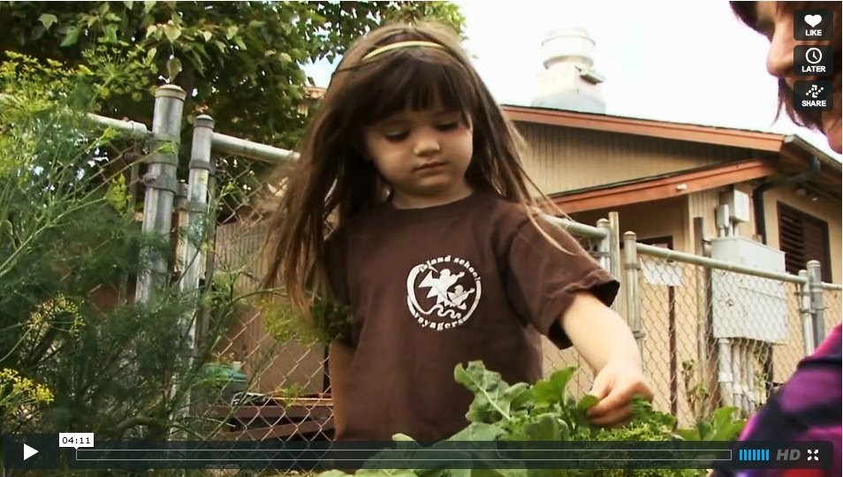
Video: From Farm to Keiki
http://vimeo.com/45469927
Notes:
Questions/comments about this?

Slide 20
Tips For Success
Buy – Eat – Teach
Repetition is key
Create a positive environment
Role model positive behaviors
Hear it. See it. Do it.
Engage parents and caregivers
Engage community partners and other providers
Use your resources 🡪 don’t reinvent the wheel
Start small
Notes:
Repetition is key: sometimes kids need to try new foods up to 15 times to acquire a taste for it. Be patient and keep trying. This also applies to messaging and key concepts – sometimes we need to hear things multiple times, and in different ways, for it to sink in. (Hence the repetition in this training)
Create a positive environment: don’t make eating a chore, and avoid rewarding good behavior or a clean plate with foods of any kind. Especially avoid forcing a child to finish the “healthy foods” to get to their dessert or sweets – this can make the healthy food seem like punishment and force the child to eat when they are full
Role model positive behaviors: eat the same meal/snack as the children, and avoid eating unhealthy foods/beverages around them. They will be much more likely to eat the healthy options if you do as well.
Hear it, see it, do it: Ancient Chinese proverb (Confucius) that says “If you hear something, you will forget it, if you see something, you will remember it, and if you do something, you will understand it”
Hear it: talking about fruits and vegetables, why they are good for kids, where they come from
Hear & see it: reading a book about nutrition, gardening, cooking, etc.
Do it: taste testing, cooking/preparing food together, gardening, going to the farmers market and/or farm
Gardening: reinforces lessons learned at the farm and classroom, and can substitute for farm trips when it isn’t feasible. Main goal is to help children understand that much of their food they eat grows in the ground, which usually adds a bonus of getting kids more excited about trying those foods.
Farm / farmers market visits: creates a “local food story,” learning how all food starts at the farm, how food grows, what the farmer needs to help it grow and how food gets from the farm to their tables. Reinforces what they are learning in the classroom.
Parents and guardians: Invite them to join activities and lessons (farm trips, gardening)
Parents can share in the experience with their kids, and see first hand how excited their children are about preparing and eating healthy foods.
Gives them confidence to purchase and prepare healthy foods at home.
Continuing these food habits at home reinforces positive behaviors for the preschool child as well as the entire family.
Most effective way to communicate with parents is face to face
Fliers and newsletters should only contain essential information
Don’t be discouraged if they don’t buy in at first, over time they will likely come around. Word of mouth will encourage others to join.
Consider soliciting parent input to shape the program by hosting parent groups for discussion
Engage community:
Look around and start talking to organizations who might have similar goals (local nonprofits organizations, local public health/SHIP, master gardeners, student groups, faith based organizations, health care providers, gardening centers)
Consider writing an article for the local newspaper or blog
Might be surprised how interested people are in preschool nutrition and physical activity education
Consider bringing in farmers, Registered Dietitians, local public health professionals, nurses, doctors, firemen, athletes, and chefs into the classroom for a “healthy chat”
These guests can be parents or local community members.
When children see adults they know and respect talking about the value of eating fruits and vegetables, being physically active, and eating nutritious foods, they are more likely to embrace healthy eating behaviors

Slide 21
Break

Slide 22
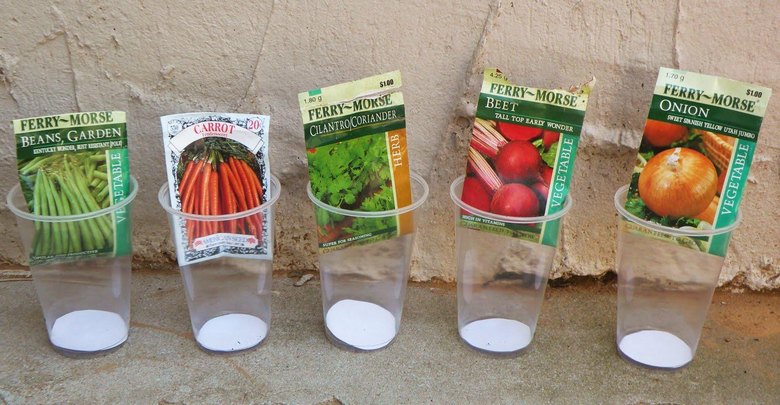
Activity: Guess that seed!

Slide 23
Resources
Books:
Growing Minds Children’s Literature Database: http://growing-minds.org/childrens-literature/
Multicultural collection of Farm to ECE Books: http://www.pareadysetgrow.org/book-list/
Examples:
  The Carrot Seed, by Ruth Krauss
  I Will Never Not Ever Eat a Tomato, by Lauren Child
  Tops and Bottoms, by Janet Stevens
  The Gardener, by Sarah Stewart

Slide 24
Resources
Nutrition and Gardening:
Farm to Childcare – Institute for Ag. and Trade Policy
Grow It! Try it! Like it! – Team Nutrition (USDA)
Got Dirt? – WI Dept. of Health Services
Got Veggies? - WI Dept. of Health Services
Pint Size Produce – Renewing the Countryside
Harvest for Healthy Kids –Portland State, Mount Hood CC
Healthy Bites – WI Depts. of Public Instruction, Health Services, Children and Families

Slide 25
Thanks!
Questions & comments?
Please complete evaluations

