Slide 1
Step-by-step Demo
www.facten.com

Slide 2
Critical business data is hidden
in millions of scientific publications.
Who works on what?
Where, with whom?
Using which products?
How much money?
Facten makes data
actionable for Sales and Marketing
15,224,597
1,444,962
51,710,225
8,040,452
Publications
Grants
Collaborations
Researchers

Slide 3
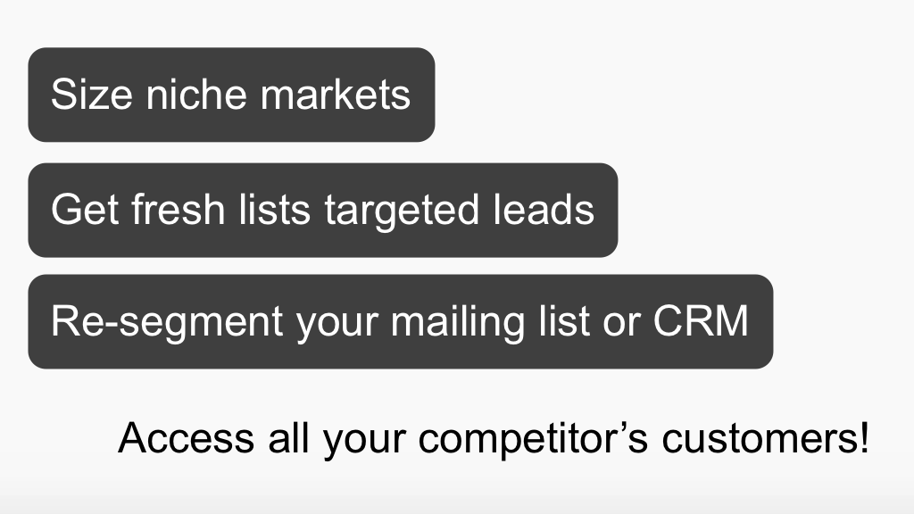

Slide 4
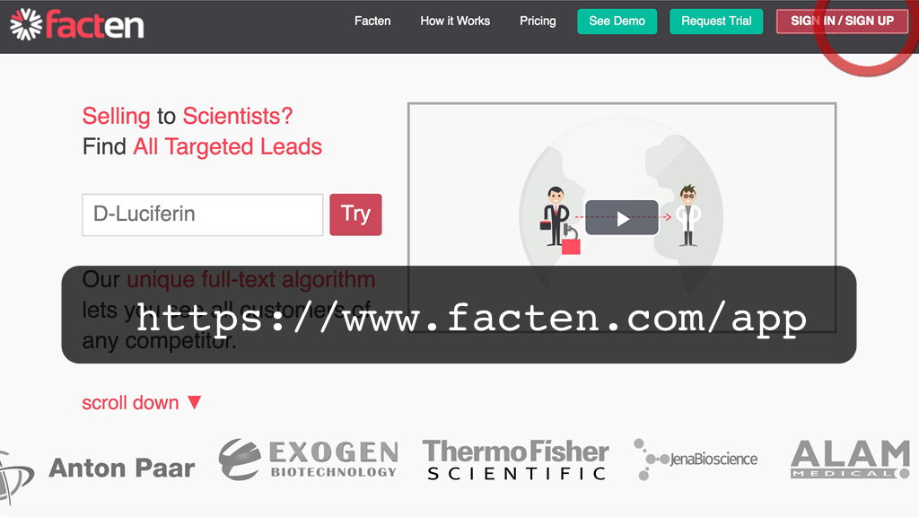
Sign-in (or sign-up) from the Facten website. Or directly from: https://www.facten.com/app
4

Slide 5
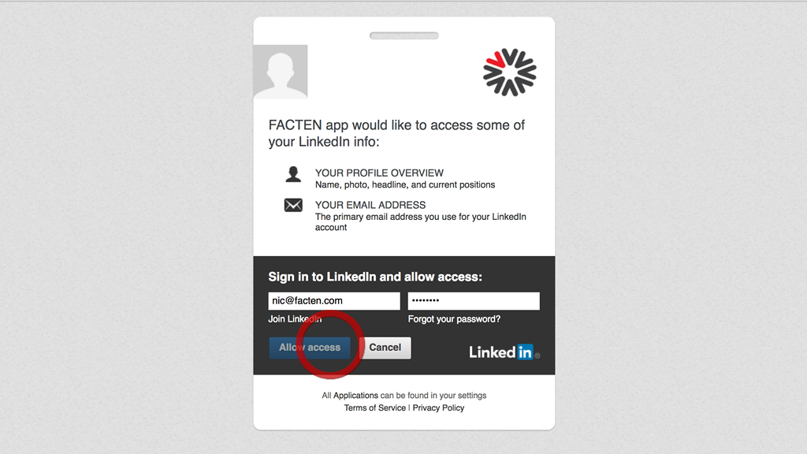
Enter your LinkedIn credentials. As explained by LinkedIn only a small part of your profile is shared with us. This is only to authenticate you on the platform. Our Privacy Policy is very strict: we do not share your information with any third party.
5

Slide 6
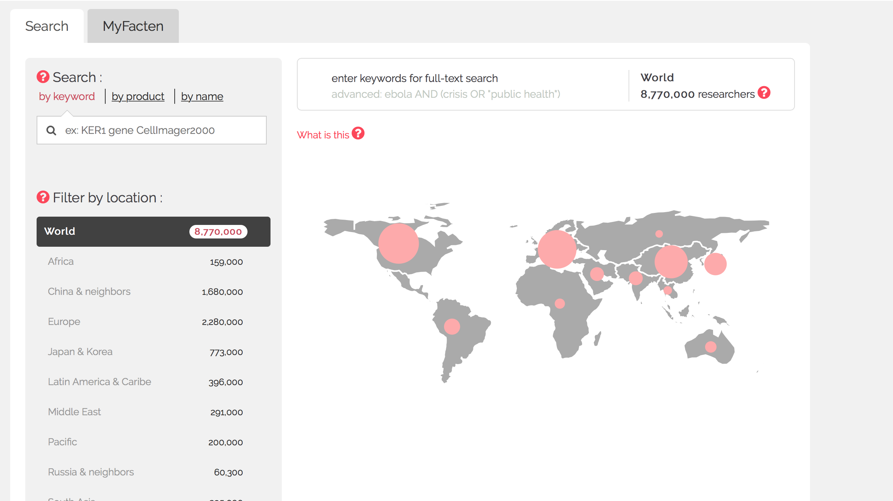
This is the main screen of the Facten web application. Millions of researchers are indexed.
6

Slide 7
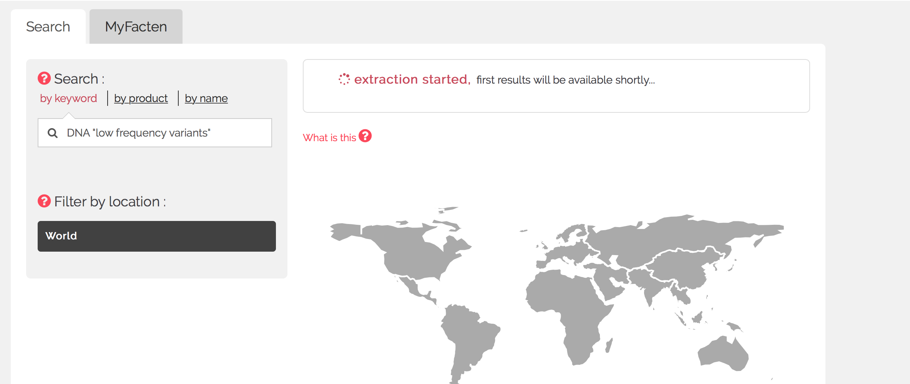
In this demo, our product is a genetic sequencer. We want all researchers that work on a particular application: DNA "low-frequency variants".
The first time we do a search, Facten needs to collect all the matching data in the World.
This can take a couple minutes but next time we want to access the same search, results will be available immediately.
7

Slide 8
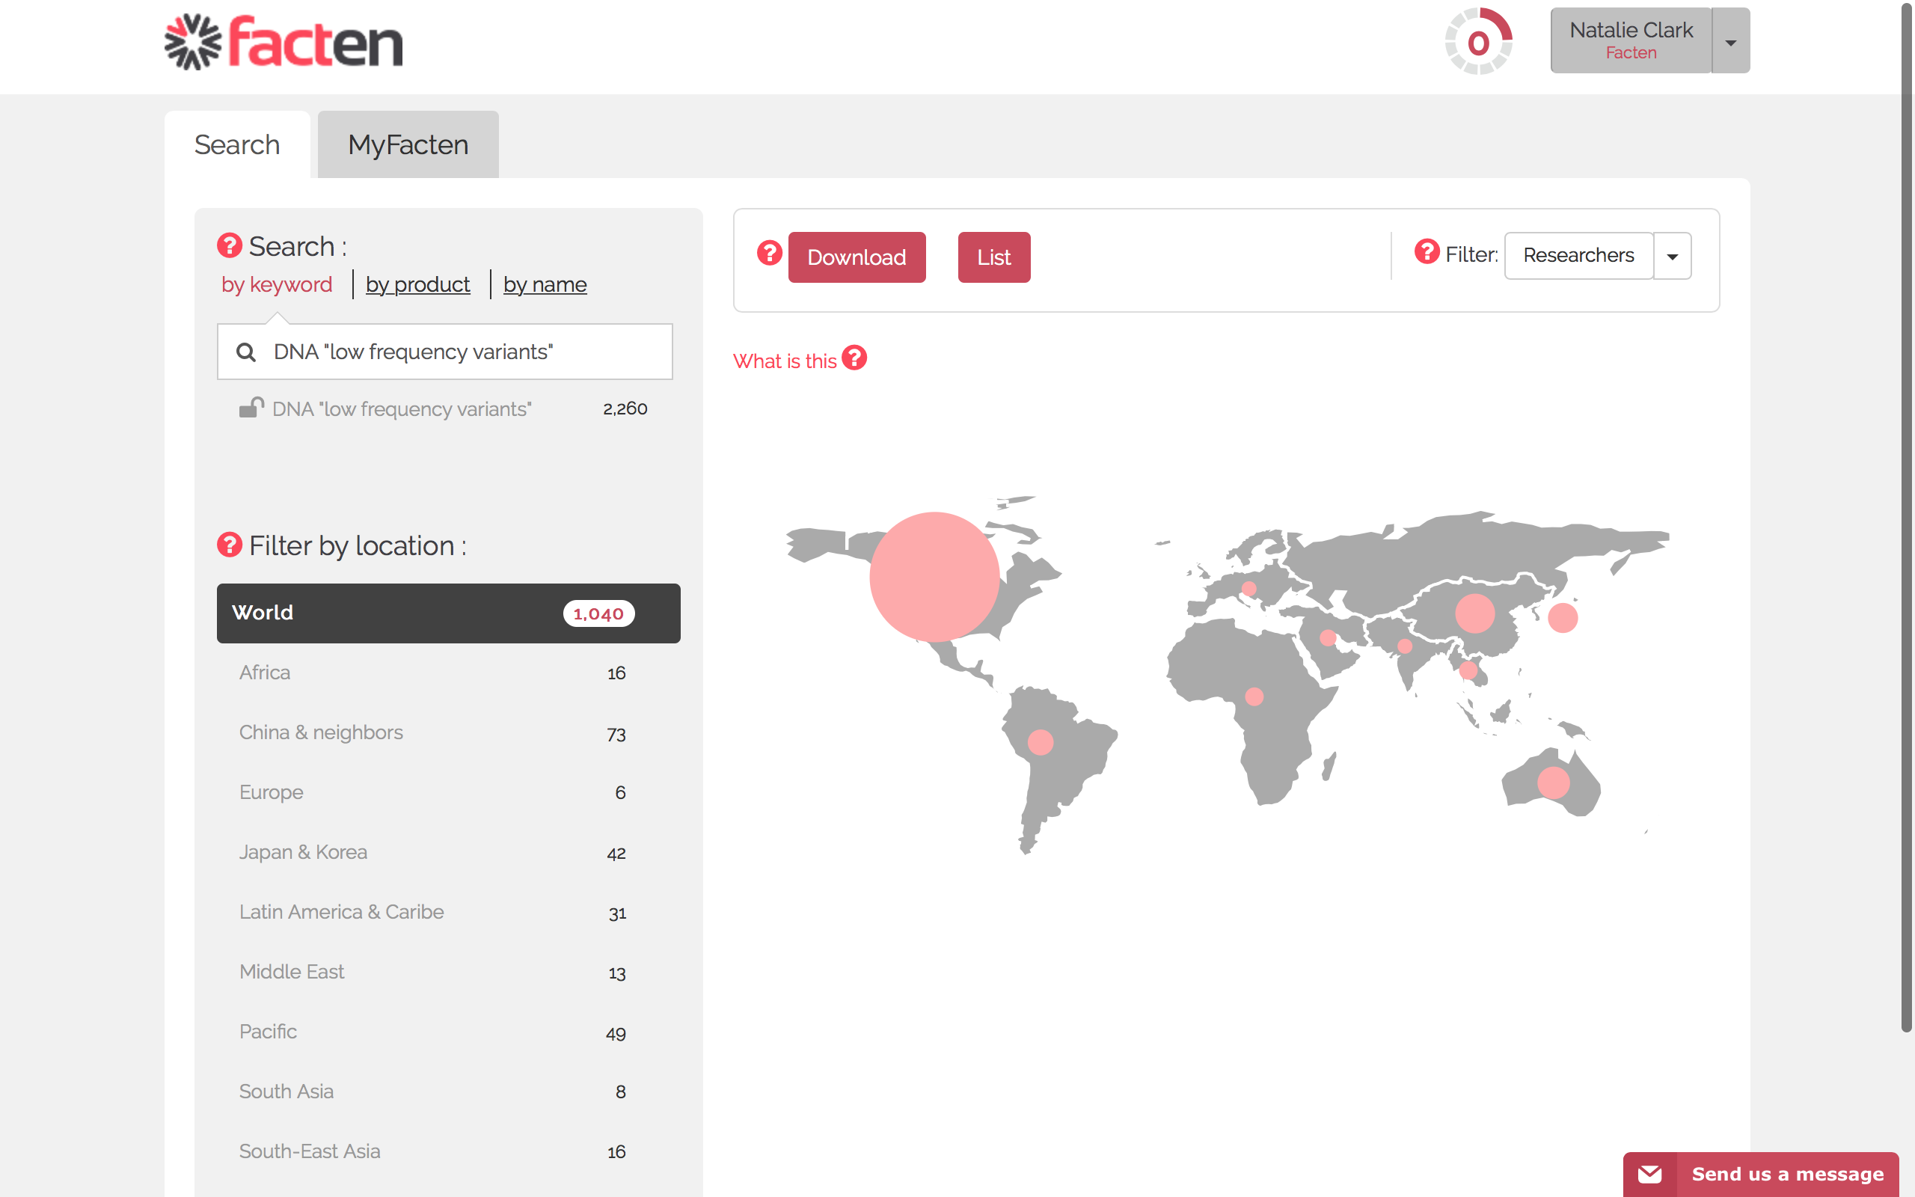
We can see the size of our market
8

Slide 9
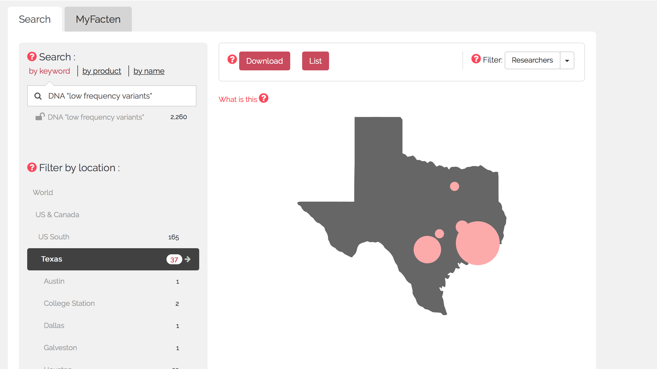
and zoom into any country
9

Slide 10
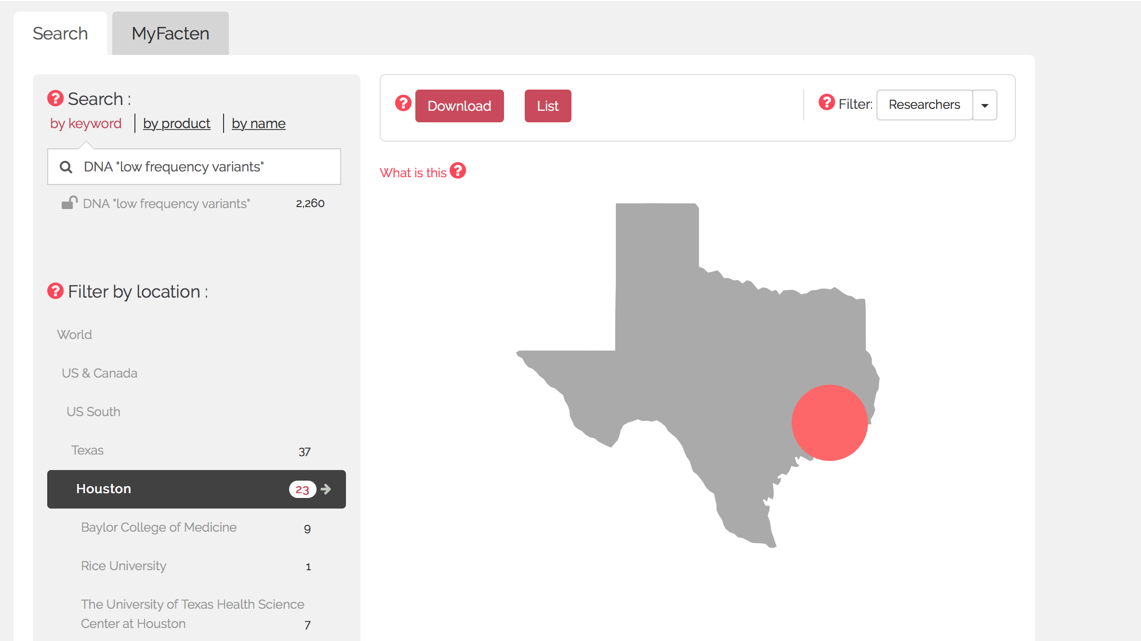
We can also zoom to particular cities and institutions
10

Slide 11
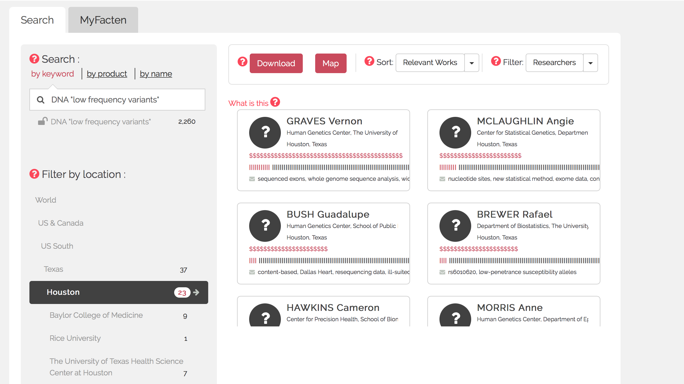
And, of course, we can see the list of people.
All researchers working on our application are listed. These are all our potential customers!
Each bar is an article that researcher has written and the red bars are when articles match our search. As part of all Facten plans, we can do an unlimited number of searches.
11

Slide 12
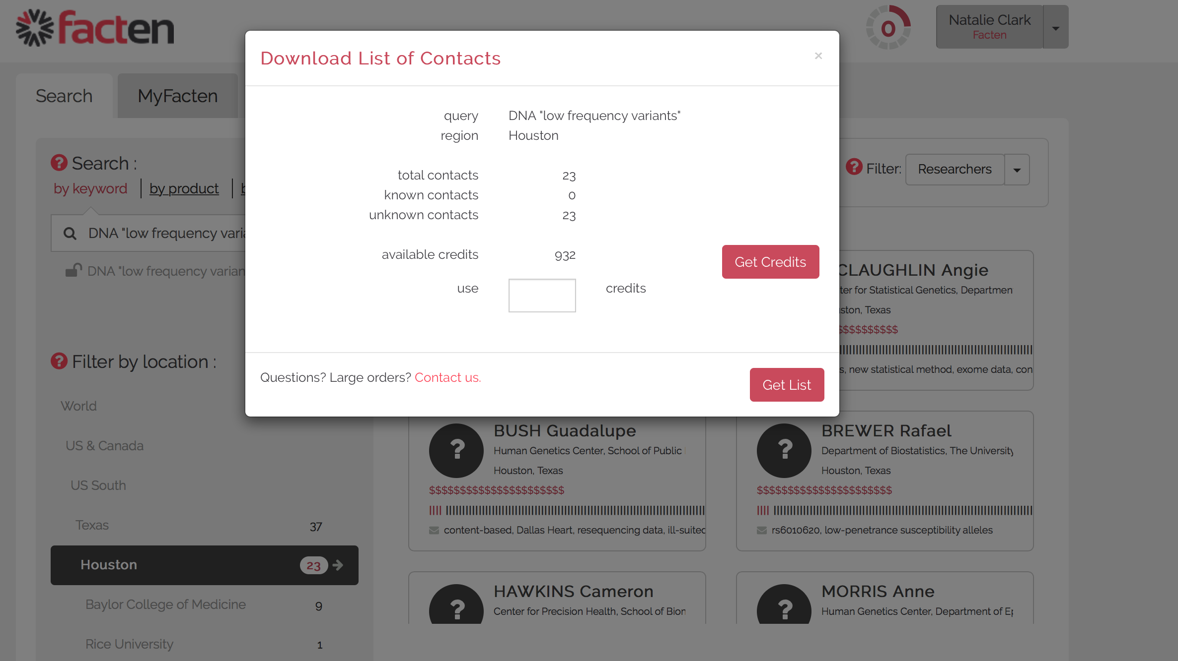
Known contacts: 0
Facten will show us how many contacts there are, and how many are already managed in our account. Since we are just starting our account is empty.
12

Slide 13
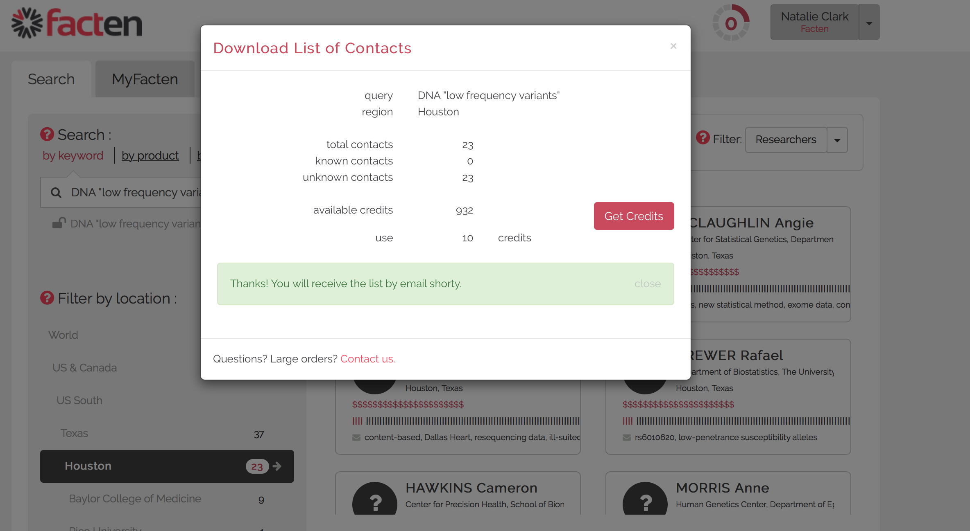
As an example, we'll just spend 10 contact credits
13

Slide 14
We receive an Excel file with 10 contacts. It contains the names, emails as well as the number of total and matching articles of each contact.
14

Slide 15
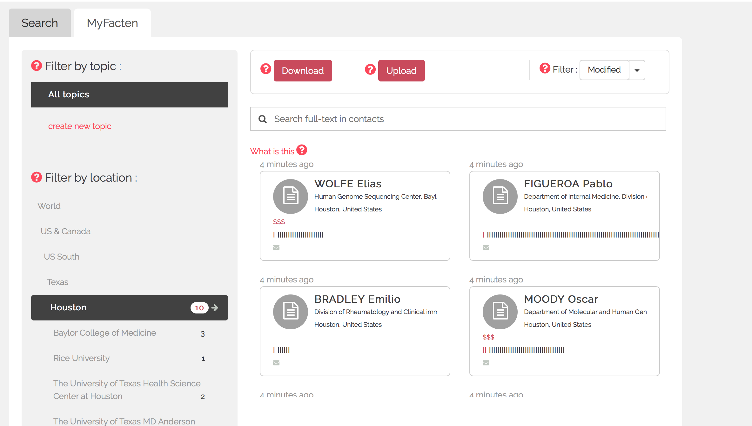
If we go back to Facten, these contacts have been added to the "MyFacten" tab.
There we can sort and extract on any criteria we like. Because these contacts are already in our account, no credits are required.
With Facten, we never pay twice for the same contact.
Once a contact is maintained in our account, it stays there. It is kept up-to-date. It is refreshed with new publications and updated when contact information changes.
15

Slide 16
We will be able to re-segment our account contacts based on any future needs.
Let's imagine we want to reach out to all current users of "HiSeq", a product from a competitor
Because Facten searches full text, including in the “Materials & Methods” section,
it can detect when products and companies are referenced there.

Slide 17
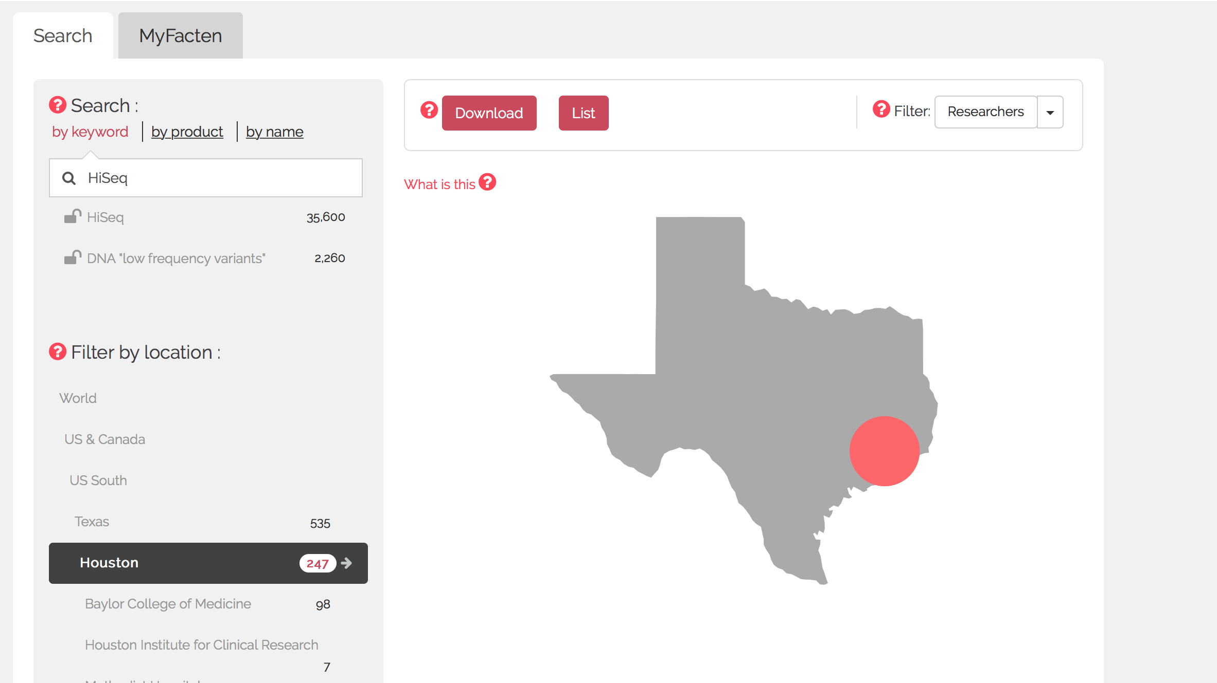
Let's download this new list.
17

Slide 18
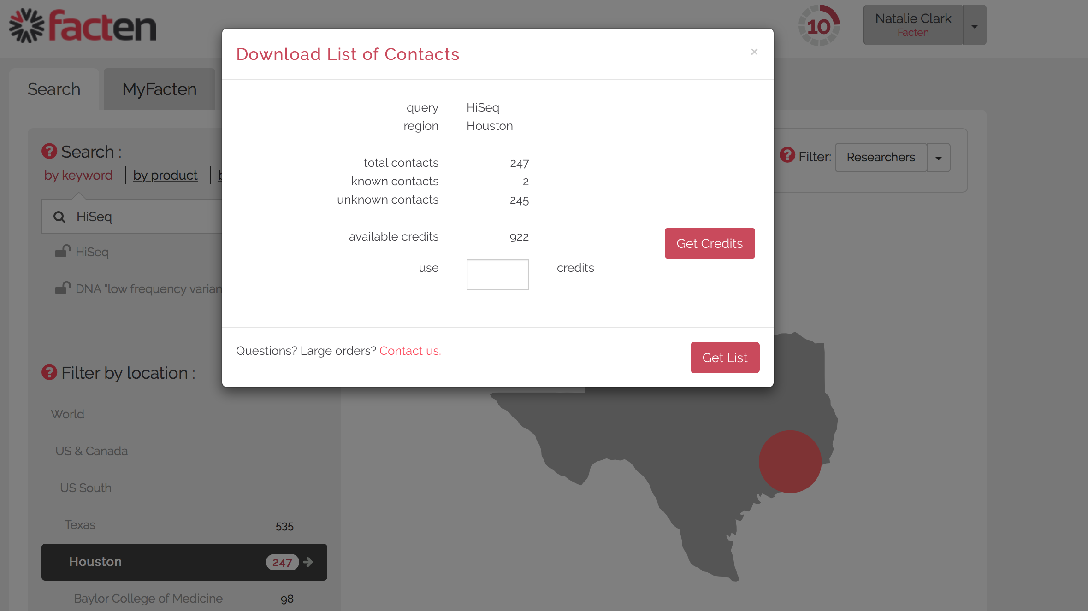
Known contacts: 2
This time, there are already "known contacts". These are the contacts that match our new search "HiSeq" but were added to our account previously.
18

Slide 19
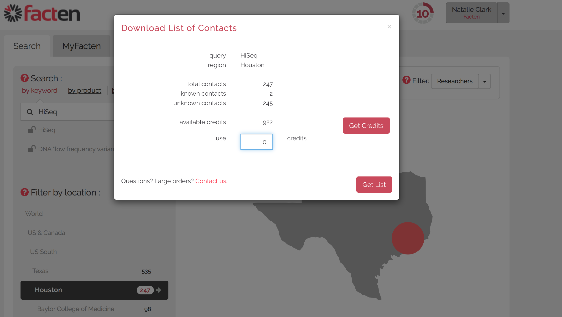
Because they are already in our account, we could download them now without spending any additional credit.
19

Slide 20
This is the list. It contains all contacts that were in our account and that happen to be HiSeq users. In just a few clicks, we can re-segment all our known contacts based on whether they reference a competitor or work on a particular application.
20

Slide 21
Now, let's imagine we have some data outside of Facten.
For example, a list of people we met recently at a tradeshow.
Or some existing customers from our CRM.
As before, we would like to know which of them are HiSeq customers.

Slide 22
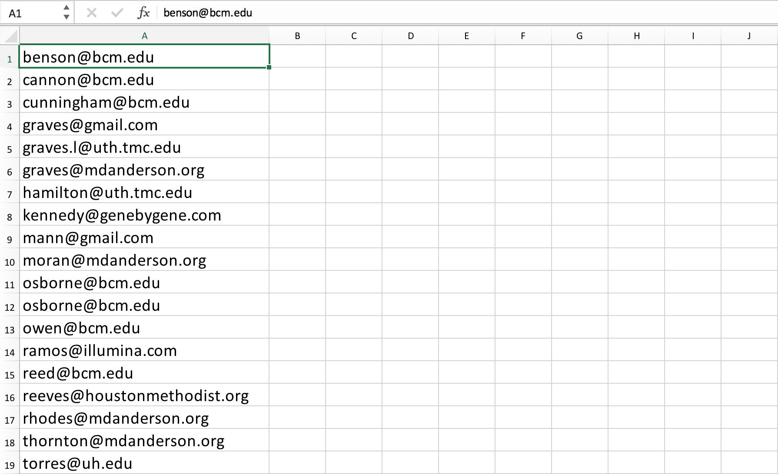
Contacts from Tradeshow or CRM

Slide 23
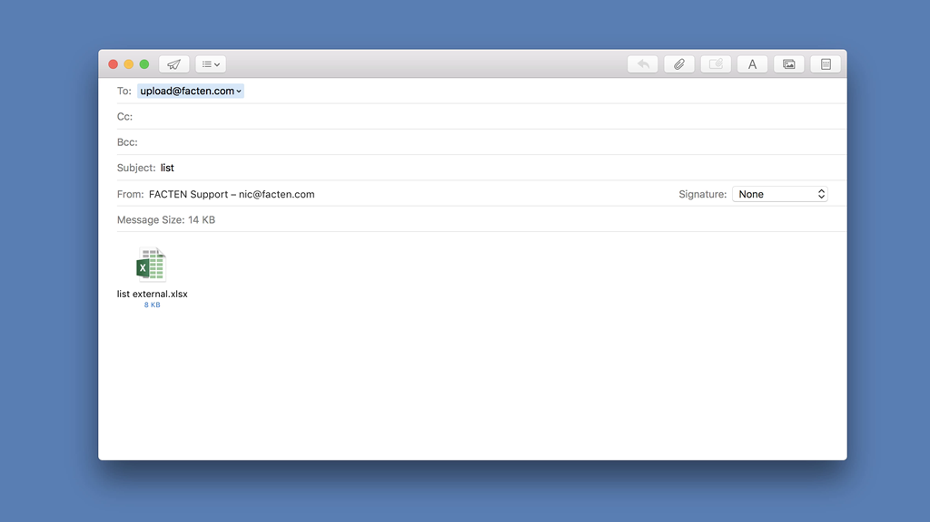
We can upload these contacts into our Facten account, simply by emailing the list to: upload@facten.com
23

Slide 24
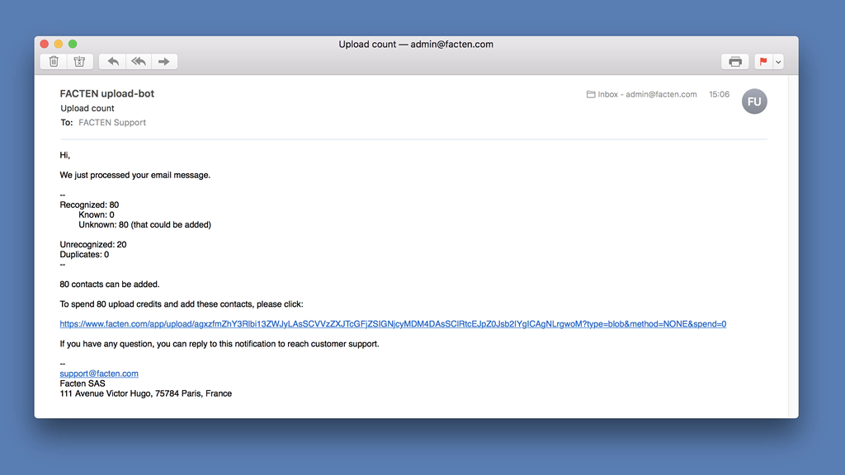
We will get an email back with the number of contacts that were recognized in the entire Facten database and in our own account. In just one click, we can add these contacts to our Facten account. They will always be kept always up-to-date and will be searchable and segmentable based on their scientific activity.
To add these contacts, we spend another type of credit called "upload credits".
Prices for all plans and credits are publicly available on the Facten website.
24

Slide 25
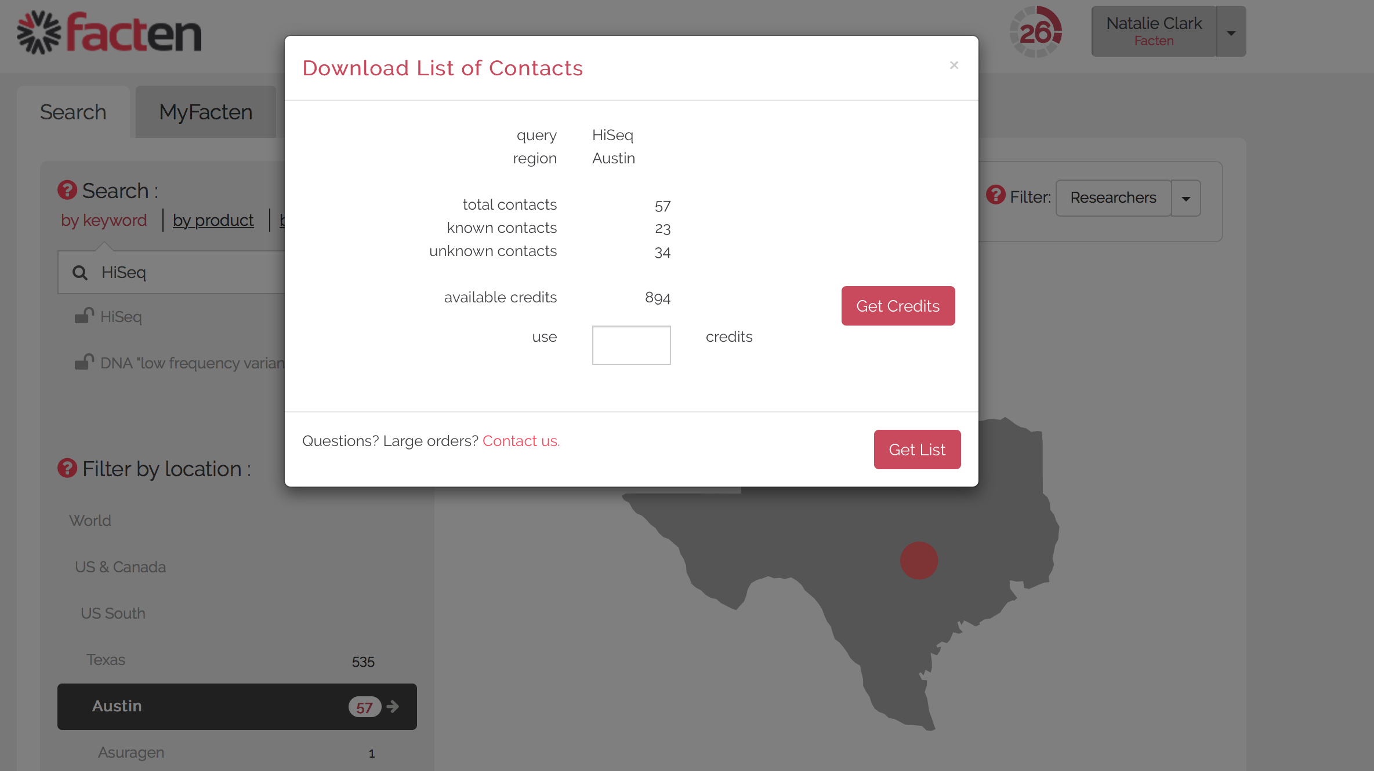
Known contacts: 23
Now, let's go back to Facten and search for “HiSeq” again.
As we can see there are more known contacts that use HiSeq. The extra known contacts are those that came from our tradeshow list. As before, we could re-download that list, or any other re-segmentation, at no cost to us because the contacts are in our account.
25

Slide 26
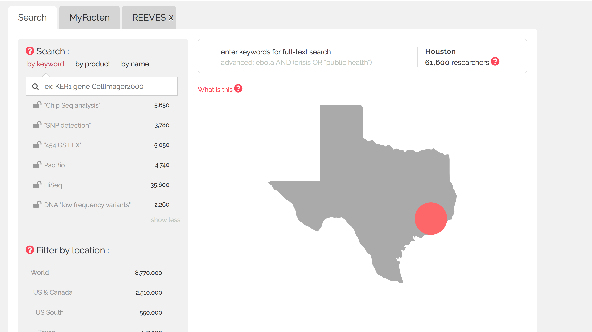
Extra applications and competitors
A common use of Facten is to add multiple searches, for different applications and different products or companies. This is a good way to get great insights into our market and our potential customers. Let's add a few now.
26

Slide 27
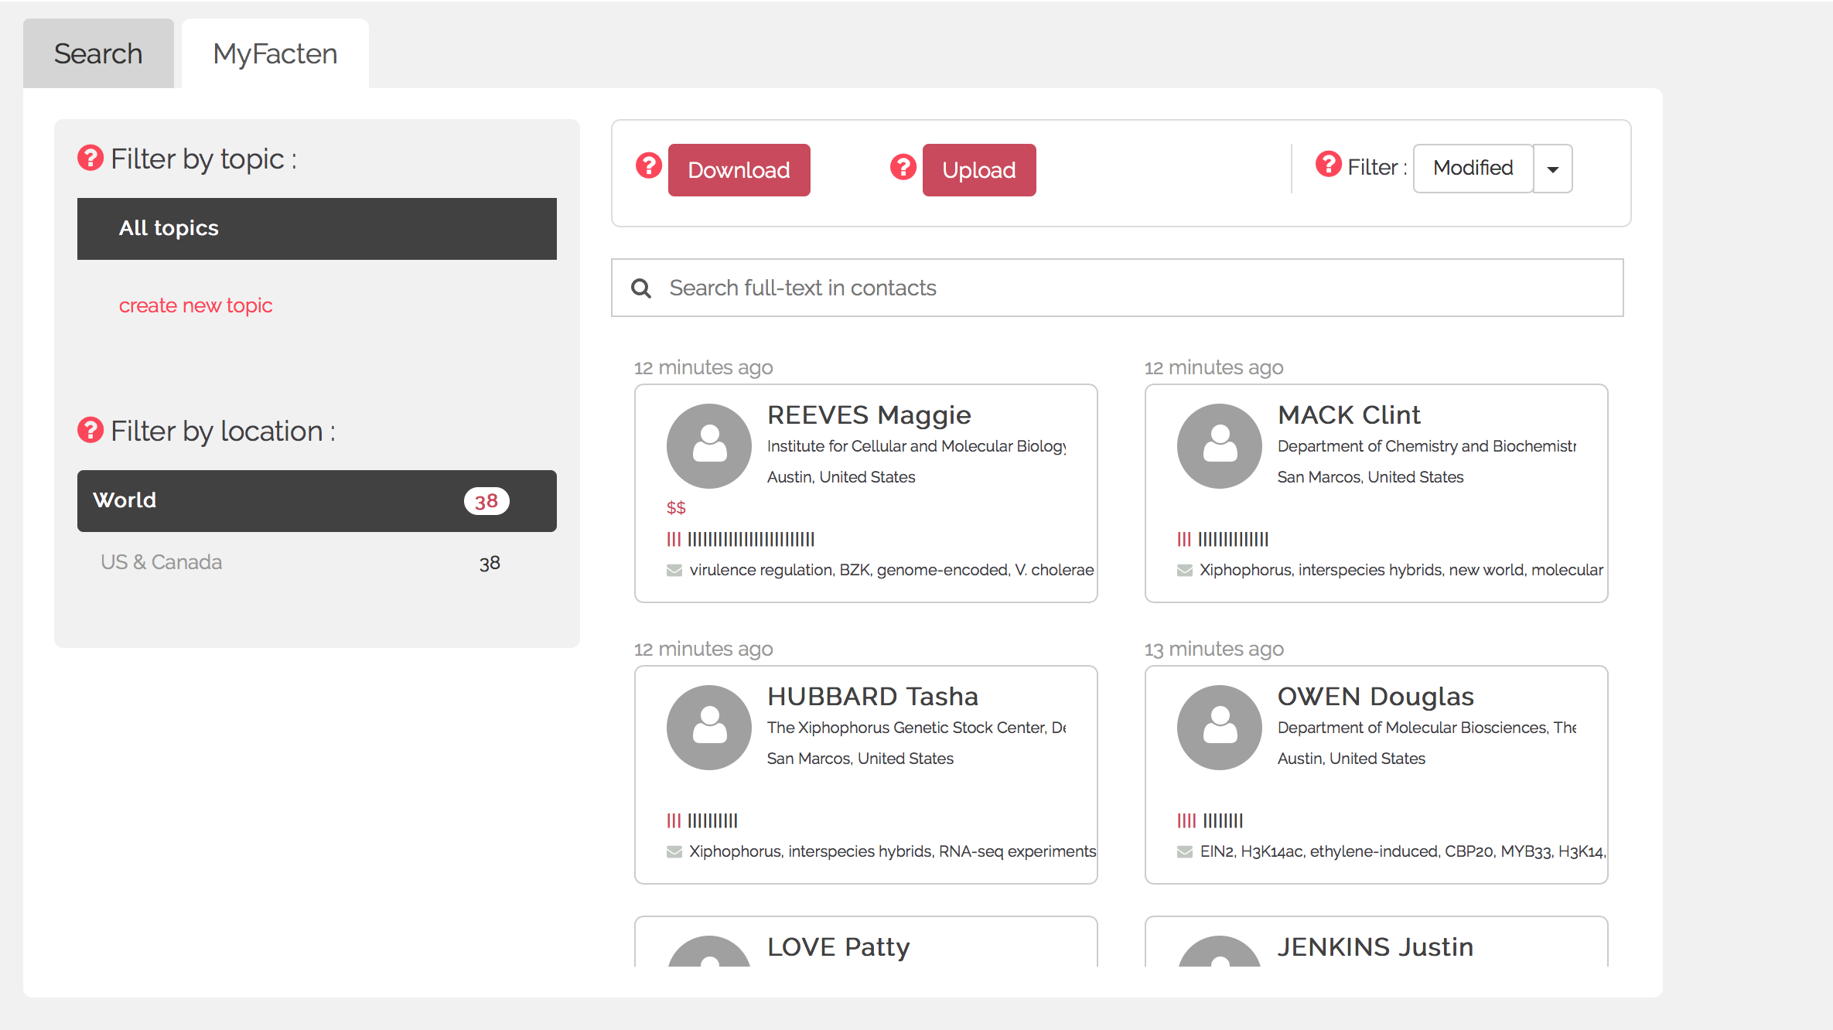
If we want deep information about a particular contact we can just click their card.
27

Slide 28
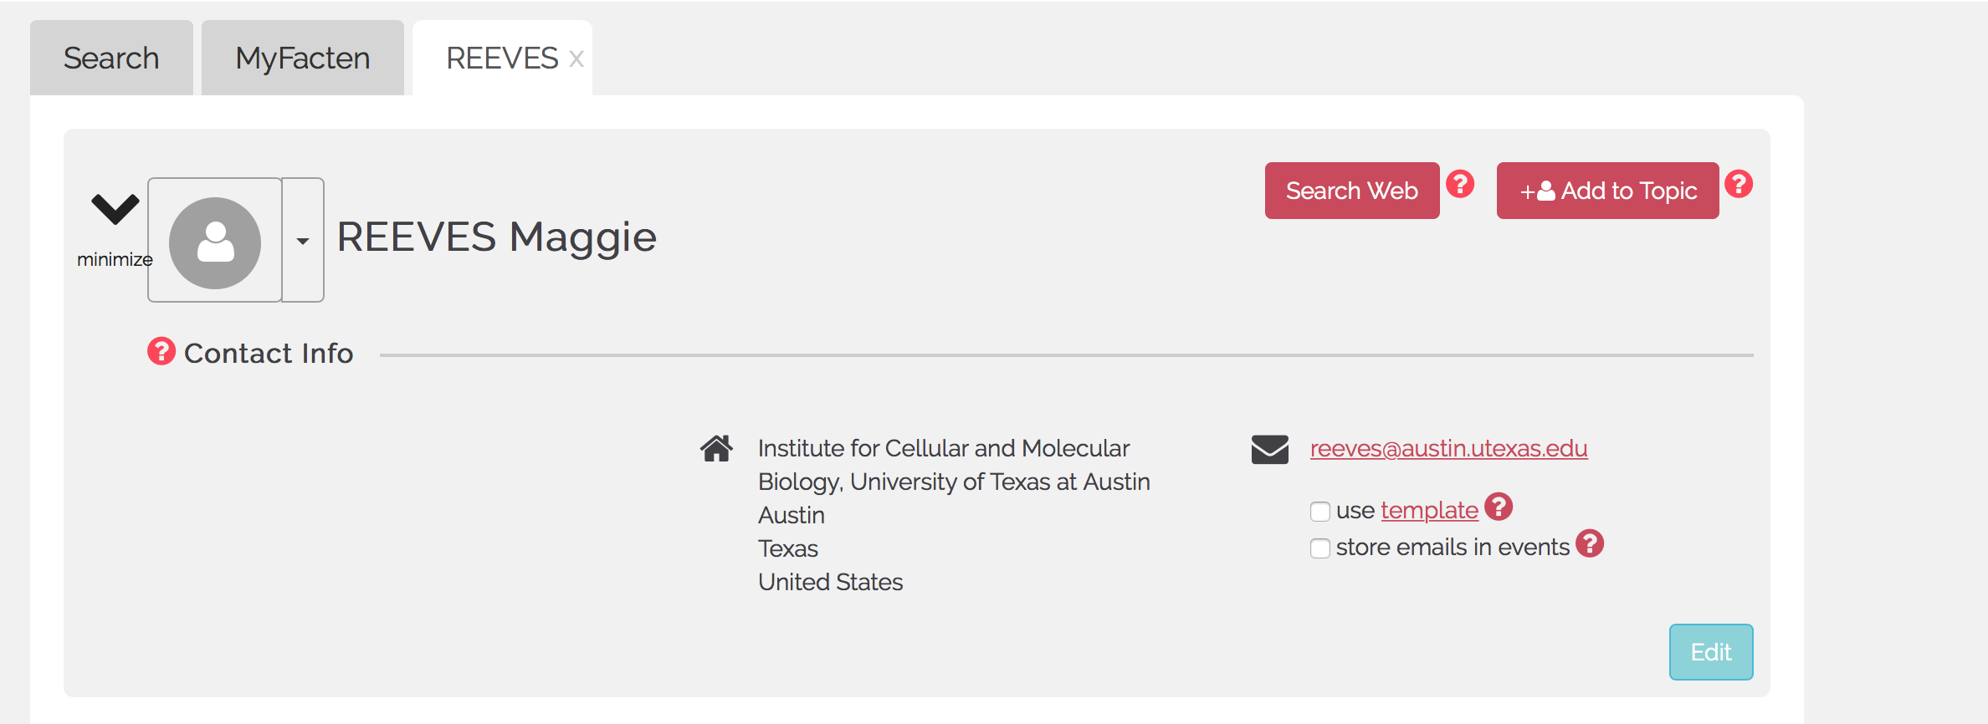
We will see their contact information.
Remember, all information in Facten was extracted from scientific publications, it is automatically kept up-to-date as new articles appear
28

Slide 29
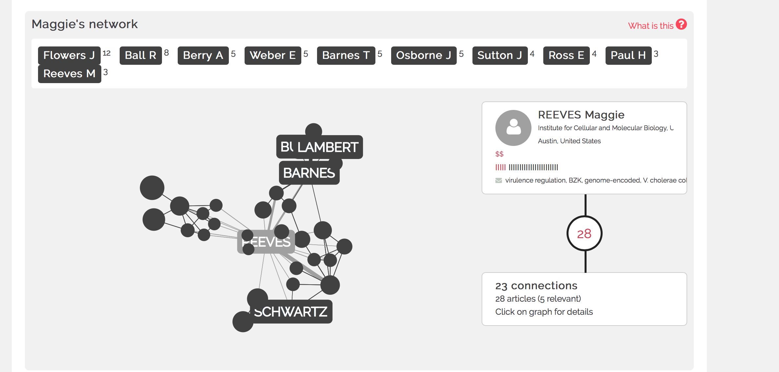
We can see their network.
This is who they collaborated with, some of these collaborators could be our customers or maybe with our competitors.
29

Slide 30
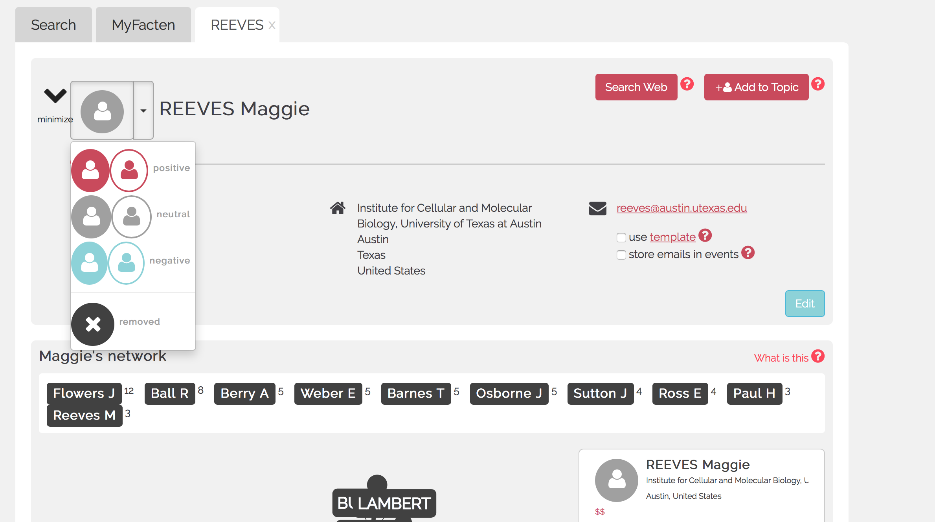
In order to better visualize interactions we can color code contacts.
Let's say that this one is one of our customers and we want to use red
30

Slide 31
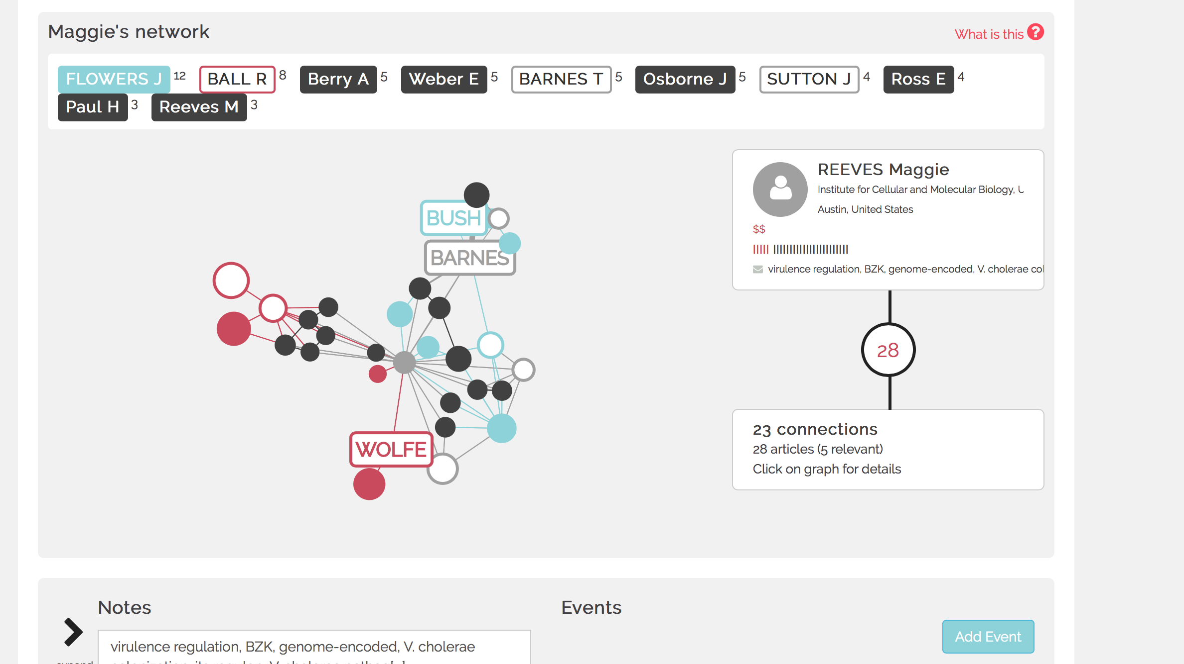
As we explore communities in our account, patterns will emerge.
After a while, networks look like this.
31

Slide 32
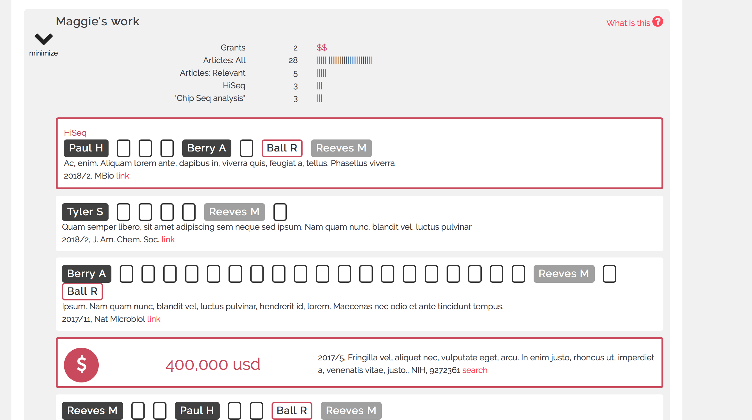
We can also view scientific activity
These are all our active searches that are matched by this contact. Remember the different searches we added about competitors and applications? We can see all those that are matched here. If we like we can see the details about their publications.
32

Slide 33
33
Grants they have received from funding agencies are also shown.

Slide 34
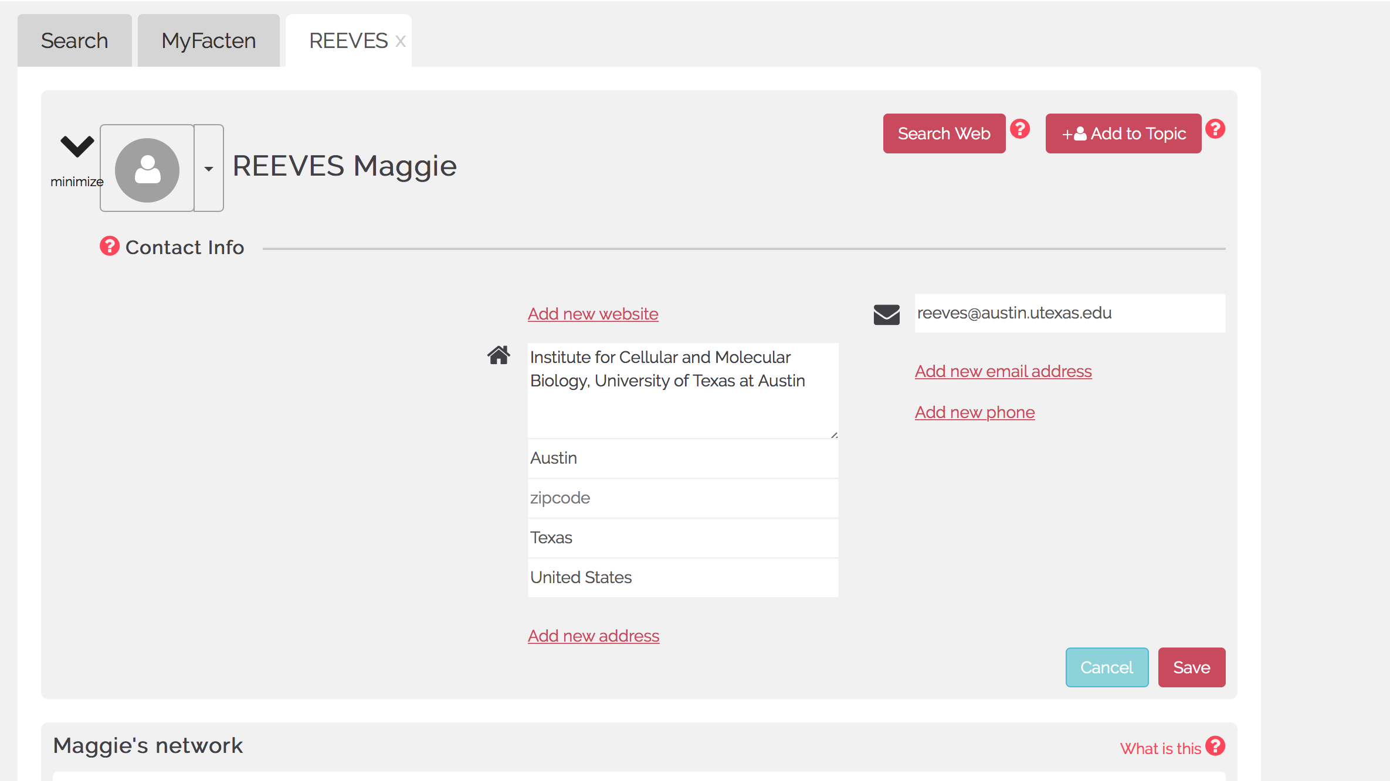
It is possible to edit contact information and to add notes or events for each contact.
Remember: all the information you put there is strictly confidential and will never be shared with any third party.
34

Slide 35
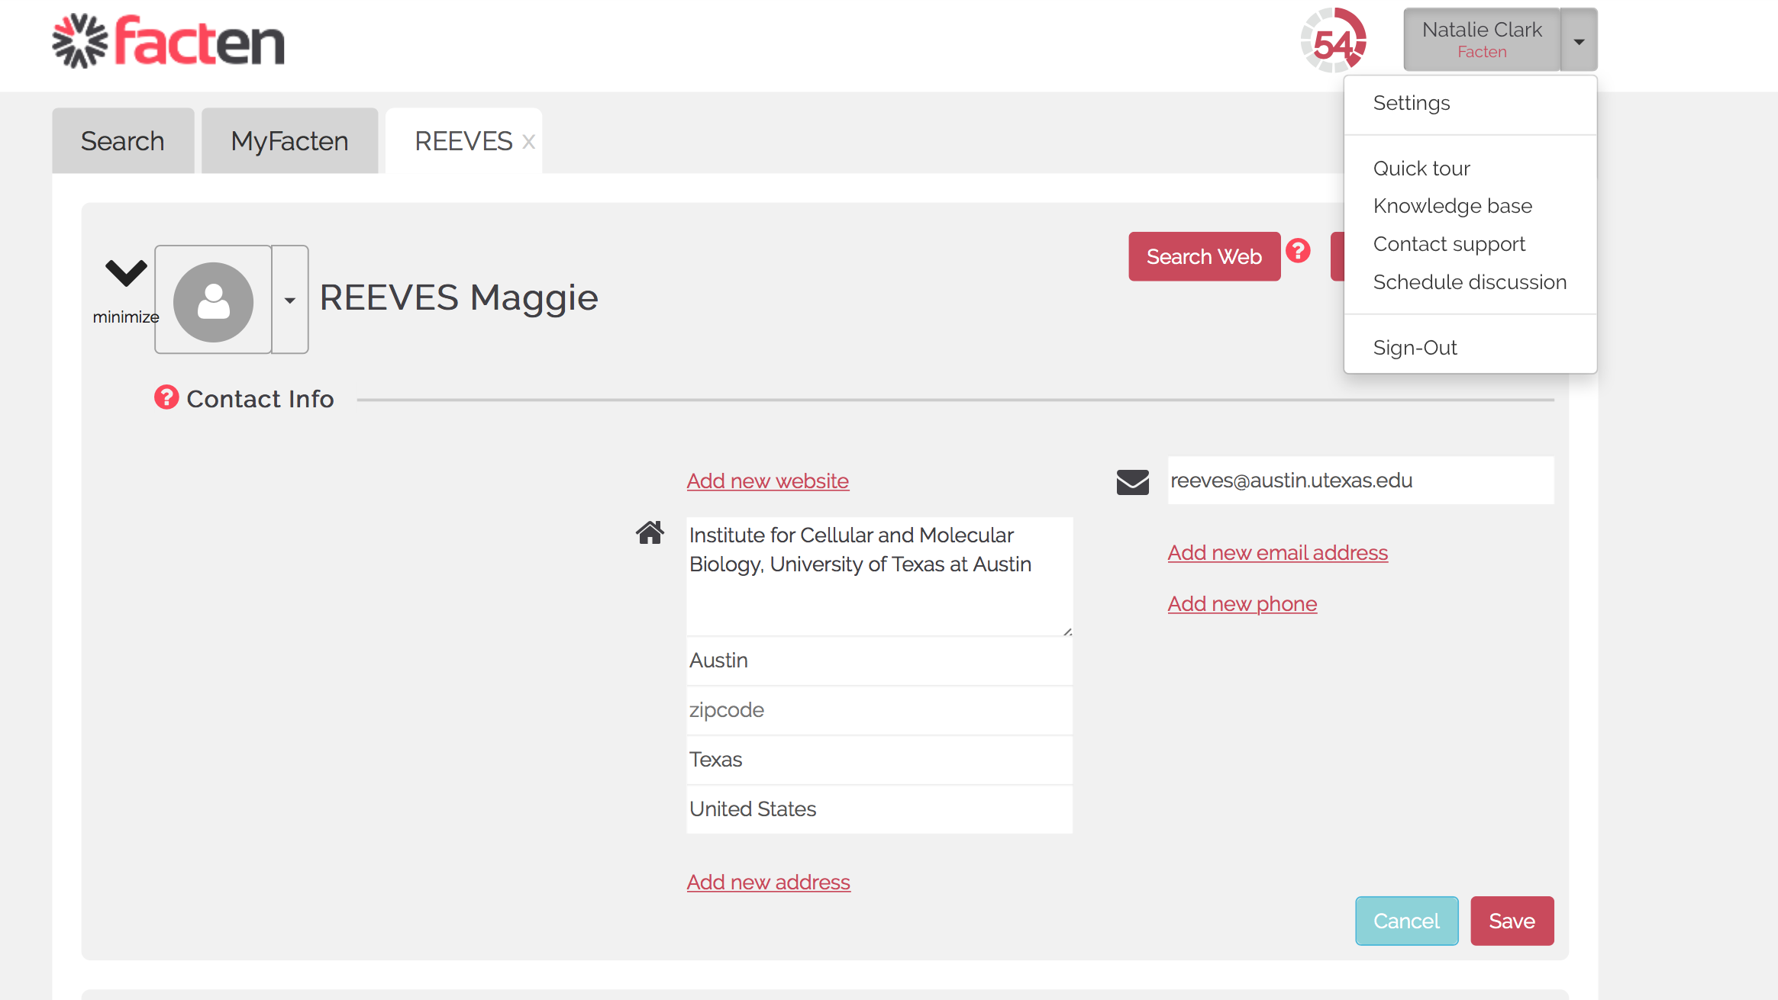
At any point, you can download your data or manage your account details by clicking into “Settings”.
35

Slide 36
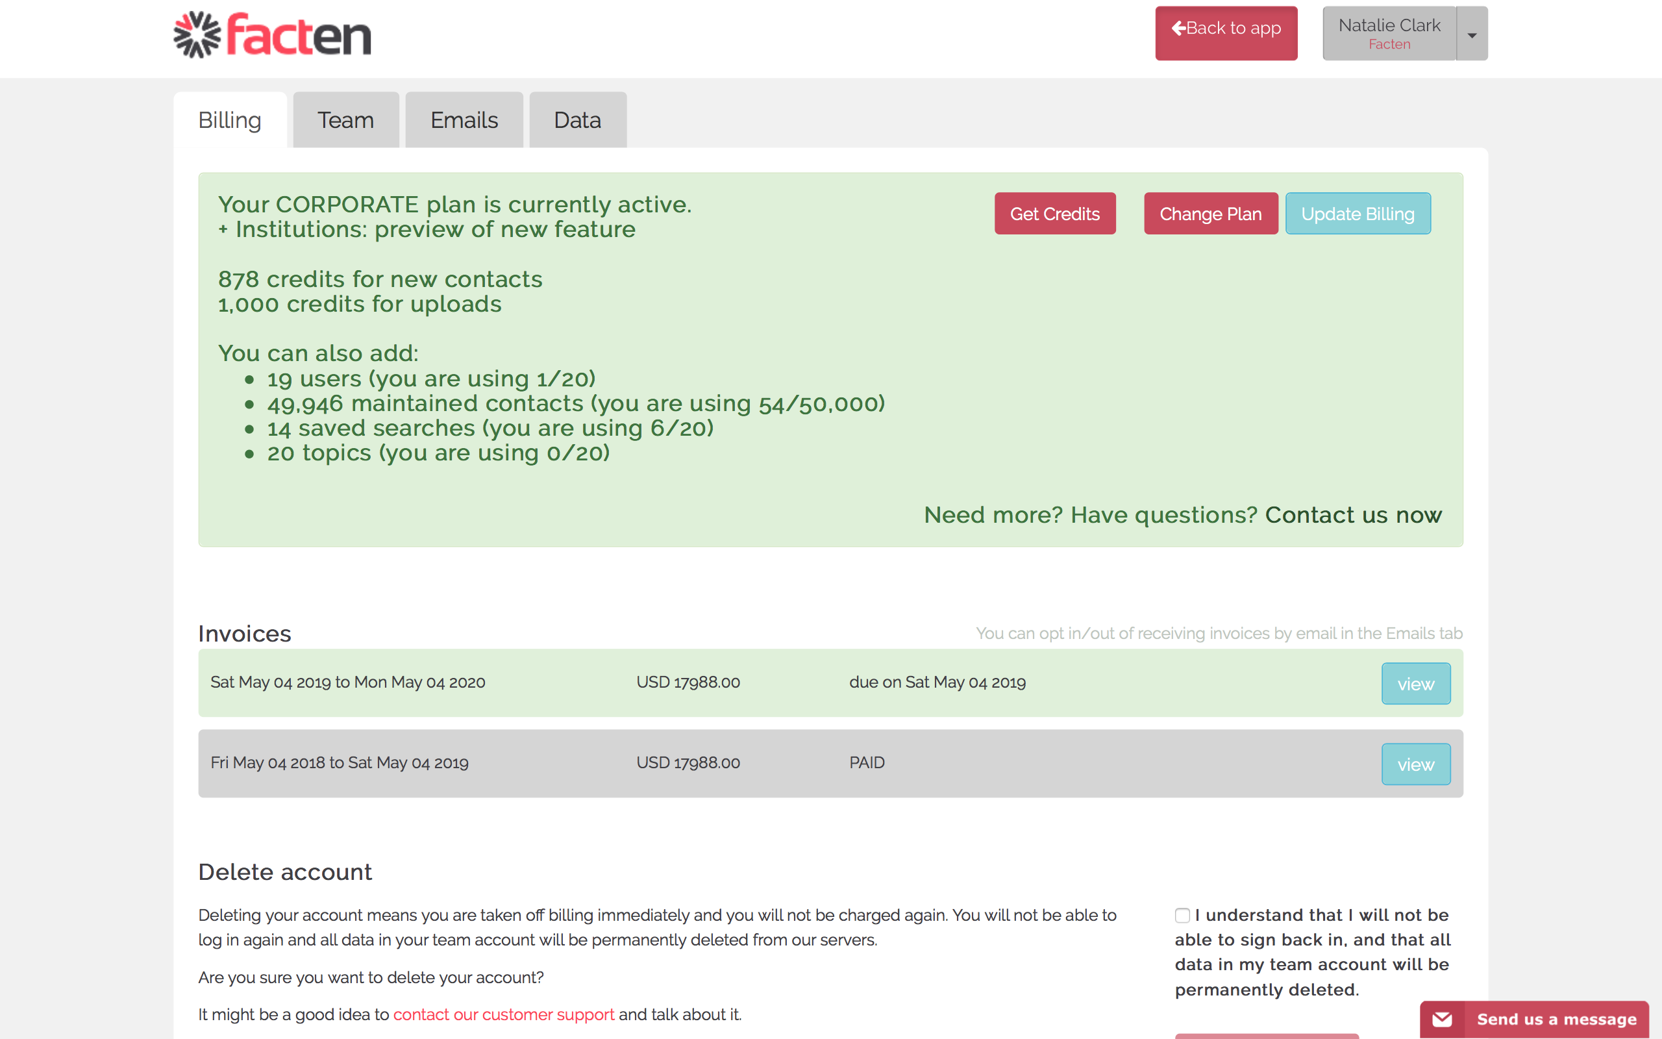

Slide 37
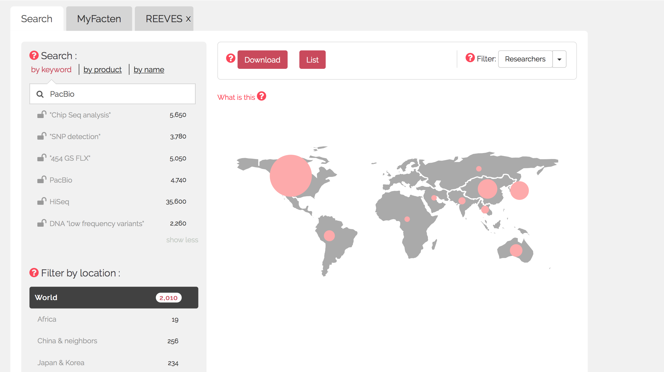
There are also lots of help resources and you can also click all the “question marks” in the application.
37

Slide 38
An important point is the search syntax.
It is straightforward but your results will be as good as your searches!
Make sure you read this and do reach out to our support if you have any question.
38

Slide 39
Facten is a web application for
Sales and Marketing in
Academic Life Science.
We pull all the data available in scientific publications so you can get the most detailed insights
into your market and access the most promising leads.
15,224,597
1,444,962
51,710,225
8,040,452
Publications
Grants
Collaborations
Researchers

Slide 40
Data is changing the Game.
We can help!

Slide 41
Facten SAS
111 Avenue Victor Hugo
75484 Paris, France
+33 977 19 88 11 info@facten.com
www.facten.com

