Slide 1
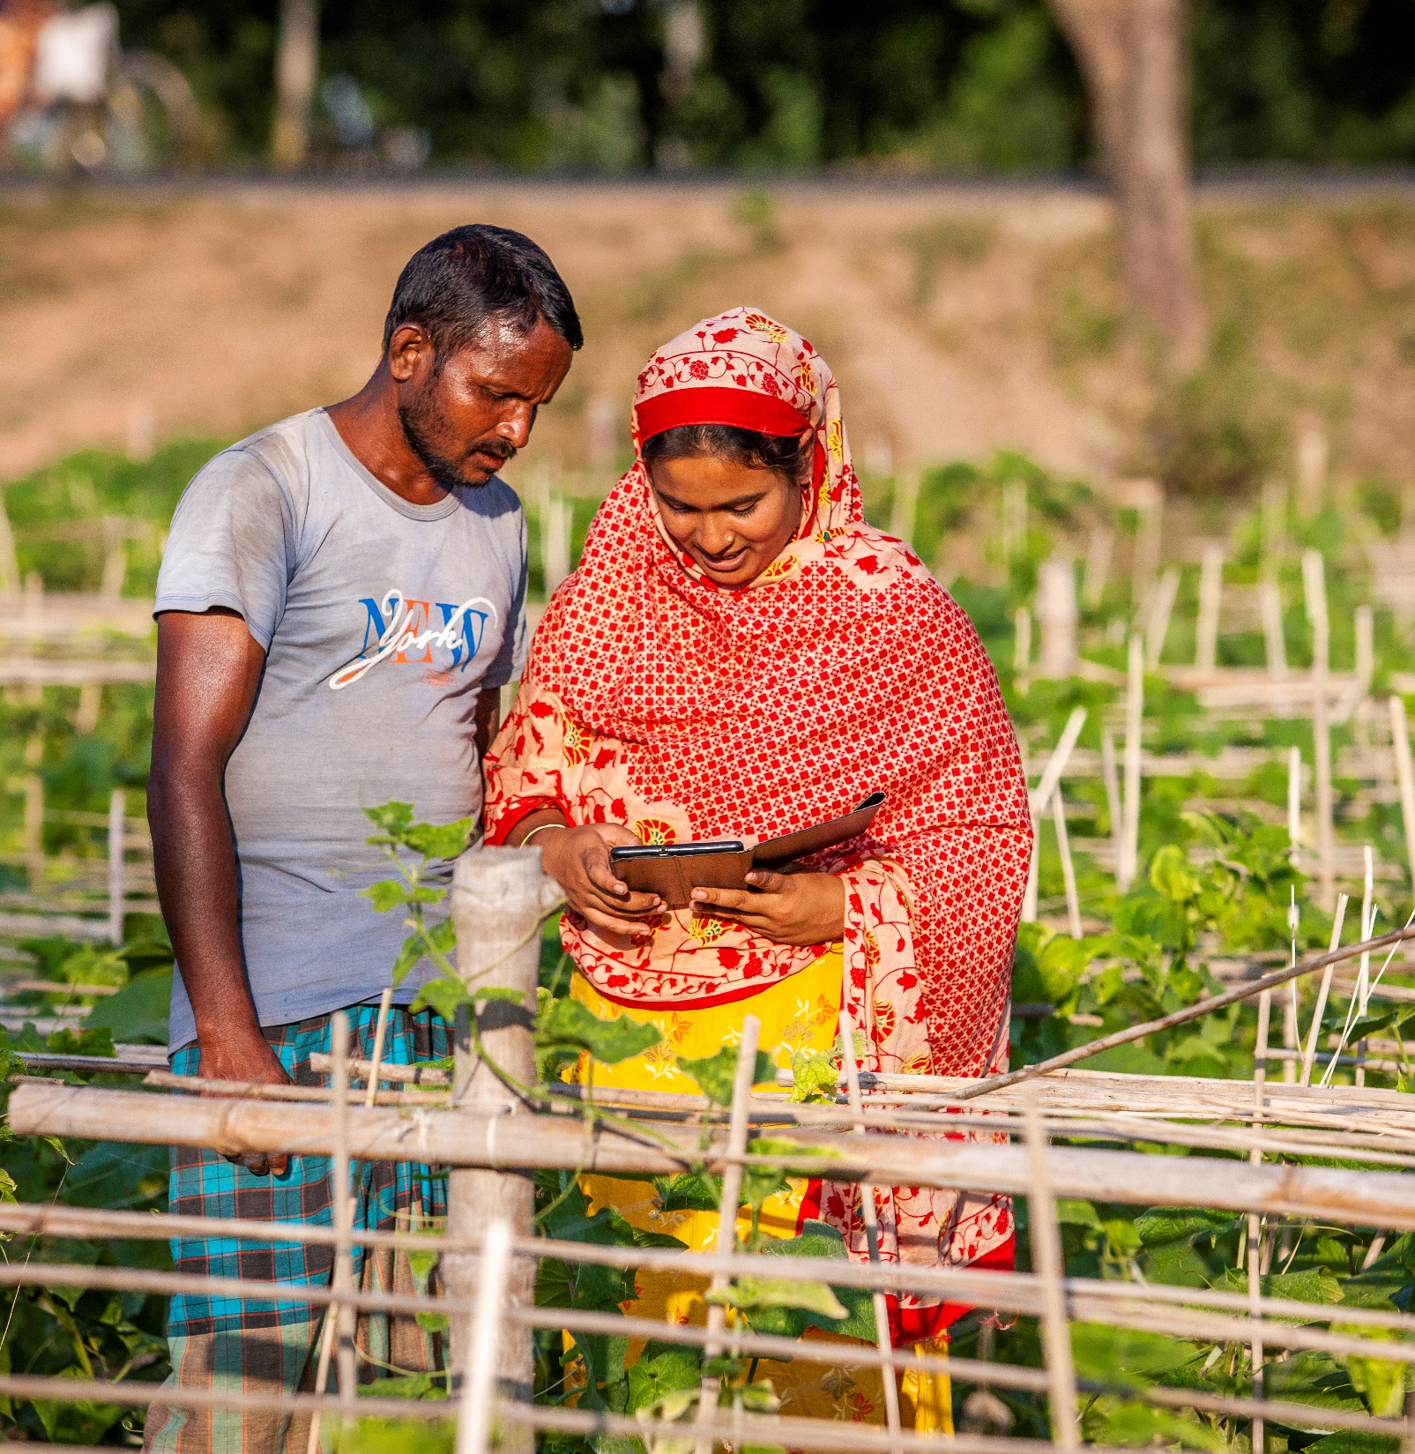
Digital Inclusion of Smallholder Farmers in Bangladesh through strong Producer Organization
Increasing Access to Finance for Farmers’ Organizations in Bangladesh (MMI-A2F+)

Slide 2
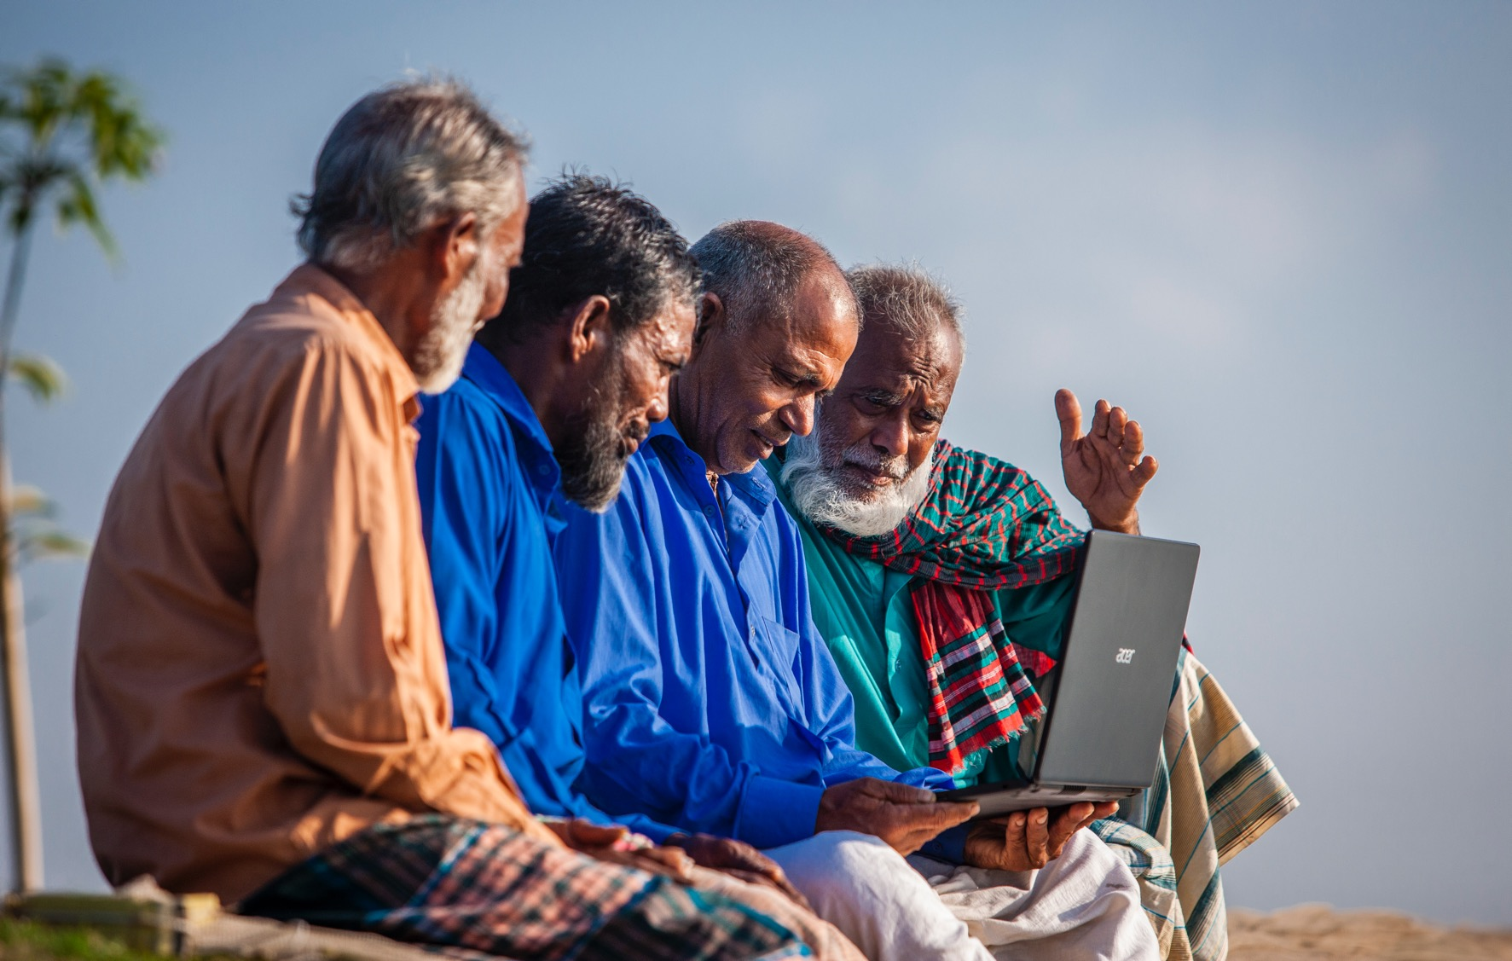
Missing Middle Initiative (MMI)
Empowering smallholders through strong producers’ organizations and digital technology

Slide 3
Strong POs and digitalization work together to build a resilient farming society and food systems
Digitalization on its own is not enough
It must come hand-in-hand with well organized farming community
When both are in place, they catalyze growth

Slide 4
Business Ecosystem of the Producer Organizations
Producer Organization
Farming Youth
Climate Finance
Mechanization
Digitalization
Export Competiveness
Investment keys:
Revolving Loan Fund
Crowed-in finance from NCBs
Farmer Business Facilitators (Rural youths)
Common Facility Centers
(C)RR Fund++
Micro-Insurance
e-arat
Strengthening POs and their Apex
Commodity Coop
Aggregation point for Value Chain Actors
Repayment
Climate finance for smallholders
Borrowing
Mobilizing smallholders into POs
Institutional Literacy
Financial Literacy
Digital Literacy
Community Modules
Business Literacy
Market Literacy
Appropriate Scale Technologies
Crop
AgroForestry
Fisheries
Livestock

Slide 5
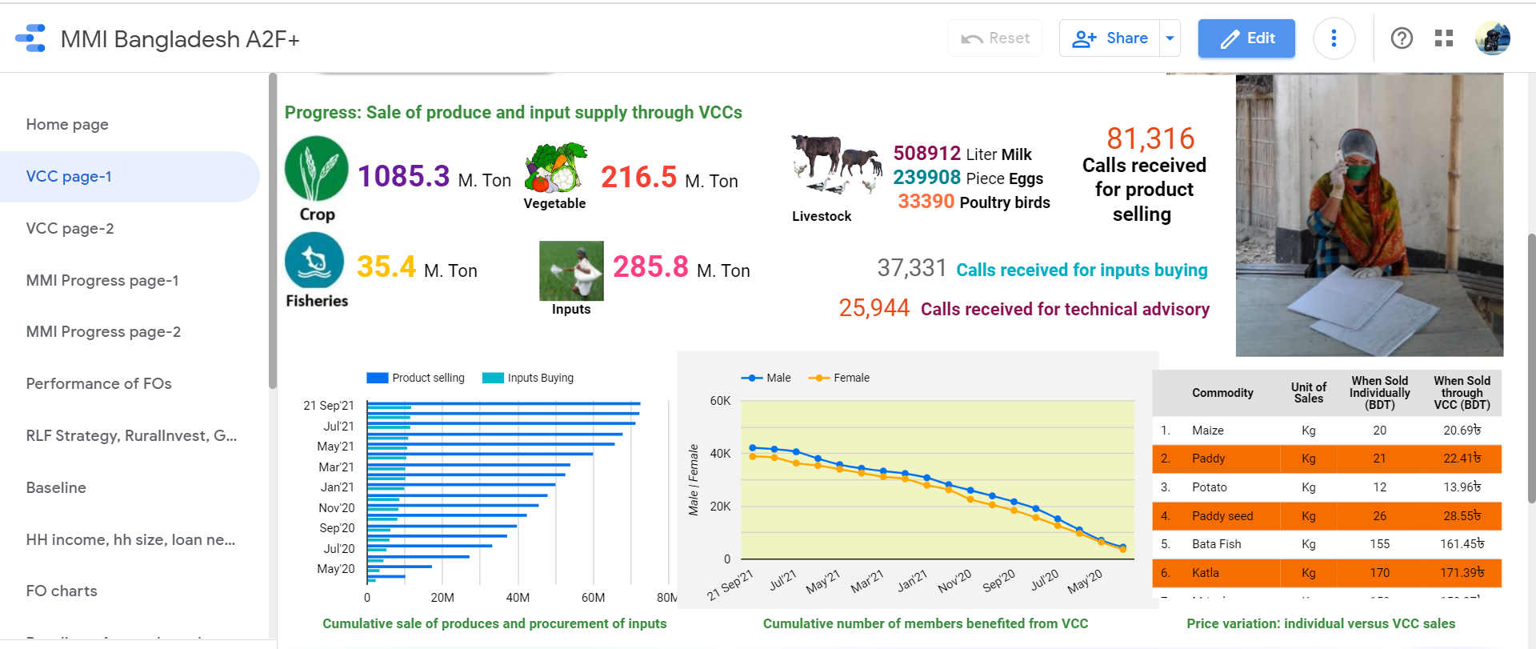
55 Primary; 2 Regional
Your Bill Payment Booth:
Electricity bill
i-top up
School/college/university fee
Admission fee
i-banking/agent banking
Insurance/Premium
Your Information Center:
Agricultural information
Agricultural credit
Climate forecasting (BAMIS)
Land mutation
Land records
Result of public examination
Admit card
Vaccination
Social Safety Net
Passport
Online classes
e-FFS
Business Modules
Service Modules (Non-income)
Community Finance
Value Chain financing
[crop, fisheries, livestock and agro-forestry]
Innovative Financing
USD 389K (NCBs)
USD 910K (FAO-MMI)
USD 660K (C-19)
Digital Village operated by strong POs
Digital Village School
Basic computer skill training for rural youths

Slide 6
Achieving better production in Asia-Pacific through digital agriculture (Achieving better production in Asia-Pacific through digital agriculture - YouTube)
MMI Bangladesh Animation Video (MMI Bangladesh Animation Video - YouTube)
Training VIDEO about safe milk production (Training VIDEO about safe milk production - YouTube)
Virtual Call Centres — how farmers’ organizations in Bangladesh manage to thrive during the pandemic (Virtual Call Centres — how farmers’ organizations in Bangladesh manage to thrive during the pandemic - YouTube)
Digital Village Initiative (DVI) (Digital Village Initiative (DVI) - YouTube)
6. FAO MMI FAOR Visit in Rangpur (FAO MMI FAOR Visit in Rangpur - YouTube)

Slide 7
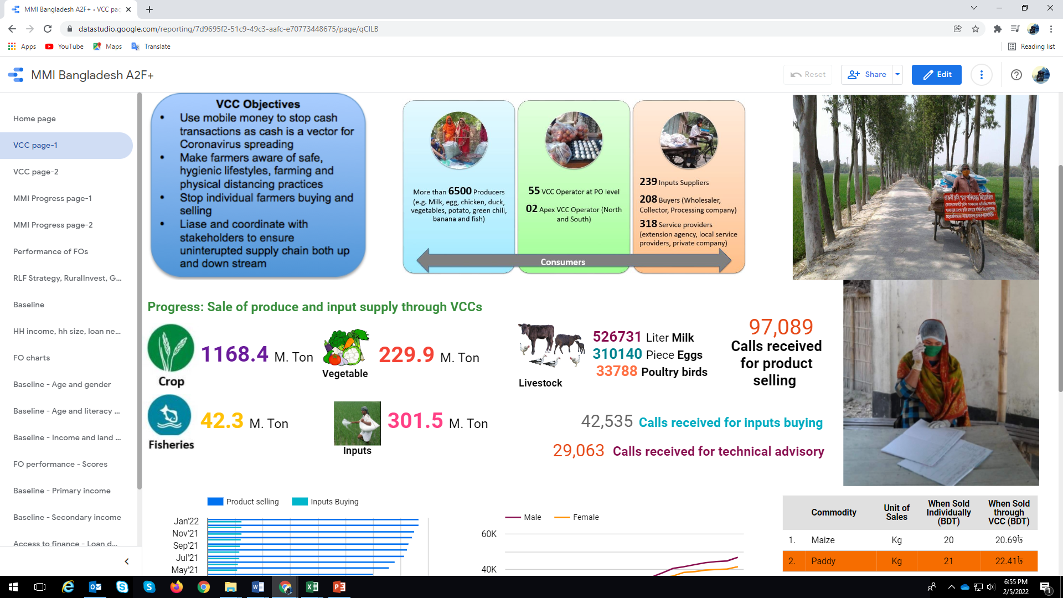
Performance of
55 Virtual Call Centers (VCCs)
bit.ly/COVID_MMI
www.sarabangla.org

Slide 8
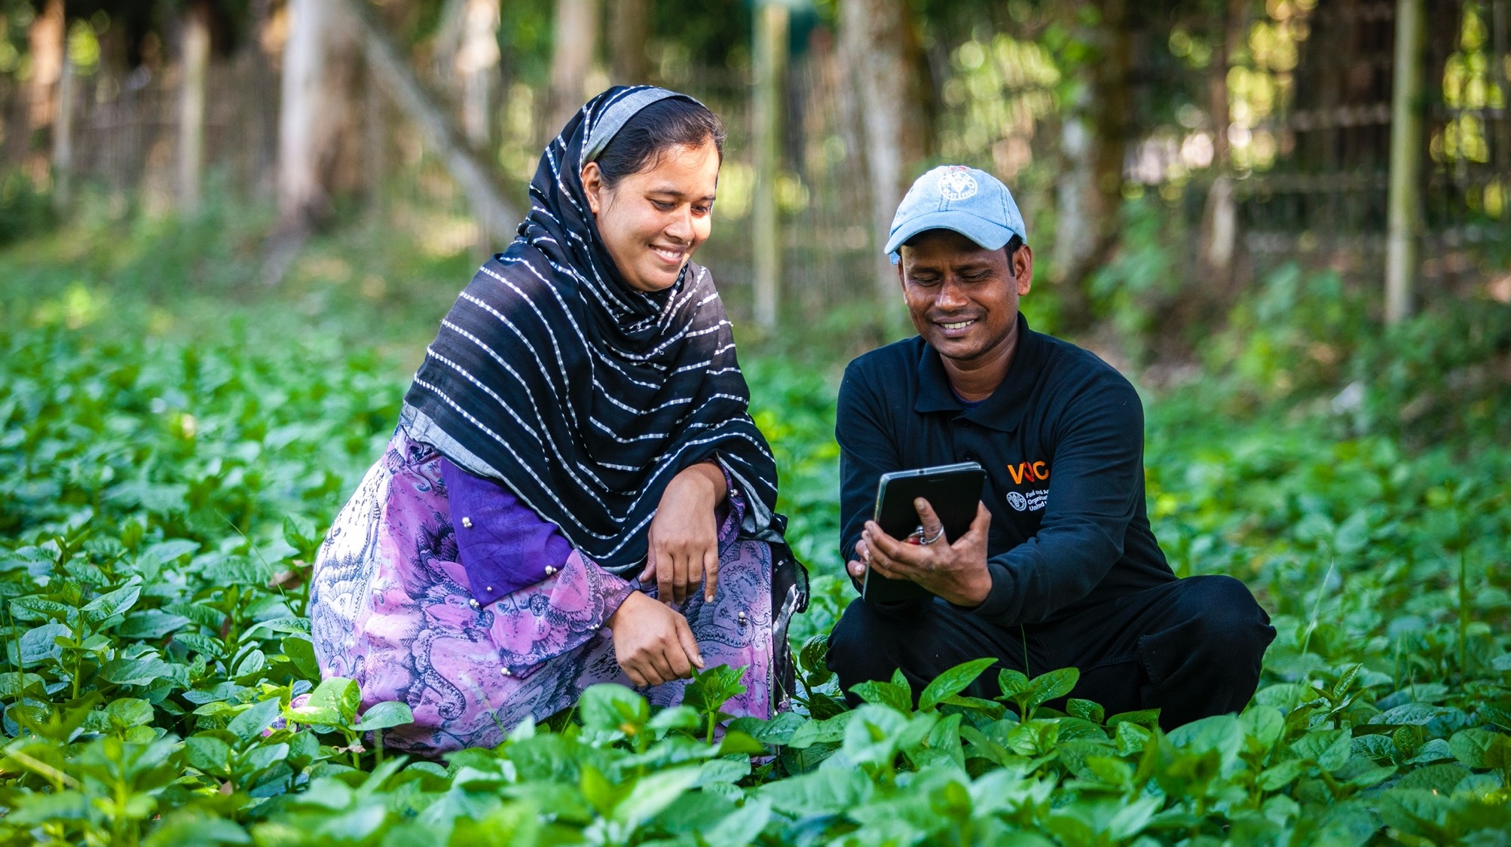
Thank​ You!​

