Slide 1
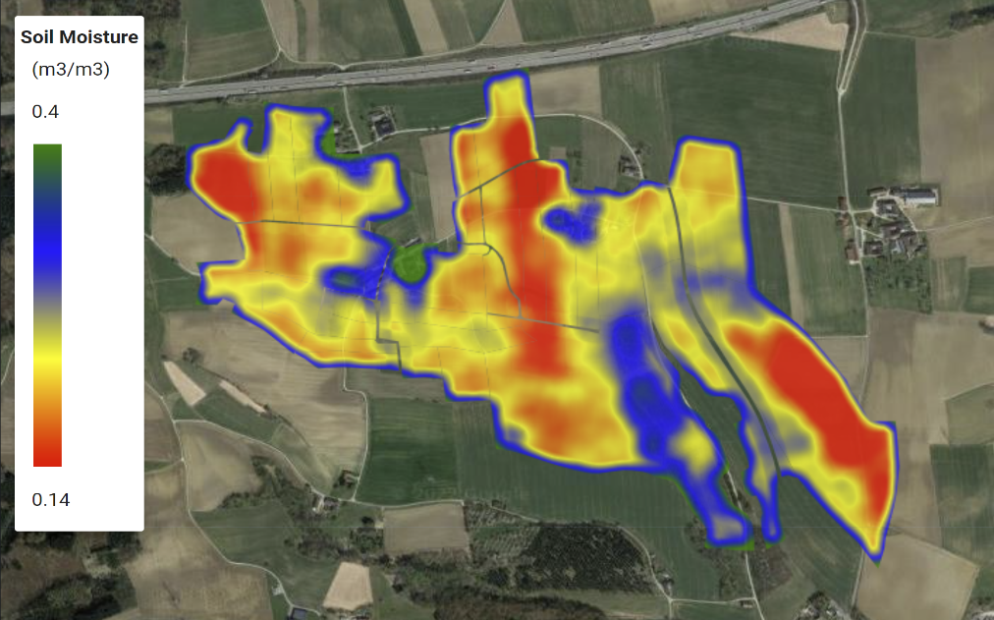
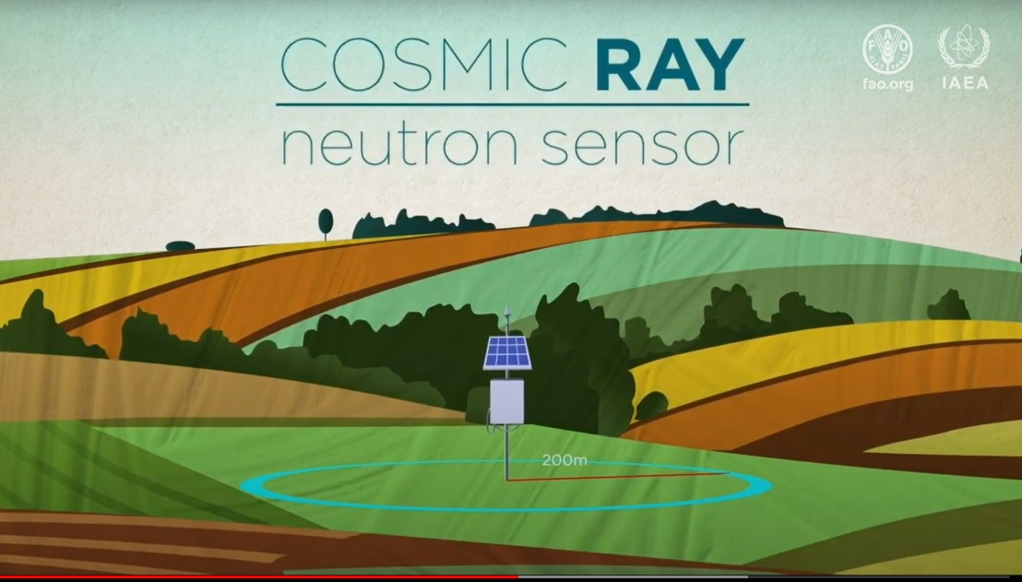
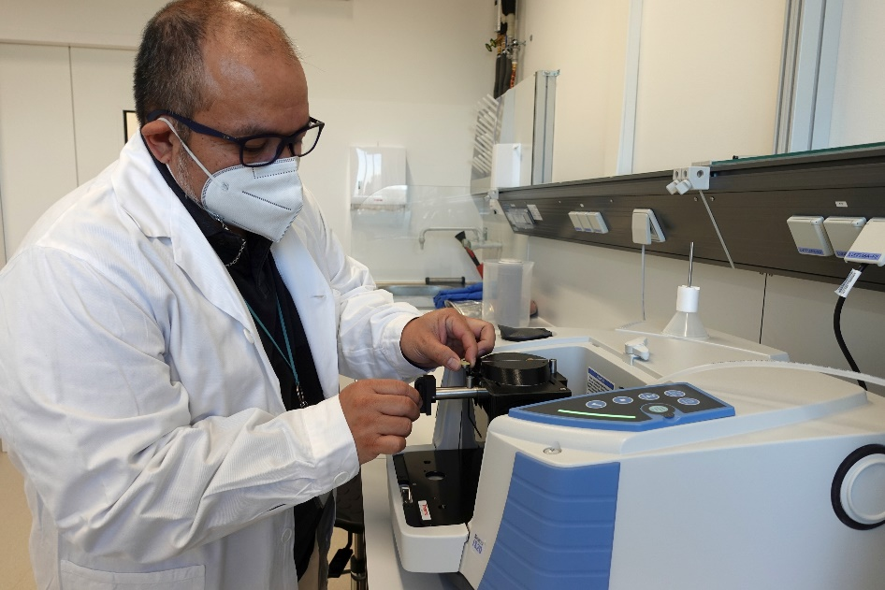
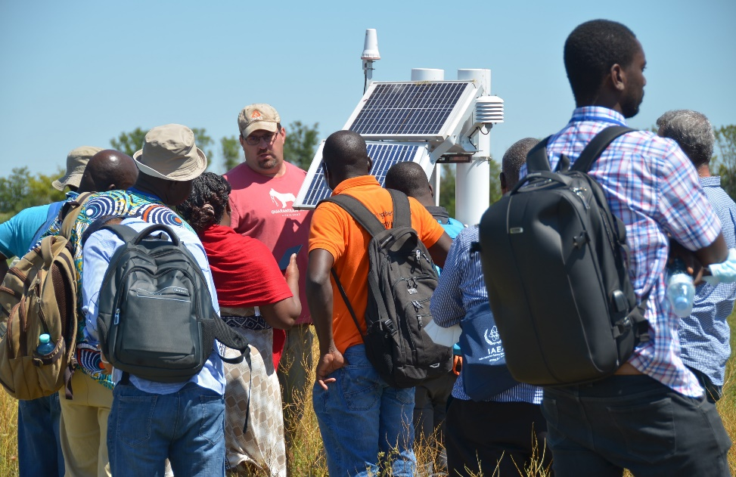
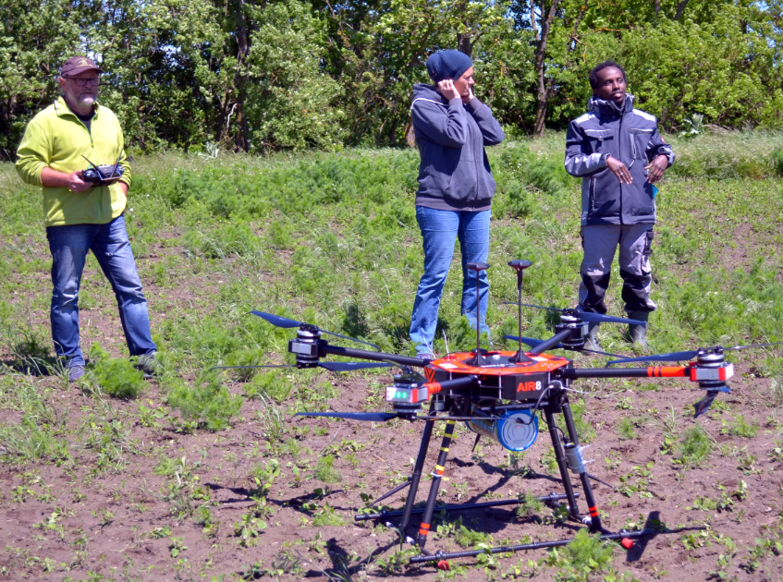
Linking nuclear and digital techniques for enhancing the use and conservation of soil and water resources Gerd Dercon
16 March 2023

Slide 2
Goal of nuclear techniques in the use and conservation of soil and water resources
Agricultural productivity
Resilience to climate change
Remediation of environmental pollution
MEASURING FOR MANAGING

Slide 3
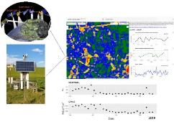
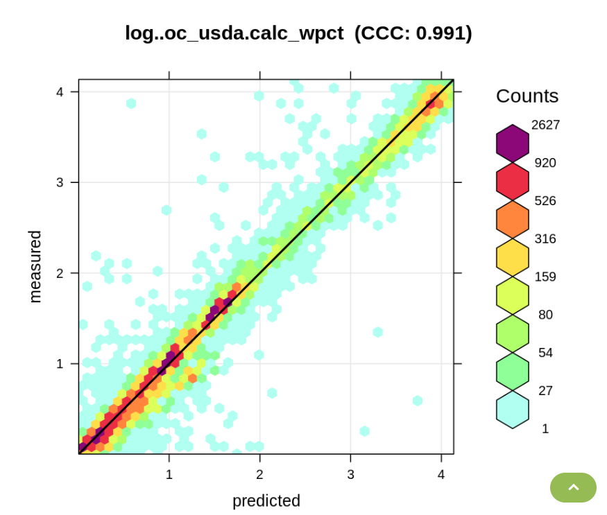
Linking nuclear and digital techniques
Baseline information (e.g. before versus after interventions)
Alternative for conventional labour intensive measurement (e.g. soil moisture, erosion)
Calibration for airborne imagery (satellite imagery, UAV)
Inputs for process modelling (e.g. crop water productivity)
Mathematical processing of big datasets (AI, Internet of Things)
Efficiency and effectiveness of data collection/processing
Nuclear
Digital

Slide 4
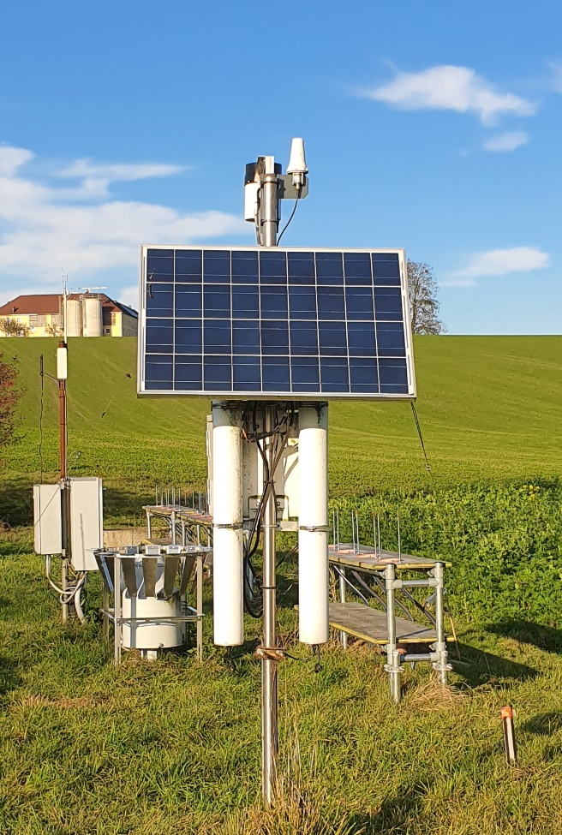
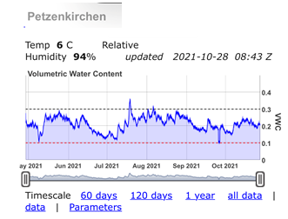
Using cosmic ray neutron sensor for soil moisture monitoring
Cosmic Ray Neutron Sensor (CRNS): From cosmic rays to soil moisture! https://www.youtube.com/watch?v=odZd3aPG8f4

Slide 5
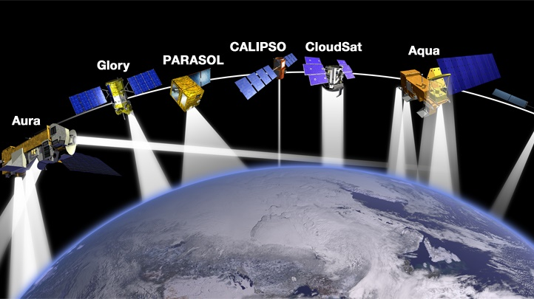
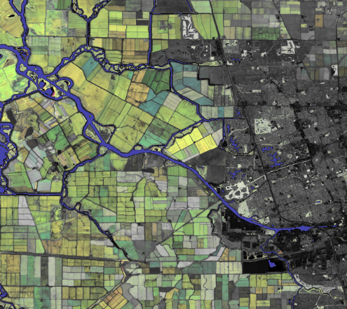
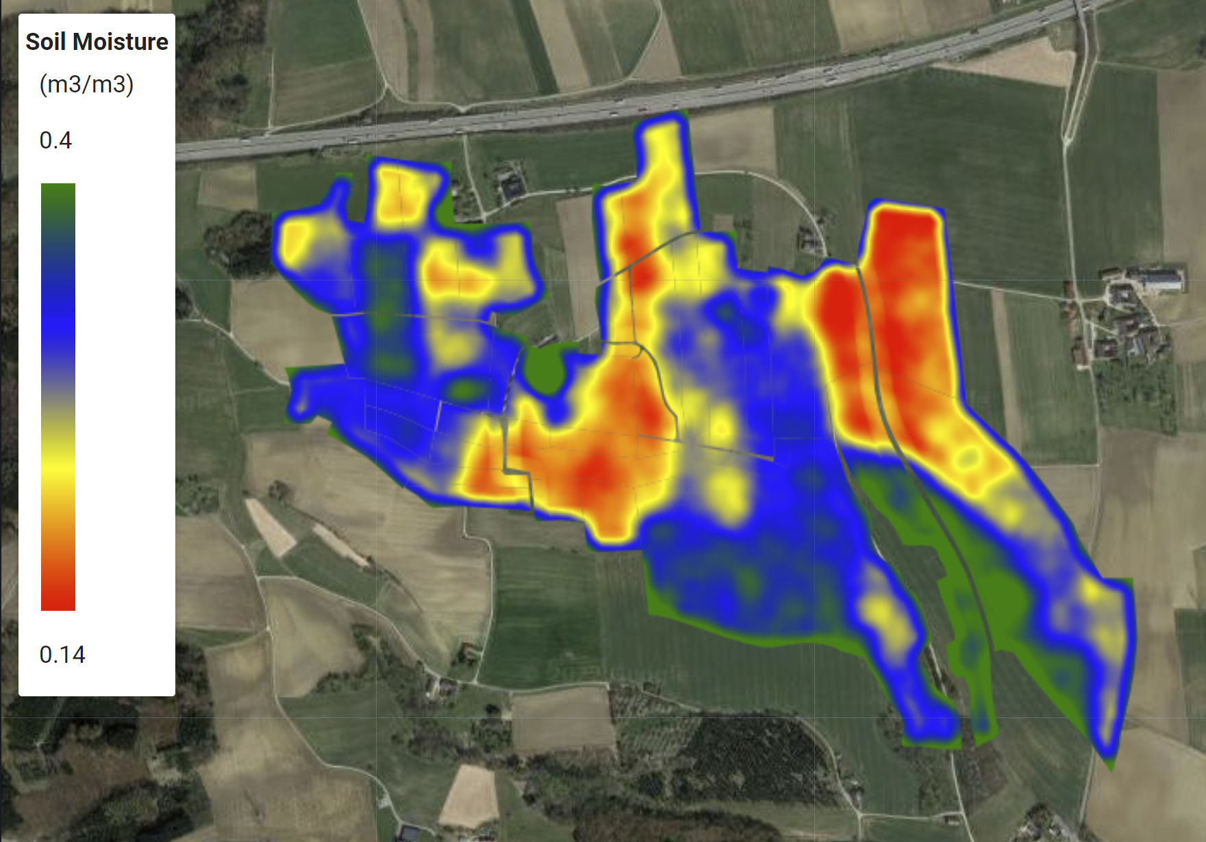
Linking cosmic ray neutron sensors and satellite imagery data
Sentinel-1
Retrieving soil moisture data from satellite images, using cosmic ray neutron sensor data
2020-06-01
2020-06-30
2021-06-01
2021-06-30
Said, H. et al, 2022
Trend analysis and inputs for crop water productivity modelling
Said, H. et al, 2022

Slide 6
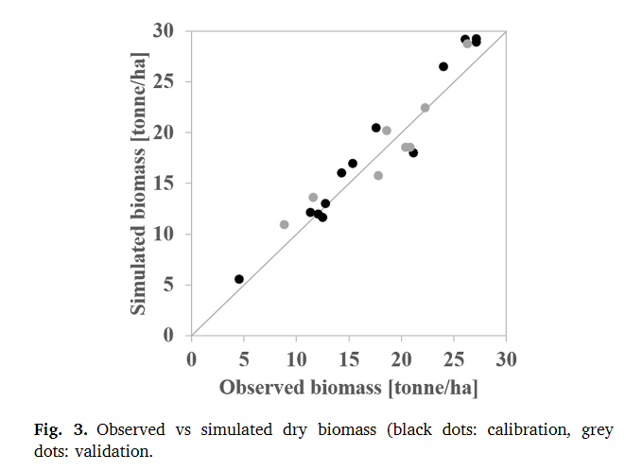
Agricultural water management with AquaCrop model
Synthesizing data/results & extrapolation for other climate scenarios
Developing packages for farmers
Planning mitigation of changing climate patterns
Wellens et al., 2022; for cassava

Slide 7
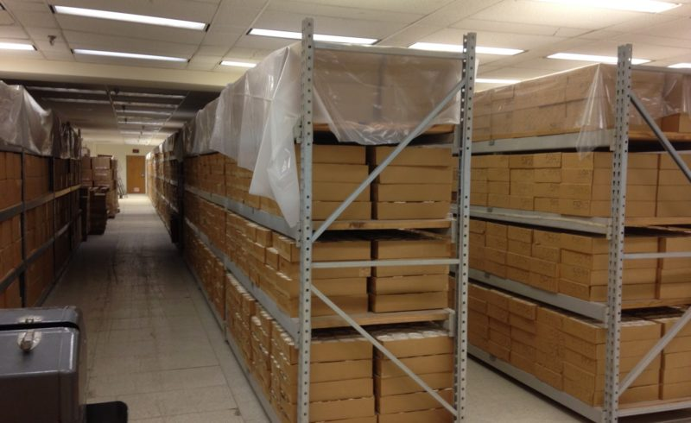
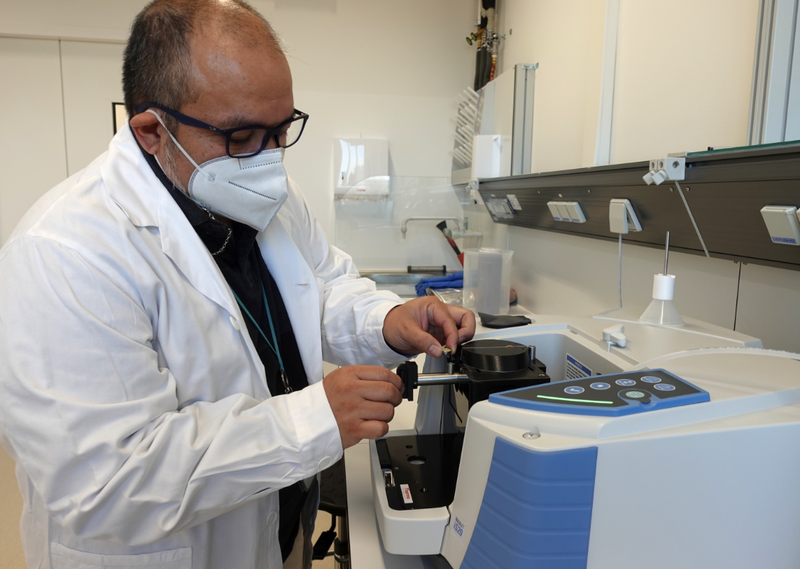
Mathematical processing of big datasets
USDA NRCS National Soil Survey Center – Kellogg Soil Survey Laboratory (NSSC-KSSL)
Now access to larger and growing datasets (e.g. Satellite imagery, soil datasets)
Extremely high capacity model classes
Computational power democratized (financially & technically)
Learning from specific data settings (e.g. emergencies)

Slide 8
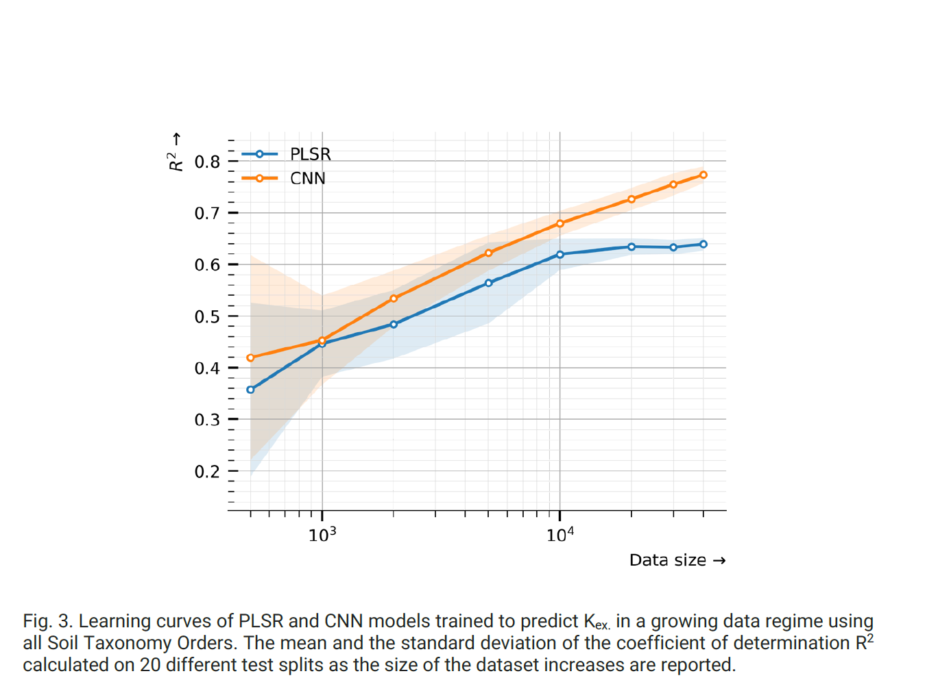
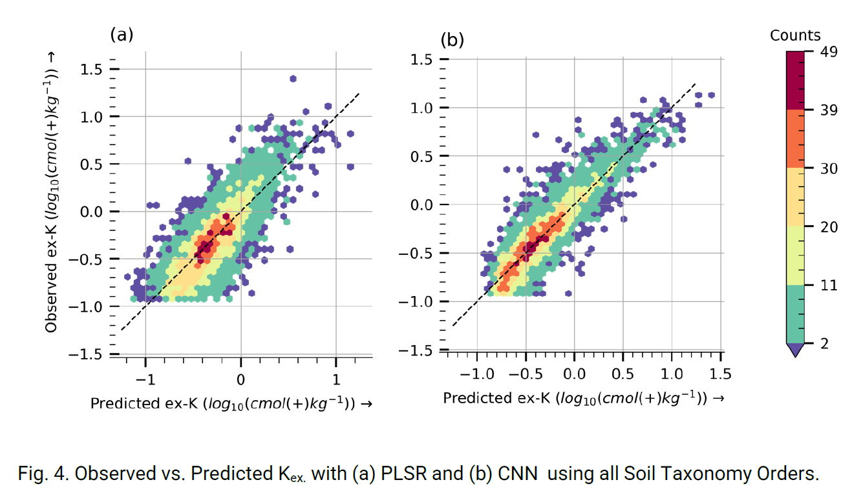
Prediction of Exchangeable Potassium in Soil through Mid-Infrared Spectroscopy and Deep Learning: from Prediction to Explainability (Albinet et al., 2022; Artificial Intelligence in Agriculture)
“Using PLSR as a baseline, CNN leads to a significantly higher prediction performance of K_{ex.} when a large amount of data is available (10000), increasing the coefficient of determination from 0.64 to 0.79 (0.84), and reducing the Mean Absolute Percentage Error from 135% to 31%.”
Prediction of exchangeable potassium in soil through mid-infrared spectroscopy and deep learning: From prediction to explainability - ScienceDirect

Slide 9
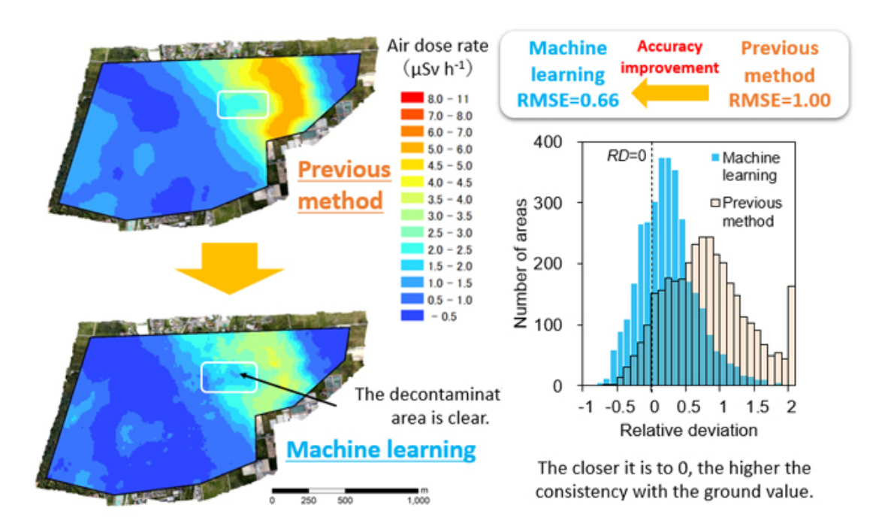
Linking nuclear and digital techniques: Learning from specific data settings (e.g. emergencies)
JAEA, 2021
Measurement of radiation
Challenge:
Merging airborne, mobile or stationary datasets, with different coverage areas and resolution
Vast quantities (in the magnitude of millions of data points)
Experiences from emergencies may help other thematic fields (e.g. airborne gamma spectrometry for soil property mapping)

Slide 10
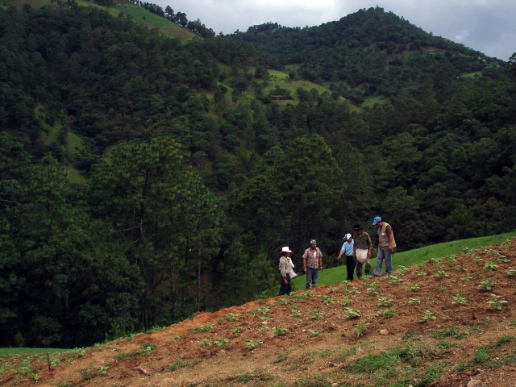
Technical support and capacity building for FAO SoilFER project (Guatemala, Honduras, Zambia)
Infrared and gamma spectroscopy for soil property estimation
Cosmic ray neutron sensor technology and satellite imagery for continuous soil moisture monitoring in representative agro-ecological zones
Control of fertilizer quality

Slide 11
Future prospects – linking nuclear and digital techniques
Increasing availability and affordability of nuclear and digital techniques (mainstream tool)
Integration of nuclear, conventional and digital monitoring technique is a continuous process
Agricultural water management with AquaCrop model
Internet of Things (IoT) for automating processes, predicting situations, even in real-time
Increasing innovation and R&D activities are still needed (more technologies are in the pipeline)
Investment and partnerships are essential
Data management (open data policy)
Training in the integration of nuclear and digital technology
Economic, social and environmental dimensions of soil and water management

Slide 12
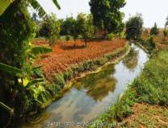
Thank You

