Slide 1
Strategic Alliance and Creation of a Unique CCI France in the UAE
Tuesday 1 June 2021

Slide 2
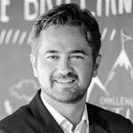
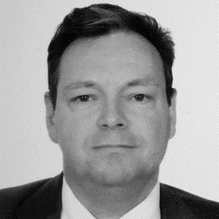
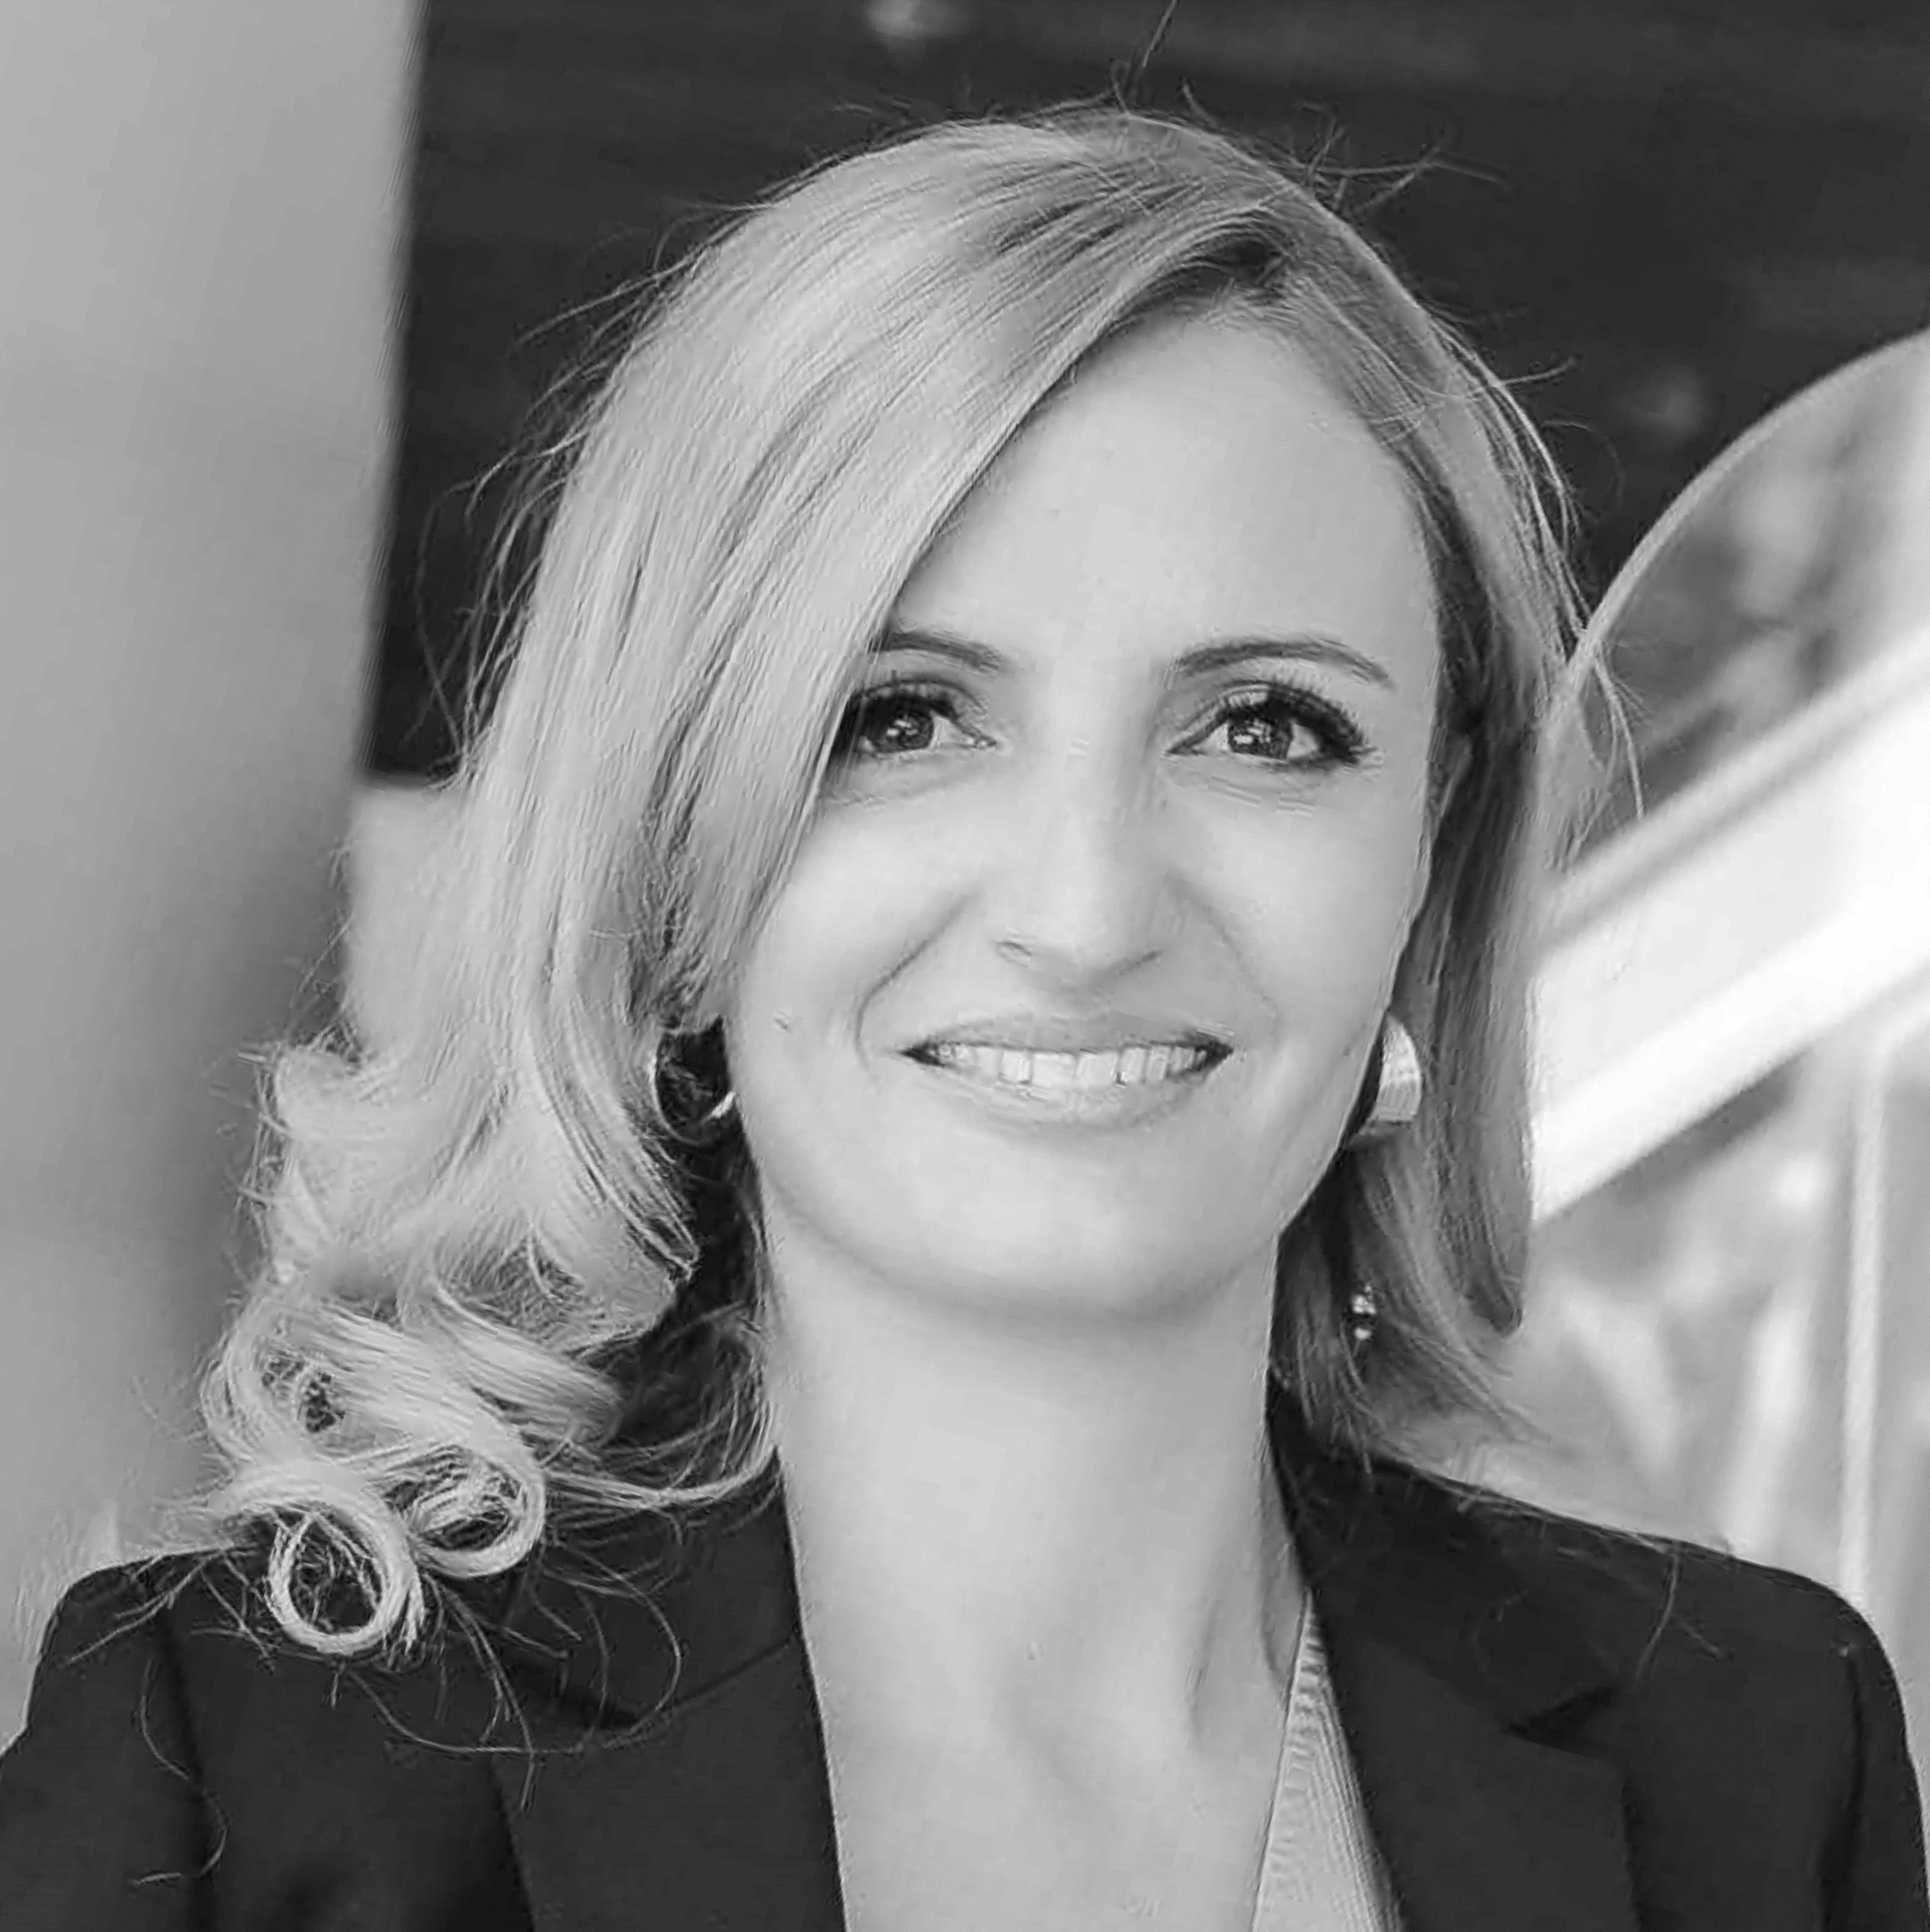
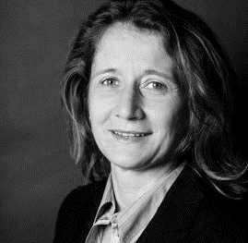
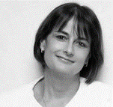
SPEAKERS
Geoffroy
BUNETEL
President
FBC, Dubai &
Northern Emirates
Eric
COHU
President
FBG, Abu Dhabi
Agnès
LOPEZ CRUZ
Managing Director
FBC, Dubai &
Northern Emirates
Hélène
DANIEL
Managing Director
FBG, Abu Dhabi
MODERATOR
Nathalie
AMIEL-FERRAULT
Vice President
FBC, Dubai &
Northern Emirates

Slide 3
AGENDA
12.00-12.20pm: Presentation of the Strategic Alliance Project
Why coming together ?
Our Strategic Alliance Agreement
Our Strategy
Articles of Association: What will change? Key highlights
Strategic Advisory Committee
Our Brand
12.20-12.40pm: What are the benefits of the Strategic Alliance?
Benefits for our Members
Coverage of Activities and Services
Our Future Organization
Road Map
12.40-1.00pm: Q&A session

Slide 4
Presentation of the Strategic Alliance Project
Geoffroy BUNETEL, President – French Business Council, Dubai & Northern Emirates
Eric COHU, President – French Business Group, Abu Dhabi
Moderated by Nathalie AMIEL-FERRAULT, Vice President – French Business Council, Dubai & Northern Emirates

Slide 5
Why coming together?
We are partnering to be stronger and more effective in serving the interests of our business communities.
Our alliance is inspired by the evolution of the Emirates and will be highly symbolic in this year of the Federation’s jubilee and Expo 2020.
The access to our services in the UAE will become simpler for our members and any French company wishing to establish itself in the Middle East.
We will keep two offices (one in Abu Dhabi and one in Dubai) to best meet the needs of our members and local authorities.
A new branding will allow us to strongly capitalize on our network of 124 French Chambers of Commerce in 95 countries.

Slide 6
Our Strategic Alliance Agreement
Adoption of New Articles of Association: similar governance to be voted by both chambers. Extraordinary General Assembly organized on the same day, on Wednesday 23rd June 2021.
Election of a common Board ensuring a unique Governance: election of the new Board in November 2021.
Common Membership and common Directory.
Common Permanent Team and Management: at least until 30 June 2022, the heads of the Permanent team will be:
Managing Director: Agnès Lopez Cruz in charge of the common general management.
Deputy Managing Director: Hélène Daniel in charge of Abu Dhabi office and New Business development.
Deputy Managing Director: Milena Chemin in charge of Dubai office.

Slide 7
Our Strategy

Slide 8
Articles of Association: What will change? Key highlights
Election for 2 years of a common Board of 15 directors: Minimum of 3 Directors resident of Dubai and minimum 3 Directors resident of Abu Dhabi. The Board will govern, oversee and supervise the continuity and directions of the entity.
Election of an Executive Committee of 7 Officers by the Board via a secret ballot. The Exec-Com will meet as often as necessary upon the request of the Chairperson, the General Secretary, the Treasurer, or the Managing Director.
Appointment of a Strategic Advisory Committee for 2 years by the Board.
Quorum is 51% of ordinary members for an Extraordinary General Assembly and 33% for a General Assembly.
The common fiscal year is from 1st January to 31st December.

Slide 9
Strategic Advisory Council
The Strategic Advisory Committee is composed of:
HE the French Ambassador to the UAE
Head of the French economic department based in the UAE
Honorary Chairperson(s)
Chairperson and the 2 vice-chairpersons of the Board of Director
Managing Director
5 members of CCI FRANCE UAE appointed for a term of 2 years by the Board
5 U.A.E. Nationals appointed for a term of 2 years by the Board
The Strategic Advisory Committee is co-chaired by HE the French Ambassador to the UAE and the Chairperson and will meet at least once per year upon invitation from the Board.
Meetings of the Strategic Advisory Committee may be held during external official events such as France and UAE bilateral business convention or conferences.

Slide 10
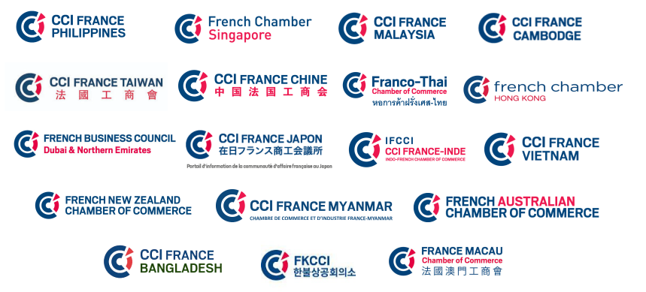
We are Members of the CCI France International Network
124 French Chambers in 95 countries.
Named “French Chamber” or “CCI France”

Slide 11
Our new Commercial Brand
We actively support and commit to the Global Brand of French Chambers established in 95 countries worldwide, delivering:
A consistent and immediately recognizable Brand to Expatriates and French businesses worldwide
A commitment to our new territory, the U.A.E.
A clear reference to our core function “Chambre de Commerce et d’Industrie”.

Slide 12
What are the Benefits of the Strategic Alliance?
Agnès LOPEZ CRUZ, Managing Director – French Business Council, Dubai & Northern Emirates
Hélène DANIEL, Managing Director - French Business Group, Abu Dhabi
Moderated by Nathalie AMIEL-FERRAULT, Vice President – French Business Council, Dubai & Northern Emirates

Slide 13
Benefits for our Members
A wider geographical coverage: our ambition is to offer a complete coverage of the United Arab Emirates, and therefore maintain our physical footprint in Dubai and Abu Dhabi. Our service offering will be extended throughout the country.
A strategic position with the authorities: the CCI FRANCE UAE will be a key player with the French and Emirati authorities to defend the interests of its members and French companies wishing to establish in the country.
Notes:
A wider geographical coverage: our ambition is to offer a complete coverage of the United Arab Emirates, and therefore maintain our physical footprint in Dubai and Abu Dhabi. Our service offering will be extended throughout the country.
A strategic position with the authorities: the CCI FRANCE UAE will be a key player with the French and Emiratis authorities to defend the interests of its members and French companies wishing to establish in the country.
A wider and diversified service offering: this union will allow us to offer the business community a wider range of sectorial and functional committees, covering all of the United Arab Emirates. Depending on the nature of our events, the industries they relate to, they will be scheduled either in Dubai, Abu Dhabi or online.
A stronger and larger business community: our members will have an easier access to a larger business community, to network and develop business opportunities.
A more powerful and impacting visibility: all of our communication tools and platforms will be mutualized. This will give to CCI FRANCE UAE and our members more visibility and enable a more personalized service.

Slide 14
Benefits for our Members
A wider and diversified service offering: this union will allow us to offer the business community a wider range of sectorial and functional committees, covering all of the United Arab Emirates. Depending on the nature of our events, the industries they relate to, they will be scheduled either in Dubai, Abu Dhabi or online.
A stronger and larger business community: our members will have an easier access to a larger business community, to network and develop business opportunities.
A powerful and impacting visibility: all of our communication tools and platforms will be mutualized. This will give CCI FRANCE UAE and our members more visibility and enable a more personalized service.
Notes:
A wider geographical coverage: our ambition is to offer a complete coverage of the United Arab Emirates, and therefore maintain our physical footprint in Dubai and Abu Dhabi. Our service offering will be extended throughout the country.
A strategic position with the authorities: the CCI FRANCE UAE will be a key player with the French and Emiratis authorities to defend the interests of its members and French companies wishing to establish in the country.
A wider and diversified service offering: this union will allow us to offer the business community a wider range of sectorial and functional committees, covering all of the United Arab Emirates. Depending on the nature of our events, the industries they relate to, they will be scheduled either in Dubai, Abu Dhabi or online.
A stronger and larger business community: our members will have an easier access to a larger business community, to network and develop business opportunities.
A more powerful and impacting visibility: all of our communication tools and platforms will be mutualized. This will give to CCI FRANCE UAE and our members more visibility and enable a more personalized service.

Slide 15
Coverage of Activities and Services
Events
8 sectorial committees: Construction, Food & Beverage, Healthcare, Luxury & Retail, New Tech & Innovation, Energy, Supply Chain, Sustainability
6 functional committees: MarCom CFO, HR, Diversity, Women Empowerment, Legal, CDO
Events will take place in Dubai, Abu Dhabi, or online.
Business support and back office
admin., finances, events, communication, marketing…
Optimizing tools: one website, one CRM, common social media pages, one Members’ Directory, one invoicing system.
Business consulting services
commercial support, business set up consultancy, business centre, VIE coaching, B2B Mentoring, recruitment…)
New businesses and partnerships

Slide 16
Our Future Organization – 17 employees
Managing Director
Agnès Lopez Cruz
Deputy Managing Director
Abu Dhabi + New Business
Hélène Daniel
Deputy Managing Director
Dubai
Milena Chemin
Communication & Digital Strategy
Key Account Managers – Dubai
Key Account Managers –
Abu Dhabi
Services + Dubai
Services + Abu Dhabi
Marketing / Events
Finance / Support
Offices in Dubai and Abu Dhabi will be maintained.

Slide 17
Road Map
Full introduction of the new Articles of Association, Board, Executive Committee, and Organization
New branding
CCI FRANCE UAE
Extraordinary General Assembly Results of the vote and next steps
Election of the new board
Officially
CCI FRANCE UAE
Vote closes
Votes
Interim Period : Preparation of the Board elections, combining teams and planning for implementation. Previous Articles of Association apply until the end of the Interim period.
Vote opens
Interim Period
2 June 2021
23 June 2021
November 2021
January 2022
1 September 2021
1 December 2021

Slide 18
Members, we Count on Your Vote !
Voting Members: The official representatives of your company listed on the directory will be able to vote online from Wednesday 2 June to Wednesday 23 June 2021, 7.30pm.
On Wednesday, 2nd June, you will receive an email from invitations@mail.electionbuddy.com containing a unique access key which can only be used to vote once.
If you don’t receive it, please check your spam.
If you still don’t receive it, please contact us at: fbc@fbcdubai.com or events@fbgabudhabi.com
Your vote will remain anonymous.

Slide 19
Questions & Answers

Slide 20
Thank you. The Vote will open tomorrow, Wednesday 2nd June. We count on you !

