Slide 1
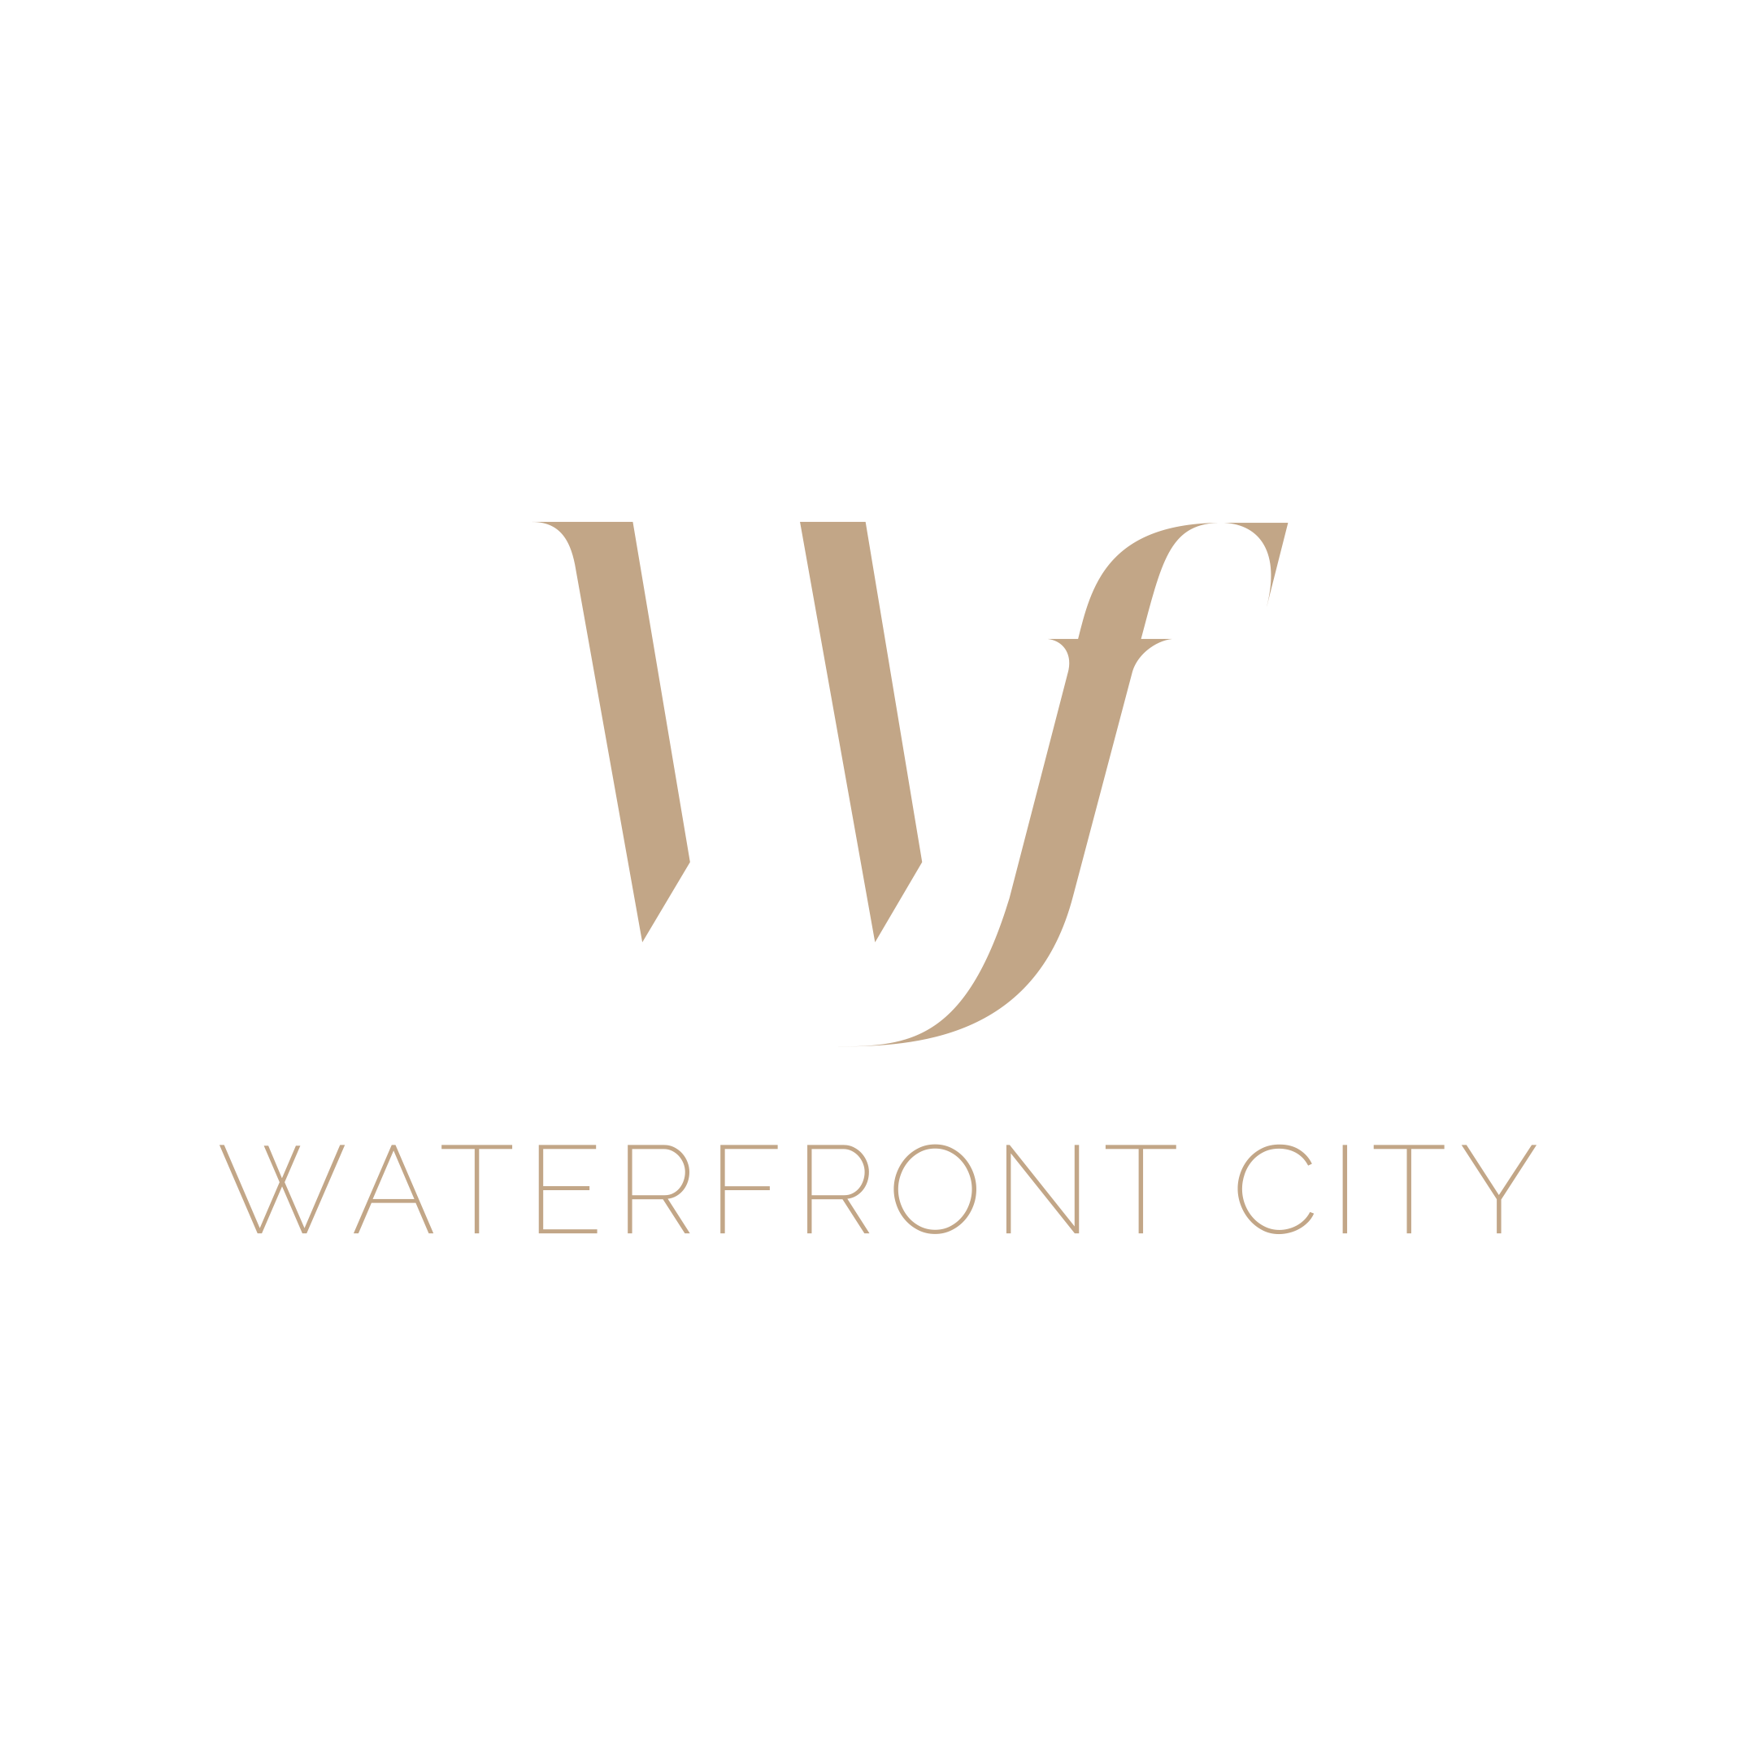
A NEW NEIGHBORHOOD IS BORN
BY THE DANUBE RIVERBANK OF ÓBUDA

Slide 2
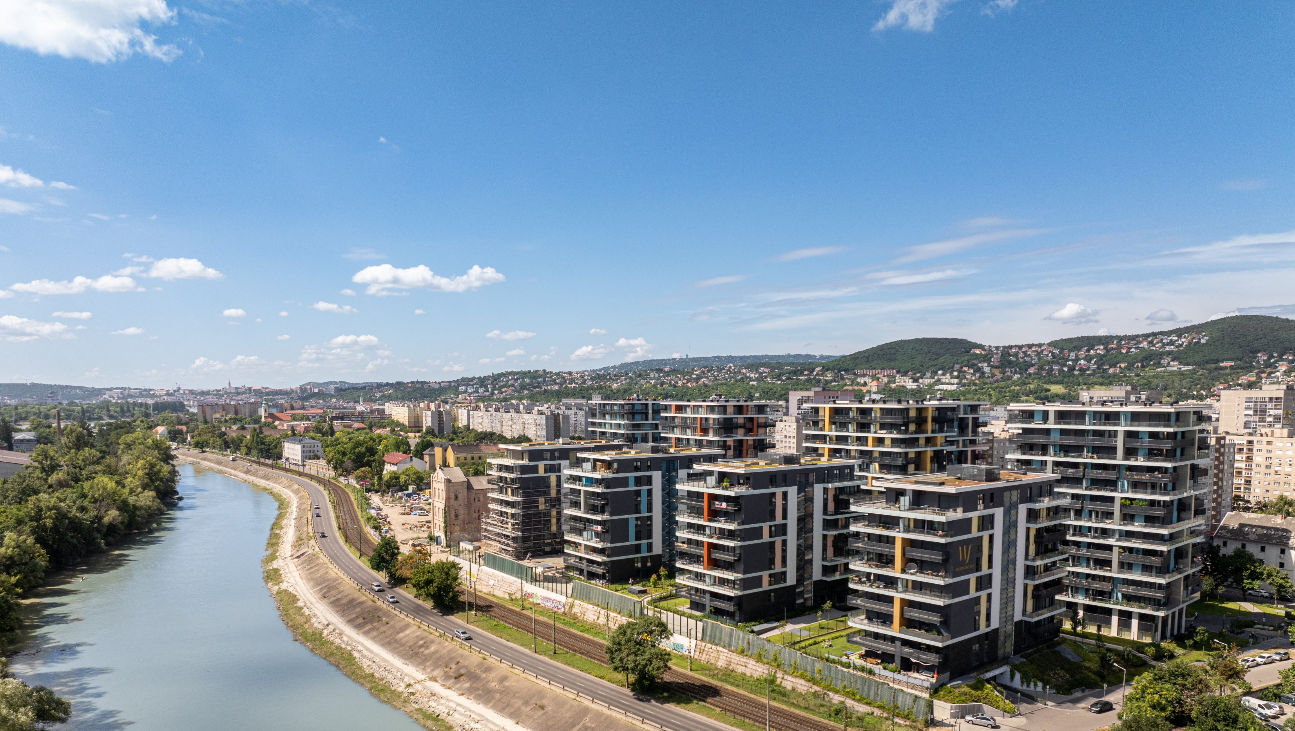

Slide 3
DEVELOPMENT CONCEPT
Neighborhood-scale residential development
on a 5-hectare land
’15-minute city’ concept
with supporting infrastructure and services
1.640 apartments
3.000 sqm retail, office and hospitality space
92.136 sqm
gross sellable area
in total
17 buildings
8 phases
I-IV: completed
2021-2024
V-VIII
to be completed 2026-2030
Ideally located:
wellbeing + accessibility
large green areas
multimodal community
transportation hubs

Slide 4
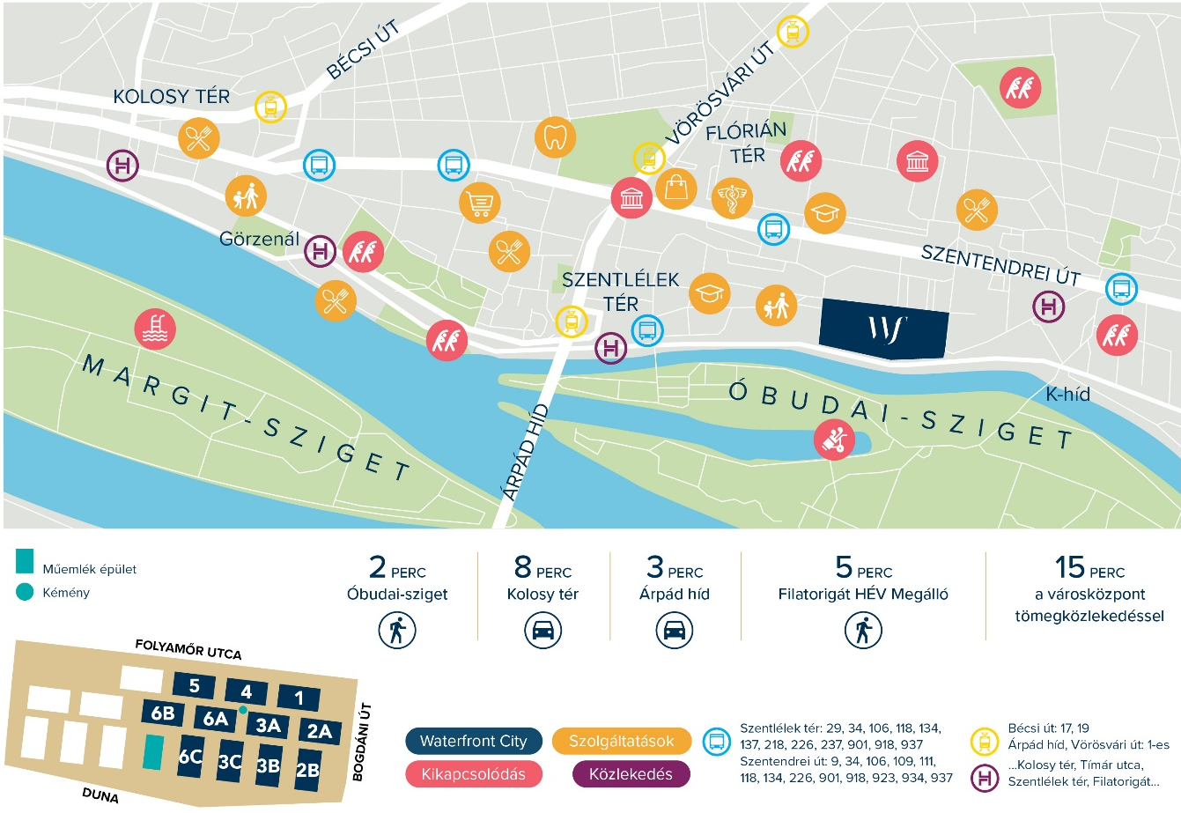
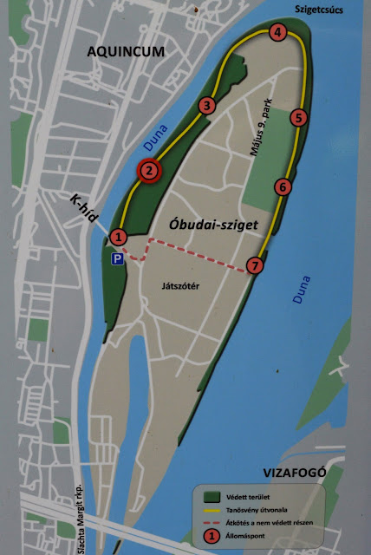
LOCATION

Slide 5
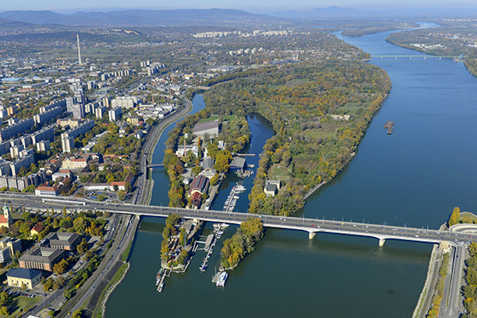
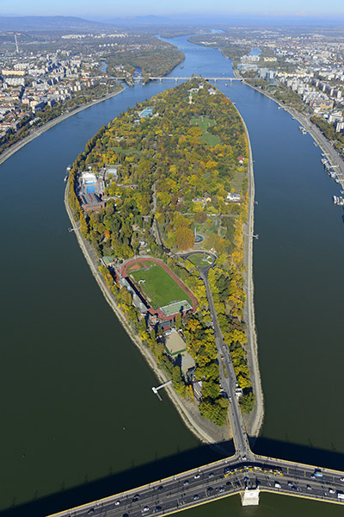
GREEN DEVELOPMENT
With the rehabilitation of the brownfield, former industrial area classified as a ’rust belt’, this Danube-front development will be integrated into the bloodstream of Budapest and, through further infrastructure developments, can become the new, secondary city center of Óbuda.
The green areas of Margaret Island and Óbuda Island will give WFC all the natural and health advantages of Budapest's 'largest park’.

Slide 6
HISTORICAL OVERVIEW
Roman Empire:
urban and military
use of the area
Early 20th century:
industrial zone,
later urban area with
residential buildings
until the end of
the 1980s
2017:
BGP launched WFC
change of
zoning plan,
urban development agreement
with the local Municipality
At the end
of the 90s:
industrial
production systems changed, the area’s
industrial significance decreased
2007:
land purchase
from Austrian owner
The economic crisis stopped
the project launch

Slide 7
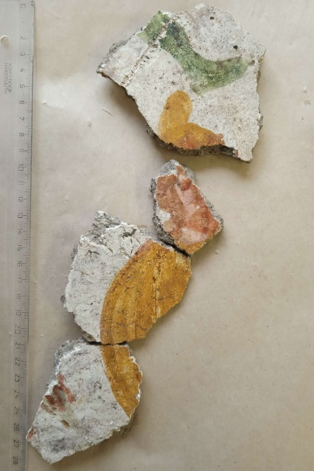
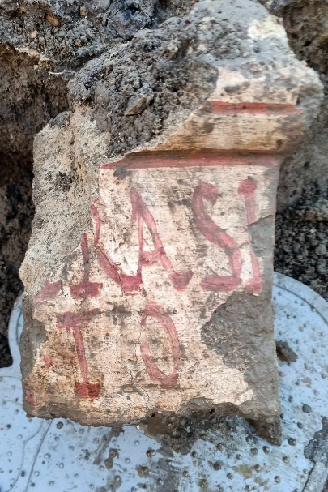
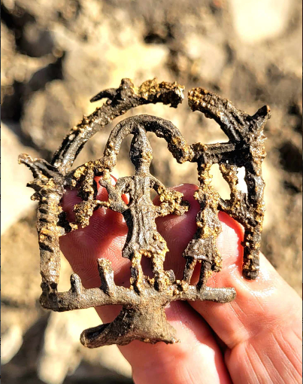
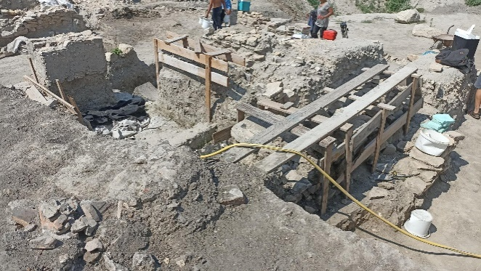
ARCHEOLOGICAL ASPECTS
A unique archaeological site of historical importance has been discovered in the Waterfront City development area with numerous artifacts and the ’Shrine of Mithras’, which will be displayed for general public viewing in the near future.

Slide 8
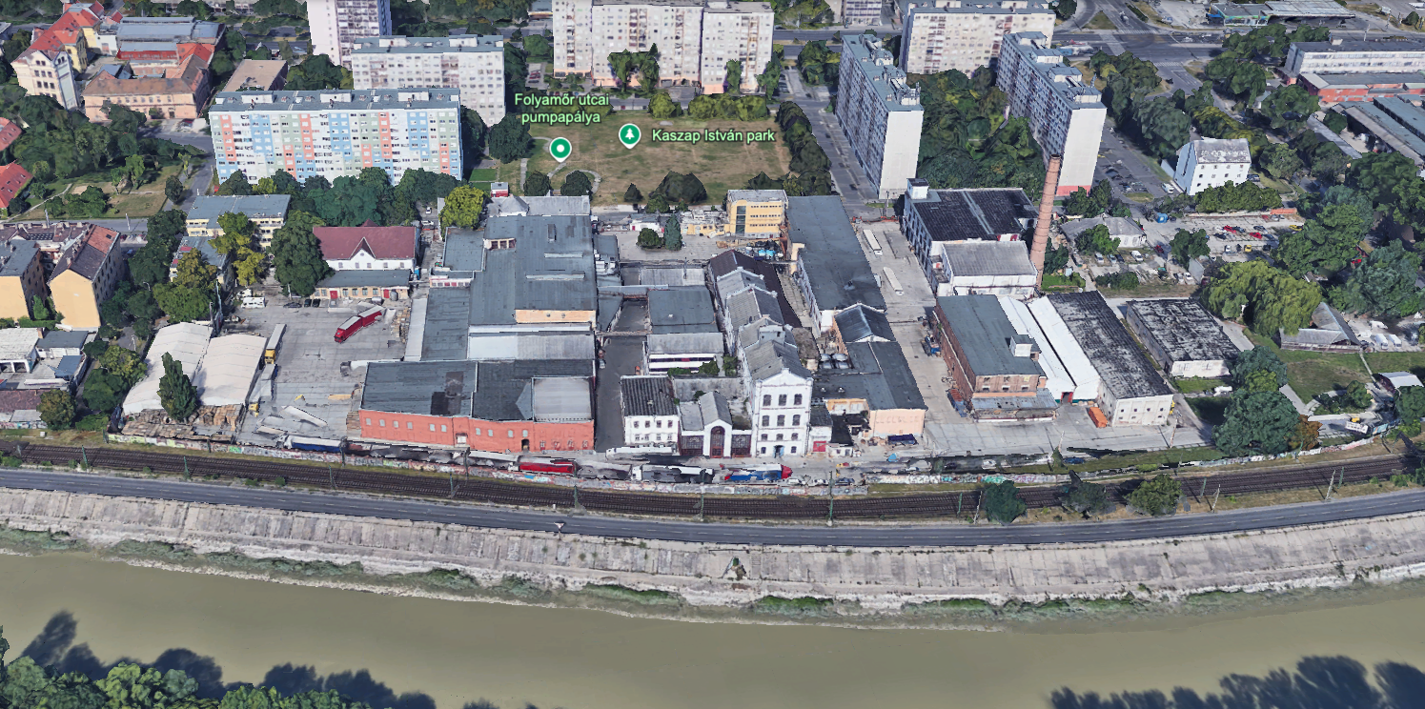
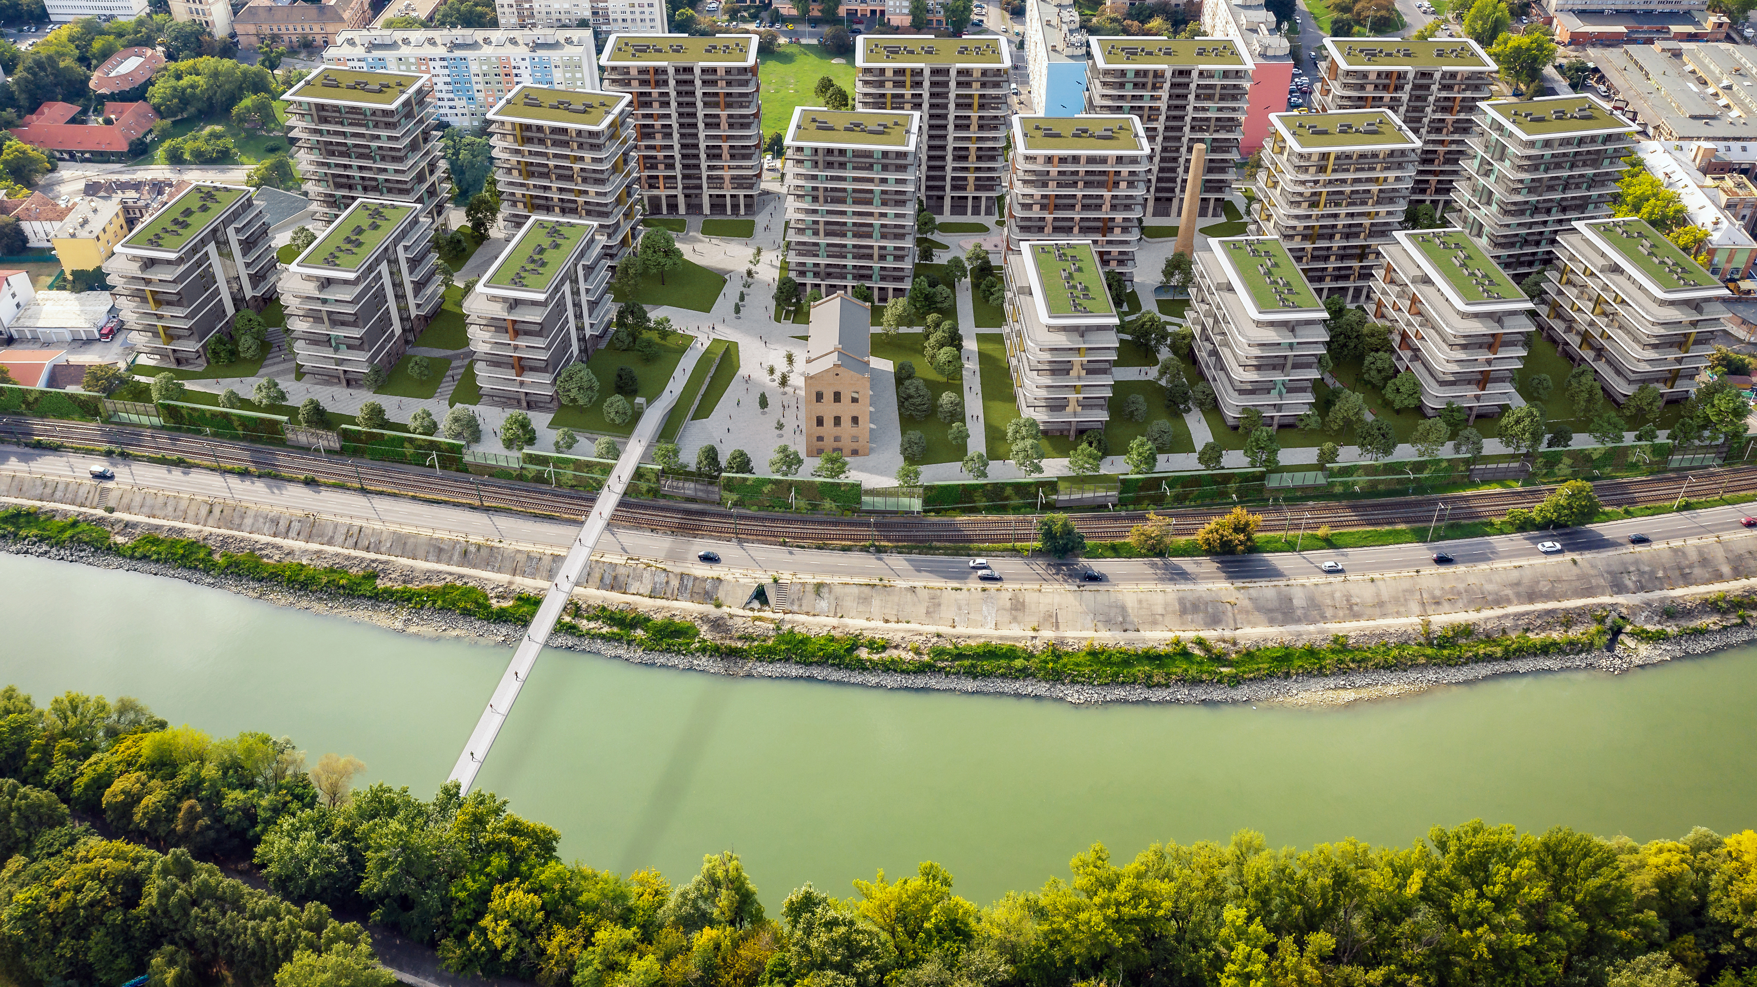
DESIGN
The 125,000 sqm gross floor area is accommodated in 17 buildings. Those in the two back rows are GF+13 floors high, while those on the Danube bank are GF+8 floors high. The lengths of the buildings are characteristically different from those of the adjacent residential blocks. The longitudinal axis of the Danube-side buildings is similar to that of the heritage building, thus creating a link between the old and new buildings despite the differences in size, while granting great views to buildings in rows 2 and 3.

Slide 9
DESIGN
An important consideration in the design of the appearance of the buildings was that they should form an ensemble, but despite their similarities, there should not be two buildings with identical facades. A key element of the façade design is the different color and size of the terraces on the floors above each other, giving the buildings a lower level appearance and reducing the number of façade elements.

Slide 10
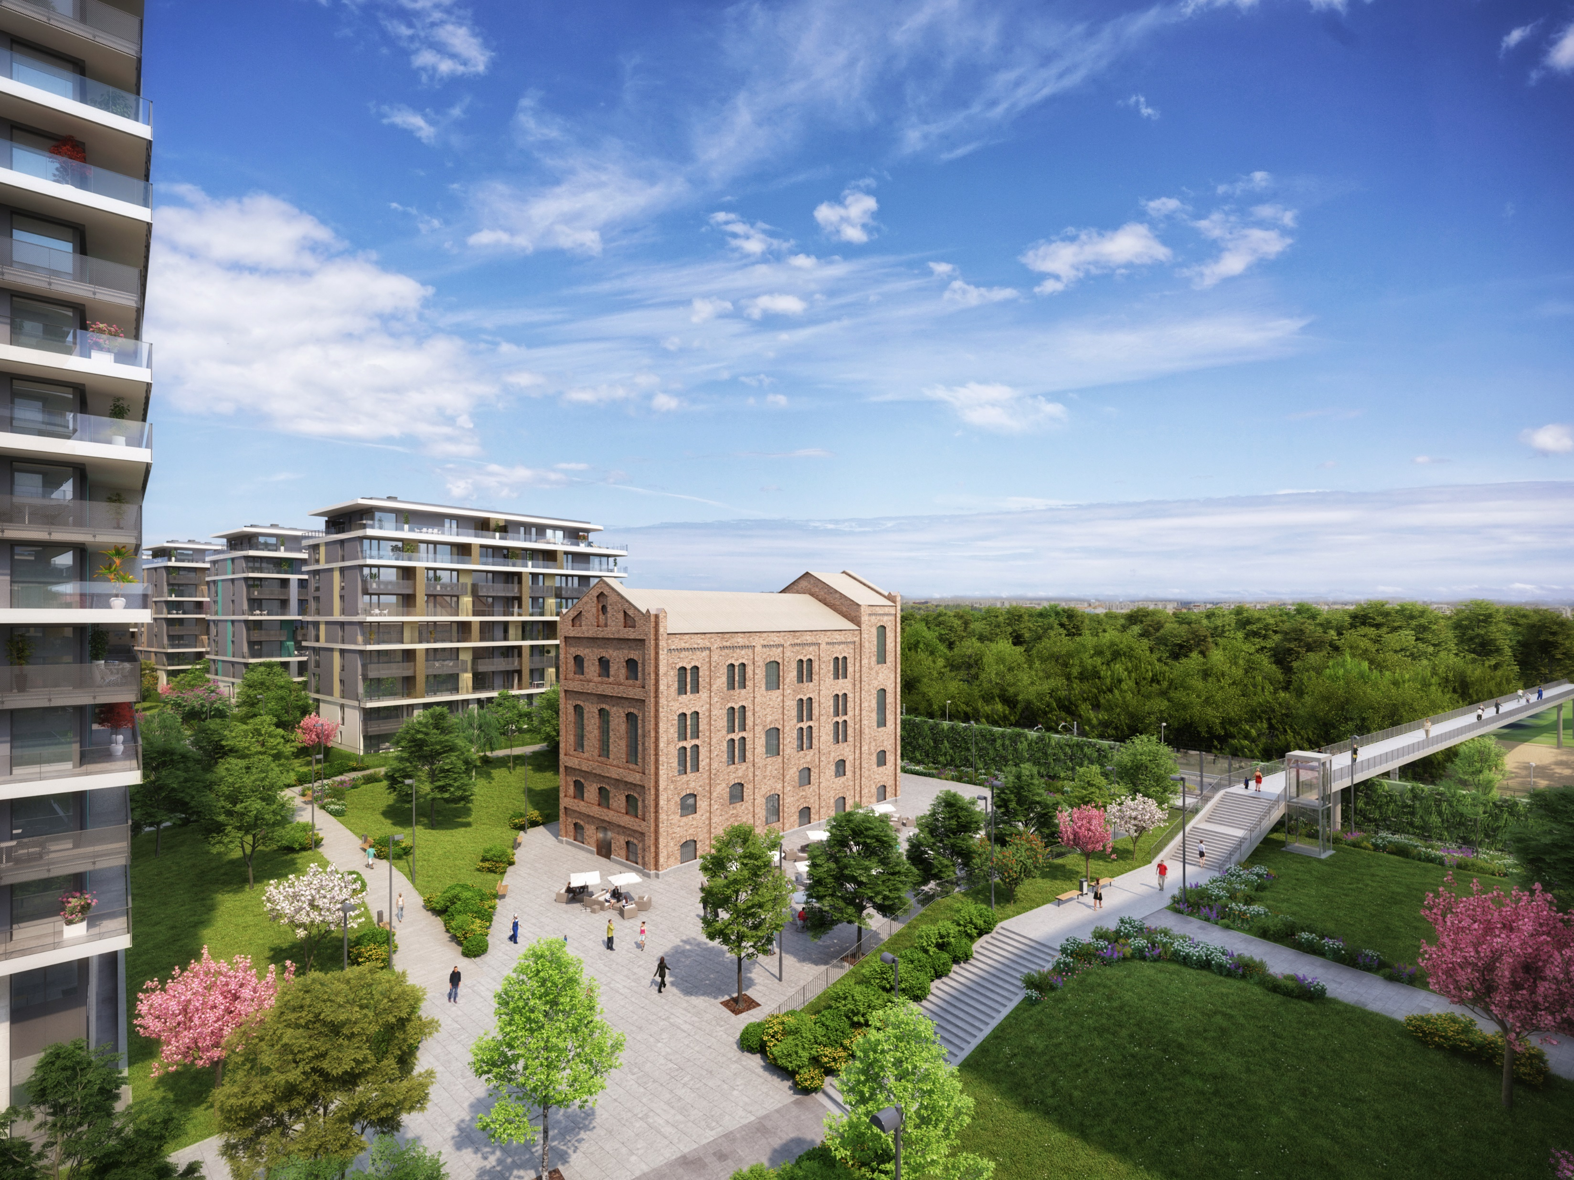
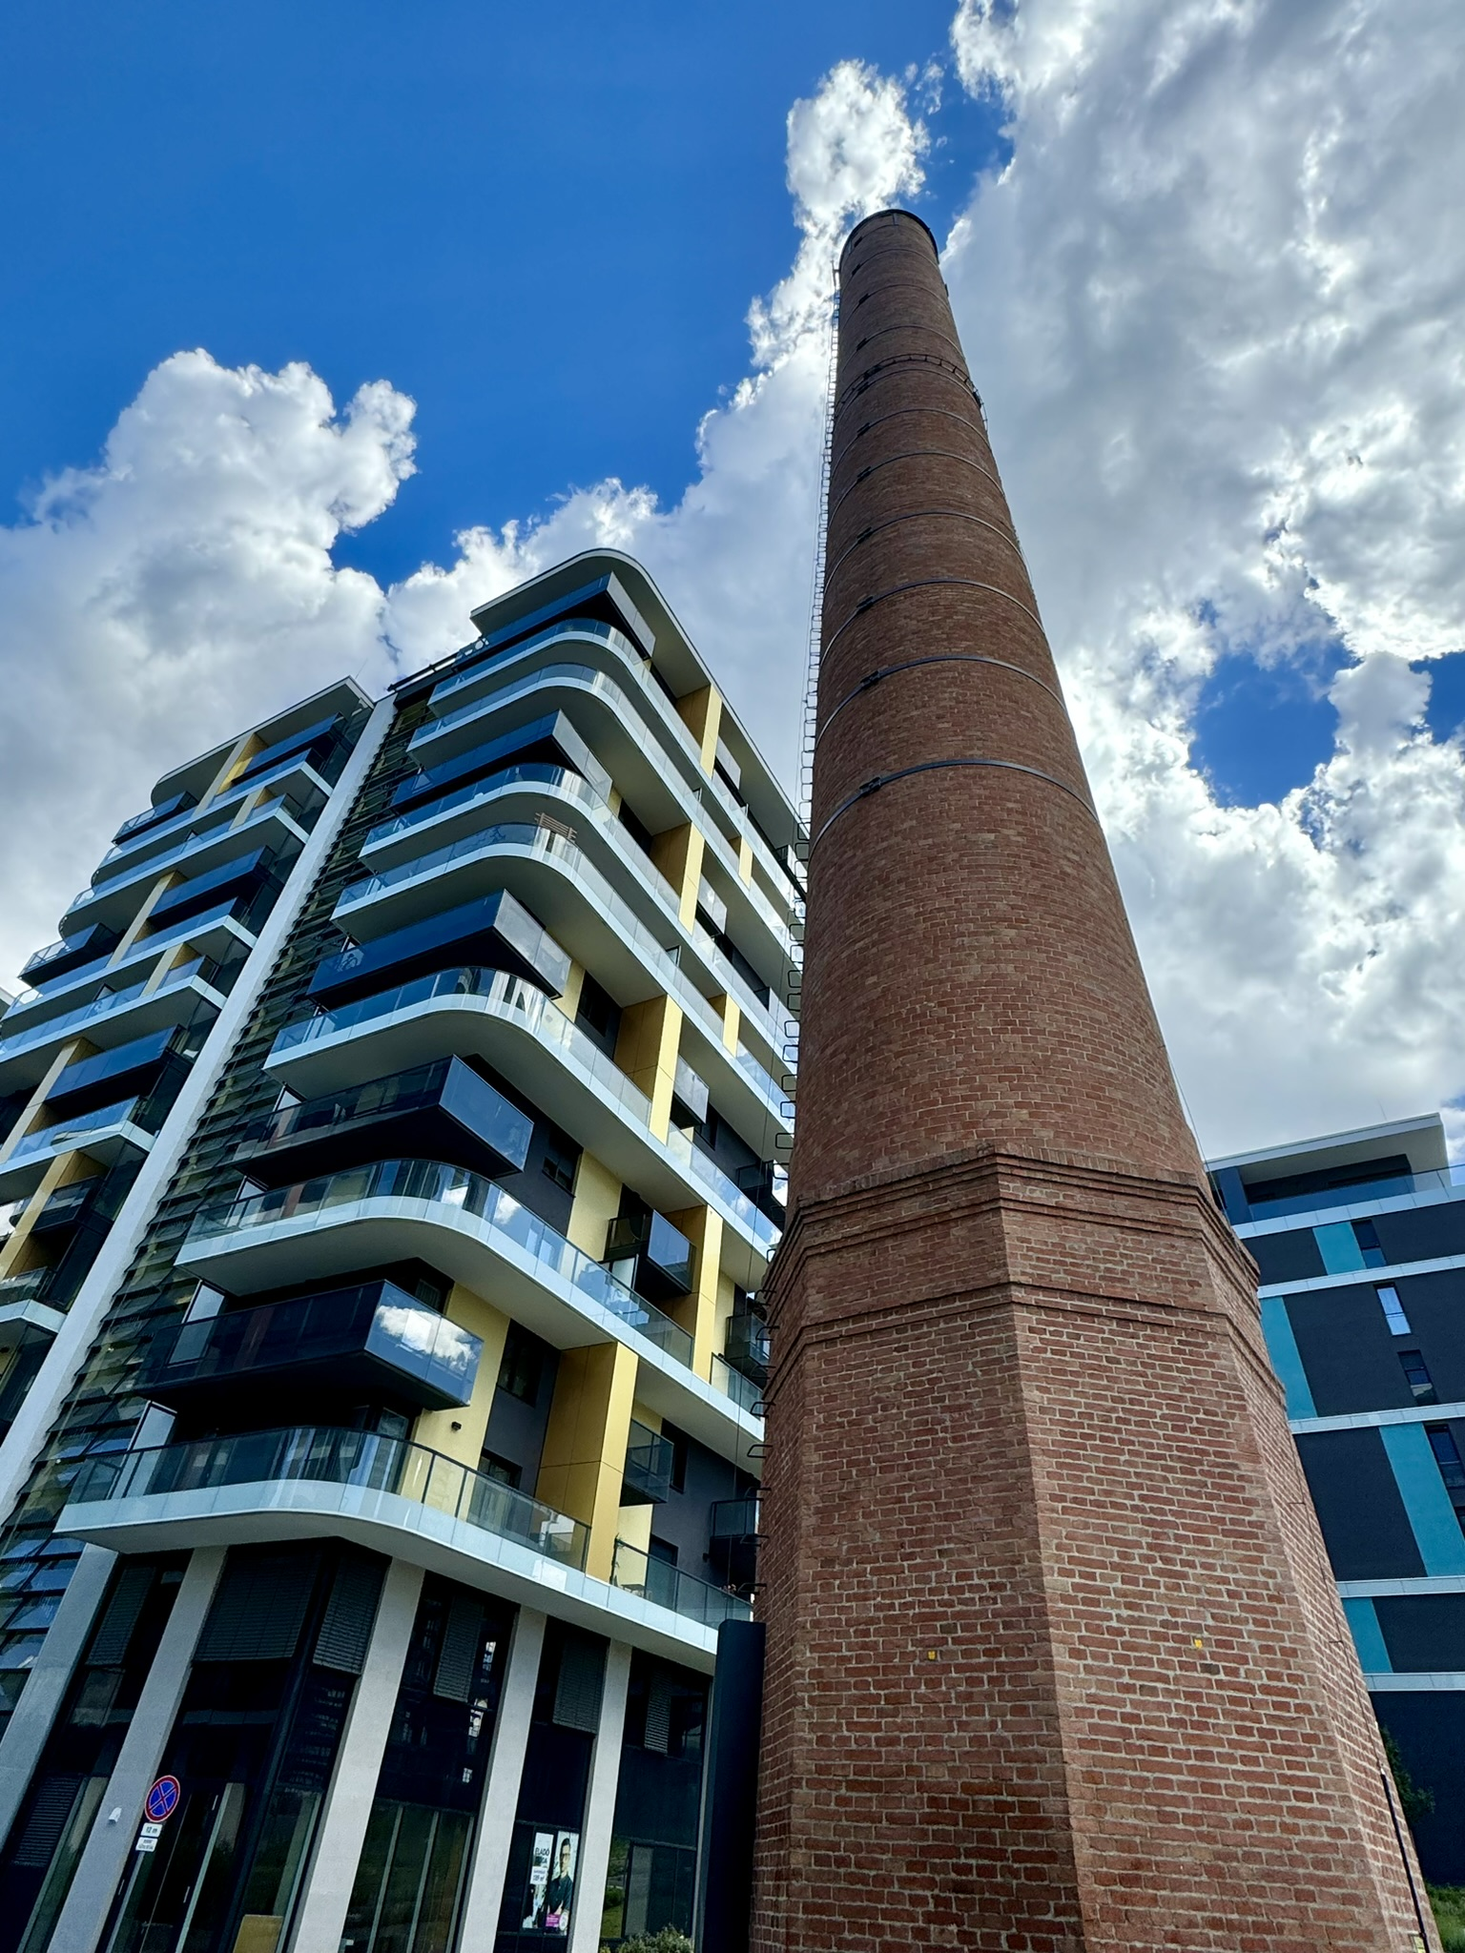
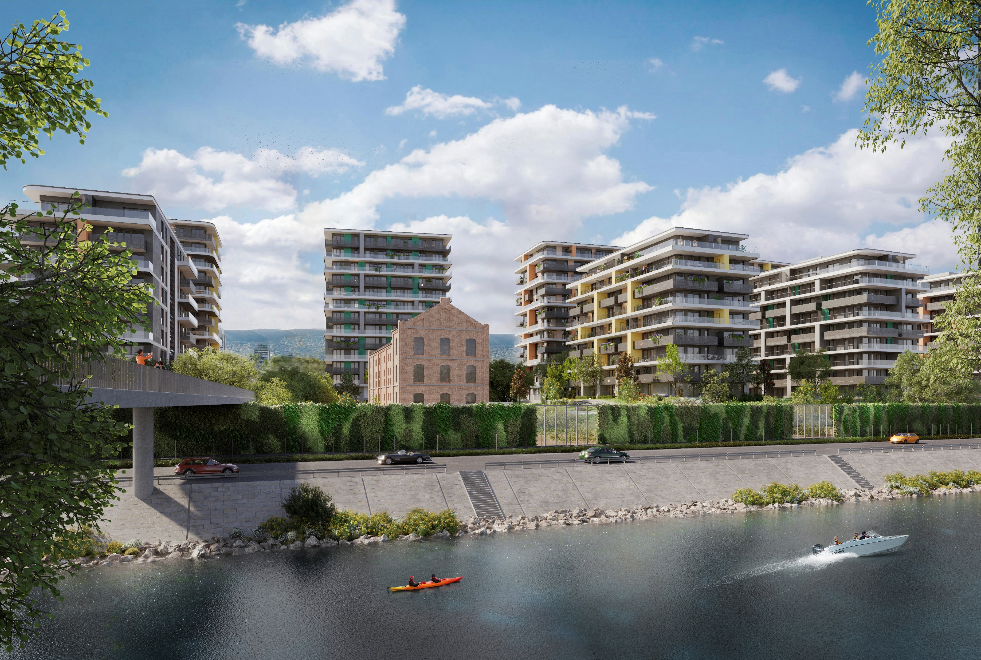
DESIGN
Referring to the former function of the area the heritage protected Óbuda Distillery’s emblematic factory building and red-brick chimney have been integrated into the overall architectural landscape of the project in their original state.

Slide 11
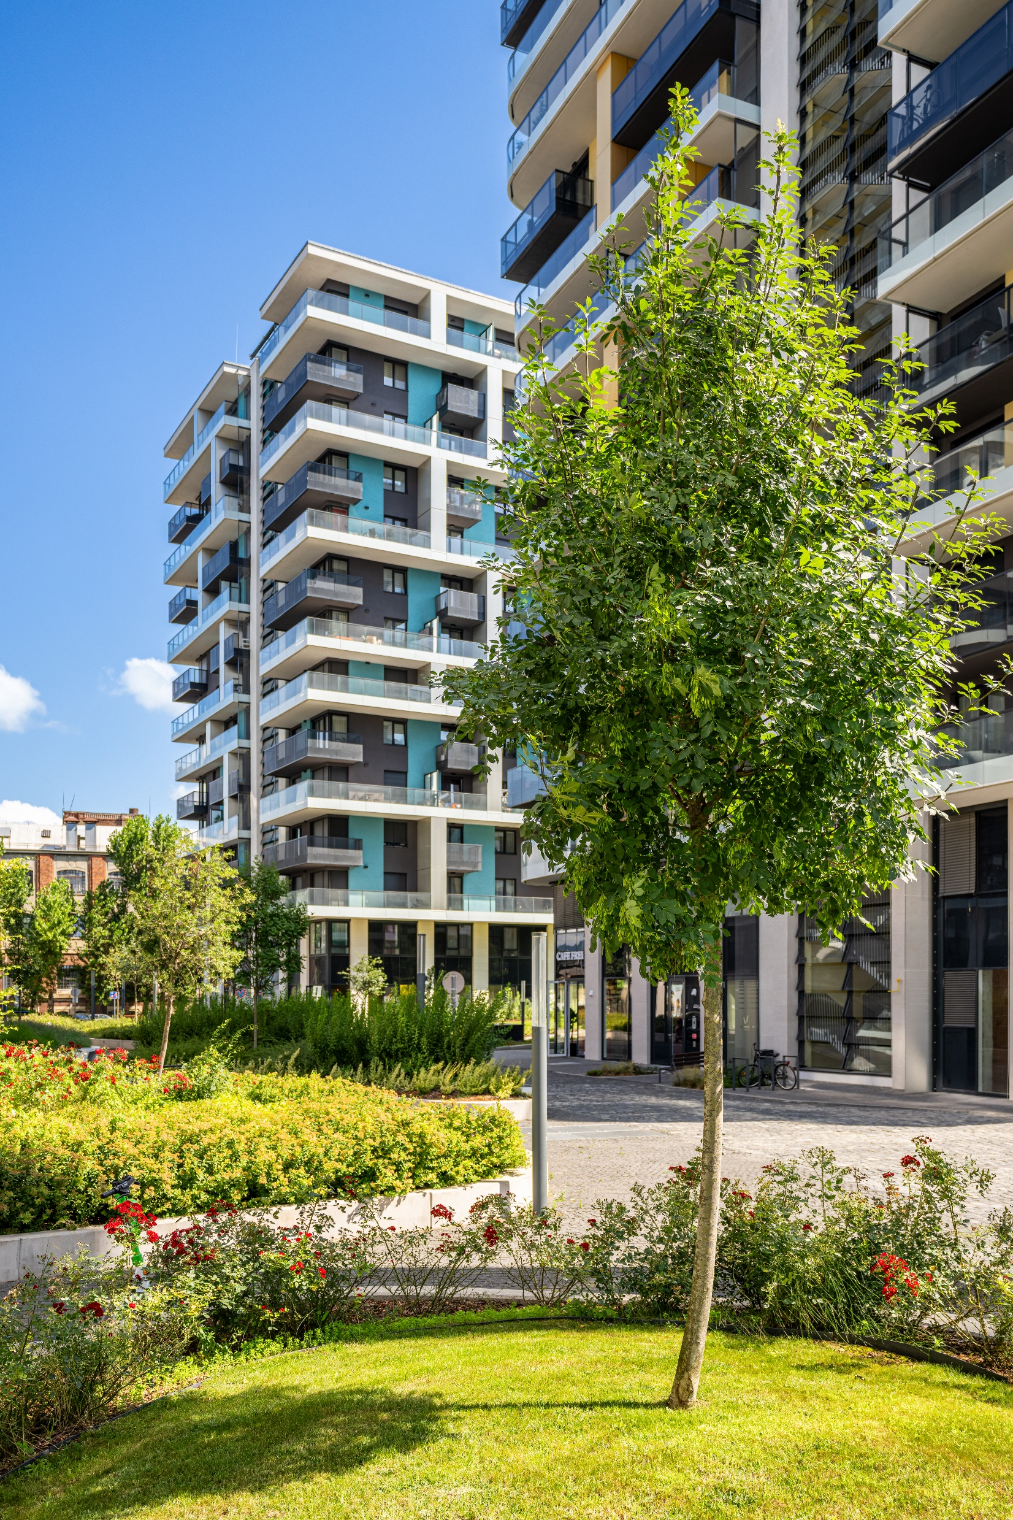
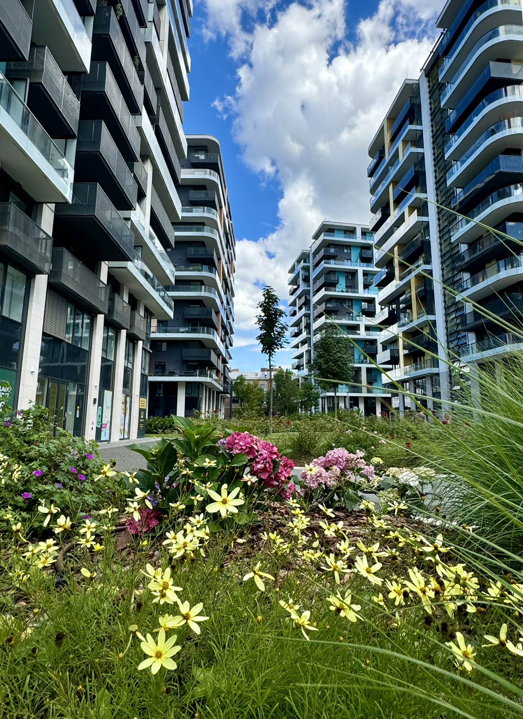
SUSTAINABLE AND INNOVATIVE SOLUTIONS
1.) Geothermal heating
2.) Solar energy
3.) Rainwater
4.) Green roofs
5.) Motion-activated street lighting
6.) Waste management
7.) Natural light
8.) Air quality
9.) Premium built-in materials
10.) Regional, certified sources

Slide 12
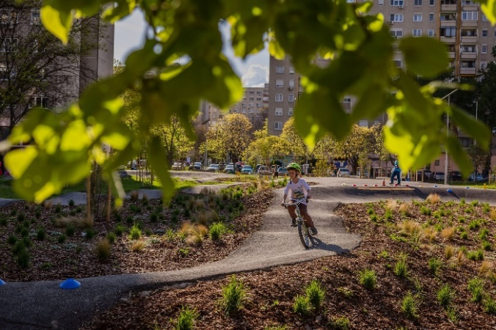
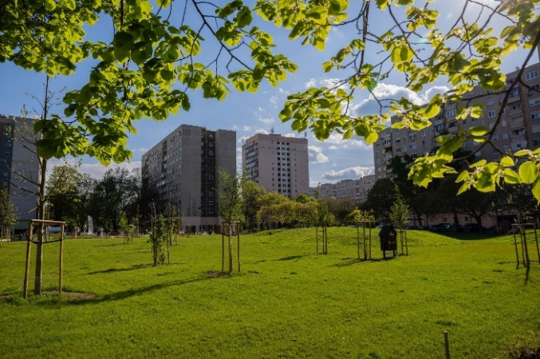
COMMUNITY INVOLVEMENT
Beyond the scope of a neighborhood-scale residential development, Waterfront City also supports its wider social context with multiple contributions to the area and its community:
1.) transport infrastructure investments
creation of parking spaces in the surrounding streets,
renovation of pavements,
rebuilding and creating transport interchanges.
2.) public investments
István Kaszap Park with 2,200 sqm greenery, new trees and rejuvenated pump-track
3.) financial contribution for the Municipality’s community programs

Slide 13
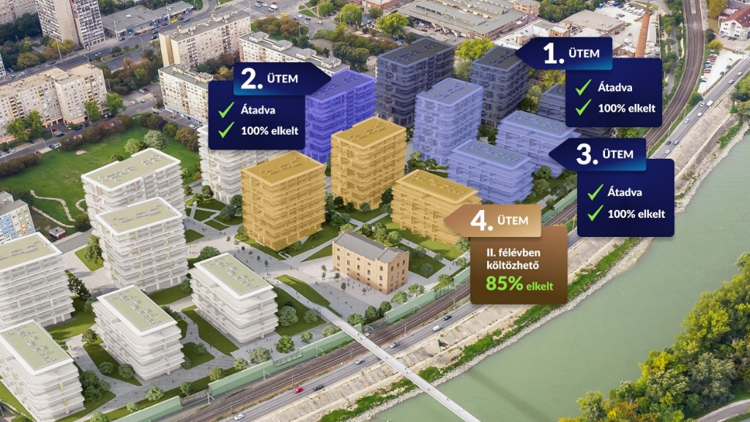
FINANCING AND SALES
The residential and commercial properties in phases I. (269 apartments), II. (169 apartments) and III. (217 apartments) are 100% sold, and units in phase IV. (252 apartments) were 90% pre-sold before handover of the building.
Units in phase V. (149 apartments) just went on the market last week, with 10% pre-sale realized already in 7 days. Buyers receive full support from the experienced sales team at both the Waterfront City on-site sales office and the Biggeorge Property sales office, who guide them through the multi-stage buying process (from selecting a property, signing a contract and choosing financing options to selecting materials and moving in).
completed
100% sold
completed
100% sold
completed
100% sold
handover in Q4 2024
85% sold
We realize our projects through real estate funds (financial investors + commercial banks).

Slide 14
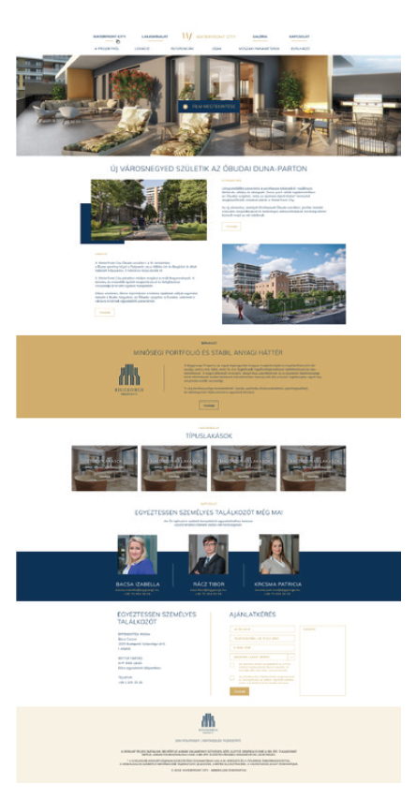
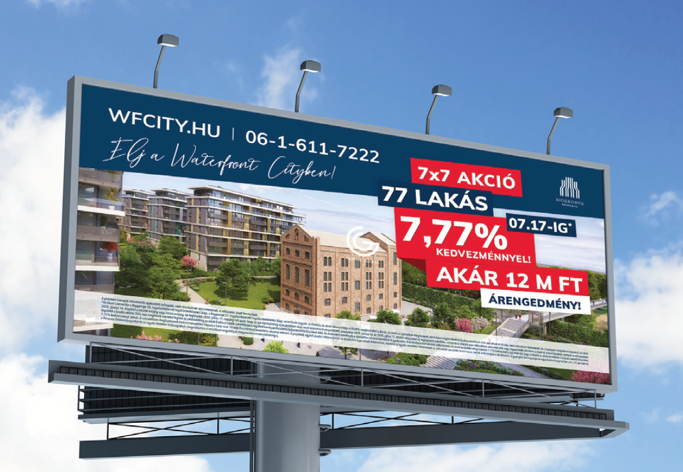
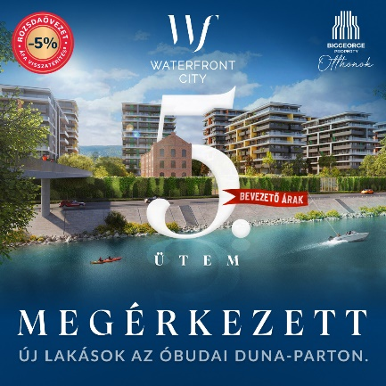
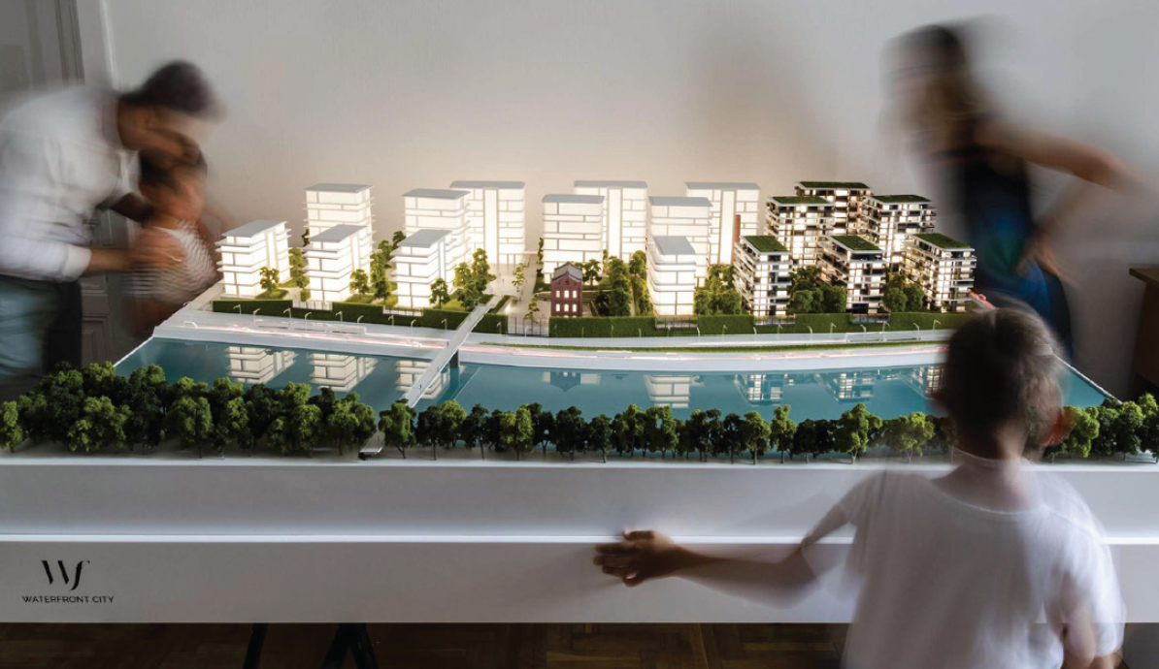
MARKETING MIX & CHANNELS
1.) Online
2.) Offline
3.) Broadcast
4.) Site branding

Slide 15
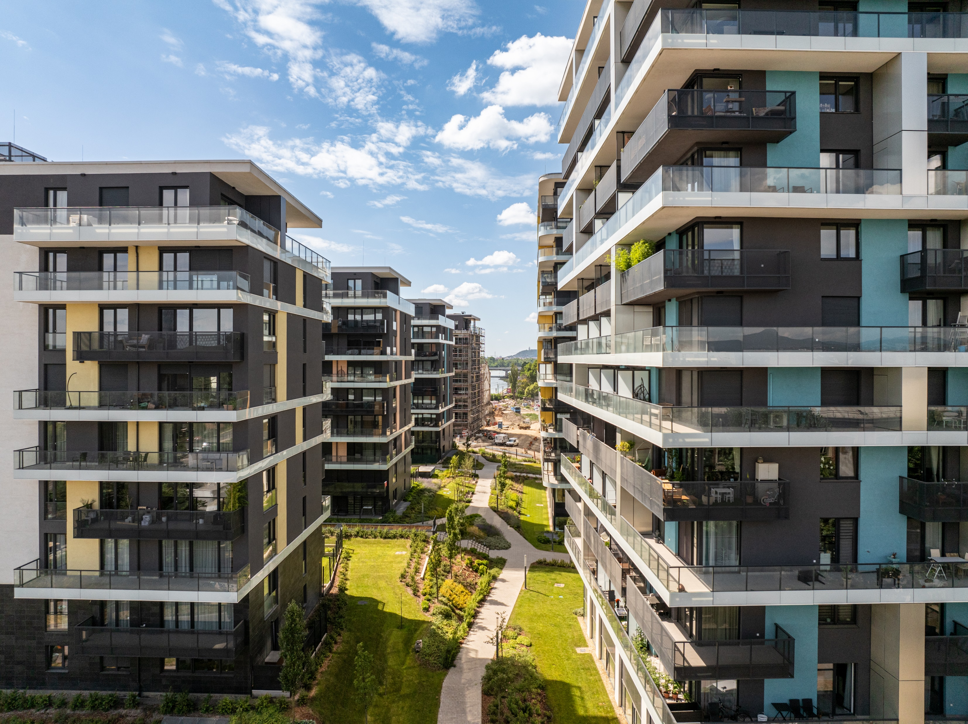
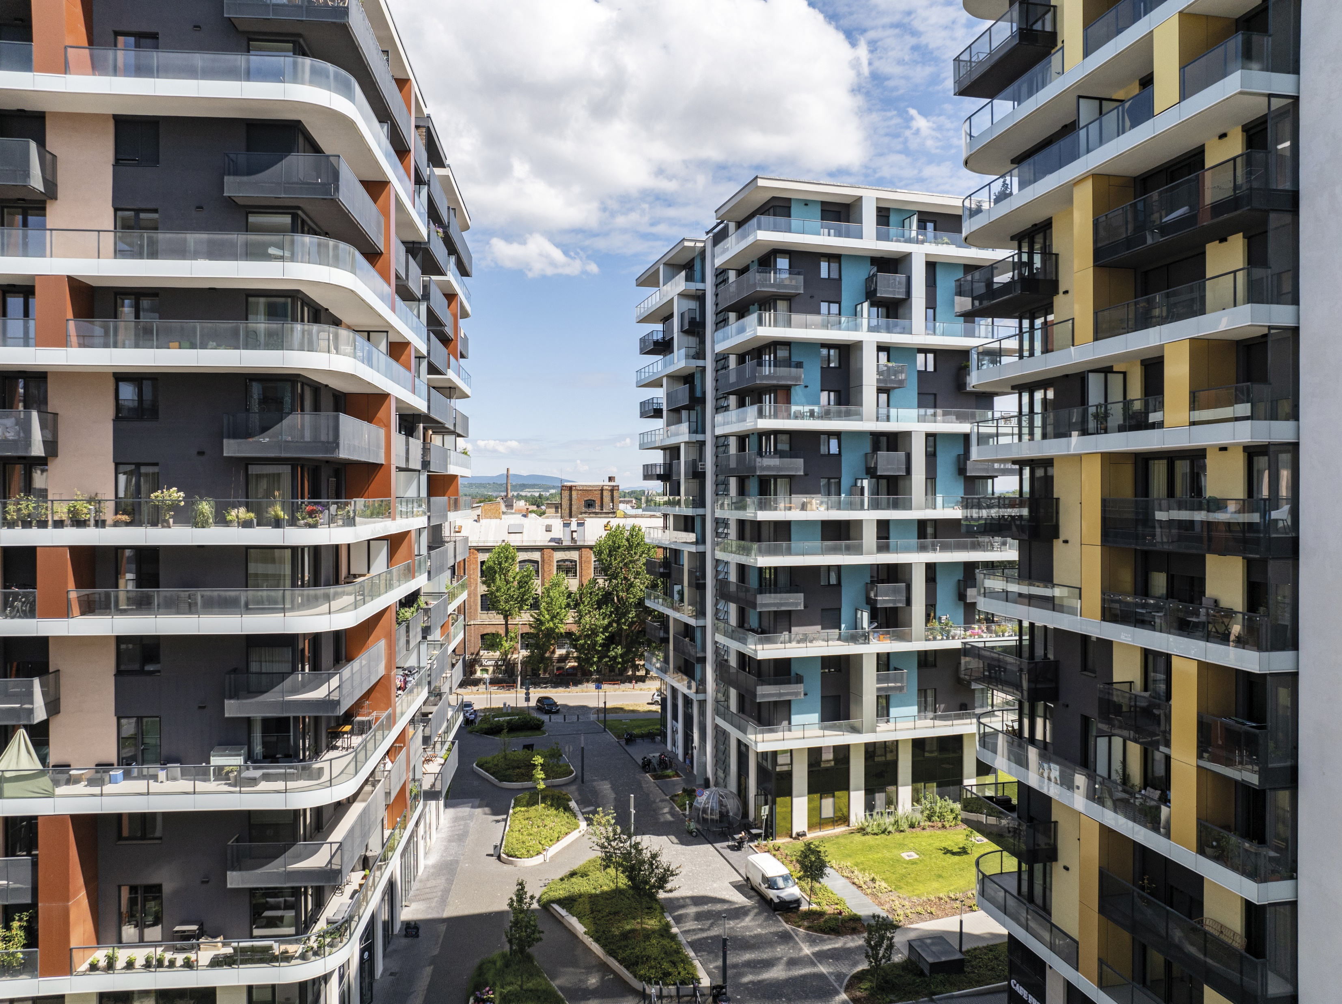
GALLERY

Slide 16
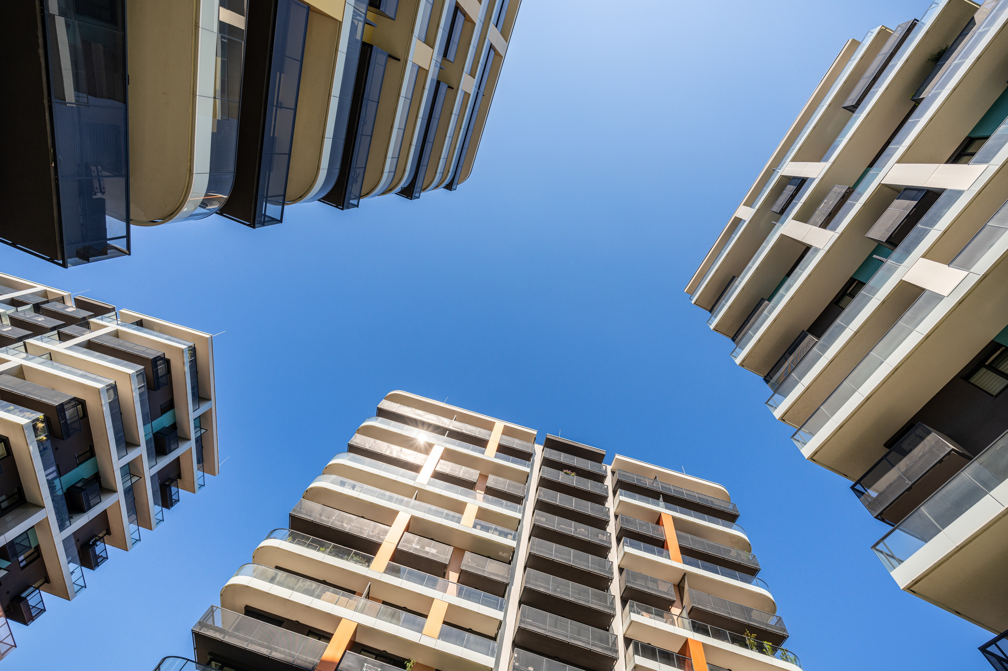
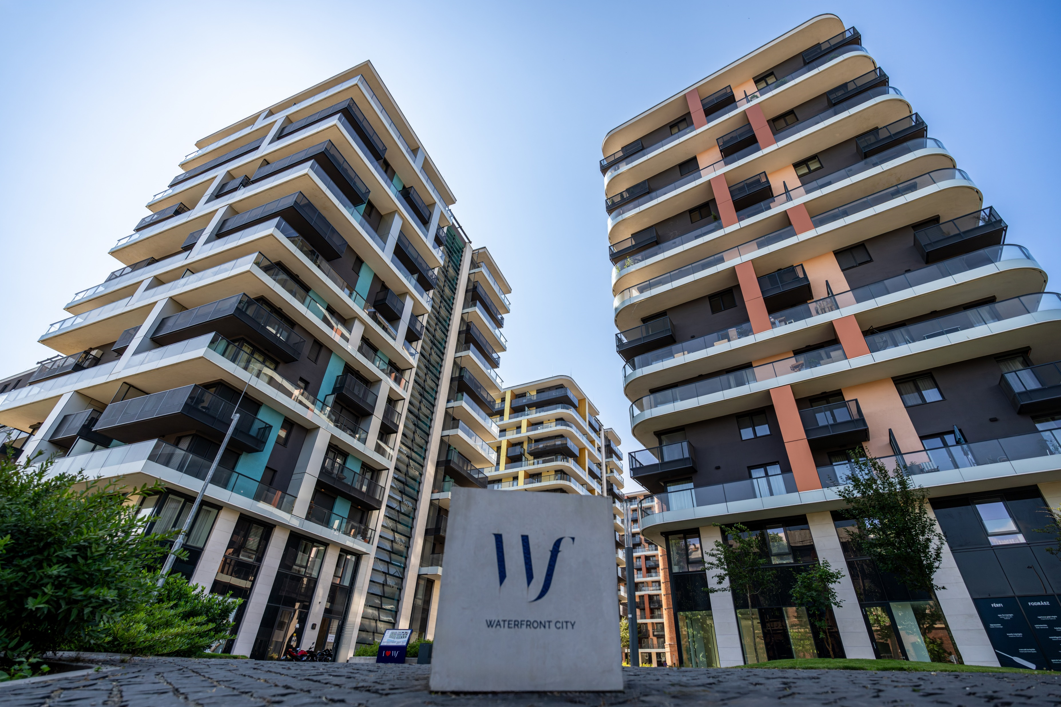
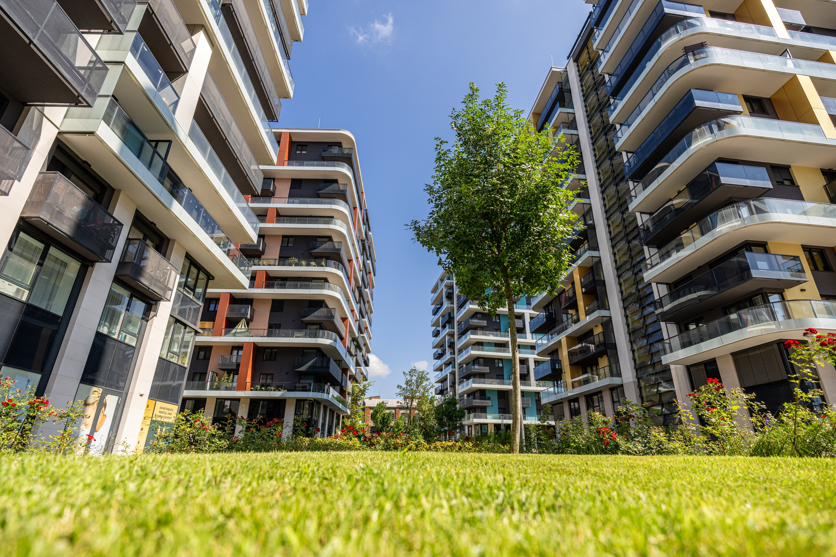
GALLERY

Slide 18
CONTACT
Gábor Kutasi
Development Director
Biggeorge Property
Bécsi Corner Office Building
H-1023 Budapest, Lajos utca 28-32.
+36 30 440 0600
kutasi.gabor@biggeorge.hu
biggeorgeproperty.hu/en

Slide 19
THANK YOU
FOR YOUR ATTENTION

