Slide 1
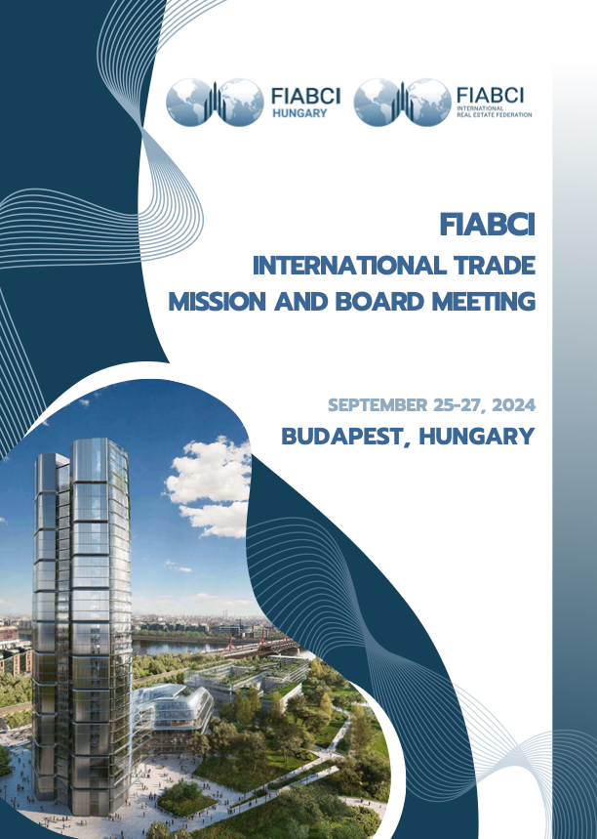

Slide 2


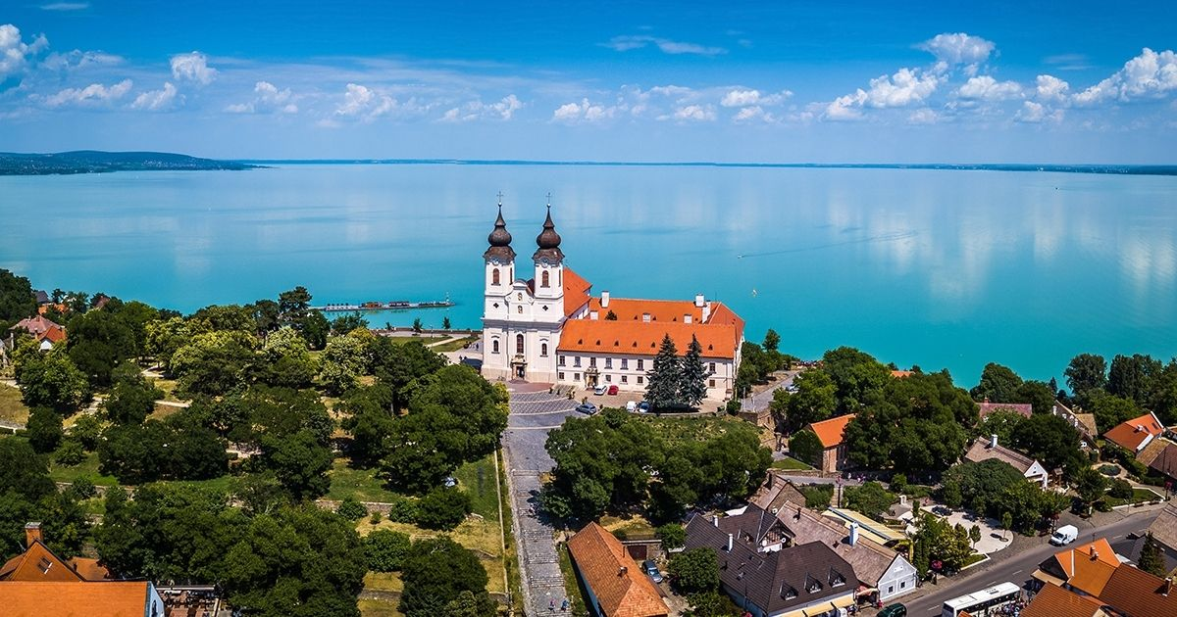
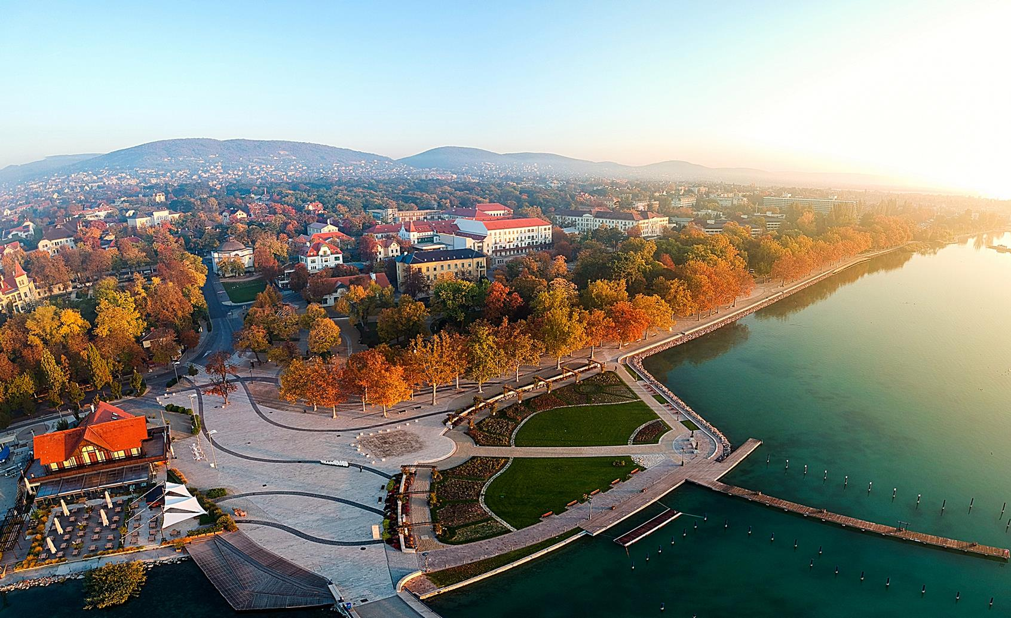
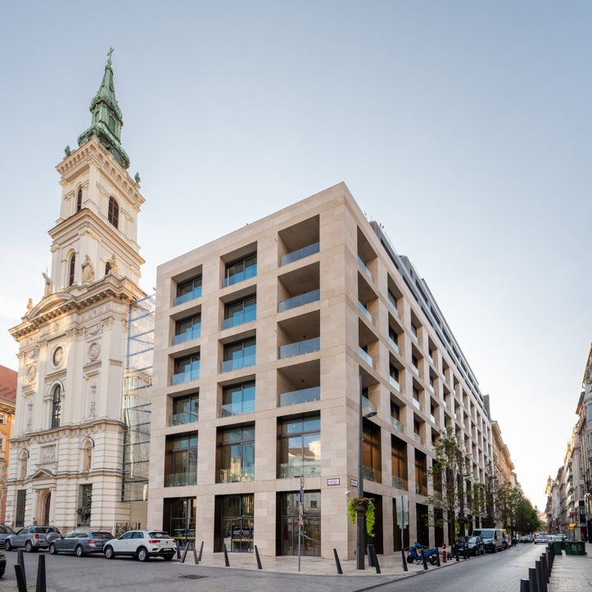
FIABCI International Trade Mission and Board Meeting
September 25-27, 2024 ׀ Budapest, Hungary
Program Summary
Wednesday, September 25, 2024
09:30 am – 04:00 pm | Visit to Tihany and Balatonfüred, Lunch in Balatonfüred - Departure from Kempinski Hotel Tihany Balatonfüred
06:30 pm – 09:00 pm | Welcome Reception - Emerald Residence, 1052 Budapest Szervita tér / Petőfi Sándor utca 17 Emerald Hotel & Suites is a brand-new boutique hotel in the very heart of Budapest, at a unique location close to Szervita Square, just a few steps away from the famous Váci Street. The whole building complex was built around the Church of St. Anne, which feature creates a unique and special atmosphere
© FIABCI, The International Real Estate Federation

Slide 3
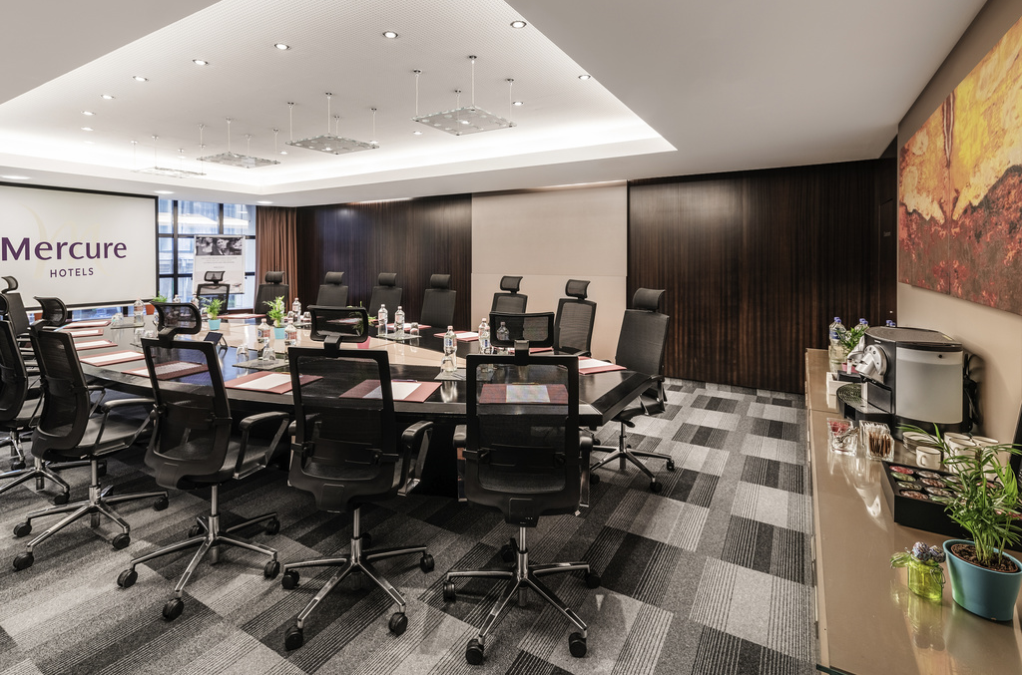

Thursday, September 26, 2024
09:30 am – 01:00 pm | Budapest Sightseeing Tour for Members and Accompanying persons - Departure from Emerald Residence Hotel & Suites
09:30 am – 12:30 pm | Board of Directors Meeting © - Mercure Hotel Budapest City Center, 1052 Budapest Váci utca 20
12:30 pm – 02:00 pm | Board of Directors Lunch Break © - Mercure Hotel Budapest City Center
 | Business Networking Forum - Mercure Hotel Budapest City Center Preliminary Agenda 02:00 pm – 02:05 pm: Opening Remarks by FIABCI World President 02:05 pm – 02:20 pm Opening speech by Regő Lánszki State Secretary 02-20 pm-02:30 pm: Advancing Innovation and Sustainability by Harely & Dikkinson, FIABCI Strategic Partner H&D aims to minimize ecological footprint and build spaces that foster social interaction and collective wellbeing while keeping in mind environmental issues related to real estate. This concept is known as Neomutualism*, road map to a brighter future. (*): "Neomutualism: Redesigning competitiveness and welfare from below" by Paolo Venturi and Flaviano Zandonai
© FIABCI, The International Real Estate Federation

Slide 4
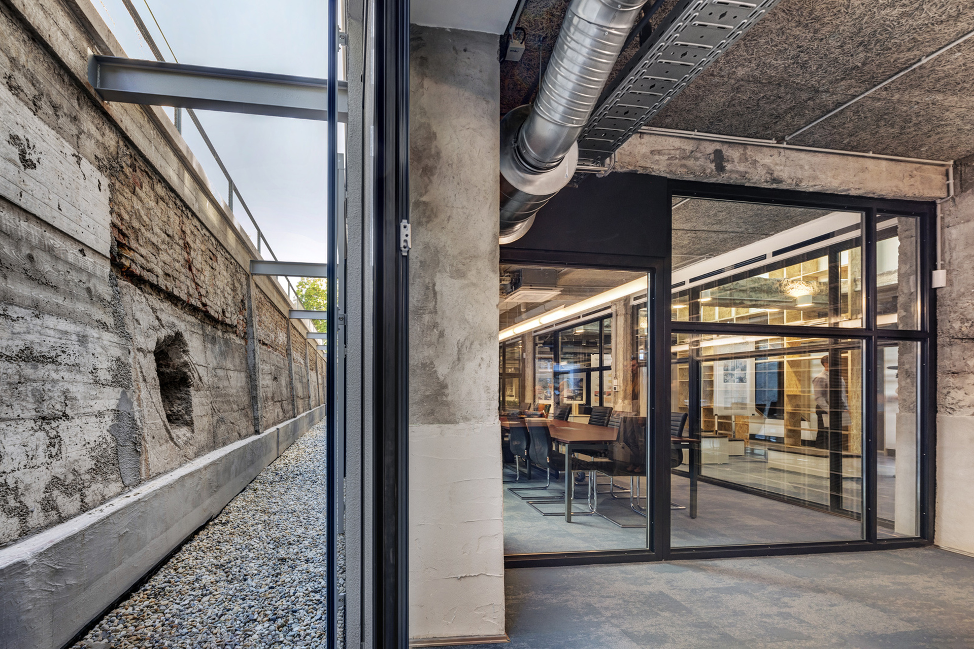
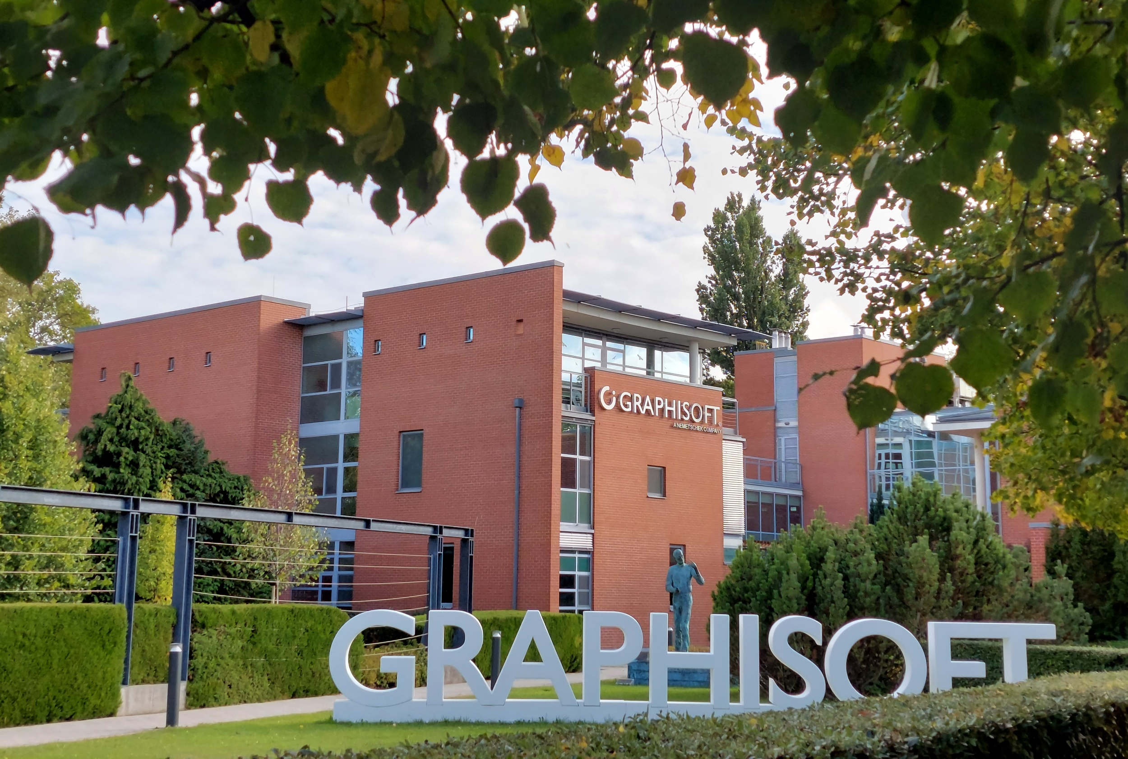
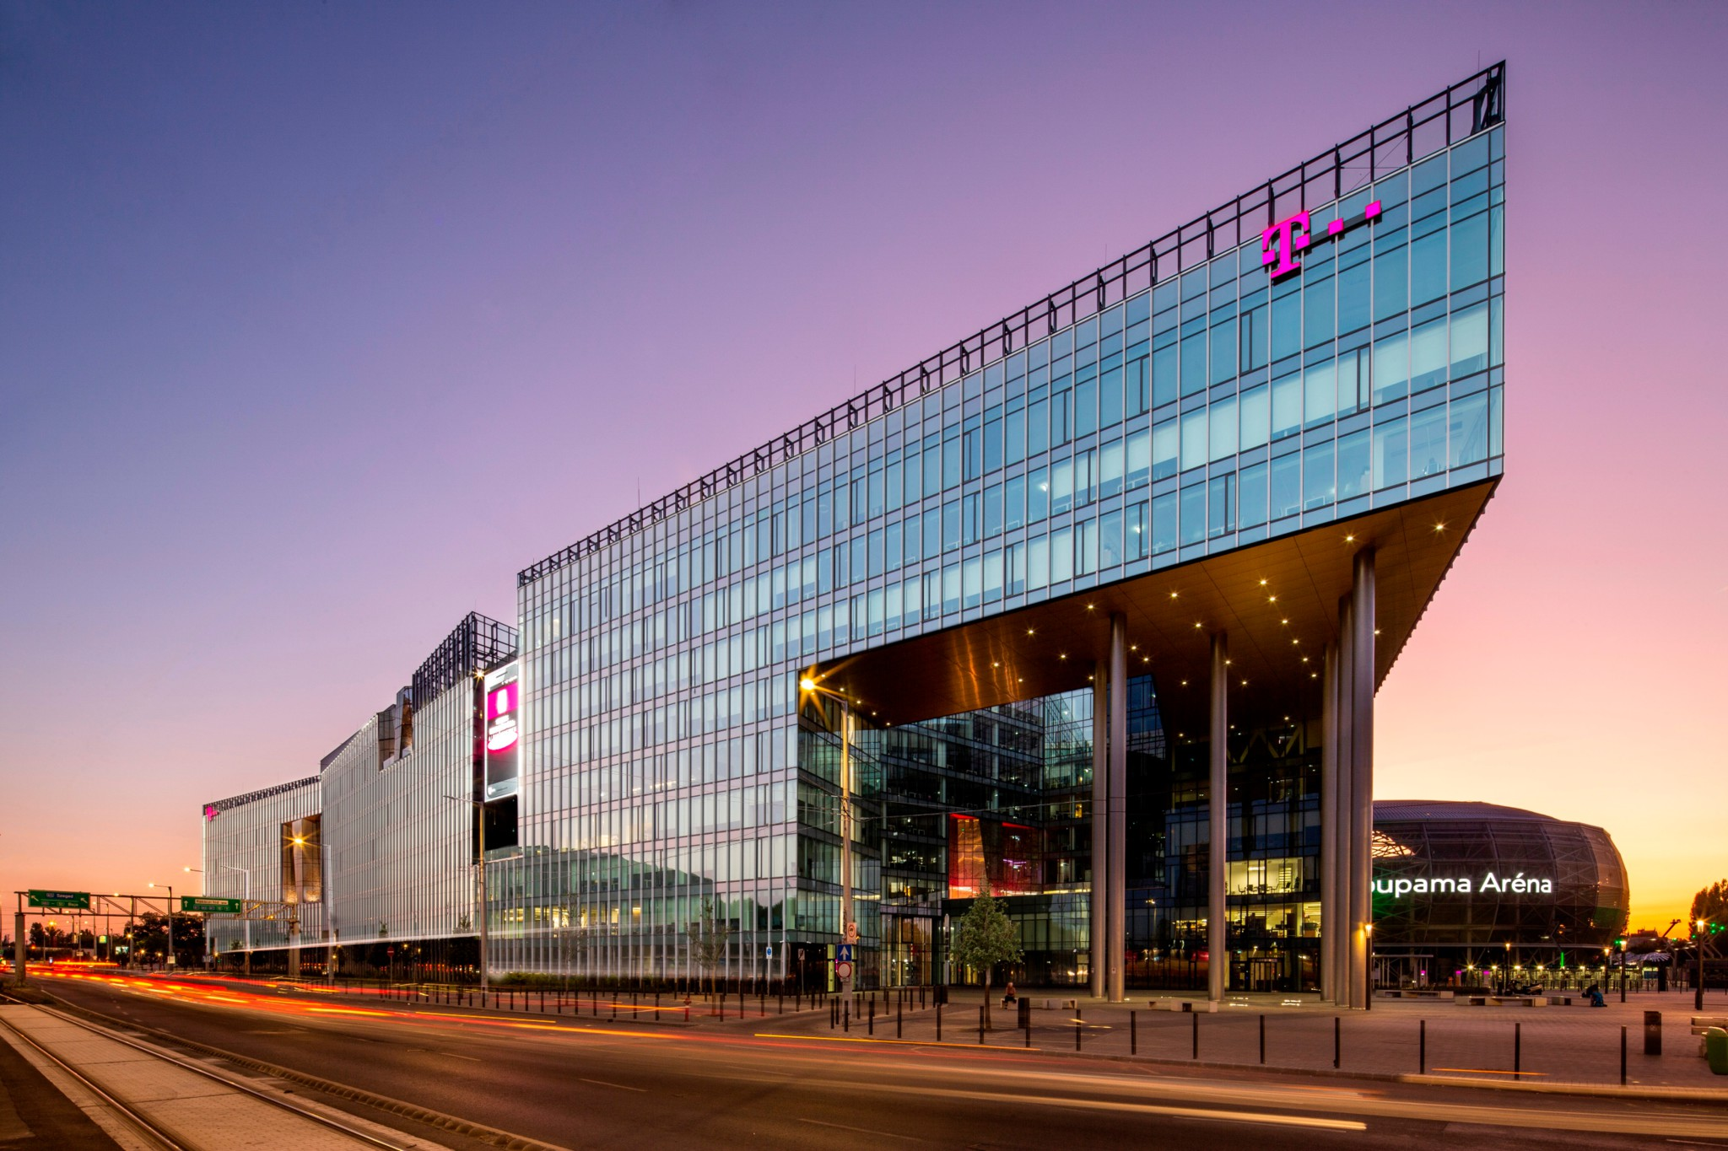
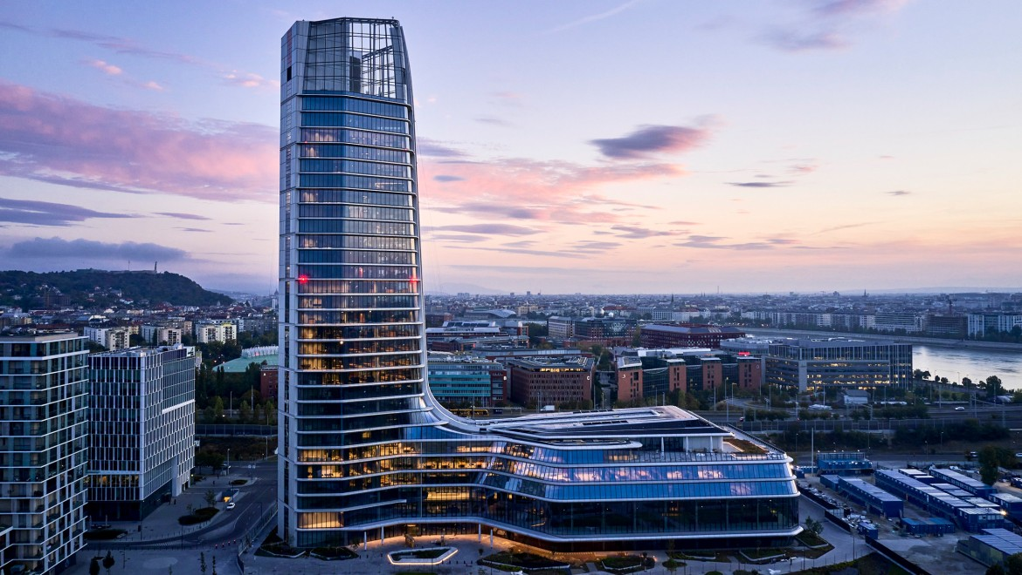
02:30 pm – 03:45 pm | Office Market
 | BÁNÁTI & HARTVIG OFFICE BUILDING FIABCI-Hungarian Prix d’Excellence winner Sustainable refurbishment of a building from the 1960s
 | GRAPHISOFT PARK FIABCI-Hungarian Prix d’Excellence winner Complex features office buildings set within a large park that is open to the public
 | TELECOM HEADQUARTERS FIABCI-Hungarian Prix d’Excellence winner New types of offices
 | MOL CAMPUS FIABCI World Prix d’Excellence 2024 Gold Winner Office and Sustainable Development categories
© FIABCI, The International Real Estate Federation

Slide 5
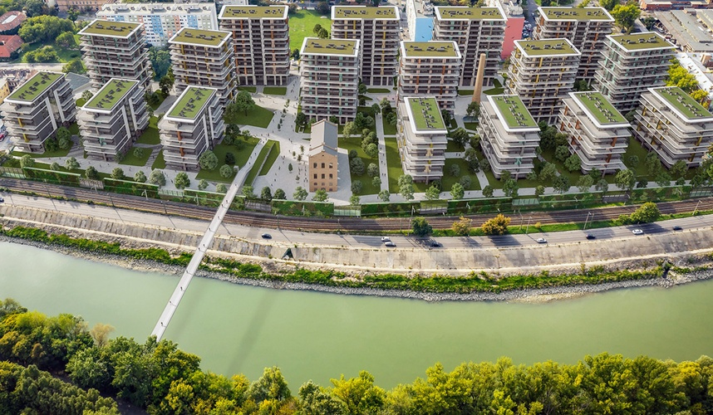
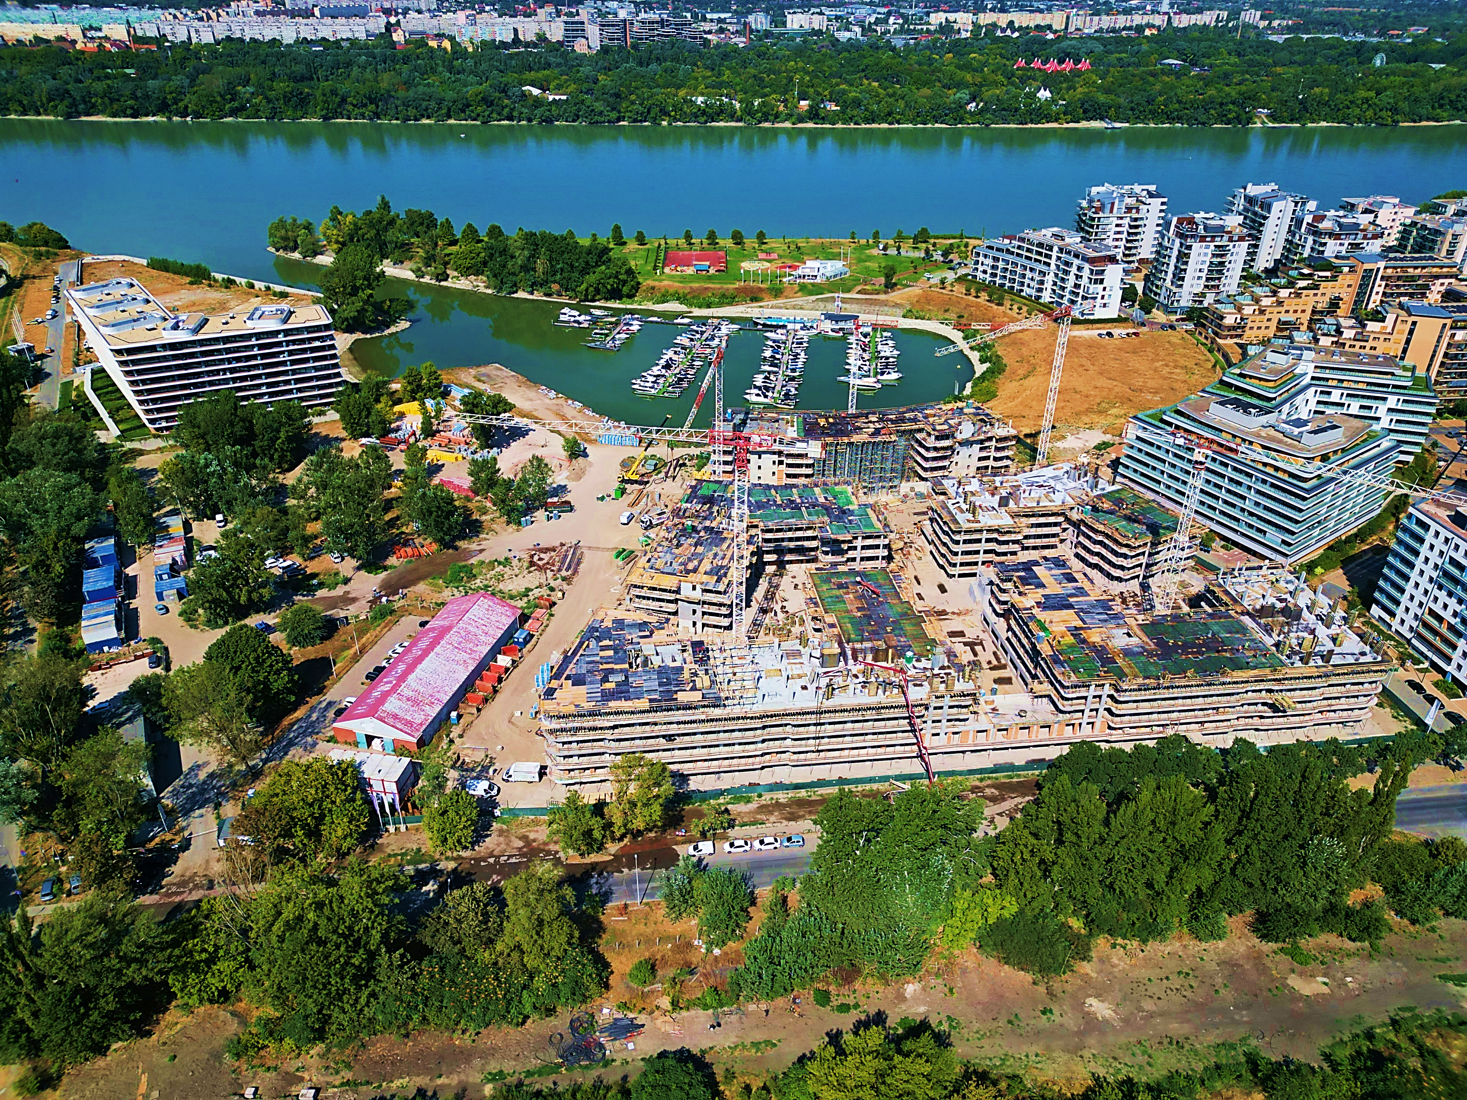
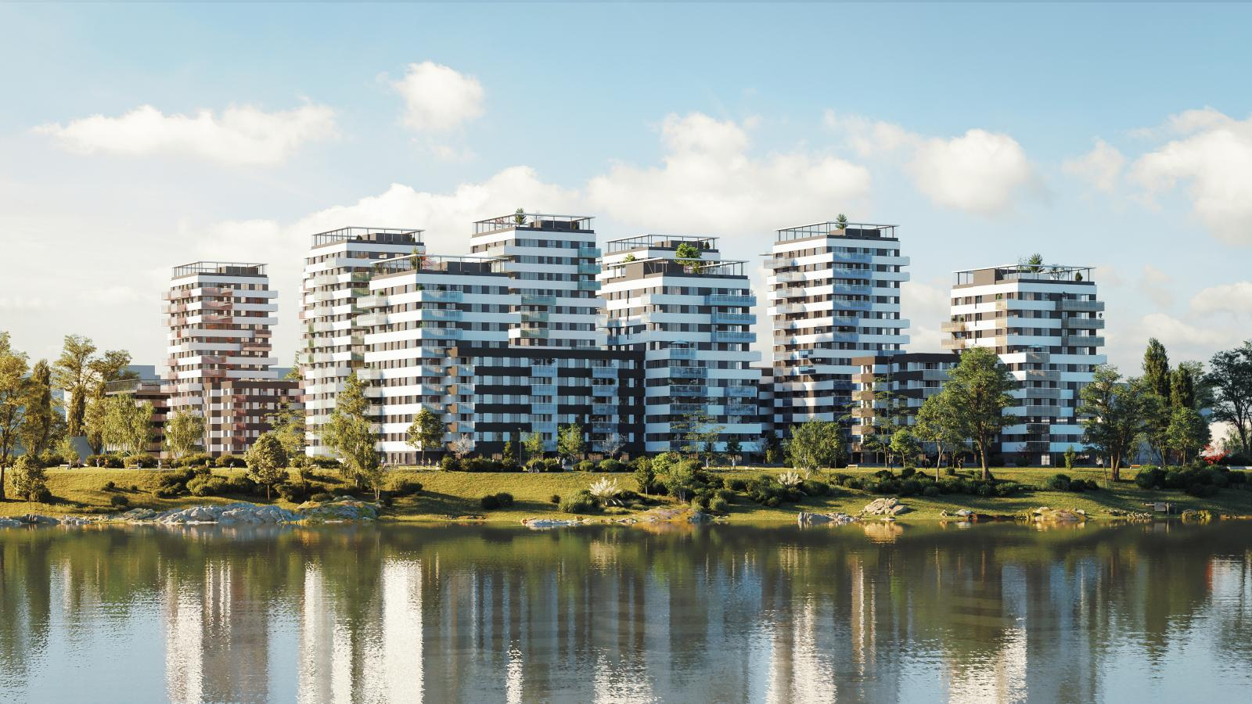
03:45 pm – 04:15 pm: | Coffee Break
04:15 pm – 05:15 pm | Urban Development: Residential Projects
 | WATERFRONT CITY FIABCI-Hungarian Prix d’Excellence Candidate 2024
 | DUNA TERASZ FIABCI-Hungarian Prix d’Excellence Candidate 2024
 | METRODOM RIVER FIABCI-Hungarian Prix d’Excellence Candidate 2024
© FIABCI, The International Real Estate Federation

Slide 6
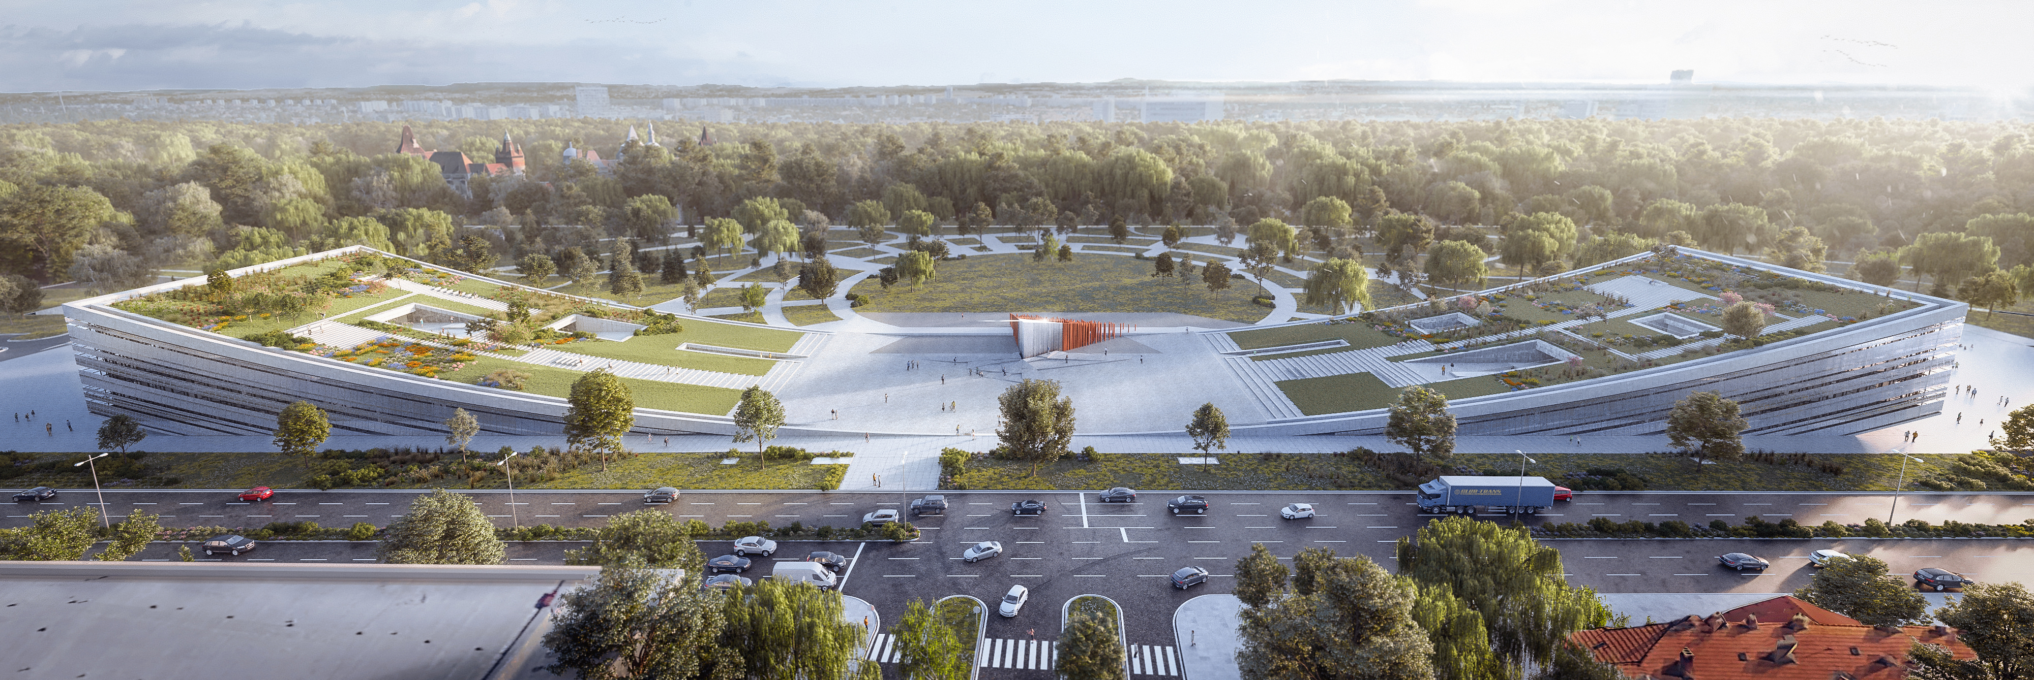
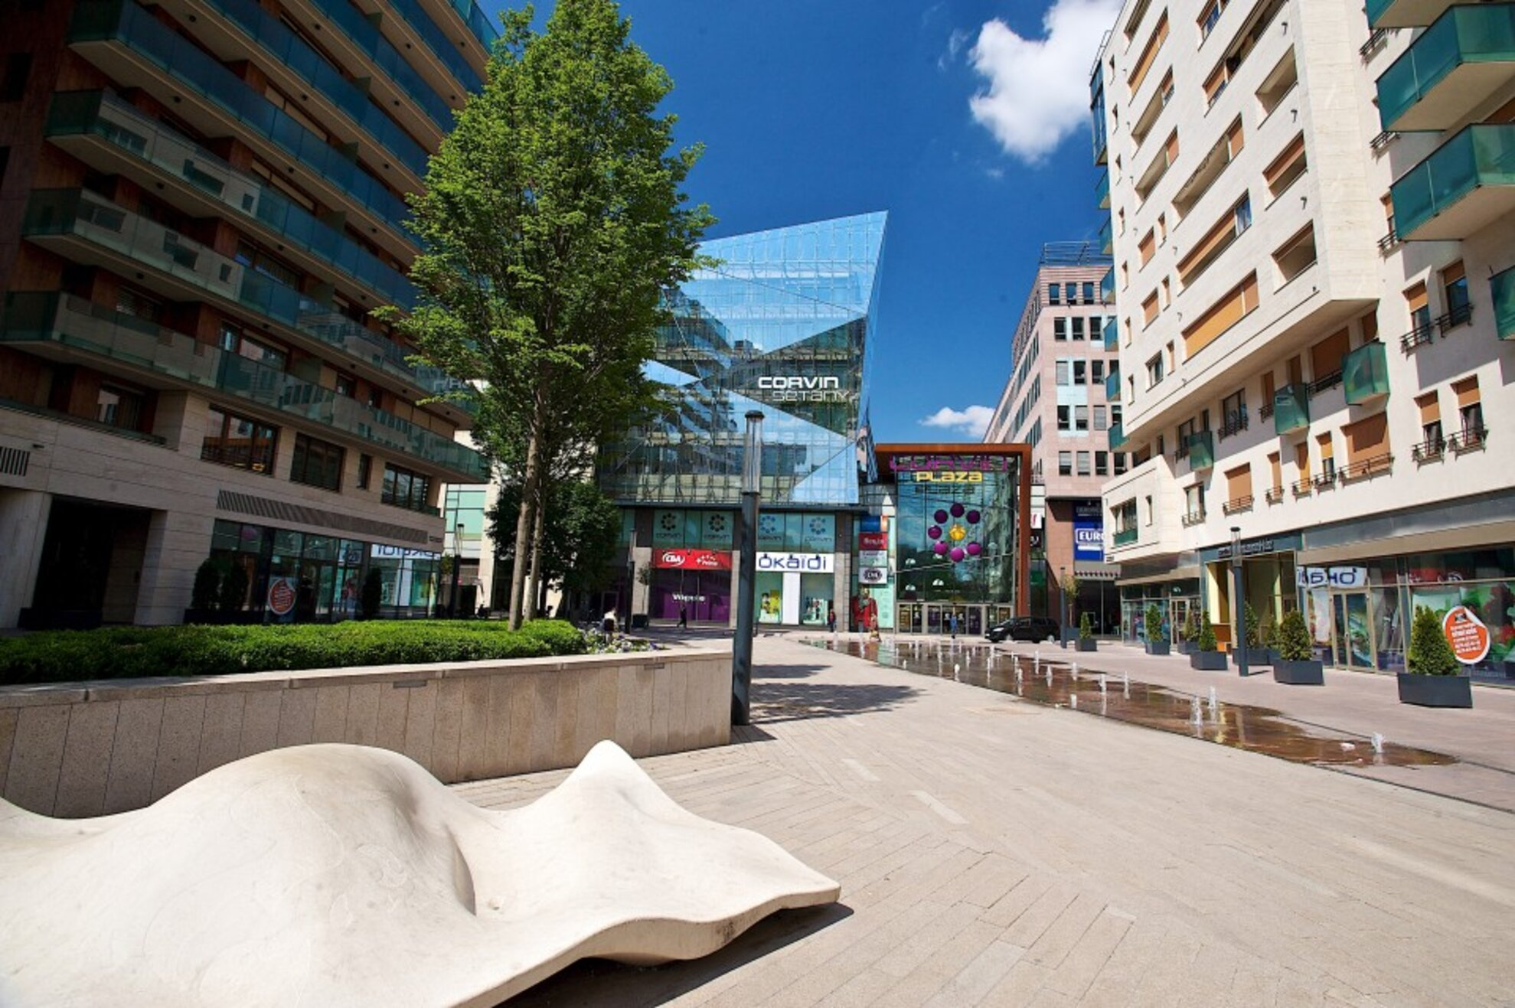
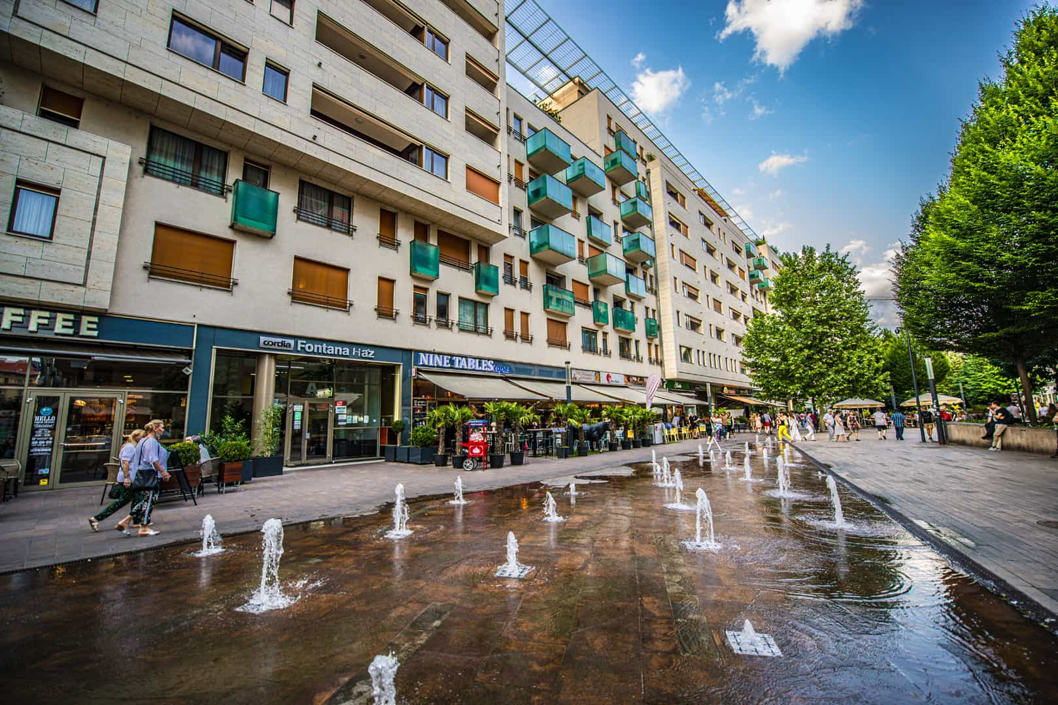
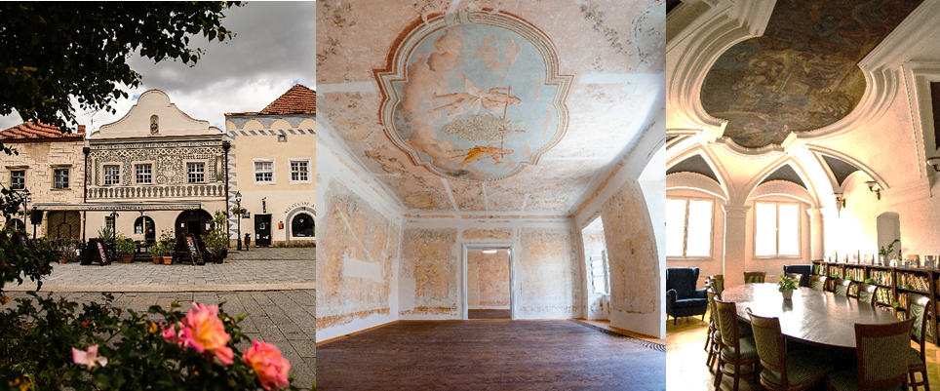

05:15 pm – 06:15 pm | Urban Development: Town Development Projects
 | LIGET PROJECT FIABCI World Prix d’Excellence Gold and Silver Winner Redevelopment of the largest public park in Budapest in 2021
 | CORVIN ALLEE World Prix d’Excellence Gold Winner
 | Kraft PROJECT, KŐSZEG FIABCI Hungarian Prix d’Excellence Award Winner Laureat of Attila Kovács memorial prize
6:30 pm-9:30 pm | FIABCI Executive Lounge: After-Forum Connect Emerald Residence Hotel & Suites In partnership with Treasure Dragon Corp., this event provides forum participants, including speakers, with a relaxed environment to continue professional discussions
© FIABCI, The International Real Estate Federation

Slide 7
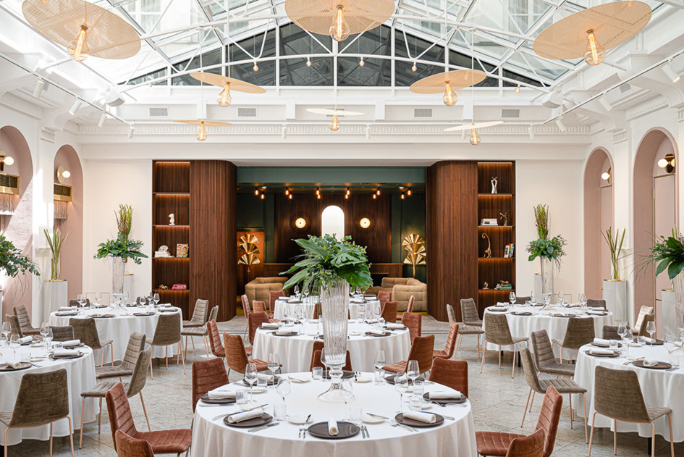
Friday, September 27, 2024
09:00 am – 04:00 pm | Budapest Project Visits Tour 1: 09:00 am - 04:00 pm Departure from Emerald Residence Hotel & Suites • Waterfront City • Graphisoft Park • Metrodom River • MOL Campus Tour 2: 09:00 am – 04:00 pm Departure from Emerald Residence Hotel & Suites • Corvin Promenade • Duna Terasz • Metrodom River • MOL Campus
07:00 pm – 09:30 pm | Farewell Dinner Gerbeaud Atrium
 | DRESS CODE Board of Directors meeting dress code: Business Networking Forum dress code: Business Dress code for all other activities/social tours: Business casual/Casual
© FIABCI, The International Real Estate Federation

Slide 8
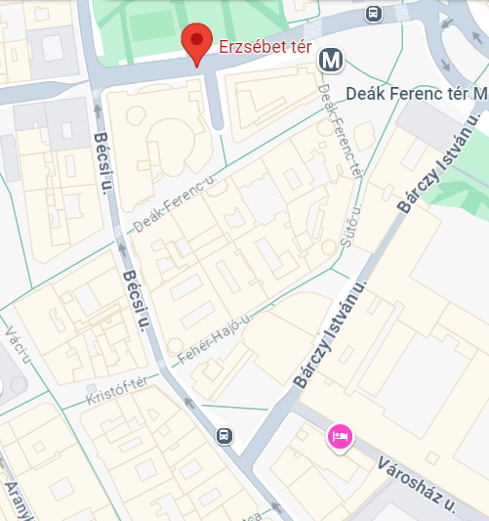
 | Recommended hotels in Budapest 1.) Emerald Hotel & Suites 1052 Budapest, Városház utca 20. 2.) Mercure Budapest City Center Hotel 1052 Budapest Váci utca 20. 3.) Párisi Udvar Hotel Budapest 1052 Budapest, Petőfi Sándor utca 2-4.
© FIABCI, International Real Estate Federation
BUS PICKUP POINTS | September 25, 2024 TIHANY - BALATONFÜRED
9:30 AM | Bus from Kempinski Hotel
BUS
EMERALD HOTEL
© FIABCI, The International Real Estate Federation

Slide 9
 | September 26, 2024 BUDAPEST SIGHTSEEING
9:30 AM | Bus from Bárczy István u. / Szervita tér
 | September 27, 2024 PROJECT TOURS
9:00 AM | Bus from Bárczy István u. / Szervita tér
BUS
EMERALD HOTEL
BUS
EMERALD HOTEL
© FIABCI, The International Real Estate Federation

Slide 10
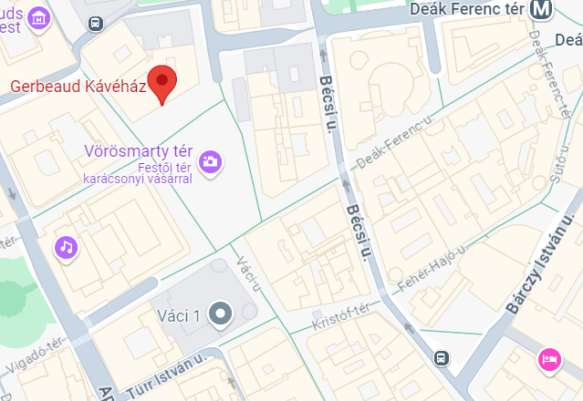
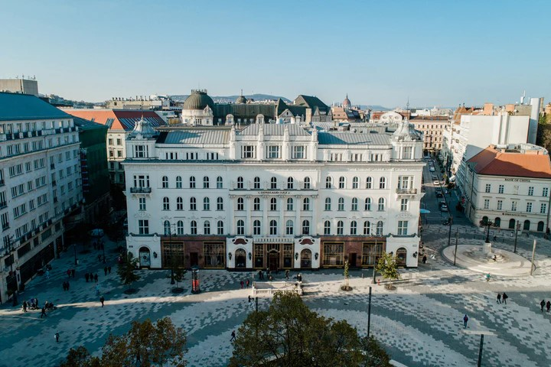
 | September 27, 2024 FAREWELL DINNER
7:00 PM | Gerbeaud Átrium, Vörösmarty square, Walking distance
GERBEAUD
EMERALD HOTEL
© FIABCI, The International Real Estate Federation

Slide 11
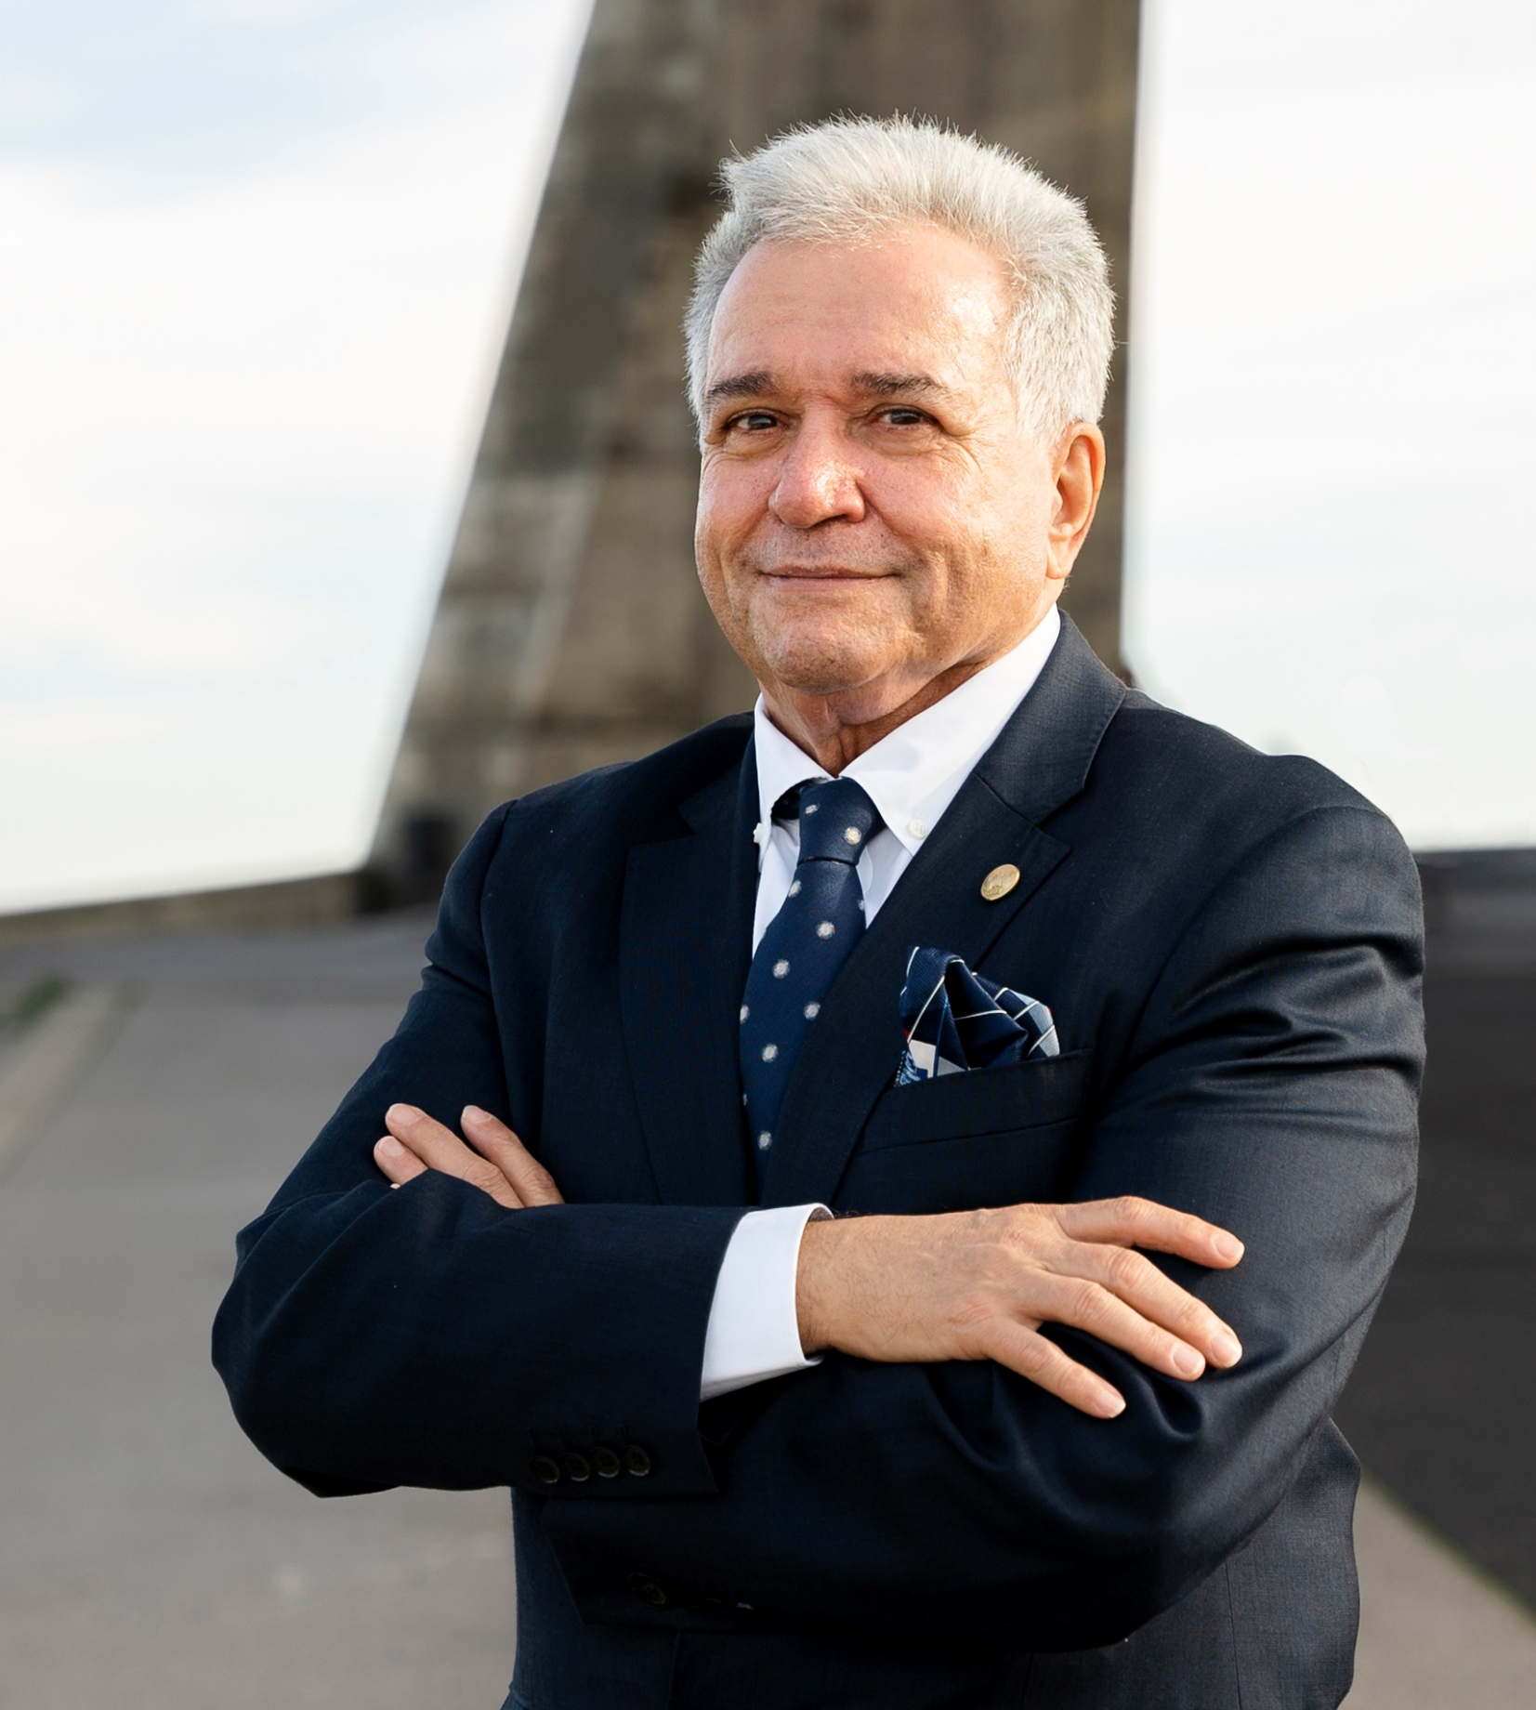
RAMÓN RIERA TORROBA
FIABCI WORLD PRESIDENT 2024-25
Ramón Riera Torroba comes from a modest family that allowed him to attend school until the age of 14, at which point he needed to start working.
At 14, Mr. Torroba began working at an insurance company. In the evenings, he attended college to finish his schooling and then pursued a degree in Law. He graduated at 22 while still working at the same insurance company. At 26, Ramón Riera Torroba was nominated as Property Manager of 4,000 properties, as the insurance company was involved in the property market. In a short time, he became involved in promoting homes throughout the Mediterranean, creating a company that quickly floated on the stock market. At 40, Mr. Torroba was appointed General Manager and Board Member of the Property Group, overseeing 3,500 properties under construction and 800 employees.
In 2005, he noticed an impending crisis and informed the Board that they should halt some construction, stop all land purchases, and reduce the headcount. His belief in reducing costs dramatically before it was too late was not in line with the rest of the board's thinking. Mr. Torroba realized that he didn't want to be part of the company's decline, so he resigned.
In 1993, his father-in-law, the founder of Eurofincas, passed away. While working at the insurance company, Ramón Riera Torroba had been assisting his father-in-law as legal counsel. After leaving the insurance company, he worked full-time for Eurofincas, a sound company in real estate and property administration.
In 2003, his path intersected with associations, and he was invited to be treasurer of API Barcelona, the most important real estate association in Spain. Through API, Mr. Torroba was offered the position of President of FIABCI-España in 2011 during a challenging period in Spanish real estate. He served as President of FIABCI-España until 2020, leaving the chapter with higher international recognition and over 100 members. During that period, he also served as President of FIABCI European Region from 2020 to 2022 and joined the FIABCI Board of Directors. In the spring of 2022, he successfully ran for the position of FIABCI Vice-President, having been elected at the 72nd FIABCI World Real Estate Congress in Paris after a well-disputed campaign. He also holds several positions of responsibility at the national level for real estate agents at FNAPI.
Ramón Riera Torroba is the father of two sons, Borja and Marc, and a grandfather of three. He greatly enjoys every moment with his family, including his brother and sister, Ricard and Teresa, and especially his lovely wife, Cristina.
© FIABCI, The International Real Estate Federation

Slide 12
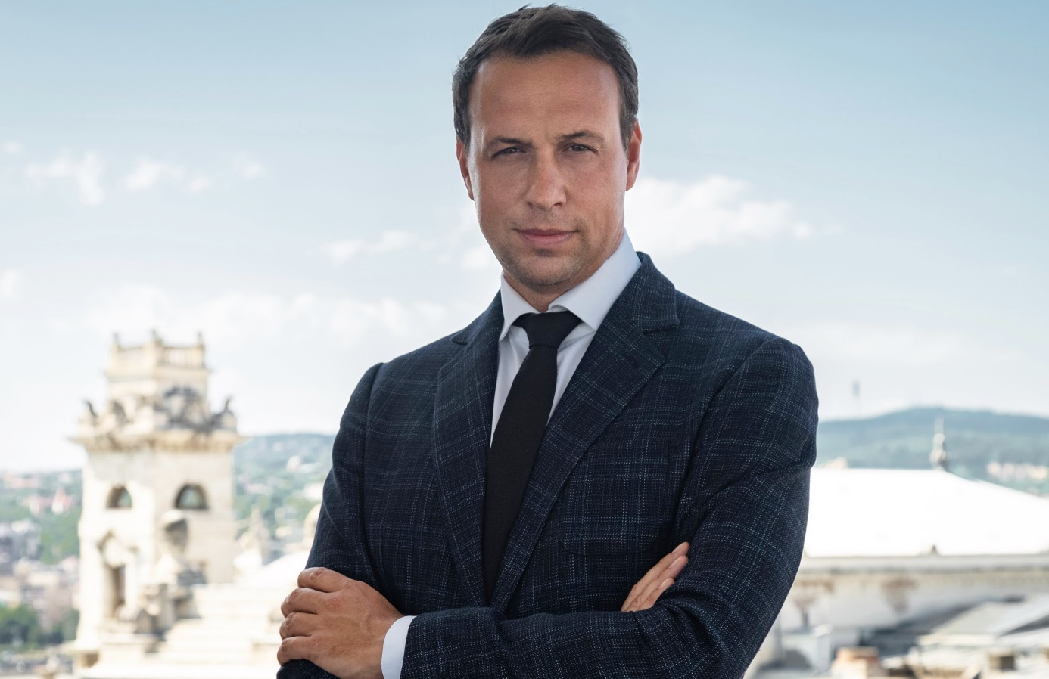
MR. REGŐ LÁNSZKI
SECRETARY OF STATE FOR ARCHITECTURE,
NATIONAL CHIEF ARCHITECT
MINISTRY OF CONSTRUCTION AND TRANSPORT
I am a Hungarian architect, and real estate expert, since 2022 Secretary of State for Architecture at the Ministry of Construction and Transport and National Chief Architect. I have been running my own business for twenty years. In addition to architectural design, I provided real estate development support, real estate market consulting, and comprehensive architectural, pre-investment, and technical analyses. My main focus was on urban development strategies and smart city strategies and have been involved in the management and implementation of several public and non-public projects.
Architecture and our built environment are public matters. Whether we know it or not, it affects us, it is part of our everyday lives. It is a living link with our common past, a co-existence with our present, a message, and a legacy for our descendants. I believe that from the small detail to the universal, the relationship of things to each other must be permeated by a human-centered approach, harmony, elegance, and a willingness to do so. Respecting local traditions, and translating innovative technologies and social sciences into an architectural language is a shared goal, a shared challenge, and a shared joy. This is what I work for.
© FIABCI, The International Real Estate Federation

Slide 13
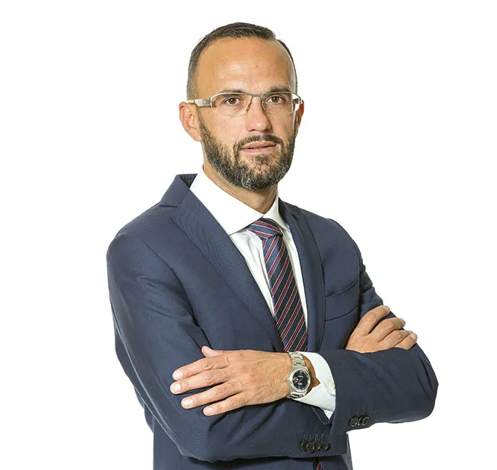
ROBERTO BRAMBILLA
Strategic Advisor for Internationalization
HARLEY&DIKKINSON
A leading manager and strategic thinker with more than 20-year experience in sales, marketing and business development at national and international level (Italy, France, Greece, Cyprus and Malta). After successful achievements as director at Hewlett-Packard and Philips, today he is engaged as strategic advisor for internationalization of the Harley & Dikkinson activities overseas.
© FIABCI, The International Real Estate Federation

Slide 14
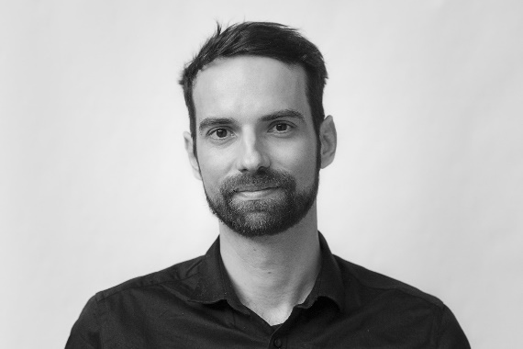
1. BLOCK OFFICE MARKET
ZOLTÁN TÓTH
MODERATOR OF BLOCK OFFICE DEVELOPMENT
Zoltán Tóth is a lead project architect / architectural engineer at Finta Studio, Budapest.
He has graduated at the Széchenyi István University, Győr in 2011.
Post gradually he worked as architect and BIM manager at Schmidt Hammer Lassen and Henning Larsen in London, Rotterdam, Munich and Copenhagen. He has joined the ranks of Finta Studio in 2017.
Main focus points of his design tasks are the following: general design & planning of large-scale projects in every phase, development of external envelope and building technics, BIM modelling & management, interdisciplinary coordination. The most important principal to him is the holistic, balanced development of architectural quality, technical solutions and optimal workflow.
Highlighted project participations:
2011-2014 International Criminal Court, the Hague
2014 Frankfurt School of Finance & Management
2015 OTH Regensburg
2016 Sabic HQ, Jubail
2015-2016 Hotel Agobili, Abastumani, Georgia
2017- Agora Project, Budapest
2017- Mol Campus, Budapest
2021 PPKE Campus development, competition
2022 Renewal of West Railway Station and its surroundings - Competition
© FIABCI, The International Real Estate Federation

Slide 15
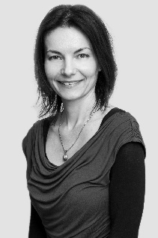
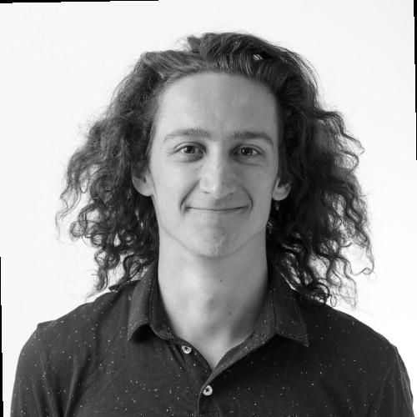
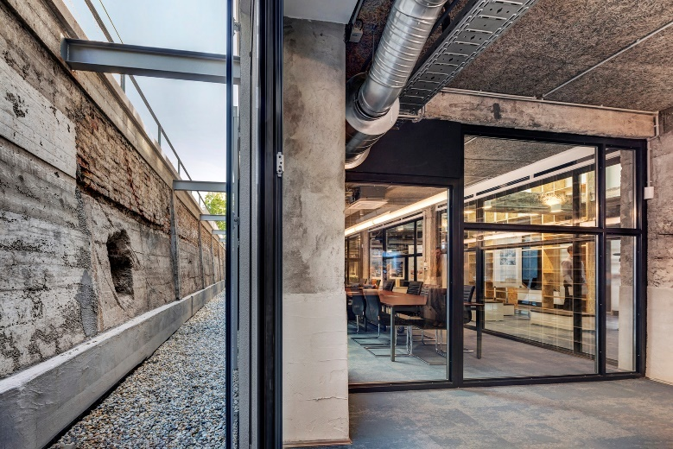
ÁGNES SZÉKELY
PARTNER, PROJECT ARCHITECT
BODÓ BÁNÁTI
PARTNER, PROJECT ARCHITECT
OFFICE BUILDING OF BÁNÁTI & HARTVIG ARCHITECTS LLC
Bánáti + Hartvig Architects is committed to sustainable development, striving to create future-proof, environmentally friendly and likeable buildings while meeting client needs. Their portfolio includes the reconstruction of the Drechsler Palace and Wellisch Palace, the German School of Budapest, the Kecskemét Campus Educational Building, and the Green Court Residences.
Bánáti & Hartvig office building
The own office building of Bánáti + Hartvig Architects provides an insight into the characteristics of environmentally friendly and circular architecture. The firm renovated a disused old building for its own use, utilizing the recyclable elements of the building. This architectural approach also significantly impacted the reduction of the carbon footprint: according to the designers' calculations, the CO2 emitted by constructing a similar new building would be absorbed by 380 trees over 100 years.
© FIABCI, The International Real Estate Federation

Slide 16
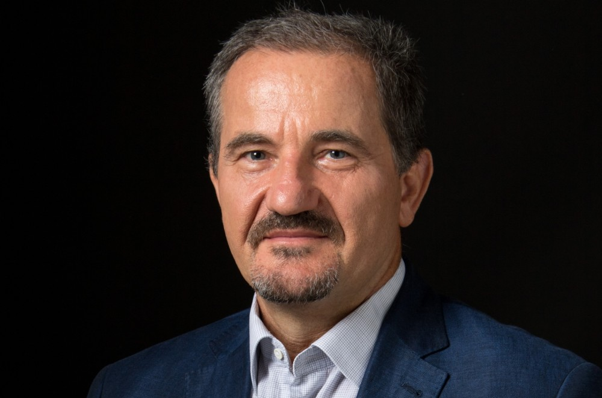
GRAPHISOFT PARK
JÁNOS KOCSÁNY
CEO OF GRAPHISOFT PARK SE
After graduating as an architect, János Kocsány studied economics, estate management and has also earned an MBA degree. In 1981 he began to work in various fields of the construction industry, mostly on building sites. He found computer support of construction site logistics as the most engaging task. Following his immersive architect career, in 1994 he began to work as an investment specialist in real estate, managing entire real estate development projects. In 1996 he joined Graphisoft R&D Rt. as the leader of Graphisoft Park’s many development projects, as well as of its leasing and operational tasks. Starting its IPO (initial public offering) as a standalone real estate developer company, listed on the stock market, he also serves as the CEO of Graphisoft Park SE.
Graphisoft Park
Nestled in Budapest's 3rd district, Graphisoft Park is a dynamic innovation hub along the serene Danube. Established in 1998 as a brownfield project, our mission is to provide a premier work environment that attracts top talent and nurtures groundbreaking ideas.
A Green Oasis of Creativity
Spread across 18 hectares, with over 60% green space and 2,500 m² of green roofs and 25% of the site built-up, our Park is a lush oasis teeming with greenery and tranquil waterways. Towering trees and contemporary art installations inspire creativity. Our tenants include leading software companies, R&D firms, and educational institutions, all benefiting from mutual synergy.
Tailored Spaces for Every Need
We offer customized office spaces for large corporations and startups alike. Our amenities include shared meeting rooms, vibrant cafés, state-of-the-art fitness facilities, and conference centers equipped with the latest technology. With over 2,000 underground parking spaces, we maintain a green space ratio above 60%. The Park is home to around 5,000 staff and more than 1,000 students.
Sustainability at Our Core
Sustainability is key at Graphisoft Park. We integrate energy-efficient technologies, electric vehicle charging stations, and extensive bike paths. Solar panels and rainwater harvesting systems enhance our eco-friendly infrastructure. Through community initiatives, we support
© FIABCI, The International Real Estate Federation

Slide 17
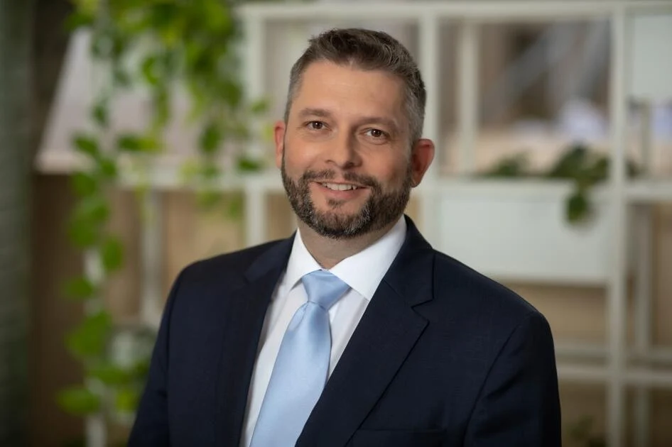
TELEKOM CAMPUS
GÁBOR ANGEL
WING DEPUTY CEO, OFFICES
Gábor Angel joined WING in 2022 as a Deputy CEO, responsible for office development and portfolio. Gabor has gained a versatile experience in real estate development, management and acquisition over the past 20 years. Previously, he was a member of the Board of Directors of Biggeorge Property, before which he held the position of CEO of BIF Plc. From 2013 to 2017 he worked as the vice-chairman of the Real Estate Developers Round Table Association (IFK).
Graduated from Szent István University (YMMF) as civil engineer.
He speaks Hungarian and English.
About WING
WING is a leading property development and investment group in Central Europe. It has significant market shares in the property markets of Germany, Poland and Hungary. WING is the majority owner of Poland’s largest property developer, ECHO Investment, which is listed on the Warsaw Stock Exchange, as well as of BAUWERT, Germany’s leading residential and commercial property developer. WING is one of the largest property developer and investor companies in Hungary. In Germany, Poland and Hungary, WING has a total of 5,5 million sqm of floorspace in its development portfolio.
About Telekom Campus
A WING development and one of the largest and most modern office buildings in the country, was completed in 2018. With its spectacular silhouette, this unique building has been a key element of the cityscape in District 9. The building with its unique and spectacular silhouette is currently the headquarters of Magyar Telekom and Deutsche Telekom IT Solutions and one of the offices of MÁV.
© FIABCI, The International Real Estate Federation

Slide 18
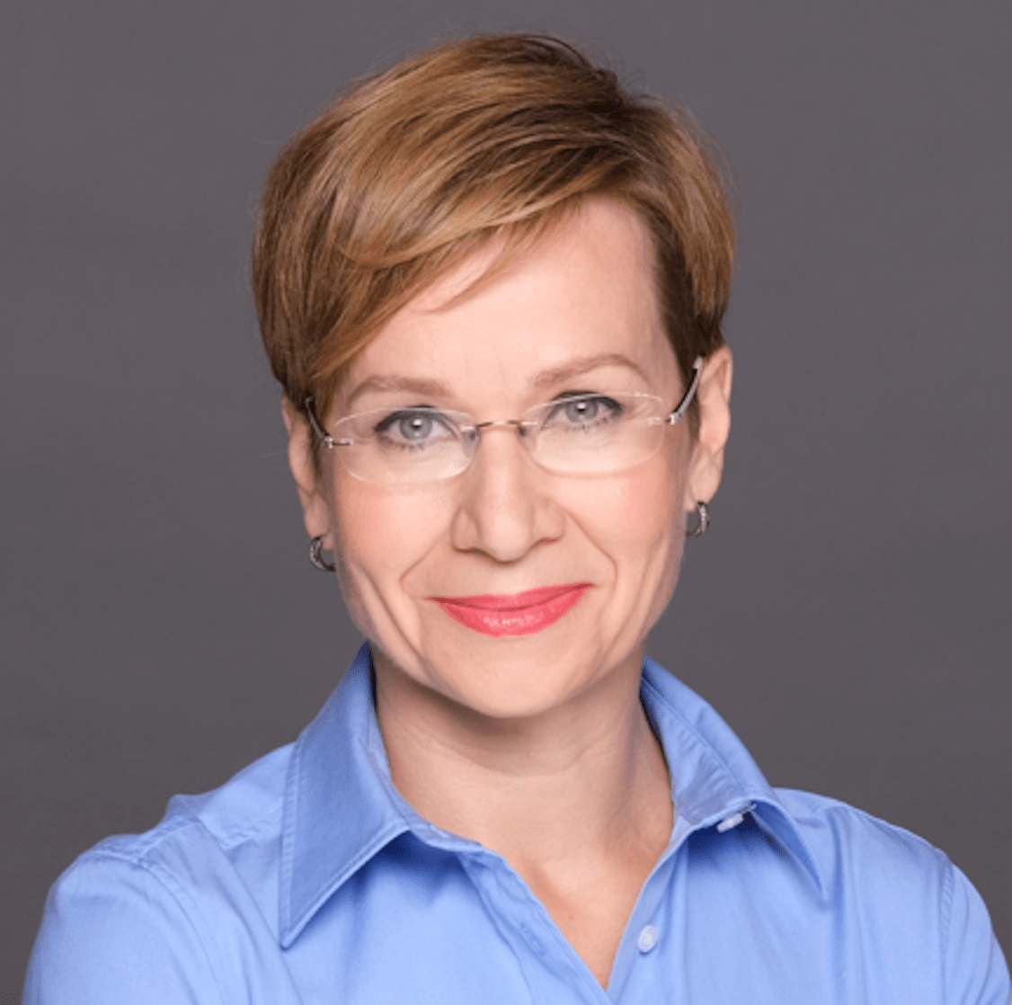
MOL Campus
PIROSKA BAKOS
SPOKESPERSON AND MEDIARELATIONS
LEAD OF MOL GROUP
Piroska Bakos is the Spokesperson and Mediarelations lead of MOL Group, an international, integrated oil, gas, petrochemicals, and consumer retail company, headquartered in Budapest, Hungary. She graduated from University of Pécs with a degree in Humanities. She studied Communication and Media Science in Germany. For 13 years she was a news presenter, editor and foreign affairs analyst at the Hungarian Public Television. On behalf of the Ministry of Foreign Affairs, she acted as a spokesperson for the first Hungarian EU Presidency in 2011. For her work she was awarded with the Order of Merit of the Hungarian Republic. Before joining MOL she has been a Hungarian correspondent for the German public broadcaster MDR (Mitteldeutscher Rundfunk) and has worked as a communication trainer and moderator of economic, diplomatic and public events.
The new headquarters is a symbol of the MOL strategy. Its unique form integrates the 28-storey Tower with the connected Podium a single form to create a unified campus. The office building has 28 floors, is 120 m high, and accommodates 2,500 employees, with a total floor area of approximately 86,000 square meters.
MOL has relocated colleagues from 3 different districts and 9 locations to the new headquarters, which has a primary mission of creating a harmonious work environment for employees and, in line with the MOL strategy, ensuring efficient work performance. The design of the interior spaces was based on the concept of creating a modern and sustainable workplace that supports collaboration.
Green spaces run through the entire building, bringing nature closer to the workplace.
The building makes the most of its surroundings, offering not only sustainable solutions but also a new reference point for both Budapest and Hungary. First in the country, it has successfully achieved the BREAM Excellent rating and the LEED Platinum certification.
© FIABCI, The International Real Estate Federation

Slide 19
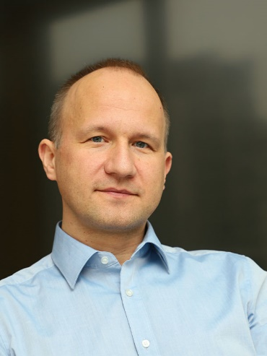
2. BLOCK URBAN DEVELOPMENT RESIDENTIAL
DR ZOLTÁN ÁDÁM
MODERATOR OF BLOCK
URBAN DEVELOPMENT RESIDENTIAL PROJECTS
Dr. Zoltán Ádám is the owner of Ádám Mérnökiroda Kft., with two decades of expertise in the civil engineering, construction and real estate development industries. His skills include project management, construction supervision, appraisals, and feasibility studies. Before starting his own business, concentrating on real estate project management and technical supervision, he held leadership roles at Erste Ingatlan Kft. and Takenaka Europe GmbH, managing major projects in Hungary. Dr. Ádám holds a PhD in Architectural Engineering from Osaka University and has received multiple awards for his outstanding work in construction execution.
He is fluent in English and Hungarian, with intermediate German and Japanese proficiency.
© FIABCI, The International Real Estate Federation

Slide 20
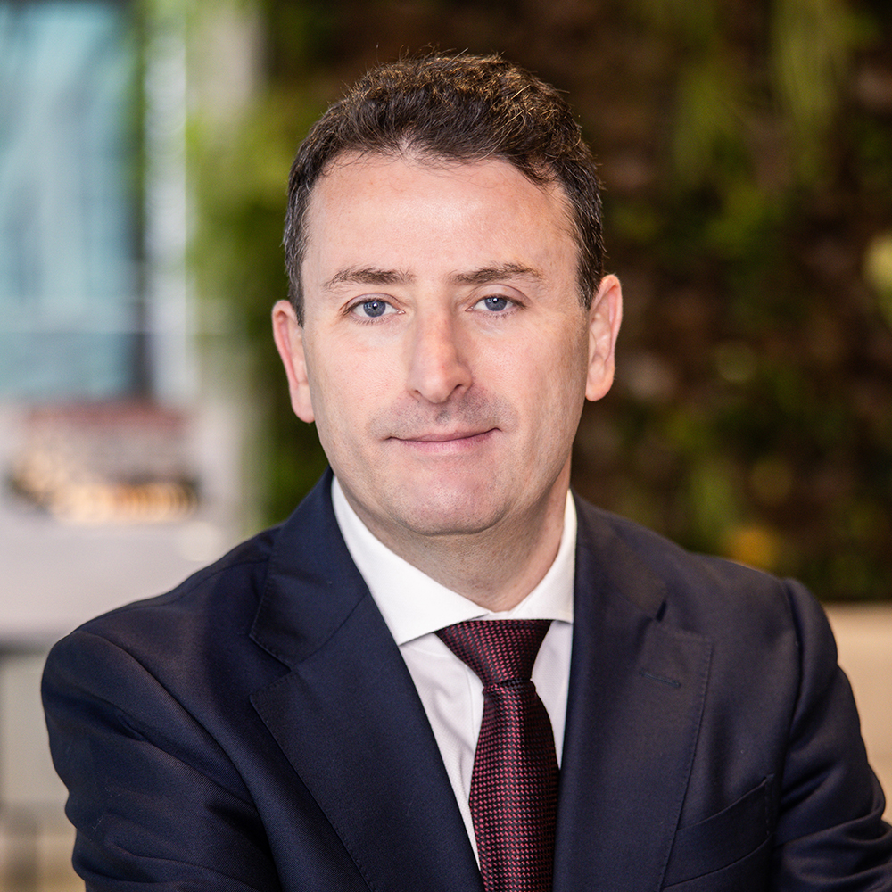
Waterfront City
TIBOR NAGYGYÖRGY MIRCS
OWNER OF BIGGEORGE HOLDING,
CEO OF BIGGEORGE PROPERTY PLC.,
FOUNDER OF OTTHON CENTRUM
Tibor Nagygyörgy graduated as an economist and later obtained his MBA from the Budapest University of Economic Sciences and the London Business School in 1997. He also completed a postgraduate course in real estate consultancy in 1999, organized by Nottingham Trent University and the Technical University of Budapest, accredited by the RICS.
He started his business career in 1991 as an undergraduate, initially brokering luxury apartments, and then moved into commercial property within Biggeorge’s International. He founded the predecessor of Otthon Centrum – a network of 190 offices in Hungary and 100 additional branches in Poland by now – in 2000, and set up Europa Real Estate Fund Management, which he sold in 2004. Nagygyörgy entered the real estate development market in the same year, and has been delivering high quality residential, logistics, office and hotel properties since, doing so under the Biggeorge Property brand since 2014. Since 2006, the Biggeorge Fund Management subsidiary has become a fundamental part of the development and investment operations, currently having approximately EUR 450 million assets under management in its real estate funds.
© FIABCI, The International Real Estate Federation

Slide 21
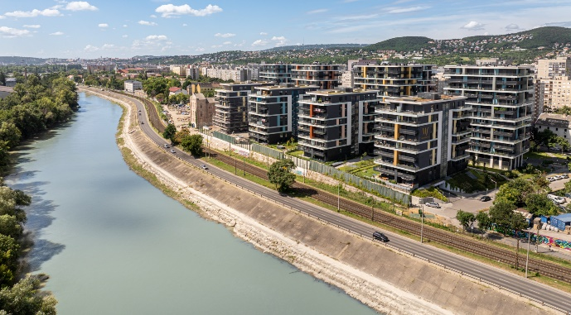
BIGGEORGE PROPERTY
Biggeorge Property Plc. – a member of Biggeorge Holding (BGH) founded in 1991 – is one of the largest privately owned Hungarian real estate development and investment companies.
BGH is a majority owner of Otthon Centrum Holding Ltd., a real estate and loan brokerage company; GroundUp Ltd. constructing Biggeorge Property projects; and BG Finance Plc. active in small business financing. BGH also holds a 50% stake in Dome Group, a facility management company, and a 34% stake in 8G Energy Holding, a provider of renewable energy solutions.
Biggeorge Property Plc.'s subsidiaries and their respective funds have developed 3,025 apartments and 167,514 sqm GLA office, industrial and logistics properties to date. Biggeorge Property Plc. – 100% owned by Biggeorge Fund Management Plc. – manages assets worth approximately HUF 177 billion, with around 1,000 residential units currently under construction. The group and its funds have plots suitable for constructing 2,533 further apartments. Biggeorge Property is currently offering apartments for sale in the residential complexes of Waterfront City (District III), Spirit Residence (District IX), Újbuda Garden (District XI), Árnyas 40 Villa Suites (District XII), Westside Garden, Westside Grand and Béke Garden (District XIII), as well as in two projects by Lake Balaton (Siófok and Balatonszemes).
LogStar, the company's logistics division, currently offers 100 hectares of industrial land for sale. Its business park portfolio (both developed and acquired properties) includes several leasable logistics facilities in Budapest and the countryside (Budapest Városkapu/M3, Budapest Megyeri City, Székesfehérvár, Törökbálint West Gate, Debrecen).
Biggeorge Property is dedicated to sustainability, bringing quality projects to life and creating architectural value in all of its business units.
© FIABCI, The International Real Estate Federation

Slide 22
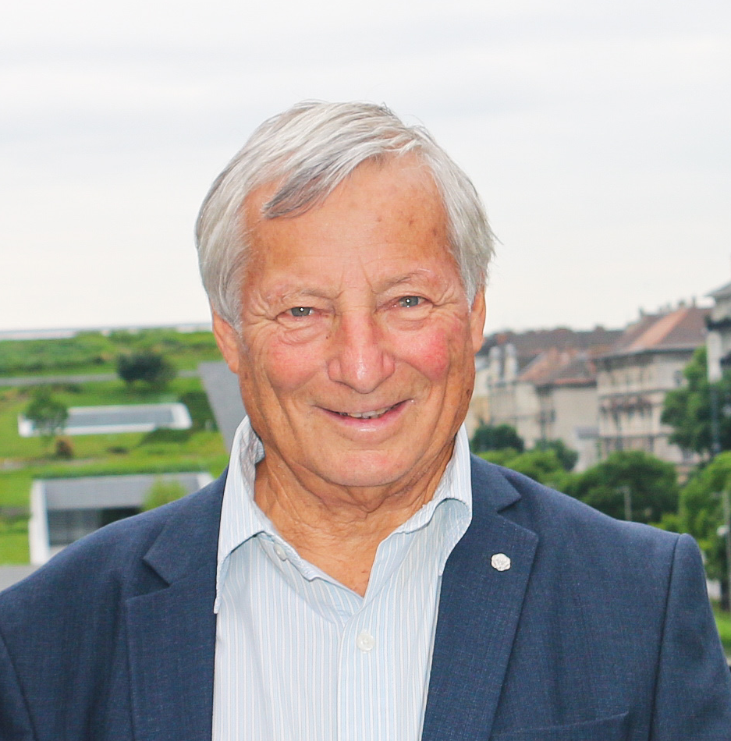
Duna Terasz
LÁSZLÓ GÖNCZI
TECHNICAL DIRECTOR OF DUNA TERASZ GROUP
László Gönczi graduated from Sankt Petersburg Construction University as town planner and architect. 17 years town planning. Two new town, different city centers etc.
CEO of different foreign owned companies, actives in real estate development in Hungary. Actually Technical Director of Duna Terasz Group.
40 years of experience in real estate development.
D&B Properties Real Estate Developer - Group
For more than 15 years, the D&B Real Estate Developer Group has been creating value with its new residential parks in one of the most popular districts of Budapest, the 13th district.
Representing a collective brand name for residential quarters built adjacent to riverside Marina, Duna Terasz implies an independent community making up the Duna Terasz Residential Quarters. Our goal is to create lasting value with the Residential Quarter in Budapest.
From the end of the 2000s onward, D&B Properties Real Estate Developer – Group is a permanent player on the Hungarian real estate and property market.
The company ’s approach is based on a thorough design phase, focused on the latest needs of the buyers and the quality of life that the apartments offer. The Group’s proficiency and stable financial background guarantee the quality of the planned and finished residential blocks that remain in value.
Duna Terasz
A big brown field residential development along the Danube bank. A new residential area, without cross traffic, with big public park near the Danube, sport fields, playgrounds, pedestrian allees, bicycle roads etc. is under creation.
© FIABCI, The International Real Estate Federation

Slide 23
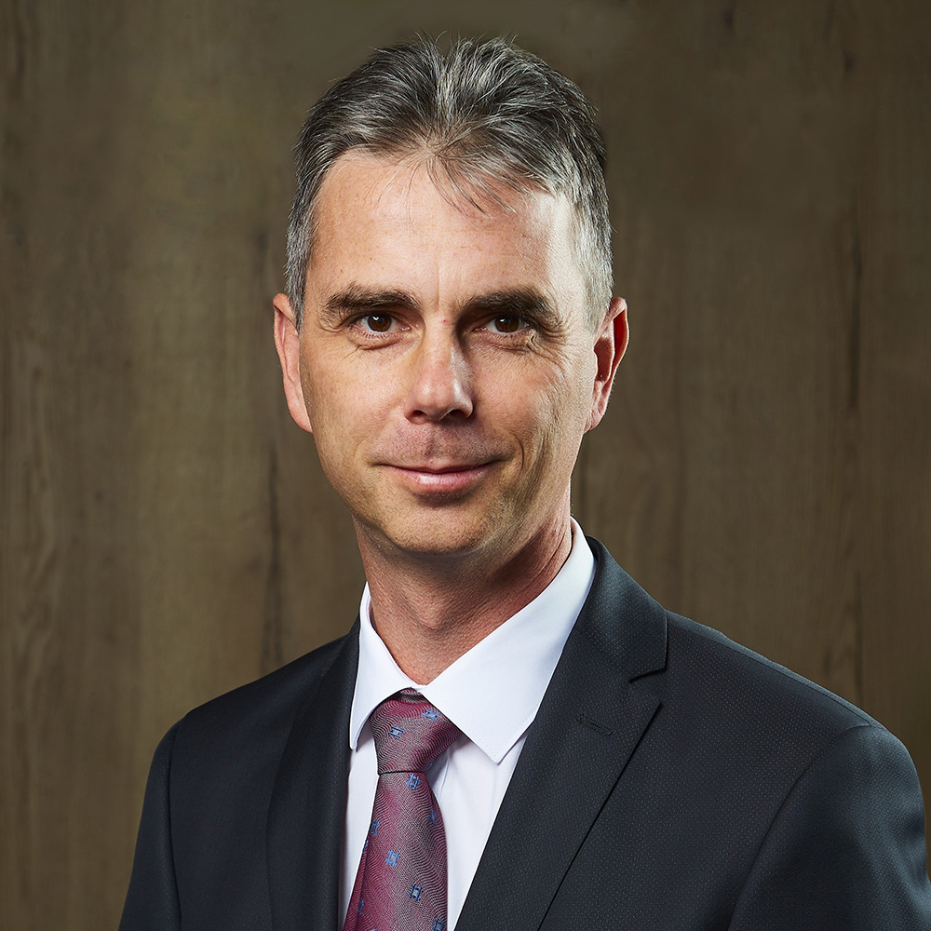
Metrodom River Residential Park
GÁBOR KISS
MANAGING DIRECTOR OF METRODOM GROUP
Mr Gábor Kiss has been the managing director of Metrodom Kivitelező Kft., which is part of the Metrodom Group of Companies, since 2012, and is also the vice-president of the Hungarian Real Estate Development Round Association (IFK). Previously, he was the managing director of Nanette Construction Hungary Kft.
As the managing director of Nanette Construction Hungary Kft., nearly 3,000 delivered apartments can be linked to his name.
As the managing director of the Metrodom Group, one of the leading players in domestic residential real estate development, he built and handed over nearly 7,000 apartments, from small condominiums to residential parks with hundreds or even thousands of apartments and is currently developing several condominiums.
The handover of the Metrodom Panorama Residential Park in 2021, which won the World Gold Winner price of FIABCI World Prix' de Excellence in Residential Mid Rise category, was considered a turning point in the company's life. Current green facade development is the Metrodom Green project being built in the IX. district.
© FIABCI, The International Real Estate Federation

Slide 24
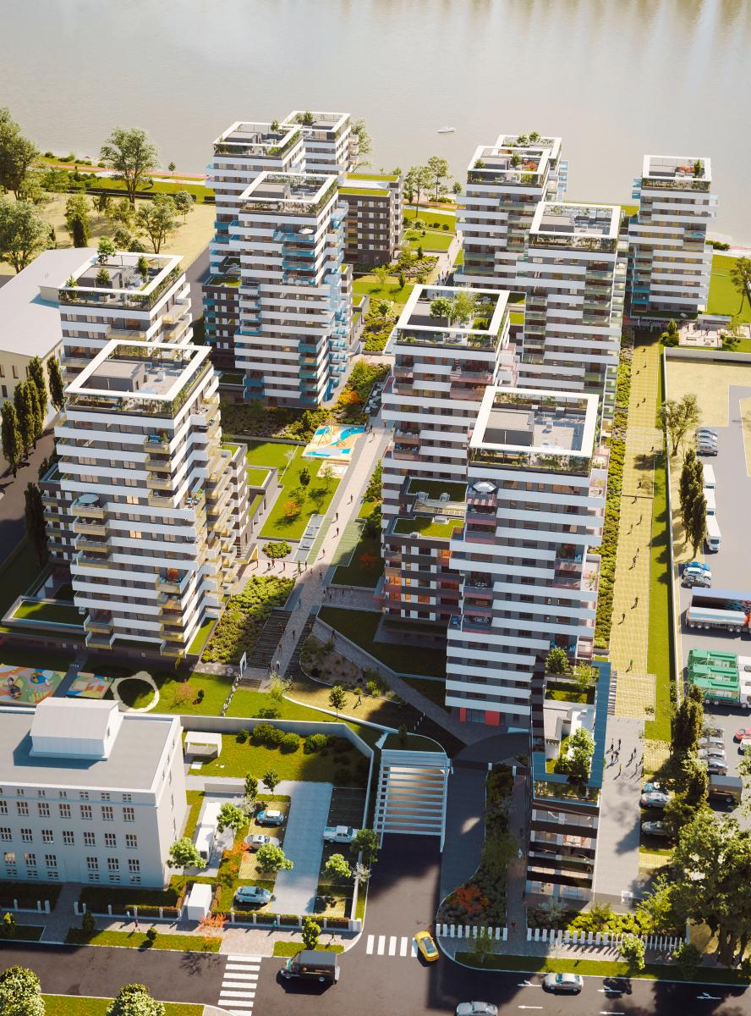
Metrodom River
All the projects of the company group are at the forefront of the utilization of rust zone areas
Metrodom River Residential Park will be built in 6 phases in one of the dynamically developing rust belt areas of Budapest. The residential complex, which will house 732 apartments, is located on the banks of the Danube and offers a range of services that make it truly unique and a real premium category home. The Residential Park is a true compact city model in addition to apartments, offices, shops - retail units, many premium community units such as kindergarten, nursery, sauna, outdoor and indoor fitness, community playroom, baby - mother's room, wet and normal playground, boat house, community roof terrace, barbecue terrace, cafe, yoga and tai chi terrace will be created. In the modern buildings, residents returning home are greeted by an elegant and homely lobby, the most exciting decoration of which is the 5-story-high vertical garden with Mediterranean vegetation. Metrodom River is more than an average residential park: real homes in the premium category with high technical and quality content, to which it is always good to be home.
Metrodom River1 and River2. phases of the residential complex have already been completed. The 4th phase of construction will begin in August 2024.
© FIABCI, The International Real Estate Federation

Slide 25
3. BLOCK URBAN DEVELOPMENT:
TOWN DEVELOPMENT
Moderator of block
LÁSZLÓ GÖNCZI
TECHNICAL DIRECTOR OF DUNA TERASZ GROUP
László Gönczi graduated from Sankt Petersburg Construction University as town planner and architect.
17 years town planning. Two new town, different city centers etc.
CEO of different foreign owned companies, actives in real estate development in Hungary.
Actually Technical Director of Duna Terasz Group.
40 years of experience in real estate development.
© FIABCI, The International Real Estate Federation

Slide 26
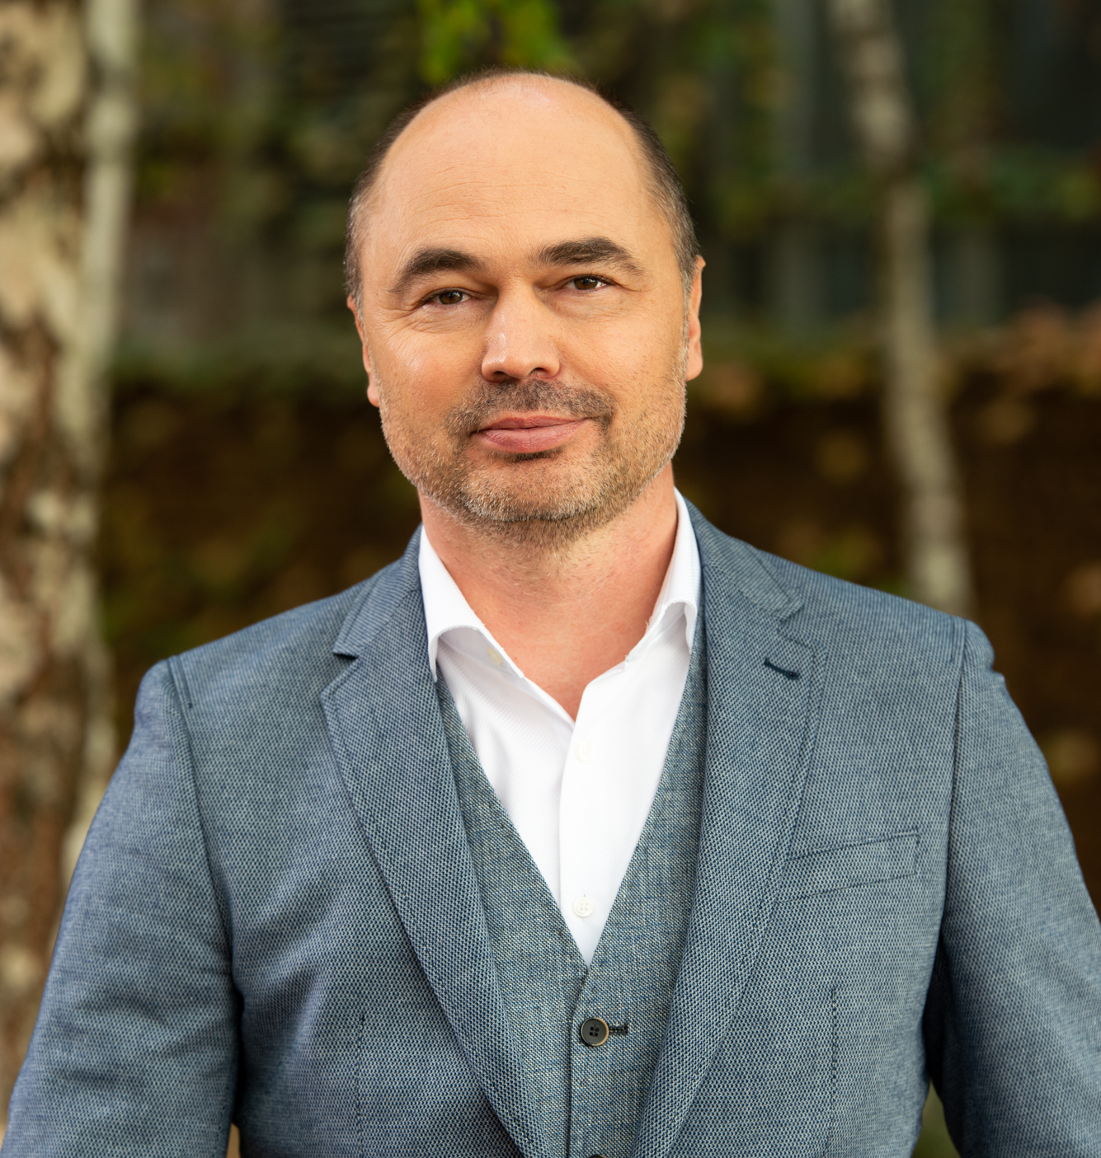
THE LIGET (TOWNPARK) BUDAPEST PROJECT
ATTILA SÁGHI
DEPUTY CEO OF VÁROSLIGET LTD
Attila Sághi is the Deputy CEO/ Chief Investment Officer of Városliget Ltd., the largest state-owned real estate development company responsible for the new Museum District in Budapest and the implementation of Liget Budapest Project, in which he was Head of Development.
Professional profile
As a structural engineer with a degree from the Budapest University of Technology and Economics and the University of Technology Delft, Attila started his professional activity in 1997 in Hungary and has been practicing as an architect ever since. With over 20 years of experience in managing major real estate and refurbishment projects on a national and international scale, he oversees various fields of project management, strategic planning, and procurement consultancy where he consistently implements innovative and creative solutions in the invested developments. As former president of the Hungarian Heritage Centre (Forster Center) he directed activities of over 50 reconstruction projects in the country and is a persistent representative of raising visibility of cultural heritage goals and popularity. His certifications and recognitions include Membership in the Chamber of Architects, Designer of Building Structures, Head of Construction of Buildings and Civil Engineering Objects, Technical Supervisor of Civil Engineering Objects, Monument and Heritage Reconstruction Architect Expert, membership of the UNESCO/ICOMOS, Membership of the FIDIC organization, Public Procurement Consultant, Europa Nostra.
The Liget Budapest Project
Europe's most complex urban cultural development, revitalizing the City Park in Budapest, reinventing it as the most preferred family theme park and cultural hub. The park is home to historic institutions like the Zoo, Kunsthalle, Museum of Fine Arts, Vajdahunyad Castle, and Széchenyi Baths, and combines rich offerings of activities through the harmony of built environment and nature. The project was initiated in 2013 and enhances the park without increasing urban density, ensuring more green areas by converting roads and parking lots into green spaces.
© FIABCI, The International Real Estate Federation

Slide 27
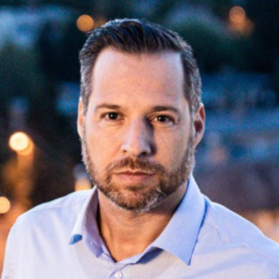
CORVIN PROMENADE
GÁBOR RADVÁNYI
CHIEF ARCHITECT OF FUTUREAL GROUP
Corvin Promenade Winner of FIABCI World Prix d’Excellence 2011
The Corvin Promenade offers an array of remarkable opportunities in the heart of Budapest. With its modern homes situated in a completely remodeled neighborhood alongside high-quality, human-centered office buildings, high-end shops, restaurants, cafes and entertainment venues, it is no surprise that the development has won numerous international awards.
© FIABCI, The International Real Estate Federation

Slide 28
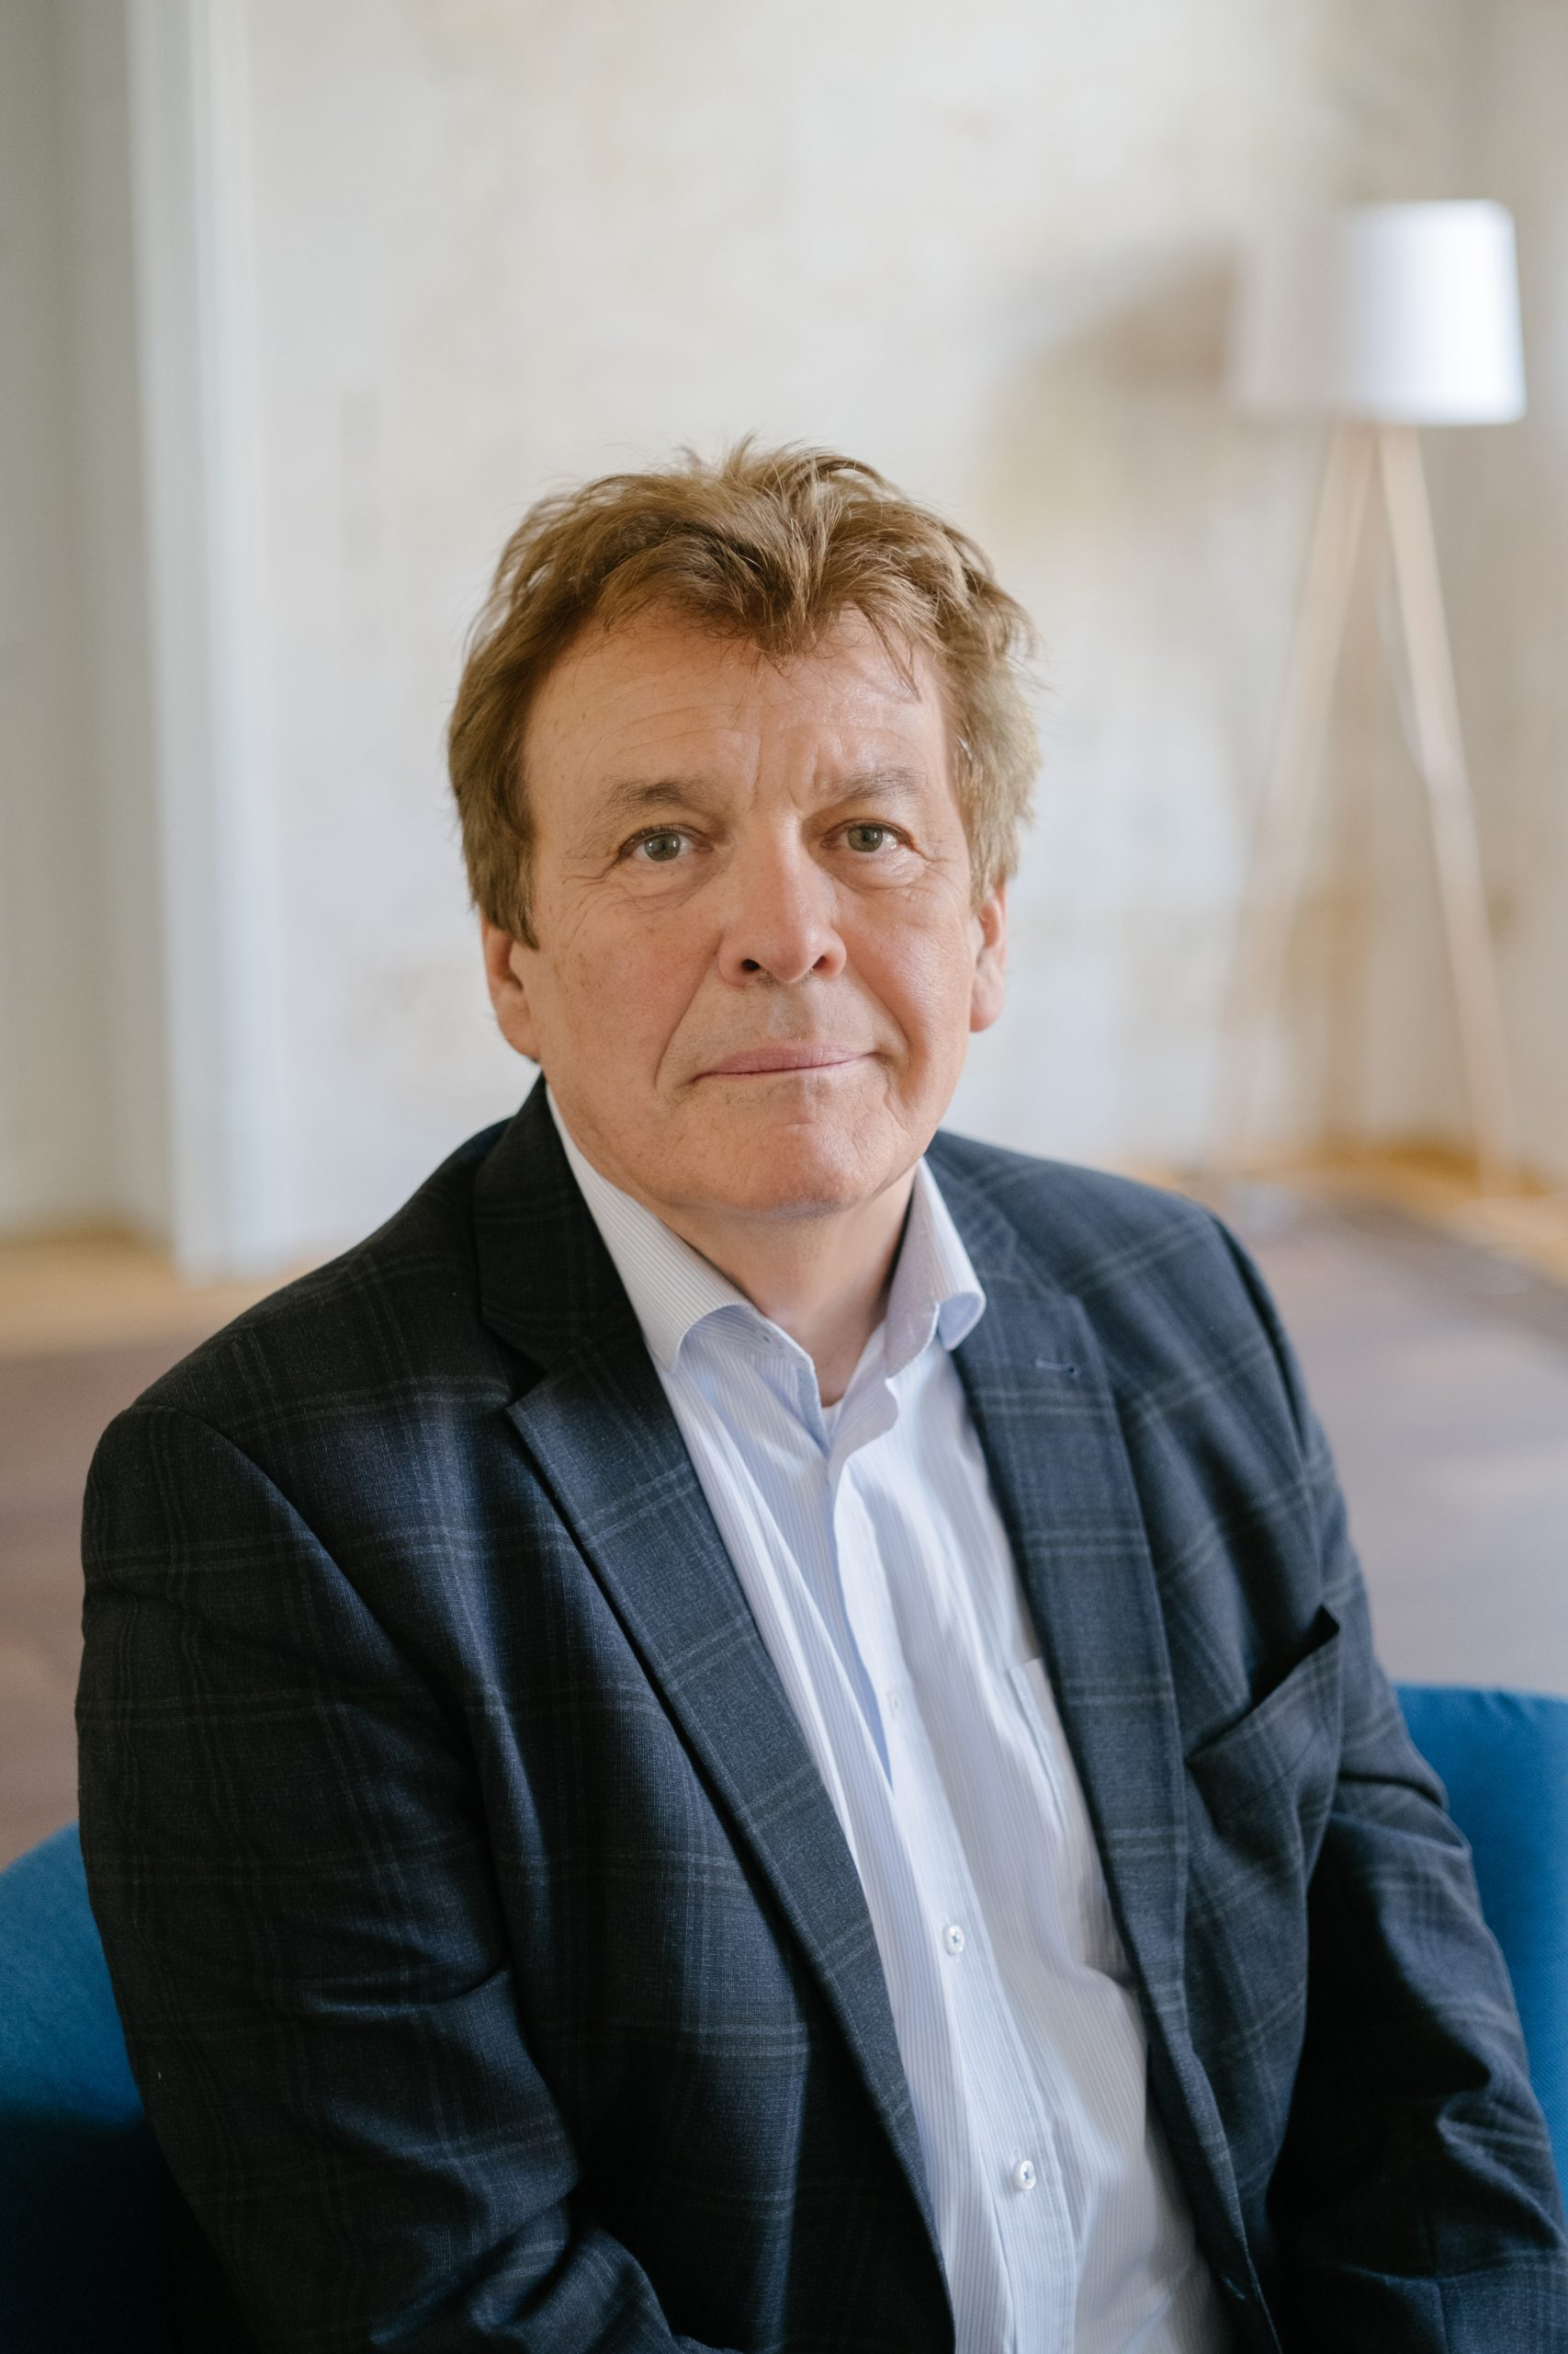
KRAFT PROJECT KŐSZEG
PROF. FERENC MISZLIVETZ
Ferenc Miszlivetz is a Hungarian sociologist, historian, university professor and Doctor of the Hungarian Academy of Sciences. He became a research fellow at the Institute for Development Studies at the University of Sussex and later received a postdoctoral scholarship from the MacArthur Foundation and did research at the Institute of International Studies at the University of California - Berkeley, Stanford University, Harvard University Center for European Studies, and the European Union Center for Advanced Studies at the Schumann Center
(European University Institute, Florence). He was a visiting professor at the Interdisciplinary Master's Programme in Eastern and Central Europe at the University of Bologna for many years, and István Deák visiting professor at Columbia University in New York. He has taught at the University of Vienna, the University of Salzburg, the Catholic University of Ruzsomberok on topics of European integration, the transformation of Central Europe, local and regional sustainability, creative cities, and new management of cultural heritage. He was twice awarded as a Jean Monnet Professor by the European Commission and the Institute for Social and European Studies, that he founded and directs, was awarded as a Jean Monnet Center of Excellence. He is a UNESCO Chair in Cultural
© FIABCI, The International Real Estate Federation

Slide 29
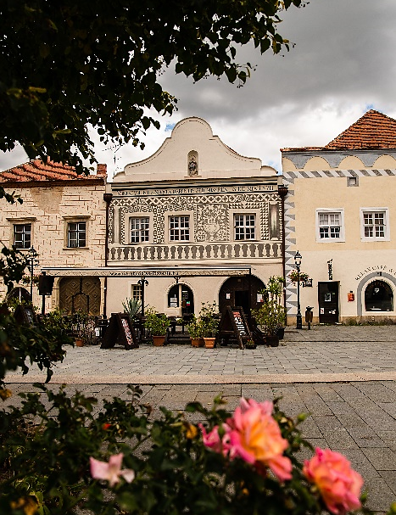
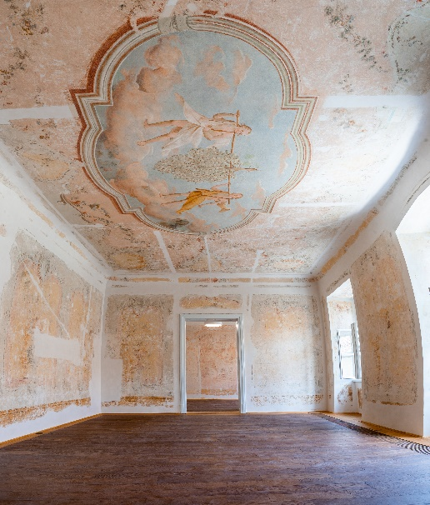
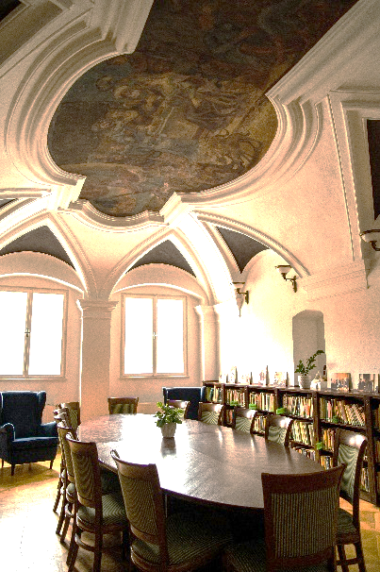
In 1994, Miszlivetz founded the Europe House in Kőszeg, which is a center for postgraduate education and scientific research, as well as a venue for cultural events in Central Europe. In 2015 he founded the Institute of Advanced Studies Kőszeg (iASK), an internationally renowned institution with wide-ranging contacts, which is an outstanding initiative for the qualitative renewal of research and education in Hungary. The Institute is an Academic Member of FIABCI and Ferenc Miszlivetz is a member of FIABCI.
His academic research is holistic and interdisciplinary in its approach, and is generally related to remedies of underdevelopment, complexities of international global transformations, trends and crises. His work and his achievements in science organization, institution building, innovation and development are complex and innovative.
The most recent result of his work is the development and application of the KRAFT (Creative Cities, Sustainable Region) Complex Development Strategy and Methodology for the West Pannon region and East-Central Europe. Its originality lies in the combined collaboration of engineering, natural sciences, social sciences, humanities and arts in the design and implementation of local and regional development projects. The renovation work carried out in the historic center of Kőszeg under the KRAFT program has resulted in beautifully restored buildings with new designated functions that recognize the social and cultural benefit of the central complex and the integration of environmental considerations. The experience of recent years has also shown that new ways of managing, presenting and exploiting cultural heritage, endowing them with new social, scientific and cultural functions enhances city and regional economic and touristic performance. The new functions of the renovated buildings create a synergy that inevitably increases the attractiveness of the city and strengthens the identity of its inhabitants. The KRAFT concept identifies a number of interrelated cultural, socio-economic and infrastructural dimensions, thus assessing the development potential of the city and its surroundings and providing a basis for a comparative analysis. The KRAFT methodology has also contributed to a new concept of complex regional re-development. The strategy contributed to the successful application of the city of Veszprém and the Lake Balaton region to become a European Capital of Culture in 2023.
© FIABCI, The International Real Estate Federation

Slide 30
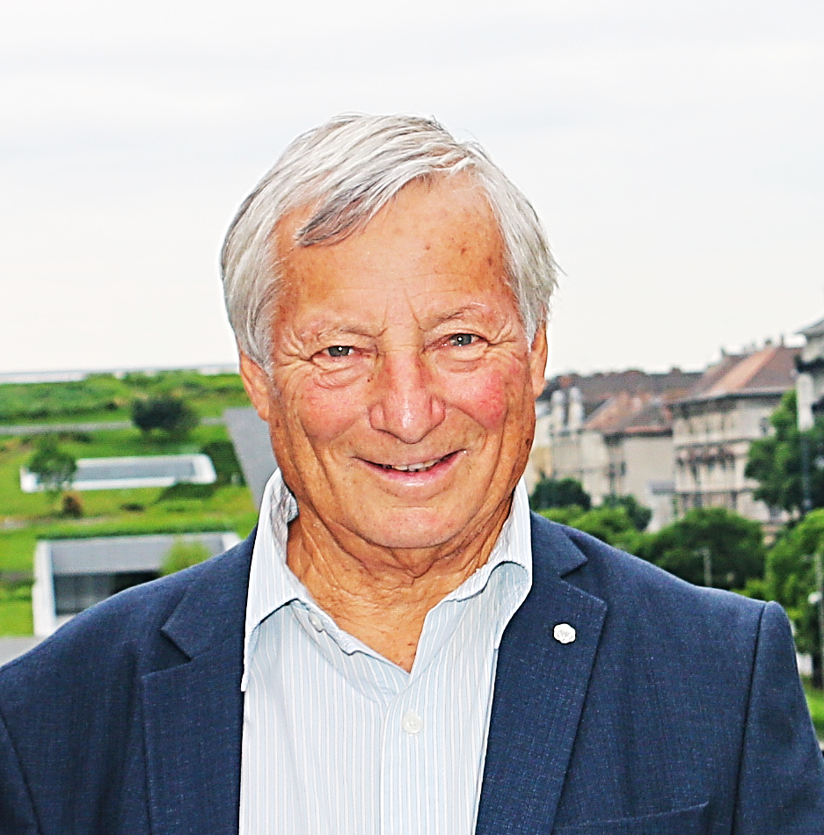

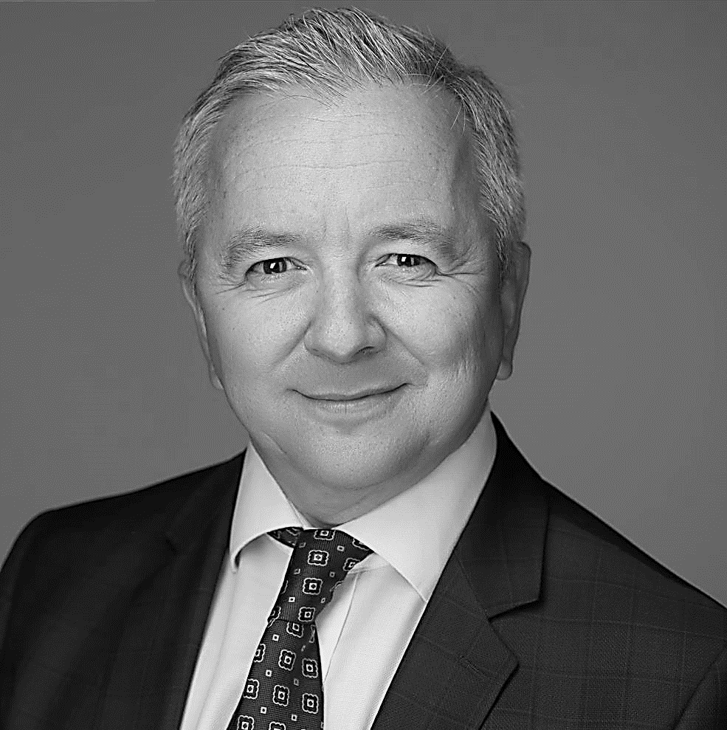
CONTACTS
GÖNCZI LÁSZLÓ
FIABCI HUNGARY President
FIABCI
Prix d'Excellence Committee
President
+36 30 730 1111
SZOMOLÁNYI JUDIT
FIABCI HUNGARY
Secretary
+36 30 346 8707
FEUERTAG OTTÓ
FIABCI HUNGARY
Board member
EUROPA DESIGN
Founder
+36 309 480 173
© FIABCI, The International Real Estate Federation

