Slide 1


Hydrogen Headstart
Public Consultation
      Department of Climate Change, Energy, the Environment & Water
      Australian Renewable Energy Agency
      July 2023

Slide 3
Disclaimer:
The following presentation was used as part of the Information and Consultation Forums for the Hydrogen Headstart Competitive Round (Competitive Round).
The Department of Climate Change, Energy, Environment and Water (DCCEEW) and the Australian Renewable Energy Agency (ARENA) are working in collaboration to design the Competitive Round.
The Consultation Paper and this presentation contain the indicative specifications for the Competitive Round, on which DCCEEW and ARENA are seeking stakeholder feedback.
These proposed specifications are indicative only and designed to stimulate input. They should not be taken to presuppose any final design features. The final program design will be developed from input from the consultation process and may differ to the parameters outlined in the Consultation Paper and this presentation.
Should you have any queries or require any clarification in relation to the following presentation, please email hydrogenheadstart@dcceew.gov.au

Slide 4
Agenda
Overview of Australian Government hydrogen initiatives
Hydrogen Headstart consultation:
  ARENA’s Role in Hydrogen
  Overview of Consultation Process
  Competitive Round Objectives
  Proposed Competitive Round Design
  Proposed Merit Criteria & Timetable
  Next Steps
  Q&A

Slide 5
Agenda
Overview of Australian Government hydrogen initiatives
Hydrogen Headstart consultation:
  ARENA’s Role in Hydrogen
  Overview of Consultation Process
  Competitive Round Objectives
  Proposed Competitive Round Design
  Proposed Merit Criteria & Timetable
  Next Steps
  Q&A

Slide 6
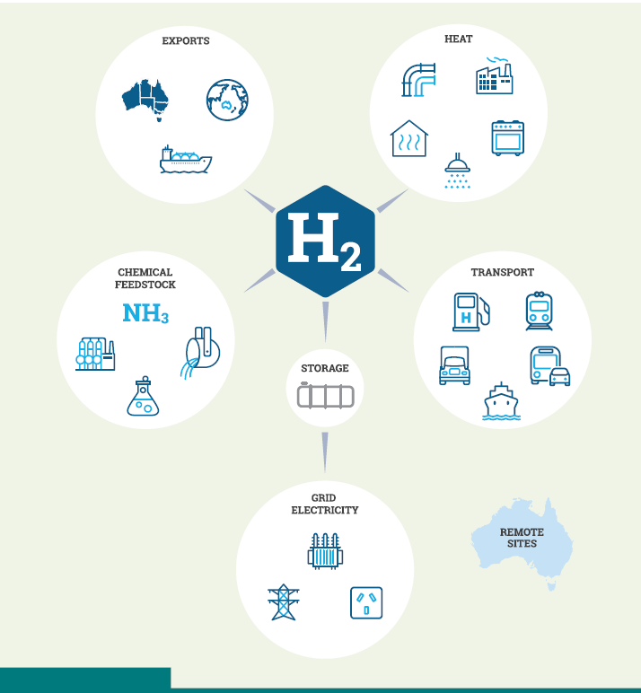
Australian government hydrogen initiatives
Programs underway to help develop Australia’s hydrogen industry include:
$2 billion Hydrogen Headstart Program
Review of the National Hydrogen Strategy
Guarantee of Origin scheme
Regional Hydrogen Hubs program
Reviewing Australia’s regulatory frameworks
Annual State of Hydrogen Report
National Hydrogen Infrastructure Assessment
Improving workforce skills and training

Slide 7

National Hydrogen Strategy Review
Australia is well placed to develop a hydrogen industry – $300 billion pipeline
Our Hydrogen Strategy provided the initial steps but was meant to be adapted
Global environment has transformed since 2019 release – appetite for decarbonisation, clean products, and willingness to secure domestic industry e.g. US IR Act
Reviewing the strategy reflects an adaptive approach, desire to integrate better with economy-wide decarbonisation, greater global competition for trade in H2 and associated manufactured goods

Slide 8



Guarantee of Origin Scheme (GO Scheme)
Internationally-aligned scheme to measure, track and verify the carbon emissions and other attributes of Australian clean energy products (including hydrogen and hydrogen energy carriers).
It will enable consumers across domestic and international markets to identify and purchase the products that meet their individual needs.
GO certificates will provide a mechanism to verify production, emissions intensity and renewable electricity use for the Headstart Program.

Slide 9
First Nations engagement
Valuing First Nations land and water rights, cultural heritage and genuine engagement with First Nations communities is essential to Australia’s social and economic success
An additional $2 million has been announced to help First Nations people engage meaningfully with hydrogen project developers
Our discussions to date with First Nations groups indicates a wide span of understanding and engagement with hydrogen.
It is common for project proponents to arrive on Country with expectations of rapid approval on land access matters – Traditional Owners are often not well equipped to make well-informed, fact-based decisions

Slide 10
Agenda
Overview of Australian Government hydrogen initiatives
Hydrogen Headstart consultation:
  ARENA’s Role in Hydrogen
  Overview of Consultation Process
  Competitive Round Objectives
  Proposed Competitive Round Design
  Proposed Merit Criteria & Timetable
  Next Steps
  Q&A

Slide 11
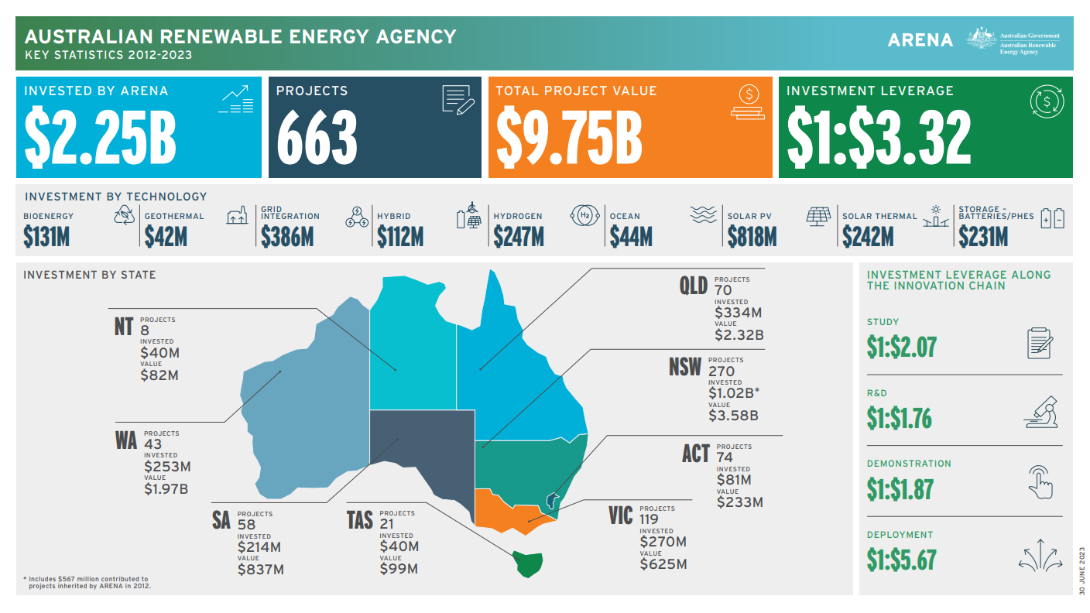
ARENA at a Glance

Slide 12




Investment Priorities
OPTIMISE THE
TRANSITION TO
RENEWABLE
ELECTRICITY
COMMERCIALISE CLEAN HYDROGEN
SUPPORT THE TRANSITION TO
LOW EMISSIONS METALS
DECARBONISE LAND TRANSPORT

Slide 13
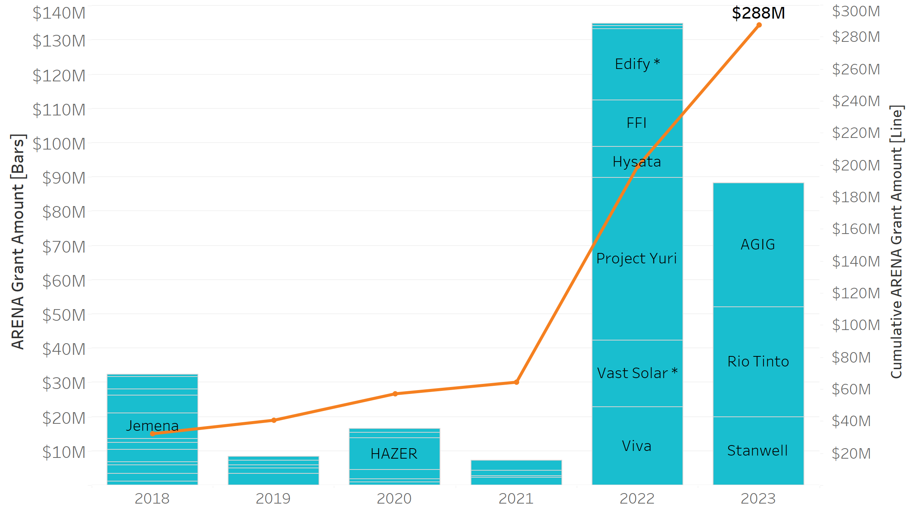
ARENA has committed $288 million to 45 projects to seed Australia’s hydrogen industry
* Announced, funding agreement under negotiation

Slide 14
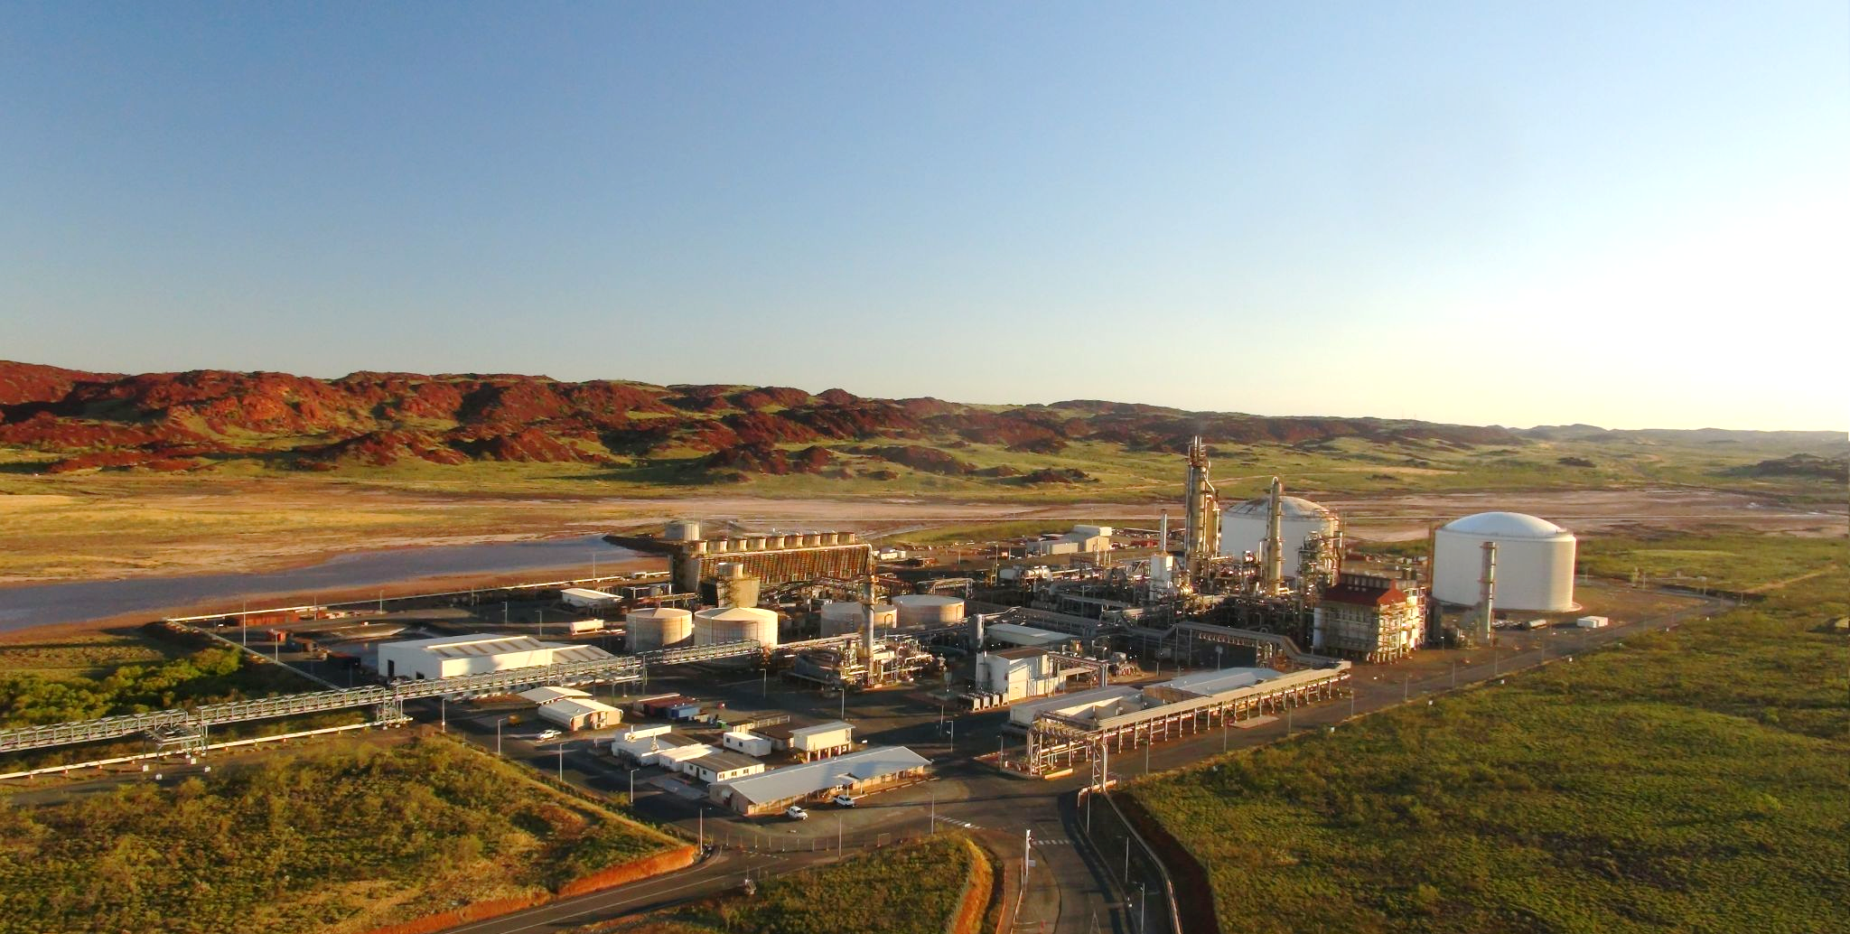
Yara Pilbara Renewable Ammonia Project
Feasibility study leading to funding approval for deployment of a renewable hydrogen and renewable ammonia production and export facility (using a 10 MW electrolyser)
Feasibility - 2020 - $995k ARENA funding | Deployment - 2021 - $47.5m approved ARENA funding

Slide 15
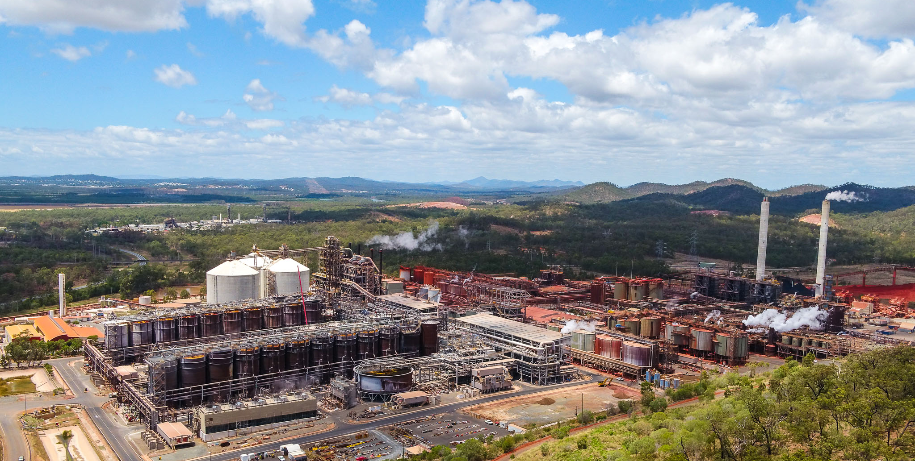
Rio Tinto and Sumitomo Hydrogen Calcination Pilot
Feasibility study leading to funding approval for a trial of hydrogen calcination technology at the Yarwun alumina refinery in Gladstone (using a 2.5 MW electrolyser)
Feasibility - 2021 - $580k ARENA funding | Pilot - 2023 - $32.1m approved ARENA funding

Slide 16
Recent key competitive rounds
Demand
Response
$28.6m / 10 projects
Renewable Hydrogen Deployment Round
$103m / 3 x 10 MW electrolysers
Hydrogen Headstart
$2bn / 2+ projects
2017
2022
2017
2020-22
2023+
Large
Scale Solar
$92m / 12 projects
Large Scale Battery Storage
$176m / 8 projects

Slide 17
Agenda
Overview of Australian Government hydrogen initiatives
Hydrogen Headstart consultation:
  ARENA’s Role in Hydrogen
  Overview of Consultation Process
  Competitive Round Objectives
  Proposed Competitive Round Design
  Proposed Merit Criteria & Timetable
  Next Steps
  Q&A
Note: Competitive Round parameters are subject to change. Information contained in these slides is indicative only.

Slide 18
Background to Hydrogen Headstart
On 9 May 2023, the Australian Government announced it will invest $2.0 billion in the new Hydrogen Headstart program.
The Program reflects a responsive approach to global market signals and intends to bridge the commercial gap for early projects, putting Australia on course for up to a gigawatt of electrolyser capacity by 2030 through at least two large-scale projects.
The Program will use a competitive process (Competitive Round), expected to focus on cost and deliverability, to select large Australian-based projects producing either hydrogen or hydrogen derivative products, produced from renewable energy.
Successful projects will be able to receive a production credit over a 10-year period to cover the commercial gap between the cost of hydrogen produced from renewables and the expected sales price.
Note: Competitive Round parameters are subject to change. Information contained in these slides is indicative only.

Slide 19
Consultation Process Overview
We are seeking feedback on the proposed specifications for the Hydrogen Headstart Program
Feedback provided through today’s Public Forum and in written form will be used to develop the final Program guidelines
Your input will help ensure the Program:
Is fit for purpose to deliver on the Government's objectives
Provides the greatest impact for the sector
Today’s Public Forum will go over key points of the paper
The consultation paper is indicative only, and final program design will be developed following consultation
We encourage participants to submit a detailed written response by:
Completing the form on the DCCEEW website
Emailing: hydrogenheadstart@dcceew.gov.au
The consultation period will close Thursday 3 August 2023
Note: Competitive Round parameters are subject to change. Information contained in these slides is indicative only.

Slide 20
Agenda
Overview of Australian Government hydrogen initiatives
Hydrogen Headstart consultation:
  ARENA’s Role in Hydrogen
  Overview of Consultation process
  Competitive Round Objectives
  Proposed Competitive Round Design
  Proposed Merit Criteria & Timetable
  Next Steps
  Q&A
Note: Competitive Round parameters are subject to change. Information contained in these slides is indicative only.

Slide 21






Hydrogen Headstart: Competitive Round Objectives
Consultation paper reference: 1. Competitive round objectives
Produce renewable hydrogen at scale in Australia, facilitating an accelerated pathway to the technical and commercial viability of renewable hydrogen production and use at scale in Australia.
Support domestic decarbonisation, build industry capability and provide for new economic opportunities in our manufacturing and export industries.
Provide price discovery and transparency in relation to current and projected economics for renewable hydrogen (and derivatives), by sharing actual and forecast economics of applications received.
Reduce barriers for future deployments through attracting private sector capital (debt, equity & offtake).
Develop and retain investment, skilled labour, intellectual property and supply chains for a domestic hydrogen industry
Facilitate knowledge sharing throughout industry to assist with maturing the Australian hydrogen industry.
Note: Competitive Round parameters are subject to change. Information contained in these slides is indicative only.

Slide 22
Agenda
Overview of Australian Government hydrogen initiatives
Hydrogen Headstart consultation:
  ARENA’s Role in Hydrogen
  Overview of Consultation Process
  Competitive Round Objectives
  Proposed Competitive Round Design
  Proposed Merit Criteria & Timetable
  Next Steps
  Q&A
Note: Competitive Round parameters are subject to change. Information contained in these slides is indicative only.

Slide 23
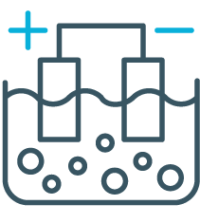
Proposed eligibility requirements (1/2)
Consultation paper reference: 2. Proposed eligibility requirements
Technology
New deployment of electrolysis/renewable hydrogen production facilities
May utilise existing energy generation or hydrogen end use infrastructure
Must be renewable hydrogen and 100% powered by one or more of:
behind the meter renewables,
grid electricity where LGCs or other certificates eligible under the GO scheme are surrendered to match 100% of electricity use, or
electricity from a renewable generation PPA with associated retirement of LGCs
Hydrogen produced using coal gasification or SMR coupled with CCS will not be eligible
Need to comply with the proposed GO Scheme (under development)
Note: Competitive Round parameters are subject to change. Information contained in these slides is indicative only.

Slide 24




Proposed eligibility requirements (2/2)
Consultation paper reference: 2. Proposed eligibility requirements
Eligible end uses / offtake
All end uses of hydrogen or hydrogen derivative products are eligible
There will be consideration of the balance between export and domestic use
Project size
50MW minimum; unrestricted maximum
Location
Within Australia; Does not need to be in a Government H2 hub region
Other
Must be for a single site deployment.
Must have a valid commercial case for the end use of hydrogen.
Applications must include a commercialisation (cost reduction) pathway analysis
Note: Competitive Round parameters are subject to change. Information contained in these slides is indicative only.

Slide 25

Proposed funding mechanism
Consultation paper reference: 4. Proposed funding mechanism
Illustrative only
Hydrogen production credit
($/kg H2 or derivative)
Volume of H2 produced
(kg H2 or derivative)
Paid quarterly in arrears based on actual production that quarter, over max. 10-year term
Hydrogen
Production
Credit
Cost of H2
production
(incl. return
on capital)
Actual volume of H2 or
derivative produced in qtr
(Capped over 10-yr period;
cap nominated by applicant)
Expected
sales
price to
offtakers
Nominated by applicant in application
Note: Competitive Round parameters are subject to change. Information contained in these slides is indicative only.

Slide 26
Proposed mechanism for upside sharing or reduction in funding
Consultation paper reference: 5. Proposed upside sharing or reduction in funding
Upside sharing
50/50
Downside sharing
Nil
Upside arising from decreased operating costs or increased sales price over the contract term will be shared 50/50
Recipients will be required to report on quantity, sales price and cost of production
If the sales price materially exceeds the level of support required within the 10 years, recipients will be required to pay back an amount of the Govt support received in previous years
As funding is capped, agreed Hydrogen Production Credit will not be increased in the event of higher capital or operating costs than expected
Note: Competitive Round parameters are subject to change. Information contained in these slides is indicative only.

Slide 27
Case study example – upside sharing (1/2)
Illustrative only
Offtake price renegotiated
Case study details:
LCOH $6/kg
Initial offtake of $4/kg renegotiated to $5/kg at yr 5
LCOH $6/kg
HPC = $1.50/kg
New offtake $5/kg
HPC = $2/kg
Initial offtake
$4/kg
Impact of renegotiation:
(50% of upside)
Offtake revenue increases
Initial HPC of $2/kg reduced to $1.50/kg (sharing 50% of $1/kg upside)
Annual subsidy decreases
Y0
Y5
Y10
Note: Competitive Round parameters are subject to change. Information contained in these slides is indicative only.

Slide 28
Case study example – upside sharing (2/2)
Illustrative only
Legend:
Offtake price renegotiated from $4/kg to $5/kg
Costs (inc. return)
Base offtake revenue
Revenue & cost per kg
($/kg)
H2 Production Credit (net)
Upside shared
(HPC reduction)
Total upside (increase in offtake revenue)
×
Upside not
shared
Volume
(kg p.a.)
=
50% of upside from higher offtake price is retained by project;
HPC value is reduced by remaining 50%
Total revenue & cost
($ p.a.)
Year:
1
2
3
4
5
6
7
8
9
10
Note: Competitive Round parameters are subject to change. Information contained in these slides is indicative only.

Slide 29
Case study example – payback scenario (1/2)
Illustrative only
Offtake price renegotiated
Case study details:
New offtake $8/kg
LCOH $6/kg
Initial offtake of $4/kg renegotiated to $8/kg at yr 8
No HPC needed
LCOH $6/kg
HPC = $2/kg
Some payback of prior yr HPC required
Impact of renegotiation:
Initial offtake
$4/kg
Initial HPC of $2/kg reduced to nil at yr 8 as revenue > LCOH (no subsidy needed)
Producer required to pay back an amount of the subsidy received in prior years (value determined at the time)
Y0
Y8
Y10
Note: Competitive Round parameters are subject to change. Information contained in these slides is indicative only.

Slide 30
Case study example – payback scenario (2/2)
Illustrative only
Offtake price renegotiated from $4/kg to $8/kg
Legend:
Costs (incl. return)
Total offtake revenue
Revenue & cost per kg
($/kg)
H2 Production Credit
Potential payback
×
Volume
(kg p.a.)
=
Total revenue & cost
($ p.a.)
Potential payback of prior HPC received, subject to negotiation
Year:
1
2
3
4
5
6
7
8
9
10
Note: Competitive Round parameters are subject to change. Information contained in these slides is indicative only.

Slide 31
Volume risk support mechanism
Consultation paper reference: 6. Volume risk support
Some international programs include volume risk as a contractual component
Key features of these include:
Example mechanism
Purpose
Top-up payment on qualifying volume when total volumes sold are less than a certain percentage of forecast volumes from offtake customers
In other programs, volume risk support is paid to recipients through an increased hydrogen production credit for each kilogram of hydrogen produced
Mitigates the risk for recipients that offtake customers unexpectedly reduce demand and sales fall below the recipient’s fixed costs. This ensures proponents can still, at a minimum, service debt repayments but are structured such that returns cannot be improved
Plant must be available to qualify
Note: Competitive Round parameters are subject to change. Information contained in these slides is indicative only.

Slide 32
Case study example – volume risk (1/2)
Illustrative only
Offtaker reduces demand by 50% resulting in increased LCOH
Case study details:
LCOH $6/kg & Offtake $4/kg
Offtaker volumes decrease by 50%
LCOH $6/kg
HPC = $(2 + top up) /kg
Higher HPC to be negotiated
HPC = $2/kg
Initial offtake
$4/kg
Impact of renegotiation:
Initial HPC of $2/kg increased from yr 5 (including top up payment as agreed)
Adjusted subsidy amount
Y0
Y5
Y10
Note: Competitive Round parameters are subject to change. Information contained in these slides is indicative only.

Slide 33
Case study example – volume risk (2/2)
Illustrative only
Legend:
Offtaker reduces demand in year 5 by 50% resulting in increased LCOH
Total costs (incl. return)
Revenue & cost per kg
($/kg)
Total costs (excl. return)
Total offtake revenue
H2 Production Credit
×
Potential H2 Production
Credit top-up payment
Volume
(kg p.a.)
=
Potential HPC top-up to cover costs of production, excluding returns
Total revenue & cost
($ p.a.)
Year:
1
2
3
4
5
6
7
8
9
10
Note: Competitive Round parameters are subject to change. Information contained in these slides is indicative only.

Slide 34
Proposed payment frequency & term
Consultation paper reference: 7. Proposed payment frequency and term
Payment frequency
Quarterly in arrears
Payment timing
Available from FY27
Over maximum 10-year term
Commencing on agreed start date, linked to commercial operations & sunset dates in key offtake agreements
Payment termination
Funding may be terminated if the project ceases development or is materially delayed, as agreed by the parties
Note: Competitive Round parameters are subject to change. Information contained in these slides is indicative only.

Slide 35
Agenda
Overview of Australian Government hydrogen initiatives
Hydrogen Headstart consultation:
  ARENA’s Role in Hydrogen
  Overview of Consultation Process
  Competitive Round Objectives
  Proposed Competitive Round Design
  Proposed Merit Criteria & Timetable
  Next Steps
  Q&A
Note: Competitive Round parameters are subject to change. Information contained in these slides is indicative only.

Slide 36
Proposed merit criteria
Consultation paper reference: 9. Proposed merit criteria
Merit Criterion A
Merit Criterion B
Merit Criterion C
Merit Criterion D
Merit Criterion E
Alignment to Competitive Round Objectives
Applicant Capability & Capacity
Scope, Methodology, Deliverability & Risk
Financial Capability
Knowledge Sharing
Note: Competitive Round parameters are subject to change. Information contained in these slides is indicative only.

Slide 37
Proposed assessment process timetable
Consultation paper reference: 15. Proposed timetable
Timetable not to scale
Application stage 1
Application stage 2
Implementation
Q4 CY23 /
Q1 CY24 /
≥8 weeks later
Q3 CY24
Q4 CY24
10 yrs (max)
EOI
Open
Date
EOI
Due
Date
Full
Application
Due Date
(subject to
change)
Decision
outcome
(subject to
change)
HPC payment & Knowledge Sharing reporting
Applicants advised if invited to proceed to Full Application
(within 45 business days of EOI due date)
Financial
close
Commissioning
date
Dates are subject to change
Note: Competitive Round parameters are subject to change. Information contained in these slides is indicative only.

Slide 38
Agenda
Overview of Australian Government hydrogen initiatives
Hydrogen Headstart consultation:
  ARENA’s Role in Hydrogen
  Overview of Consultation Process
  Competitive Round Objectives
  Proposed Competitive Round Design
  Proposed Merit Criteria & Timetable
  Next Steps
  Q&A

Slide 39
Next steps
Review detailed consultation paper at: https://consult.dcceew.gov.au/hydrogen-headstart-program-consultation
Stakeholders can provide a response to the consultation paper by:
        Submitting via the DCCEEW Consultation Hub
        Emailing: hydrogenheadstart@dcceew.gov.au
        The consultation period will close Thursday 3 August 2023
Submit a written response to the consultation paper by
3 Aug 2023
Stay informed via DCCEEW website
Stay informed with the latest updates via the DCCEEW website: https://www.dcceew.gov.au/energy/hydrogen/hydrogen-headstart-program
EOIs targeted to open in Q4 2023 / Q1 2024

Slide 40
Tips to maximise feedback impact
Submit a detailed response to the consultation paper
Submit details on any hydrogen project(s) you are developing
Remember: the consultation period closes Thursday 3 August 2023
1
Ensure your responses are detailed and contain reasoning to support your feedback if your views diverge from the proposed specifications
2
Don’t forget to provide us with details of any hydrogen project(s) you are currently developing that may seek support under the Hydrogen Headstart Program
3
If you have additional feedback, email hydrogenheadstart@dcceew.gov.au

Slide 41
Agenda
Overview of Australian Government hydrogen initiatives
Hydrogen Headstart consultation:
  ARENA’s Role in Hydrogen
  Overview of Consultation Process
  Competitive Round Objectives
  Proposed Competitive Round Design
  Proposed Merit Criteria & Timetable
  Next Steps
  Q&A

Slide 42
Further information:
https://www.dcceew.gov.au/energy/hydrogen/hydrogen-headstart-program

