Slide 1
Capacity Investment Scheme
    Peak Market Bodies
      August 2023
Notes:
Fiona

Slide 2
Notes:
Fiona

Slide 3

Disclaimer
The Commonwealth of Australia, as represented by the Department of Climate Change, Energy, the Environment and Water, has produced this publication to provide high-level and initial guidance on the proposed Capacity Investment Scheme (CIS). The CIS is presently under development and the information contained in this publication is subject to change. This publication does not indicate commitment by the Australian Government to a particular course of action in relation to the CIS or otherwise.
The Commonwealth of Australia has exercised due care and skill in the preparation and compilation of the information and data in this publication, however the Commonwealth of Australia, its officers, employees, representatives, professional advisors or agents disclaim any liability, including liability for negligence, loss howsoever caused, damage, injury, expense or cost incurred by any person as a result of accessing, using or relying upon any of the information or data in this publication to the maximum extent permitted by law. No representation expressed or implied is made as to the currency, accuracy, reliability or completeness of the information contained in this publication.
This document is not intended to provide any advice or imply any recommendation or opinion constituting advice. The presenters do not guarantee the accuracy, currency or completeness of any information contained in this document and (to the maximum extent permitted by law) will not accept responsibility for any loss caused by reliance on it.

Slide 4



Our presenters today
Zoe Konovalov |
Director, Targets & Modelling Team – Capacity Investment Scheme, Electricity Division, DCCEEW
Brad Hopkins |
General Manager – Commercial, AEMO Services
Matt Stocks |
Targets & Modelling Team – Capacity Investment Scheme, Electricity Division, DCCEEW

Slide 5
Key issues for consultation
Minimum duration and reliability
Social license requirements
Payment mechanism
Operational requirements (97% availability requirement, LOR3 operational requirement)
WA design considerations
Capacity Investment Scheme | August 2023
5

Slide 6
Minimum duration and reliability
The first CIS tender in SA and VIC is expected to include an eligibility requirement for projects to dispatch at a minimum duration of output at full capacity to ensure contribution to the reliability standard
Benefits of lower minimum duration requirement
Potentially better value for money for the Commonwealth given that lower duration capacity may be closer to commercial and therefore require lower revenue floors
Greater peak availability for a given quantity of MWH
Fewer incentive problems associated with less commercial projects relying mainly on Cwlth top-up payments rather than market incentives
Benefits of higher minimum duration requirement
AEMO ISP Step Change scenario points to a least-cost capacity mix including medium duration capacity (4+ hours)
Jurisdictions are concerned about tail risks associated with higher penetration renewable systems and want longer duration capacity
Lack of perfect foresight may mean that in practice, shorter duration storage may not be available to discharge at times of greatest need
  The assessment task may be simpler with a higher min duration requirement
Capacity Investment Scheme | August 2023
6

Slide 7
Enabling social licence
Social licence is critical to the energy transition and is considered in the CIS policy design and implementation
Importance of social licence
Early investment in community engagement can improve local acceptance, approval and operation of projects
Driving the best possible outcomes for local communities is key to ensuring whole-of-system benefits
Considerations in developing CIS approach
Enforceability of commitments – legislation, contractual requirements, monitoring
Potential constitutional issues associated with requirements that could be different across jurisdictions
Changing community interests across a project’s long life-cycle
Overlaps and complementarity with existing State-based policies and law
Some jurisdictions have expressed interest in a requirement for projects to be located within REZs - how would this affect project economics?
Capacity Investment Scheme | August 2023
7

Slide 8

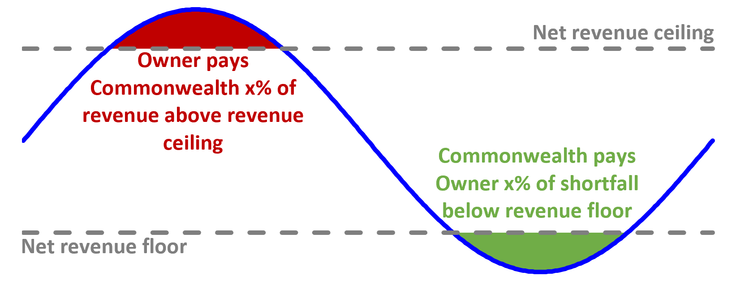


Payment mechanism
Projects under CIS contracts will have a revenue floor and ceiling
Contract terms for feedback
Revenue sharing below floor (%)
Revenue sharing above ceiling (%)
Contract term (years)
Contracted capacity (%)
There may be an option for projects to submit 2x financial value bids per project (as in LTESA) – is this valued?
Payments to CIS counterparties will be calculated and paid on a quarterly basis, with an annual true up
Term Sheet for consultation to be published
Capacity Investment Scheme | August 2023
8

Slide 9
Operational requirements for CIS projects
Benefits of operational requirements:
  Projects receiving Commonwealth support will be expected to ensure their contribution to reliability outcomes
  These operational requirements may counterbalance the downsides of contracting with lower duration capacity and may enable a more flexible approach to minimum duration requirements
Downsides of operational requirements:
  To the extent that these affect project economics, this may be reflected in bids
The intent is to have minimal operational requirements for CIS projects so as to preserve normal commercial incentives
This includes participation in wholesale contract markets (however will need to be on an arm’s length basis)
The operational requirements we are considering:
  97% availability guarantee
  LOR3 operational requirement
Capacity Investment Scheme | August 2023
9

Slide 10


Have Your Say
Have your say on the Capacity Investment Scheme Public Consultation Paper – by 31 August 2023
Q&A
Submit your feedback through the department’s Consultation Hub at:
https://consult.dcceew.gov.au/capacity-investment-scheme-public-consultation-paper
The Department of Climate Change, Energy, the Environment and Water looks forward to hearing from you and receiving your feedback on the scheme.
10

Slide 11
Contact us
CapacityInvestmentScheme@dcceew.gov.au
For more information visit
https://www.energy.gov.au/government-priorities/energy-supply/capacity-investment-scheme
dcceew
gov.au

