Slide 1
Capacity Investment Scheme
    Consultation Paper Webinar
      August 2023
Notes:
Fiona

Slide 2
Notes:
Fiona

Slide 3

Disclaimer
The Commonwealth of Australia, as represented by the Department of Climate Change, Energy, the Environment and Water, has produced this publication to provide high-level and initial guidance on the proposed Capacity Investment Scheme (CIS). The CIS is presently under development and the information contained in this publication is subject to change. This publication does not indicate commitment by the Australian Government to a particular course of action in relation to the CIS or otherwise.
The Commonwealth of Australia has exercised due care and skill in the preparation and compilation of the information and data in this publication, however the Commonwealth of Australia, its officers, employees, representatives, professional advisors or agents disclaim any liability, including liability for negligence, loss howsoever caused, damage, injury, expense or cost incurred by any person as a result of accessing, using or relying upon any of the information or data in this publication to the maximum extent permitted by law. No representation expressed or implied is made as to the currency, accuracy, reliability or completeness of the information contained in this publication.
This document is not intended to provide any advice or imply any recommendation or opinion constituting advice. The presenters do not guarantee the accuracy, currency or completeness of any information contained in this document and (to the maximum extent permitted by law) will not accept responsibility for any loss caused by reliance on it.
Notes:
Fiona

Slide 4
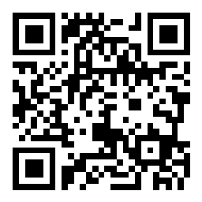

Housekeeping
Your microphone should be automatically muted and your camera off
If you have a question, please use Sli.do to ask it – the chat and Q&A function are not available.
If you are unable to access the Q&A, please text your question to 0425 413 902
Join the discussion at slido.com
Code: #3535545

Slide 5
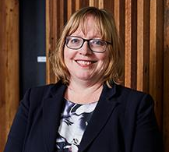


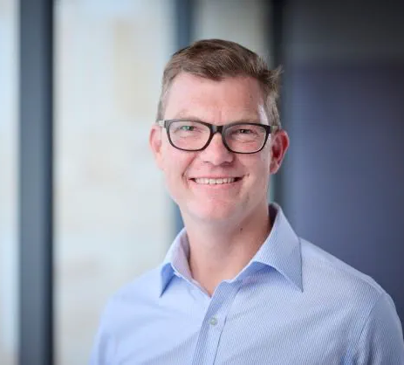
Our presenters today
Kirsty Gowans |
Head of Division – Electricity Division, DCCEEW
Salim Mazouz |
General Manager – Capacity Investment Scheme, Electricity Division, DCCEEW
Zoe Konovalov |
Director, Targets & Modelling Team – Capacity Investment Scheme, Electricity Division, DCCEEW
Brad Hopkins |
General Manager – Commercial, AEMO Services
Notes:
DQ - Kirsty

Slide 6



Purpose of today’s discussion
Slido Q&A
Introduce the Capacity Investment Scheme (CIS)
Outline tender process and project eligibility for participation in the CIS
Provide overview of next steps and Q&A
Capacity Investment Scheme – Consultation Paper Webinar| August 2023
6
Notes:
DQ - Kirsty

Slide 7
Policy context
Slido Q&A
Energy Minister’s Meetings - a need for deeper actions was recognised
National Energy Transformation Partnership
National Capacity Investment Scheme
Commonwealth other investment supporting the transformation
Capacity Investment Scheme – Consultation Paper Webinar| August 2023
7
Notes:
DQ – Kirsty

Slide 8
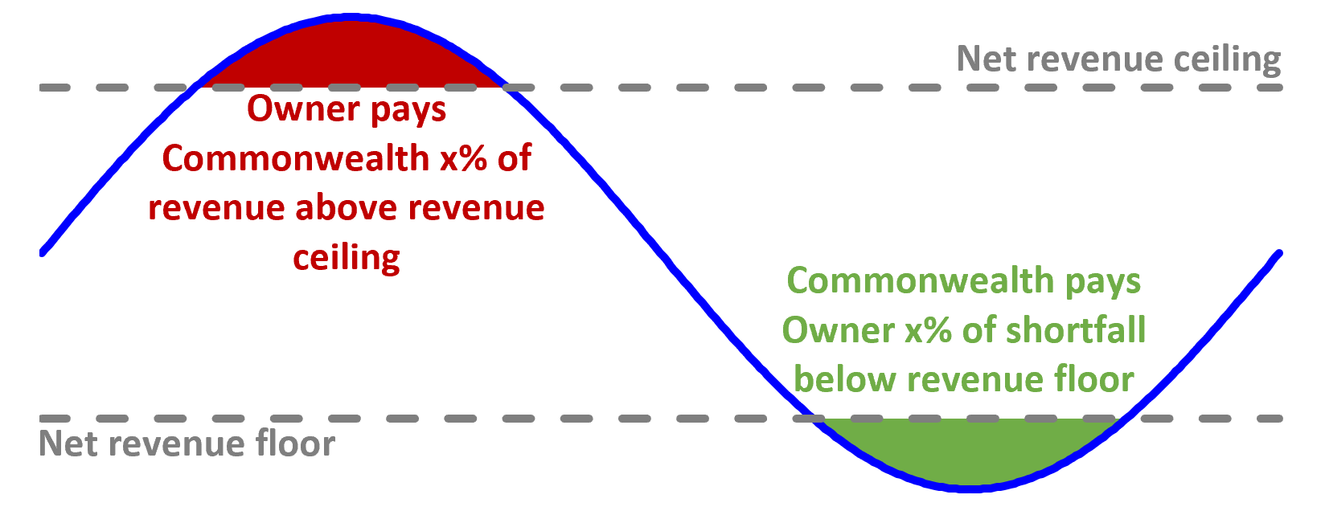
Introducing the CIS
Slido Q&A
Delivering at least 6GW of clean dispatchable capacity by 2030 and making a significant contribution to support grid reliability
Seeking bids for clean renewable generation and storage projects through a series of competitive tenders
Offering long-term Commonwealth revenue underwriting agreements for an agreed ‘floor’ and ‘ceiling’.
Capacity Investment Scheme – Consultation Paper Webinar| August 2023
8
Notes:
DQ – Salim

Slide 9


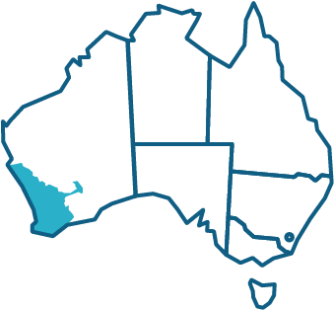
Delivering the CIS
Slido Q&A
The CIS will operate in on-grid Australian electricity networks, and complement existing State and Territory schemes to deliver the national energy transition
Options are also being explored to support capacity in the Darwin-Katherine Electricity System (DKIS)
Partnership with the NSW Roadmap – additional CIS support for up to 550MW of firmed capacity, announced on 29 June 2023
The WEM has specific features to be reflected in CIS implementation in WA – there will be targeted consultation upcoming
The next CIS tender expected to commence in SA and VIC in late 2023.
Capacity Investment Scheme – Consultation Paper Webinar| August 2023
9
Notes:
DQ – Salim

Slide 10




Setting CIS contribution to reliability
Slido Q&A
Principles
Transparent
Aligned to reliability needs
Affordable
Fair and objective
Zero emissions technologies
Capped for 2030
6GW investment available for on-grid dispatchable power
AEMO ISP and ESOO inform CIS reliability modelling
State jurisdiction consulted on modelling
6GW allocation to States based on modelling output
Capacity Investment Scheme – Consultation Paper Webinar| August 2023
10
Notes:
DQ – Zoe

Slide 11
CIS Tender process
Slido Q&A
The CIS will establish robust, transparent processes to ensure market trust in the tender process. The CIS Tenders will be rolled out from 2023-27.
Commonwealth sets objectives, commercial in-confidence financial budgets and MW capacity targets for the CIS in each jurisdiction
1
AEMO runs competitive tenders in partnership with its subsidiary, AEMO Services, in accordance with Tender Guidelines
2
AEMO recommends projects for underwriting by the Commonwealth based on the Tenders
3
Commonwealth makes final contracting decisions based on AEMO recommendations
4
Capacity Investment Scheme – Consultation Paper Webinar| August 2023
11
Notes:
DQ – Zoe

Slide 12
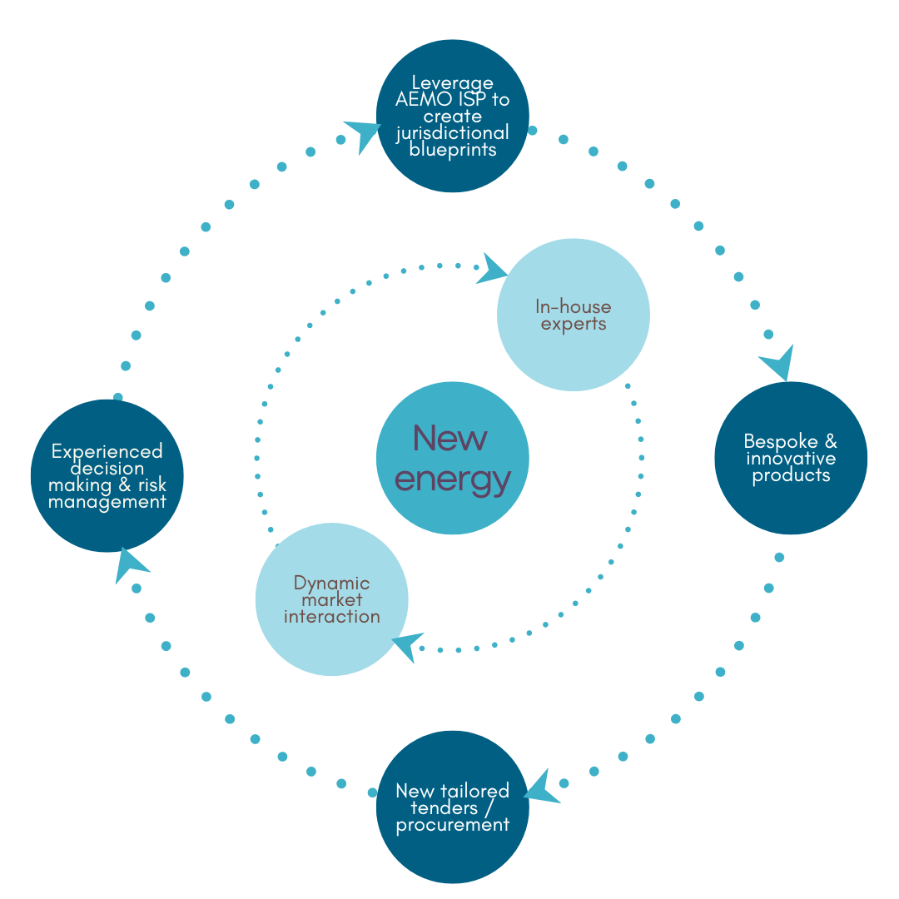
About ASL
Slido Q&A
AEMO Services, an independent subsidiary of AEMO, provides independent expertise to transform the energy sector
Our team
The ASL team consists of commercial, financial and energy professionals, who provide energy and advisory services to reshape our energy systems.
Delivery
ASL delivers repeatable tenders and deliver innovative processes, products and partnerships that fast-track tomorrow’s energy infrastructure.
Services
ASL provides services to NSW under the Electricity Infrastructure Roadmap in our role as the Consumer Trustee
Capacity Investment Scheme – Consultation Paper Webinar| August 2023
12
Notes:
ASL – Brad

Slide 13






Eligibility to participate in CIS Tender
Slido Q&A
The purpose of specifying eligibility criteria is to establish minimum standards for participating in a CIS tender
Zero Emission technology consistent with emissions reduction objective
Minimum duration of output at full capacity
Achieve Financial Close on or from 8 December 2022
Registered with relevant market operator to participate in central dispatch
Public or private owned projects, not in receipt of similar revenue support
Meets baseline development requirements for target COD date
The final eligibility criteria may vary for each tender, and within each State, and will be outlined in the CIS Tender Guidelines for the specific tender.
Capacity Investment Scheme – Consultation Paper Webinar| August 2023
13
Notes:
ASL – Brad

Slide 14


Assessing projects in the CIS Tender
Slido Q&A
The CIS Tenders will select eligible projects which perform strongly against all objective merit criteria.
Stage A: Project Bid
Projects will be assessed against their technical, commercial and social licence merit.
Projects may be asked to provide an indicative financial bid at the project bid stage
Successful projects
Availability guarantee of 97%
LOR3 operational requirement
Stage B: Financial Bid Stage
Projects will be assessed against their contribution to the policy objectives of the CIS – contribution to reliability and lower prices for consumers.
Projects will be expected to provide pricing bid variables
Capacity Investment Scheme – Consultation Paper Webinar| August 2023
14
Notes:
ASL – Brad

Slide 15
Next steps
Slido Q&A
Have your say on the CIS Consultation Paper – by 31 August 2023
Consultation Paper – WA addendum
Delivery of CIS Tender in SA/VIC
CIS Tender Schedule
Capacity Investment Scheme – Consultation Paper Webinar| August 2023
15
Notes:
Fiona

Slide 16
Q&A
Join the discussion at slido.com
Code: #3535545
If you are unable to access the Q&A, please text your question to 0425 413 902

Slide 17


Have your say
Have your say on the Capacity Investment Scheme Public Consultation Paper – by 31 August 2023
Submit your feedback through the department’s Consultation Hub at:
https://consult.dcceew.gov.au/capacity-investment-scheme-public-consultation-paper
The Department of Climate Change, Energy, the Environment and Water looks forward to hearing from you and receiving your feedback on the scheme.
17
Notes:
Fiona

Slide 18
Contact us
CapacityInvestmentScheme@dcceew.gov.au
For more information visit
https://www.energy.gov.au/government-priorities/energy-supply/capacity-investment-scheme
dcceew
gov.au
Notes:
Fiona

