Slide 1
Commentaries on Problems
Judge Team
ICPC 2019 Asia YOKOHAMA Regional

Slide 2
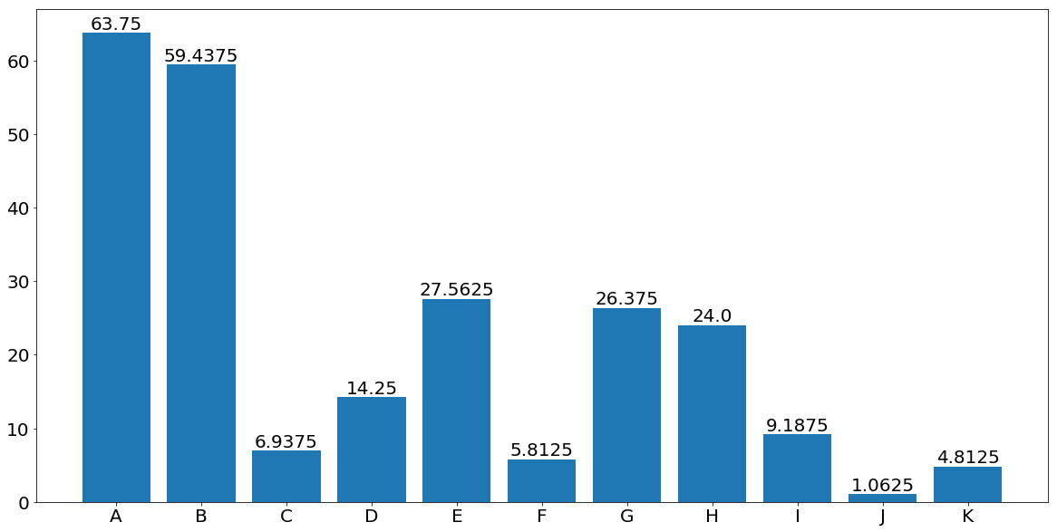
Predicted # of Correct Answers

Slide 3
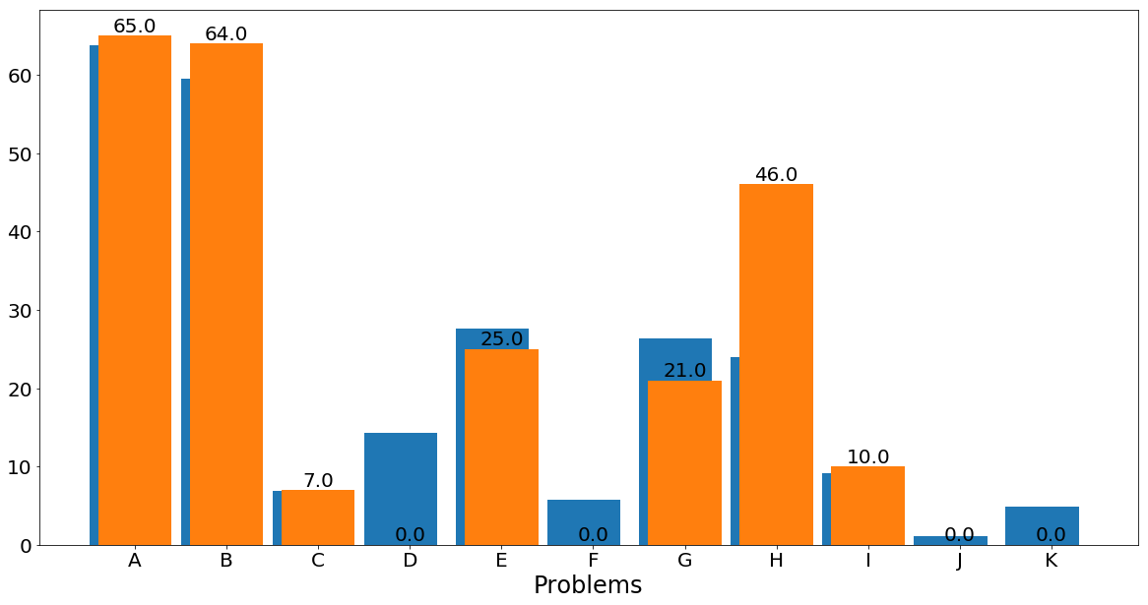
Estimated vs. Solved @Freeze

Slide 4
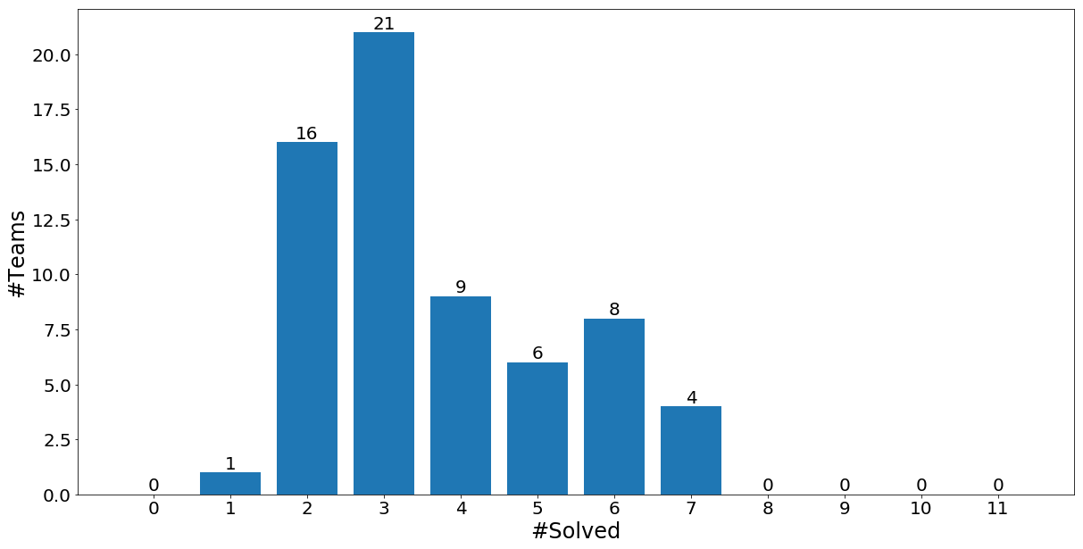
#Solved vs #Teams @Freeze

Slide 5
Commentaries
Decreasing order of #solved teams
(tie-breaked by judge's estimation)
A --> B --> H --> E --> G --> I --> C --> D --> F --> K --> J

Slide 6
A:Fast Forwarding

Slide 7

Story
3x
triples the video playing speed.
1/3x
reduces the speed to one-third.
Button state is checked each 1 second.
How quick can you fast-forward the video to the start of your favorite scene?

Slide 8
Key Observations
No need to consider pressing [1/3x] before any [3x].
1+3+3+1+3+1 = 1+3+3+3+1+1
3x
1/3
3x
1/3
3x
1/3
No need to consider pressing [3x] later than sooner.
1+3+3+3+9+3 = 1+3+9+3+3+3
3x
3x
1/3
3x
3x
1/3

Slide 9
Solution
No need to search all button pressing patterns!
Greedily press [3x] for a first few seconds
(until it overruns the target scene.)
3x
3x
3x
1/3
1/3
1/3
1+3+9+27+(…+27)+(…+9)+(…+3)+(…+1)
Then the timing of [1/3x] easily follows from the remainder of the divisions by 3, 9, 27, …

Slide 10
B: Estimating the Flood Risk

Slide 11
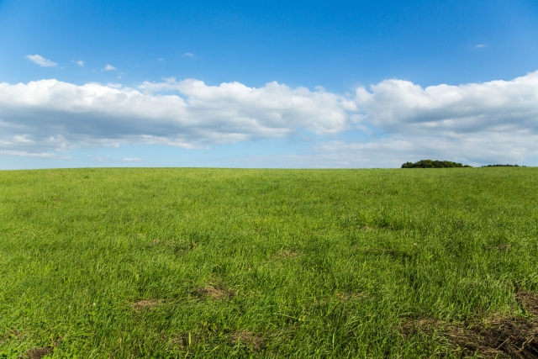
Story
Mr. Boat wants to know the average altitude of his land in order to estimate the flood risk.
As no steep slopes are in his estate, he thought that it would be enough to measure the altitudes of only limited number of sites and approximate the altitudes of the rest based on them.
Your job is to write a program that computes total of altitudes of all the mesh-divided areas.
If there are multiple possibilities, among which one that gives the lowest average altitude should be considered.
Mr. Boat wants to know the average altitude of his land in order to estimate the flood risk.
As no steep slopes are in his estate, he thought that it would be enough to measure the altitudes of only limited number of sites and approximate the altitudes of the rest based on them.
Your job is to write a program that computes total of altitudes of all the mesh-divided areas.
If there are multiple possibilities, among which one that gives the lowest average altitude should be considered.

Slide 12
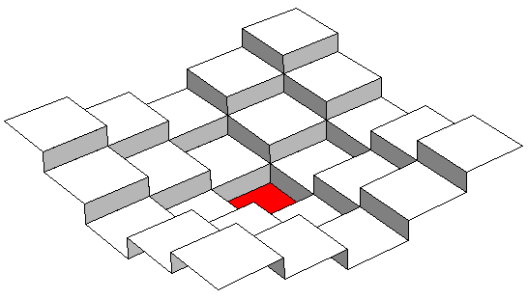
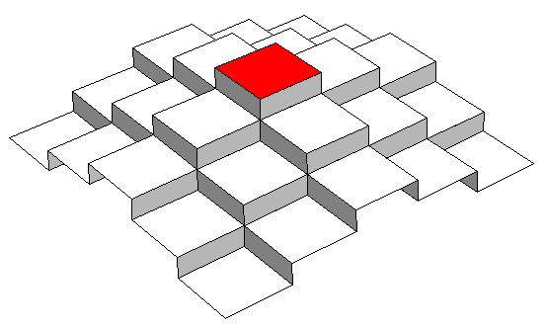
Solution
The range of the altitude of each area (x, y) is the intersection of [ z_{i} - d, z_{i}+d ] for all measured area (x_{i}, y_{i}) of altitude z_{i}, where d is the Manhattan distance between (x, y) and (x_{i}, y_{i}).
upper bound
lower bound
If there exist one or more area in which the range of the altitude is empty, answer "No".

Slide 13
H:Parentheses Editor

Slide 14
Problem
Given text editing commands
Append (
Append )
Delete last character
Count the number of balanced substrings
Examples
(()) answer = 2
()() answer = 3
(()()) answer = 4

Slide 15
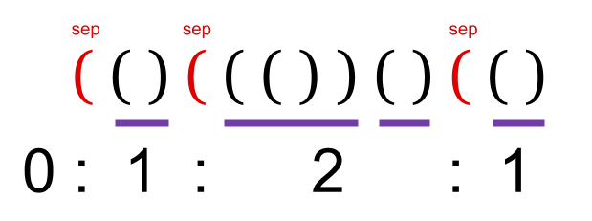
Solution
Count the difference of the answer after commands
Separate with unmatching left parens
Divide into minimal balanced strings. This is a stack

Slide 16
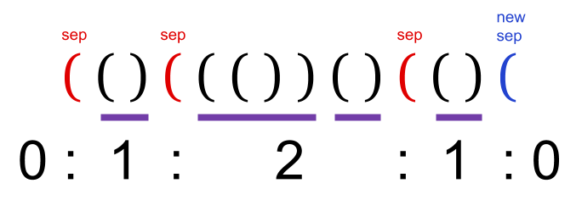
Append left paren (
stack.Push(0)

Slide 17
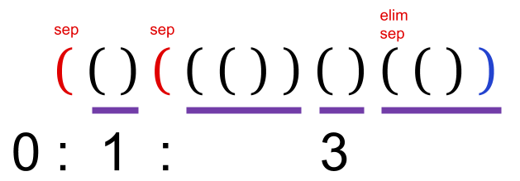
Append right paren )
stack.Pop()
stack.Top() += 1
answer += stack.Top()

Slide 18
Append right paren ), no sep
When there is no separator, the size of stack is one.
stack.Top() = 0

Slide 19

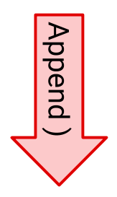
Delete Last Character
Append commands run in O(1)
Rollback also runs in O(1)
x = stack.Pop()
stack.Top() += 1
answer += stack.Top()
stack.Push(x)
stack.Top() -= 1
answer -= stack.Top()

Slide 20

Problem E:
Reordering the Documents

Slide 21
Reorder documents via two extra piles
１
Documents with larger seq. num.
should be piled above
１
３
to allow moving them to the
document box in order
２
４
Height limit
３
２
６
５
４
６
２
４
５
５
１
３
６
Temporary Piles

Slide 22
The document with the largest seq# moved so far (M) must be on top for the temporary piles to be properly ordered
If the next document to move has # less than M, the document should not be placed upon M. No choice here.
If the next document to move has # larger than M, the document can be moved to either of the temp. piles.
The height limit should be respected in both cases.
Height limit
２
５
５
２
６
５
２
４
４
６
１
３

Slide 23
If any remaining documents have # less than both tops of the temporary piles, they can never be handled properly.
The min. seq. # below each doc can be computed beforehand with O(n).
With this info, moves leading to a problem in future can be avoided beforehand.
１(2)
４
３(2)
５
４
４(2)
２
３
５(2)
６
１
４
２(6)
６(∞)

Slide 24
Solution: O(mn)
For docs on the pile, compute the min. doc # below: O(n)
Build a table t of the different possible ways to move docs, indexed by the height of the pile with the larger # doc on top.
Initiate it as [0]=1 and other elements 0: O(m)
For each doc, from the top, update the table: O(mn)
  If its # is less than the largest so far, no changes are needed
  If it is larger, it may be placed on either of the temp. piles.
  Initiate a new table n with all its items 0
  For i = 1..m,
    n[i] += t[i] ; move to the pile with smaller top
    n[i+1] += t[k-i] ; move to the pile with larger top, k is # docs so far
  Copy n to t
Pile height constraints should be checked during the operation

Slide 25
G:Ambiguous
Encoding

Slide 26
Problem Description
Find the shortest length of ambiguous binary sequences made from the given code set.
Characters
to encode
Encoding of
String to Binary Seq.
Code Set
1
. . .
‘A’
“AAB” -> 1 1 01
01
. . .
‘B’
?
. . .
Ambiguous!
(You can’t decode
this correctly)
100
‘C’
1101
110
. . .
‘D’
?
“DA” -> 110 1

Slide 27
Naïve Way to Find Amb. Seq.
Code Set
Code Set
001
001
01
01
01
01
0111
11010
11010
0111
0111
0111
Start from a pair of codes s.t. one is a prefix of the other.

Slide 28
Naïve Way to Find Amb. Seq.
Code Set
Code Set
001
001
01
11010
01
01
11010
0111
11010
11010
0111
0111
Start from a pair of codes s.t. one is a prefix of the other.
Put a code whose prefix is the remainder, or

Slide 29
Naïve Way to Find Amb. Seq.
Code Set
Code Set
001
001
01
11010
01
01
01
0111
01
11010
11010
0111
0111
Start from a pair of codes s.t. one is a prefix of the other.
Put a code whose prefix is the remainder, or
Put a code that is a prefix of the remainder.

Slide 30
Naïve Way to Find Amb. Seq.
Code Set
Code Set
001
001
001
01
11010
01
01
01
01
Found an ambiguous seq.
01
0111
001
11010
11010
0111
0111
Start from a pair of codes s.t. one is a prefix of the other.
Put a code whose prefix is the remainder, or
Put a code that is a prefix of the remainder.
Done when the remainder is an empty sequence.

Slide 31
Observation
01
01
1100
1011010
11010
1100
0111
0101100
011011
0101100
Given an intermediate state of the naïve process,
the shortest tail to the even length depends only on the remainder.
So, we can do DP on remainders
  You need to remember only the shortest seq. to the remainder

Slide 32
Solution: Shortest Path Search
V = Possible remainders :: |V| = O(2¹⁶)
E = Transition by code :: |E| = O(16 * n + 16 * 2¹⁶)
  (R1, R2) in E ⬄ there exists a code C such that
  C = R1 + R2 (at most 16 for each code), or
  R1 = C + R2 (at most 16 for each remainder)
  Length = min( |R1|, |C| )
Start = Remainders of all possible pairs of the given codes
Goal = Empty remainder
No path to the goal ⬄ no ambiguous sequence exists.
So, you can use Dijkstra algorithm to solve this prob. in time

Slide 33
I:One-Way Conveyors

Slide 34

Problem Summary
Given an undirected graph and necessary moves
Make the graph directed while keeping all the necessary moves
$$2≤n≤10000, 1≤m≤100000, 1≤k≤100000$$

Slide 35
Observation
If an edge is always passed in two moves with different directions,
it’s definitely impossible to make the graph directed
If an edge is a bridge, it’s passed in any possible paths for the move
Directions of all bridges are determined uniquely (or not relevant)

Slide 36
Decompose graph by bridges
Decompose the graph by bridges
The graph is a tree
Every vertex is a 2-edge-connected graph
Every edge is a bridge

Slide 37
2-edge connected graph
Is it possible to make a 2-edge connected graph directed
while keeping all the moves?
Robbins’ theorem
It’s possible to make a 2-edge connected graph directed
that has a path from every vertex to every other vertex
Always Yes!!

Slide 38
2-edge connected graph
One easy way to assign directions of edges
Perform a depth-first search
Forward edges are directed from the top to the bottom
Back edges are directed from the bottom to the top

Slide 39
Directions of bridges
The graph is a tree now
Each move is divided to two moves by its lowest common ancestor

Slide 40
Directions of bridges
For each upward (downward) move, add +1 to its edges
If an edge has a value, the edge should be upward (downward)
This can be efficiently done by adding +1/-1 to endpoints
and traversing the tree with summing the values
-1
+1
+1
+1
+1
-1
+1

Slide 41
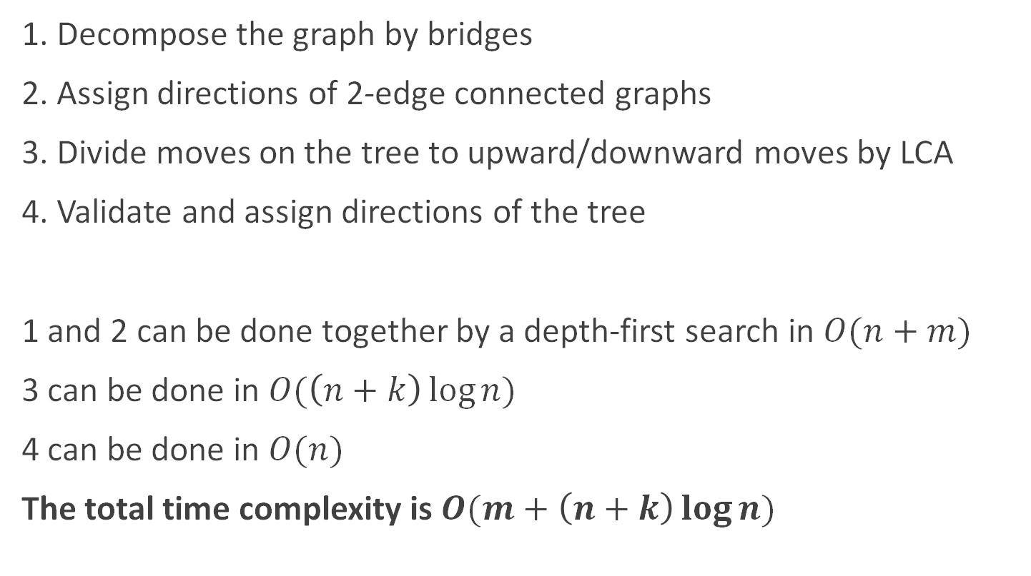
Summary
1. Decompose the graph by bridges
2. Assign directions of 2-edge connected graphs
3. Divide moves on the tree to upward/downward moves by LCA
4. Validate and assign directions of the tree
1 and 2 can be done together by a depth-first search in $O(n+m)$
3 can be done in $O(\left(n+k\right)\log{n})$
4 can be done in $O(n)$
The total time complexity is $O(m+\left(n+k\right)\log{n})$

Slide 42
Appendix
It’s also interesting to consider how to validate answers efficiently
Given a directed graph and necessary moves
Check if all the moves are actually valid

Slide 43
C:Wall Painting

Slide 44
Problem Description
i-th robot paints j (in [l_{i}, r_{i}])-th panel in color c_{i}, when activated.
The aesthetic value of each panel is defined as follows:
Left unpained: zero score
Painted in 1 color: positive score (+x)
Painted in 2+ colors: negative score (-y)
Maximize the sum of aesthetic values.
In case of x=7 and y=2, the sum of values is 61.

Slide 45
Observation
The following cases are ignorable. (There is a redundant range)
- There is a range overlapped by another range.
- There is a panel which is painted 3+ times.

Slide 46
Solution
First, sort all robots increasing based on r_{i}.
Let dp[i] be the maximum sum of aesthetic values when the right most activated robot is i-th robot.
dp[i] = max{
max_[j s.t. j < i and r_{j} < l_{i}] dp[j] + (r_{i} – l_{i}) * x
max_[j s.t. j < i, l_{j}<l_{i}≤r_{j} and c_{i}=c_{j}] dp[j] + (r_{i} – r_{j}) * x
max_[j s.t. j < i, l_{j}<l_{i}≤r_{j} and c_{i}≠c_{j}] dp[j] + (r_{i} – r_{j}) * x – (r_{j} – l_{i}) * y
}

Slide 47
Solution
Let dp[c][i] be the maximum values, when the right most activated robot is i-th robot and their color is c. This expression can be transformed as follows:
dp[c][i] = {
-∞ (if color ≠ ci)
max{
(max_[j, c’ s.t. j < i and r_{j} < l_{i}], c’ ∈ {1, 2, 3}] dp[c’][j]) + (r_{i} – l_{i}) * x
(max_[j s.t. j < i, l_{j}<l_{i}≤r_{j}] dp[c][j] - r_{j} * x) + r_{i} * x
(max_[j s.t. j < i, l_{j}<l_{i}≤r_{j}] dp[(c+1)%3][j] - r_{j} * (x + y)) + (r_{i} * x + l_{i} * y)
(max_[j s.t. j < i, l_{j}<l_{i}≤r_{j}] dp[(c+2)%3][j] - r_{j} * (x + y)) + (r_{i} * x + l_{i} * y)
} (otherwise)
}
We can speed up the calculation by using RMQs!

Slide 48
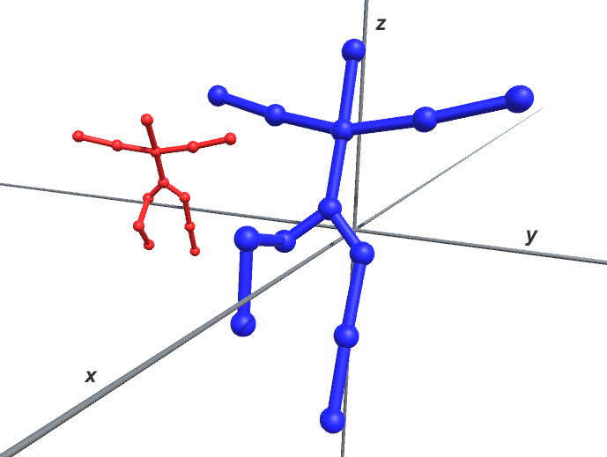
D:Twin Trees Bros.
Problem D
Twin Trees Bros.
ACM ICPC 2019 Yokohama

Slide 49
How to check whether two trees are twin or not. → Translate
Find a leaf node of a tree.
Translate the leaf node to the origin point (0,0,0).
Rotate the edge between the leaf node and its parent around z-axis onto yz-plane.
Rotate the parent node around x-axis onto z-axis.
(Optional) Rotate an ancestor node around z-axis onto yz-plane.

Slide 50
(1) Find a leaf node of the tree
z
ez
leaf
node
ey
y
ex
x

Slide 51
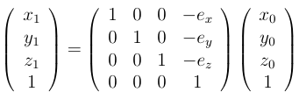
(2) Translate the tree so that the leaf node moves to the origin point.
z
ez
leaf
node
ey
y
ex
x

Slide 52
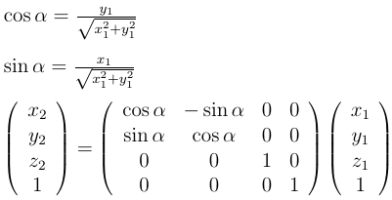

(3) Rotate the tree around z-axis so that the parent node moves onto the yz-plane.
z
parent
node
α
y1
y
x1
x
x

Slide 53
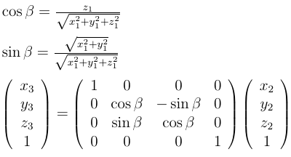

(4) Rotate the tree around x-axis so that the parent node moves onto the z-axis.
z
parent
node
β
leaf
node
y
x

Slide 54
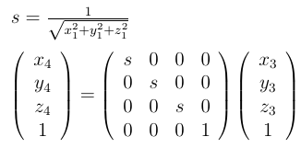
(5) Scale the tree so that the length of edge between the leaf and parent nodes is 1.
z
parent
node
1
parent
node
leaf
node
y
x

Slide 55
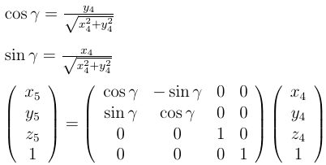
(6) (Optional) Rotate the tree around z-axis an ancestor node moves onto yz-plane.
z
parent
node
ancestor
node
leaf
node
γ
y
x

Slide 56
(7) For each leaf node of T, transform T and compare it with S.
Tree S
Transformed Tree T
z
z
z
Compare
y
x
y
x
x
y
Tree T
z
twin
z
Transform
x
y
x
y

Slide 57
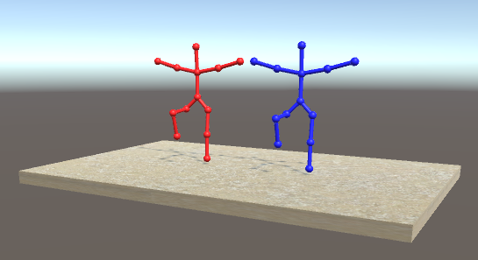
Thank you very much for your attention.

Slide 58
F:Halting Problem

Slide 59
Problem Summary
∧_∧ ババババ
（ ・ω・)=つ≡つ
（っ ≡つ=つ
`/ )
Solve the Halting problem of the following program.
The program has two variables x, i.
In the initialization, set x = x₀ and i = 1
(an execution step) When i < N + 1,
  if x is equal to a_{i}, then set x = x + b_{i} and i = c_{i},
  otherwise, set x = x + d_{i} and i = e_{i}.
When i becomes N + 1, the program terminates.
For given x₀, a, b, c, d, determine whether the program halts or not.
  If it halts, compute how many steps are executed.

Slide 60
Example
Sample 1 (N=2)
x = x + 1
x = x + 2
x is 5?
1
x is 10?
2
3
x = x + 1
x = x + 1
x = 0
i = 1
true
false

Slide 61
Example
Sample 1 (N=2)
x = x + 1
x = x + 2
x is 5?
1
x is 10?
2
3
x = x + 1
x = x + 1
x = 1
i = 1
true
false

Slide 62
Example
Sample 1 (N=2)
x = x + 1
x = x + 2
x is 5?
1
x is 10?
2
3
x = x + 1
x = x + 1
x = 5
i = 1
true
false

Slide 63
Example
Sample 1 (N=2)
x = x + 1
x = x + 2
x is 5?
1
x is 10?
2
3
x = x + 1
x = x + 1
x = 6
i = 2
true
false

Slide 64
Example
Sample 1 (N=2)
x = x + 1
x = x + 2
x is 5?
1
x is 10?
2
3
x = x + 1
x = x + 1
The program halts!
The number of executed steps is 9.
x = 12
i = 3
true
false

Slide 65
Solution (Graph)
Make a graph
  vertex = state i (1, 2, 3, …, N+1)
  edge = false part
This graph has at most one loop
in each connected component.
  outdegree = 1 for every vertices

Slide 66
Solution (query)
(query) given (x, i), find the nearest vertex
where the condition is true.
  If the same condition becomes true twice,
  the program does not halt.
Remove one edge in the loop.
  one tree + one loop
Divide into two problems
  in the tree
  in the loop
now
true
find here

Slide 67
Solution (Loop part)
Fix a vertex v₀(e.g. the root of the tree).
x become x + L after one loop.
Reduction to v₀
  The condition x == a_{u} at u
  ⇔ x == a’_{u} at v₀
  (in one loop)
Make a table and do binary search here.
  Table[a’_{u} mod L] := {a’_{u}: u is a vertex in the loop}
  O(log(N)) for each query
x is a_{u}?
u
x is a’_{u}?
v₀

Slide 68
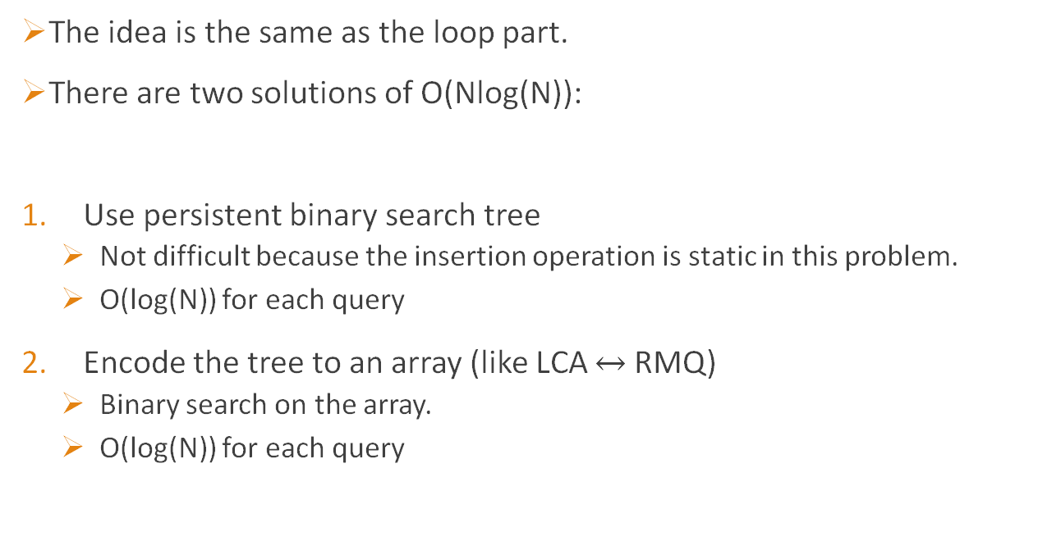
Solution (Tree part)
The idea is the same as the loop part.
There are two solutions of O(Nlog(N)):
Use persistent binary search tree
  Not difficult because the insertion operation is static in this problem.
  O(log(N)) for each query
Encode the tree to an array (like LCA $↔$ RMQ)
  Binary search on the array.
  O(log(N)) for each query

Slide 69
K: Draw in Straight Lines

Slide 70
Draw the specified image
Input
Solution

Slide 71
Draw the specified image
Input
Solution
1

Slide 72
Draw the specified image
Input
Solution
2

Slide 73
Draw the specified image
Input
Solution
3
Overpaint

Slide 74

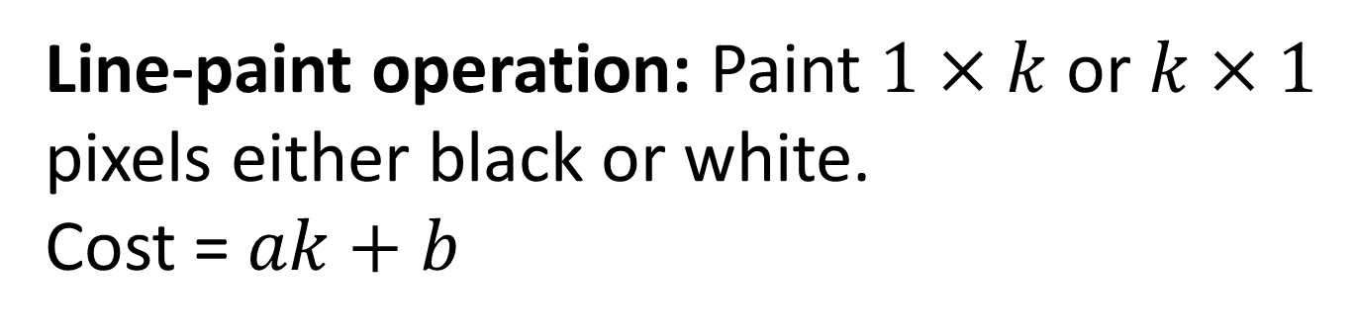
Line-paint operation: Paint $1×k$ or $k×1$ pixels either black or white.
Cost = $ak+b$
1 | 2 | … | k
Single-paint operation: Paint a single pixel either black or white.
Cost = $c$

Slide 75

Overpainting
You can overpaint black $⇒$ white
Overpaint

Slide 76

Overpainting
You cannot overpaint white $⇒$ black
2
1

Slide 77
Overpainting
You can overpaint a pixel at most once
2
1
3

Slide 78
Solution
Minimum Cut !!!!!

Slide 79
Key observation 1
We can assume the following order of operations:
Black line-paint
White line-paint
Black/white single-paint (uniquely decided)

Slide 80



Key observation 2
Once we have painted a pixel horizontally, we don’t have to paint it horizontally anymore.
$$8a+2b$$
$$>$$
$$4a+2b$$

Slide 81
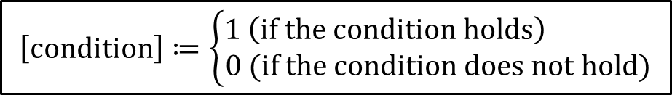
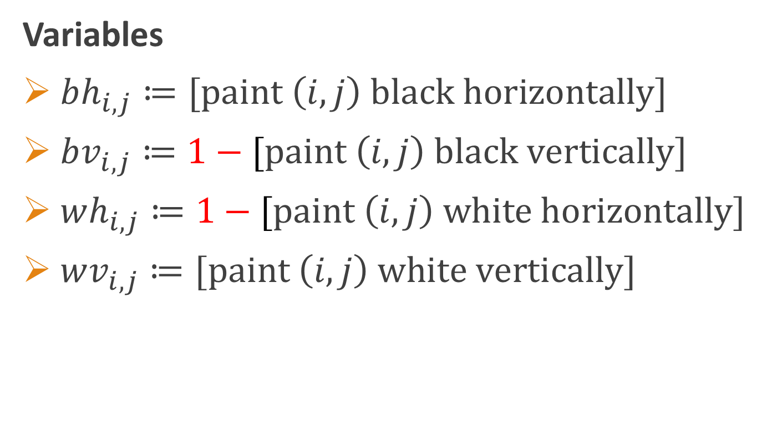
Variables
$bh_{i,j}≔[paint \left(i,j\right) black horizontally]$
$bv_{i,j}≔1−[paint \left(i,j\right) black vertically]$
$wh_{i,j}≔1−[paint \left(i,j\right) white horizontally]$
$wv_{i,j}≔[paint \left(i,j\right) white vertically]$
$$\left[condition\right]≔\left\{\begin{aligned}1 \#\#\left(if the condition holds\right) \\ 0 (if the condition does not hold)\end{aligned}\right.$$

Slide 82




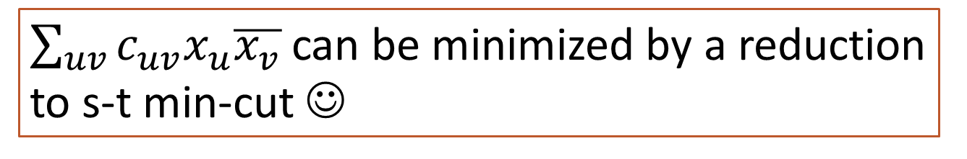




Total cost of black-horizontal-line-paints
$$a×\sum_{i,j}{bh_{i,j}}+b×\sum_{i,j}{bh_{i,j}\overline{bh_{i,j+1}}}$$
$$\overline{x}≔1−x$$
$\sum_{uv}{c_{uv}x_{u}\overline{x_{v}}}$ can be minimized by a reduction to s-t min-cut ☺
$$x=1$$
$$x=0$$
$s$
$u$
$v$
$t$

Slide 83


Cost of painting $(i,j)$ black
$$c×bv_{i,j}\overline{bh_{i,j}}+∞×\left(\overline{wh_{i,j}}+wv_{i,j}\right)$$
No black-line
$⇒$ black-single
cannot overpaint black over white

Slide 84


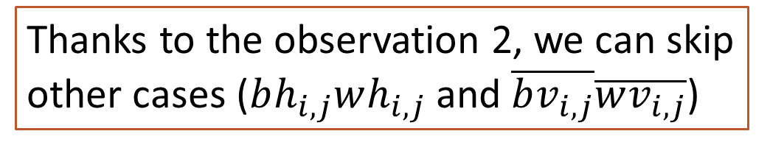
Cost of painting $(i,j)$ white
$$c×\left(bh_{i,j}\overline{wv_{i,j}}+wh_{i,j}\overline{bv_{i,j}}\right)+∞×bh_{i,j}\overline{bv_{i,j}}$$
cannot overpaint a pixel twice
black-line & no white-line
$⇒$ white-single
Thanks to the observation 2, we can skip other cases ($bh_{i,j}wh_{i,j}$ and $\overline{bv_{i,j}}\overline{wv_{i,j}}$)

Slide 85
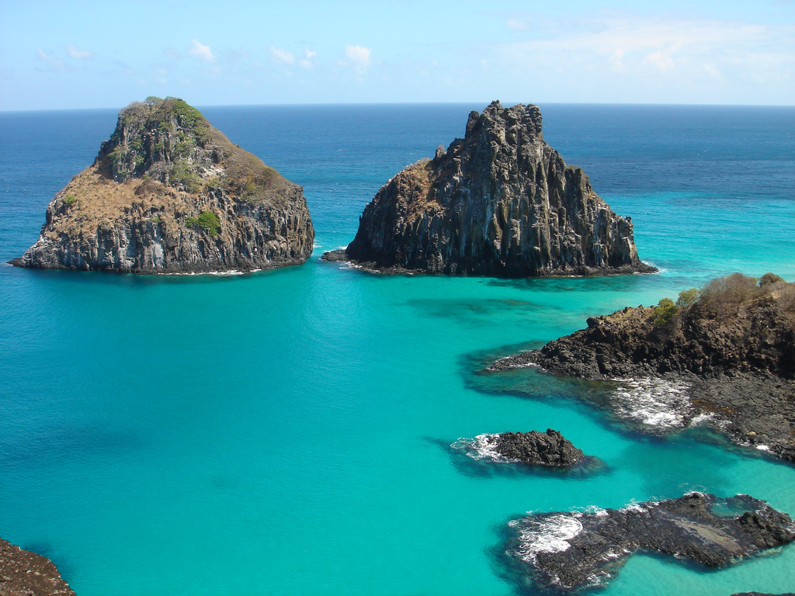
J:Fun Region
Image source: https://en.wikipedia.org/wiki/Island#/media/File:Fernando_noronha.jpg

Slide 86
Problem
You are given a polygon.
An inside point is fun if you can reach every vertex by some spiral path.
Fun region := All fun points.
Calculate the area of a fun region.
Not fun
Fun

Slide 87
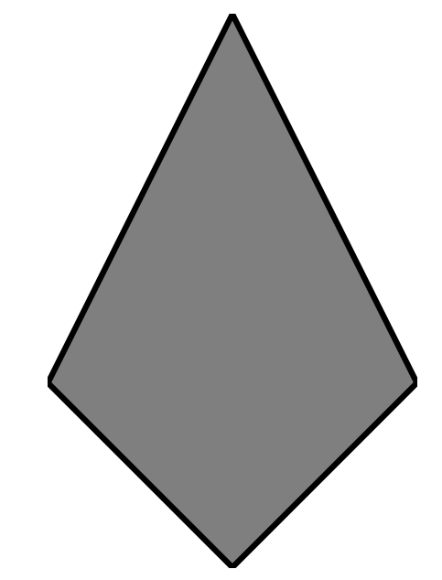
Trivial Case
Convex → Fun region is entire parts

Slide 88

Concave?
Only one concave vertex → ?

Slide 89
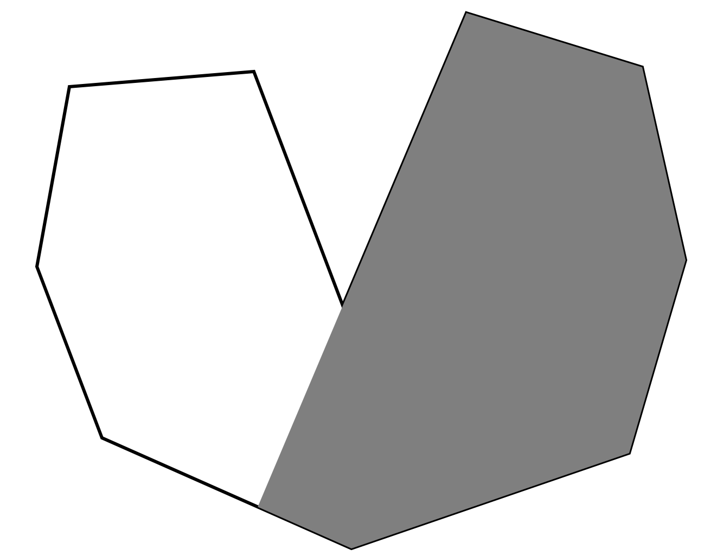
Concave?
Fun region can be obtained by cutting the polygon with a segment from the concave vertex.

Slide 90
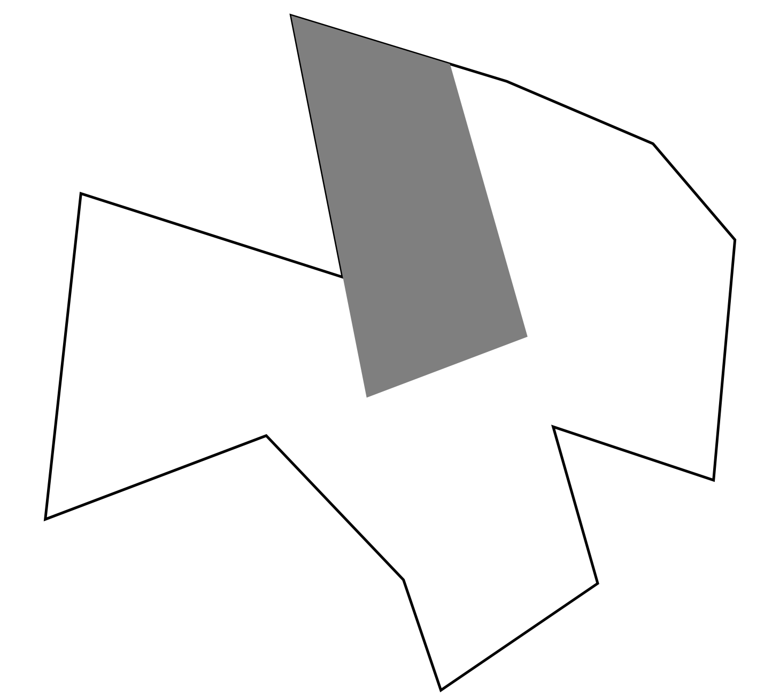
In General
For every concave point, perform cuts.
The remained polygon is the answer.

Slide 91
Solution
Perform non-convex cuts from each concave point.
Each cut can be done in O(n) time.
Total complexity is O(n^2).

Slide 92
Correctness?

Slide 93
Correctness (1/7)
Point p is fun
⇔ Every vertex is reachable from p by a spiral path
⇔ p is reachable from every vertex by a ccw-spiral path

Slide 94
Correctness (2/7)
Point p is fun
⇔ Every vertex is reachable from p by a spiral path
⇔ p is reachable from every vertex by a ccw-spiral path
Let S(v) := {p | p is reachable from v by a ccw-spiral path}.
Fun region = ∩_{v:vertex} S(v).

Slide 95
Correctness (3/7)
When v_{i+1} is non-concave, S(v_{i+1}) ⊆ S(v_{i}) holds. So,
I := {i | v_{i+1} is concave},
Fun region = ∩_{i∈I} S(v_{i}).
v_{i}
v_{i+1}

Slide 96
Correctness (4/7)
Assume that v_{i+1} is concave.
Take a line that passes v_{i} and v_{i+1} and let q be a first contact point.
We can see that S(v_{i}) does not include any points in a region enclosed by v_{i+1}q and the polygon. Why?
v_{i}
v_{i+1}
q

Slide 97
Correctness (5/7)
Suppose that there exists some ccw-spiral path from v_{i} to X.
The ccw-spiral path cannot cross segments v_{i+1}q.
If the path can reach X without crossing v_{i+1}q, it implies there is a hole in the input. Contradiction.
v_{i}
v_{i+1}
q

Slide 98
Correctness (6/7)
This implies that (remaining region by cuts) ⊇ (fun region).
Lastly, we will prove that “⊇” is actually “=“.
v_{i}
v_{i+1}
q

Slide 99
Correctness (7/7)
“(remaining region by cuts) = (fun region)”
Suppose that (remaining region by cuts) - (fun region) is nonempty. This means there exists a point X and vertex v_{i} such that X won’t be cut and X is not in S(v_{i}). The boundary of S(v_{i}) is a polygon such that each edge is either (i) some edge of original polygon or (ii) half line passing from v_{j} to v_{k} where v_{k} is concave vertex. When X is in a region enclosed by the polygon and half line v_{i}v_{k}, X should have been cut by a half line from v_{k}. This is contradiction.
v_{k}
S(v_{i})
v_{i}=v_{j}

